Slide 1
Boost and Coordinate System Follow-up
Brian Page
September 10th, 2021
Ad-Hoc Crossing Angle Group

Slide 2
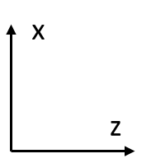
Boost to Head-On Frame
Boost
(6.896/293.29,0.022/293.29,257.15/293.29)
(0.003,-0.001,-18.026,18.026)
(6.892,0.023,275.176,275.264)
Initial Configuration in the Lab Frame (beam momenta from a random event)

Slide 3
Boost to Head-On Frame
(-1.402,-0.006,-70.420,70.434)
(1.402,0.006,70.420,70.440)
Initial Configuration in the Lab Frame (beam momenta from a random event)
Boost by sum of beam 4-momenta to get to CM Frame

Slide 4
Boost to Head-On Frame
(0.0,-0.006,-70.434,70.434)
(0.0,0.006,70.434,70.440)
Initial Configuration in the Lab Frame (beam momenta from a random event)
Boost by sum of beam 4-momenta to get to CM Frame
Rotate about y-axis to eliminate x-component of momentum

Slide 5
Boost to Head-On Frame
Boost
(0.0,0.0,-257.15/293.29)
(0.0,0.0,-18.048,18.048)
(0.0,0.0,274.890,274.891)
Initial Configuration in the Lab Frame (beam momenta from a random event)
Boost by sum of beam 4-momenta to get to CM Frame
Rotate about y-axis to eliminate x-component of momentum
Rotate about x-axis to eliminate y-component of momentum (not shown)
Boost back along z to (nearly) restore original beam energies

Slide 6
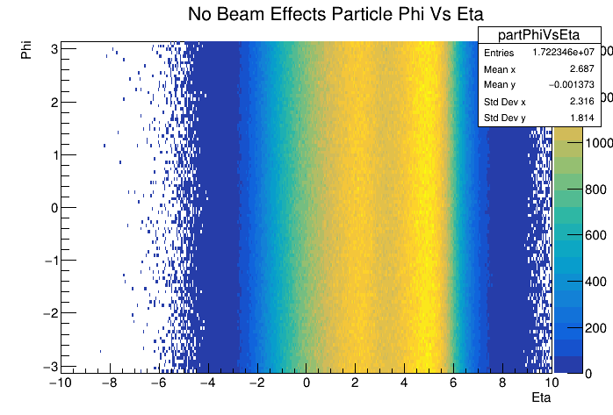
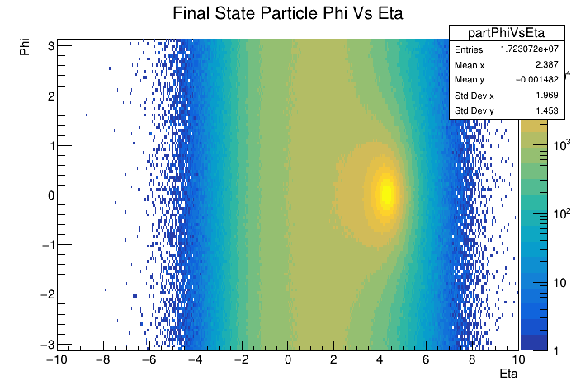
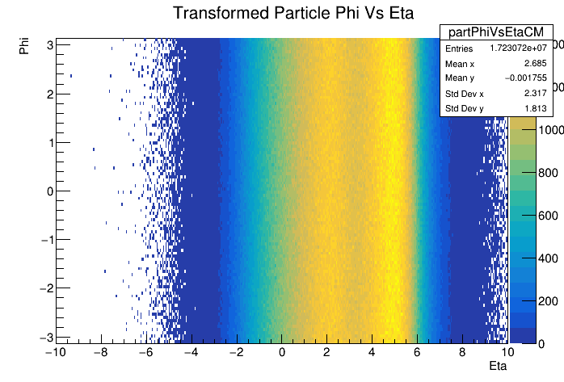
Frame Comparison: Phi Vs Eta
Transform
Crossing angle introduces a hot-spot at phi = 0 and eta = ~4.2 in the lab frame (top left)
Transformation described above removes phi modulation and smooths out eta (bottom right)
Matches very well with distribution obtained from default Pythia with no beam effects included (top right)

Slide 7
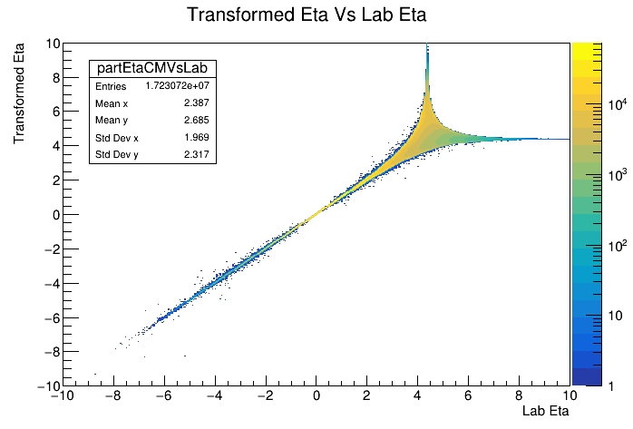
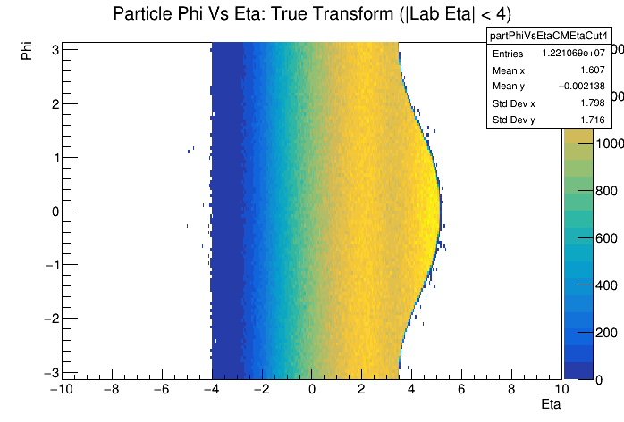
Acceptance Effects: Lab Eta < 4
How does limiting acceptance due to finite detector acceptance effect transformed distribution
See the ‘bulge’ from crossing angle, but particle distribution is still flat in phi within this region
Question from last time is how to best define eta. Alexander claims if we define with respect to hadron beam, these effects will disappear

Slide 8
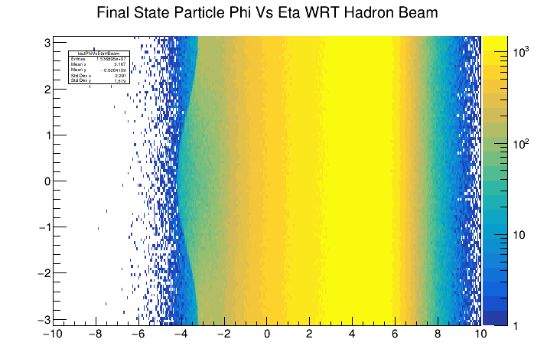
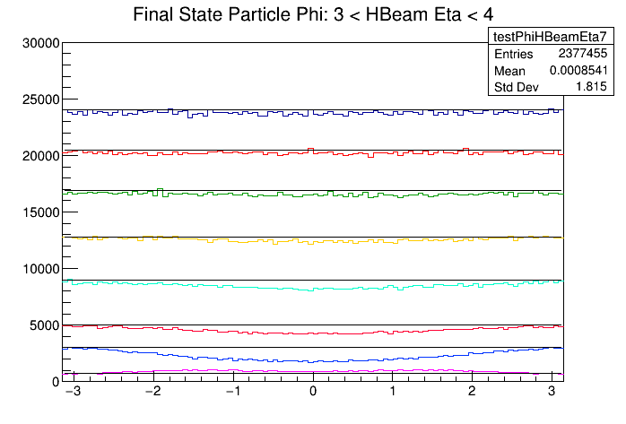
What if We Measure WRT Hadron Beam?
Last meeting, Alexander argued that if we defined eta with respect the hadron beam, many of the effects we see will disappear
Indeed, measuring phi and eta from hadron beam seems to flatten distribution on hadron going side
This is really just saying that the physics in the hadron going direction looks the same around the hadron beam no matter where that beam is pointing
With a crossing angle, however, this axis is not unique across all eta and we get distortions as we move toward negative eta

Slide 9
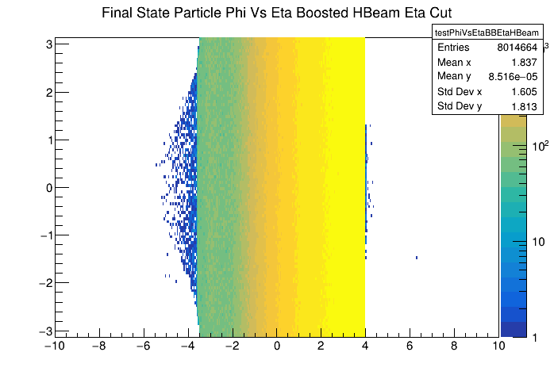
How to Define Acceptance Cuts
Because it has a single meaningful axis, the head-on frame is still likely the best frame for defining our physics quantities
However, will our detector acceptance (the limit of HCal or tracking coverage) be symmetric around the electron beam or the hadron beam? If it is symmetric about the hadron beam, we should use eta as defined with respect to the hadron beam to place our cuts
Both plots show the phi vs eta distribution where these quantities are defined in the head-on frame
Top plot applies a cut for |eta| < 4 where eta is defined relative to the electron beam
Bottom plot applies a cut for |eta| < 4 where eta is defined relative to the hadron beam

