Slide 1



Update for note
Xinbai Li, Wangmei Zha
17/11/21

Slide 2
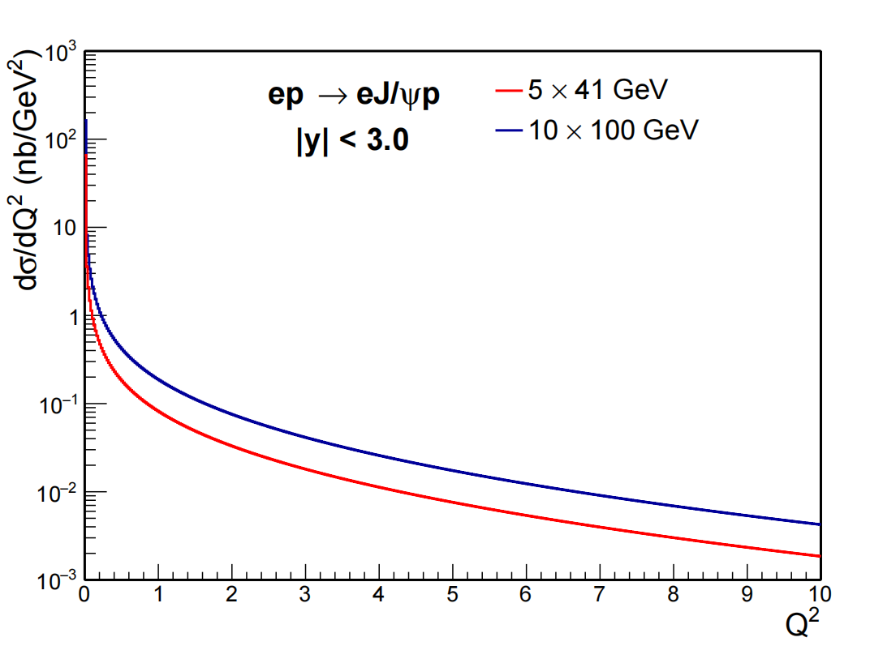
Update

Slide 3
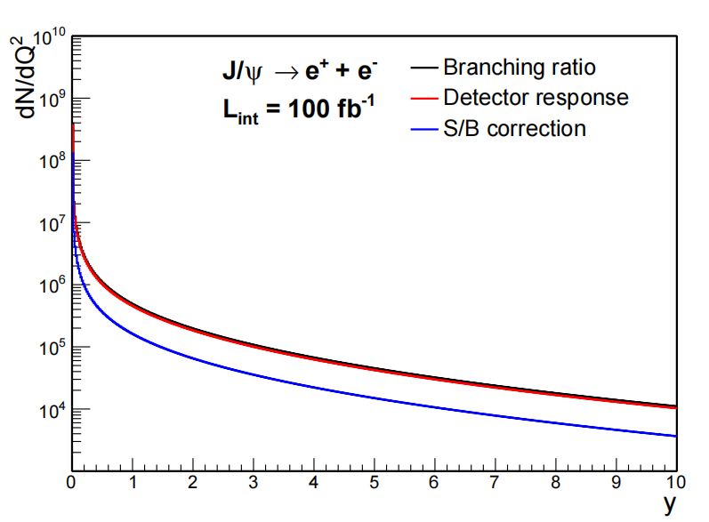
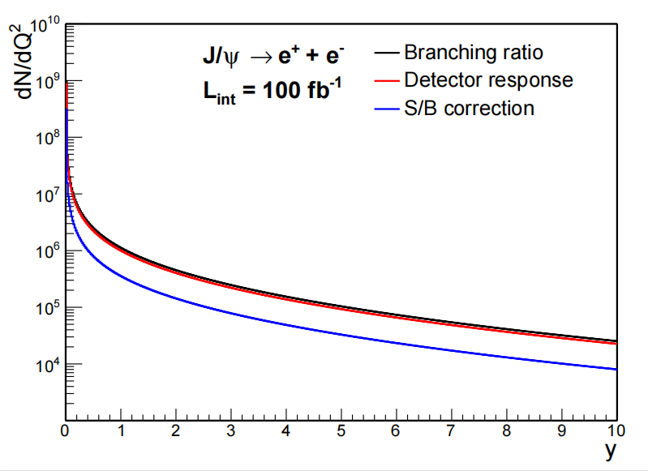
Update
Q²（GeV²）
Q²（GeV²）
5×41 GeV
10×100 GeV

Slide 4
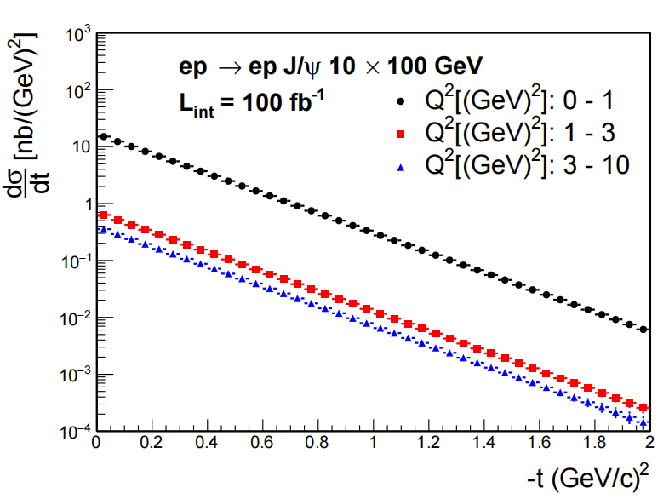
Update

Slide 5
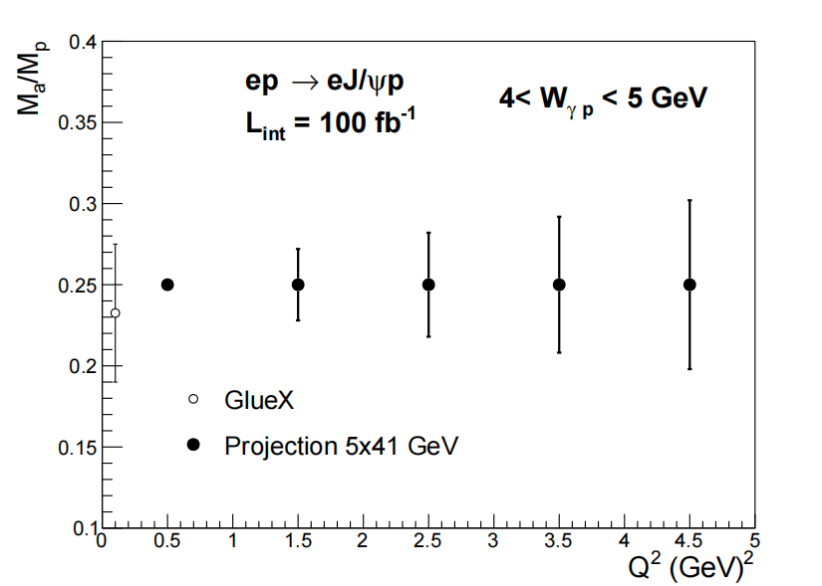
Update

Slide 6

Backup

Slide 7
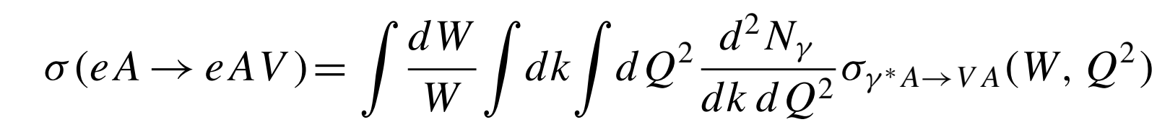
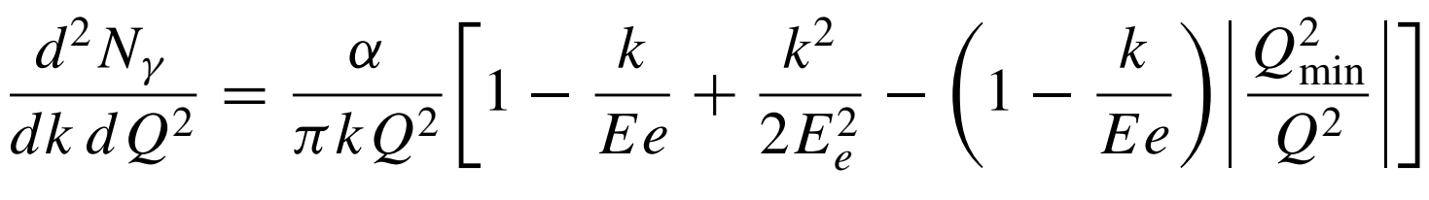
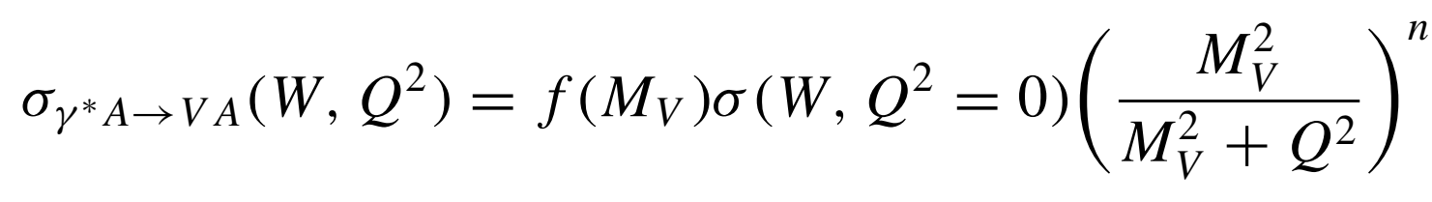
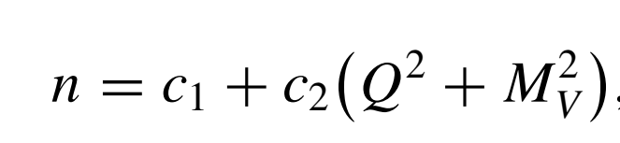

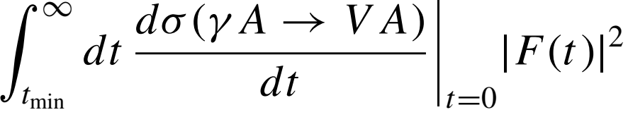
The theoretical setup for projection (eSTARLight)
=
Can be related to the cross section for σ(γ+p → V+p)
eSTARLight: Michael Lomnitz and Spencer Klein, Phys. Rev. C 99 (2019) 015203
Wangmei Zha etal, Phys. Rev. C 97 (2018) 044910

Slide 8

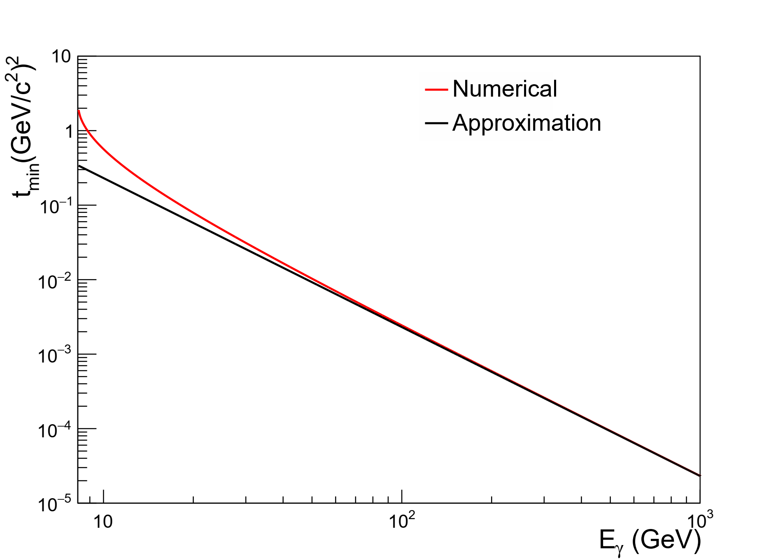
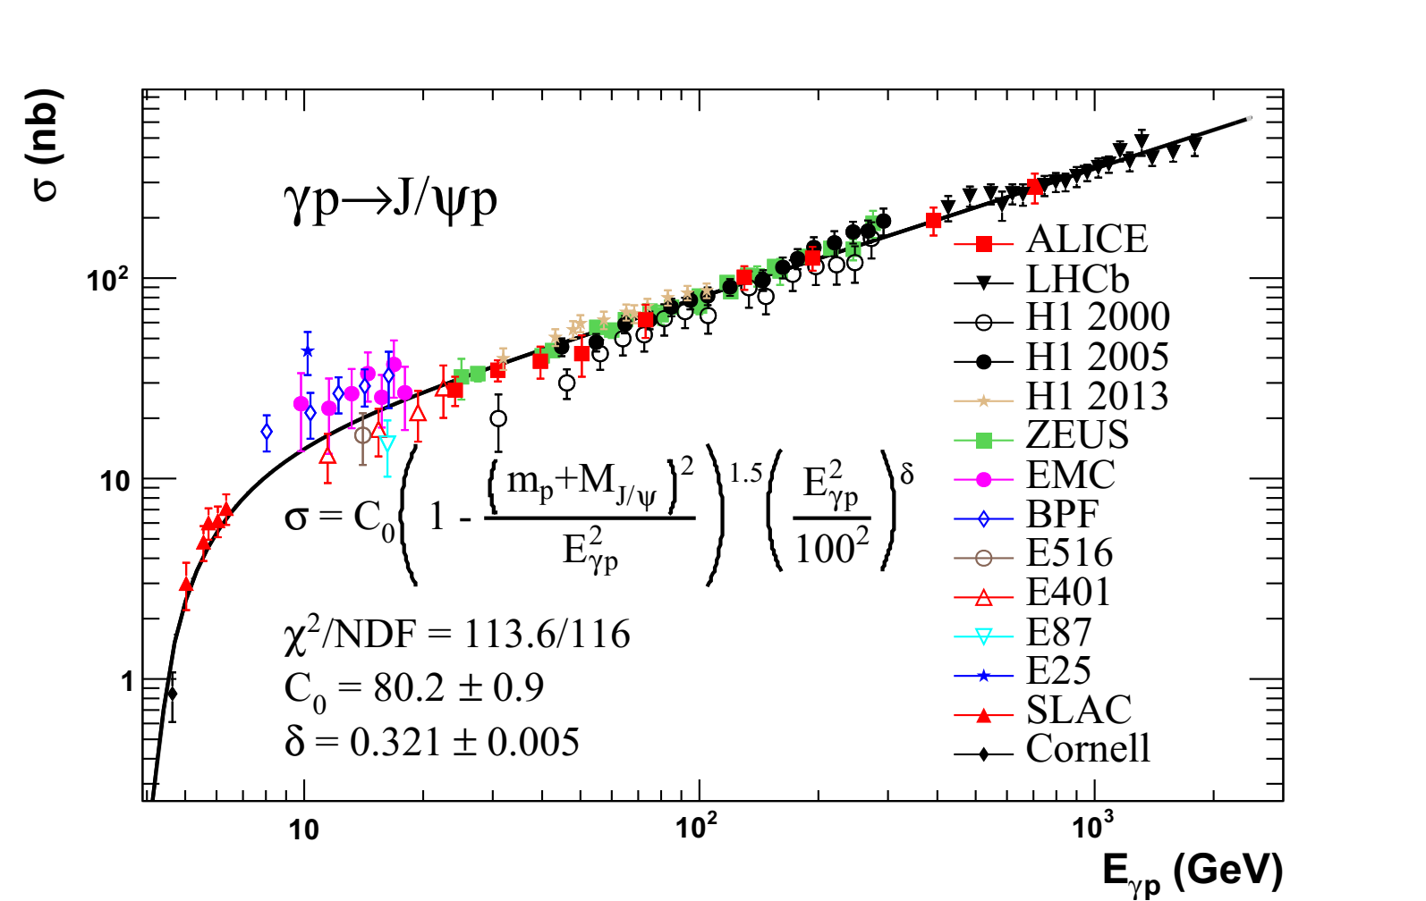
Two improvements for eSTARLight
Minimum momentum transfer
Parametrization for cross section input
Approximation
Z. Cao etal., Chin. Phys. C43 (2019) 064103

Slide 9
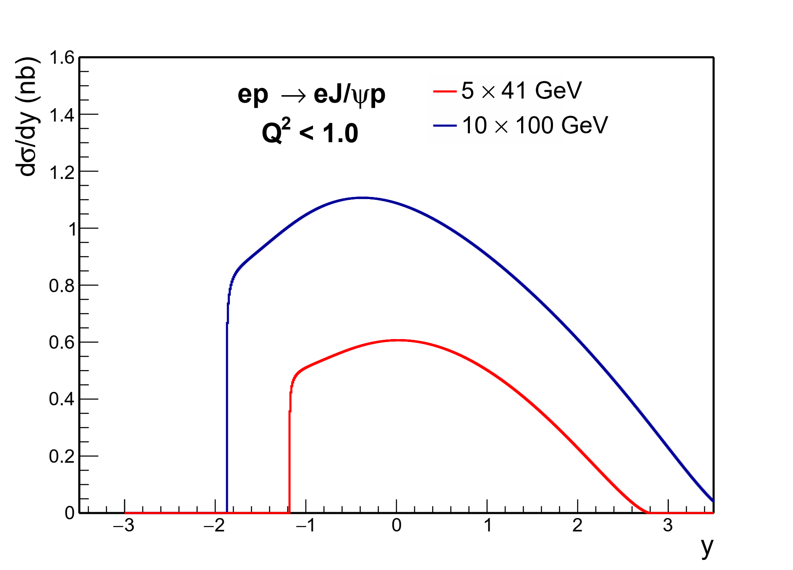
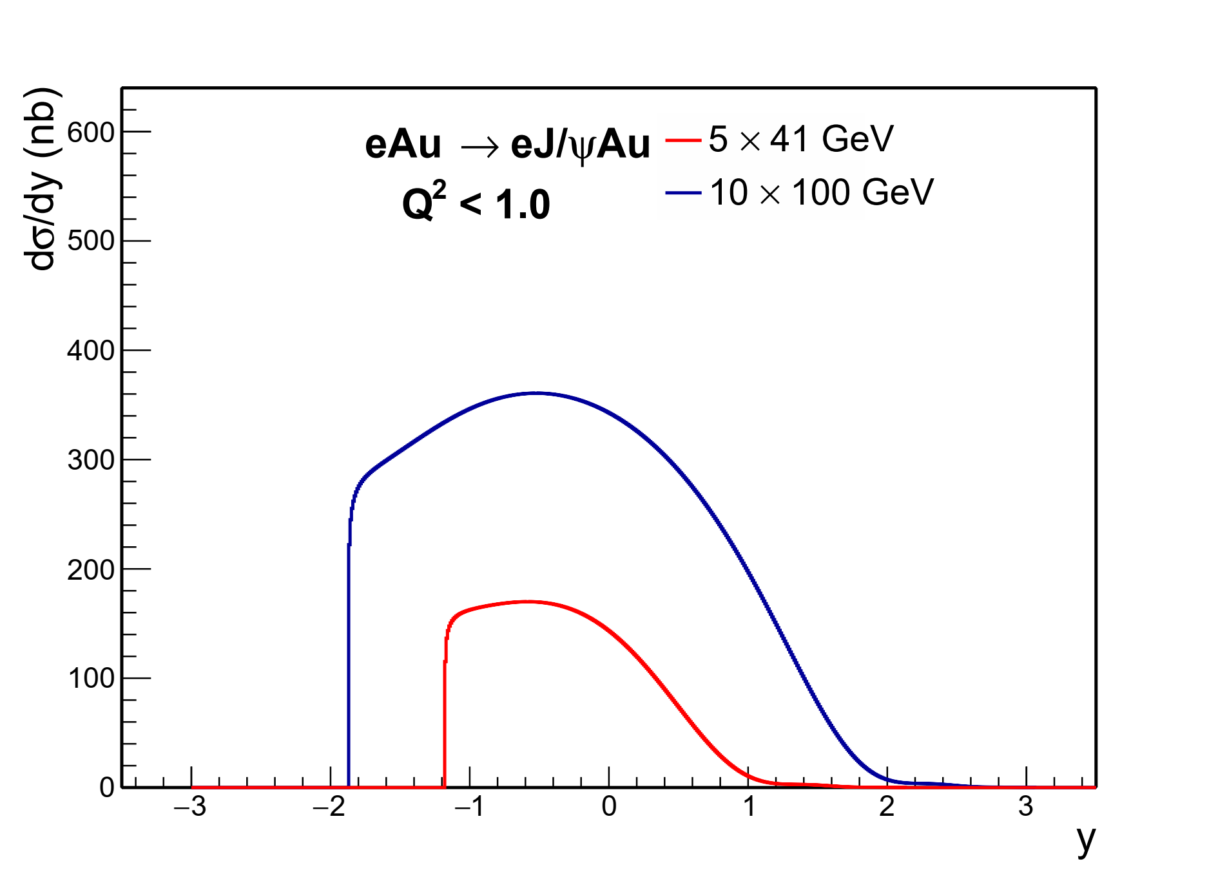
The theoretical input for ep and eAu

Slide 10
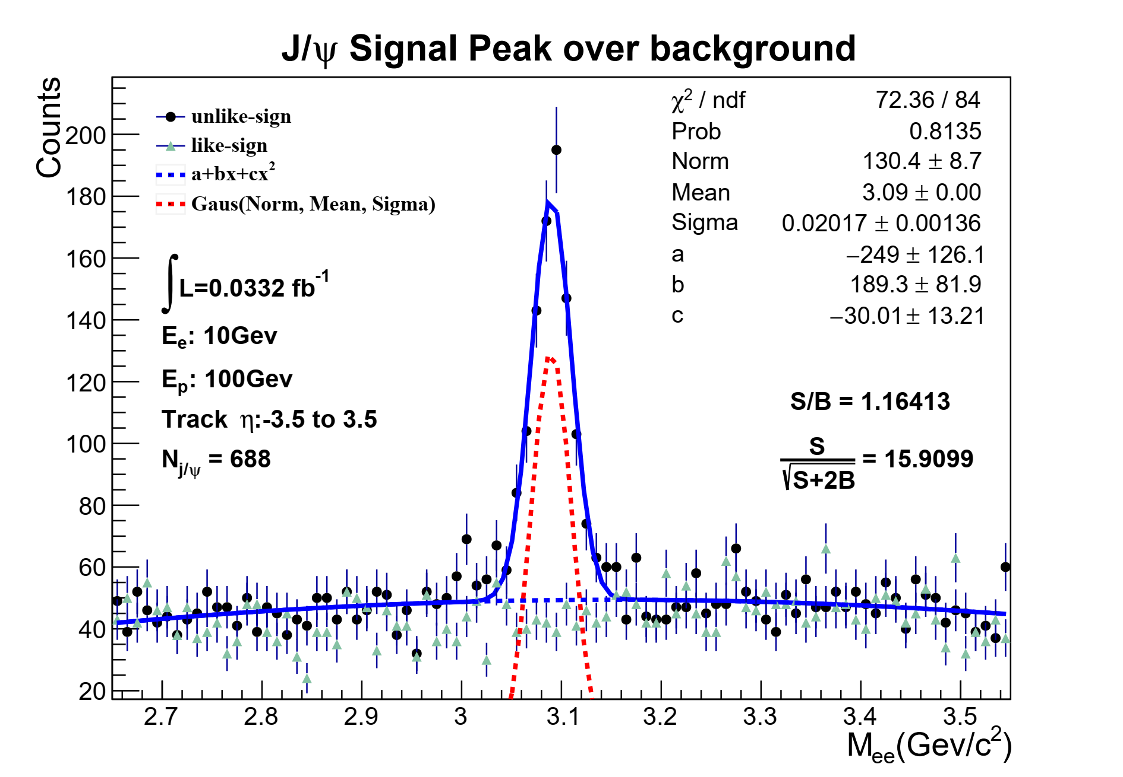
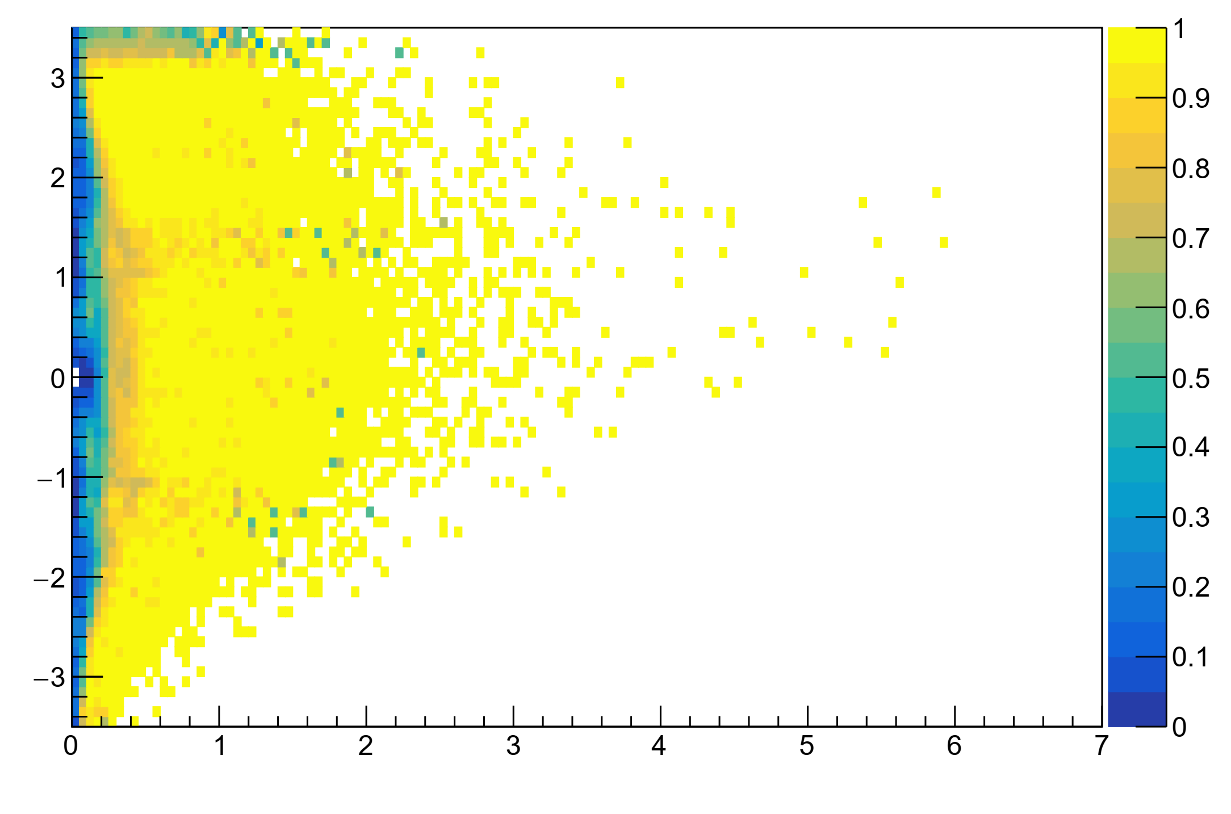
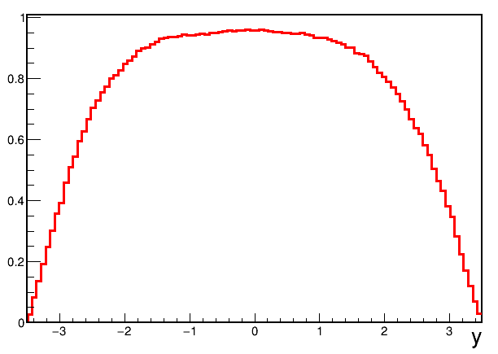
Efficiency and S/B correction
Single electron efficiency
J/ψ efficiency
S/B correction
η
p_{T} (GeV/c)
High J/ψ efficiency in central region
Forward region with a low efficiency

Slide 11
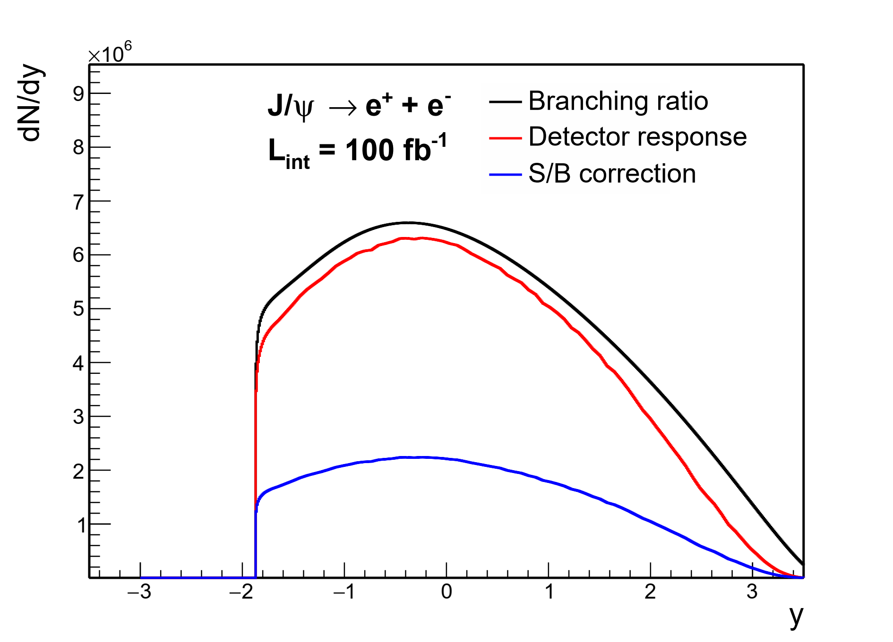
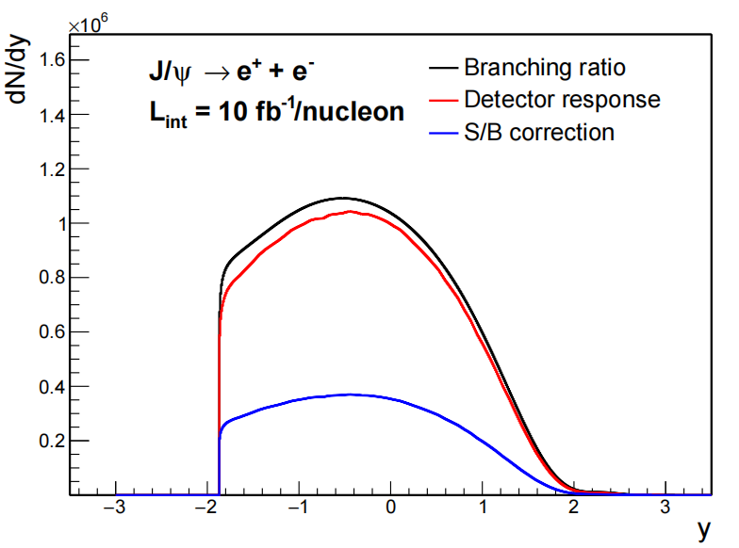
The projected statistics
ep
eAu

Slide 12
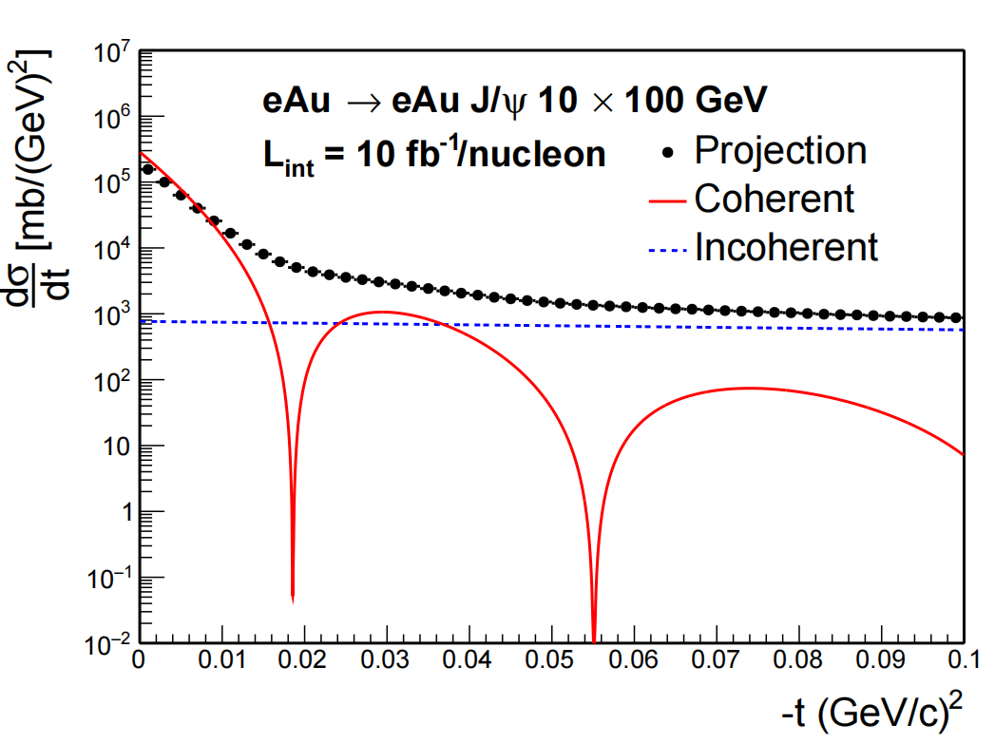
The t distribution projection
The momentum resolution would wipe out the diffraction dips.

Slide 13
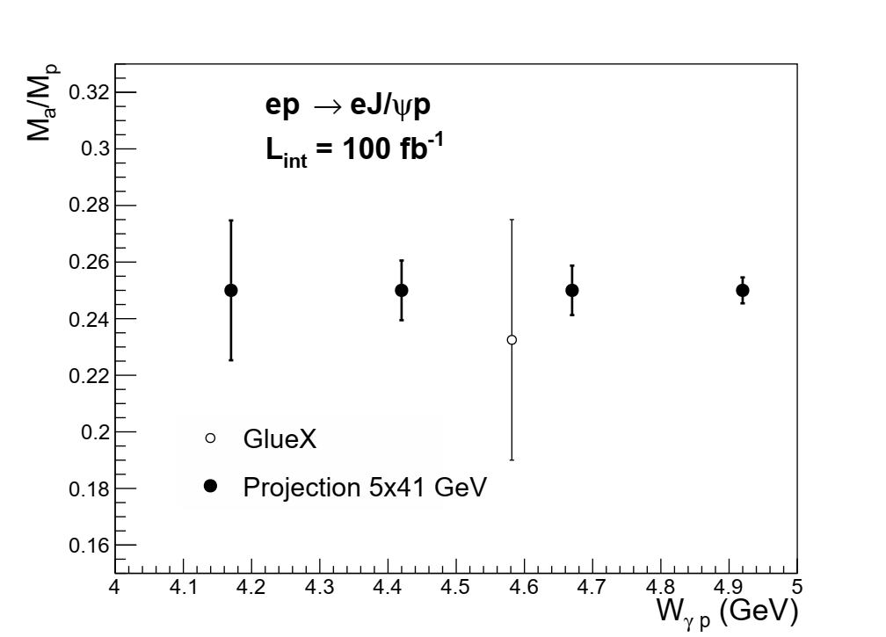
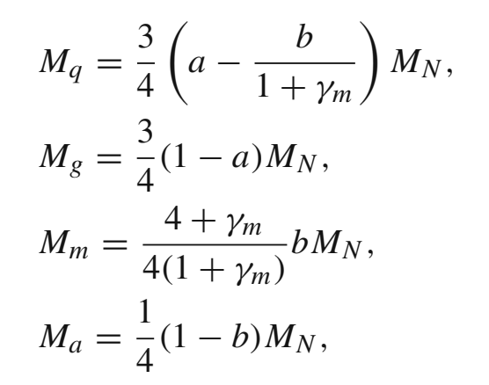
The trace anomaly parameter projection
Rong Wang, Xurong Chen and Jarah Evslin, Eur. Phys. J. C (2020) 80:507
Guzey, Zhalov, JHEP 10 (2013) 207; JHEP 02 (2014) 046
Extract the QCD trace anomaly parameter b

