Slide 1
DAQ WG Meeting Agenda – 10/7/21
Announcements
To do list status
Discussion of Supplemental Materials
Costing Update
AOB

Slide 2
Announcements (Page 1)
Costing:
Costing group (Bernd/Zhangbu/James Symons) did a “line-by-line” walkthrough last Friday. I have a number of tasks, including assigning types of labor, dividing tasks into phases and quasi-schedule. Will continue meetings each Friday through October. The level of detail is acceptable, the focus is on capturing full system.
Yesterday, met with project/other collaborations again towards the goal of having a uniform costing basis among the collaborations. My goals:
How do we incorporate FELIX development
Treat as commodity items with 15k cost… assuming only incremental development expected.
Low utilized links (Still some subtlety)
Take as true statements from detector groups regarding required numbers of fibers, and allow low utilized links
But…. Within reason, don’t assume links less than 1-10% utilization.
Uniformity of cost of Global Timing systems.
Uniformity of Manpower requests
“Types” not well defined, I think assuming a reasonable hierarchy (students/postdocs working with engineers/software experts) is expected
Useful discussion/guidance regarding level of software/firmware expected on the order of x1-x2 of hardware cost, and discussion of getting historical GlueX data (which members of project have available).

Slide 3
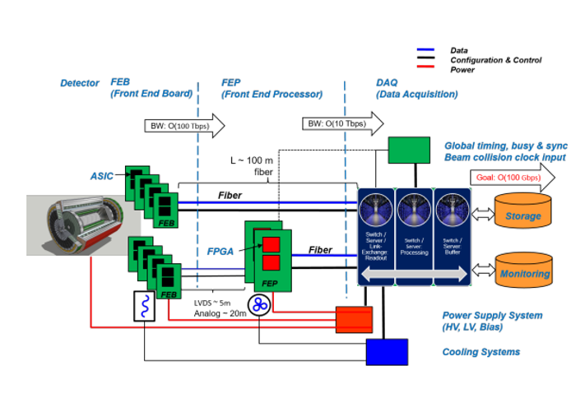
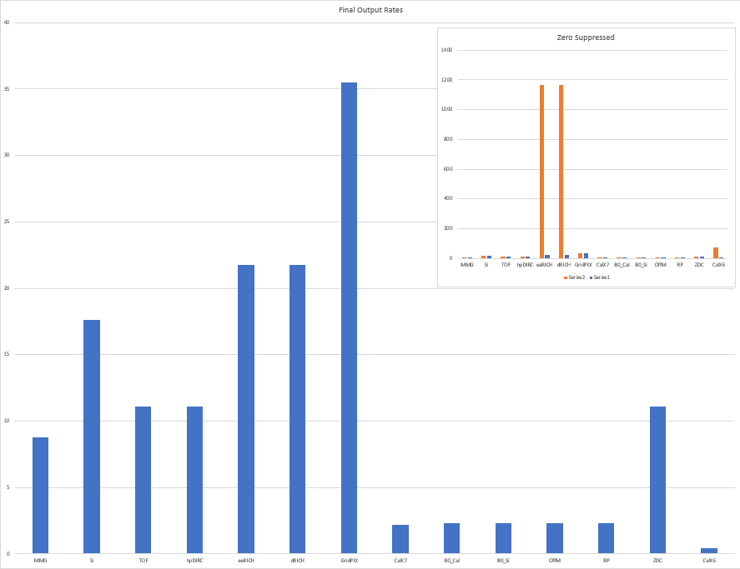
Announcements (Page 2)
Drafting – meeting last week at conveners meeting. They wanted to see plots.
We showed these (assembled to present concept, and demonstrate issues)
Have editable version of diagram, need to refine numbers for bar graph, and
BW: Raw

Slide 4
To do list for Nov 1
Get solid occupancy / hit counts from simulation [needed for proposal plot]
Synchrotron radiation [In Progress]
Collisions [Awaiting full simulations / discussion with software]
Beam gas [Project generator, but not started]
Decide how to proceed with regard to low data volume FELIX [Discuss at project meeting]
Assume/or verify aggregation close to data volume in the end [Verify – send each WG our current assumptions, and biggest issues/plans with specific detectors]
Propose cheaper aggregation to go into FELIX [Done: Take this out of plan with regard to proposal, if not with regard to reality]
Propose R&D goals for FELIX a simpler parallel version [Done: Take out of plan with regard to proposal]
Labor costing estimate iteration: current estimate 29 FTE total. [In progress / Feedback from Athena & project planned]
Global Timing System actual costing [made up numbers, possibly ok, need to run experts]
System diagram [Have editable version, Still need to update]
Proposal text iteration https://www.overleaf.com/4462197242wshdzrtdvhcm [Awaiting feedback, may send update with explanation]
Costing → official spreadsheets [In progress, regular scheduled updates with Bernd/Zhangbu/James]
Supplemental materials (needs to be considered, brief, and of equally high quality to proposal) [Not yet started, will produce outline]
Detector | Data Volume (Collission) | Data Volume (Synchrotron) | Data Volume (Beam Gas) | Data Volume (Noise)
Si Tracker |  |  |  | X
MPGD Tracker | X
dRICH |  |  |  | X
(…)

Slide 5
Supplemental Material Discussion
Timing System Detail
Detector Subsystem Detail
Counts, data volumes, specific strategies as far as known
To what extend to we hedge bets with regard to providing a trigger for RICH detectors in the supplemental material?
DAQ Computing Block Diagram
Fully parallel streamed detector writing (As per Jan)
But with connection between detectors for monitoring, DBs, event counting, and data volume reduction/software triggering
Event building
But with individual parallel detectors where required by data volume (As per my ideas)
In both cases, the connections between detectors must exist and to zeroth order the extend of these connections is choosable at will… But these ideas should be explicite in the supplemental material, in this group, and in the collaboration as a whole.

