Slide 1
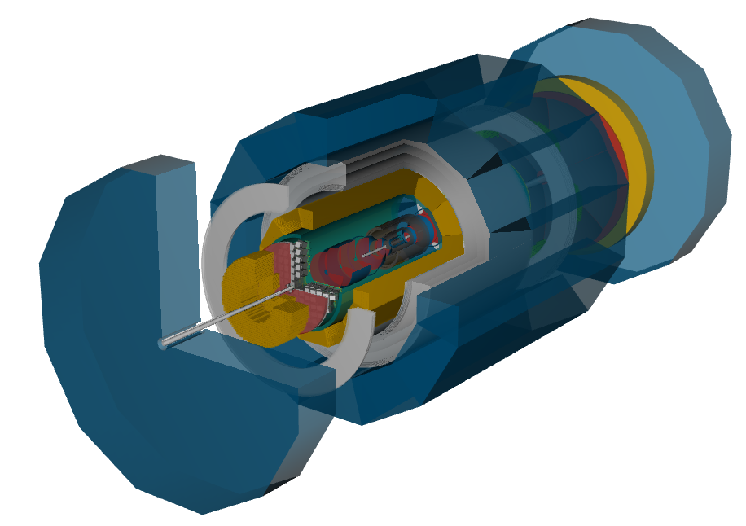
Athena Calorimetery WG
erhtjhtyhy
From DD4HEP Geometry Viewer
Paul E Reimer
Oleg Tsai
Vladimir Berdnikov
This work is supported in part by the U.S. Department of Energy, Office of Nuclear Physics under contract No. DE-AC02-06CH11357.

Slide 2
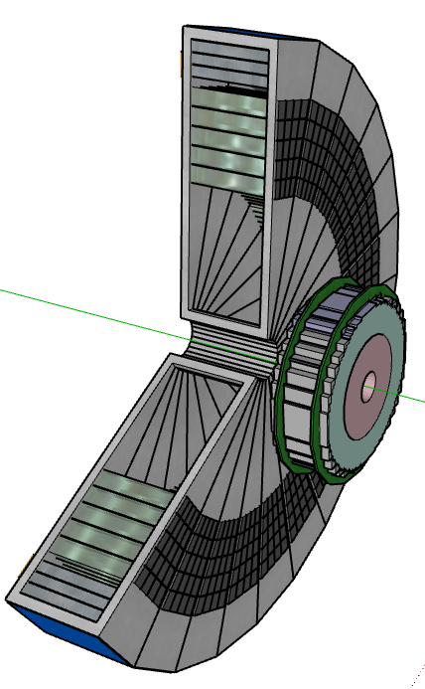
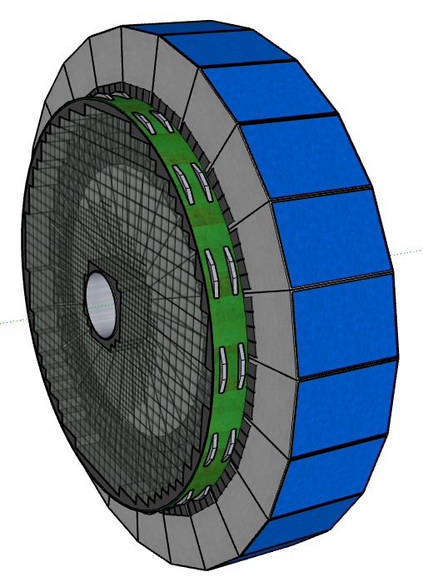
Calorimeter WG: Endcaps
NECal
Crystals are now 55 cm for 20 X₀
Already in DD4HEP
Some passive material missing between NE & NHCal
PECal
Tungsten SciFi
DD4HEP description needs memory optimization to run efficiently

Slide 3
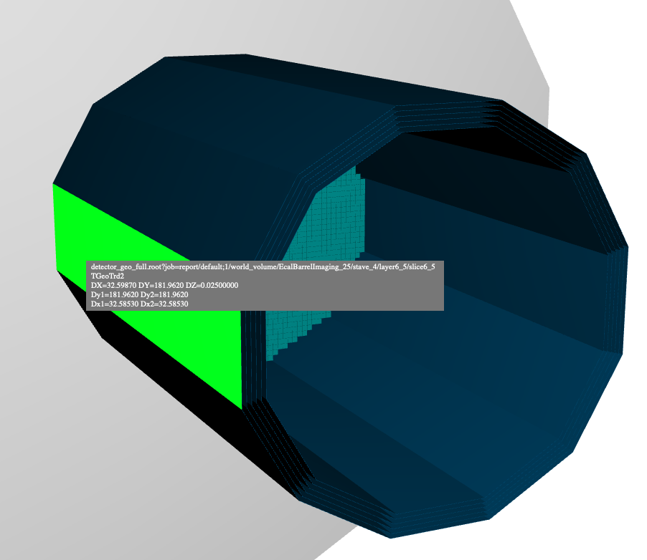
Calorimeter WG: Barrel
BHCal
layer steel + scintillator design
10cm square pad size (as above)
Somewhat orphaned?
BECal—imaging
implemented with 6 tracking layers
optimization of the number tracking layers and the spacing between them is ongoing.
BECal
Pb/SciFi calorimeter
Readout on ends

Slide 4
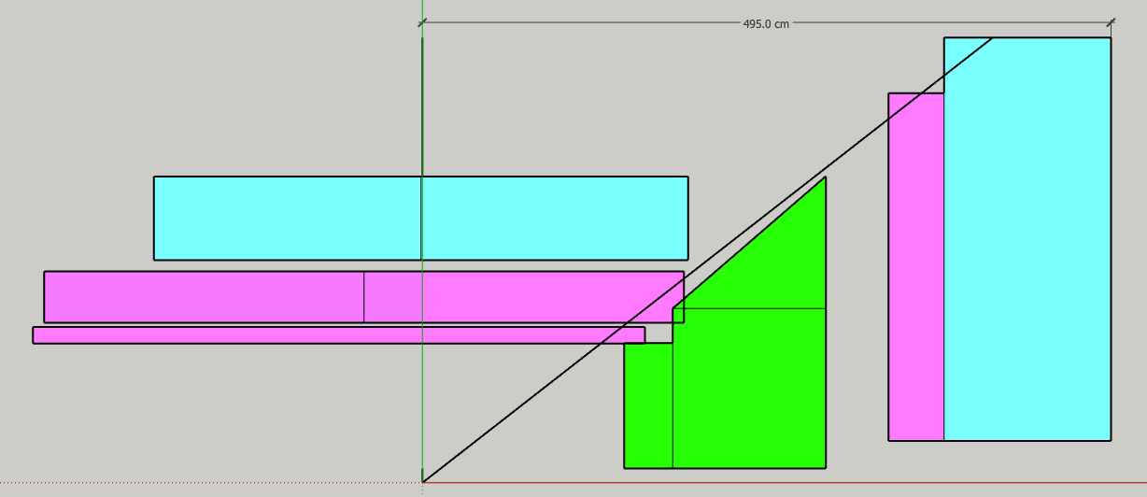
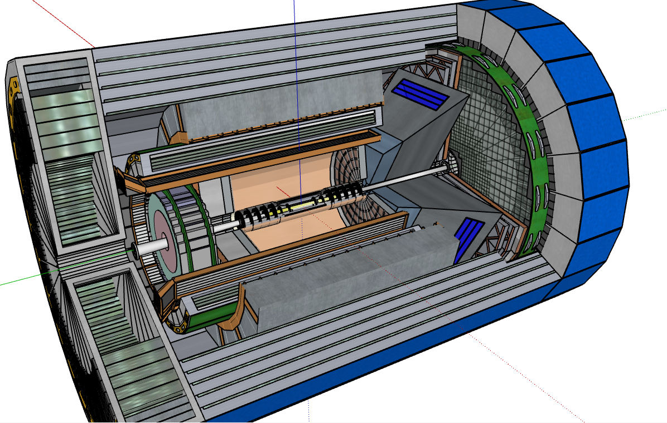
Barrel-Positive Endcap Interface
Not up-to-date
How much room is needed for
BECal support structure
BECal readout
DRICH
Utilities
. . .
Possible solution:
Extend PECal radially outward?
Would this work with the supporting structure for the BHCal/flux return steel?

Slide 5
Material Budget Before ECal’s
ECal can’t measure energy that it never sees.
Material between interaction and Ecal
1.5 < |η| < 2.5 this is around 0.75 to 0.10 X₀
|η| < 1 minimum of 0.04-0.05 X₀
See presentation by Alexander Bazilevsky at https://indico.bnl.gov/event/12911/contributions/53748/attachments/36834/60612/ATHENA_EMCal_Material.
Yellow Report Tab 8.20: Electron and photon minimum E = 0.05 GeV

