Slide 1
PID Update for Global Design/Integration
TK Hemmick, F Geurts, R Preghenella

Slide 2
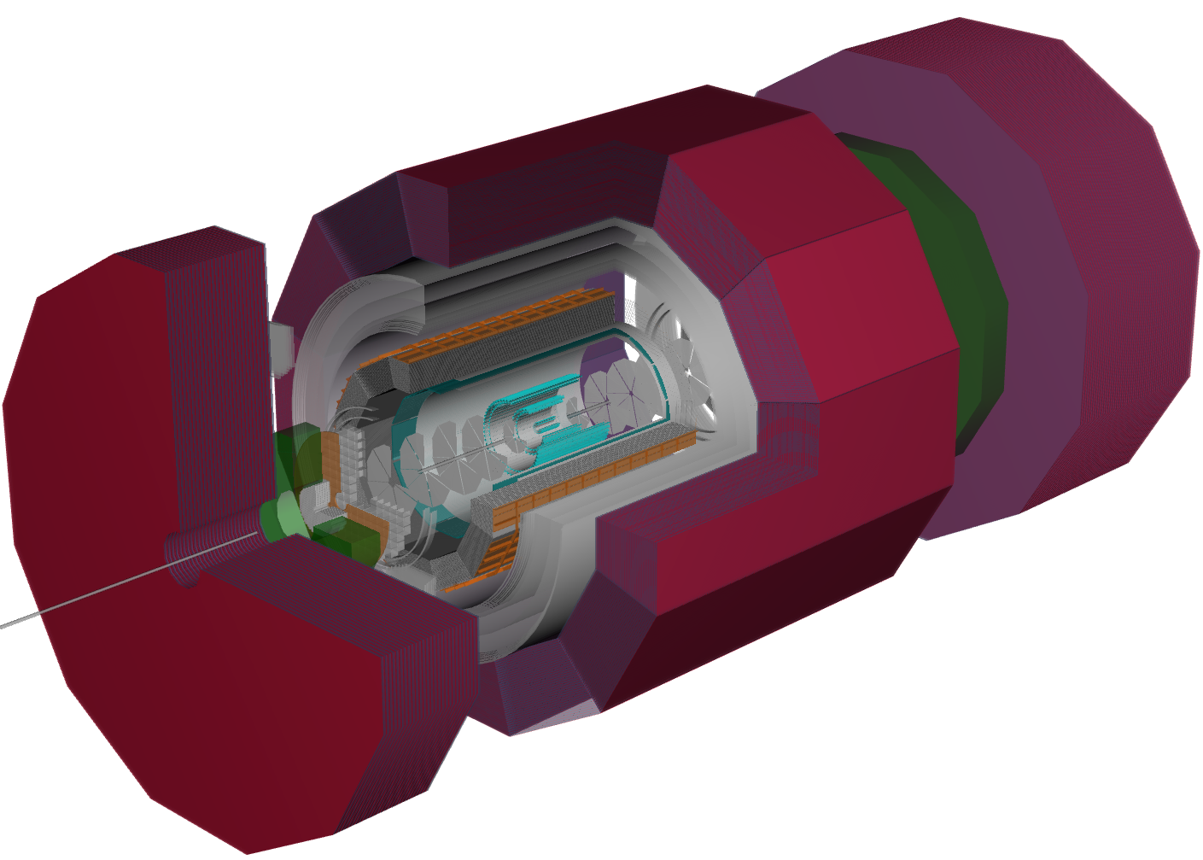
Reminder of Baseline Configuration
Negative direction:
Projective mRICH
Principle concern(s)
Response (trapped light)
Material thickness (can we do less material)
Barrel
DIRC
Principle concern(s)
Support/Integration
Positive direction:
dRICH
Principle concern(s)
Optics (coupled directly to detector location)

Slide 3
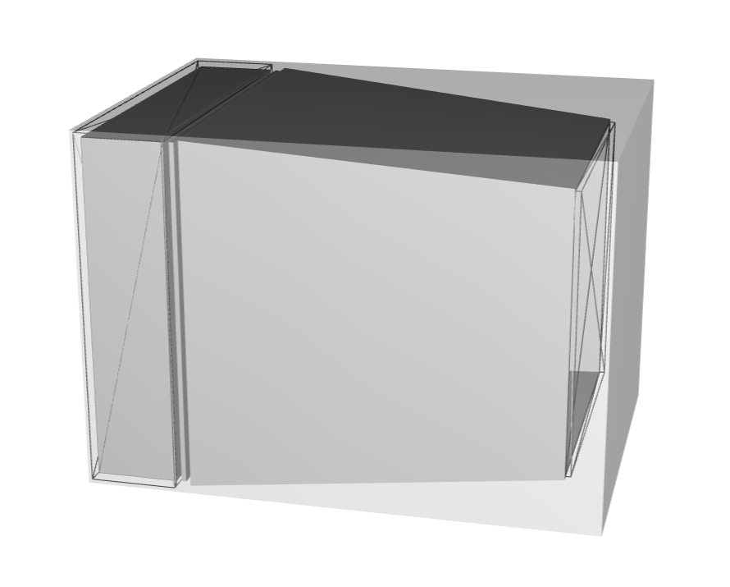
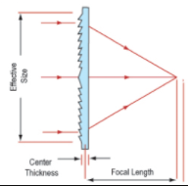
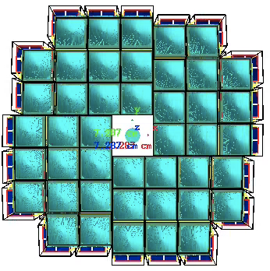
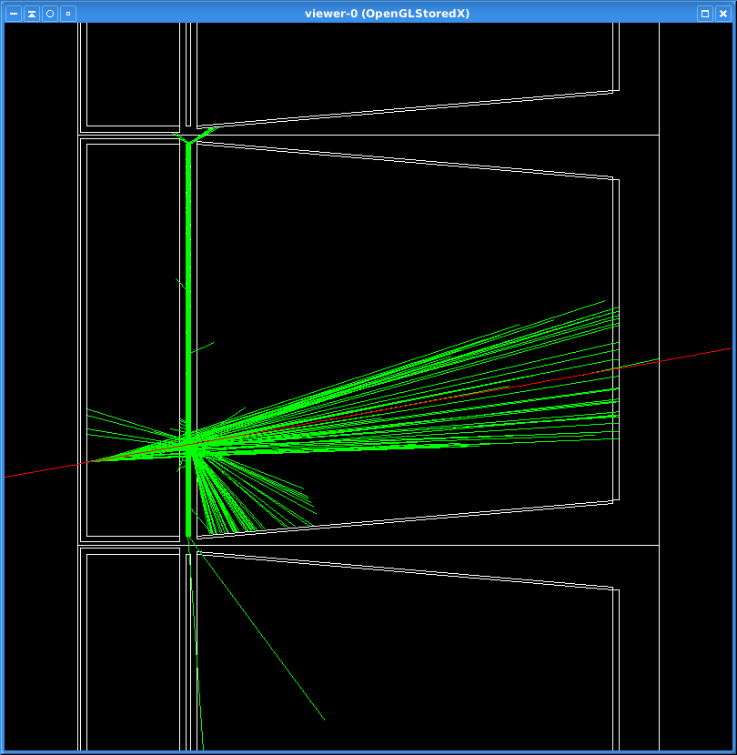
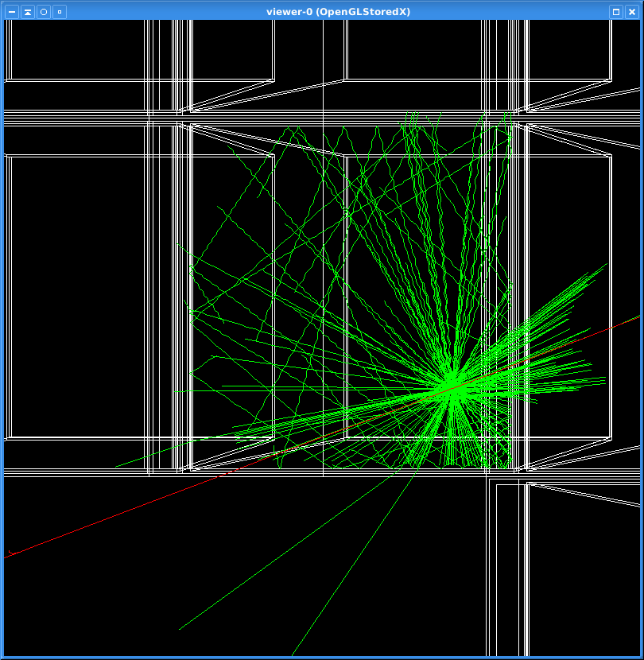
mRICH in Backward Region
Cherenkov Photons in DD4HEP
Implemented as a pseudo-projective array:
Detector envelope ~planar in Zed.
Individual modules tilted toward nominal collision point.
Advanced stage of implementation in DD4HEP
Concern:
Calorimeter Group concerned about material
Not yet evaluated “globally”.
Nonetheless simulations are “optimistic”

Slide 4
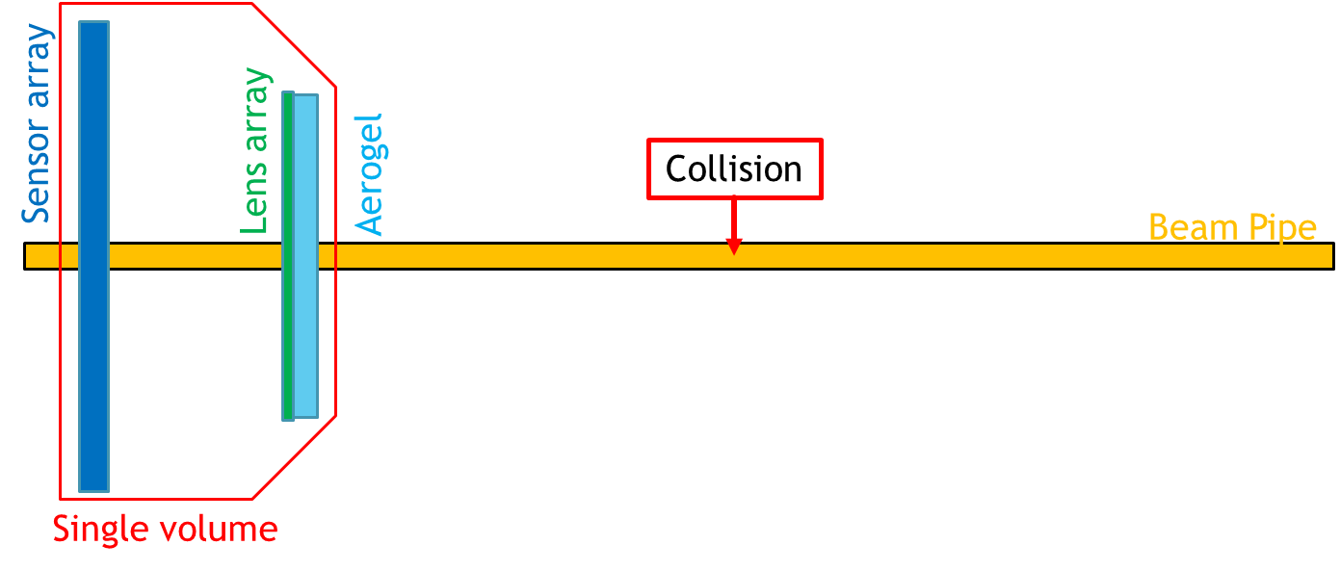
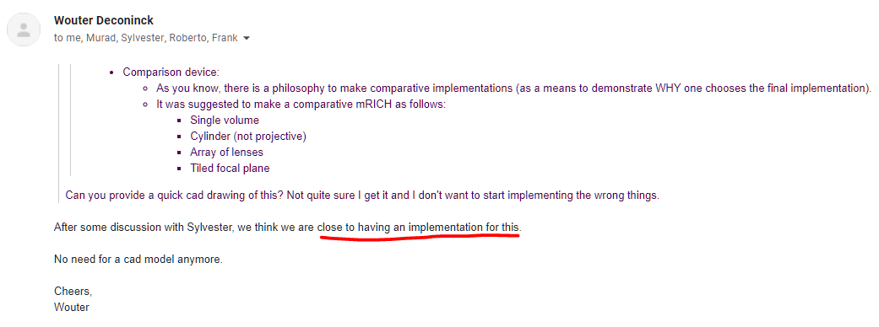
Requested Alternative Implementation:
Monolithic geometry
Thinner due to no walls.
Support very likely thinner (note: too thick before support!)
Optics options:
Lens array:
Focused but sometimes split and non-circular rings
Proximity:
How much zed-gap to achieve required performance.

Slide 5
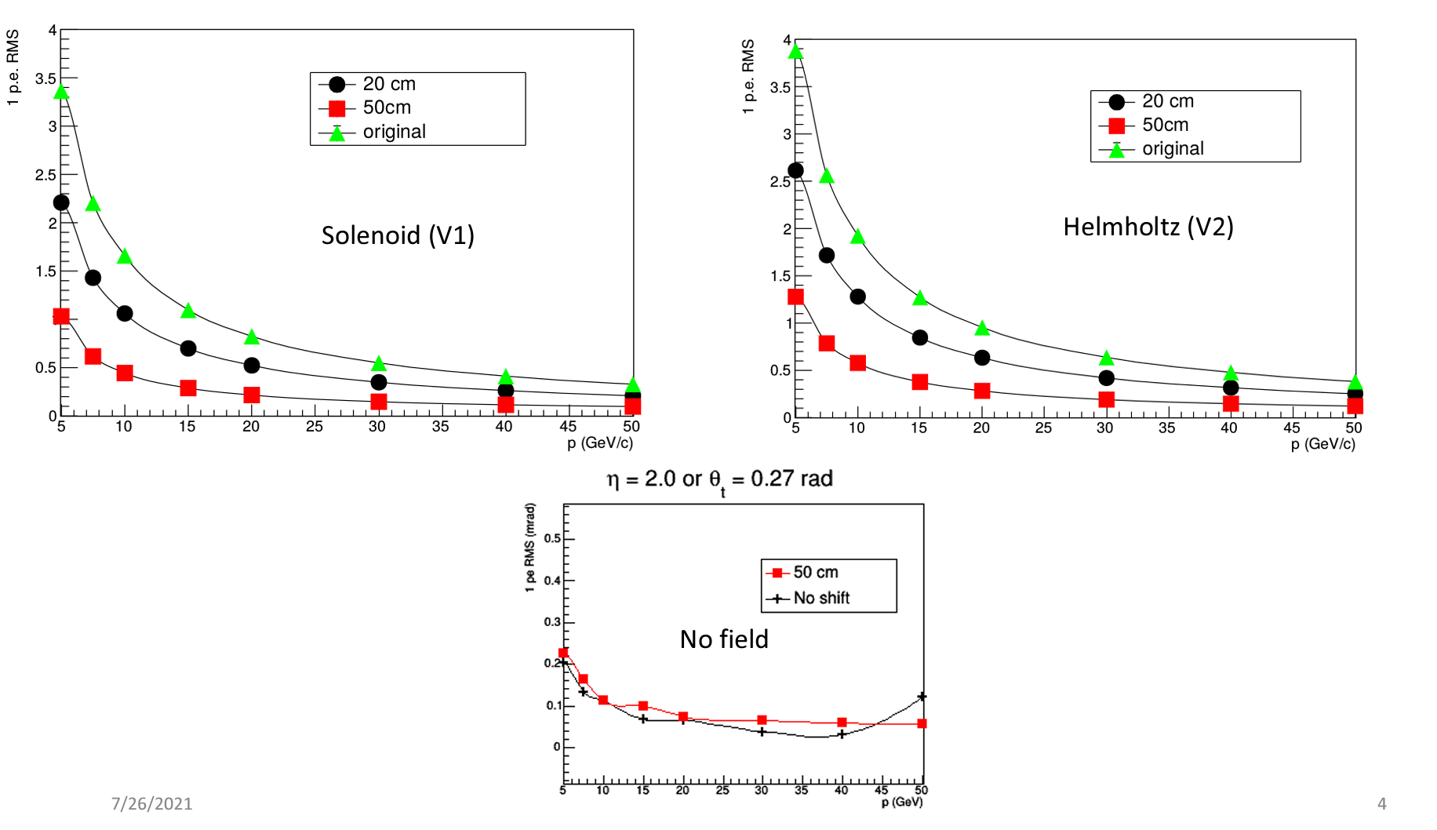
dRICH
Performance in brief (too brief)
Single Photon Resolution (linear)
Chromatic: n(λ)
Emission: emission point vs detection
Pixel: Sensor pixel & focal length
Magnetic Field: Smears ring
Track Resolution: WITHIN radiator
Aerogel dominated by irreducible contribution (chromatic/scattering)
Gas limited by Emission even in “less constrained” JLEIC design.
Photon Count (improves as SQRT(n))
Simulation Result(s)
Magnetic field contributions
Backing away more impactful than solenoid-vs-Helmholtz
Implications for interface location.
More detail:
Ayk contributions on additional slides
JLEIC Design
1 mrad

Slide 6
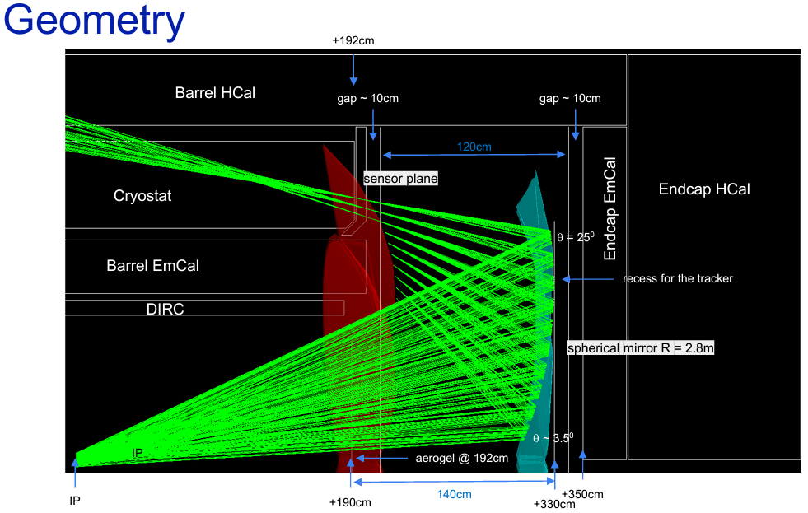
A few trials…
Note(s)
Simple implementation very useful for optics
Likely p.e. count is over-estimated.
Pretty small gaps
Need detailed understanding of the focal plane
How thick is the focal plane?
Separate cooling for sensors & electronics?
Use gaps between focal plane segments?

Slide 7
Other…
Without planar mirror, detection >25 degrees very tough.
With planar mirror even more restricted.

Slide 8
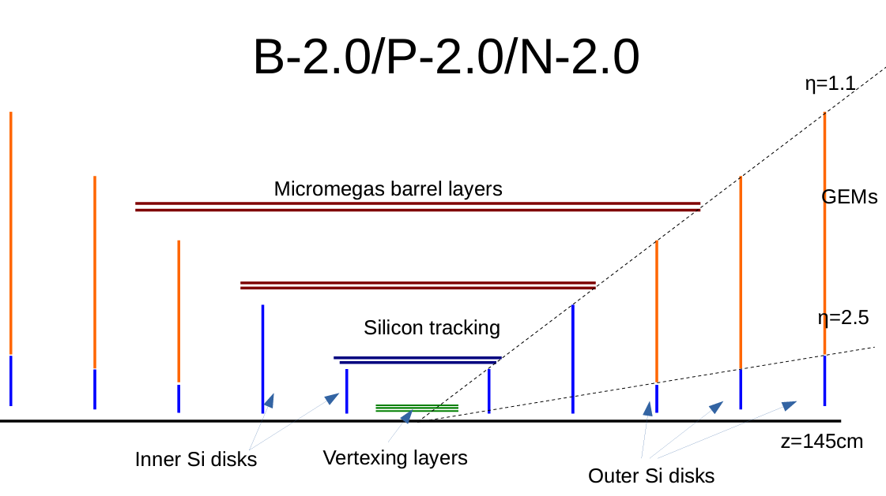
Beyond Baseline
9/14: Trk mtg
LGAD
GridPIX
Proposed GridPIX in the B-2.0
Last Silicon @ R=18.5cm
First μMEGAS @ R=50cm
Sandwich with plausible services gaps to avoid overlaps.
Likely need larger gap on Silicon side than on μMEGAS side.
Similar for LGAD (~matches cost document)
ΔR = 31.5 cm…GridPIX comfortable using ~20 cm
LGAD

