Slide 1
How should we deal with exotic near-threshold phenomena?
kelley

Slide 2
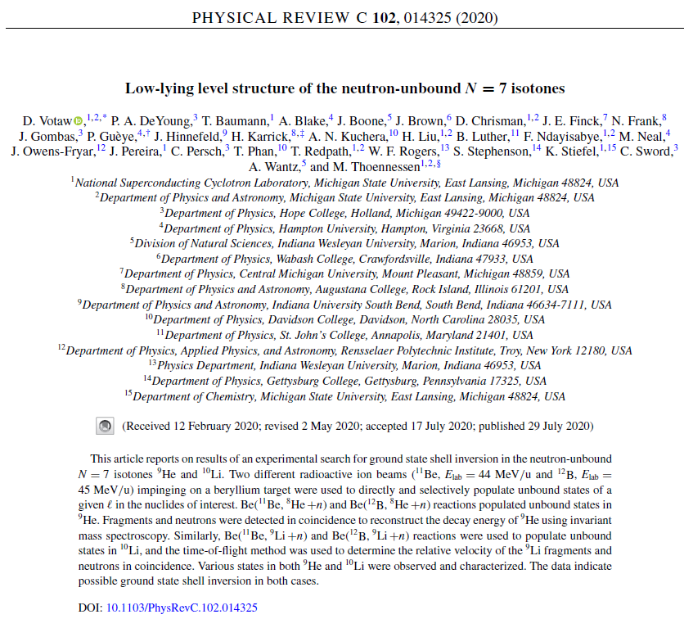

Slide 3
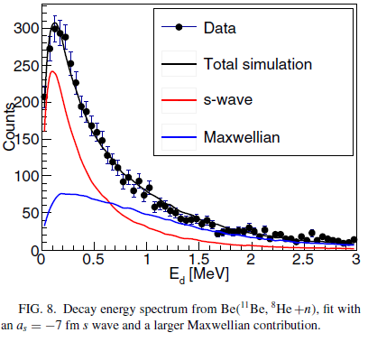
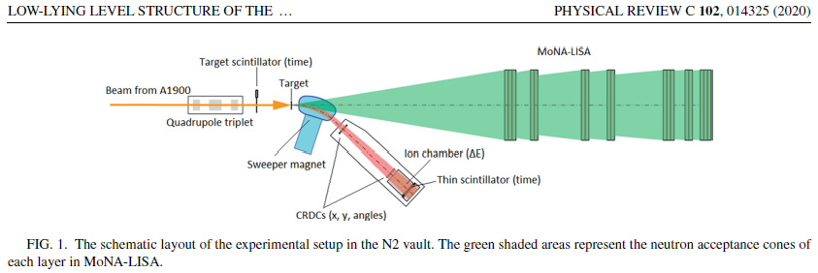

Slide 5
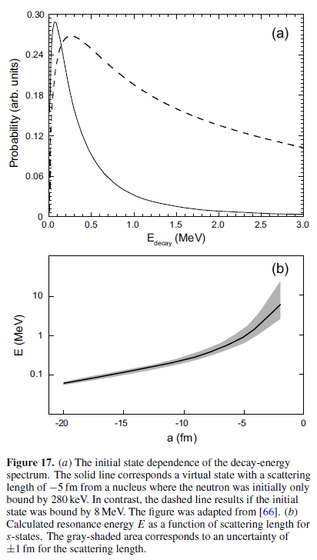
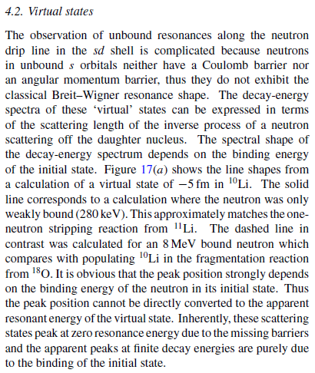
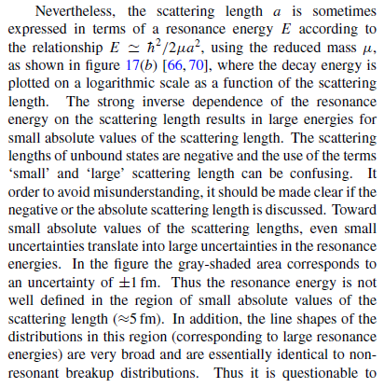
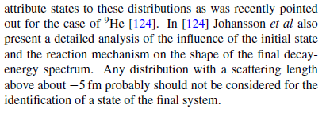

Slide 6
Should ENSDF develop a policy?
Asked MONA-LISA collaboration to speak on the issue at the LECM
Not much interest
These cases will become more common.
Light nuclei face the issue related to g.s. assignment
The issue is relevant for ground and excited s-wave states near threshold

