Slide 1
A few comments on NSR (j. Kelley)
Foreword: All ENSDF evaluators rely on the NSR to be complete, accurate and up-to-date. Overall, the database is very good in this regard.
But there are many avoidable false positives.

Slide 2
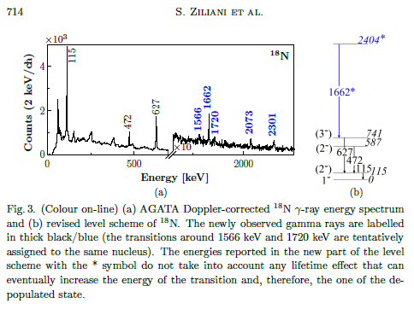
With such a title, why isn’t this article given keywords? These results are most precise for this nucleus.

Slide 3
4He(n,n)5He*
If not listed like this, ⁵He is not in the keywords.

Slide 4
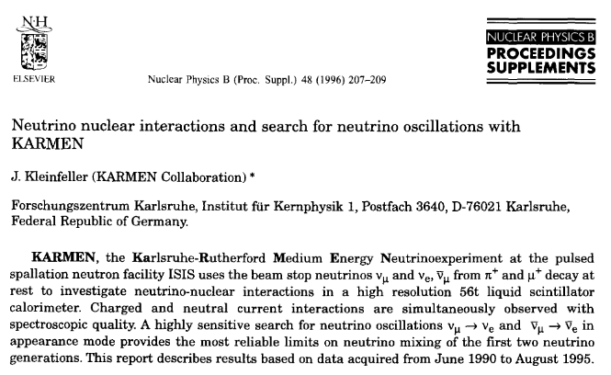
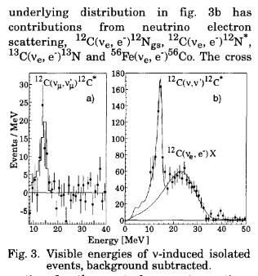
¹³C(ν,e-) is mentioned in passing as a background contribution. No quantified “signal is shown in any graph.”
Why is this included in the keywords?

Slide 5
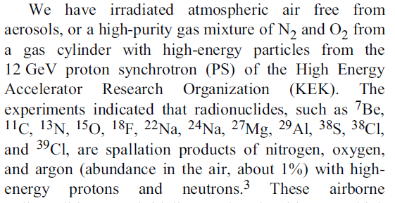
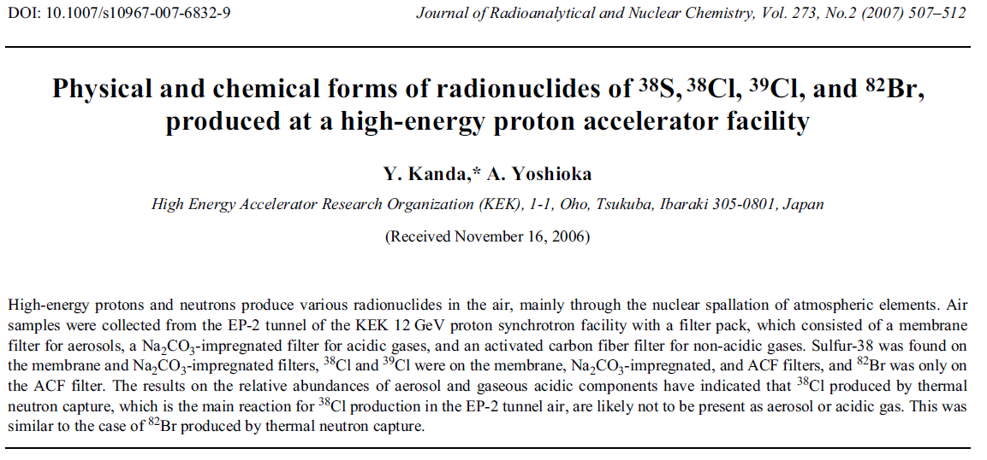
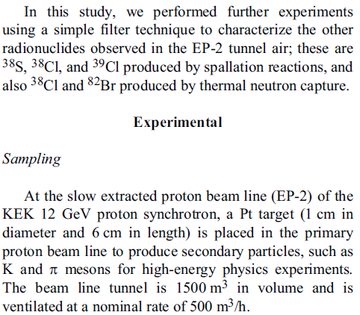

Slide 6
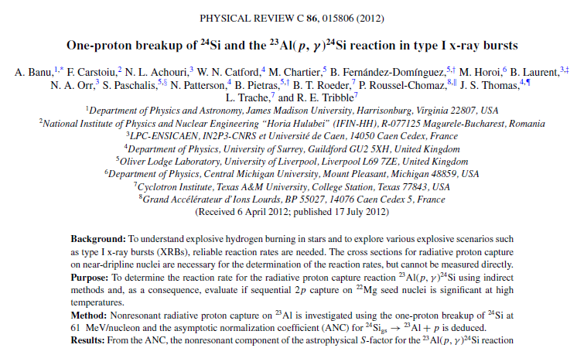
Shows up under ¹³N because ¹²C(²⁴Si,²³Al) is used to obtain the ANC.
¹³N is never mentioned in the article
Focus is on ²³Al(p,γ)²⁴Si

Slide 7
As an organization we don’t have a good format to express
The article dealt significantly with
But the article is not found under a search on ¹⁶O

Slide 8
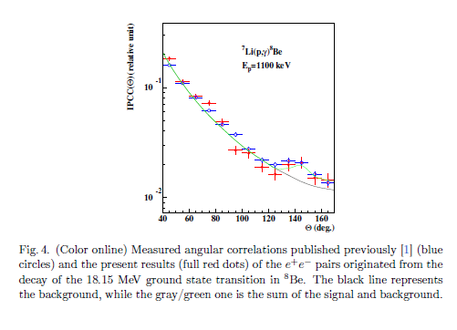
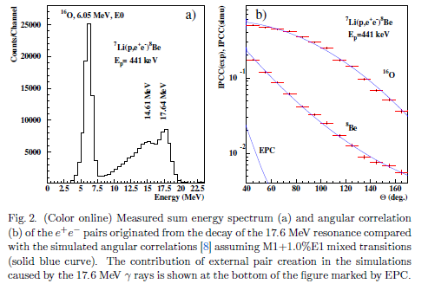
⁷Li+p->⁸Be*->⁸Be_{gs} + e⁺e⁻
³Η+p−>⁴Ηe*->⁴He + e⁺e⁻

Slide 9
