Slide 1


LBNL/UC Report
12 November 2021
Lee A. Bernstein
Department of Nuclear Engineering
University of California – Berkeley
Nuclear Science Division
Lawrence Berkeley National Laboratory
Andrew S. Voyles
13 June 2018 – Program Review for NSSC2 – TA1
http://nucleardata.berkeley.edu
Notes:
Emerging trends for next-generation (targeted & personalized) nuclear medicine:
Targeted alpha therapy (5-10 MeV)
40-80 μm range → single cell
Targeted Auger therapy (20 eV – 1 keV)
1 nm – 2 μm → cellular nucleus
Theranostic medicine
Simultaneous imaging and therapy

Slide 2
BLUF: A short talk about lots of stuff
Our group works collaboratively with numerous sponsors/partners on nuclear data related projects.
    DOE/NNSA-NA22, DOE-NE, DOE-IP, Google, UC
    19 peer-reviewed papers + 6 dissertations in FY21
There’s no way that I can cover all of this in 20 min.
There’s been a good deal of outreach work done to NASA, DTRA and MDA that I won’t be able to report on, but I’m happy to discuss with anyone in the community offline
The best way to learn about our work is to check our website – https://nucleardata.berkeley.edu

Slide 3
FY21 Personnel & FTE Breakdown
Name | Position | USNDP Activity | USNDP % | Other support
L.A. Bernstein | Joint Appt. | Coord, Measurements (n,n’γ) | 50% | NA-22, UC, Isotopes
M.S. Basunia | Staff | ENSDF, XUNDL | 90% | Isotopes
A.M. Hurst | Staff (UC) | (n,γ), (n,n’γ), website | 10% | NA-22, DTRA
J.C. Batchelder | Staff (UC) | α/β-particle eval., ENSDF | 75% | Isotope Program
B.L. Goldblum | Staff | AI/ML, Measurements | 33% | NA-22, ARPA-E
A.S. Voyles | Staff (UC) | Reac. measure., website | 25% | Isotope Program
J.A. Brown | Staff (UC) | ²³⁸U(n,n’γ), (n,f) yields | 25% | DOE-NE, NA-22
J.T. Morrell* | GS→PD | (n,x) Isotope Production | 0% | Isotope Program
C. Apgar* | GS | Sb(p,x) to 200 MeV | 0% | Isotope Program
J. Matheny* | GS | Gamma-Xray Database | 0% | DTRA
E.F. Matthews* | GS | Fission modeling | 0% | NSSC Fellow
M. Fox* | GS | ⁹³Nb,⁷⁵As(p,x) to 200 MeV | 0% | Isotope Program
J.M. Gordon* | GS | ⁵⁶Fe(n,n’γ) | 0% | NE, LLNL
W. Younes | Consultant | ML, Fission Cov. | 40% | N/A
P. Vincente-Valdez* | GS* | ML for reaction eval. | 25% | UC
J. Tuli | Consultant | ENSDF | 40% | n.a.
C. Romano | Consultant | Coordination (NDWG) | 15% | n.a.
USNDP
≈30%
*GS limited to 50%

Slide 4
FY21 Personnel & FTE Breakdown
Name | Position | USNDP Activity | USNDP % | Other support
L.A. Bernstein | Joint Appt. | Coord, Measurements (n,n’γ) | 50% | NA-22, UC, Isotopes
M.S. Basunia | Staff | ENSDF, XUNDL | 90% | Isotopes
A.M. Hurst | Staff (UC) | (n,γ), (n,n’γ), website | 10% | NA-22, DTRA
J.C. Batchelder | Staff (UC) | α/β-particle eval., ENSDF | 75% | Isotope Program
B.L. Goldblum | Staff | AI/ML, Measurements | 33% | NA-22, ARPA-E
A.S. Voyles | Staff (UC) | Reac. measure., website | 25% | Isotope Program
J.A. Brown | Staff (UC) | ²³⁸U(n,n’γ), (n,f) yields | 25% | DOE-NE, NA-22
J.T. Morrell* | GS→PD | (n,x) Isotope Production | 0% | Isotope Program
C. Apgar* | GS | Sb(p,x) to 200 MeV | 0% | Isotope Program
J. Matheny* | GS | Gamma-Xray Database | 0% | DTRA
E.F. Matthews* | GS | Fission modeling | 0% | NSSC Fellow
M. Fox* | GS | ⁹³Nb,⁷⁵As(p,x) to 200 MeV | 0% | Isotope Program
J.M. Gordon* | GS | ⁵⁶Fe(n,n’γ) | 0% | NE, LLNL
W. Younes | Consultant | ML, Fission Cov. | 40% | N/A
P. Vincente-Valdez* | GS* | ML for reaction eval. | 25% | UC
J. Tuli | Consultant | ENSDF | 40% | n.a.
C. Romano | Consultant | Coordination (NDWG) | 15% | n.a.
FY21 Graduates
*GS limited to 50%

Slide 5
Mass chain/nuclide Evaluation (Shamsu)
    Publications
        A=23 - NDS 171, 1 (2021) – M.S. Basunia, A. Chakraborty
        A=233 – NDS 170, 499 (2020) – B. Singh, J. Tuli, E. Browne
    Submitted: 24.5 nuclides
        A=24 (8 nuclides) – M.S. Basunia, A. Chakraborty
        A=213 (12 nuclides) – M.S. Basunia
        A=231 (9 nuclides) – B. Singh (4.5), J. Tuli (4.5)
    Addressed reviewer’s comments (resubmitted):
        A=186 J.C. Batchelder, A.M. Hurst, M.S. Basunia
    Reviewed 2 mass chains
      M.S. Basunia (1), J.C. Batchelder (1)
    In progress
      A=191 – M.S. Basunia

Slide 6
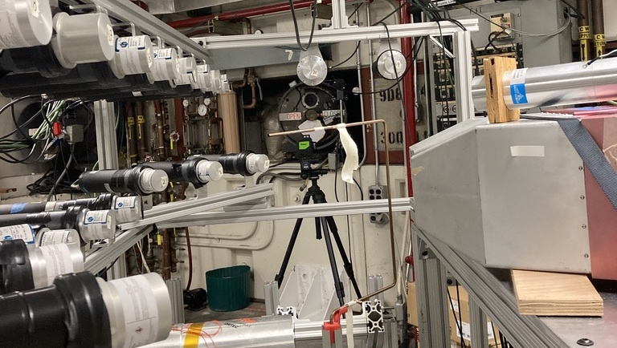
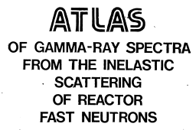
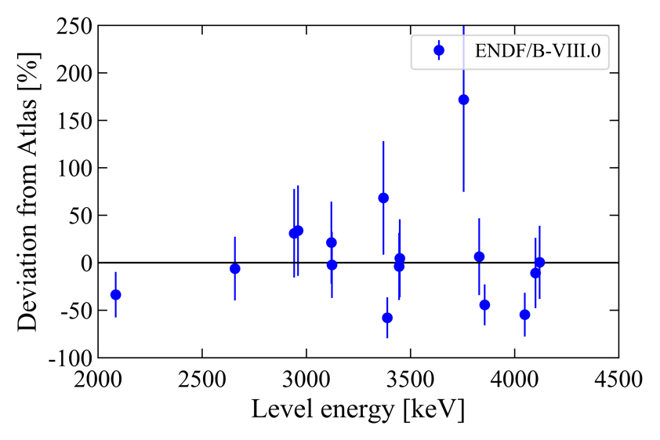
Berkeley works to address identified evaluation, validation and experimental nuclear data needs that support and complement the “Flagship” nuclear databases
The first (n_{fast},n’γ) benchmark database
Evaluation of (p,x) data for E_{p} ≥ 100 MeV
New FPY & (n,n’γ) data
FPY covariance database
ENDF Validation
⁵⁶Fe(n,n’γ)
TREND (BNL & LANL)
https://nucleardata.berkeley.edu/#research

Slide 7
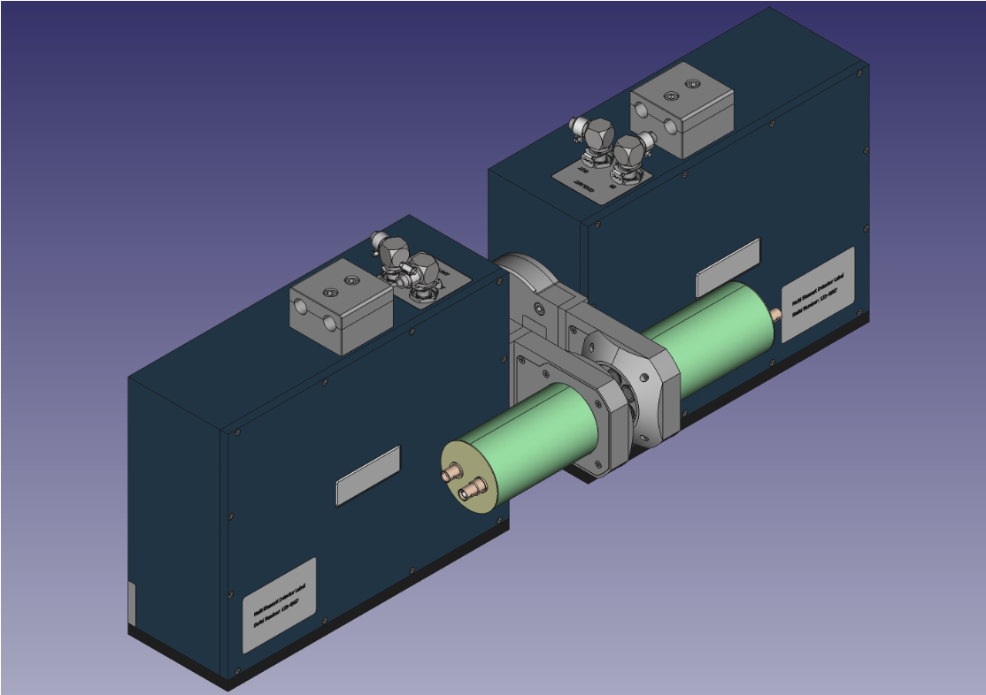
Aaron is developing a new coincident decay database in collaboration with Bruce Pierson (PNNL)
    DTRA has funded the production of a robust portable γ/X-ray coincidence detector system being developed at PNNL.
    Aaron has developed an ENSDF-sourced database that provides correct coincident intensities of γ-rays/X-rays emitted via α-, β-, γ- or EC-decay to a specific final level for use with this detector.

Slide 8



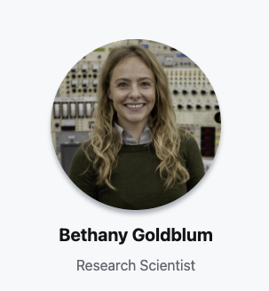


Bethany is developing NucScholar - A Natural Language Processing for Nuclear Science References
pdf to text conversion
Keyword and natural language queries
BERT embeddings index (for fast retrieval)
preprocessing
User
named entity recognition
topic
modeling
Semantic similarity (for fine-tuning)
BERT QA processing
The NucScholar Team
Notes:
NucScholar is a framework for using AI/ML methods to enhance and accelerate nuclear science literature search. Topic modeling allows automated categorization and keywording of nuclear science literature. BERT is a deep learning model that has given state-of-the-art results on a wide variety of natural language processing tasks. It stands for Bidirectional Encoder Representations for Transformers. It has been pre-trained on Wikipedia and BooksCorpus and requires task-specific fine-tuning.
Question answering (QA) is a prediction task. Given a question and a context paragraph, the model predicts a start and an end token from the paragraph that most likely answers the question.

Slide 9
FY21 Publications – Evaluation (5)
P. Vicente-Valdez, L.A. Bernstein, and M. Fratoni., "Nuclear data evaluation augmented by machine learning," Ann. Nucl. Energy, 163, 108596 (2021), https://doi.org/10.1016/j.anucene.2021.108596
E. F. Matthews, L. A. Bernstein, and W. Younes, “Stochastically estimated covariance matrices for independent and cumulative fission yields in the ENDF/B-VIII.0 and JEFF-3.3 evaluations,” At. Data Nucl. Data Tables, 101441, (2021), https://doi.org/10.1016/j.adt.2021.101441
A.M. Hurst, L.A. Bernstein, T. Kawano, A.M. Lewis, and K. Song, "The Baghdad Atlas: A relational database of inelastic neutron-scattering (n,n′γ) data," Nuc. Inst. Meth. A 995, 165095. (2021), https://doi.org/10.1016/j.nima.2021.165095
B. Singh, J.K. Tuli, E. Browne. Nuclear Data Sheets for A=233. 170, 499 (2020). https://doi.org/10.1016/j.nds.2020.11.002
M.S. Basunia, Anagha Chakraborty. Nuclear Data Sheets for A=23. Vol. 171, January 2021, Pages 1-252. https://doi.org/10.1016/j.nds.2020.12.001

Slide 10
We are developing a high-energy (p,x) modeling approach as part of a LANL-BNL-LBNL* collaboration (Morgan)
We are using TALYS since it allows for the exploration of reaction model physics, is well-documented and is easy to use.
Level density and exciton model parameters are adjusted to match the strongest independent channels
The modeling is validated via comparison to cumulative channels.
Publications:
  M.B. Fox et al., “Investigating high-energy proton-induced reactions on spherical nuclei: Implications for the preequilibrium exciton model” PRC 103, # 3, 034601, 3/21 https://doi.org/10.1103/PhysRevC.103.034601
  M.B. Fox et al., “Measurement and modeling of proton-induced reactions on arsenic from 35 to 200 MeV”. Accepted for publication in PRC – 10/1/21
a
*Modeling collaborator: A. Koning
Notes:
Well, I developed this standardized framework to specifically go about improving our predictive power in these high-energy proton reactions. The framework is possible because of this unique charged-particle YATC dataset that we have. Akin to developing an early evaluation thought process essentially for proton-induced reactions.
Ok but what is this framework actually doing. Its goal is to provide a logical process for adjusting parameters within a predictive code, in a physically justified manner, and accounts for both compound and pre-equilibrium effects, to ultimately find the best fit for high energy proton induced reactions. The framework’s specific focus is on pre-equilibrium, which I will get to. A similar goal to evaluated (n,x) work, which just doesn’t exist for (p,x), Since simply protons weren't quite as important as neutrons for bombs and reactors.
Also note, that the framework is first built for improving predictions of spherical nuclei targets, like the niobium, where I haven’t yet worried about deformation and more complicated associated effects.
And these ideas are currently built within the TALYS code modelling space, as TALYS has widespread use in the nuclear community and is an accessible code-of-choice for reaction cross section prediction, well documented available literature.
Ok, but let’s go through the procedure and see the logic behind it and what I’m trying to accomplish and then I’ll show its effect.

Slide 11
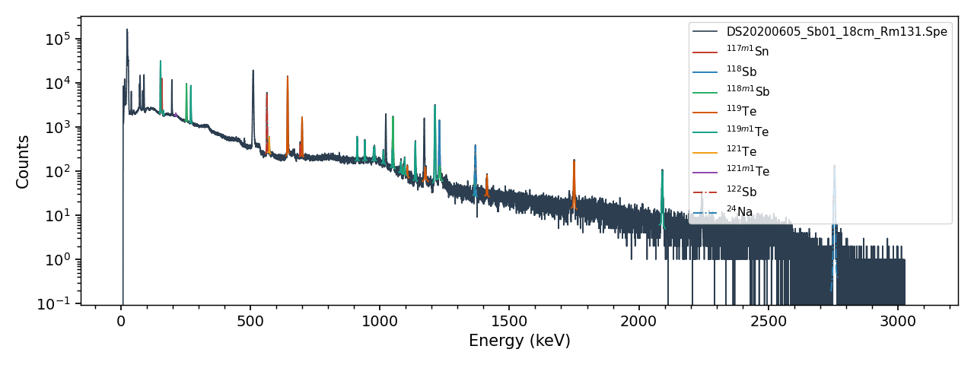
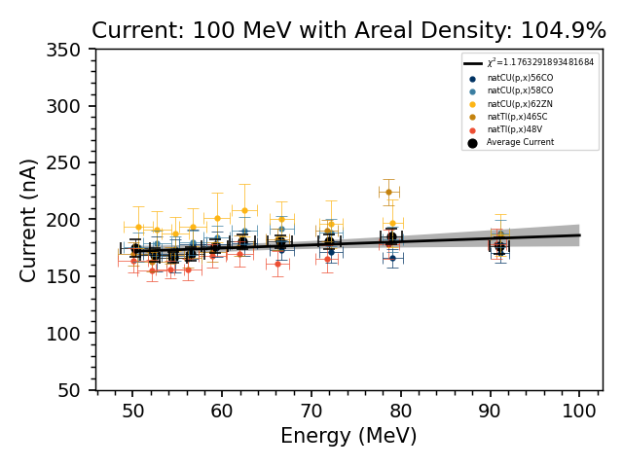
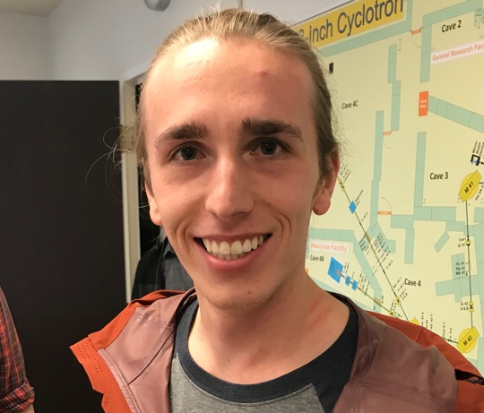
Curie* - A Python Toolkit for Activation Analysis
Curie is a Python API toolkit that provides :
Peak fitting for HPGe/⍺-spec detector data
HPGe energy & efficiency calibration
Charged-particle energy loss characterization
General-purpose Bateman equation solver
Isotopic mass and decay data from ENSDF
API to search and retrieve reaction data from multiple libraries
13,791 downloads since release, ≈7,500 in FY21
* https://jtmorrell.github.io/curie/build/html/index.html
Jon Morrell
Notes:
What about when there’s no data? Modeling codes must be used to predict XS, to design thick targets, or guide the design of a thin-target measurement. However, modeling efforts using default parameters often fail to exhibit modest predictive power (within ~20%).
Several trends:
Modeling is better where data have been measured previously, for strongly fed channels, and for reactions whose ejectiles don’t need to cross shell closures.
Common issues are: failure to model high-spin transfer reactions, or miss the shape (wrong compound peak, wrong amplitude)
11

Slide 12
2021 Publications Reaction Measurement/Modeling (4)
D. L. Bleuel, L. A. Bernstein, R. A. Marsh, J. T. Morrell, B. Rusnak, and A. S. Voyles, “Precision measurement of relative γ-ray intensities from the decay of ⁶¹Cu,” Appl. Radiat. Isot., 170, 109625 (2021), https://doi.org/10.1016/j.apradiso.2021.109625
A.S. Voyles, A. M. Lewis, J. T. Morrell, M. S. Basunia, L. A. Bernstein, J. W. Engle, S. A. Graves, and E. F. Matthews, “Proton-induced reactions on Fe, Cu, and Ti from threshold to 55 MeV,” Eur. Phys. J. A, 57 (3), (2021), https://doi.org/10.1140/epja/s10050-021-00401-2
R. K. Chapman, A. S. Voyles, N. Gharibyan, L. A. Bernstein, and J. E. Bevins, “Measurement of the 160Gd(p,n)160Tb excitation function from 4–18 MeV using stacked-target activation,” Appl. Radiat. Isot., 171, 109647 (2021), https://doi.org/10.1016/j.apradiso.2021.109647
M. B. Fox, A. S. Voyles, J. T. Morrell, L. A. Bernstein, A. M. Lewis, A. J. Koning, J. C. Batchelder, E. R. Birnbaum, C. S. Cutler, D. G. Medvedev, F. M. Nortier, E. M. O'Brien, and C. Vermeulen, “Investigating high-energy proton-induced reactions on spherical nuclei: Implications for the preequilibrium exciton model,” Phys. Rev. C, 103 (3), 034601 (2021), https://doi.org/10.1103/PhysRevC.103.034601
This research is supported in part by the U.S. Department of Energy Isotope Program, managed by the Office of Science for Isotope R&D and Production

Slide 13
We are developing an online* compilation and evaluation of heavy charged particle emitting (βxp, βα, xp, α) rare isotopes
Expands on Batch’s recent ADNDT publication
  “Recommended Values for Beta-Delayed Proton Alpha Emission” J. C. Batchelder, Atomic Dat. Nucl. Data Tables 132, 101323 (2020).)
Gives recommended values based on all available experimental data
Will be kept up to date as new papers come out
The goal is to aid researchers by putting all current information in one place to allow users to look for patterns and trends which can lead to the discovery of new physical phenomena.
In most cases levels in daughter nuclei can only be observed via heavy charged particle emission
Precursor (A,Z)
p
p
α
p-decay
(A-1,Z-1)
p
α-decay
(A-4,Z-2)
β-4p
β−α
β-3p
β-p
β-2p
This work takes advantage of Batch’s established role in the field to enable cutting edge research in the FRIB era.
*Web interface courtesy of A.M. Hurst

Slide 14
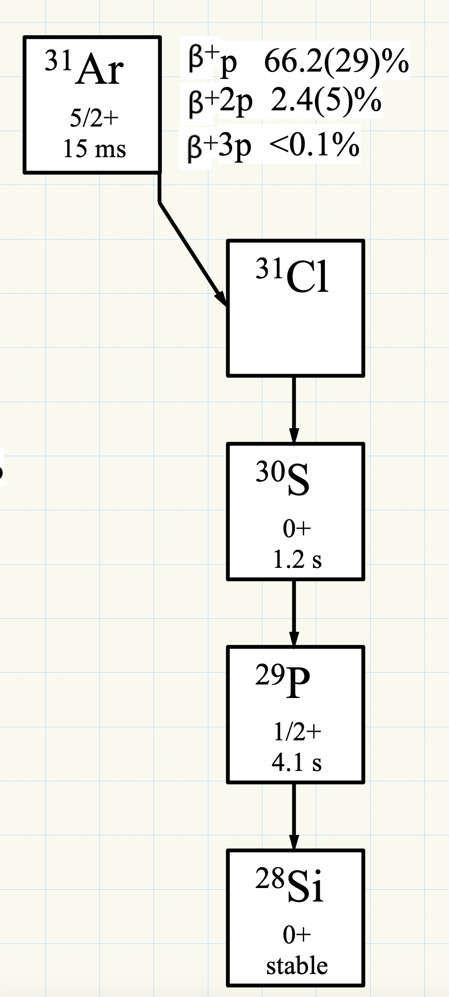
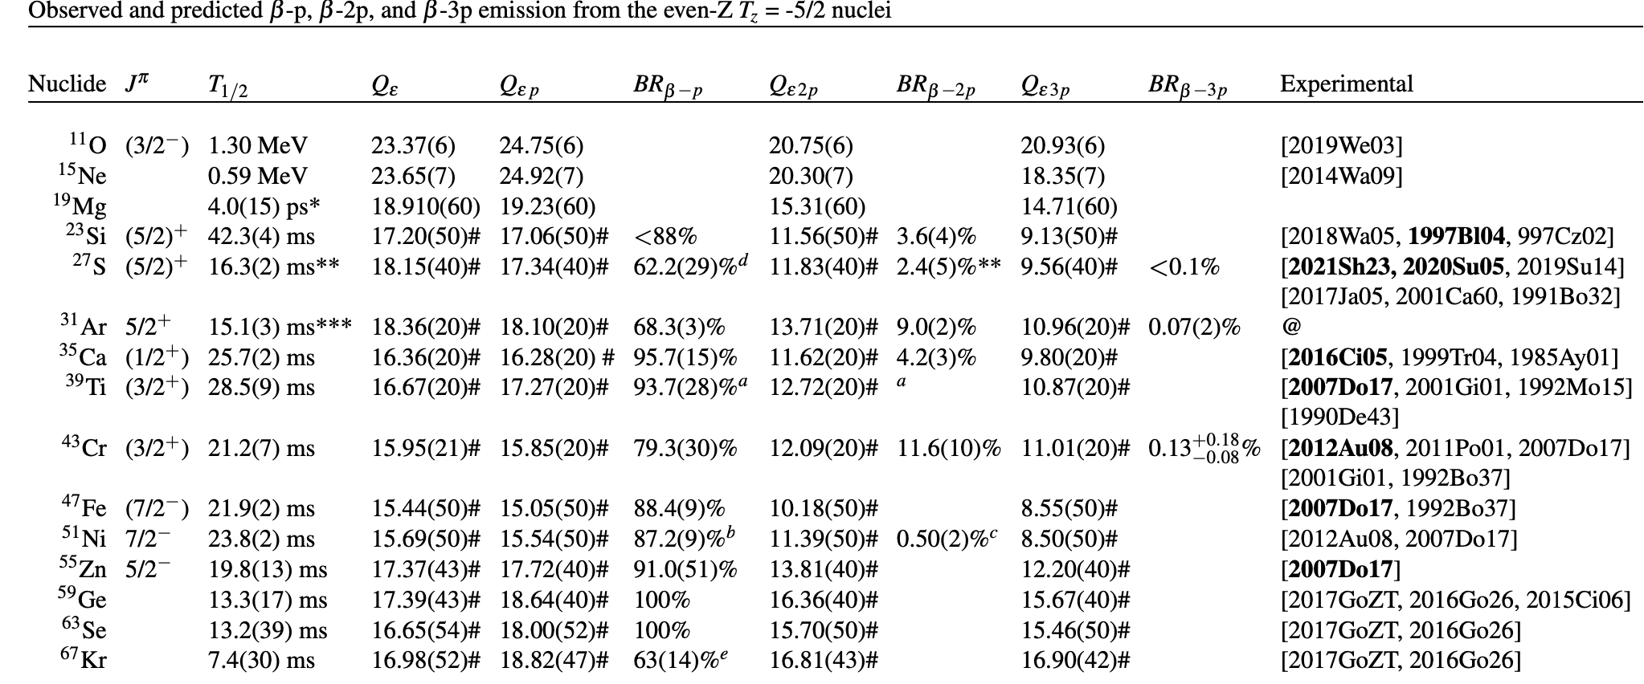
We are developing an online* compilation and evaluation of heavy charged particle emitting (βxp, βα, xp, α) rare isotopes
Physics Motivated!
Organized by isospin projection (T_{z})
Measured Q_{ε}, Q_{εxp}, S_{p}, S_{α}, Q_{εα} branchings
Complete set of up-to-date references
Downloadable pdf, CSV and JSON files

Slide 15
2021 Publications - Rare Isotope Decay Data (4)
E. H. Wang, J. M. Eldridge, N. T. Brewer, J. H. Hamilton, J. C. Batchelder, Y. X. Liu, Y. Sun, C. Brown, C. J. Zachary, B. M. Musangu, A. V. Ramayya, K. P. Rykaczewski, C. J. Gross, R. Grzywacz, M. Madurga, D. Miller, D. W. Stracener, C. Jost, E. F. Zganjar, J. A. Winger, M. Karny, S. V. Paulauskas, S. H. Liu, M. Wolinska-Cichocka, S. W. Padgett, A. J. Mendez, K. Miernik, A. Fijalkowska, and S. V. Ilyushkin, "Long-lived isomeric states and quasiparticle band structures in neutron-rich ^{162,164}Gd nuclei from β decay," Phys.Rev. C 103 (1), 014317 (2021), https://doi.org/10.1103/PhysRevC.103.014317
S. Go, R. Grzywacz, C. Mazzocchi, S. N. Liddick, M. Alshudifat, J. C. Batchelder, T. Baumann, A. A. Ciemny, T. N. Ginter, K. Kolos, A. Korgul, S. V. Paulauskas, C. J. Prokop, M. M. Rajabali, K. P. Rykaczewski, S. Taylor, and Y. Xiao, "Mapping of the fragmentation of the νf5/2→πf7/2 transition in decay of ⁷³Co→⁷³Ni," Phys. Rev. C. 102 (4), 044331 (2020), https://doi.org/10.1103/PhysRevC.102.044331
C. J. Zachary, N. T. Brewer, J. C. Batchelder, E. Wang, J. H. Hamilton, J. M. Eldridge, B. M. Musangu, A. V. Ramayya, C. J. Gross, K. P. Rykaczewski, R. Grzywacz, M. Madurga, D. Miller, D. W. Stracener, C. Jost, E. F. Zganjar, J. A. Winger, M. Karny, S. V. Paulauskas, S. H. Liu, M. Wolinska-Cichocka, S. W. Padgett, A. J. Mendez, K. Miernik, A. Fijalkowska, S. V. Ilyushkin, A. C. Dai, and F. R. Xu, "New transitions and levels in ¹⁶³Tb obtained from β decay studies," Phys Rev. C 102 (4), 044302 (2020), https://doi.org/10.1103/PhysRevC.102.044302
J. C. Batchelder, C. Apgar, N. T. Brewer, C. J. Gross, R. Grzywacz, S. Ilyushkin, M. Madurga, K. Miernik, S. W. Padgett, S. V. Paulauskas, W. Peters, C. Rasco, K. P. Rykaczewski, D. Stracener, J. A. Winger, M. Wolin ́ska-Cichocka, E. F. Zganjar, D. Bardayan, M. E. Howard, B. Manning, M. Matos, A. Mendez, D. Miller, A. Ratkiewski, and E. H. Wang, Levels in ¹²⁵Cd populated by the β-decay of ^{125m}Ag and ¹²⁵Ag. Phys. Rev. C. 104, 024308 (2021). https://doi.org/10.1103/PhysRevC.104.024308
10 papers submitted and published in the last 4 years

Slide 16
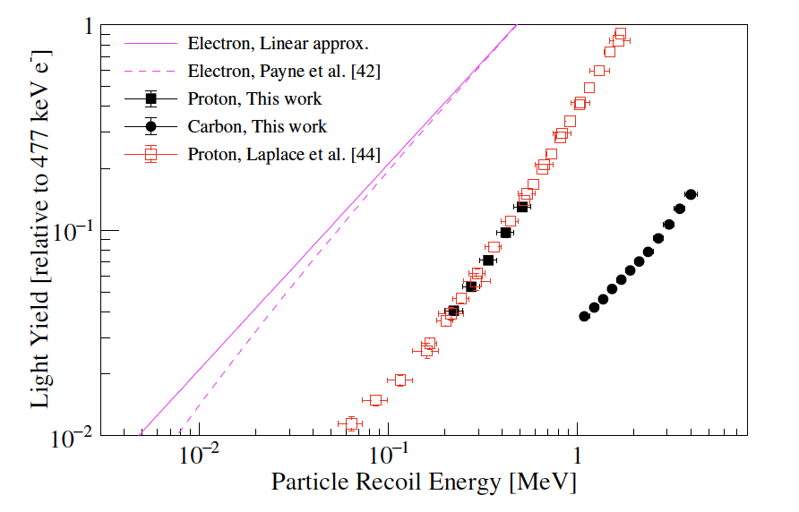
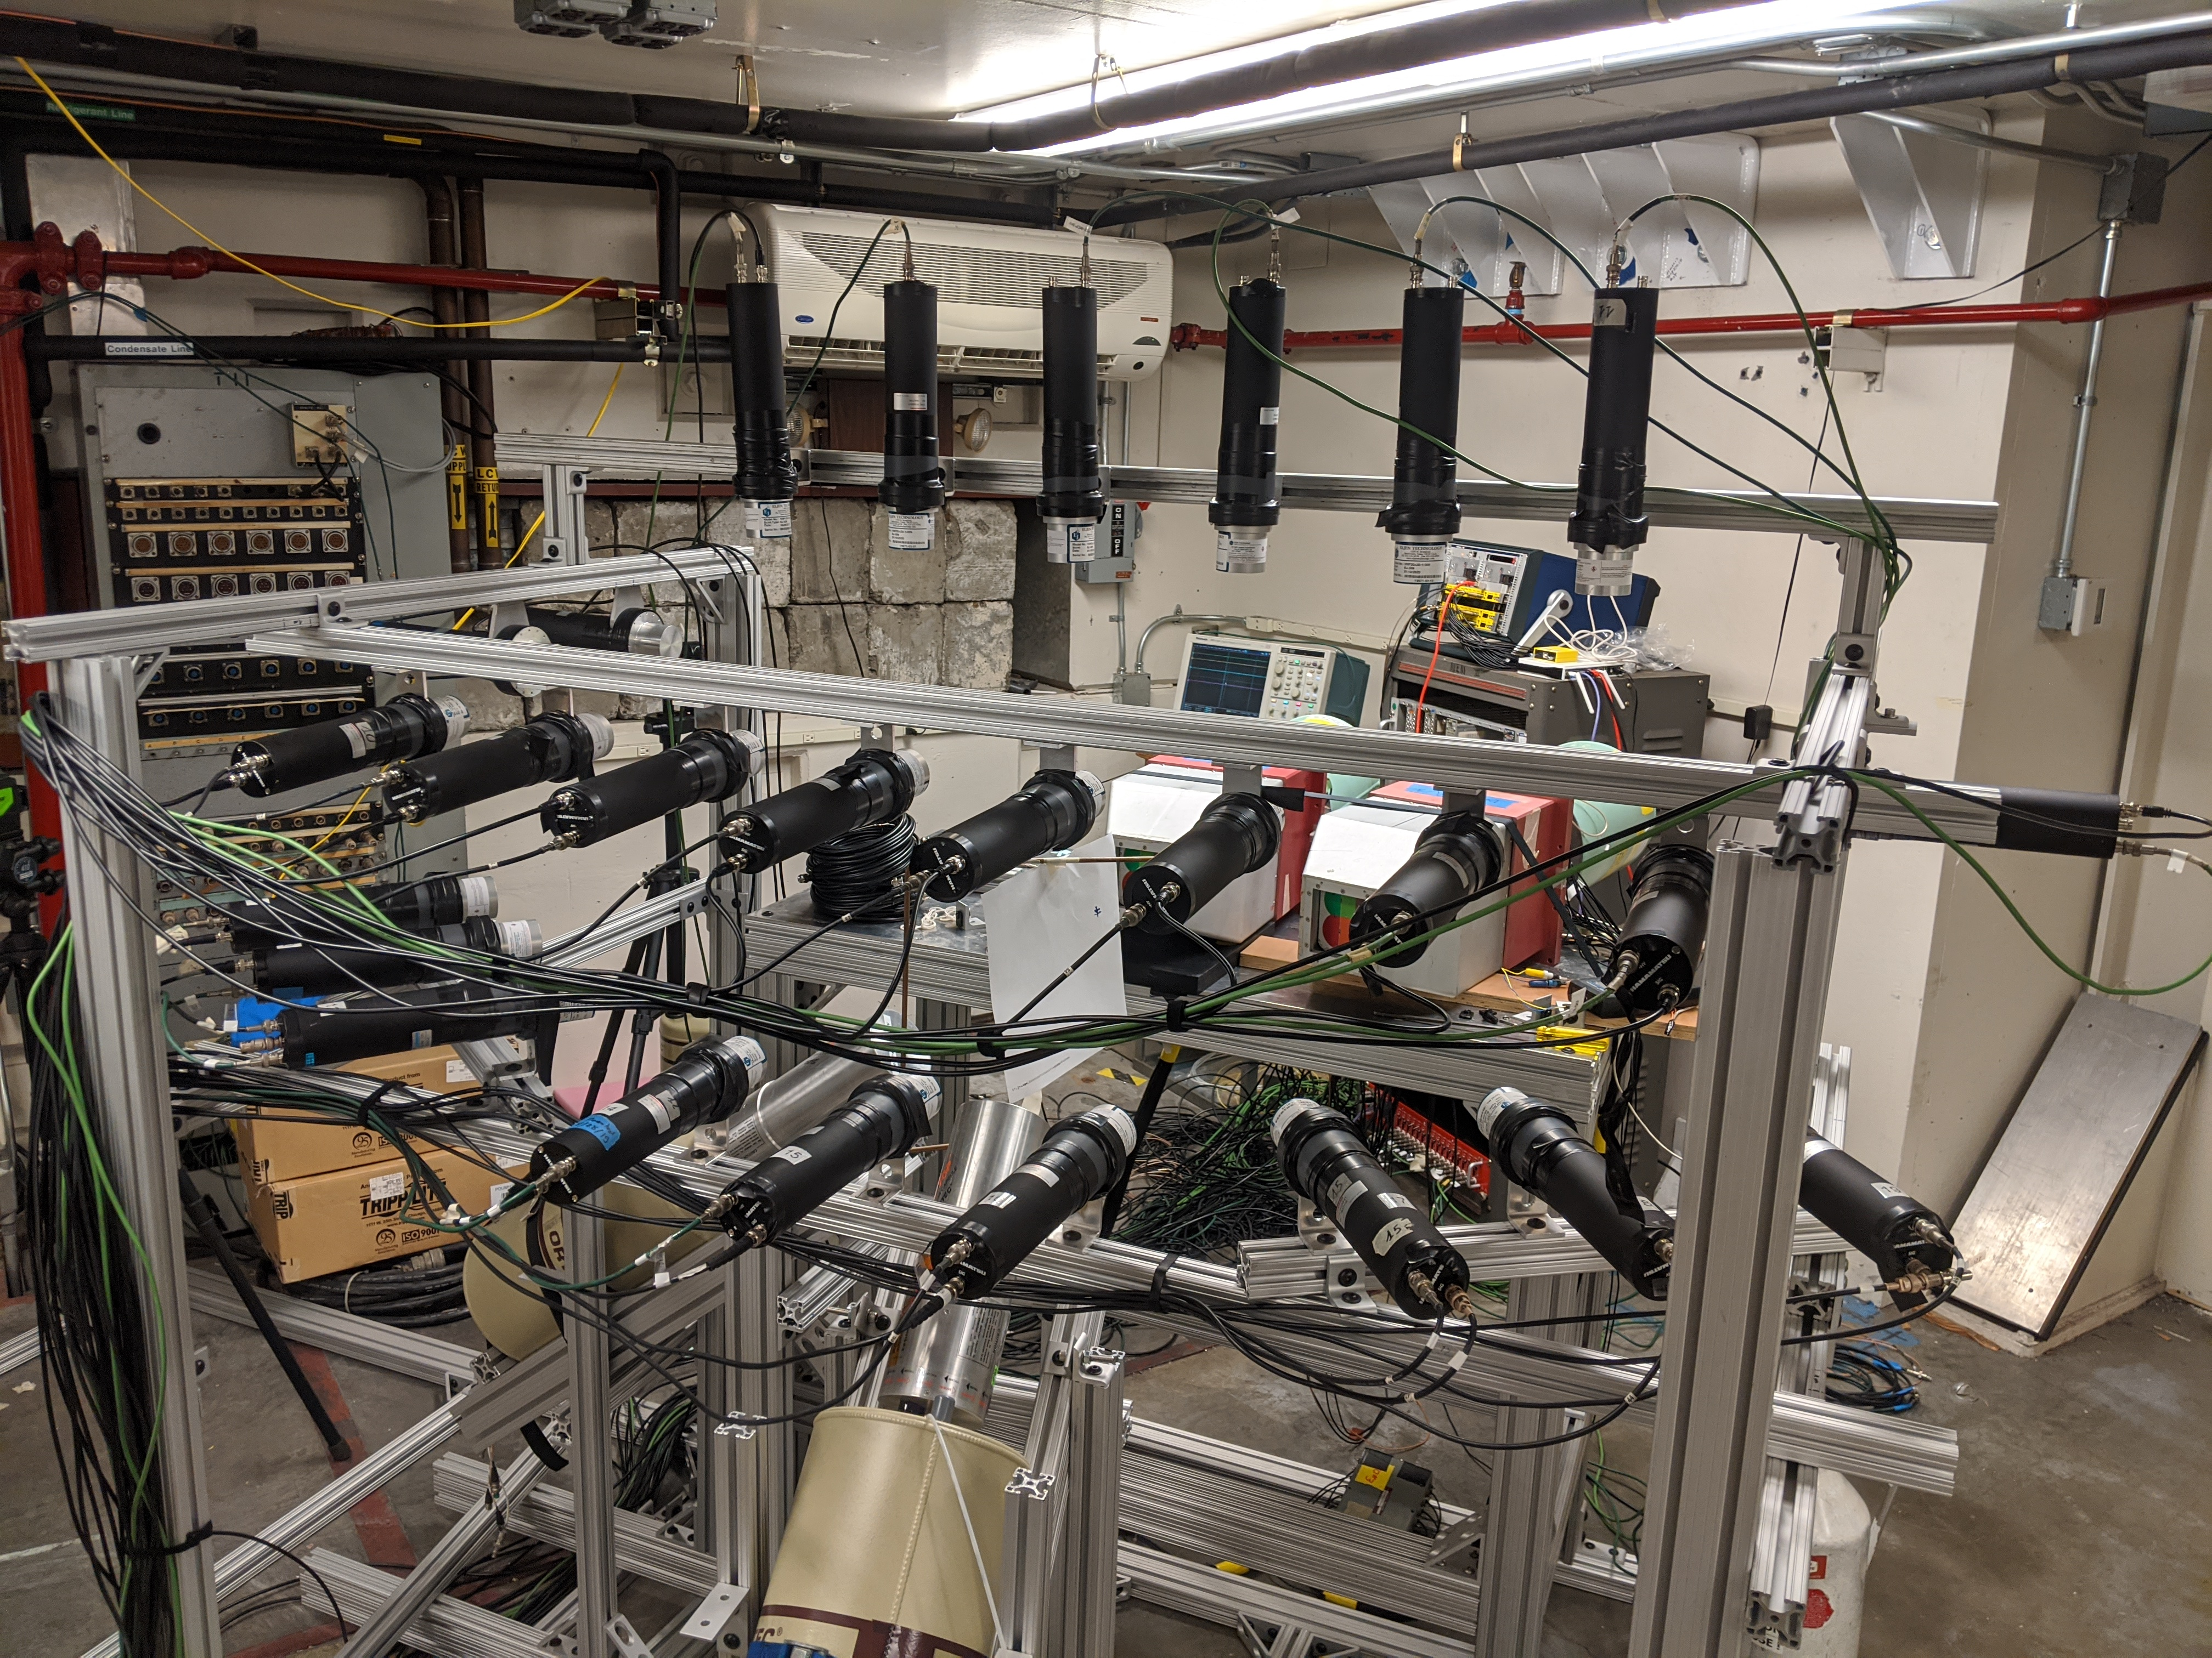
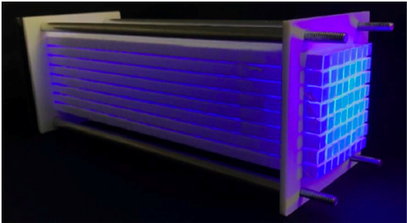
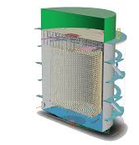
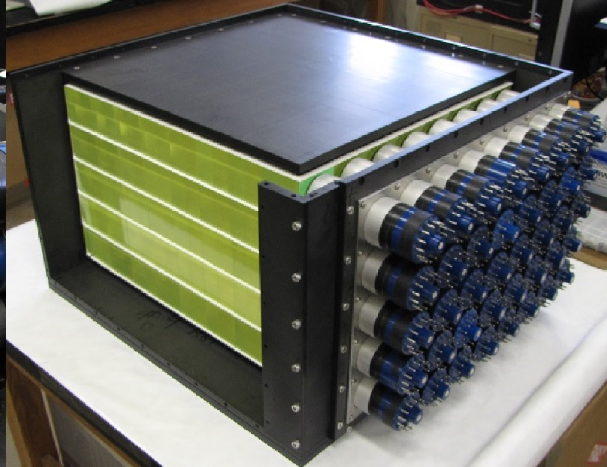
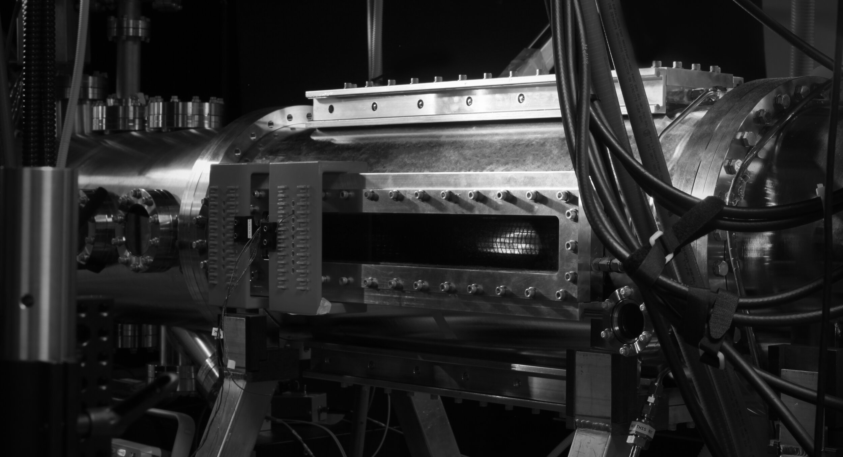
WANDA 2020 and WoNDRAM 2021 Roadmaps call for scintillator quenching data
“An understanding of quenching phenomena in organic scintillators is a crosscutting need.” –WANDA 2020 Roadmap
“It is recommended that funding agencies prioritize experimental studies of scintillator response—including light yield, electron light nonproportionality, and quenching factors for heavy nuclei—as a key component of the science.” –WoNDRAM 2021 Roadmap
EJ-204
T.A. Laplace, B.L. Goldblum, et al. Phys. Rev. C (2021).
Wide range of applications:
Nuclear security
(kinematic reconstruction for imaging)
Nuclear physics (threshold estimation & forward modeling)
Fusion energy
(plasma diagnostics)
Neutrino detection (background in IBD detectors)
Notes:
Recommended actions are a continued emphasis on integration of experimental studies with the modeling community; MONA nuclear reactions; BLOWFISH nuclear structure, CHANDLER neutrinos

Slide 17
2021 Publications Scintillator Characterization (4)
Lucas Q Nguyen, Gino Gabella, Bethany L Goldblum, Thibault A Laplace, Joseph S Carlson, Erik Brubaker, and Patrick L Feng, "Boron-loaded organic glass scintillators," Nucl. Instrum. Meth. A 988, 164898 (2021), https://doi.org/10.1016/j.nima.2020.164898
T.A. Laplace, B.L. Goldblum, J.E. Bevins, D.L. Bleuel, E. Bourret, J.A. Brown, E.J. Callaghan, J.S. Carlson, P.L. Feng, and G. Gabella, "Comparative scintillation performance of EJ-309, EJ-276, and a novel organic glass," J. Instrum. 15 (11), P11020 (2020), https://doi.org/10.1088/1748-0221/15/11/P11020
T.A. Laplace, B.L. Goldblum, J.J. Manfredi, J.A. Brown, D.L. Bleuel, C.A. Brand, G. Gabella, J. Gordon, and E. Brubaker. "Simultaneous measurement of organic scintillator response to carbon and proton recoils", Phys. Rev. C 104, 014609 – Published 9 July 2021 https://doi.org/10.1103/PhysRevC.104.014609
G. Gabella, B.L. Goldblum, T.A. Laplace, J.J. Manfredi, J. Gordon, Z.W. Sweger, E. Bourret, “Neutron Response of the EJ-254 Boron-Loaded Plastic Scintillator,” IEEE Trans. Nucl. Sci. 68, 46 (2021). https://doi.org/10.1109/TNS.2020.3041215

Slide 18
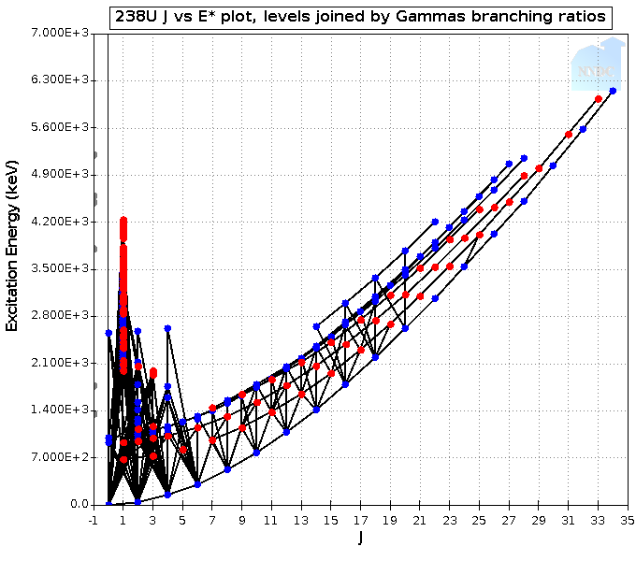

Future directions: Structure beyond ENSDF
There is a huge “evaluation gap” between ENSDF & ENDF – the Quasicontinuum (QC) region.
The data in this region (level density and radiative strength) are key to modeling photonuclear and capture cross sections for:
  Stellar nucleosynthesis;
  Isotope Production;
  Damage studies for nuclear energy and space exploration;
  Active Interrogation for Nonproliferation
FRIB will create a large body of this sort of data (β-Oslo method).
  We are coupled to this community through the NSSC (Liddick) and our long-standing collaboration with the University of Oslo.
ENDF (mostly n)
Here there be
Dragons…
ρ(E_{x}), Γ_{γ}
(n,γ)
ENSDF
  We are starting a search for a researchers who can work with the community to address this crosscutting nuclear data need

Slide 19

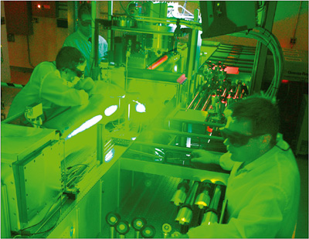
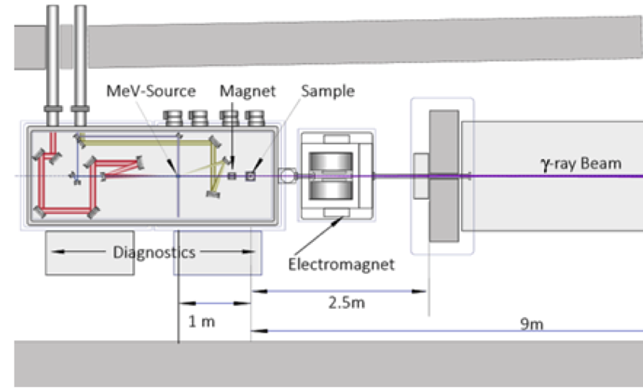
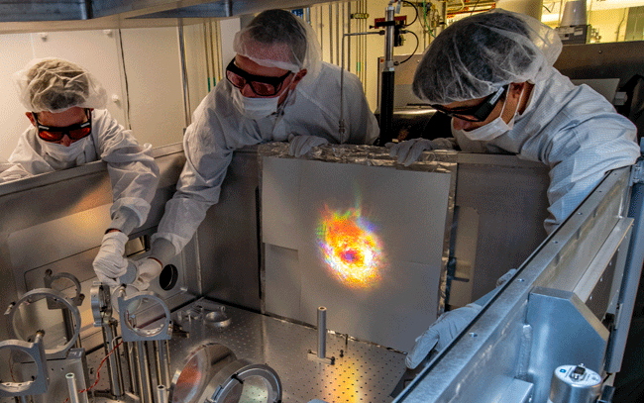

Google Project X is supporting us to explore the use of electrons and γ-rays from the BELLA laser to speed up the decay of nuclear isomers
The 141 year ^{242m}Am isomer is a problematic constituent of nuclear waster.
A UCB/LBNL team led by Lee Bernstein high energy photon beam from the BELLA laser will be used to populate QC states above the ^{242m}Am isomer (Step #1).
²⁴²Am
QC
These states will feed the 16 hour ground
state and its decay observed off-line. (Step #2).
^{242m}Am (141 y)
^{242g}Am (16 h)
γ-rays
^{242m}Am
BELLA
Electrons

Slide 20
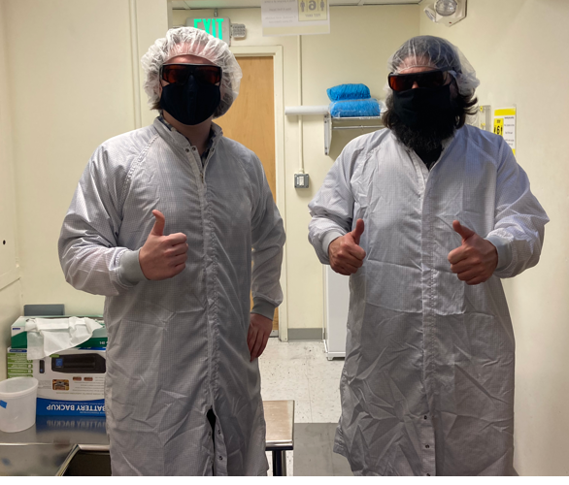
Google Project X is supporting us to explore the use of electrons and γ-rays from the BELLA laser to speed up the decay of nuclear isomers
The 141 year ^{242m}Am isomer is a problematic constituent of nuclear waster.
A UCB/LBNL team led by Lee Bernstein high energy photon beam from the BELLA laser will be used to populate QC states above the ^{242m}Am isomer (Step #1).
⁷⁹Br
QC
These states will feed the 16 hour ground
state and its decay observed off-line. (Step #2).
First proof-of-principle measurements using a LaBr and CLYC surrogate are planned for late 2021.
^{79m}Br (4.85 s)
^{79g}Br (Stable)
Robert Jacob (GS)
γ-rays
^{242m}Am
BELLA
Electrons
Josh Brown (Staff)

Slide 21
2021 Publications Quasicontinuum Structure/Lasers (2)
D. Gjestvang, S. Siem, F. Zeiser, J. Randrup, R. Vogt, J. N. Wilson, F. Bello-Garrote, L. A. Bernstein, D. L. Bleuel, M. Guttormsen, A. Görgen, A. C. Larsen, K. L. Malatji, E. F. Matthews, A. Oberstedt, S. Oberstedt, T. Tornyi, G. M. Tveten, and A. S. Voyles, “Excitation energy dependence of prompt fission γ-ray emission from Pu241* ,” Phys. Rev. C, 103 (3), 034609 (2021), https://doi.org/10.1103/PhysRevC.103.034609
Pascal Boller, Alex Zylstra, Paul Neumayer, Lee Bernstein, Christian Brabetz, John Despotopulos, Jan Glorius, Johannes Hellmund, Eugene A. Henry, Johannes Hornung, Justin Jeet, Jadambaa Khuyagbaatar, Lotte Lens, Simon Roeder, Thomas Stoehlker, Alexander Yakushev, Yuri A. Litvinov, Dawn Shaughnessy, Vincent Bagnoud, Thomas Kuehl & Dieter H. G. Schneider, "First on-line detection of radioactive fission isotopes produced by laser-accelerated protons", Scientific Reports 10, 17183 (2020). https://doi.org/10.1038/s41598-020-74045-5

Slide 22
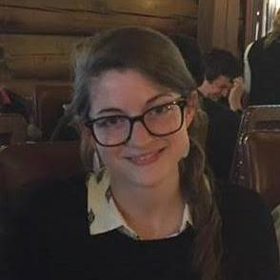

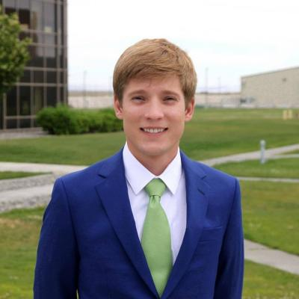



CY2020-2021 BAND Ph.D. Dissertations
“Uncertainty Analysis Procedures for Neutron-Induced Cross Section Measurements and Evaluations”
  Amanda Marie Lewis – Spring 2020* NNL Staff
“Fission plasmas and their novel application to power producing nuclear reactors in space”
  Austin Troy Lo – Fall 2020 ORNL Postdoc
“Advancements in the Nuclear Data of Fission Yields”
  Eric Francis Matthews – Spring 2021 UCB Researcher
“Nuclear Data Evaluation of High-Energy Proton-Induced Reactions for Isotope Production”
Morgan B. Fox – Spring 2021 – Terrestrial Energy Staff
“Next-Generation Isotope Production via Deuteron Breakup” -
  Jonathan T. Morrell – Spring 2021 – LANL Postdoc
“Machine Learning Augmented Nuclear Data Evaluations” -
  Pedro Vincente-Valdez – Spring 2021 – Senior AI Software Engineer at Mythic
Future Colleagues - Our most valuable product
*FY20 graduate

Slide 23

NSSC Nuclear Data
Summer School https://nssc.berkeley.edu/
On the topic of education, I have one request
To be held either 6/22 or 1/23
Hybrid in-person/online program at either UCB or UTK
For the online program, Zoom will be used to broadcast lectures and to take live questions from virtual participants.
We also plan to record lectures and make them available online
If you’d like to volunteer to lecture, please let us know!

