Slide 1
Texas A&M University US Nuclear Data Program
TAMU NSDD CENTER
Report 2021
N. Nica
J.C. Hardy

Slide 2
Evaluation of Nuclear Structure and Decay Data OVERVIEW
Scope:
Promote and accomplish mass-chain nuclear structure data evaluation at Texas A&M University - Cyclotron Institute as regular activity and foresee future developments.
Address gaps in data through targeted experiments
2005-2017: under contract with BNL/NNDC
67% FTE Mass Chain Evaluation
N. Nica (PI, evaluator), J.C. Hardy (scientific adviser)
2018-2021: NSDD Data Center
FY18: 67% FTE Mass Chain Evaluation
FY19-21: 100% FTE Mass Chain Evaluation
N. Nica (PI, evaluator), J.C. Hardy (retiree, scientific adviser)

Slide 3
Texas A&M - Cyclotron Institute Contributions
Major Direct Contribution to USNDP/NSDD: Nuclear Data Evaluation
17 publications
Important Contribution to USNDP/NSDD: Precision ICC Measurements
BrIcc adopted the “Frozen Orbitals” calculations
⁹³Nb, ¹⁰³Rh, ¹²⁵Te, ¹²⁷Te, ¹¹¹Cd, ¹¹⁹Sn, ¹³⁴Cs, ¹³⁷Ba, ¹⁹¹Os, ¹⁹³Ir, ¹⁹⁷Pt
17 publications
Texas A&M Contribution to Precision Nuclear Data Production: Precision β-γ Measurements (Standard Model, CKM matrix)
T_{1/2} , Branching Ratios, Efficiency calibration
21 publications
Texas A&M Medical Radioisotopes
⁶⁷Cu, ⁹⁹Mo
3 publications

Slide 4
Mass Chain Evaluation: 280 nuclei, 20 A-chains
1. N.Nica, Nuclear Data Sheets for A = 252, Nucl.Data Sheets 106, 813 (2005)
8 nuclei: ²⁵²Cm, ²⁵²Bk, ²⁵²Cf, ²⁵²Es, ²⁵²Fm, ²⁵²Md, ²⁵²No, ²⁵²Lr
2. N.Nica, Nuclear Data Sheets for A = 140, Nucl.Data Sheets 108, 1287 (2007)
16 nuclei: ¹⁴⁰Te, ¹⁴⁰I, ¹⁴⁰Xe, ¹⁴⁰Cs, ¹⁴⁰Ba, ¹⁴⁰La, ¹⁴⁰Ce, ¹⁴⁰Pr, ¹⁴⁰Nd, ¹⁴⁰Pm, ¹⁴⁰Sm, ¹⁴⁰Eu, ¹⁴⁰Gd, ¹⁴⁰Tb, ¹⁴⁰Dy, ¹⁴⁰Ho
3. D.Abriola et al., Nuclear Data Sheets for A = 84, Nucl.Data Sheets 110, 2815 (2009)
1 nucleus: ⁸⁴Y
4. N.Nica, Nuclear Data Sheets for A = 147, Nucl.Data Sheets 110, 749 (2009)
16 nuclei: ¹⁴⁷Xe, ¹⁴⁷Cs, ¹⁴⁷Ba, ¹⁴⁷La, ¹⁴⁷Ce, ¹⁴⁷Pr, ¹⁴⁷Nd, ¹⁴⁷Pm, ¹⁴⁷Sm, ¹⁴⁷Eu, ¹⁴⁷Gd, ¹⁴⁷Tb, ¹⁴⁷Dy, ¹⁴⁷Ho, ¹⁴⁷Er, ¹⁴⁷Tm
5. N.Nica, Nuclear Data Sheets for A = 97, Nucl.Data Sheets 111, 525 (2010)
14 nuclei: ⁹⁷Br, ⁹⁷Kr, ⁹⁷Rb, ⁹⁷Sr, ⁹⁷Y, ⁹⁷Zr, ⁹⁷Nb, ⁹⁷Mo, ⁹⁷Tc, ⁹⁷Ru, ⁹⁷Rh, ⁹⁷Pd, ⁹⁷Ag, ⁹⁷Cd
6. J.Cameron, J.Chen, B.Singh, N.Nica, Nuclear Data Sheets for A = 37, Nucl.Data Sheets 113, 365 (2012)
10 nuclei: ³⁷Na, ³⁷Mg, ³⁷Al, ³⁷Si, ³⁷P, ³⁷S, ³⁷Cl, ³⁷Ar, ³⁷K, ³⁷Ca
7. N.Nica, J.Cameron, B.Singh, Nuclear Data Sheets for A = 36, Nucl.Data Sheets 113, 1 (2012)
10 nuclei: ³⁶Na, ³⁶Mg, ³⁶Al, ³⁶Si, ³⁶P, ³⁶S, ³⁶Cl, ³⁶Ar, ³⁶K, ³⁶Ca
8. N.Nica, B.Singh, Nuclear Data Sheets for A = 34, Nucl.Data Sheets 113, 1563 (2012)
11 nuclei: ³⁴Ne, ³⁴Na, ³⁴Mg, ³⁴Al, ³⁴Si, ³⁴P, ³⁴S, ³⁴Cl, ³⁴Ar, ³⁴K, ³⁴Ca
9. B.Singh, N.Nica, Nuclear Data Sheets for A = 77, Nucl.Data Sheets 113, 1115 (2012)
12 nuclei: ⁷⁷Ni, ⁷⁷Cu, ⁷⁷Zn, ⁷⁷Ga, ⁷⁷Ge, ⁷⁷As, ⁷⁷Se, ⁷⁷Br, ⁷⁷Kr, ⁷⁷Rb, ⁷⁷Sr, ⁷⁷Y
10. N.Nica, Nuclear Data Sheets for A = 148, Nucl.Data Sheets 117, 1 (2014)
16 nuclei: ¹⁴⁸Xe, ¹⁴⁸Cs, ¹⁴⁸Ba, ¹⁴⁸La, ¹⁴⁸Ce, ¹⁴⁸Pr, ¹⁴⁸Nd, ¹⁴⁸Pm, ¹⁴⁸Sm, ¹⁴⁸Eu, ¹⁴⁸Gd, ¹⁴⁸Tb, ¹⁴⁸Dy, ¹⁴⁸Ho, ¹⁴⁸Er, ¹⁴⁸Tm
11. N.Nica, Nuclear Data Sheets for A = 141, Nucl.Data Sheets 122, 1 (2014)
16 nuclei: ¹⁴¹Te, ¹⁴¹I, ¹⁴¹Xe, ¹⁴¹Cs, ¹⁴¹Ba, ¹⁴¹La, ¹⁴¹Ce, ¹⁴¹Pr, ¹⁴¹Nd, ¹⁴¹Pm, ¹⁴¹Sm, ¹⁴¹Eu, ¹⁴¹Gd, ¹⁴¹Tb, ¹⁴¹Dy, ¹⁴¹Ho
12. N.Nica, Nuclear Data Sheets for A = 157, Nucl.Data Sheets 132, 1 (2016)
15 nuclei: ¹⁵⁷Nd, ¹⁵⁷Pm, ¹⁵⁷Sm, ¹⁵⁷Eu, ¹⁵⁷Gd, ¹⁵⁷Tb, ¹⁵⁷Dy, ¹⁵⁷Ho, ¹⁵⁷Er, ¹⁵⁷Tm, ¹⁵⁷Yb, ¹⁵⁷Lu, ¹⁵⁷Hf, ¹⁵⁷Ta, ¹⁵⁷W
13. N.Nica, Nuclear Data Sheets for A = 158, Nucl.Data Sheets 141, 1 (2017)
15 nuclei: ¹⁵⁸Nd, ¹⁵⁸Pm, ¹⁵⁸Sm, ¹⁵⁸Eu, ¹⁵⁸Gd, ¹⁵⁸Tb, ¹⁵⁸Dy, ¹⁵⁸Ho, ¹⁵⁸Er, ¹⁵⁸Tm, ¹⁵⁸Yb, ¹⁵⁸Lu, ¹⁵⁸Hf, ¹⁵⁸Ta, ¹⁵⁸W
14. N.Nica, Nuclear Data Sheets for A = 140, Nucl.Data Sheets – Nucl.Data Sheets 154, 1 (2018)
17 nuclei: ¹⁴⁰Sb, ¹⁴⁰Te, ¹⁴⁰I, ¹⁴⁰Xe, ¹⁴⁰Cs, ¹⁴⁰Ba, ¹⁴⁰La, ¹⁴⁰Ce, ¹⁴⁰Pr, ¹⁴⁰Nd, ¹⁴⁰Pm, ¹⁴⁰Sm, ¹⁴⁰Eu, ¹⁴⁰Gd, ¹⁴⁰Tb, ¹⁴⁰Dy, ¹⁴⁰Ho
15. N.Nica, A =155, Nuclear Data Sheets for A = 155, Nucl.Data Sheets 160, 1 (2019)
16 nuclei: ¹⁵⁵Ce, ¹⁵⁵Pr, ¹⁵⁵Nd, ¹⁵⁵Pm, ¹⁵⁵Sm, ¹⁵⁵Eu, ¹⁵⁵Gd, ¹⁵⁵Tb, ¹⁵⁵Dy, ¹⁵⁵Ho, ¹⁵⁵Er, ¹⁵⁵Tm, ¹⁵⁵Yb, ¹⁵⁵Lu, ¹⁵⁵Hf, ¹⁵⁵Ta
16. N.Nica, A =153, Nuclear Data Sheets for A = 153, Nucl.Data Sheets 170, 1 (2020)
16 nuclei: ¹⁵³La, ¹⁵³Ce, ¹⁵³Pr, ¹⁵³Nd, ¹⁵³Pm, ¹⁵³Sm, ¹⁵³Eu, ¹⁵³Gd, ¹⁵³Tb, ¹⁵³Dy, ¹⁵³Ho, ¹⁵³Er, ¹⁵³Tm, ¹⁵³Yb, ¹⁵³Lu, ¹⁵³Hf
17. N.Nica, A =160, Nuclear Data Sheets for A = 160, Nucl.Data Sheets 176, 1 (2021)
17 nuclei: ¹⁶⁰Pr, ¹⁶⁰Nd, ¹⁶⁰Pm, ¹⁶⁰Sm, ¹⁶⁰Eu, ¹⁶⁰Gd, ¹⁶⁰Tb, ¹⁶⁰Dy, ¹⁶⁰Ho, ¹⁶⁰Er, ¹⁶⁰Tm, ¹⁶⁰Yb, ¹⁶⁰Lu, ¹⁶⁰Hf, ¹⁶⁰Ta, ¹⁶⁰W, ¹⁶⁰Re

Slide 5
Mass Chain Evaluation: 280 nuclei, 20 A-chains
16. N.Nica, A =153, Nuclear Data Sheets for A = 153, Nucl.Data Sheets 170, 1 (2020)
16 nuclei: ¹⁵³La, ¹⁵³Ce, ¹⁵³Pr, ¹⁵³Nd, ¹⁵³Pm, ¹⁵³Sm, ¹⁵³Eu, ¹⁵³Gd, ¹⁵³Tb, ¹⁵³Dy, ¹⁵³Ho, ¹⁵³Er, ¹⁵³Tm, ¹⁵³Yb, ¹⁵³Lu, ¹⁵³Hf
17. N.Nica, A =160, Nuclear Data Sheets for A = 160, Nucl.Data Sheets 176, 1 (2021)
17 nuclei: ¹⁶⁰Pr, ¹⁶⁰Nd, ¹⁶⁰Pm, ¹⁶⁰Sm, ¹⁶⁰Eu, ¹⁶⁰Gd, ¹⁶⁰Tb, ¹⁶⁰Dy, ¹⁶⁰Ho, ¹⁶⁰Er, ¹⁶⁰Tm, ¹⁶⁰Yb, ¹⁶⁰Lu, ¹⁶⁰Hf, ¹⁶⁰Ta, ¹⁶⁰W, ¹⁶⁰Re
18. N.Nica, Nuclear Data Sheets for A = 147 – submitted to NNDC (FY19) , after review (with evaluator)
16 nuclei: ¹⁴⁷Xe, ¹⁴⁷Cs, ¹⁴⁷Ba, ¹⁴⁷La, ¹⁴⁷Ce, ¹⁴⁷Pr, ¹⁴⁷Nd, (¹⁴⁷Pm Balraj Singh), ¹⁴⁷Sm, ¹⁴⁷Eu, ¹⁴⁷Gd, ¹⁴⁷Tb, ¹⁴⁷Dy, ¹⁴⁷Ho, ¹⁴⁷Er, ¹⁴⁷Tm
19. N.Nica, Nuclear Data Sheets for A = 141 – submitted to NNDC (FY20), after review (with evaluator)
17 nuclei: ¹⁴¹Sb, ¹⁴¹Te, ¹⁴¹I, ¹⁴¹Xe, ¹⁴¹Cs, ¹⁴¹Ba, ¹⁴¹La, ¹⁴¹Ce, ¹⁴¹Pr, ¹⁴¹Nd, ¹⁴¹Pm, ¹⁴¹Sm, ¹⁴¹Eu, ¹⁴¹Gd, ¹⁴¹Tb, ¹⁴¹Dy, ¹⁴¹Ho
20. N.Nica, Nuclear Data Sheets for A = 162 – submitted to NNDC (FY21), with reviewer
17 nuclei: ¹⁶²Nd, ¹⁶²Pm, ¹⁶²Sm, ¹⁶²Eu, ¹⁶²Gd, ¹⁶²Tb, ¹⁶²Dy, ¹⁶²Ho, ¹⁶²Er, ¹⁶²Tm, ¹⁶²Yb, ¹⁶²Lu, ¹⁶²Hf, ¹⁶²Ta, ¹⁶²W, ¹⁶²Re, ¹⁶²Os
21. N.Nica, Nuclear Data Sheets for A = 154 – in progress (FY22)
17 nuclei: ¹⁵⁴Ba, ¹⁵⁴La, ¹⁵⁴Ce, ¹⁵⁴Pr, ¹⁵⁴Nd, ¹⁵⁴Pm, ¹⁵⁴Sm, ¹⁵⁴Eu, ¹⁵⁴Gd, ¹⁵⁴Tb, ¹⁵⁴Dy, ¹⁵⁴Ho, ¹⁵⁴Er, ¹⁵⁴Tm, ¹⁵⁴Yb, ¹⁵⁴Lu, ¹⁵⁴Hf

Slide 6
280 nuclei, 20 A-chains
17 publications

Slide 7
280 nuclei, 20 A-chains
17 publications
SIZE IS LARGE!
VERY COMPLX
1 A-chain/FY

Slide 8
Texas A&M - Cyclotron Institute
ICC Precision Measurements
Published ^{93m}Nb ICC (PRC)
Last ICC measurement in the series of 10
Completed 10 ICC measurements
Hole FO calculations adopted by USNDP, NSDD, DDEP
Search for cases to extend the (93-197) A-number interval
^{198m}Au, 115.2 -keV M4, multiple IT γ , T_{1/2}=2.3 d: Very difficult α_{K}; Doable α_{L}
^{58m}Co, 24.9-keV M4, single IT γ , T_{1/2}=9.1 h: Doable α_{K}

Slide 9
Texas A&M - Cyclotron Institute
β-γ Precision Measurements
⁻ New precise half-life measurement for the superallowed β⁺ emitter ³⁰P,
(Oct 2021)
Analysis in progress
Medical Isotopes, K500 Cyclotron - MARS
- ⁶⁷Cu“A novel approach to medical radioisotope production using inverse kinematics”,
Published in EPJ Web of Conferences 252, 08002 (2021)
- ⁹⁹Mo“Enhanced production of ⁹⁹Mo in inverse kinematics heavy ion reactions”,
Published in EPJ Web of Conferences 252, 08003 (2021)

Slide 10
Texas A&M - Cyclotron Institute, FY2021:
15. N.Nica, Nuclear Data Sheets for A =153, Nucl.Data Sheets (2020) (Dec) FY2018
17 nuclei: ¹⁵³Ba, ¹⁵³La, ¹⁵³Ce, ¹⁵³Pr, ¹⁵³Nd, ¹⁵³Pm, ¹⁵³Sm, ¹⁵³Eu, ¹⁵³Gd, ¹⁵³Tb, ¹⁵³Dy, ¹⁵³Ho, ¹⁵³Er, ¹⁵³Tm, ¹⁵³Yb, ¹⁵³Lu, ¹⁵³Hf
16. N.Nica, Nuclear Data Sheets for A = 160, Nucl.Data Sheets 176, 1 (2021) FY2017
17 nuclei: ¹⁶⁰Pr, ¹⁶⁰Nd, ¹⁶⁰Pm, ¹⁶⁰Sm, ¹⁶⁰Eu, ¹⁶⁰Gd, ¹⁶⁰Tb, ¹⁶⁰Dy, ¹⁶⁰Ho, ¹⁶⁰Er, ¹⁶⁰Tm, ¹⁶⁰Yb, ¹⁶⁰Lu, ¹⁶⁰Hf, ¹⁶⁰Ta, ¹⁶⁰W, ¹⁶⁰Re
Review: A = 245, Review of full mass chain evaluation
9 nuclei: ²⁴⁵U, ²⁴⁵Pu, ²⁴⁵Am, ²⁴⁵Cm, ²⁴⁵Bk, ²⁴⁵Cf, ²⁴⁵Es, ²⁴⁵Fm, ²⁴⁵Nd
18. N.Nica, A = 147 – After review work, FY2019
16 nuclei: ¹⁴⁷I, ¹⁴⁷Xe, ¹⁴⁷Cs, ¹⁴⁷Ba, ¹⁴⁷La, ¹⁴⁷Ce, ¹⁴⁷Pr, ¹⁴⁷Nd, (¹⁴⁷Pm-NO), ¹⁴⁷Sm, ¹⁴⁷Eu, ¹⁴⁷Gd, ¹⁴⁷Tb, ¹⁴⁷Dy, ¹⁴⁷Ho, ¹⁴⁷Er, ¹⁴⁷Tm
20. N.Nica, Nuclear Data Sheets for A = 162 – Submitted to NNDC, FY2021
17 nuclei: ¹⁶²Nd, ¹⁶²Pm, ¹⁶²Sm, ¹⁶²Eu, ¹⁶²Gd, ¹⁶²Tb, ¹⁶²Dy, ¹⁶²Ho, ¹⁶²Er, ¹⁶²Tm, ¹⁶²Yb, ¹⁶²Lu, ¹⁶²Hf, ¹⁶²Ta, ¹⁶²W, ¹⁶²Re, ¹⁶²Os

Slide 11
Texas A&M - Cyclotron Institute, FY2019 Mass chain evaluations: Statistics
 | A=153 Evaluation (published) | A=160 Evaluation (published) | A=141 Evaluation (submitted) | A=162 Evaluation (submitted) | A=147 Evaluation (after review) | A=154 Evaluation (before eval) | A=148 Evaluation (before eval) | A=245 Review
Number of Adopted Levels | 1532 | 1242 | 1069 | 1082 | 1318 | 1131 | 1219 | -
Number of Adopted Gammas | 2983 | 2503 | 1886 | 1704 | 2168 | 2395 | 1937 | -
Number of nuclides | 17 | 17 | 17 | 17 | 16 | 17 | 16 | -
Number of datasets | 95 | 78 | 97 | 84 | 81 | 84 | 92 | -
Number of lines | 26629 | 22837 | 17434 | 19364 | 20510 | 20944 | 17932 | -

Slide 12
Mass chains: Review, Updates & Editorial
Mass Chain A153: FY2018
.ens database file | Number of Publications | Increment | CUT Date
A153_old | 460 |  | 31-Dec-2005
A153_new | 485 | +25 | 10-Nov-2017
A153_upd.arv | 490 | +5 | 16-Aug-2020, +2y9m
Mass Chain A160: FY2016
.ens database file | Number of Publications | Increment | CUT Date
A160_old | 368 |  | 1-Jun-2005
A160_new | 444 | +76 | 1-Mar-2017
A160_upd.arv | 460 | +16 | 20-May-2021, +4y3m

Slide 13
Texas A&M - Cyclotron Institute, FY2021 Publications
Publications USNDP 2021 N. Nica TAMU
Nucl.Data Sheets 170, 1 (2020)
N.Nica
Nuclear Data Sheets for A=153
Nucl.Data Sheets 176, 1 (2020)
N.Nica
Nuclear Data Sheets for A=160
EPJ Web of Conferences 252, 08001 (2021)
Ninel Nica
“Texas A&M US Nuclear Data Program”
EPJ Web of Conferences 252, 08002 (2021)
Márcia Regina Dias Rodrigues, Victor E. Iacob, Ninel Nica, Brian Roeder, Gabriel Tabacaru, Kang Wang, Meixiang Yu, Paulo Zanotti-Fregonara, Justin Mabiala, Jedidiah Romo, Georgios A. Souliotis and Aldo Bonasera,
“A novel approach to medical radioisotope production using inverse kinematics”,
EPJ Web of Conferences 252, 08003 (2021)
Justin Mabiala, Marcia R. D. Rodrigues, Georgios A. Souliotis, Victor E. Iacob, Ninel Nica, Brian Roeder, Gabriel Tabacaru, Kang Wang, Jedidiah Romo, Dustin Scriven, Nolan Tenpas and Aldo Bonasera
“Enhanced production of ⁹⁹Mo in inverse kinematics heavy ion reactions”

Slide 14
Texas A&M - Cyclotron Institute, FY2021 Conferences
Conferences USNDP 2021 N. Nica TAMU
N. Nica, “TAMU NSDD Evaluation Center Report 2021”, 24th Technical Meeting of the NSDD network, IAEA Vienna, May 25, 2021
N. Nica, “Texas A&M US Nuclear DATA Program @HINPw6”, Hellenic Institute of Nuclear Physics Workshop (HINPw6), organized by National and Kapodistrian University of Athens, May 14-16, 2021
N. Nica, “About difficult evaluation decisions-a case study”, ENSDF 2021 Meeting, Apr 29, 2021, Brookhaven National Laboratory, Upton, NY, USA
N. Nica, “Texas A&M US Nuclear DATA Program”, DOE Nuclear Data Program Manager's Inspection at the Texas A&M University Nuclear Data Evaluation Center, Mar 24, 2021, TAMU Cyclotron Institute, College Station, TX, USA
N. Nica, “Texas A&M US Nuclear DATA Program“, Virtual Joint Nuclear and Astrophysics Seminar, Feb 26, 2021, TAMU Cyclotron Institute, College Station, TX, USA
N. Nica, “Texas A&M Evaluation Center Report”, Nuclear Data Week 2020, USDNP Meeting, Dec 1-4, 2020, Brookhaven National Laboratory, Upton, NY, USA
N. Nica, “Precision Internal Conversion Coefficients Measurements Follow-up”, Nuclear Data Week 2020, USDNP Meeting, Dec 1-4, 2020, Brookhaven National Laboratory, Upton, NY, USA

Slide 15
Texas A&M - Cyclotron Institute FY 2022
A-chain evaluation FTE: 100%
A=154 full mass chain evaluation
Review
(Xundl)
3 big A-chains in the publication pipe!
A=147 with evaluator
A=141 with evaluator
A=162 with reviwer

Slide 16
A-Chain Evaluation Responsibility @Texas A&M University
Responsibility:
140, 141, 147, 148, 153, 154, 155, 157, 158, 160, 162
Status:
160 (May 2021)
153 (Aug 2020)
155 (Oct-2019)
140 (Nov 2018)
158 (Feb 2017)
157 (Dec 2015)
147 (Nov-2021 – with evaluator)
141 (Sept 2020 – with evaluator)
162 (Mar 2007 – in reviewer)
FY2022: 154 (May 2008)
FY2023: 148 (Oct 2013)
OBS.: 162 and 154 are NOT TAMU RESPONSABILITY

Slide 17
Texas A&M Nuclear Data Program under DOE Grant and NSDD Data Center
Promoting Scientific Research Programs related to data evaluation:
Possible Follow-up of ICC Measurements (?)
Precise half-life measurement for the superallowed β⁺ emitter ³⁰P
Medial Isotopes Production Tests
Promoting original research ideas from reevaluating existing data !

Slide 18
Texas A&M Evaluation Center Strategic Priorities
Continuing ENSDF Mass Chain Evaluation (1 FTE)
First Strategic Priority according to the Mission Statement.
All other priorities will be strictly subordinated to this purpose
Produce experimental nuclear data to aid data evaluation
Precision Internal Conversion Coefficients Measurements at Cyclotron Institute, Texas A&M University to give USDNP the best approach for ENSDF ICC-calculated values (concluding cases pending on conditions)
Produce very precise experimental data for testing Standard Model Precision T1/2 and BR Measurements at MARS spectrometer of Cyclotron Institute, Texas A&M University
Experimental studies of Medical Isotopes
Invers kinematics methodology, Cyclotron Institute, Texas A&M University
Reevaluation of data procedures for basic science and data evaluation
Level scheme re-concept based on Repeatability, a newly revealed experimental data evidence

Slide 19
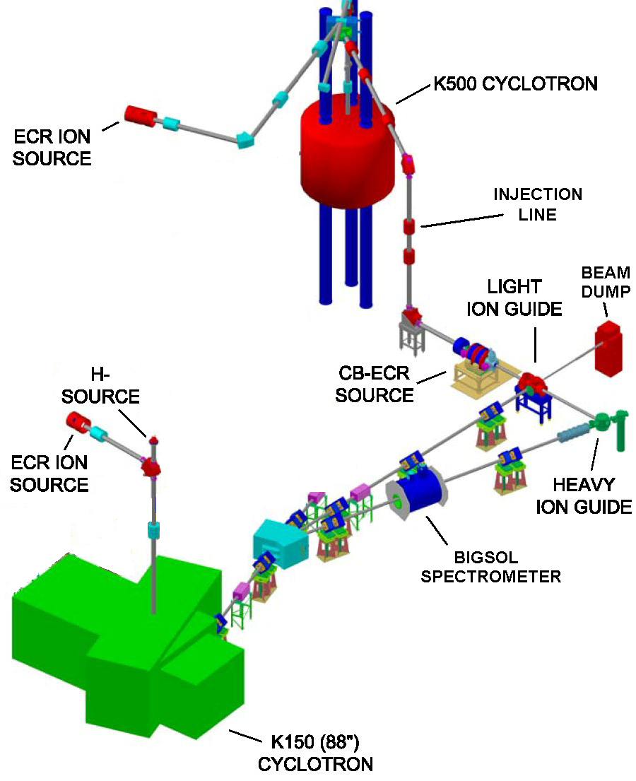
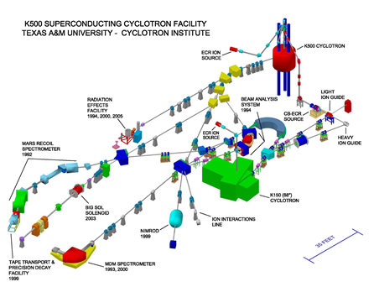
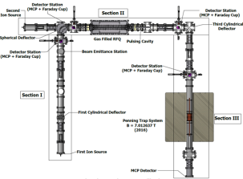
Texas A&M Evaluation Center: Data Evaluation Station at Cyclotron Radioactive Ion Beam Facility to assist experiments and pre-evaluate data
Focus on the Light-Ion Guide (LIG), the Heavy Ion Guide (HIG) and the Charge-Breeding Electron-Cyclotron-Resonance ion source (CB-ECRIS).
TAMUTRAP

