Slide 1
TUNL Contributions in the US Nuclear Data Program
J.H. Kelley - USNDP Structure Group Leader: (9 months),
J. Purcell (emeritus 0.1 FTE), G. Sheu (Adm. Assist. 0.75 FTE)

Slide 2
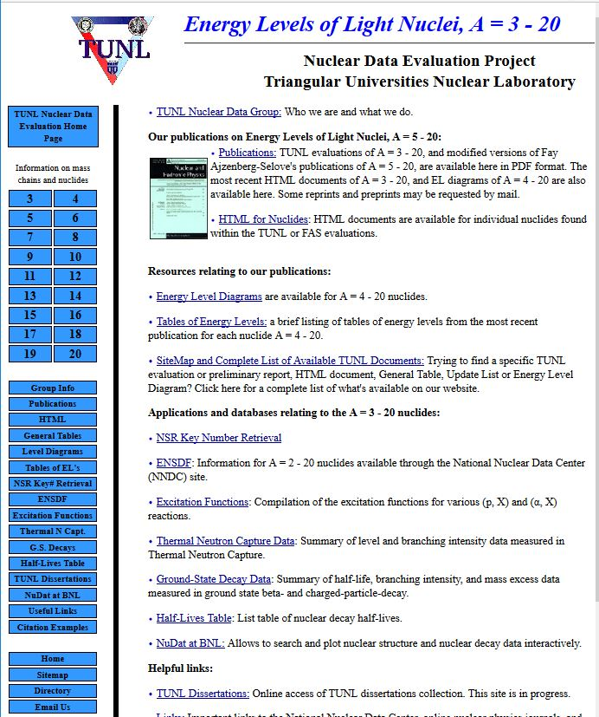
TUNL Primary Responsibilities
Nuclear Structure
We are responsible for nuclear structure evaluation in the A=2-20 mass region
ENSDF files for A=2-20
XUNDL from A=2-20
Web interface for A=3-20 Information

Slide 3
Evaluation Activities
Prepared/updated ENSDF datasets for
¹³F, ¹⁷O, ¹⁸N(with REU)
Maintain up-to-date β-decay lifetimes for A=2-20
Work in progress:
Preparing A=13 ENSDF file
Preparing evaluations of ¹⁸Ne and A=5

Slide 4
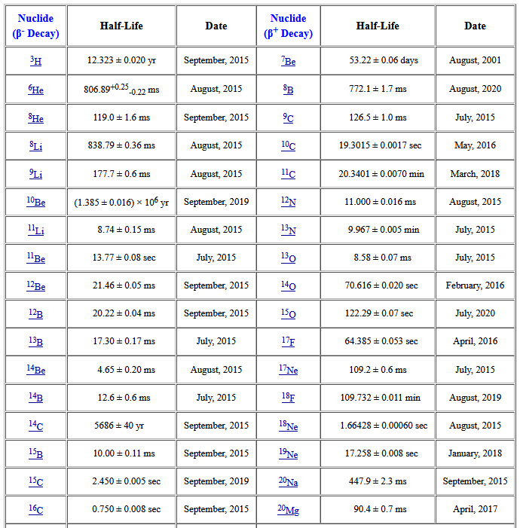
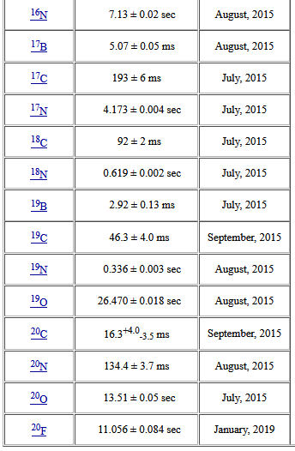
Comments on β-decay lifetimes
Research Experience for Undergraduate Project (Susan Olmstead) in 2015:
Compiled relevant articles
Use McMaster data group’s Java averaging program
Evaluated lifetimes using a variety of averaging methods
Produced a table of recommended values

Slide 5
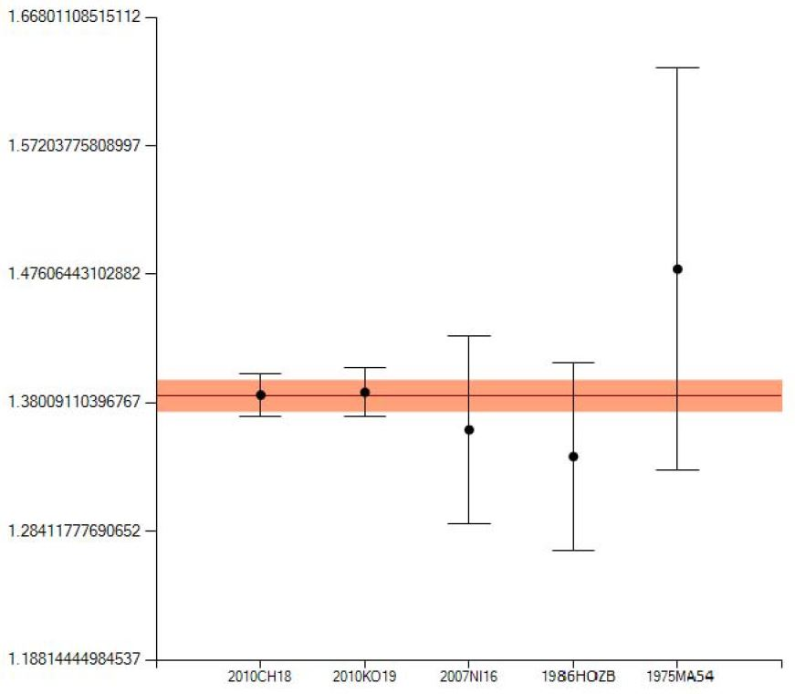
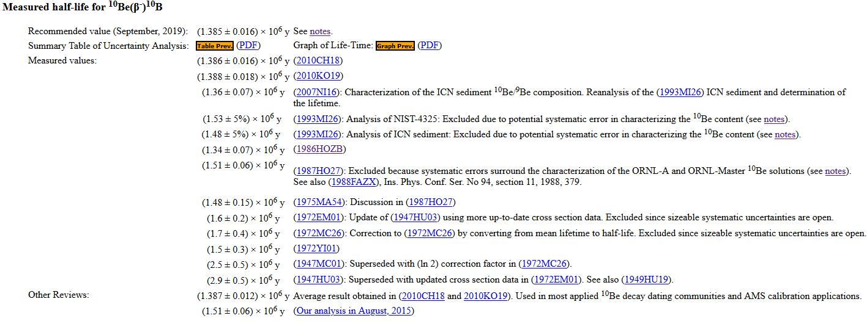
β-decay lifetimes -continued

Slide 6
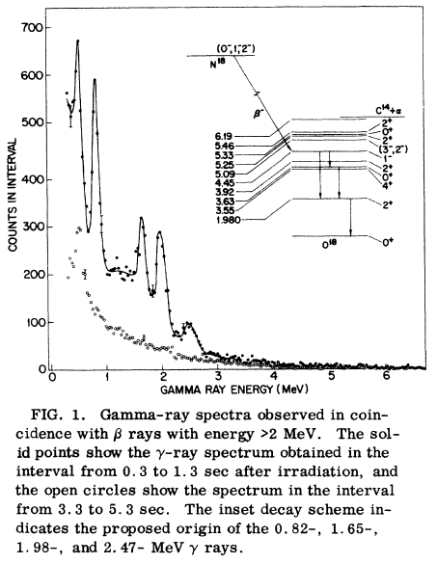
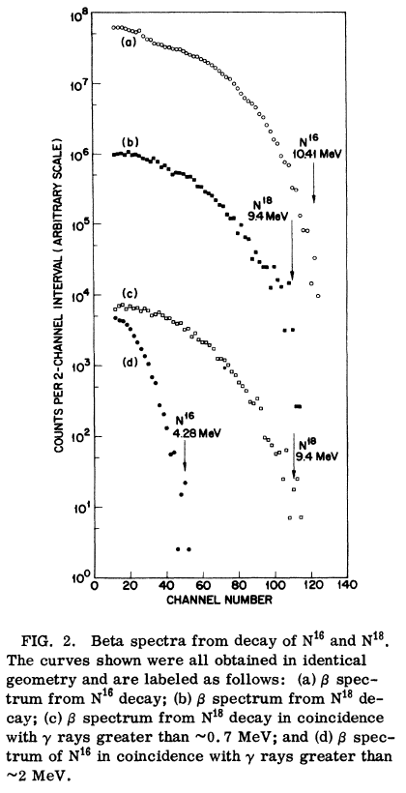
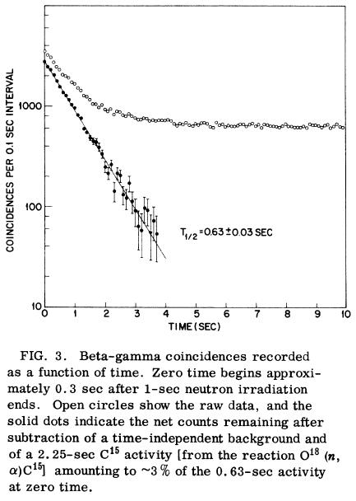
Evaluation of ¹⁸N (with TUNL REU student)
New work compiled for XUNDL motivated an evaluation on ¹⁸N.

Slide 7
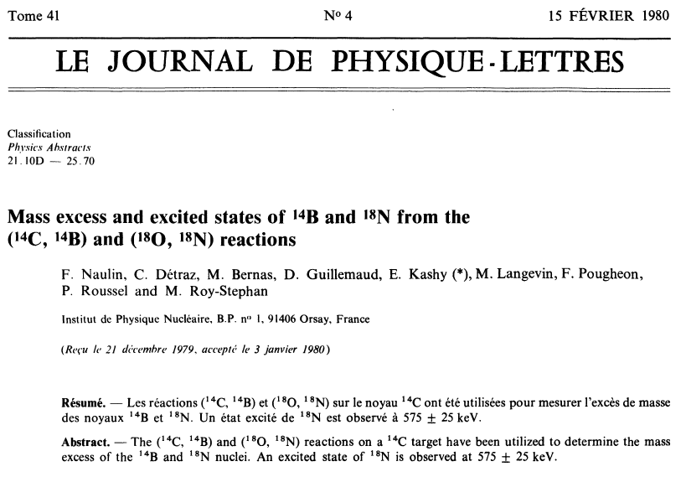
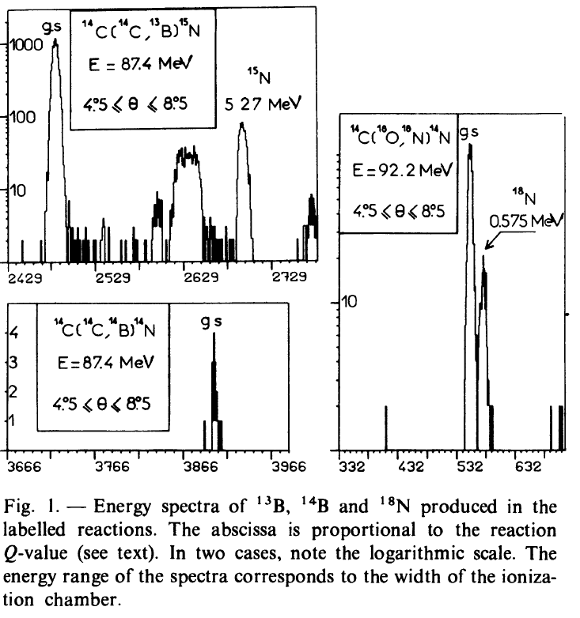
Evaluation of ¹⁸N (with TUNL REU student)
Progress was murky

Slide 8
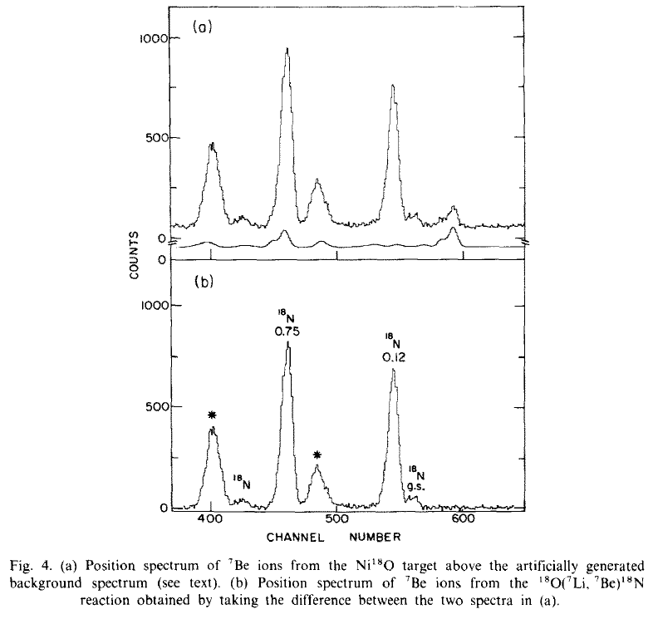
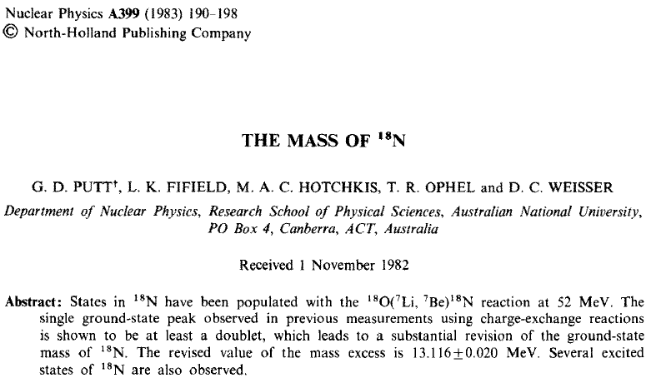
Evaluation of ¹⁸N (with TUNL REU student)
Improved capabilities painted a new picture

Slide 9
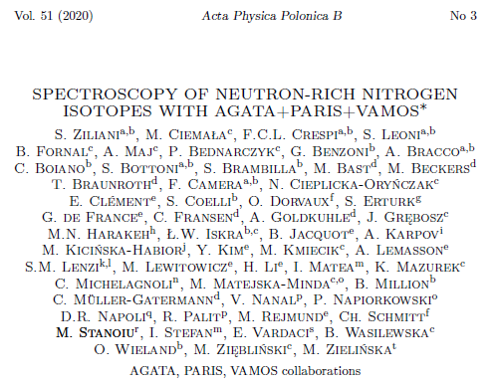
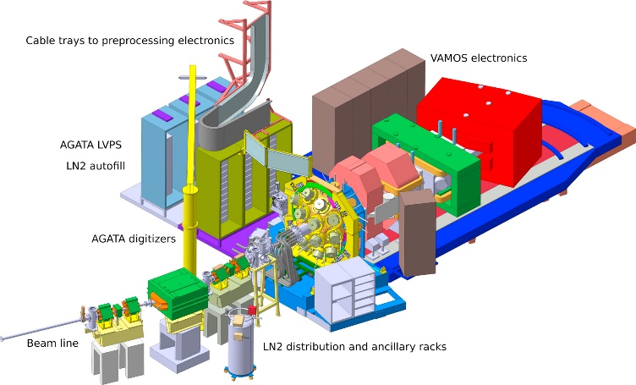
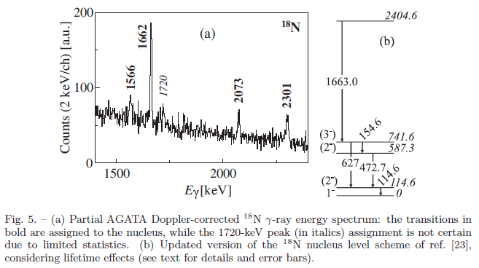
Evaluation of ¹⁸N (with TUNL REU student)

Slide 10
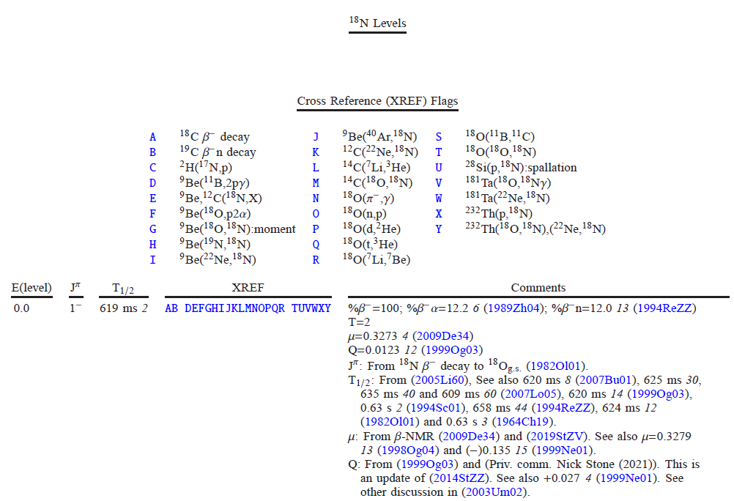
Evaluation of ¹⁸N (with TUNL REU student)
There is a bit more to the story….

Slide 11
Compilation Activities
eXperimental Unevaluated Nuclear Data Library
41 data sets/year (~36 articles)
Compilation of ground state decay & β-decay references and data
Compilation of (p,X) and (α,X) excitation functions
Compilation of thermal neutron capture references and data
Maintain TUNL Dissertations online

Slide 12
Website metrics (April 2002-present)
2021: Σ=40 k (est.)
Using Analog - finding issues with excluding new search engine "robots"

Slide 13
FY 2021 FTE Distribution
FTE Distribution
 | PhD Permanent | PhD Temporary | Technical & Admin. | Graduate Students
I. NNDC Facility Operation | 0 | 0 | 0 | 0
Management | 0 | 0 | 0 | 0
Secretarial/Administrative Support | 0 | 0 | 0 | 0
Library | 0 | 0 | 0 | 0
Computer Operations | 0 | 0 | 0 | 0
II. Coordination | 0.05 | 0 | 0 | 0
National Coordination | 0.05 | 0 | 0 | 0
International Coordination | 0 | 0 | 0 | 0
III. Nuclear Physics Databases | 0 | 0 | 0 | 0
Nuclear Science References, NSR | 0 | 0 | 0 | 0
Exper. Nucl. Structure Data, XUNDL | 0 | 0 | 0 | 0
Eval. Nucl. Structure Data, ENSDF | 0 | 0 | 0 | 0
Numerical Nuclear Data, NuDat | 0 | 0 | 0 | 0
Reaction Data Bibliography, CINDA | 0 | 0 | 0 | 0
Experimental Reaction Data, CSISRS | 0 | 0 | 0 | 0
Evaluated Nuclear Data File, ENDF | 0 | 0 | 0 | 0
Database Software Maintenance | 0 | 0 | 0 | 0
Future Database System Develop. | 0 | 0 | 0 | 0
IV. Information Dissemination | 0 | 0 | 0.40 | 0
Nuclear Data Sheets | 0 | 0 | 0 | 0
Customer Services | 0 | 0 | 0 | 0
Web Maintenance & Development | 0 | 0 | 0.40 | 0
V. Nuclear Structure Physics | 0.70 | 0.10 | 0.35 | 0
NSR Abstract Preparation | 0 | 0 | 0 | 0
Compilation of Exper. Structure Data | 0.10 | 0 | 0.10 | 0
Eval. of Masses & Nuclides for ENSDF | 0.60 | 0.10 | 0.25 | 0
Ground & Metastable State Properties | 0 | 0 | 0 | 0
Radioactive Decay Data Evaluation | 0 | 0 | 0 | 0
Thermal Capture Gamma Data Eval. | 0 | 0 | 0 | 0
Light Mass Eval. for Nucl. Physics A | 0 | 0 | 0 | 0
Nuclear Structure Data Measurement | 0 | 0 | 0 | 0
ENSDF Evaluation Support Codes | 0 | 0 | 0 | 0
VI. Nuclear Reaction Physics | 0 | 0 | 0 | 0
Experimental Data Compilation | 0 | 0 | 0 | 0
ENDF Manuals and Documentation | 0 | 0 | 0 | 0
ENDF Evaluations | 0 | 0 | 0 | 0
Nuclear Reaction Standards | 0 | 0 | 0 | 0
Nuclear Model Development | 0 | 0 | 0 | 0
Nucl. Reaction Data Measurements | 0 | 0 | 0 | 0
Astrophysics Nuclear Data Needs | 0 | 0 | 0 | 0
Covariances development | 0 | 0 | 0 | 0
Reactor anti-neutrino & decay heat calculations | 0 | 0 | 0 | 0
Verification and Validation | 0 | 0 | 0 | 0
DOE-SC Nucl. Data Funded Staff | 0.75 | 010 | 0.75 | 0
Staff Supported by Other Funds | 0 | 0 | 0 | 0
TOTAL STAFF | 0.75 | 0.10 | 0.75 | 0
FY 2021 Metrics
NSR Compilations | 0
EXFOR Compilations | 0
XUNDL Compilations | 41 |  | 36 articles
Total Compilations | 41
ENSDF Evaluations | 3 |  | ¹³F, ¹⁷O, ¹⁸N
ENDF Evaluations | 0
Total Evaluations | 3
Diseminations (k) | 40 | Estimated
Articles | 1
Reports | 0
Invited Talks | 0

Slide 14
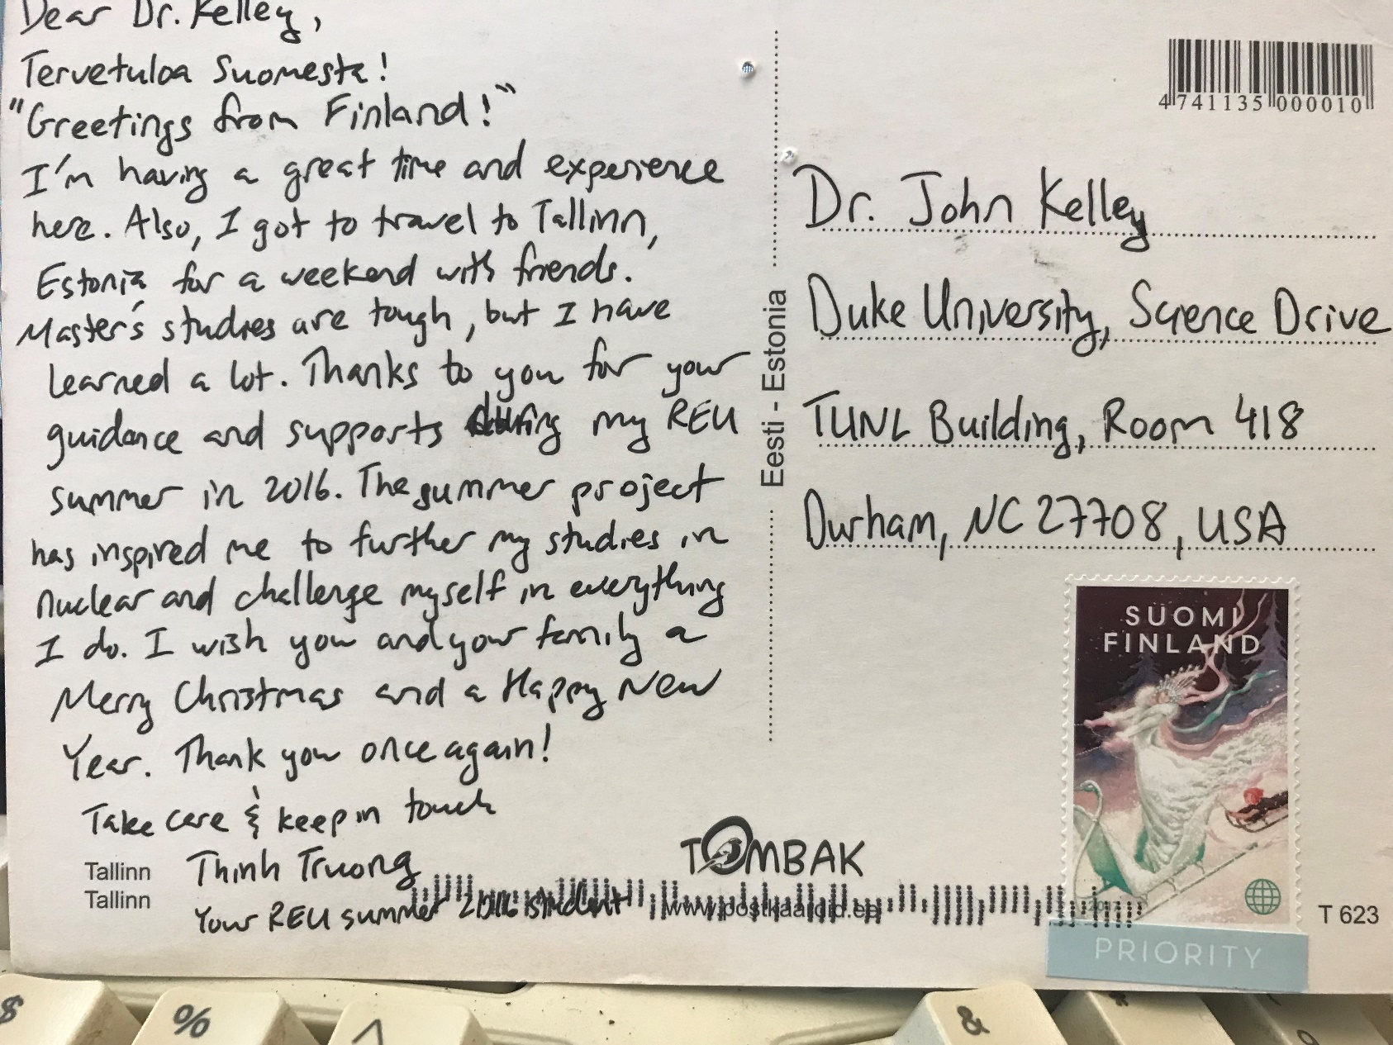
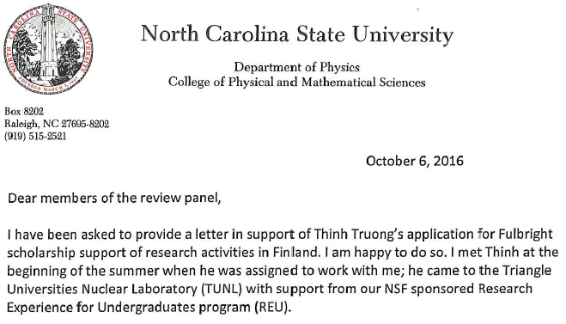
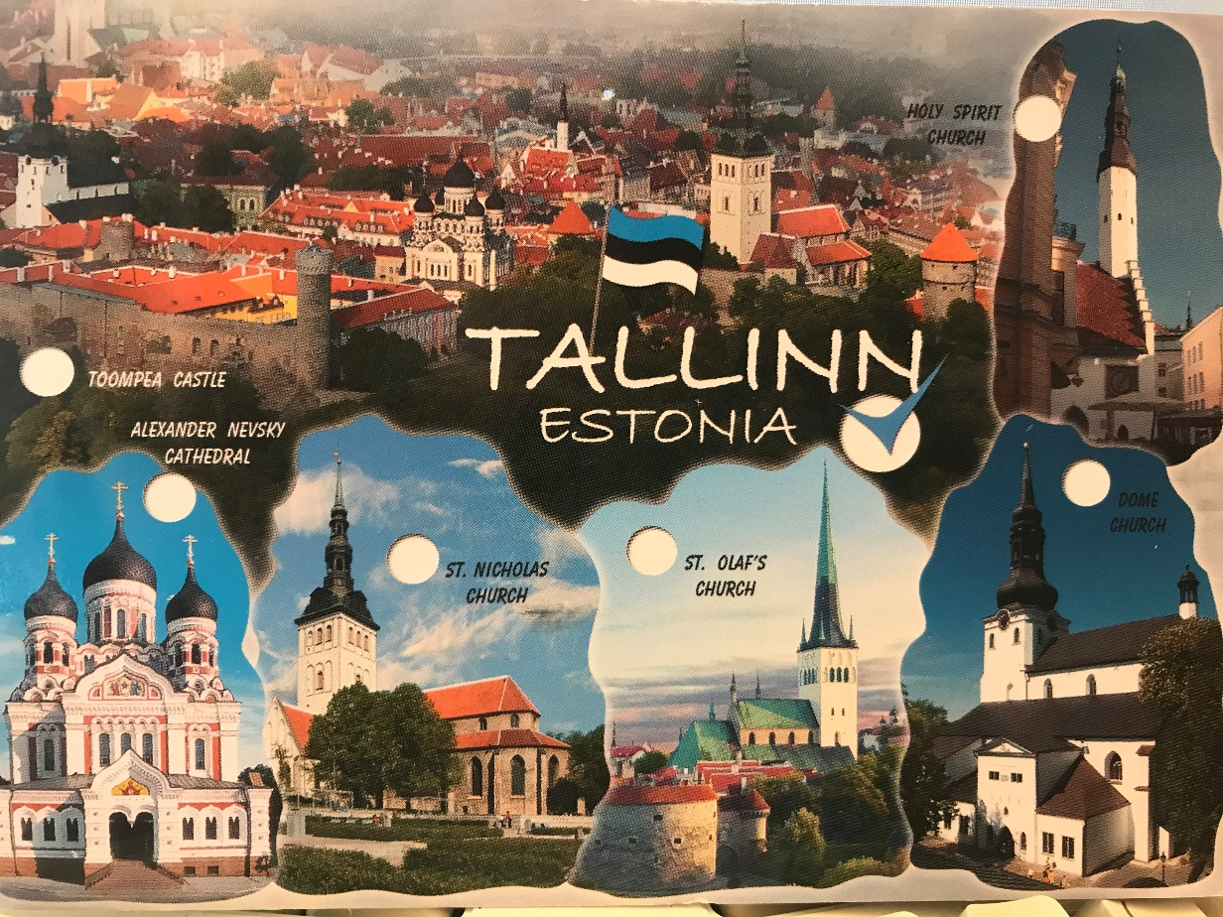
A success story

