Slide 1
Isotope Effects in Thermal Neutron Scattering
Chris W. Chapman, Andrew Holcomb, Doro Wiarda
Oak Ridge National Laboratory
Cross Section Evaluation Working Group Meeting
15-19 November 2021

Slide 2
Background
AMPX links Thermal Scattering Law (TSL) libraries to isotopes in the resolved resonance region
  TSL eval explicitly names isotope, we only bind TSL data to that isotope
    tsl-013_Al_027, tsl-026_Fe_05
  Otherwise, assumes all isotopes can apply the TSL eval
    tsl-reactor-graphite-10P -> ¹²C-10p-graphite, ¹³C-10p-graphite
    U-UO₂ -> ²³³UO₂ + ²³⁴UO₂ + ²³⁵UO₂ + …
    Zr-ZrH -> ⁹⁰ZrH + ⁹¹ZrH + ⁹²ZrH + …
No guidance is given in the TSL files or the ENDF format if this is acceptable or advised
This can lead to some issues…

Slide 3
Different Scattering Lengths
Isotopes of the same element can have significantly different scattering lengths and, therefore, different bound/free scattering cross sections
Element-specific bound/free scattering cross section given in File 7, but not sub-divided into isotopic distribution
User must rely on either description in the ENDF file or references, which may not provide necessary description
Different from issue in incoherent elastic bound scattering cross section issue (#13)

Slide 4
Different Scattering Lengths – Comparison of Elemental and Isotopic Free Scattering Cross Sections
Examples [1]:
Up to 50% difference between isotopic & elemental scattering xs
Isotope/Material | Weight pct. | Free Scattering xs [b]
⁹⁰Zr | 51.45 | 4.99
⁹¹Zr | 11.32 | 9.49
⁹²Zr | 17.19 | 6.75
⁹⁴Zr | 17.28 | 8.22
⁹⁶Zr | 2.76 | 3.72
^{nat}Zr |  | 6.32
Zr-ZrH |  | 6.34
Isotope/Material | Weight pct. | Free Scattering xs [b]
²⁸Si | 92.23 | 1.98
²⁹Si | 4.67 | 2.60
³⁰Si | 3.1 | 2.47
^{nat}Si |  | 2.02
Si-SiC |  | 2.042

Slide 5
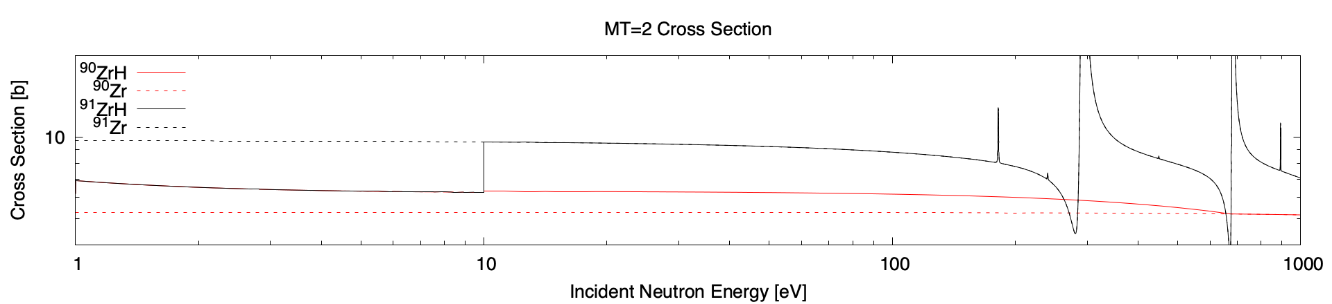
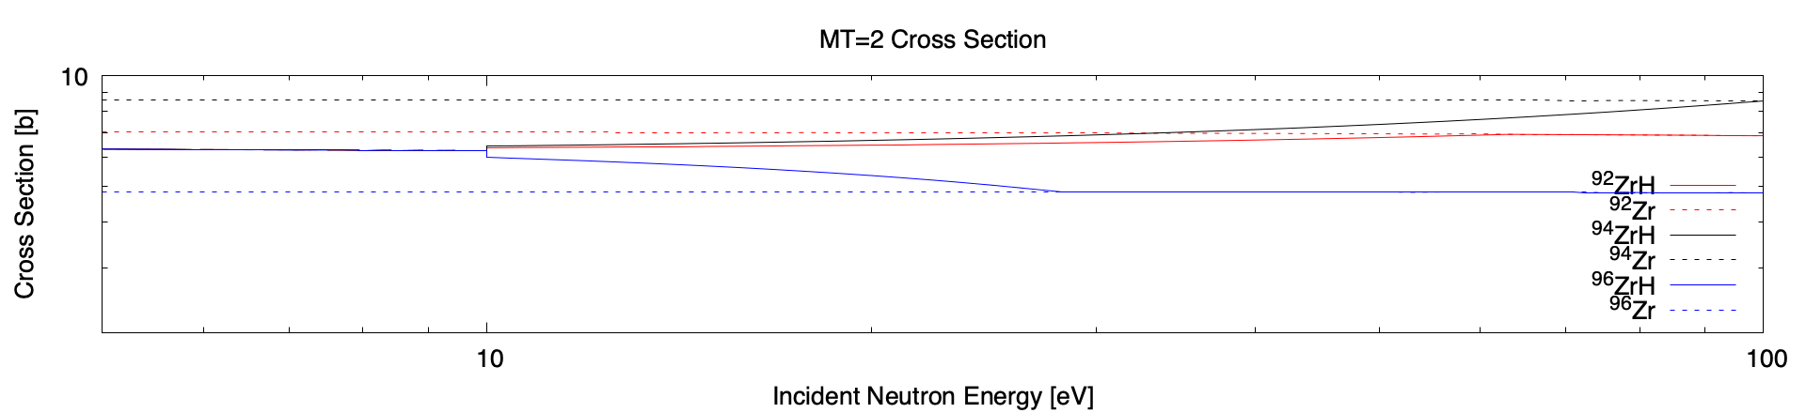
Different Scattering Lengths

Slide 6
Resonances
Some isotopes have resonances near (or sometimes IN) the thermal range
Resonance theory is not currently incorporated into thermal scattering evaluations
These can have a noticeable effect on the thermal scattering cross section

Slide 7
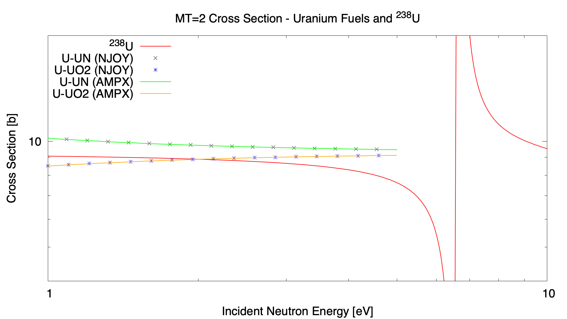
Resonances

Slide 8
Discussion
Should information about the isotopic composition be provided in ENDF TSL files?
Can anything be done regarding low-lying resonances?
  Try and match the TSL cross section with the resonance at a specific cutoff energy (tricky, but doable)?
  Implement resonances in thermal scattering (very difficult)?

Slide 9
Acknowledgements
This work was supported by the Nuclear Criticality Safety Program, funded and managed by the National Nuclear Security Administration for the Department of Energy

Slide 10
References
[1] https://www.ncnr.nist.gov/resources/n-lengths/

