Slide 1
WPEC/SG46 TAR exercise:
Preliminary Results
O. Cabellos
Universidad Politécnica de Madrid (UPM), Madrid, Spain
E-mail: oscar.cabellos@upm.es
WPEC/SG46 Participants
Special thanks to JAEA, CIEMAT, UPM and SCK

Slide 2
Outline
Legacy Work WPEC/SG26 (2005-2008)
WPEC/SG46 (2019-2021)
Target Accuracy Requirements: Necessity of “Expert Judgment”
Methodology: The inverse problem
TAR Benchmark Specifications
  https://oecd-nea.org/download/wpec/sg46/
Processing Covariances
New reactor systems in WPEC/SG46: ASTRID, ESFR-SMART, JSFR750 and ALFRED
Preliminary Results: Uncertainty Quantification
Preliminary TAR Results for ENDF/B-VIII.0

Slide 3
Legacy Work WPEC/SG26 (2005-2008)
https://oecd-nea.org/download/wpec/volume26/volume26.pdf
Systems
A first list of data priorities (i.e. for uncertainty reduction) for GEN-IV reactors was established and implemented in the HPRL at NEA
ABTR: 250 MWth | Na cooled
SFR: (Burner: CR=0.25) 840 MWth | Na cooled
EFR: 3600 MWth | Na cooled
GFR: 2400 MWth | He cooled
LFR: 900 MWth | Pb cooled
ADMAB: 377 MWth | Pb-Bi cooled
VHTR | TRISO fuel
Extended BU PWR | 8.5wo%
Integral parameters
TAR Exercise in WPEC/SG26:
Covariance data matrices: BOLNA
Energy structure: “15 energy groups (based on physical considerations)”
No-correlations in energy, reactions and isotopes are considered in TAR exercise
14 HPRL entries based on SG26 studies!
Criticality (keff) | (in pcm)
Local Power Peak | (in %)
Burnup reactivity swing | (in pcm)
Reactivity coefficients | (in %)
Nuclide inventories/transmutation at EOL | (in %)

Slide 4
WPEC/SG46 (2019-2021)
https://oecd-nea.org/download/wpec/sg46/
  WPEC/SG46 is again a new bridge between ND evaluators and end-users in the utilisation of integral experiments
  WPEC/SG46 to provide updated target accuracies for nuclear data uncertainty reduction
    “It is essential to verify the status of design target accuracies and their potential evolution (reactor operation and fuel cycle parameters)”
    New reactors concepts are presently explored besides Gen-IV, MA burners, and ADS: MSR, SMR, micro reactors, and test reactors
  TAR WPEC/SG46 methodology based on:
    New covariance data matrices: ENDF/B-VIII.0, JEFF-3.3 and JENDL-4.0u
    Using correlations in energy, reactions and isotopes
    Energy structure: “7 energy groups (based on physical considerations)”
  “The HPRL will certainly benefit from an update, to motivate and focus new experiments and to meet potential new requirements”

Slide 5
Target Accuracy Requirements: Necessity of “Expert Judgment”
Ref. Evgeny Ivanov (WPEC/S46, Nov.2020)

Slide 6
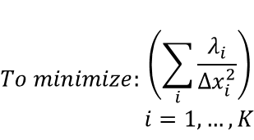
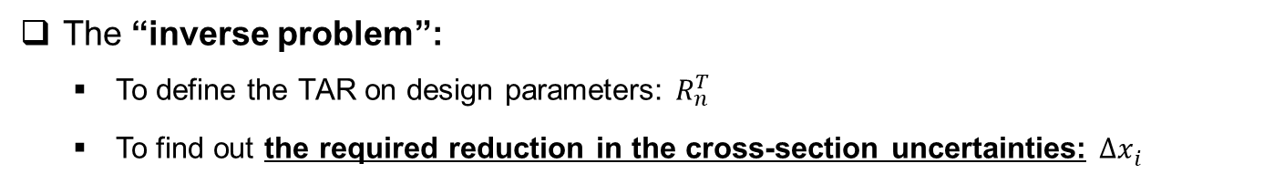
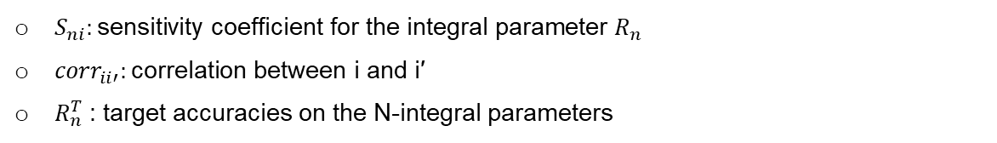
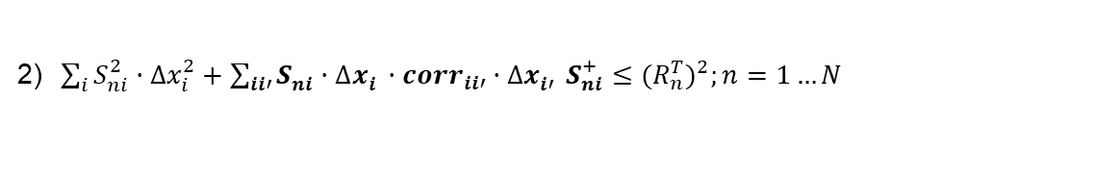
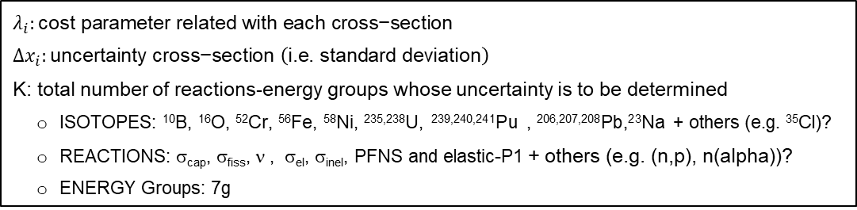
Methodology: The inverse problem
https://oecd-nea.org/download/wpec/sg46/
The “inverse problem”:
  To define the TAR on design parameters: $R_{n}^{T}$
  To find out the required reduction in the cross-section uncertainties: ${∆x}_{i}^{}$
$$To minimize:\begin{matrix}\left(\sum_{i}{\frac{λ_{i}}{{∆x}_{i}^{2}}}\right) \\ i=1,…, K\end{matrix}$$
$$λ_{i}:\text{cost} \text{parameter} \text{related} \text{with} \text{each} \text{cross}\text{−}\text{section}$$
$${∆x}_{i}:\text{uncertainty} \text{cross}\text{−}\text{section} \left(\text{i}\text{.}\text{e}\text{. }\text{standard} \text{deviation}\right)$$
K: total number of reactions-energy groups whose uncertainty is to be determined
  ISOTOPES: ¹⁰B, ¹⁶O, ⁵²Cr, ⁵⁶Fe, ⁵⁸Ni, ^{235,238}U, ^{239,240,241}Pu , ^{206,207,208}Pb,²³Na + others (e.g. ³⁵Cl)?
  REACTIONS: σ_{cap}, σ_{fiss}, ν , σ_{el}, σ_{inel}, PFNS and elastic-P1 + others (e.g. (n,p), n(alpha))?
  ENERGY Groups: 7g
The objective function is constrained to:
correlation terms
1) ${∆x}_{i0} ≥{∆x}_{i} ≥0;i=1…K$
2)$\sum_{i}{S_{ni}^{2}{·∆x}_{i}^{2}}+\sum_{ii′}{S_{ni}^{}{·∆x}_{i}^{}·{corr}_{ii′}{{·∆x}_{i′}^{}S}_{ni}^{+}}≤{(R_{n}^{T})}^{2};n=1…N$
$S_{ni}:\text{sensitivity} \text{coefficient} \text{for} \text{the} \text{integral} \text{parameter} R_{n}$
${corr}_{ii′}:\text{correlation} \text{between} \text{i} \text{and} \text{i}\text{′}$
$R_{n}^{T}$: target accuracies on the N-integral parameters

Slide 7
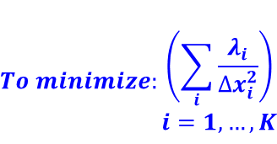
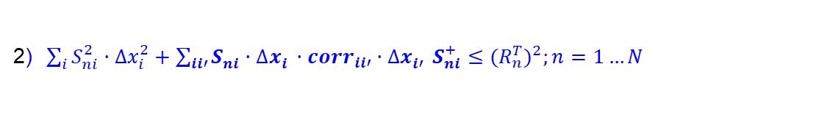
Methodology: The inverse problem
https://oecd-nea.org/download/wpec/sg46/
Who is involved in TAR exercise?
$$To minimize:\begin{matrix}\left(\sum_{i}{\frac{λ_{i}}{{∆x}_{i}^{2}}}\right) \\ i=1,…, K\end{matrix}$$
ND Differential measurement experts
  Cost parameters assigned to isotopes, reactions, and/or energy group
ND Processing
  AMPX/NJOY codes
  Issues to be solved:
    MF34/O16-P₁ for JENDL
    MF34/235U and 238U in ENDF/B-VIII.0
  Limitations in NJOY: unique Ein value for MF35/PFNS
  Correlations between MATs-MTs-Energy to be processed and used
The objective function is constrained to:
1) ${∆x}_{i0} ≥{∆x}_{i} ≥0;i=1…K$
ND Evaluators
  Uncertainties for all MATs/MTs
  Credible uncertainties
  Mathematically “definite positive” for full covariance data
  Lower uncertainty achievable in nuclear data
Reactor Designers
  Safety margins
  Licensing
2)$\sum_{i}{S_{ni}^{2}{·∆x}_{i}^{2}}+\sum_{ii′}{S_{ni}^{}{·∆x}_{i}^{}·{corr}_{ii′}{{·∆x}_{i′}^{}S}_{ni}^{+}}≤{(R_{n}^{T})}^{2};n=1…N$
Reactor Physicists
  Reactor Model
  Sensitivity Profiles
TAR Solving
  Assumptions
  Inverse method + others ML/AI?
  Note: TAR calculations performed by UPM using the solver DONLP2 (Spelluci P., 1998)
    Ref.: Spellucci, P. “An SQP method for general nonlinear programs using only equality constrained subproblems”. Math. Program. 82, 413–448 (1998)

Slide 8
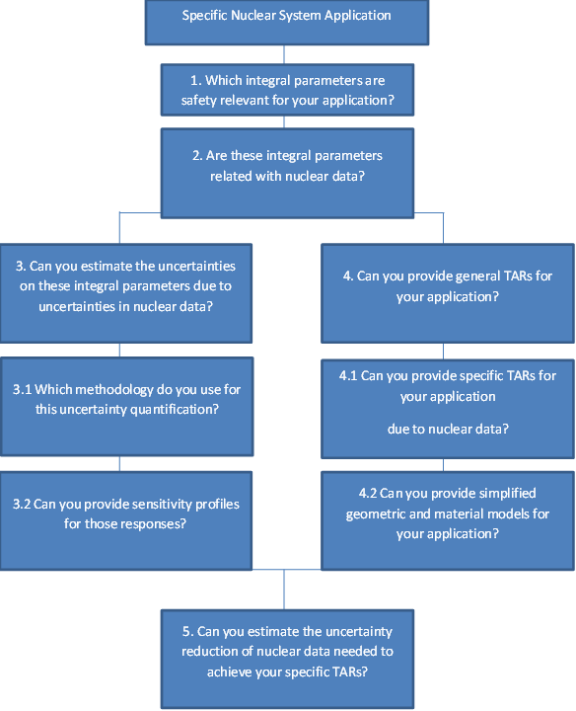
TAR Benchmark Specifications:
https://oecd-nea.org/download/wpec/sg46/
Benchmark Specifications: WPEC/SG46 Exercise on Target Accuracy Requirement (TAR)
  WPEC/SG46, May 2021
Figure 1. Procedure for any specific application to participate in WPEC/SG46 exercise on TAR
Table 1. Energy group structure
Group # | Lower Energy (eV) | Upper Energy (eV)
1 | 2.23130 10⁶ | 1.96403 10⁷ | Above Threshold fertile
2 | 4.97871 10⁵ | 2.23130 10⁶ | Above Threshold inelastic
3 | 6.73795 10⁴ | 4.97871 10⁵ | Continuum to URR
4 | 2.03468 10³ | 6.73795 10⁴ | URR
5 | 2.26033 10¹ | 2.03468 10³ | RRR
6 | 5.40000 10⁻¹ | 2.26033 10¹ | EPITHERMAL
7 | 1.40000 10⁻⁵ | 5.40000 10⁻¹ | THERMAL
https://oecd-nea.org/download/wpec/sg46/materials/documents/WPEC_SG46_TAR_Exercise-v2_HM41-OC_GP-OC-v1.pdf

Slide 9
Processing Covariances
NJOY2016.63
Processing issues
  Discrepancy between NJOY2016 and NJOY99 for JENDL4 MF34 processing in O16
    Issue #210 · njoy/NJOY2016 · GitHub
  ERRORR covout subroutine only outputs the first subsubsection covariance matrix
      Issue #205 · njoy/NJOY2016 · GitHub
      NJOY2016/ERRORR is now capable of reading MF34 for ENDF/B-VIII.0 mubar for 235U and 239Pu
  NJOY2016/MF35 may be improved: definition of a weighting function instead of only one Ein value
  Need of definite positive for “full” covariance matrices
  Working on progress
  AMPX –NJOY processing and comparison

Slide 10
Processing Covariances
Issues in evaluated files
ND Evaluation | Large procesed uncertainties (> 100%) | Lack of ND covariances | Processed null
ENDF/B-VIII.0 | B10(n,n’) – g=2 Cr52(n, n,alpha) - g=2 O16(n,n’) – g=1 O16(n, elastic-P1) – g=5-7 | No MF33 Fe56 (n,alpha) Pb206(n,p), Pb206(n,alpha) Pb207(n,p), Pb207(n,alpha) Pb208(n,p), Pb208(n,alpha) No MF34 B10 Cr52 Fe56 Ni58 Pu240, Pu241 No MF35 Pu-241 | Processed null values B10(n,alpha) – g=1 B10(n,n’) – g=3-7 Cr52(n,n’) – g=3-7 Ni58(n,p) – g=3-7 Ni58(n,alpha) –g=3-7 Na23(n,elasticP1) - g=7 Pu239(CHI) – g=7 Pu240(CHI) –g=7 Fail NJOY2016.63: U235(n,elasticP1) U238(n,elasticP1) Pu239(n,elasticP1)
Note: See Appendix I.

Slide 11

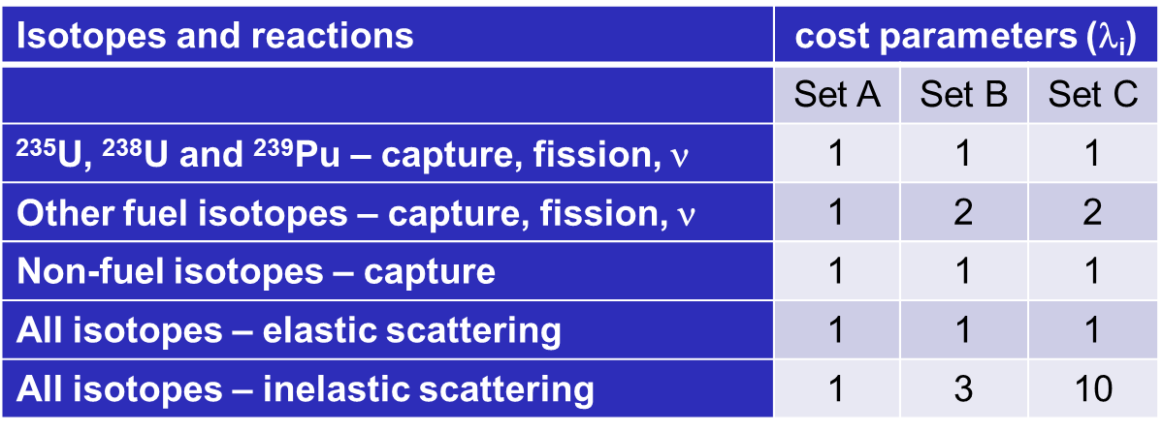
$\text{Values} \text{for} \text{Cost} \text{parameters}\text{ (}\text{l}\text{i}\text{) }\text{related} \text{to} \text{each} \text{cross}\text{−}\text{section}$
Table 2. Different set of values for the cost parameters ($\text{l}\text{i}$)
Isotopes and reactions | cost parameters ($\text{l}\text{i}$)
 | Set A | Set B | Set C
²³⁵U, ²³⁸U and ²³⁹Pu – capture, fission, ν | 1 | 1 | 1
Other fuel isotopes – capture, fission, ν | 1 | 2 | 2
Non-fuel isotopes – capture | 1 | 1 | 1
All isotopes – elastic scattering | 1 | 1 | 1
All isotopes – inelastic scattering | 1 | 3 | 10
  Additional set of values:
  Add energy dependence?
  Reference:
  M. Salvatores et al., “OECD/NEA WPEC Subgroup 26 Final Report: Uncertainty and Target Accuracy Assessment for Innovative Systems Using Recent Covariance Data Evaluations”, OECD/NEA/Nuclear Science, 2008.

Slide 12
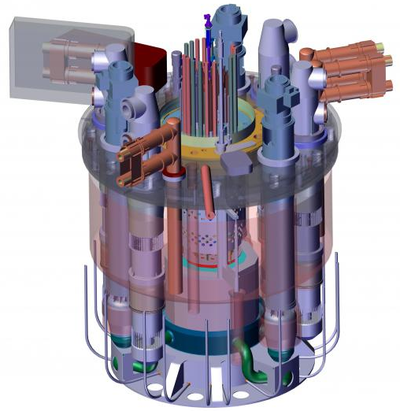
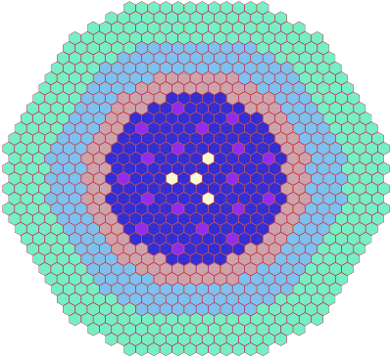
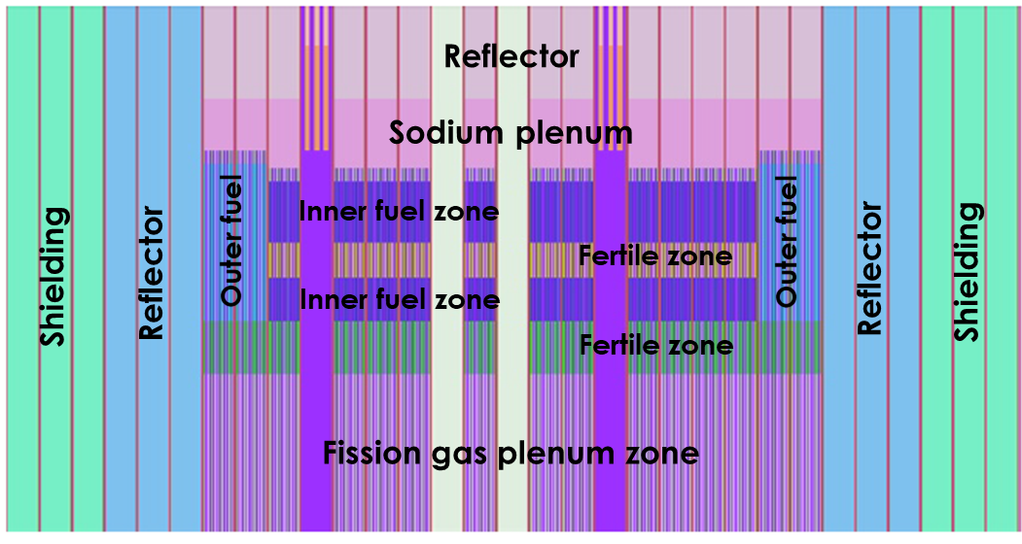
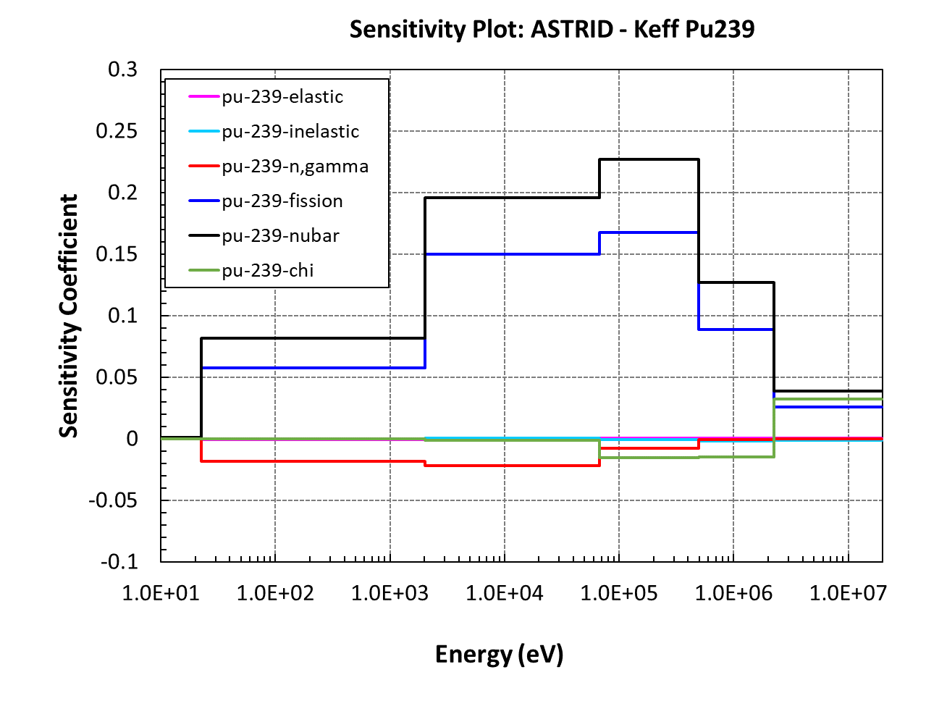
New reactor systems in WPEC/SG46:
ASTRID
  Reference: P. Sciora, ESNII+ deliverable D6.1.1-1
Core Power – medium size: 1500MWth / 600 MWe
Sodium-cooled fast reactor
Fuel type: MOX
  177 Inner FA, Pu content (%) 24.3wt%
  114 Outer FA, , Pu content (%) 20.7wt%
Active fuel: 90 cm (fissile height) + 20 cm (axial blanket)
main region
  Reference:
  P. Romojaro et al., Joint CIEMAT and UPM contribution: ASTRID, ESFR, ALFRED and MYRRHA , WPEC/SG46, June 2019.

Slide 13
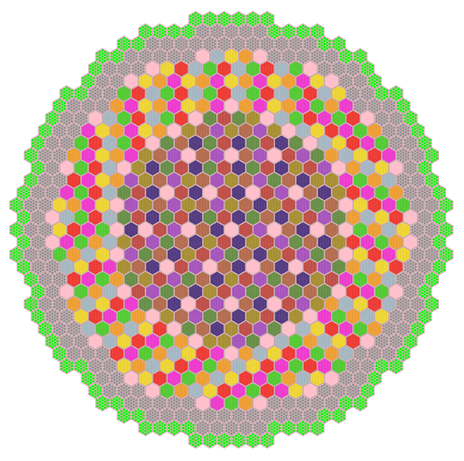
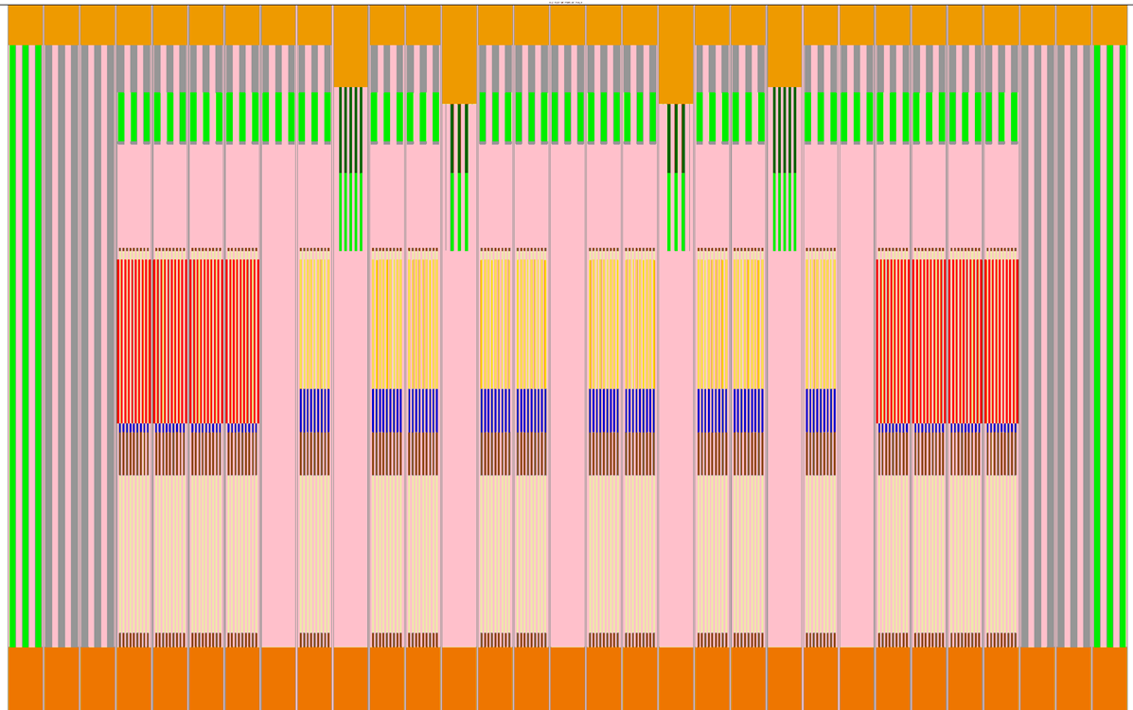
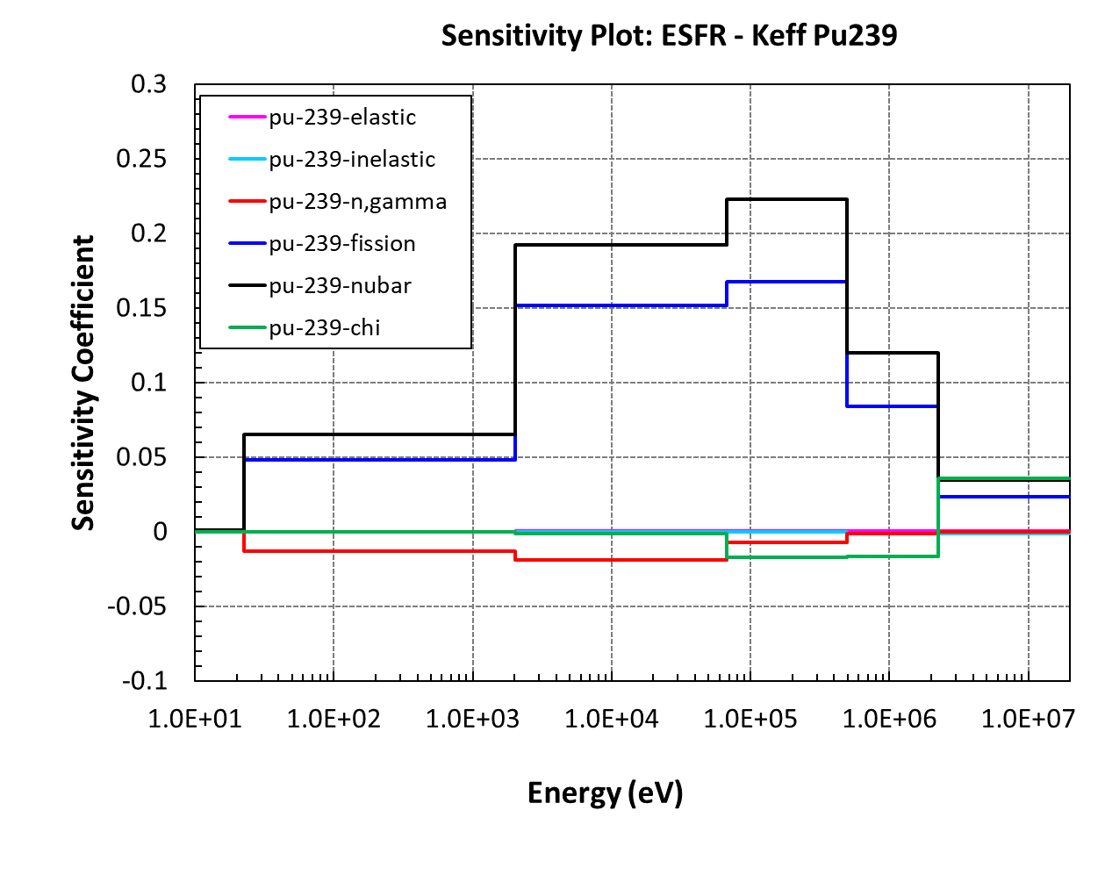
New reactor systems in WPEC/SG46:
ESFR-SMART
  Reference: A. Rineiski et al., ESFR-SMART deliverable D1.1.2
Core Power – commercial size: 3600MWth / 1500 MWe
Sodium-cooled fast reactor
Fuel type: MOX
  216 Inner FA, Pu content (%) 17.99wt%
  288 Outer FA, , Pu content (%) 17.99wt%
24 control rods
Active fuel region height (inner core): 75 cm
main region
6 5 4 3 2 1
  Reference:
  A. Jiménez-Carrascosa et al., Joint UPM and CIEMAT contribution: Progress on European Sodium Fast Reactor (ESFR) , WPEC/SG46, November 2020.

Slide 14
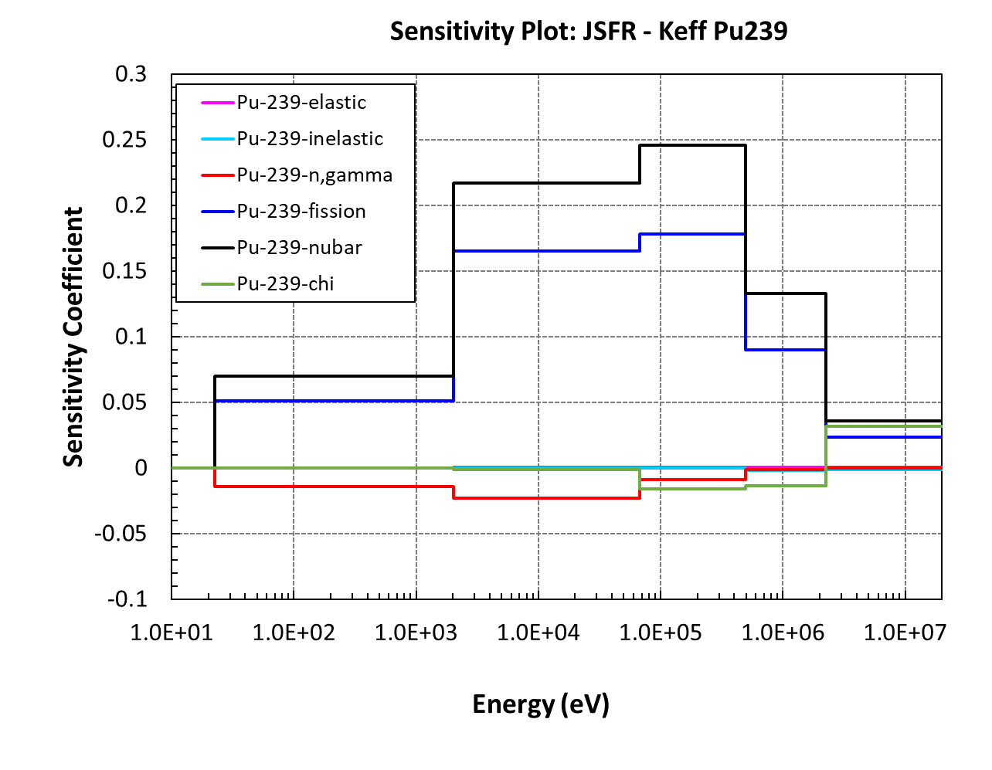
New reactor systems in WPEC/SG46:
J-SFR750
Core Power : 750 MWe
Sodium-cooled Fast Reactor
184 Inner FA (126 pins+1 dummy): 19.1 wt.% Pu/HM
94 Outer FA (126 pins+1 dummy): 25.3 wt.% Pu/HM
31 Control Rod
Active fuel: 100 cm
Ref: T. Kan, et al, Proc. Int. Conf. of ICAPP2017, April 24-28, 2017, Fukui and Kyoto, Japan
  Reference:
  K. Sugino, et al., Models of the 750MWe JSFR core, WPEC/SG46, November 2018
  K. Yokoyama, Reactivity and Sensitivity Calculation Results with Leakage and Non-leakage Components for Sodium Void Reactivity of the 750MWe JSFR Core, WPEC/SG46, November 2020
  K. Yokoyama, Input Information for SG46 Target Accuracy Requirements (TAR) Exercise using Models of 750MWe JSFR Core, WPEC/SG46, April 2021
main region

Slide 15
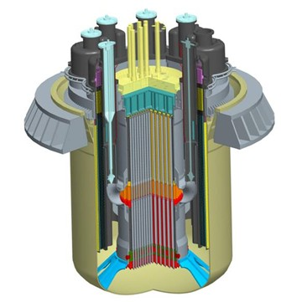
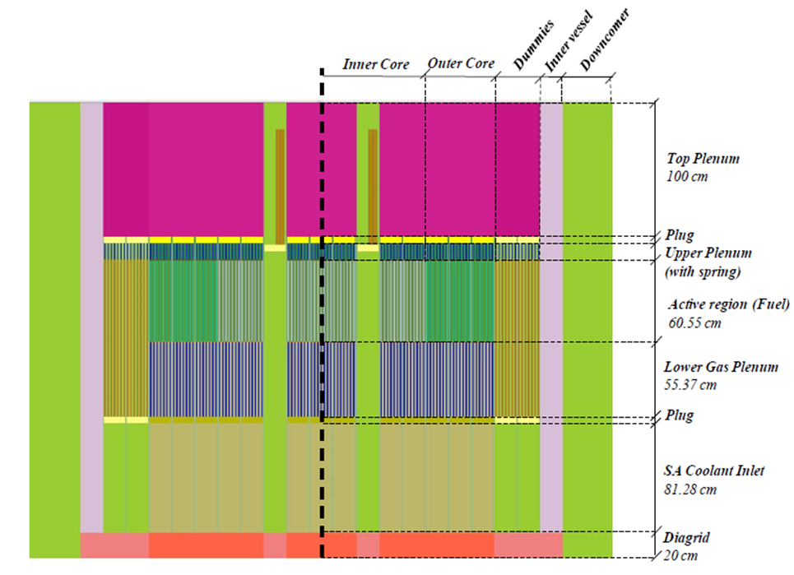
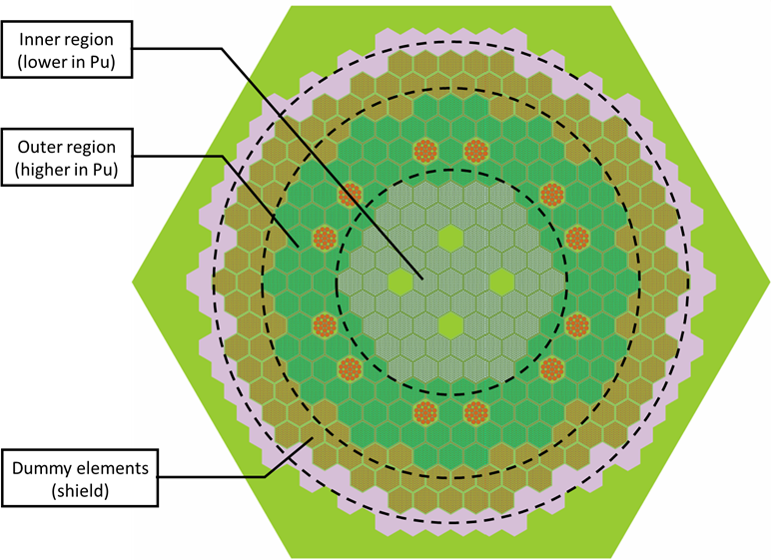
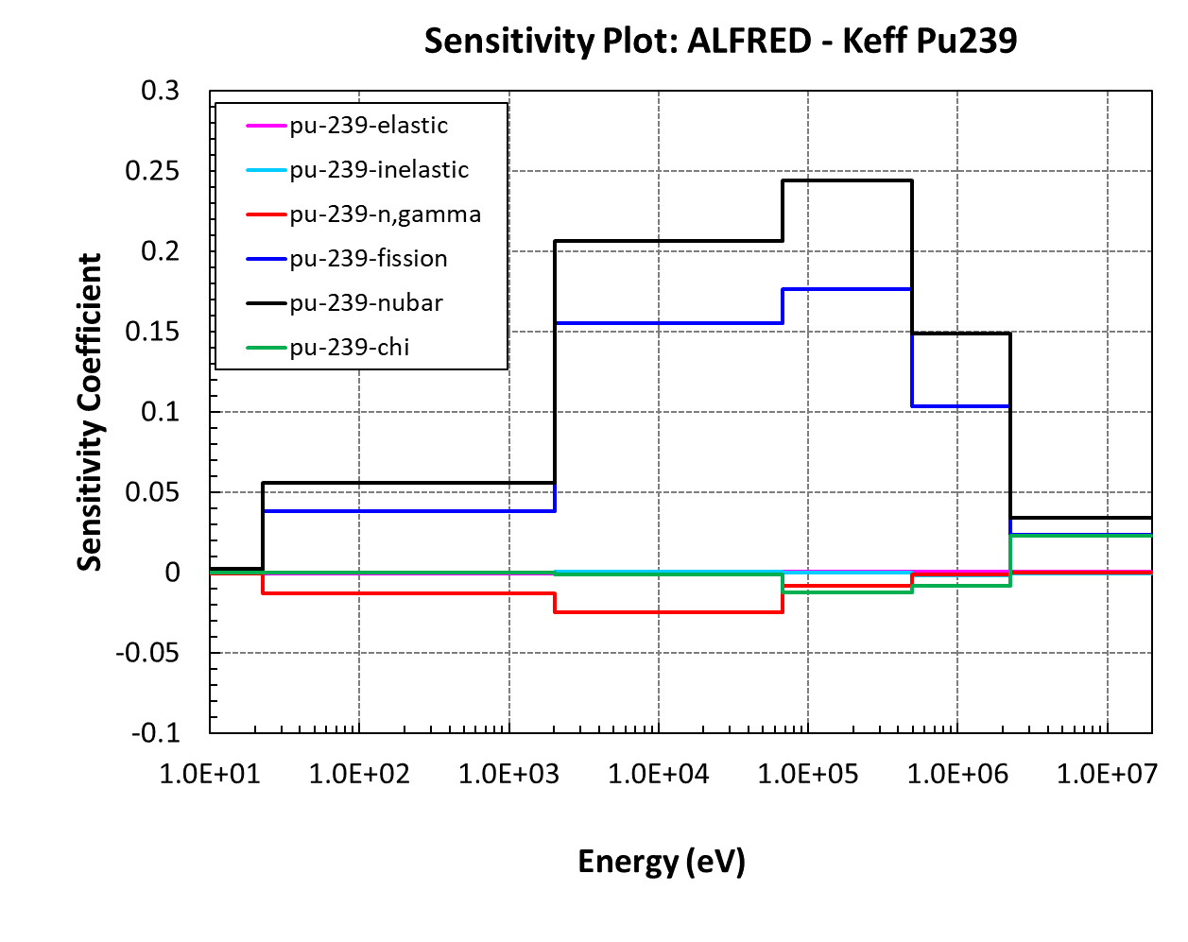
New reactor systems in WPEC/SG46:
ALFRED
  Reference: G. Grasso et al., ESNII+ deliverable D6.1.1-3
Core Power – demonstrator: 300 MWth / 125 MWe
Lead-cooled Fast Reactor
Fuel type: MOX
  57 Inner FA, Pu content (%) 21.8wt%
  114 Outer FA, , Pu content (%) 27.9wt%
12 Control Rod
Active fuel: 81 cm
main region
  Reference:
  G. Grasso et al, The current ALFRED code design, WPEC/SG46, June 2019.
  P. Romojaro et al., Joint CIEMAT and UPM contribution: ASTRID, ESFR, ALFRED and MYRRHA , WPEC/SG46, June 2019.
  G. Grasso, TAR update: Application to ALFRED, WPEC/SG46, April 2021.

Slide 16
Preliminary Results:
Uncertainty Quantification
Table 3. Uncertainties quantification due to nuclear data and preliminary SG46 TAR values
 | ENDF/B-VII.1 | ENDF/B-VIII.0 | JEFF-3.3 | JENDL-4.0u | Target
ALFRED-00-keff (in pcm) | 701 | 865 | 827 | 675 | 435 pcm
ALFRED-01-coolant-density (in %) | 57.0 | 35.0 | 62.3 | 64.7 | -
ALFRED-02-doppler (in %) | 9.4 | 5.7 | 6.1 | 4.9 | -
ASTRID-00-keff (in pcm) | 988 | 919 | 894 | 728 | 300 pcm
ASTRID-01-fullvoid (in %) | 20.0 | 21.6 | 16.5 | 18.8 | -
ESFR-00-keff (in pcm) | 1199 | 928 | 961 | 774 | 300 pcm
ESFR-01-fullvoid (in %) | 10.8 | 13.2 | 9.3 | 10.9 | -
ESFR-02-temp-coef (in %) | 4.6 | 3.7 | 3.4 | 3.3 | 5%
ESFR-03-control (in %) | 2.1 | 1.5 | 1.7 | 1.4 | 5%
JSFR_KEFF (in pcm) | 951 | 969 | 903 | 750 | 200 pcm
JSFR_BRS (in %) | 5.0 | 5.6 | 5.8 | 6.1 | 18%
JSFR_CRW (in %) | 2.8 | 2.8 | 3.0 | 2.3 | 2%
JSFR_DOP (in %) | 4.1 | 3.9 | 3.5 | 3.0 | 2%
JSFR_Power distribution (F49) (in %) | 1.6 | 1.7 | 1.7 | 1.3 | 1%
JSFR_SVR (in %) | 4.6 | 5.9 | 3.9 | 4.8 | 3%
UQ performed with sandwich formula and using the full ND covariance matrix

Slide 17
1) Preliminary TAR Results:
Methodology: No correlations .vs. correlations
J-SFR: TAR preliminary results for ENDF/B-VIII.0, “set A” cost parameters
Table 4. Target accuracy requirement on top-10 most important reactions. No-correlations in TAR exercise.
Table 5. Target accuracy requirement on top-10 most important reactions. Correlations* in TAR exercise.
Rank # | Reaction | Energy Group | Current (%) | Target (%) | Rel. Unc. Reduction (%)
1 | pu-239(n,fission) | 3 | 1.3 | 0.3 | 18.4
2 | pu-239(n,fission) | 4 | 1.3 | 0.4 | 17.0
3 | fe-56(n,inelastic) | 2 | 18.9 | 1.2 | 9.6
4 | pu-239(n,fission) | 2 | 1.3 | 0.5 | 8.2
5 | pu-239(n,fission) | 5 | 4.6 | 0.6 | 5.9
6 | u-238(n,gamma) | 4 | 1.5 | 0.4 | 5.1
7 | pu-239(n,gamma) | 4 | 7.5 | 0.9 | 4.5
8 | u-238(n,gamma) | 3 | 1.8 | 0.7 | 3.4
9 | u-238(n,inelastic) | 1 | 5.7 | 1.0 | 2.1
10 | pu-239(n,gamma) | 3 | 9.3 | 1.5 | 2.0
Rank # | Reaction | Energy Group | Current (%) | Target (%) | Rel. Unc. Reduction (%)
1 | pu-239(n,fission) | 3 | 1.3 | 0.2 | 18.4
2 | pu-239(n,fission) | 4 | 1.3 | 0.2 | 17.2
3 | pu-239(n,fission) | 2 | 1.3 | 0.2 | 9.3
4 | fe-56(n,inelastic) | 2 | 18.9 | 0.9 | 8.4
5 | pu-239(n,fission) | 5 | 4.6 | 0.4 | 5.2
6 | u-238(n,gamma) | 4 | 1.5 | 0.3 | 5.0
7 | pu-239(n,gamma) | 4 | 7.5 | 0.7 | 4.0
8 | u-238(n,gamma) | 3 | 1.8 | 0.4 | 3.7
9 | pu-239(n,fission) | 1 | 1.3 | 0.4 | 2.1
10 | u-238(n,inelastic) | 1 | 5.7 | 0.8 | 1.9
* Ref: G. Palmiotti et al., “Nuclear Data Target Accuracies for GenIV Systems Based on the Use of New Covariance Data”, ND2010
Total keff unc. due to ND with ENDF/B-VIII.0: 969 pcm
“The impact of correlation terms is very significant in TAR assessments evaluation and produces very stringent requirements in ND”, Ref. : ND2010
TAR JSFR/keff value : 200 pcm
Ref.: K. Yokoyama, Input Information for SG46 Target Accuracy Requirements (TAR) Exercise using Models of 750MWe JSFR Core, WPEC/SG46 November 2019

Slide 18
2) Preliminary TAR Results
Cost parameters: set A .vs. set C
J-SFR: TAR preliminary results for ENDF/B-VIII.0, “set A – set C” cost param.
Table 6. Target accuracy requirement on top-10 most important reactions. Correlations in TAR exercise - set A.
Table7 . Target accuracy requirement on top-10 most important reactions. Correlations* in TAR exercise – set C.
Rank # | Reaction | Energy Group | Current (%) | Target (%) | Rel. Unc. Reduction (%)
1 | pu-239(n,fission) | 3 | 1.3 | 0.2 | 18.4
2 | pu-239(n,fission) | 4 | 1.3 | 0.2 | 17.2
3 | pu-239(n,fission) | 2 | 1.3 | 0.2 | 9.3
4 | fe-56(n,inelastic) | 2 | 18.9 | 0.9 | 8.4
5 | pu-239(n,fission) | 5 | 4.6 | 0.4 | 5.2
6 | u-238(n,gamma) | 4 | 1.5 | 0.3 | 5.0
7 | pu-239(n,gamma) | 4 | 7.5 | 0.7 | 4.0
8 | u-238(n,gamma) | 3 | 1.8 | 0.4 | 3.7
9 | pu-239(n,fission) | 1 | 1.3 | 0.4 | 2.1
10 | u-238(n,inelastic) | 1 | 5.7 | 0.8 | 1.9
Rank # | Reaction | Energy Group | Current (%) | Target (%) | Rel. Unc. Reduction (%)
1 | pu-239(n,fission) | 3 | 1.3 | 0.2 | 18.5
2 | pu-239(n,fission) | 4 | 1.3 | 0.2 | 17.3
3 | pu-239(n,fission) | 2 | 1.3 | 0.2 | 9.4
4 | fe-56(n,inelastic) | 2 | 18.9 | 1.5 | 8.4
5 | pu-239(n,fission) | 5 | 4.6 | 0.4 | 5.2
6 | u-238(n,gamma) | 4 | 1.5 | 0.3 | 5.1
7 | pu-239(n,gamma) | 4 | 7.5 | 0.6 | 4.0
8 | u-238(n,gamma) | 3 | 1.8 | 0.3 | 3.8
9 | pu-239(n,fission) | 1 | 1.3 | 0.4 | 2.2
10 | pu-239(n,gamma) | 3 | 9.3 | 0.9 | 1.9
11 | u-238(n,inelastic) | 1 | 5.7 | 1.3 | 1.8
Total keff unc. due to ND with ENDF/B-VIII.0: 969 pcm
TAR JSFR/keff value : 200 pcm
Ref.: K. Yokoyama, Input Information for SG46 Target Accuracy Requirements (TAR) Exercise using Models of 750MWe JSFR Core, WPEC/SG46 November 2019

Slide 19
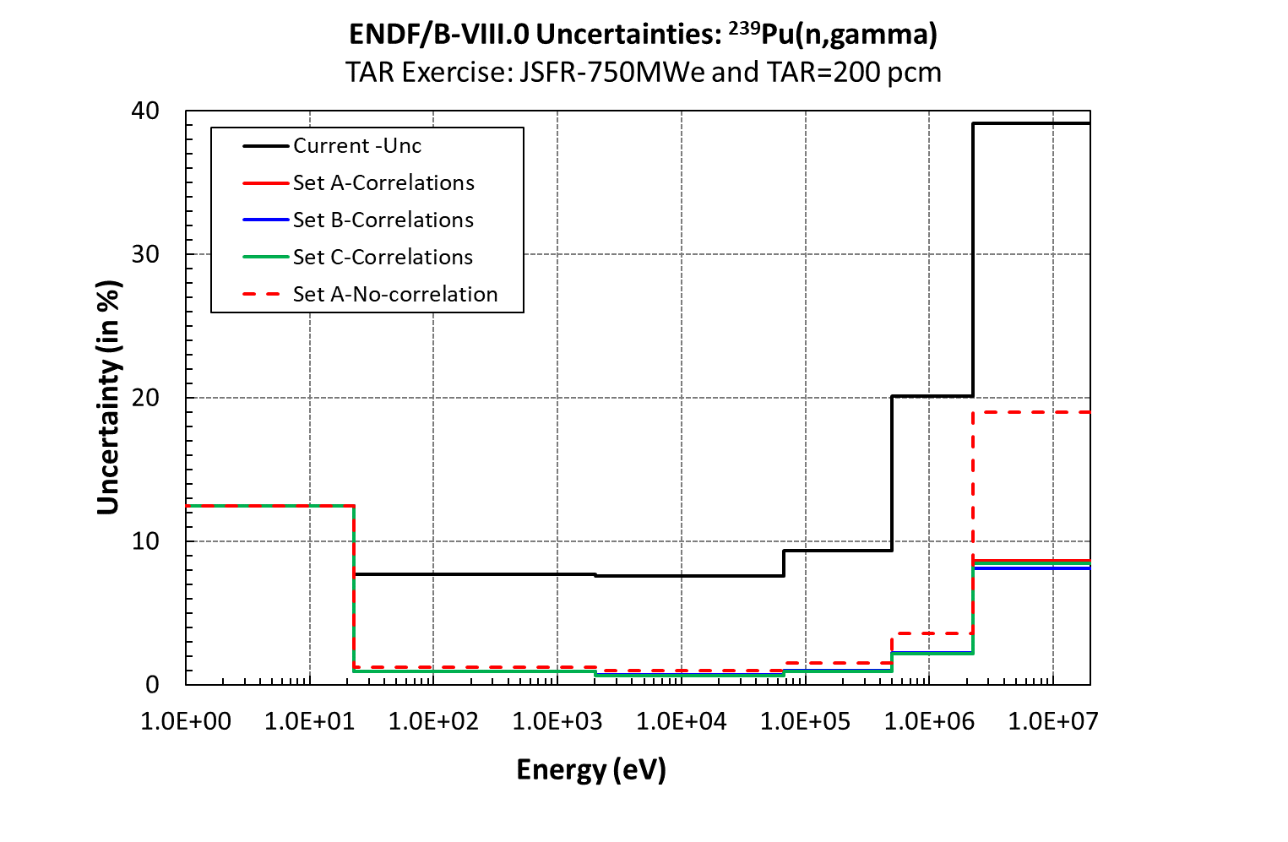
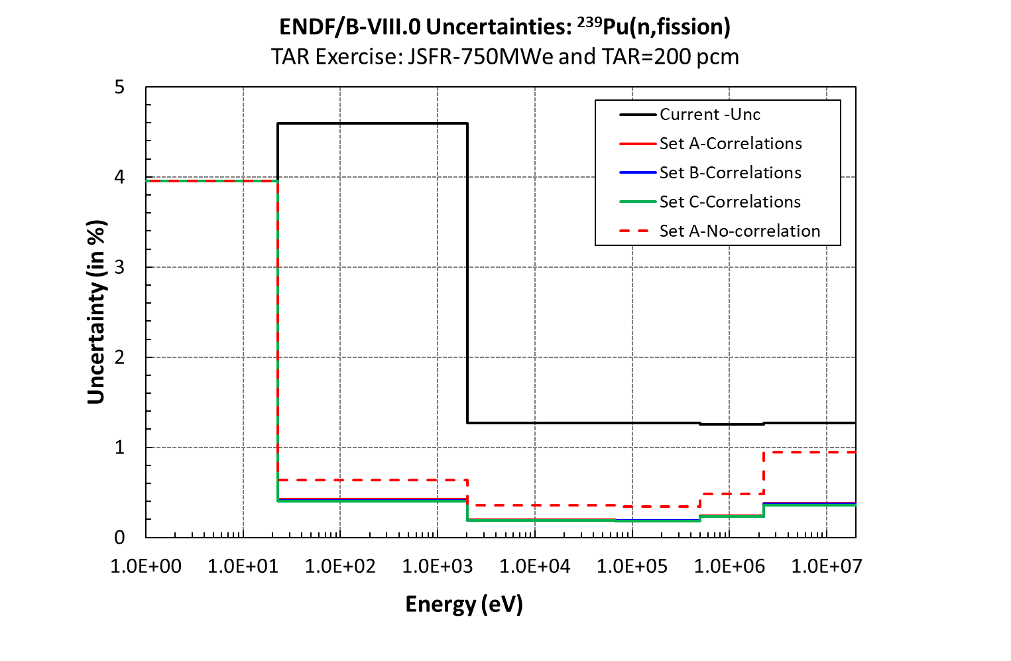
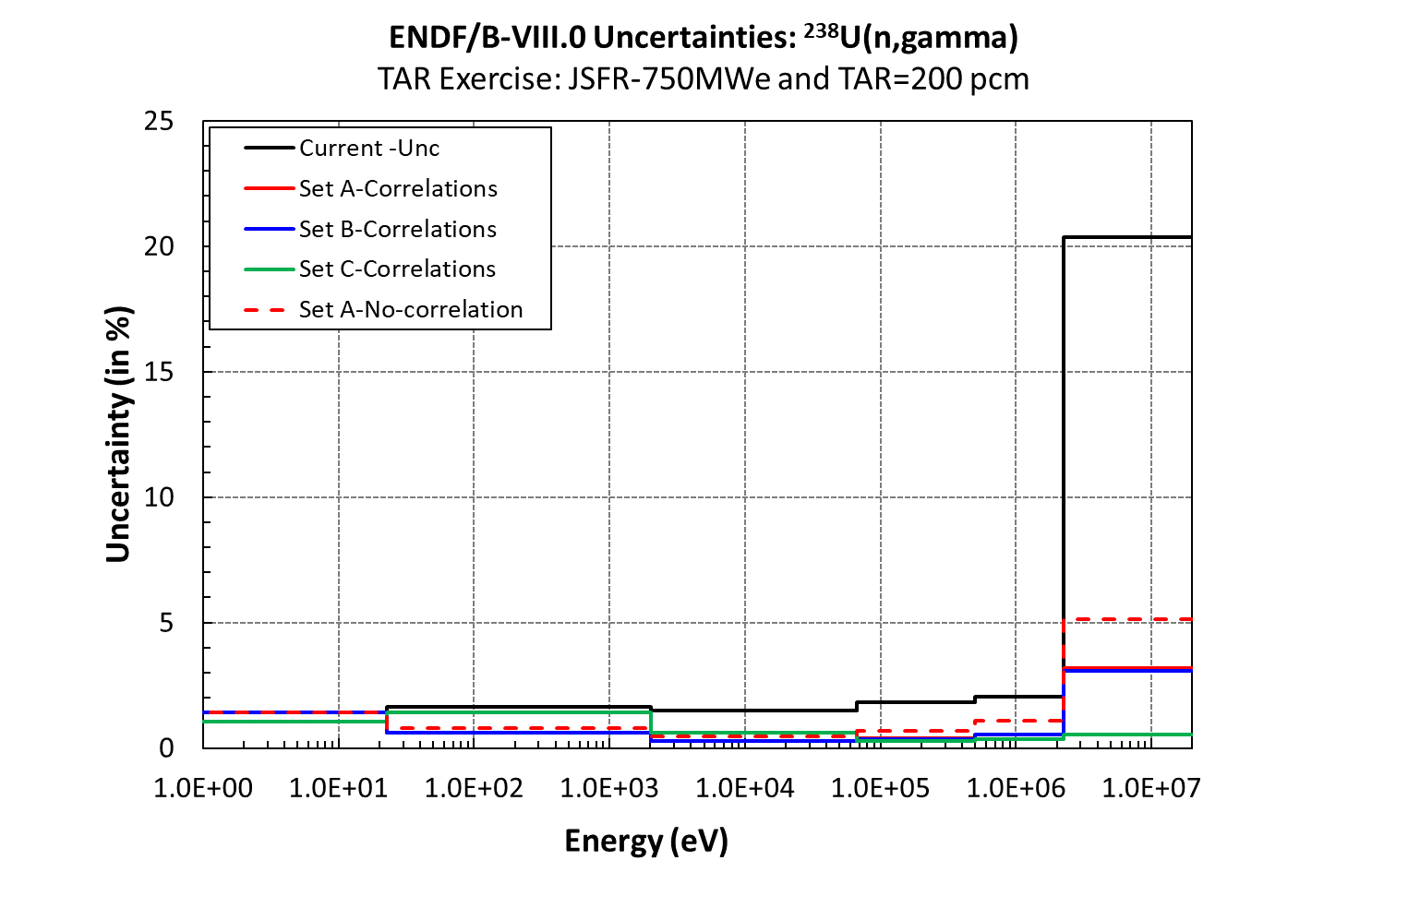
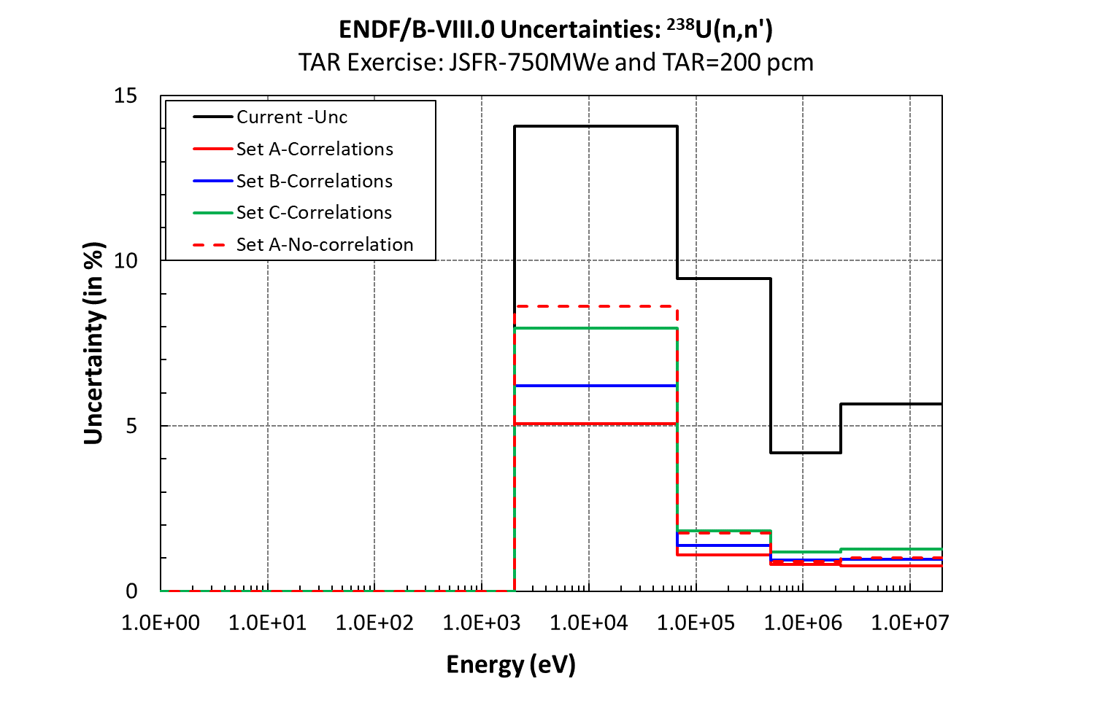
TAR preliminary results
System JSFR - ENDF/B-VIII.0

Slide 20
3) Preliminary TAR Results
Different ND evaluations: ENDF/B-VIII.0 .vs. Others
J-SFR: TAR preliminary results for ENDF/B-VIII.0 and other evaluations
Table 8. Target accuracy requirement on top-10 most important reactions. Correlations in TAR exercise - set C, ENDF/B-VIII.0
Table 9. Target accuracy requirement on top-10 most important reactions. Correlations* in TAR exercise – set C. ENDF/B-VII.1
Rank # | Reaction | Energy Group | Current (%) | Target (%) | Rel. Unc. Reduction (%)
1 | pu-239(n,fission) | 3 | 1.3 | 0.2 | 18.5
2 | pu-239(n,fission) | 4 | 1.3 | 0.2 | 17.3
3 | pu-239(n,fission) | 2 | 1.3 | 0.2 | 9.4
4 | fe-56(n,inelastic) | 2 | 18.9 | 1.5 | 8.4
5 | pu-239(n,fission) | 5 | 4.6 | 0.4 | 5.2
6 | u-238(n,gamma) | 4 | 1.5 | 0.3 | 5.1
7 | pu-239(n,gamma) | 4 | 7.5 | 0.6 | 4.0
8 | u-238(n,gamma) | 3 | 1.8 | 0.3 | 3.8
9 | pu-239(n,fission) | 1 | 1.3 | 0.4 | 2.2
10 | pu-239(n,gamma) | 3 | 9.3 | 0.9 | 1.9
11 | u-238(n,inelastic) | 1 | 5.7 | 1.3 | 1.8
Rank # | Reaction | Energy Group | Current (%) | Target (%) | Rel. Unc. Reduction (%)
1 | u-238(n,inelastic) | 1 | 24.3 | 1.4 | 38.4
2 | u-238(n,inelastic) | 2 | 15.5 | 1.3 | 27.1
3 | pu-239(n,gamma) | 4 | 8.4 | 0.8 | 4.6
4 | u-238(n,gamma) | 4 | 1.5 | 0.4 | 2.9
5 | u-238(n,elastic) | 2 | 7.8 | 1.1 | 2.5
6 | pu-239(n,gamma) | 3 | 10.4 | 1.2 | 2.2
7 | fe-56(n,inelastic) | 2 | 9.5 | 1.8 | 2.0
8 | pu-240(n,gamma) | 2 | 59.3 | 2.5 | 1.5
9 | pu-239(n,chi) | 1 | 2.7 | 0.6 | 1.4
10 | o-16(n,gamma) | 1 | 50 | 2.6 | 1.3
11 | u-238(n,elastic) | 1 | 16.7 | 2.1 | 1.1
Total keff unc. due to ND with ENDF/B-VIII.0: 969 pcm
Total keff unc. due to ND with ENDF/B-VII.1: 951 pcm
TAR JSFR/keff value : 200 pcm
Ref.: K. Yokoyama, Input Information for SG46 Target Accuracy Requirements (TAR) Exercise using Models of 750MWe JSFR Core, WPEC/SG46 November 2019

Slide 21
4) Preliminary TAR Results
Different ND evaluations: keff .vs. Others
J-SFR: TAR preliminary results for ENDF/B-VIII.0: Other integral parameters
Table 10. Target accuracy requirement on top-10 most important reactions. Correlations in TAR exercise - set C, ENDF/B-VIII.0: keff
Table 11. Target accuracy requirement on top-10 most important reactions. Correlations in TAR exercise - set C, ENDF/B-VIII.0: SVR
Rank # | Reaction | Energy Group | Current (%) | Target (%) | Rel. Unc. Reduction (%)
1 | pu-239(n,fission) | 3 | 1.3 | 0.2 | 18.5
2 | pu-239(n,fission) | 4 | 1.3 | 0.2 | 17.3
3 | pu-239(n,fission) | 2 | 1.3 | 0.2 | 9.4
4 | fe-56(n,inelastic) | 2 | 18.9 | 1.5 | 8.4
5 | pu-239(n,fission) | 5 | 4.6 | 0.4 | 5.2
6 | u-238(n,gamma) | 4 | 1.5 | 0.3 | 5.1
7 | pu-239(n,gamma) | 4 | 7.5 | 0.6 | 4.0
8 | u-238(n,gamma) | 3 | 1.8 | 0.3 | 3.8
9 | pu-239(n,fission) | 1 | 1.3 | 0.4 | 2.2
10 | pu-239(n,gamma) | 3 | 9.3 | 0.9 | 1.9
11 | u-238(n,inelastic) | 1 | 5.7 | 1.3 | 1.8
Rank # | Reaction | Energy Group | Current (%) | Target (%) | Rel. Unc. Reduction (%)
1 | pu-239(n,fission) | 5 | 4.6 | 1.7 | 50.2
2 | na-23(n,elastic) | 3 | 7.3 | 2.8 | 18.2
3 | na-23(n,inelastic) | 2 | 11.8 | 6.1 | 17.8
4 | pu-239(n,gamma) | 5 | 7.7 | 3.8 | 4.8
5 | na-23(n,elastic) | 2 | 6.8 | 3.9 | 3.6
6 | o-16(n,elastic-P1) | 2 | 58.5 | 13.7 | 2.9
7 | na-23(n,gamma) | 1 | 56.9 | 16.5 | 1.3
8 | o-16(n,inelastic) | 1 | 265.2 | 55.1 | 0.3
9 | pu-240(n,fission) | 5 | 18.9 | 12.6 | 0.3
10 | na-23(n,gamma) | 2 | 67.5 | 25.8 | 0.3
11 | u-238(n,elastic-P1) | 2 | 0 | 10 | -0.2
Total keff unc. due to ND with ENDF/B-VIII.0: 969 pcm
Total SVR unc. due to ND with ENDF/B-VIII.0: 5.9%
TAR JSFR/keff value : 200 pcm TAR JSFR/SVR value: 3%
Ref.: K. Yokoyama, Input Information for SG46 Target Accuracy Requirements (TAR) Exercise using Models of 750MWe JSFR Core, WPEC/SG46 November 2019

Slide 22
5) Preliminary TAR Results
Different systems: JSFR .vs. Others
TAR preliminary results for ENDF/B-VIII.0: Other systems
Table 12. Target accuracy requirement on top-10 most important reactions. Correlations in TAR exercise - set C, ENDF/B-VIII.0: J-SFR
Table 13. Target accuracy requirement on top-10 most important reactions. Correlations in TAR exercise - set C, ENDF/B-VIII.0: ESFR
Rank # | Reaction | Energy Group | Current (%) | Target (%) | Rel. Unc. Reduction (%)
1 | pu-239(n,fission) | 3 | 1.3 | 0.2 | 18.5
2 | pu-239(n,fission) | 4 | 1.3 | 0.2 | 17.3
3 | pu-239(n,fission) | 2 | 1.3 | 0.2 | 9.4
4 | fe-56(n,inelastic) | 2 | 18.9 | 1.5 | 8.4
5 | pu-239(n,fission) | 5 | 4.6 | 0.4 | 5.2
6 | u-238(n,gamma) | 4 | 1.5 | 0.3 | 5.1
7 | pu-239(n,gamma) | 4 | 7.5 | 0.6 | 4.0
8 | u-238(n,gamma) | 3 | 1.8 | 0.3 | 3.8
9 | pu-239(n,fission) | 1 | 1.3 | 0.4 | 2.2
10 | pu-239(n,gamma) | 3 | 9.3 | 0.9 | 1.9
11 | u-238(n,inelastic) | 1 | 5.7 | 1.3 | 1.8
Rank # | Reaction | Energy Group | Current (%) | Target (%) | Rel. Unc. Reduction (%)
1 | pu-239(n,fission) | 3 | 1.3 | 0.3 | 18.1
2 | pu-239(n,fission) | 4 | 1.3 | 0.3 | 16.4
3 | pu-239(n,fission) | 2 | 1.3 | 0.4 | 8.8
4 | u-238(n,gamma) | 4 | 1.5 | 0.4 | 5.9
5 | pu-239(n,fission) | 5 | 4.6 | 0.6 | 5.5
6 | u-238(n,inelastic) | 1 | 5.7 | 1.5 | 5.0
7 | fe-56(n,inelastic) | 2 | 18.9 | 2.7 | 4.8
8 | u-238(n,gamma) | 3 | 1.8 | 0.5 | 4.5
9 | pu-239(n,gamma) | 4 | 7.5 | 1.4 | 3.2
10 | u-238(n,inelastic) | 2 | 4.2 | 1.5 | 3.0
11 | o-16(n,inelastic) | 1 | 265.2 | 7 | 2.4
Total keff unc. due to ND with ENDF/B-VIII.0: 969 pcm
Total keff unc. due to ND with ENDF/B-VIII.0: 928 pcm
TAR JSFR/keff value : 200 pcm TAR ESFR/keff value: 300 pcm
Ref.: K. Yokoyama, Input Information for SG46 Target Accuracy Requirements (TAR) Exercise using Models of 750MWe JSFR Core, WPEC/SG46 November 2019

Slide 23
Conclusion
1st Phase: Definition of TAR
  So far, ALFRED, ASTRID, ESFR-SMART and JSFR
  More reactors + sensitivity profiles: SMR, MSR, …Other systems ?
2nd Phase: Uncertainty Quantifications
  Different libraries and associate covariance data (e.g. ENDF/B-VIII.0)
  Assessment of 7-energy groups
3rd Phase: Performing TAR with inverse approach
  7-energy groups
  Correlation and no-correlation
  Different set of cost parameters
  One system and all parameters: e.g. JSFR

Slide 24
Acknowledgments
This work is part of the SANDA project (Supplying Accurate Nuclear Data for energy and non-energy Applications) that has received funding from the European Union’s H2020/Euratom under grant agreement No. 847552

