Slide 1






























INDEN (nubar) covariance update
U-235, Pu-239, U-233
R. Capote (IAEA) on behalf of the INDEN collaboration
https://www-nds.iaea.org/INDEN

Slide 2
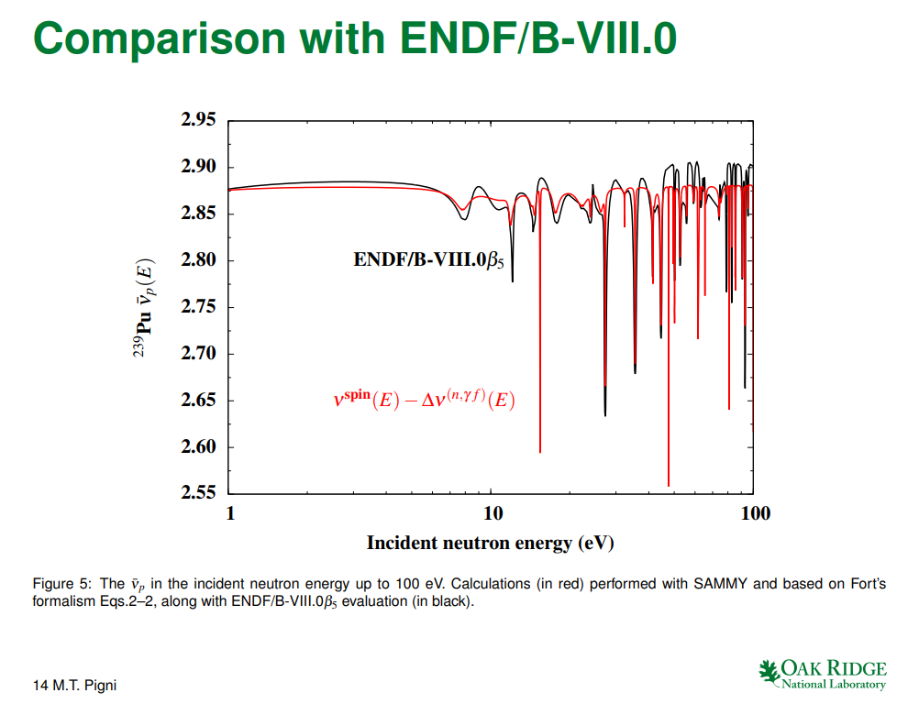
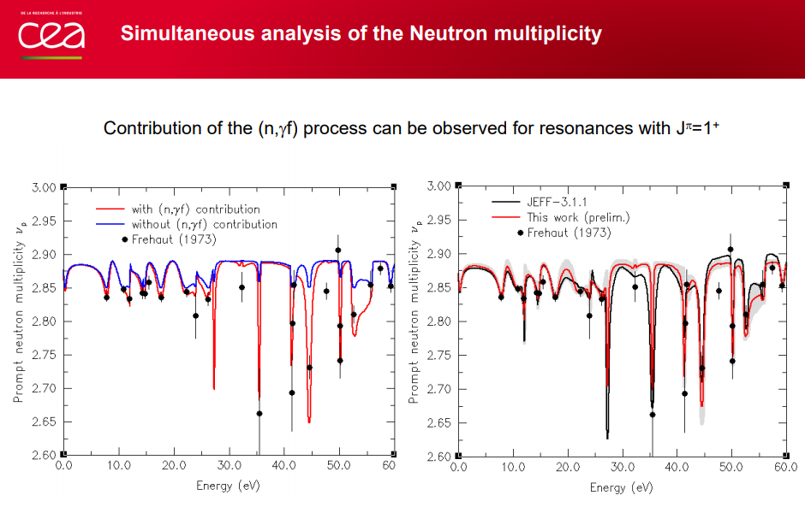
nubar fluctuations for resonances: reintroduced in ENDF/B-VIII.0 for n+²³⁵U
U-235 nubar
Pu-239 nubar
M. Pigni, INDEN CM 2018
G. Noguere, INDEN CM 2018
Fluctuations will be added for all major fissiles

Slide 3
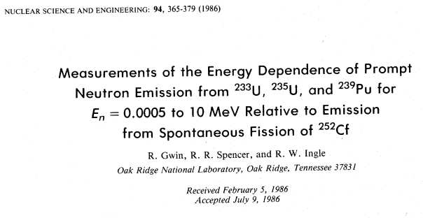
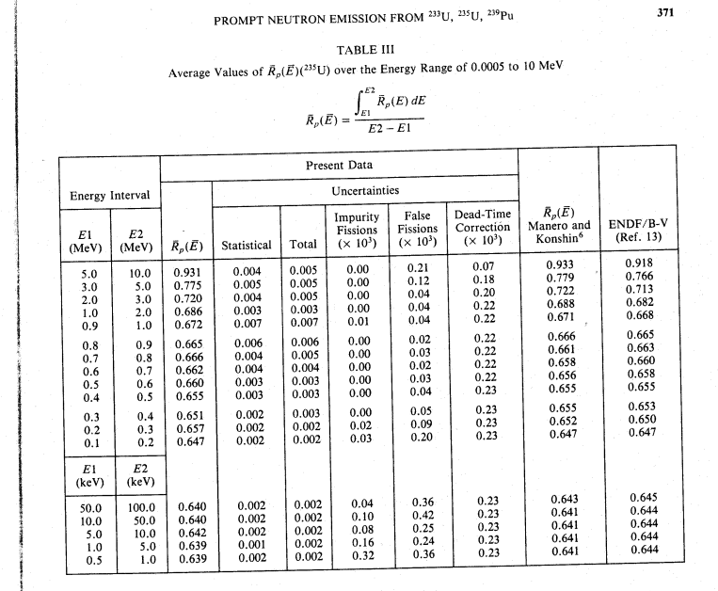
Missed experiment by Gwin et al (1986) in ²³⁵U ENDF/B-VIII.0 nubar 500 eV-10 MeV
Data for U-233, U-235, Pu-239
with uncertainties !!
Relative to Cf-252 prompt (TNC)
Fissile nubar uncert. ~ 0.5%
500eV - 100keV
For all fissiles

Slide 4
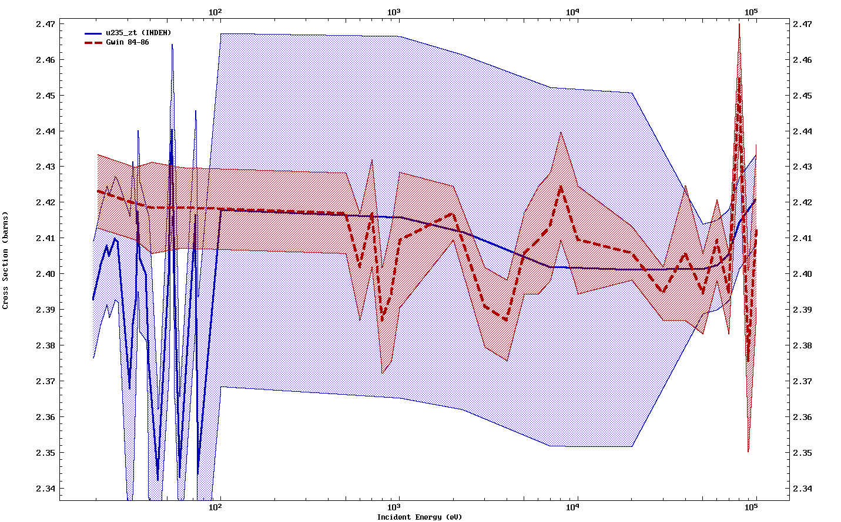
Uncertainties reduced from 2% down to 0.5% in range 20eV-50keV (U-235, Pu-239, U-233)
nubar
0.1 1 10 100
Incident energy (keV)

