Slide 1

Neutron-Gamma Correlations in ²⁵²Cf(sf)
Stefano Marin¹, Ramona Vogt^{2,3}
1. University of Michigan, Ann Arbor
2. Lawrence Livermore National Laboratory
3. University of California, Davis
Nuclear Data Week
CSEWG virtual meeting
Nov 15th, 2021

Slide 2
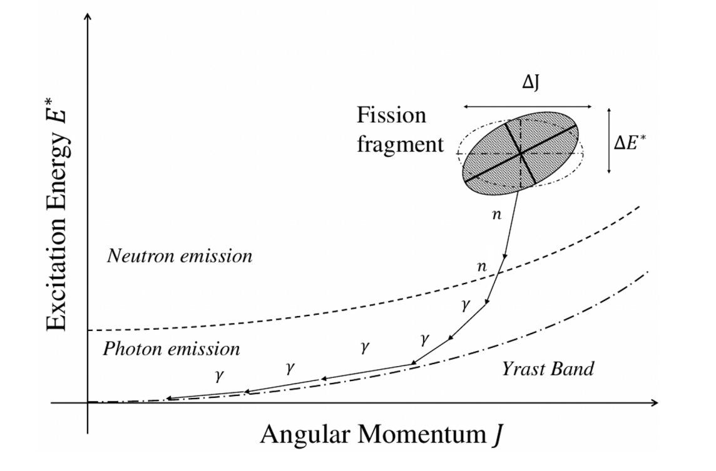
Importance of Neutron-Gamma Correlations
Give insight into the physics of the fission process
Correlated neutron-gamma emission are a signature of fission, albeit small in magnitude
Correlations introduce systematic bias in asymmetric and inefficient detection systems
Neutron-gamma correlations can arise because of:
  Fragment energy and angular momentum conservation
  Correlations between excitation energy and angular momentum

Slide 3
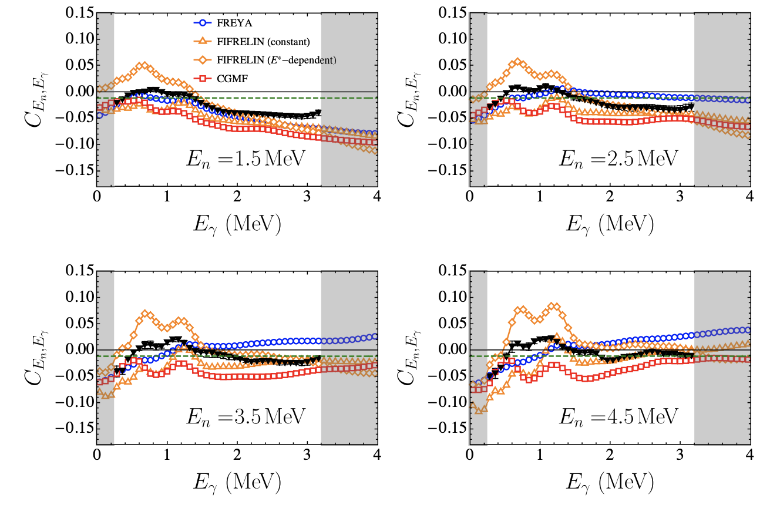
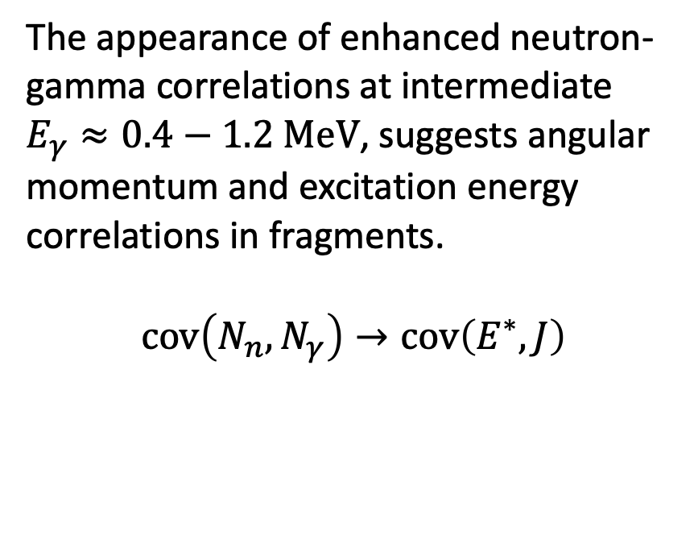
Covariance Reveals Enhanced n-γ Correlations
The appearance of enhanced neutron-gamma correlations at intermediate $E_{γ}≈0.4−1.2 MeV$, suggests angular momentum and excitation energy correlations in fragments.
$$cov\left(N_{n},N_{γ}\right)→cov\left(E^{∗}, J\right)$$
Stefano Marin et al. “Structure in the Energy-Dependent Event-by-Event Correlations in Neutron Emission of ²⁵²Cf(sf)”, Physical Review C, Vol 104, 024602. (2021)

Slide 4



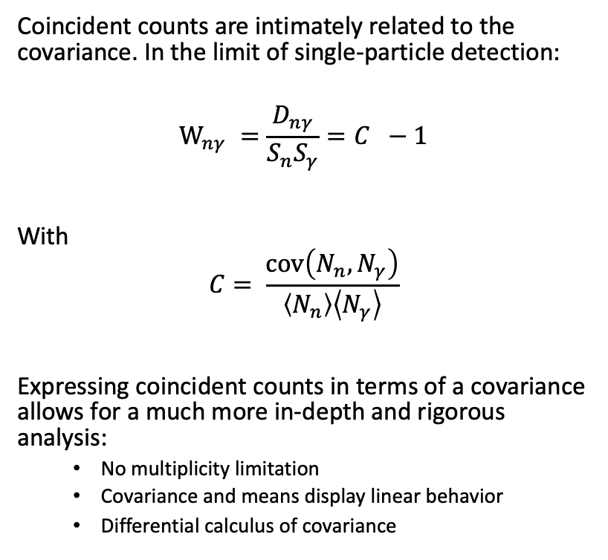



Going More in Depth: Covariance vs. E_{n}, E_{γ,} θ_{nγ}
Coincident counts are intimately related to the covariance. In the limit of single-particle detection:
$$W_{nγ} =\frac{D_{nγ}}{S_{n}S_{γ}}=C −1$$
With
$$C= \frac{cov\left(N_{n},N_{γ}\right)}{\left\langle N_{n}\right\rangle \left\langle N_{γ}\right\rangle }$$
Expressing coincident counts in terms of a covariance allows for a much more in-depth and rigorous analysis:
  No multiplicity limitation
  Covariance and means display linear behavior
  Differential calculus of covariance
$$θ_{nγ}$$
$$d_{n}$$
$$d_{γ}$$
$$ε_{γ}\left(E_{γ}\right)$$
$$ε_{n}\left(E_{n}\right)$$
$$252Cf\left(sf\right)$$

Slide 5

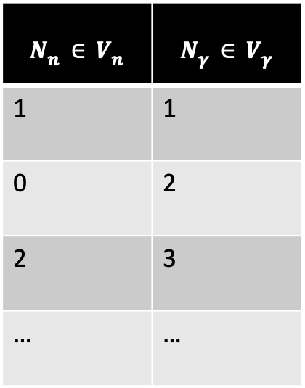



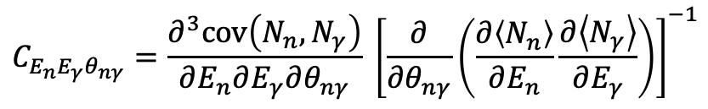






Covariance Analysis in Phase Space
$$8 MeV$$
$$N_{γ}$$
$$N_{n}∈V_{n}$$ | $$N_{γ}∈V_{γ}$$
1 | 1
0 | 2
2 | 3
… | …
$$N_{n}$$
$$3 MeV$$
$$4 MeV$$
$$1 MeV$$
$$0 MeV$$
$$V_{n}$$
$$0 MeV$$
$$V_{γ}$$
$$C_{E_{n}E_{γ}θ_{nγ}}=\frac{∂^{3}cov\left(N_{n},N_{γ}\right)}{∂E_{n}∂E_{γ}∂θ_{nγ}} {\left[\frac{∂}{∂θ_{nγ}}\left(\frac{∂\left\langle N_{n}\right\rangle }{∂E_{n}}\frac{∂\left\langle N_{γ}\right\rangle }{∂E_{γ}}\right)\right]}^{−1}$$

Slide 6
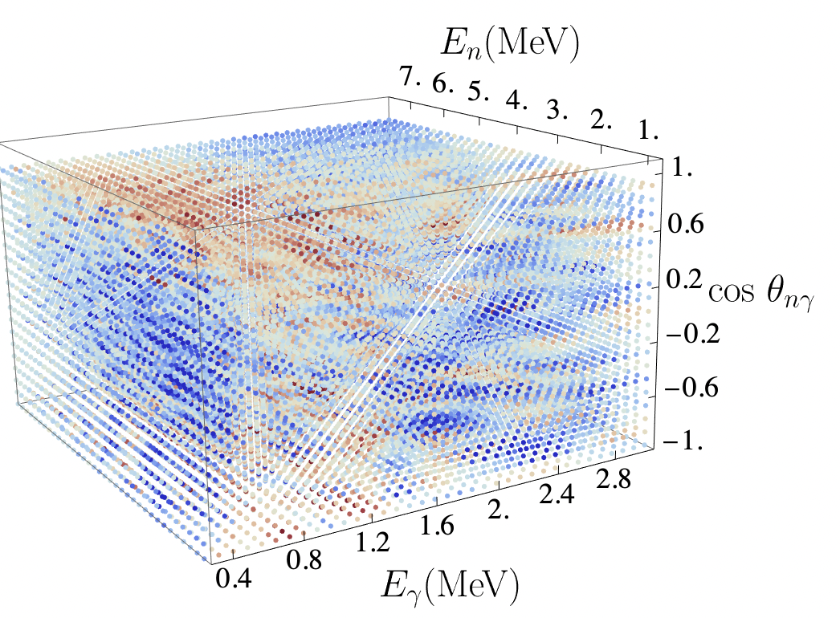
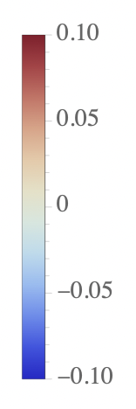

Differential Covariance Results
Legendre polynomial to collapse angular dimension:
$$C_{E_{n}E_{γ}θ_{nγ}}$$
$C_{E_{n}E_{γ}θ_{nγ}}=A_{0}\left(E_{n},E_{γ}\right)+A_{2}\left(E_{n},E_{γ}\right) P_{2}(\cos{θ_{nγ}) }$

Slide 7
Conclusions
We have found evidence of neutron-gamma correlations in phase space. An enhancement of neutron-aligned, band-transition gamma-rays has been observed.
  The findings were confirmed with an independent experiment on ²⁵²Cf(sf). We have also observed a similar enhancement in ²⁴²Pu(sf).
The correlations are small (few %) but, for certain configurations of detector geometry and energy acceptance, can become significant (~10-15%).
To better understand the physics of fission fragments giving rise to these correlations we are pursuing two simultaneous investigations:
  ²³⁹Pu(n,f) to test the incident-neutron energy dependence of the correlations across a large energy range
  ²⁵²Cf(sf) with fragment detectors to gate on the event-by-event excitation energy of the fragments.
S. Marin et al. “Event-by-event Neutron-Photon Multiplicity Correlations In ²⁴²Pu(sf)”, Proceedings of the Institute for Nuclear Materials Management (2021).

