Slide 1
On the Reactivity Trends in ENDF/B-VIII.0 With Burnup Due to Uranium Cross Sections
Andrej Trkov (JSI), Jan Malec (JSI), Roberto Capote (IAEA)
Jožef Stefan Institute
Ljubljana, Slovenia

Slide 2
Loss of reactivity with burnup for PWR with ENDF/B-VIII.0 library compared to ENDF/B-VII.1
Reported by Kang Seong Kim et al. at CSEWG 2019
Extensive analysis by Kang Seong Kim and William A. Wieselquist in J.Nucl.Eng. 2021,2, pinpointing the problem to U-238
Criticality prediction of U-238 was benchmarked extensively – small differences overall
Problems appear with burnup:
FP yields library unchanged from ENDF/B-VII.1
Major FP cross section not so different
Focus on Pu-239 production

Slide 3
Differences in reactivity when individual nuclides from ENDF/B-VIII.0 library are substituted into ENDF/B-VII.1 (K.S. Kim et al., J.Nucl.Eng. 2021,2, Fig.2)

Slide 4
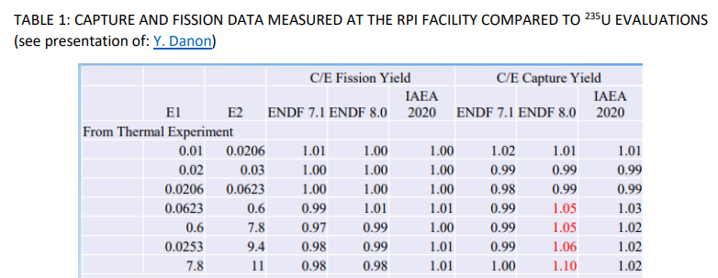
INDEN update of U-235 evaluation (ORNL/IAEA/JSI)
Detailed fission-XS shape that follows
better the fluctuating data in the URR
Spurious cross-reaction covariance
elements between the resonance and
the fast energy ranges removed to avoid
negative eigenvalues.
Cross-covariances between nu-bar and
fission cross section removed for the same
reason.
RRR: additional work below 20eV to
improve agreement with RPI data→ → → →
See INDC(NDS)-0810, IAEA INDEN-ACT III meeting
capture decreased from 0.0623 up to 11eV
U-235 file: nds.iaea.org/INDEN/data/u235ib46o28t6DNcnu5ef0STzt_ENDF.zip

Slide 5
What is different in ENDF/B-VIII.0 ?
U-238 in ENDF/B-VIII.0 is a CIELO evaluation (R. Capote, A.Trkov et al., Nucl.Data Sheets 148 (2018) 254-292)
Thermal reactors → let us focus on the lower resonance range
Slight change was made in ENDF/B-VIII.0 to the bound level widths to fit the measured transmission data of Olsen.
This affected the capture below and above the first resonance by about 2–5%.
Thermal value was unchanged.

Slide 7
Cumulative U-238 capture reaction rate integral in a PWR spectrum
Thermal part of the spectrum in a PWR is suppressed due to boron in the coolant, emphasizing the importance of the epithermal energy range.
Importance of the resonance range up to 200eV emphasized by D. Bernard and O. Cabellos at the INDEN IAEA TM (Nov. 2021)
Cumulative reaction rate integral ratio of U-238 capture (at infinite dilution) between ENDF/B-VIII.0 (label “e80”) and “e80V02” (with resolved resonance data substituted from ENDF/B-VII.1) increases up to ~200 eV, except at the 6 eV resonance.
The opposite effect of the 6 eV resonance diminishes when self-shielding is taken into account

Slide 8
Data substitution exercise
Replace resolved resonance parameters in ENDF/B-VIII.0 by ENDF/B-VII.1, keep background in (n,f) (filename “u238e80V02b”)
Process with NJOY into WIMS-D format
Replace U-238 in the WIMS-D library with “u238e80V02b”
Supercell calculations with WIMSD-5B
Test enrichments 2.1% and 4.75% at HFP conditions

Slide 9
Reactivity trends due to ²³⁵U, ²³⁸U (k_inf of central cell)
Full ENDF/B-VII.1 (green)
‘e80’+U238 V02b (black)
+U235’zt’ (red)
Enrichment 2.1%
Reactivity starts low at -200 pcm and increases
After a few 1000 MWd/tU becomes steady at about +150 pcm
Enrichment 4.75%
Reactivity starts low ~150 pcm and increases steadily
Compared to ENDF/B-VIII.0, updated files produce reactivity trends closer to ENDF/B-VII.1
Full ENDF/B-VII.1 (green)
‘e80’+ U238 V02b (black)
+U235’zt’ (red)

Slide 10
Full ENDF/B-VII.1 (green)
‘e80’+U238 V02b (black)
+U235’zt’ (red)

Slide 11
Full ENDF/B-VII.1 (green)
‘e80’+ U238 V02b (black)
+U235’zt’ (red)

Slide 12
Why WIMS-D ?
Full control of the library
Runs quickly
We are only interested in relative differences
We already have a library based on ENDF/B-VIII.0
WIMS-D calculations were benchmarked with Serpent and OpenMC on ENDF/B-VIII.0 data

Slide 13
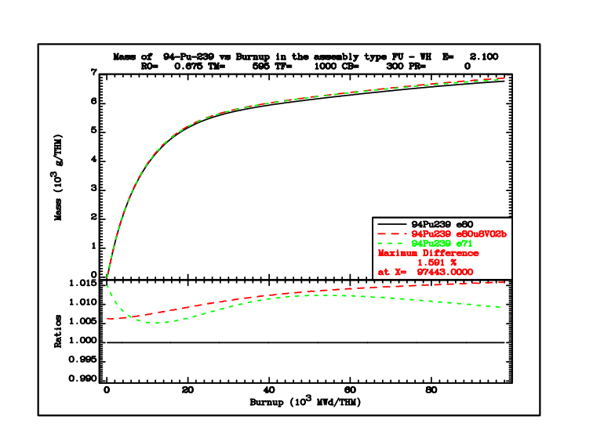
Pu-239 buildup
Full ENDF/B-VII.1 (green)
‘e80’+ U238 V02b (black)
+U235’zt’ (red)
Enrichment 2.1%
Pu-239 continues to increase at high burnup
The increase partly compensates reactivity loss
Enrichment 4.75%
Pu-239 reaches saturation
Its steady concentration does not compensate reactivity loss
Full ENDF/B-VII.1 (green)
‘e80’+ U238 V02b (black)
+U235’zt’ (red)

Slide 14
Full ENDF/B-VII.1 (green)
‘e80’+ U238 V02b (black)
+U235’zt’ (red)

Slide 15
Full ENDF/B-VII.1 (green)
‘e80’+ U238 V02b (black)
+U235’zt’ (red)

Slide 16
Conclusions
Resonance substitution in U-238 from ENDF/B-VII.1 into ENDF/B-VIII.0 indeed compensates large reactivity loss of with burnup; small contribution comes from U-235
The higher capture in the energy region 0.1 – 100 eV in ENDF/B-VII.1 decreases initial reactivity, but enhances Pu-239 production
The Pu-239 production at 4.75% enrichment leads to saturation, while at 2.1% enrichment Pu-239 concentration continues to increase → the trend of reactivity loss is stronger at higher enrichments
New U-238 RRR evaluation desirable
Possible solution is offered at: nds.iaea.org/INDEN (U-238 tab, v02b)

