Slide 1






























INDEN evaluation of n + (U-233), Pu-239. Status and updates
R. Capote, A. Trkov, M. Pigni, D. Martyanov
on behalf of the INDEN collaboration
https://www-nds.iaea.org/INDEN

Slide 2
Outlook
Thermal Neutron Constants (standards)
PFNS
U-233 short review
Pu-239 status
Planned updates

Slide 3
Thermal Neutron Constants (STD 2017)
 |  | Standards 2006 (+Maxwellian) | ENDF/B-VII.1 | Standards 2017 (2200 m/s) | ENDF/B-VIII.0
²³³U(n_{th},f) | σ_{s} | 12.1±0.7 | 12.17 | 12.2±0.7 | 12.2
 | σ_{f} | 531.2±1.3 | 531.3 | 533.0±2.2 | 534.1
 | σ_{γ} | 45.6±0.7 | 45.3 | 44.9±0.9 | 42.3
 | ν_{t} | 2.4968±0.0035 | 2.4968 | 2.487±0.011 | 2.4852
²³⁵U(n_{th},f) | σ_{s} | 14.09±0.22 | 15.11 | 14.09±0.22 | 14.10
 | σ_{f} | 584.3±1.0 | 584.99 | 587.3±1.4 | 586.7
 | σ_{γ} | 99.4±0.7 | 98.69 | 99.5±1.3 | 99.4
 | ν_{t} | 2.4355(.0023) | 2.4367(.0005) | 2.425±0.011 | 2.4298
²³⁹Pu(n_{th},f) | σ_{s} | 7.8±1.0 | 7.99 | 7.8±1.0 | 8.1
 | σ_{f} | 750.0±1.8 | 747.91 | 752.4±2.2 | X 747.4
 | σ_{γ} | 271.5±2.1 | 270.7 | 269.8±2.5 | 270.1
 | ν_{t} | 2.8836±0.0047 | 2.8807 | 2.878±0.013 | 2.8769
²⁴¹Pu(n_{th},f) | σ_{s} | 12.1±2.6 | 11.2 | 11.9±2.6 | 11.3
 | σ_{f} | 1014±7 | 1012 | 1023.6±10.8 | X 1012
 | σ_{γ} | 361.8±5.0 | 363.0 | 362.3±6.1 | 363.0
 | ν_{t} | 2.9479±0.0054 | 2.9453 | 2.940±0.013 | 2.9453
²⁵²Cf(sf) | ν_{t} | 3.7692±0.0047 | 3.7676 | 3.764±0.015

Slide 4
New integral constraints for RP fit fissile targets
All measured ToF
high-resolution data
(1955-2019)
used to derive:
I₁, I₃, I₃ /I₁, σ_{f}(th)/I₁
May require small revision of
RP fits for all fissiles
Duran et al, 2021, discussed at
INDEN CM November 2021

Slide 5
n_{th}+X PFNS <E> (IAEA 2016, STD 2017 )
²³³U | ²³⁵U | ²³⁹Pu | evaluation
2.074 2.030 2.032 2.074 | 2.03 2.00 2.00 2.00 | 2.112 2.074 2.074 2.112 | ENDF/B-VII.1 IAEA Standards 2017 Talou, Rising et al 2016 ENDF/B-VIII.0 2018 | E_{n}=0.0253eV
ENDF/B-VIII.1 candidate evaluations
Pu-239: LANL new evaluation based on
ChiNu + CEA data ready + IAEA thermal
U-235: LANL new evaluation based on
ChiNu (almost) ready + IAEA thermal
U-233: IAEA thermal + Talou, Rising
evaluation 2016 evaluation
ALL RPs were refitted, nubar(E ) !!!
ORNL in collaboration with IAEA/JSI
Capote et al.

Slide 6
INDEN updated “actinide” evaluations
U-233 (ORNL/IAEA/JSI)
nds.iaea.org/INDEN/data/u233a506b-c_ENDF.zip
PFNS: Use of the IAEA U-233(n_{th},f) PFNS <E>=2.030 MeV vs ENDF/B-VIII.0 <E>=2.074 MeV). Talou et al PFNS evaluation (IAEA PFNS CRP) is used in the fast region.
Adjustment of thermal cross sections to agree with TNC from IAEA Standards 2017 (=B8).
Introduction of energy dependence for nubar below 30eV from Reed et al data.
RRR refitted at ORNL (see Pigni’s talk).
ENDF/B-VIII.0 adopted JENDL-4 fast neutron region based on the paper:
Fast neutron nubar needed minor changes to compensate loss of criticality
due to softer PFNS by Talou et al (see NDS PFNS paper)
BIG improvement in performance of U-233 solutions ! Good k_{eff} vs ATLF trend
(PFNS thermal + new resonance parameters)
Nuclear Data Sheets 139 (2017) 138–170

Slide 7
Status of INDEN Pu-239 evaluation: RRR
Presented by M. Pigni at IAEA INDEN-AC 2020, CSWEG 2020

Slide 8
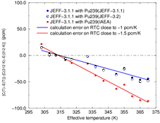
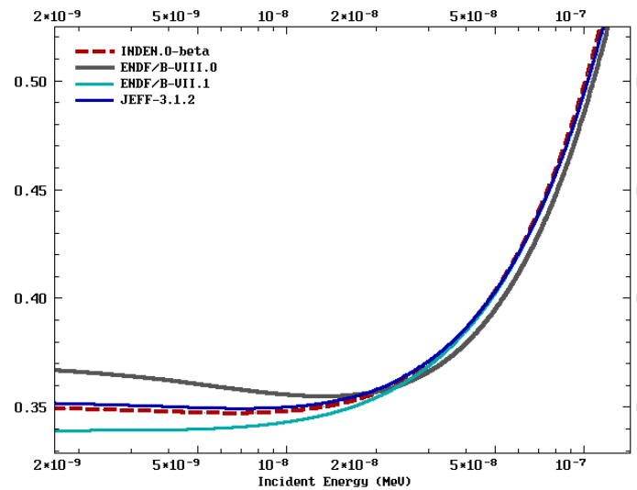
²³⁹Pu RTC-MISTRAL2 experiment, CEA
²³⁹Pu α( E)
Presented by G. Noguere @ INDEN meet.
Modifications to the RR fit required:
↑subthermal α, ↓ α till 1eV (closer to B8)
To improve RTC and ↑ crit. @ high burnup
NOTE: ↑ crit. may compensate U-238 criticality reduction

Slide 9
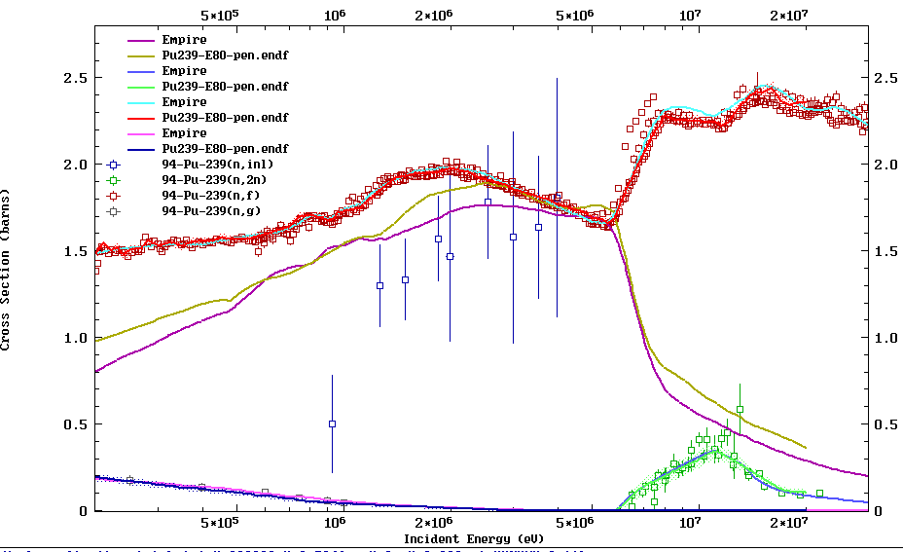
EMPIRE (p27) vs ENDF/B-VIII.0

Slide 10
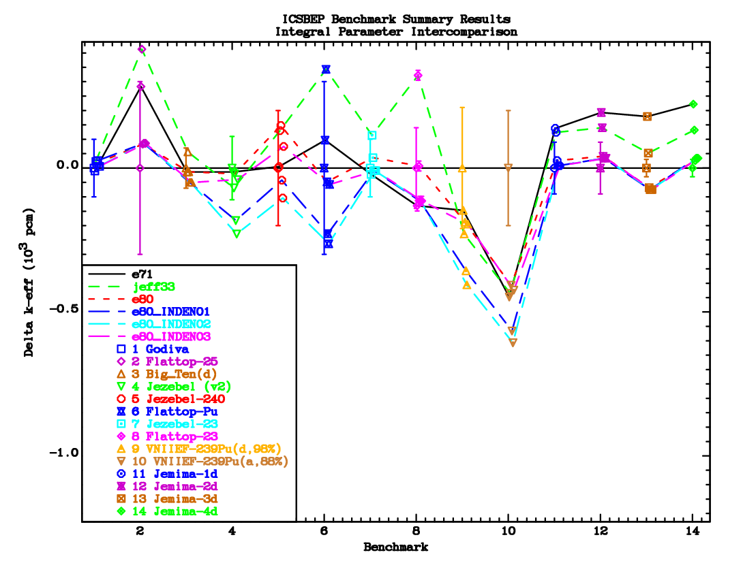
Criticality validation (main fast benchmarks)
Pu9
U5 + U8
U5,U8
U3
Pu9,U8
235U same;
U-233 need small nubar tweak (increase)
²³⁹Pu INDEN03 (p29,p35,p38) good

Slide 11
LPS validation (currently better than B8)
p27 better than B8

Slide 12
INDEN updated “actinide” evaluations
Pu-239 (ORNL/IAEA/JSI), current EMPIRE (p27)
Validation of this file already presented in Denise’s 2021 talk
Updated standards with NIFFTE data + UQ
Fission term: LANL nubar evaluation + PFNS fast, IAEA PFNS th
RRR refitted at ORNL/IAEA/JSI (see Pigni’s 2020 talk)
To do:
Use of Mosby data to improve capture (slightly lower capture may be needed)
Reevaluation of nubar( E) in 1-80keV using Gwin data
Reevaluation of nubar considering (n,gf) data
Addressing Dopler temperature coefficient issue: Increase of subthermal alpha/ Decrease of alpha above thermal and below the first resonance)
Study of impact of changes in the low-energy RRR on burnup
Further improvement:
SRM optical model potential - even better physics for neutron scattering description.

Slide 13
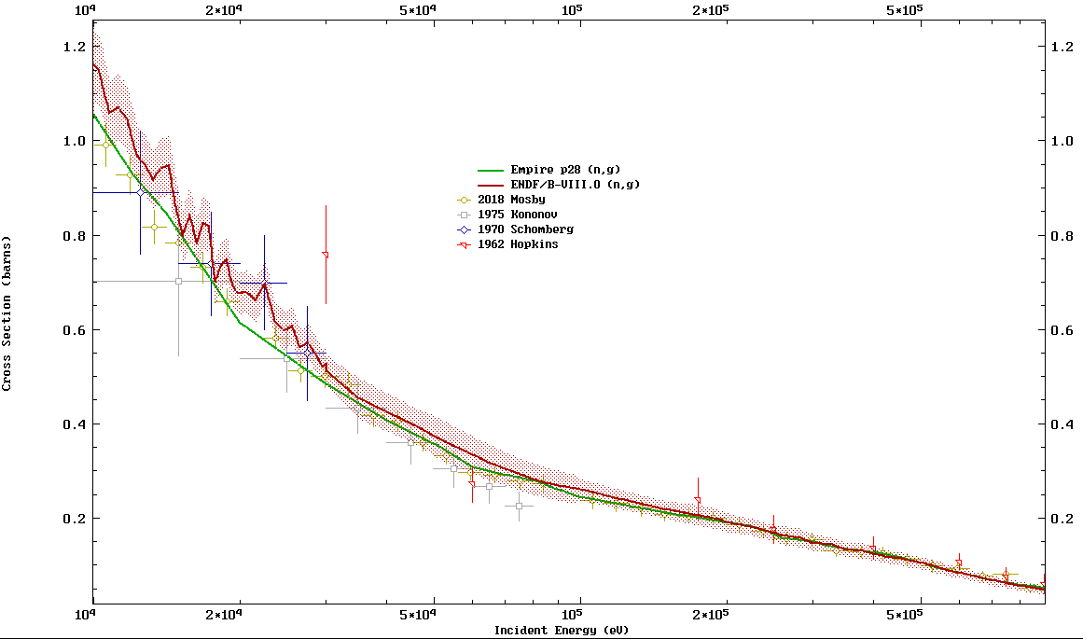
²³⁹Pu(n,γ): ENDF/B-VIII.0 vs Mosby data
(n,γ) reduction 10keV-200keV => criticality increase vs ENDF/B-VIII.0

Slide 14
FUTURE UPDATES

Slide 15
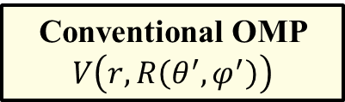
Optical model for soft deformed nuclei
Conventional OMP
$$V\left(r,R\left(θ^{′},φ^{′}\right)\right)$$
Soft spherical nucleus
(vibrational excitations)
Rigid deformed nucleus
(rotational excitations)
Taylor expansion near sphere
Static multipolar expansion
Explicit deformations → vibrations
bad convergence for big deformations
Good convergence for big static deformations
no explicit deformations → no vibrations!
Actinides: Big static deformation – expansion around statically deformed shape
E.S. Soukhovitskii, RC et al, PRC94(2016)064605, erratum: PRC102(2020)059901
DCCOMP based on Soft Rotator Model (SRM) for deformed nuclei

Slide 16
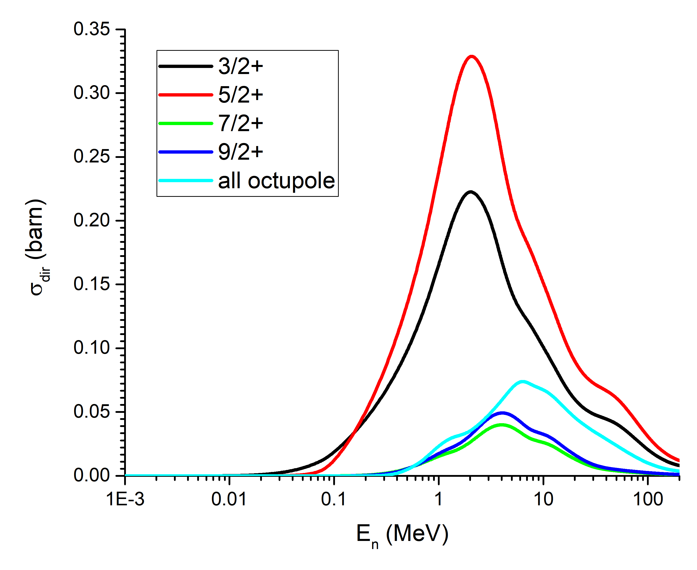
²³⁹Pu coupling scheme: New OMP 2420
Important octupole band (built on ½⁻ state)coupled:
½⁻ ≡ (core exc) 0⁻ ⊗ ½⁺ (single-particle GS)
better physics lead to better nuclear data
U_{exc}(MeV)

Slide 17
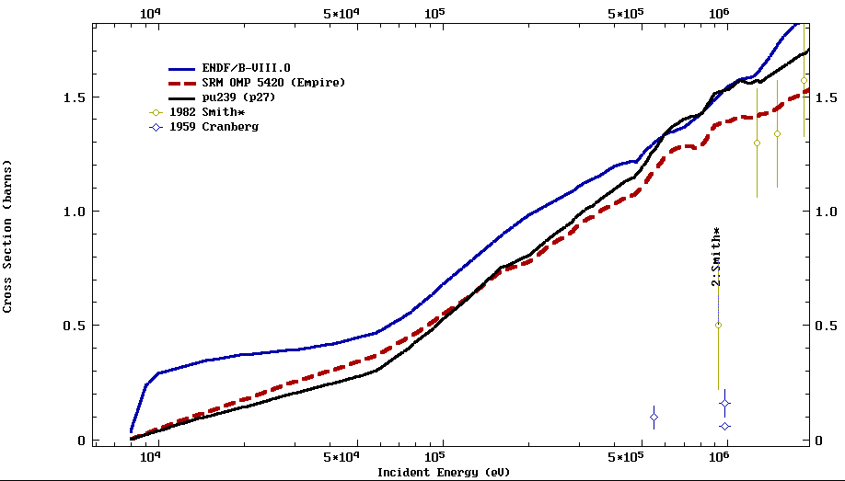
Pu239(n,inl): SRM vs Rigid OMP
criticality increase
in SRM vs p27
comp. (n,γ) reduction

Slide 18
²³³U coupling scheme: New OMP 2420
Octupole band (on 5/2⁻ state) and β-band (on 5/2⁺ state) coupled
Octupolar: 5/2⁻ ≡ (core exc) 0⁻ ⊗ 5/2⁺ (single-particle GS)
Quadrupolar: 5/2⁺ ≡ (core exc) 0⁺ ⊗ 5/2⁺ (single-particle GS)
better physics lead to better nuclear data

Slide 19
INDEN Summary @nds.iaea.org/INDEN/
Updated evaluations of major actinides available from INDEN
See Andrej Trkov talk:
U-238 (nds.iaea.org/INDEN/data/u238e80V02_ENDF.zip)
U-235 (nds.iaea.org/INDEN/data/u235ib46o28t6DNcnu5ef0STzt_ENDF.zip)
In this talk:
U-233 (nds.iaea.org/INDEN/data/u233a506b-c_ENDF.zip)
Pu-239 (nds.iaea.org/INDEN/data/pu239e80p38_ENDF.zip = p39)
see validation in Denise talk
Future updates planned
U-233: Nubar tweaks for fast neutrons needed (+ 0.1-0.2% ~ 0.5σ)
Pu-239: RP fit needs minor modifications below 2eV (RTC, ref. integrals, TNC)
Pu-239: Drop ENDF/B-VIII.0 Pu-239(n,g) capture to better reproduce Mosby data
Pu-239: New SRM optical model to be used for even better inelastic scattering
The INDEN scheme of international collaboration is working well.

Slide 20
Backup slides

Slide 21
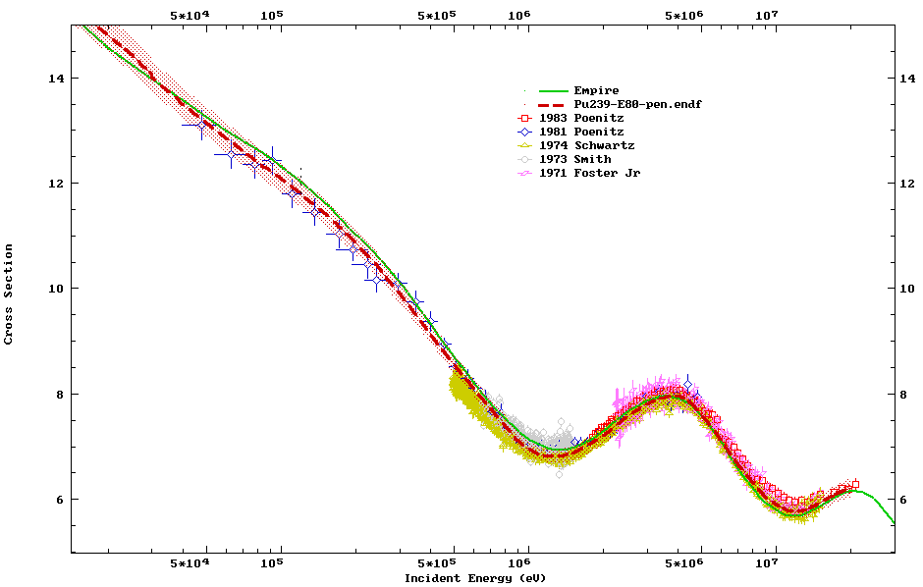
²³⁹Pu(n,tot) EXP vs EMPIRE (p27)
and ENDF/B-VIII.0
New SRM OMP 2420
B8 & p27

Slide 22
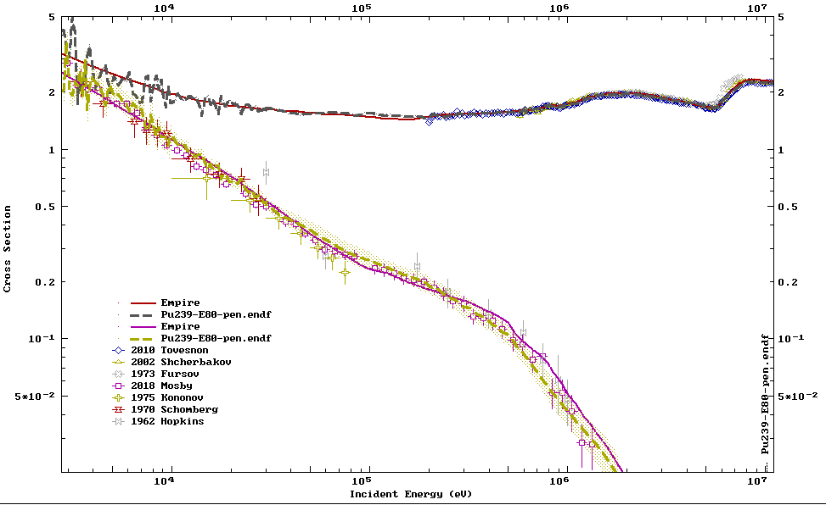
(n,γ) and (n,f) selected exper. data vs EMPIRE (p27) and ENDF/B-VIII.0
²³⁹Pu(n,f)
²³⁹Pu(n,γ)

