Slide 1
Thermal Scattering Law Data for ZrH
Andrej Trkov, Ingrid Švajger
CSEWG Meeting, BNL
15-19 November 2021

Slide 2
IAEA Code Verification Project for processing evaluated nuclear data into ACE format
Stage-1: Processing cross sections, differential and double-differential data (9 codes participated, done)
Stage-2: Preparation of probability tables / multi-band parameters (done)
Stage-3: Processing of thermal scattering law data (7 codes participated https://www-nds.iaea.org/index-meeting-crp/TM-NDP-2021/ )

Slide 3
Stage-3: Thermal scattering law
Preference was given to TSL processing for Stage-3 so that thermal systems could be analyzed
Test case: H in ZrH from the ENDF/B-VIII.0 library
Selected benchmarks from the ICSBEP Handbook containing ZrH (15 cases)
Note that two formats exist for TSL-ACE designated by IFENG=1 or IFENG=2 flag
The latter (continuous energy) is favoured.

Slide 4
List of benchmarks involving H in ZrH
No. ICSBEP Label Short name Common name Comment
-----------------------------------------------------------------------------
1 HEU-COMP-MIXED-003 hcm003-001 Narcis-M-1 ZrH moderator, H/Zr=1.92
2 HEU-COMP-MIXED-003 hcm003-002 Narcis-M-2 * ZrH moderator, H/Zr=1.92
3 HEU-COMP-MIXED-003 hcm003-003 Narcis-M-3 * ZrH moderator, H/Zr=1.92
4 HEU-COMP-MIXED-003 hcm003-004 Narcis-M-4 * ZrH moderator, H/Zr=1.92
5 HEU-COMP-MIXED-003 hcm003-005 Narcis-M-5 * ZrH moderator, H/Zr=1.92
6 HEU-COMP-MIXED-003 hcm003-006 Narcis-M-6 * ZrH moderator, H/Zr=1.92
7 HEU-COMP-THERM-007 hct007-004 RRCt-1(cyl) U-Cu/ZrH fuel, SS_clad
8 HEU-COMP-THERM-007 hct007-005 RRCt-2(cyl) U-Cu/ZrH fuel, SS_clad
9 HEU-COMP-THERM-007 hct007-006 RRCt-3(cyl) U-Cu/ZrH fuel, SS_clad
10 IEU-COMP-THERM-003 ict003-001 TRIGA_JSI SS_clad H(ZrH) H/Zr=1.6
11 IEU-COMP-THERM-003 ict003-002 TRIGA_JSI SS_clad H(ZrH) H/Zr=1.6
12 IEU-COMP-THERM-013 ict013-001 NRAD_TRIGA_56 ZrH Er U(20) H/Zr=1.58
13 IEU-COMP-THERM-013 ict013-002 NRAD_TRIGA_60 ZrH Er U(20) H/Zr=1.58
14 IEU-COMP-THERM-013 ict013-003 NRAD_TRIGA_62 ZrH Er U(20) H/Zr=1.58
15 IEU-COMP-THERM-013 ict013-004 NRAD_TRIGA_64 ZrH Er U(20) H/Zr=1.58
-----------------------------------------------------------------------------
(*) Input models provided by Yongqiang Tang, Xi’an Jiaotong University (XJTU)

Slide 5
Participating codes
Code N_{c} N_{e} E_{t} [eV] Lab. Author .
NJOY16 (SAB2) 20 98 1.855 LANL J. Conlin ENDF80SaB2 library ENDF/B-VIII.0 .
NJOY16 (SAB) 20 98 1.855 LANL J. Conlin ENDF80SaB library ENDF/B-VIII.0 .
NJOY16_IRSN 14 98 1.855 IRSN N. Leclaire (IFENG=1)
NJOY16_TSL 14 109 4.90 UPM O. Cabellos (IFENG=1)
NJOY16_Kahler 20 117 9.85 - A.C. Kahler
ACEMAKER/PREPRO 64 196 4.0 IAEA D. Lopez Aldama
32 89 4.0
NECP-ATLAS 20 116 9.15 XJTU Tiejun Zu
FUDGE 18 20 5.0 LLNL B. Beck, C. Matoon
FRENDY 60 498 10.0 JAEA K. Tada
58 498 10.0 (IFENG=1)
GRUCON (2a) 64 193 4.0 NRC KI V. Sinitsa
(2f) 64 107 4.0 Fixed energy grid as in NJOY
62 107 4.0 (IFENG=1)
FLASSH - - - NCSU A. Hawari (to be delivered)

Slide 6
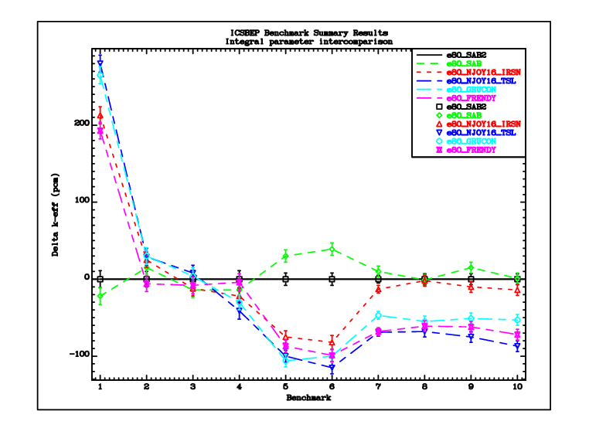
ACE-TSL formatting option IFENG=1
Ref.: SAB2 (IFENG=2)
Cases 2-6 from the list on slide-4 not included

Slide 7
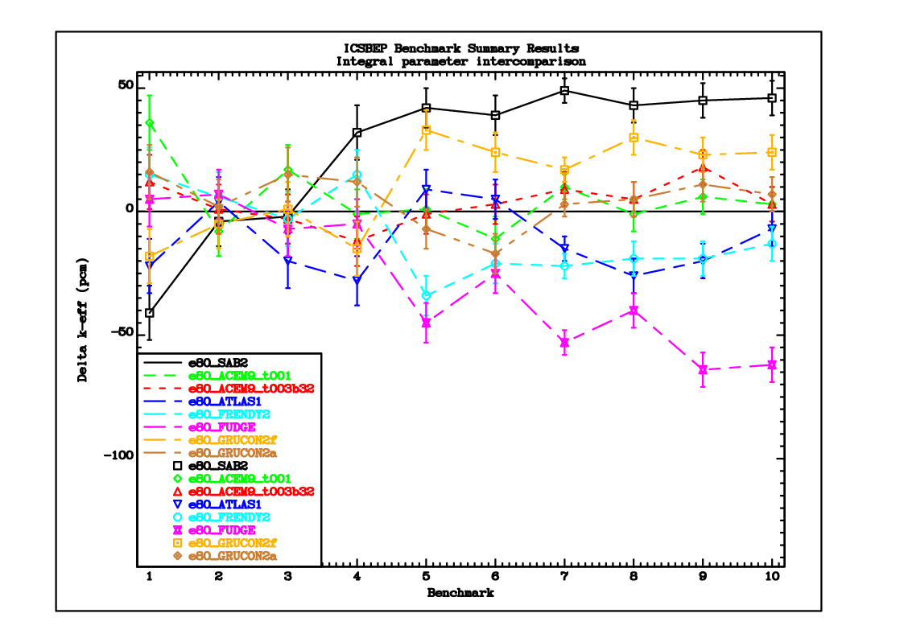
ACE-TSL formatting option IFENG=2
Cases 2-6 from the list on slide-4 not included

Slide 8
New TSL evaluations for ZrH
Work is in progress by Ingrid Švajger from JSI (in collaboration with NCSU) on ZrH TSL data from first principles
Preliminary file for H in ZrH₂ is available
Work on ZrH was published by Tiejun Zu et al. from Xi’an Jiaotong University (XJTU) (ANE 161 (2021) 108489)
Files for H in ZrH₂ and H in ZrH_{1.5} were provided for testing
Input models for HCM003 were provided (ICSBEP Handbook only gives Case-1)

Slide 9
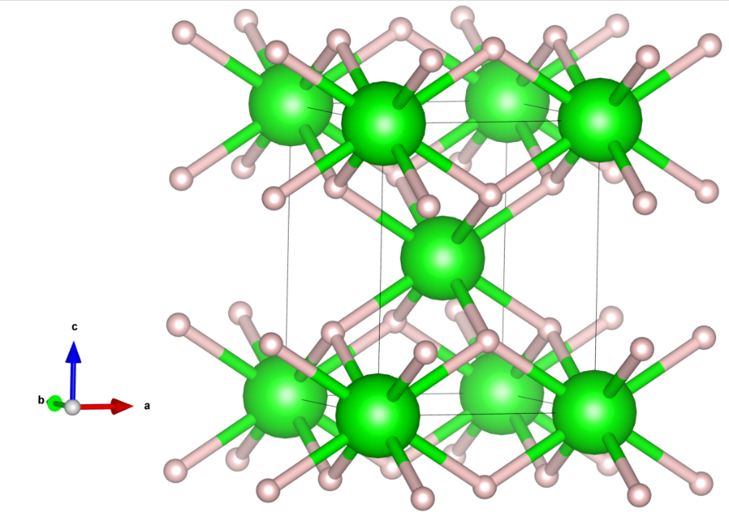
Atomic Structure – ZrH₂
Tetragonal crystalline structure
Zr at (0, 0, 0)
H at (0, ½, ¼ )
H
Zr
Cell dimensions | Present work | Experiment
a [Å] | 3.540 | 3.522
c [Å] | 4.408 | 4.451

Slide 10
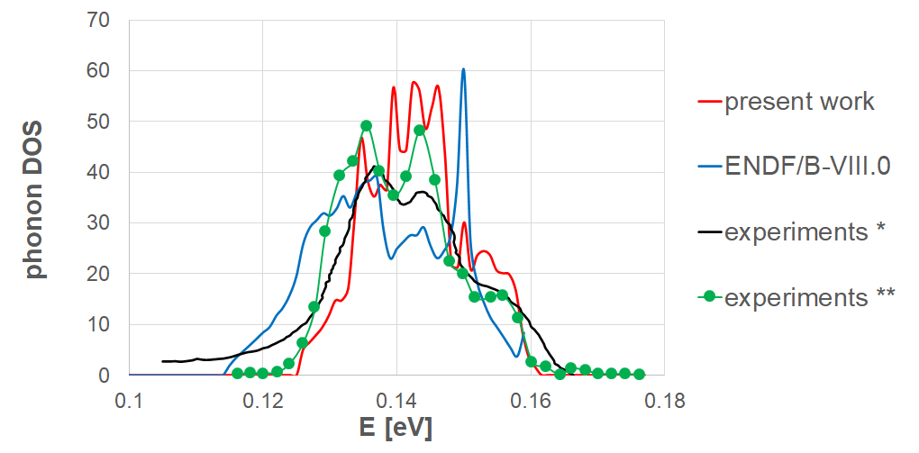
Phonon density of states – ZrH₂
* Weaver J H, Peterman D J, Peterson D T and Franciosi A 1981 Phys. Rev. B 23 1692.
** Evans, A., Timms, D., Mayers, J., Bennington, S., 1996. Neutron-scattering study of the impulse approximation in ZrH2. Phys. Rev. B - Condens. Matter Mater. Phys. 53, 3023–3031.

Slide 11
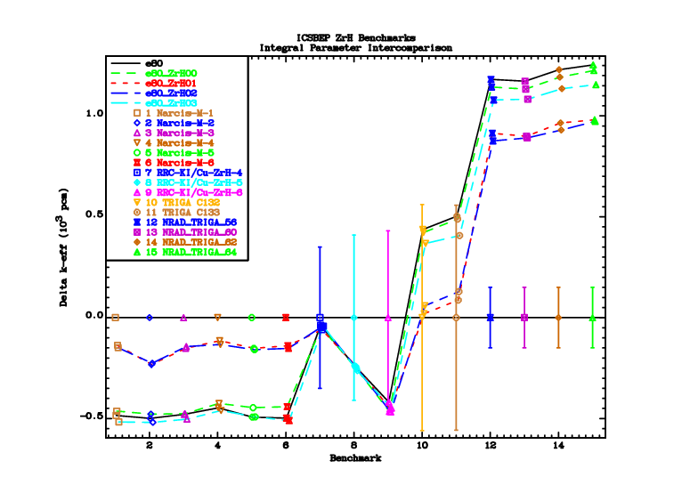
SAB2 from LANL
ENDF/B-VIII.0 processed locally
H in ZrH2 from JSI
H in ZrH2 from XJTU
H in ZrH1.5 from XJTU

Slide 12
Observations
IAEA Project on data processing for ACE libraries provides guidelines for accurate processing and particularly for the use of the continuous energy (IFENG=2) format option
Local processing of H in ZrH with NJOY agrees reasonably with the results using the official SAB2 library from LANL
New evaluations for the TSL of ZrH are available and are being tested on a selection of ICSBEP benchmarks
HCM003 benchmarks (Narcis-M) have H/Zr ratio of 1.92 – calculations with TSL for H in ZrH2 from JSI and XJTU agree with each other and with the measured values
TSL for H in ZrH1.5 from XJTU gives results very close to the original LANL SAB2 data from the ENDF/B-VIII.0 library
ICT013 benchmarks (NRAD TRIGA containing Er) remain strongly discrepant with all TSL data.

