Slide 1

Evaluation of thermal neutron scattering laws of the δ-phase yttrium hydride ($YH_{1.31}$ to $YH_{2}$)
Vedant Mehta
Sven Vogel
Michael Cooper
Nov. 2021
LA-UR-21-31508

Slide 2
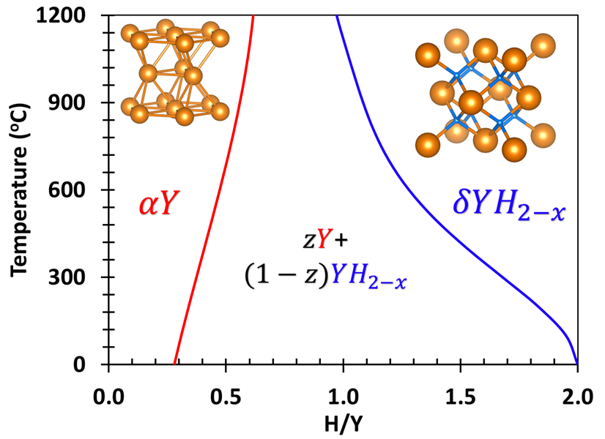
Y-H phase diagram
Motivation - Microreactors
Reactor operating regime
Current ENDF/B-VIII.0
YH₂

Slide 3
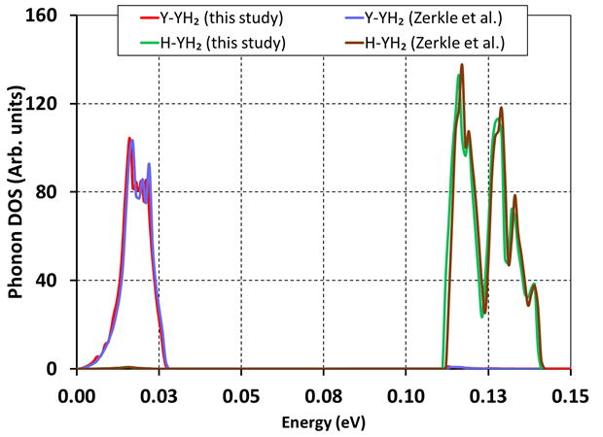
YH₂ Phonon Density of States
Benchmark calculations
Excellent agreement with Zerkle et al. phonons
Large mass difference causes large frequency gap
Hydrogen predominantly vibrating in optical range
Yttrium predominantly vibrating in acoustic range
Refs. 1. Zerkle, Michael, and Jesse Holmes. "A thermal neutron scattering law for yttrium hydride." EPJ Web of Conferences. Vol. 146. EDP Sciences, 2017. 2. Brown, David A., et al. "ENDF/B-VIII. 0: the 8th major release of the nuclear reaction data library with CIELO-project cross sections, new standards and thermal scattering data." Nuclear Data Sheets 148 (2018): 1-142.

Slide 4
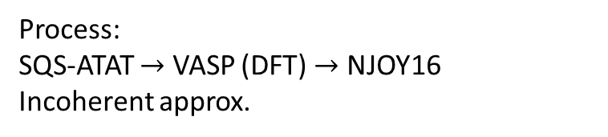
Benchmark with ENDF/B-VIII.0
Process:
SQS-ATAT $→$ VASP (DFT) $→$ NJOY16
Incoherent approx.
Refs.:
1. Zerkle, Michael, and Jesse Holmes. "A thermal neutron scattering law for yttrium hydride." EPJ Web of Conferences. Vol. 146. EDP Sciences, 2017.
2. Brown, David A., et al. "ENDF/B-VIII. 0: the 8th major release of the nuclear reaction data library with CIELO-project cross sections, new standards and thermal scattering data." Nuclear Data Sheets 148 (2018): 1-142.

Slide 5
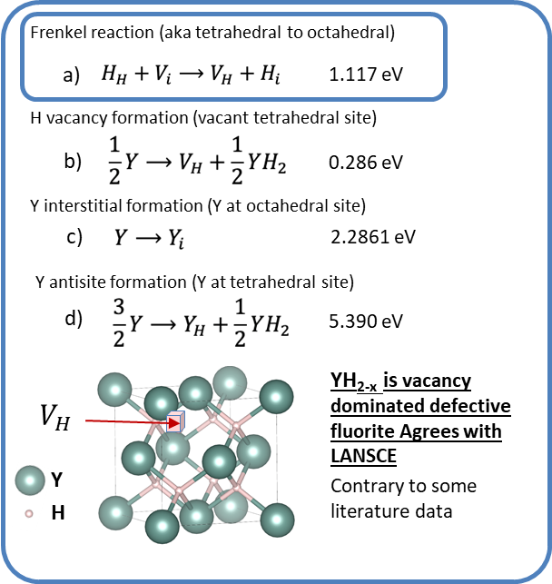
Point defects in YH₂ – first step to YH_{2-x}
Firstly, the positive energy to form a Frenkel defect (a) in YH₂ confirms H is stable at the tetrahedral site and unstable at the octahedral site – YH₂ is fluorite
Small deviations from YH₂ to YH_{2-x} are studied through three possible mechanisms under Y-rich conditions by which YH₂ can become YH_{2-x}: b) hydrogen vacancy, c) antisite, and d) Yttrium interstitial
The hydrogen vacancy at the tetrahedral site is dominant in YH_{2-x} – this will be used as basis for bigger deviations in H/Y
The small positive formation energy indicates Y metal + YH₂ at low temperatures in line with the phase diagram

Slide 6
Thermal Scattering Laws
The phonon spectrum for the defective supercells for YH_{1.31-1.91} has been used to evaluate neutron thermal scattering laws (TSLs) for use in MCNP
  TSLs provide the interaction probability of an incident neutron with target nucleus at thermal energies
  TSLs differ from free gas XS as they rely on the molecular structure of the compound
For significant sub-stoichiometries, the molecular structure, and thus TSLs, differ
Due to predominance of hydrogen, incoherent approximation was used.

Slide 7
Phonons at sub-stoichiometry
Special Quasi-random Structures provided 5 crystal structures for individual stoichiometry
Energy minimization provided the lowest energy structure
Phonons calculated for the lowest energy structure
Phonon calculations applied to a wide range of compositions of YH_{2-x}
Removal of H causes phonon splitting in the phonon dispersion curves

Slide 8
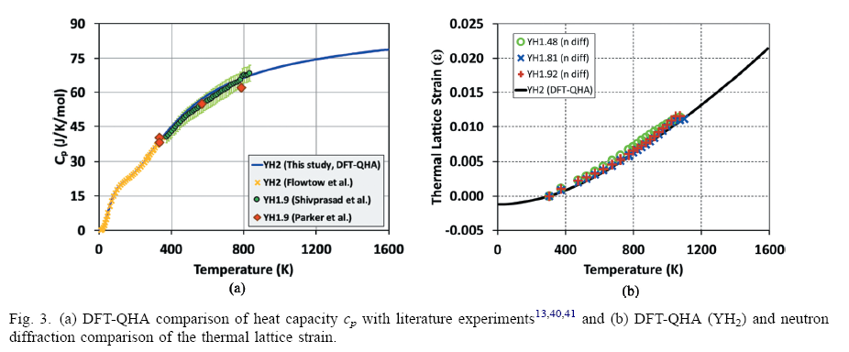
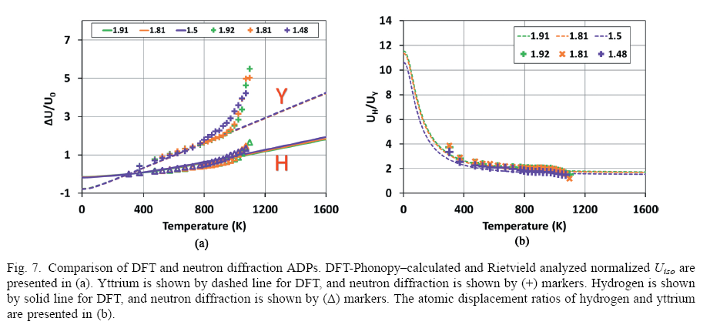
Crystal structure and phonons benchmarked at several stages
Benchmark against literature data and neutron diffraction data
Cp and thermal lattice strain comparison with experiments.
Atomic displacement parameter comparison

Slide 9
Thermal Scattering Laws
New Evaluations
Novel TSLs for significant sub-stoichiometries were developed and are planned to be released in the next ENDF evaluation
Phonon DOS were used to generate the TSLs between stoichiometries YH_{1.31} to YH₂
Deviations up to ~60% at most probable energies observed in the new TSLs

Slide 10
New Evaluations published in NSE
Mehta, Vedant K., et al. "Evaluation of Yttrium Hydride (δ-YH_{2-x}) Thermal Neutron Scattering Laws and Thermophysical Properties." Nuclear Science and Engineering 195.6 (2021): 563-577.
DOI: https://doi.org/10.1080/00295639.2020.1851632
Future work: Inclusion of coherence for Y in YH_{2-x} using NJOY-Ncrystal
  Ref: Ramic, Kemal, et al. "NJOY+ NCrystal: an open-source tool for creating thermal neutron scattering libraries." arXiv preprint arXiv:2108.11737 (2021).
Thank you! Questions?

