Slide 1



Update on short-lived and cumulative fission product yields from the NPML Collaboration
J.T. Harke, B. Bandong LLNL
T.A. Bredeweg LANL
B. Pierson, J.Friese PNNL
November 2021
Notes:
5 minutes!

Slide 2
Multi-Lab multi-disciplinary collaboration
LLNL
J.T. Harke
B. Bandong
S. Burcher
S. W. Padgett
J. Goodell
J. Church
P. Zhao
N. Gharibyan
N. Harward
R.A. Henderson
K. Roberts
P. Yap-chiongco
G. Slavik
LANL
T. Bredeweg
S. Hanson
I. May
J. Goda
D. Hayes
J. Hutchinson
J. Walker
PNNL
J. Friese
B. Pierson
L. Greenwood
S. Stave
A.M. Prinke
L.A. Metz
S. Herman
N. Uhnak
M. Haney
Oregon State University
A.S. Tamashiro
C. Palmer
T. Palmer
S. Reese
S. Menn
L. Minc

Slide 3
Introduction
Motivation:
There have been few short-lived fission product yield studies since the publication of the England and Rider report in 1993 (28 years). The yields in the England and Rider report are a collection of results from experiments occurring from the 1950s through to the early 1990s.
Integral cross-section measurements in unperturbed fast fission neutron fields are rare but crucial data for a range of applied fields (criticality safety, reactor operations, etc…)
Approach:
Project is conducting the first set of self consistent irradiations of major actinides in nearly 30 years using:
Long irradiations with fission chambers for an absolute fission basis estimate of yields
Long irradiations of high purity mixed foil sets for cross-section measurements
Prompt (< 60 μs) fission neutron bursts for relative fission yield measurements
High quality nuclear data essential to data evaluation and modeling;
Improve nuclear data libraries
Provide valuable nuclear data references for the nuclear science community

Slide 4
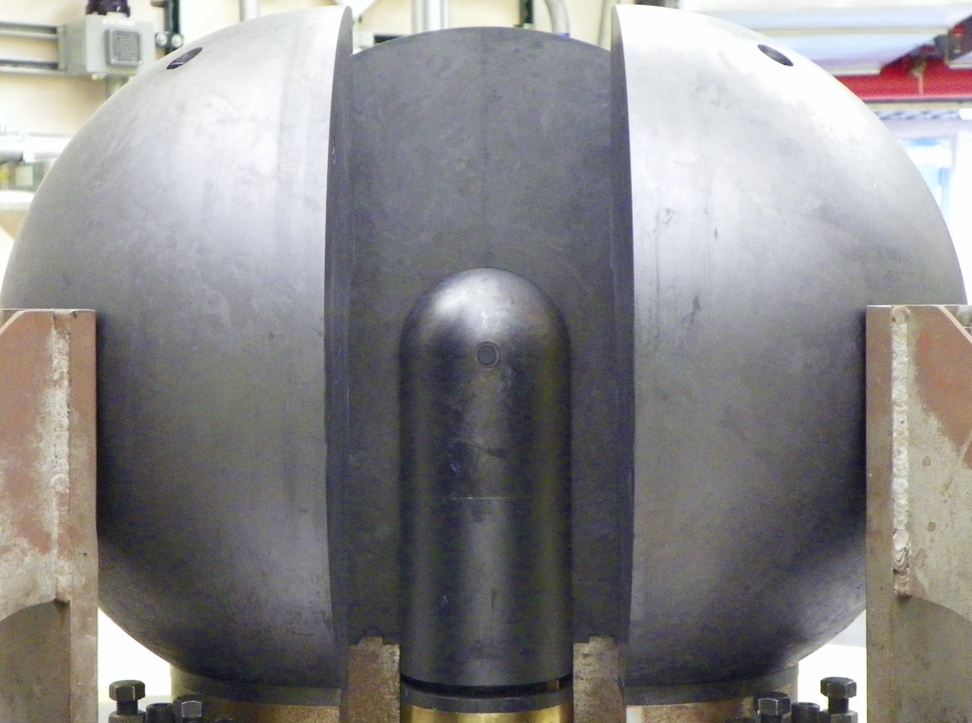
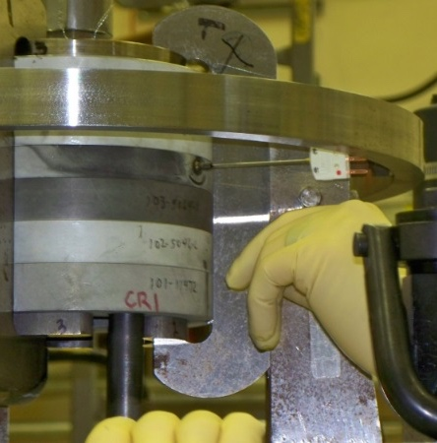


Neutron Sources
Operations conducted at the NCERC include both subcritical and critical experiments with the ability to measure a wide variety of nuclear properties.
Flattop (NCERC)
Fast/fission Spectrum
Horizontal (“traverse”) glory hole
10¹³ fissions/g on samples
Godiva IV (NCERC)
Fast/fission neutron spectrum
Super-Prompt Critical Operations
Vertical glory hole for samples
1-4 $×$ 10¹⁶ Total Fissions / burst
D-T Generator (PNNL)
Thermo D711 neutron generator
Low scatter facility at PNNL
Max neutron flux of $1×{10}^{9}$ n/cm²/s
New D-T source at LLNL Jan-2022
Cumulative FPY Task
Days to weeks post irradiation
Short-Lived FPY Task
Hours to days post irradiation
Cumulative FPY Task
Days to weeks post irradiation

Slide 5
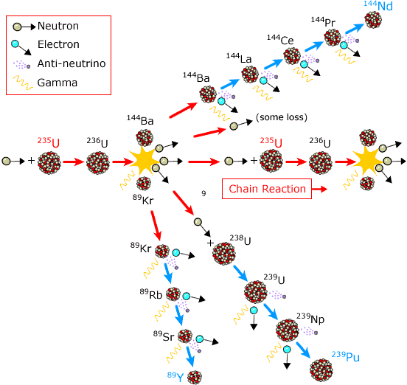
Time scales of isotopes we can investigate
Fission product isotopes cover a wide range of time scales from microsecond to day++ half-lives.
We can currently make measurements:
At the 10s of minutes time scales by whole gamma counting
Hours/days by performing radiochemistry and beta/gamma counting
17.3 m
285 d
40.8 s
11.5 s
3.15 m
23.4 m
2.36 d
15.2 m
2.4E4 y
50.5 d

Slide 6
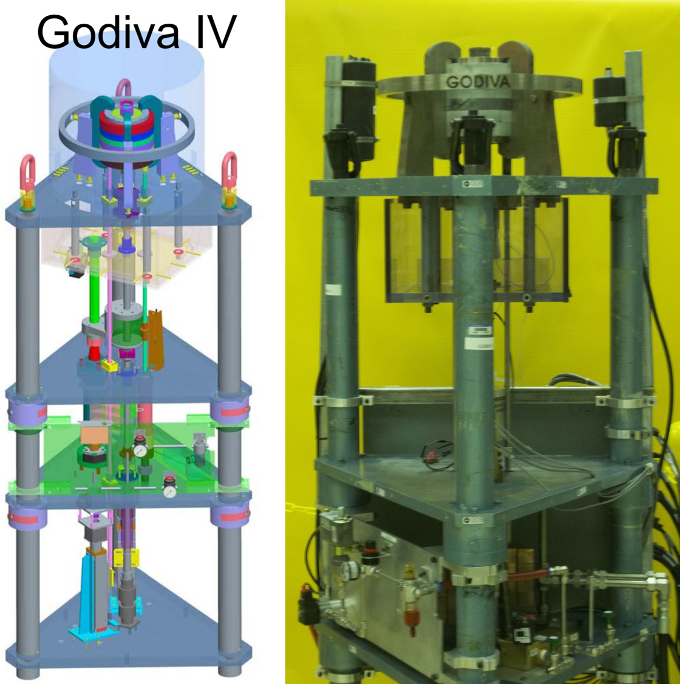
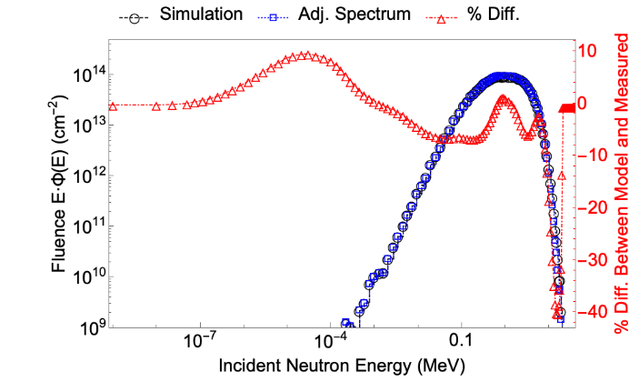
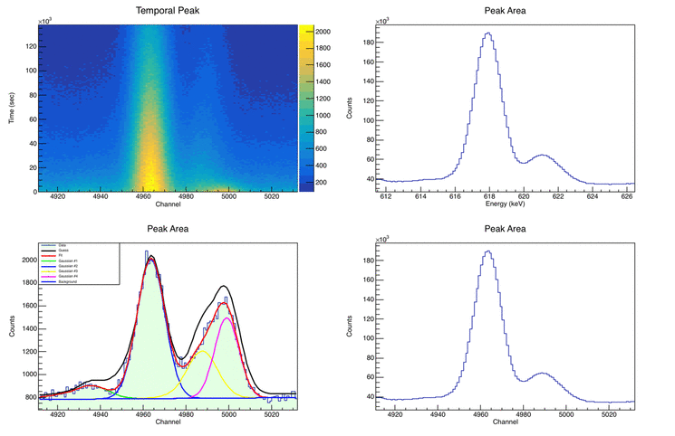
Short-Lived Fission Product Yields (SLFPY)
Fabricate High Quality Targets
Pulse Irradiate at NCERC
Acquire 𝛾 spectral data
Publish Fission Yields in Nuclear Data Sheets for NNDC
Symmetric Temporal Spectral Analysis (LLNL)
Asymmetric Temporal Spectral Analysis (PNNL)
Evaluate Neutron Fluence & Fissions
Godiva Neutron Fluence-energy Distribution & Covariance Matrix
Photo & Model of Godiva
Nuclear Data Sheets 155, 86 (2019).
Nuclear Data Sheets 163, 249 (2020).
Godiva Irradiation Pulse Width
Temporal Assay of ¹³⁴I

Slide 7
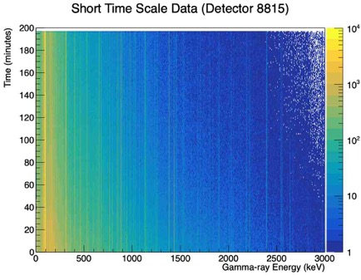
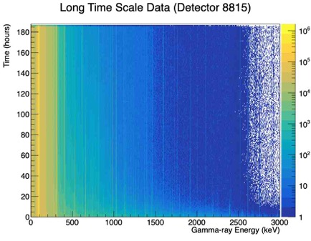

Np237 Data Time Dependent Spectra Example
Currently, we can retrieve the sample from Godiva ~30-40 minutes after the burst mode operation. Then begin measuring gamma-ray spectra at about 1 hour.
Fit a peak in each in time bin and plot the intensity versus time (decay curve)
  Use half-life and $γ$-ray energy to identify isotope
Use decay curve to extract the activity of the isotope immediately after irradiation
Courtesy Sean Burcher

Slide 8
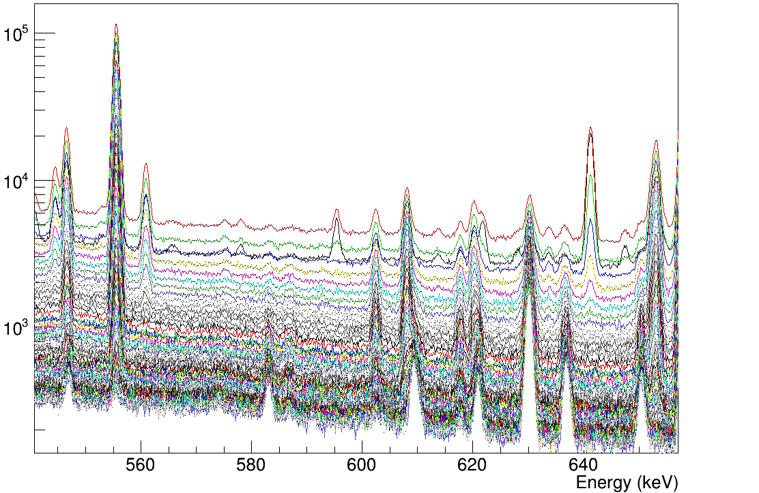
Technical Approach: identifying gamma rays
Time dependent gamma ray spectra from 45 minutes to 7 days post-irradiation
Persistent line
Short half-life
Grow-In daughter product
List mode data taken with high resolution HPGe detectors to perform the gamma-ray spectroscopy is essential to unfolding the very complex spectra obtained from fission products.
Counts per hour
8
8

Slide 9
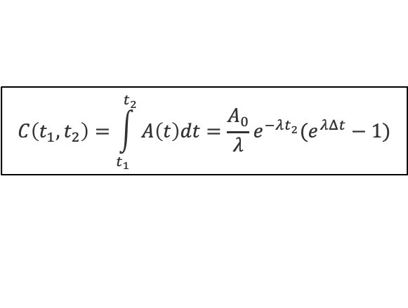
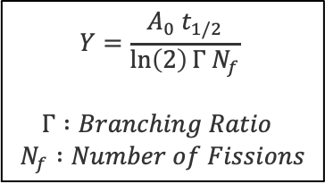




Np237 Results : Example ⁹³Y
$$Y=\frac{A_{0} t_{1/2}}{\ln\left(2\right)Γ N_{f}}$$
$$Γ :Branching Ratio$$
$$N_{f} :Number of Fissions$$
Observed 3 ‘clean’ $γ$-rays from the decay of ⁹³Y
Extrapolate Decay Curve fits back to irradiation time : $A_{0}$
  Correct for DAQ livetime, detection efficiency, and self-attenuation
$$C\left(t_{1},t_{2}\right)=\int_{t_{1}}^{t_{2}}{A\left(t\right)dt}=\frac{A_{0}}{λ}e^{−λt_{2}}(e^{λΔt}−1)$$
$$E_{γ}=267 keV$$
$$E_{γ}=947 keV$$
$$E_{γ}=1918 keV$$
Courtesy Sean Burcher

Slide 10

Results for ²³⁷Np FPYs
Fission Product yields for 45 unique isotopes/isomers have been measured
  Using 191 different $γ$-rays
  Isomer Yields
Half-lives ranging from 10s of minutes to a few days.
Use multiple $γ$-rays from each decay if possible
  Reduces sensitivity to systematic uncertainties introduced by potentially imprecise nuclear data

Slide 11
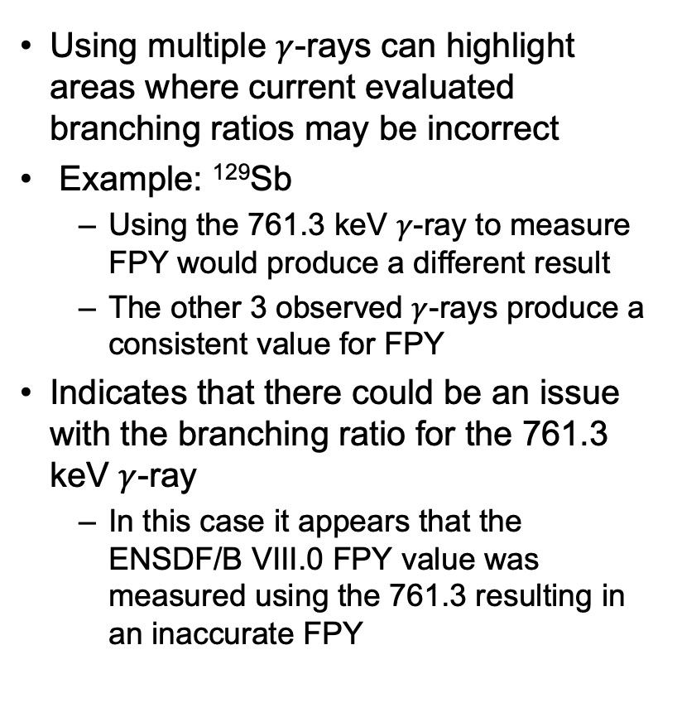
Results for ²³⁷Np FPYs : Investigating Nuclear Data
Using multiple $γ$-rays can highlight areas where current evaluated branching ratios may be incorrect
Example: ¹²⁹Sb
  Using the 761.3 keV $γ$-ray to measure FPY would produce a different result
  The other 3 observed $γ$-rays produce a consistent value for FPY
Indicates that there could be an issue with the branching ratio for the 761.3 keV $γ$-ray
  In this case it appears that the ENSDF/B VIII.0 FPY value was measured using the 761.3 resulting in an inaccurate FPY

Slide 12
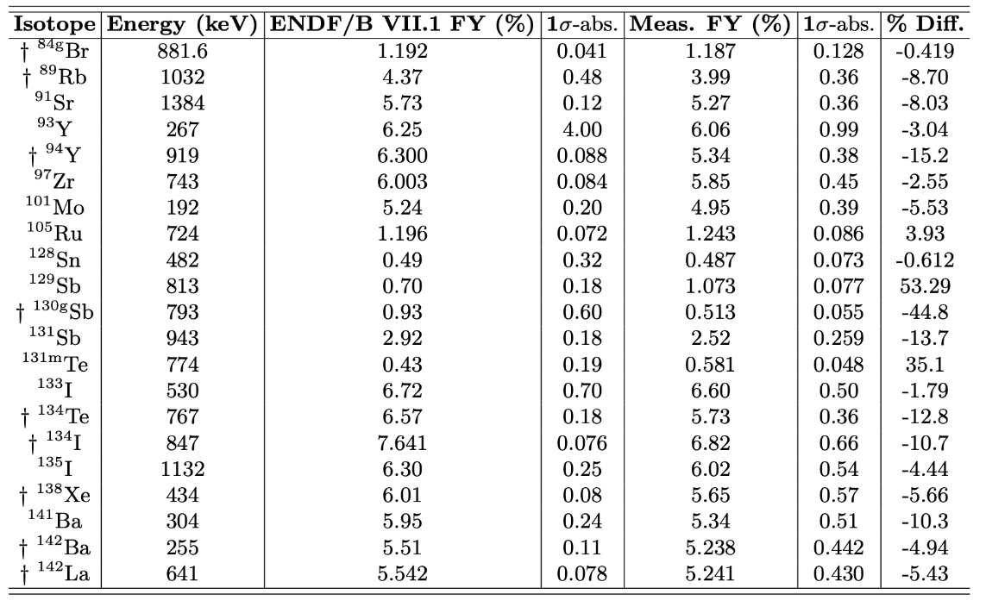
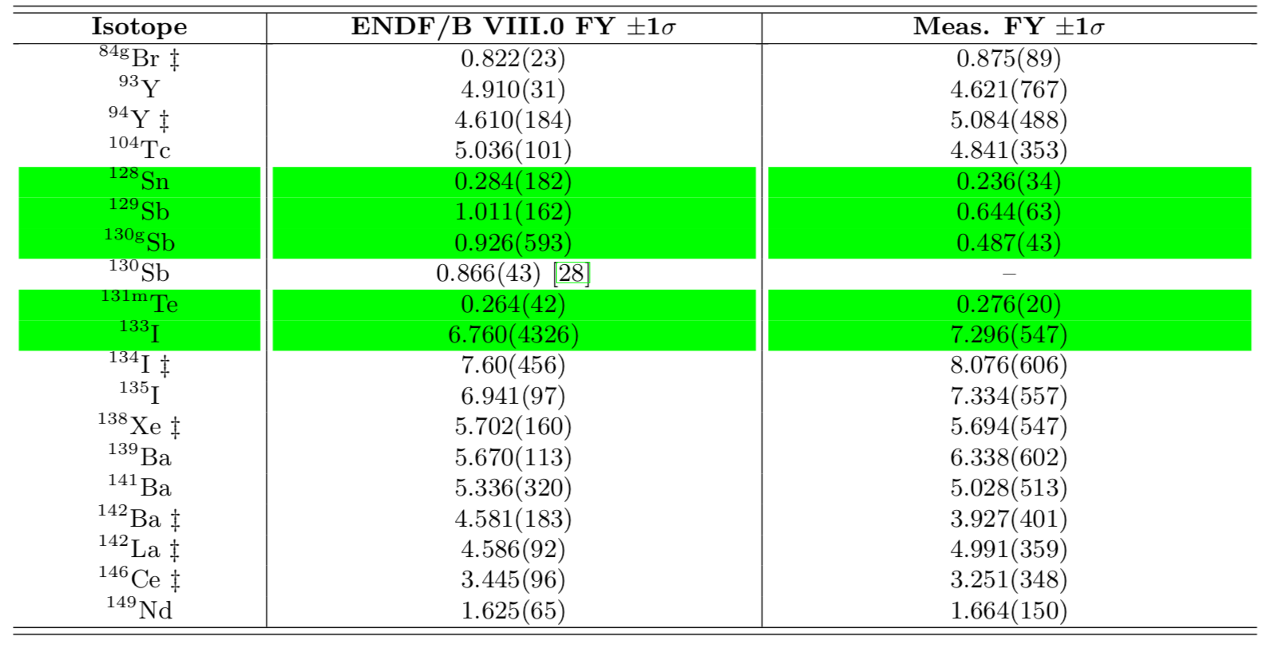
Past Results from ²³⁵U, ²³⁸U, ²³⁹Pu
Preliminary ²³⁹Pu FY
 | ENDF VII.0/B |  | Small Target |  |  | Large Target
Isotope | FY | ± | FY | ± | Ratio | FY | ± | Ratio
Kr-85m | 0.59 | 0.01 | 0.58 | 0.03 | 0.98 | 0.62 | 0.03 | 1.05
Rb-89 | 1.72 | 0.07 | 1.69 | 0.08 | 0.98
Y-93 | 3.82 | 2.45 | 3.58 | 0.29 | 0.94 | 3.36 | 0.25 | 0.88
Y-94 | 4.22 | 0.06 | 4.13 | 0.19 | 0.98
Mo-101 | 6.67 | 0.27 | 6.37 | 0.29 | 0.96
Ru-105 | 5.36 | 0.21 | 5.51 | 0.25 | 1.03 | 5.52 | 0.25 | 1.03
Rh-107 | 3.22 | 0.52 | 3.19 | 0.16 | 0.99
Sb-127 | 0.50 | 0.16 |  |  |  | 0.530 | 0.02 | 1.06
Sn-128 | 0.79 | 0.51 | 0.64 | 0.03 | 0.81 | 0.75 | 0.07 | 0.94
Sb-129 | 1.45 | 0.12 | 1.49 | 0.07 | 1.03 | 1.32 | 0.06 | 0.91
Sb-131 | 2.89 | 0.32 | 1.87 | 0.09 | 0.65
Te-131 | 3.11 | 0.50 | 4.72 | 0.74 | 1.52
Te-131m | 0.92 | 0.41 | 1.52 | 0.08 | 1.66 | 1.28 | 0.06 | 1.39
I-131 | 3.88 | 0.04 | 3.18 | 0.23 | 0.82 | 4.09 | 0.19 | 1.06
Te-132 | 5.15 | 0.10 | 5.49 | 0.25 | 1.07
I-133 | 6.91 | 4.42 | 6.28 | 0.30 | 0.91 | 6.83 | 0.32 | 0.99
Te-134 | 4.79 | 0.29 | 3.60 | 0.16 | 0.75 | 3.46 | 0.23 | 0.72
I-135 | 6.08 | 0.24 | 5.84 | 0.26 | 0.96 | 5.92 | 0.27 | 0.97
Xe-138 | 4.71 | 0.09 | 4.36 | 0.22 | 0.93
Cs-139 | 5.37 | 0.43 | 4.36 | 1.06 | 0.81
Ba-139 | 5.61 | 0.11 | 5.88 | 0.39 | 1.05 | 6.44 | 0.55 | 1.15
Ba-140 | 5.32 | 0.07 | 5.66 | 0.70 | 1.06 | 5.02 | 0.23 | 0.94
Ba-141 | 5.08 | 0.30 | 4.90 | 0.22 | 0.97
Ce-141 | 5.15 | 0.14 |  |  |  | 4.57 | 0.21 | 0.89
Ba-142 | 4.48 | 0.49 | 3.82 | 0.21 | 0.85
La-142 | 4.75 | 0.07 | 5.17 | 0.23 | 1.09 | 5.12 | 0.23 | 1.08
Ce-143 | 4.34 | 0.02 | 3.59 | 0.17 | 0.83 | 4.09 | 0.18 | 0.94
Ce-146 | 2.42 | 0.10 | 1.81 | 0.11 | 0.75
Nd-147 | 1.99 | 0.03 |  |  |  | 1.77 | 0.09 | 0.89
Pr-147 | 1.99 | 0.06 | 2.01 | 0.14 | 1.01
Nd-149 | 1.24 | 0.02 | 1.23 | 0.06 | 0.99 | 1.18 | 0.06 | 0.95
Pm-151 | 0.78 | 0.01 |  |  |  | 0.73 | 0.05 | 0.93
Sm-153 | 0.43 | 0.03 |  |  |  | 0.43 | 0.02 | 1.01
²³⁵U FY
²³⁸U FY
Highlighted in GREEN are improved measurements

Slide 13
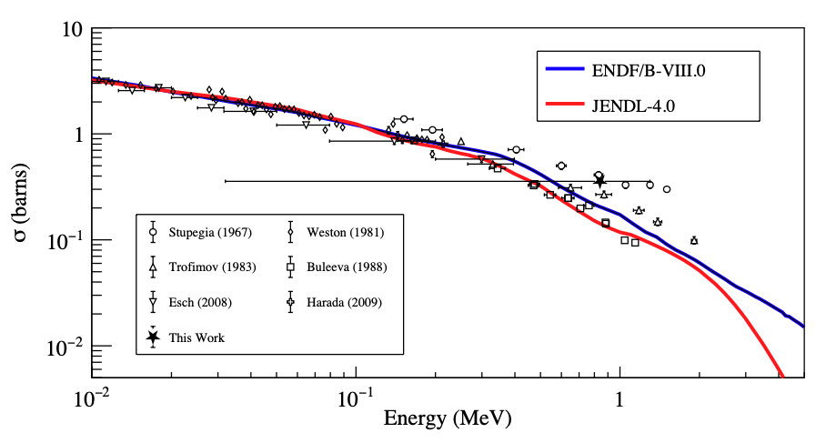
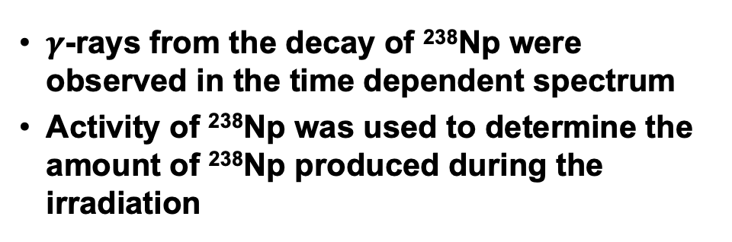
Integral Measurement ²³⁷Np(n,$γ$)²³⁸Np Cross Section
$γ$-rays from the decay of ²³⁸Np were observed in the time dependent spectrum
Activity of ²³⁸Np was used to determine the amount of ²³⁸Np produced during the irradiation

Slide 14
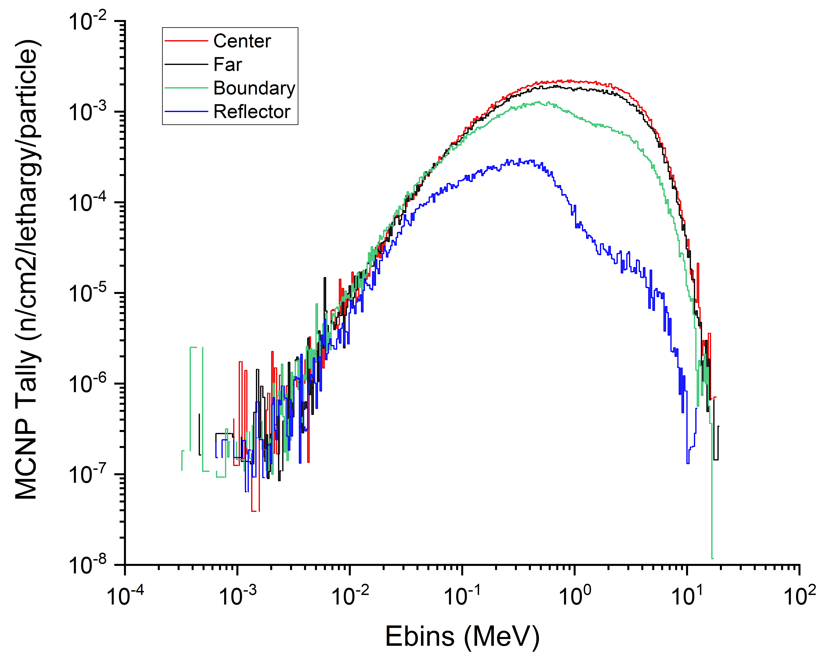
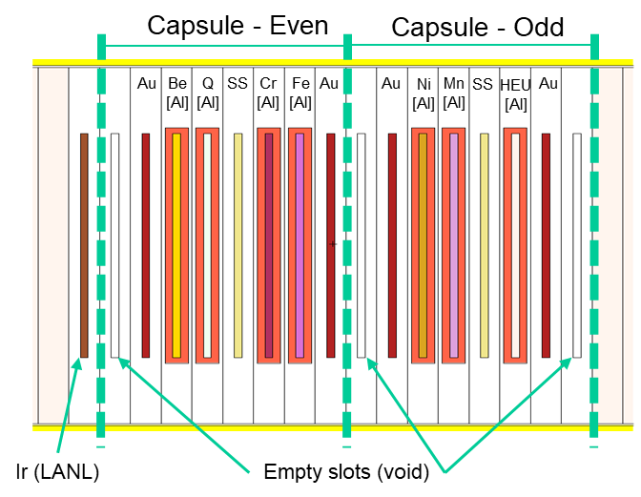
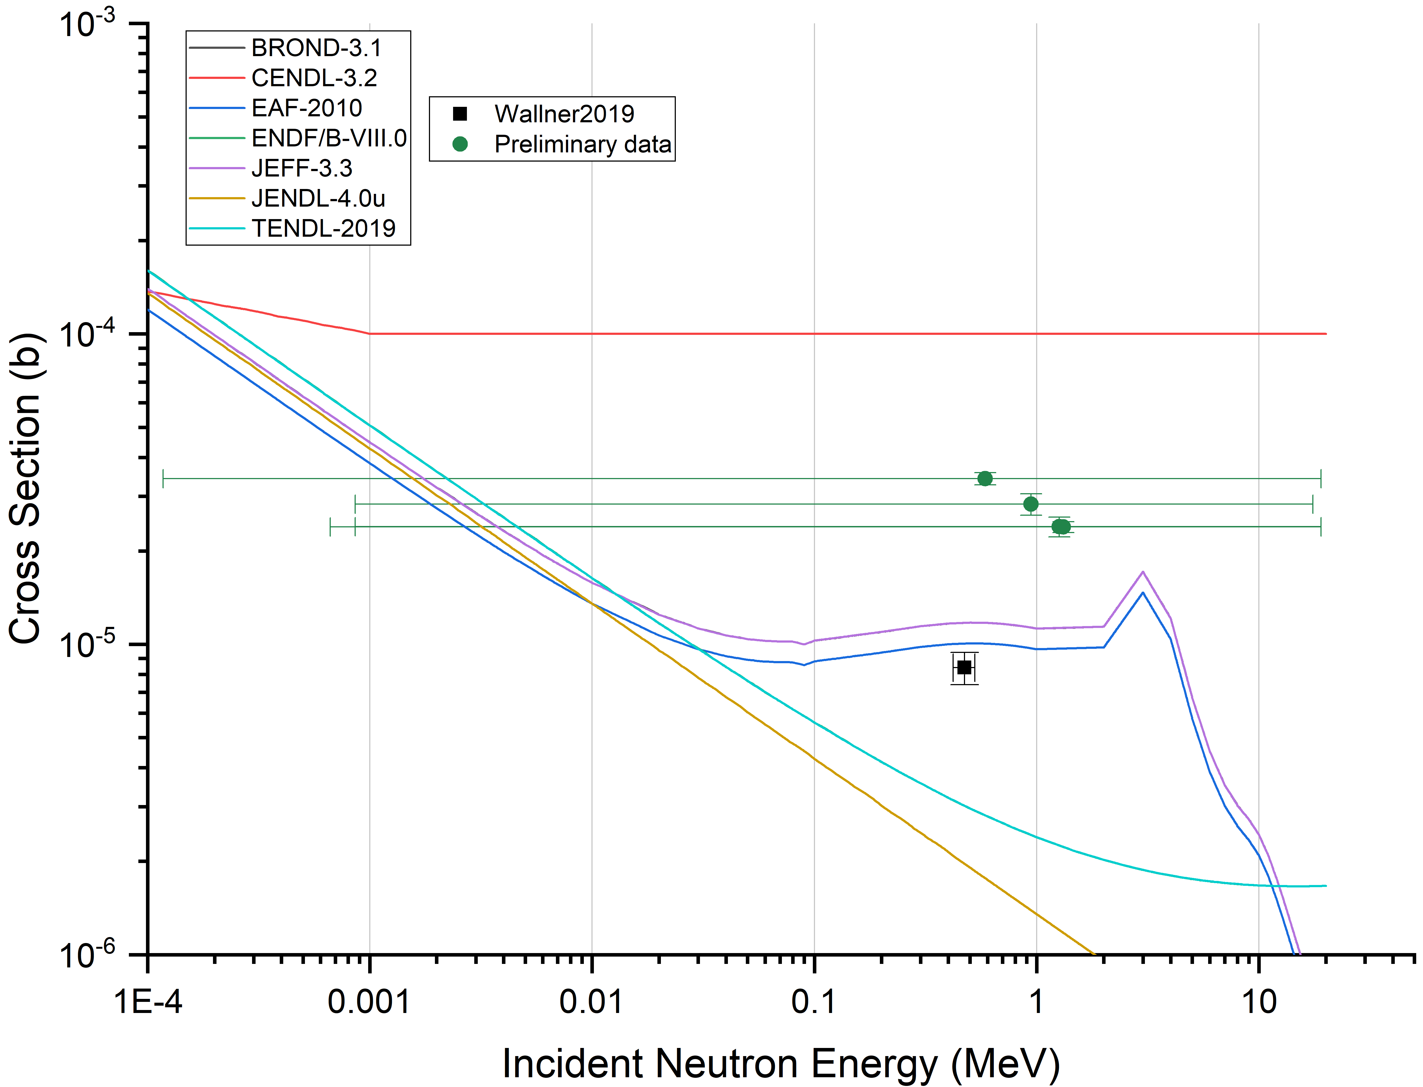
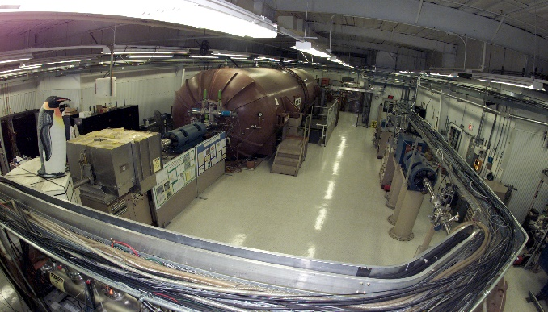

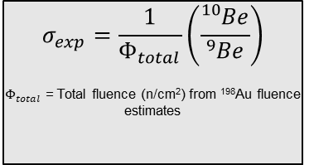
NCERC Flattop assembly irradiation and modeling to evaluate the ⁹Be(n,γ)¹⁰Be cross section at fission energies
Courtesy of Jack Goodell, Jennifer Church and Bryan Bandong
High-fidelity model of the Flattop assembly and experimental configuration simulated using MCNP6.2
⁹Be(n,γ)¹⁰Be integral cross section determined by total neutron fluence and the ¹⁰Be/⁹Be ratio
Neutron fluence estimates determined by ¹⁹⁷Au(n,γ)¹⁹⁸Au analysis
¹⁰Be/⁹Be ratio measured by accelerator mass spectrometry
Preliminary ⁹Be(n,γ)¹⁰Be integral cross section results do not agree with current evaluated libraries
Simulated neutron fluence softens and decreases with distance from center of the assembly
MCNP Visualization of the Flattop Model
Foil Configuration
⁹Be(n,γ)¹⁰Be or ¹⁰Be production: JANIS-NEA/EXFOR
CENDL-3.2
100 µb
CAMS assay
BROND-3.1
JEFF-3.3
$$σ_{exp}=\frac{1}{Φ_{total}}\left(\frac{{}_{ }^{10}{Be}}{{}_{ }^{9}{Be}}\right)$$
$Φ_{total}$ = Total fluence (n/cm²) from ¹⁹⁸Au fluence estimates
EAF-2010
LLNL Center for Accelerator Mass Spectrometry (CAMS)
[1]
*X-error bars represent width of neutron distribution; symbol at average neutron energy
JENDL-4.0u
ENDF/B-VIII.0
TENDL-2019
1 µb
[1] Wallner et al. Phys Rev C 99, 015804 (20129)
*From Corey Keith - LANL

Slide 15
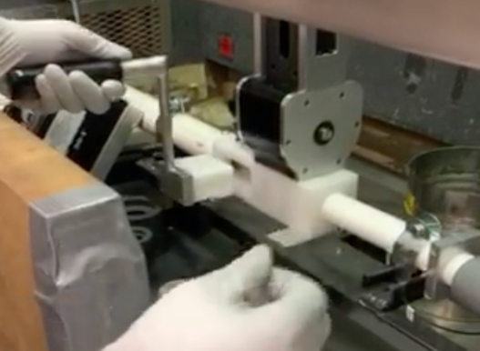
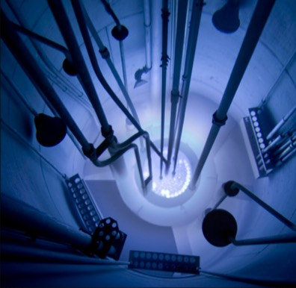
We are aiming to return to Oregon State University Jan-2022 to perform the short time scale U238 irradiations
Rabbit shuttle injection station
OSU TRIGA reactor pulsed

Slide 16
Reports with compendia of results for SLFPY
“Interim Report on Fission Product Yields from the Irradiation of Np237 using the Godiva Critical Assembly”, S. Burcher et al. Sept. 2020 LLNL-TR-1023214
“Report on Short-Lived Fission Product Yields from Pu239”, S. Padgett et al. LLNL-TR-799578 Dec 2019
“Interim Report on Short-Lived Fission Product Yields from U238”, J.T. Burke et al. LLNL-TR-738508 Sept 2017
“Interim Report on Short-Lived Fission Product Yields from U235”, J.T. Burke et al. LLNL-TR-704065 Sept 2016
“Improved Cumulative Fission Yield Measurements with Fission Spectrum Neutrons on ²³⁵U,” Nuclear Data Sheets, 155, 86–97, Jan. 2019, doi: 10.1016/j.nds.2019.01.005
“Improved Cumulative Fission Yield Measurements with Fission Spectrum Neutrons on 238U,” Nuclear Data Sheets, 163, 249–260, 2020, doi: 10.1016/j.nds.2019.12.006.

Slide 17
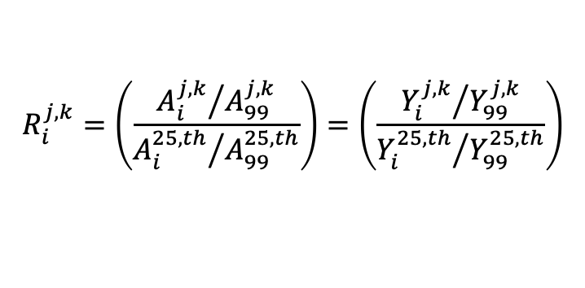
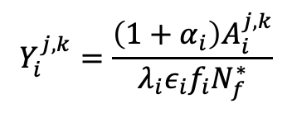
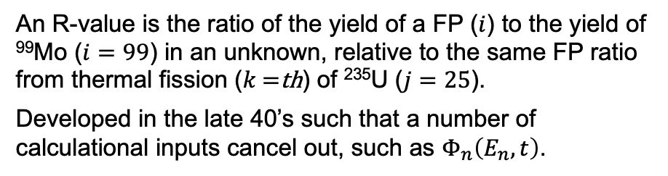
Cumulative Fissions Product Yields and the R-Value
An R-value is the ratio of the yield of a FP ($i$) to the yield of ⁹⁹Mo ($i=99$) in an unknown, relative to the same FP ratio from thermal fission ($k$ =th) of ²³⁵U ($j=25$).
Developed in the late 40’s such that a number of calculational inputs cancel out, such as $Φ_{n}\left(E_{n},t\right)$.
$$R_{i}^{j,k}=\left(\frac{{A_{i}^{j,k}}/{A_{99}^{j,k}}}{{A_{i}^{25,th}}/{A_{99}^{25,th}}}\right)=\left(\frac{{Y_{i}^{j,k}}/{Y_{99}^{j,k}}}{{Y_{i}^{25,th}}/{Y_{99}^{25,th}}}\right)$$
$$Y_{i}^{j,k}=\frac{\left(1+α_{i}\right)A_{i}^{j,k}}{λ_{i}{ε_{i}f_{i}N}_{f}^{∗}}$$
G.P. Ford and A.E. Norris, LA-6129 (1976)
H.D. Selby, et al., Nucl Data Sheets 111, 2891 (2010)
M.B. Chadwick, et al., Nucl Data Sheets 111, 2923 (2010)
J. Laurec, et al., Nucl Data Sheets 111, 2965 (2010)
Notes:
The fission product mass distribution is a function of the fissioning nucleus and the neutron energy causing fission

Slide 18
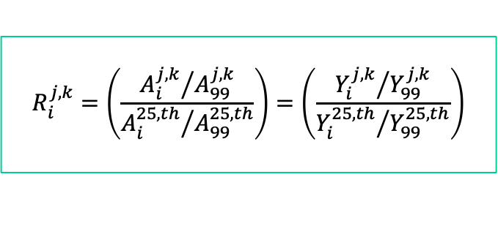
Execution
Target preparation
  Actinides for FPY measurements by:
    Direct counting
    Radiochemistry
  Stacked foils for integral cross-section measurements in- and ex-core
Irradiation at NCERC & Other (NNSS/DAF)
Sample assay @ NCERC
  LANL/LLNL counting facilities (HPGe coincidence)
Sample shipping (from NNSS/DAF to labs)
  Assay by gamma & beta
  Post assay of list-mode data
Outlier | ENDF/B | LANL | PNNL
¹¹¹Ag (β) | 1.76 | 2.76 | n/a
¹¹¹Ag (γ) | 1.76 | n/a | 3.30
¹³⁶Cs (β) | 0.69 | 2.22 | n/a
¹³⁶Cs (γ) | 0.69 | n/a | 2.47
¹⁵³Sm (β) | 1.08 | 1.28 | n/a
¹⁵³Sm (γ) | 1.08 | 0.95 | 1.20
$$R_{i}^{j,k}=\left(\frac{{A_{i}^{j,k}}/{A_{99}^{j,k}}}{{A_{i}^{25,th}}/{A_{99}^{25,th}}}\right)=\left(\frac{{Y_{i}^{j,k}}/{Y_{99}^{j,k}}}{{Y_{i}^{25,th}}/{Y_{99}^{25,th}}}\right)$$

Slide 19
Cumulative Fission Product Yield Sample Preparation
Sample preparation (can involve more than one lab)
  Select stock material and determine/verify chemical and isotopic composition
  Actinides, e.g. ²³³U, ²³⁵U, ²³⁸U, ²³⁷Np, ²³⁹Pu, in 100s of milligram quantities
  Geometric characterization of all target foils (mass and dimensions)
  Sample containment prior to shipping (containment of Pu samples is part of the NPML)
Sample shipping NCERC
  Current experimental activities involve multiple actinide (SNM) samples

Slide 20
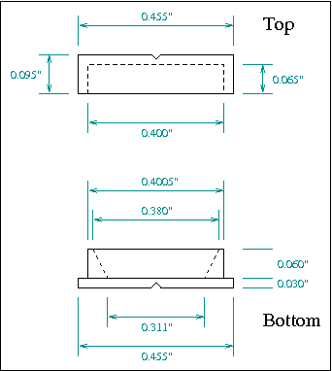
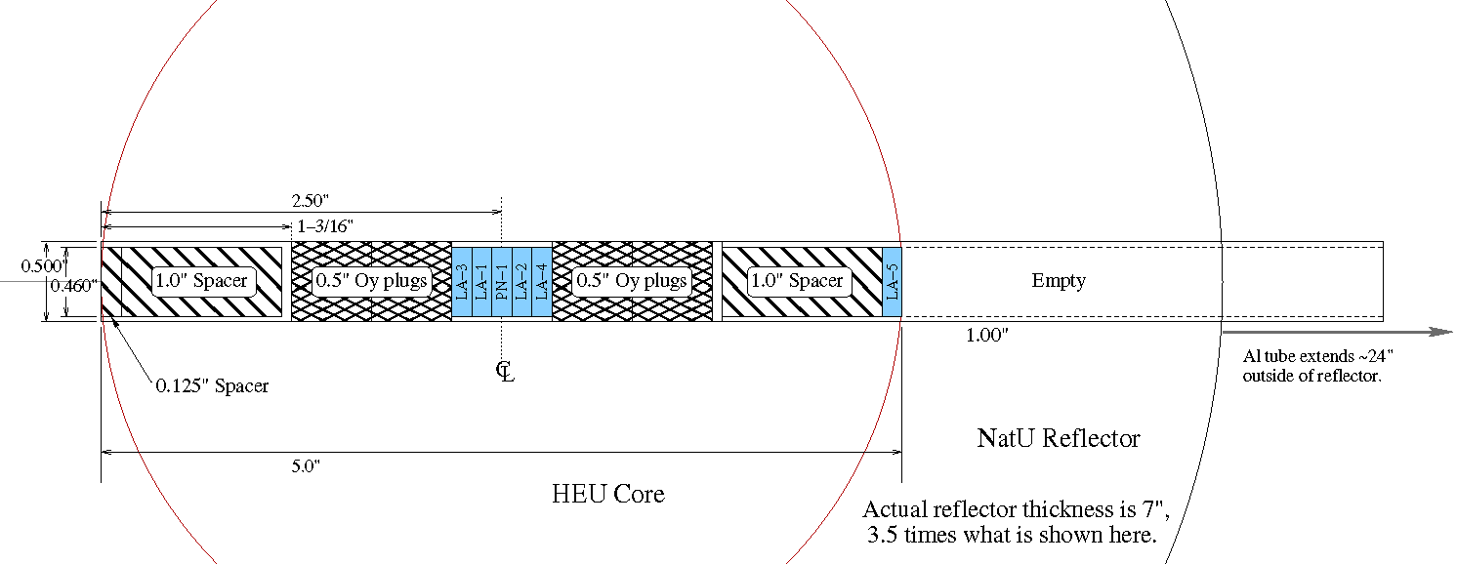
Cumulative Fission Product Yields:
Previous work
Experimentally determined R-values for ²³⁵U in the center position of Flattop compared to R-values calculated from ENDF/B-VII.1 fission product yields for 0.5 and 14 MeV incident neutrons.
The lower panel shows the absolute difference between the experimental values determined by β counting (black circles) and γ counting (red circles) and ENDF/B-VII.1.
Previous measurements on the Flattop assembly
²³⁵U, ²³⁸U, ²³³U, ²³⁷Np and ²³⁹Pu (no fission chambers)
²³⁵U, ²³⁷Np (prototype fission chambers)
Outlier | ENDF/B | LANL | PNNL
¹¹¹Ag (β) | 1.76 | 2.76 | n/a
¹¹¹Ag (γ) | 1.76 | n/a | 3.30
¹³⁶Cs (β) | 0.69 | 2.22 | n/a
¹³⁶Cs (γ) | 0.69 | n/a | 2.47
¹⁵³Sm (β) | 1.08 | 1.28 | n/a
¹⁵³Sm (γ) | 1.08 | 0.95 | 1.20

Slide 21
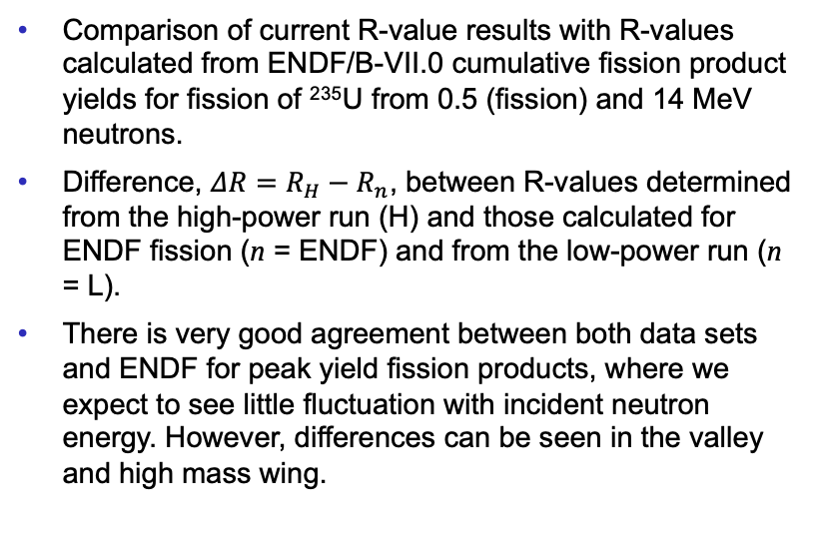
Results For Experiments #4253 and 4256 (HEU)
Comparison of current R-value results with R-values calculated from ENDF/B-VII.0 cumulative fission product yields for fission of ²³⁵U from 0.5 (fission) and 14 MeV neutrons.
Difference, $ΔR=R_{H}−R_{n}$, between R-values determined from the high-power run (H) and those calculated for ENDF fission (n = ENDF) and from the low-power run (n = L).
There is very good agreement between both data sets and ENDF for peak yield fission products, where we expect to see little fluctuation with incident neutron energy. However, differences can be seen in the valley and high mass wing.

Slide 22
Results For Recent Experiments #4510 (PNNL DU), #4512 (LANL DU)
Irradiation of DU at NCERC on Flattop in April 2021, samples split between LANL and PNNL.
Comparison of R-values determined through whole A-solution or radiochemical separations performed by LANL and PNNL on a DU compared ENDF.V.III.0
There is excellent agreement between the two laboratories and calculated ENDF values with some notable improvements to R-value uncertainties
  ⁹¹Y, ¹³⁶Cs
LANL 4512 DU
PNNL 4510 DU
ENDF DU

Slide 23
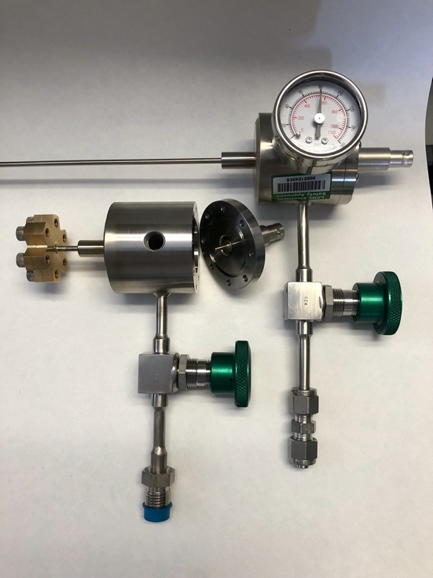
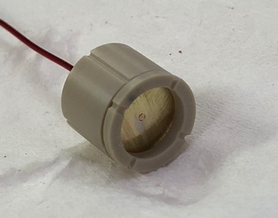
Fission Chamber Performance
MIT Nuclear Reactor Laboratory
Pulse height spectra from the Mark II fission chamber
Benchtop testing with ²⁵²Cf
Testing at MIT with ²³⁵U
Both using P-10 fill gas
100V/90PSI
²³⁵U(n,f)
Data taken with a CAEN DT5781 Desktop MCA
Heavy
Light
300V/90psi
²³⁵U(n,f)
Data taken with an Amp-Tek MCA8000D Pocket MCA
Alphas
Heavy
Light
Notes:
Benchtop testing with 252Cf (~3500 Bq alpha at time of measurements) reference foils
~23 hour acquisition
MIT NRL testing with U(93) reference foils
~1 hour acquisition

Slide 24
Results
MIT FC Tests 9-13-21 (½ gap)
Radiochemistry Results (R-values)
Isotope | Beta or gamma | R | ±% | Atoms/g target | ±% | Notes
⁸⁹Sr | B | 0.921 | 2.4 | 3.15E+10 | 2.2
⁹¹Y | B | 0.888 | 4.6 | 3.75E+10 | 4.5
⁹⁵Zr | G | 0.973 | 3.8 | 4.58E+10 | 3.0 | Beta analysis - within one s
⁹⁷Zr | G | 0.986 | 3.8 | 4.27E+10 | 3.1 | Beta analysis - within one s
⁹⁹Mo | B | 7.24E+11 | 2.2 | 4.43E+10 | 2.2 | R- value column used to report fissions/g target
¹¹¹Ag | B | 2.79 | 2.9 | 3.52E+08 | 2.8
¹¹⁵Cd | B | 3.15 | 3.8 | 2.65E+08 | 3.7
^{115m}Cd | B | - | - | - | - | Too few counts to fit beta data with confidence
¹³⁶Cs | G | 2.28 | 5.7 | 9.81E+07 | 5.2
¹³⁷Cs | G | 1.07 | 3.6 | 4.81E+10 | 2.8
¹⁴⁰Ba | B | 0.904 | 2.7 | 4.07E+10 | 2.5 | Beta analysis - within one s
¹⁴¹Ce | - | - | - | - | - | Incomplete analysis
¹⁴³Ce | - | - | - | - | - | Incomplete analysis
¹⁴⁴Ce | - | - | - | - | - | Incomplete analysis
¹⁴⁷Nd | B | 0.927 | 6.9 | 1.51E+10 | 6.8 | A beta 'no absorber' measurement, within 1 s of the beta 'with absorber and gamma measurements
¹⁵³Sm | B | 1.33 | 10.7 | 1.29E+09 | 10.6 | High uncertainty driven by low gravimetric yield
¹⁵⁶Eu | B | 1.59 | 6.3 | 1.72E+08 | 6.2
¹⁶¹Tb | - | - | - | - | - | Analysis not attempted
+
The red curve is “zero” threshold. The black curve is the same settings used during the Flattop irradiation in April.
Need to confirm with ²⁵²Cf, then correct detector efficiency for the high threshold.
HEU Low-power Irradiation

Slide 25
Fission Product Yield Evaluations
Data from this and other projects will feed into a new FPY evaluation that will happen over the next few years.
Regular interactions with another NA-22 funded multi-lab project “Evaluation of Energy Dependent Fission Product Yields”
  LANL (leading lab) develops FPY models and produce the final FPY data files
  BNL compiles experimental FPY data and produces a set of recommended FPY values, performs FPY data validation calculations
  LBNL performs measurements of energy-integrated and differential CNAA (Cyclical Neutron Activation Analysis) using the intense neutron source by the LBNL cyclotron, and data interpretation by the FIER code
  PNNL develops a new Bragg curve-based fission TPC (Time Projection Chamber) analysis in collaboration with LANL and LLNL
  LLNL develops theories and methods to calculate primary fission fragment yields, and performs FREYA calculations for prompt decay
The theory effort draws on the experimental results of several experimental activities funded by federal agencies through the Nuclear Data Interagency Working Group

Slide 26
Thanks for your time and attention.
Contact info for team members who can help with questions:
harke2@llnl.gov - SLFPY
toddb@lanl.gov – CFPY/rad-chem
friese@pnnl.gov – CFPY/rad-chem
bandong1@llnl.gov - AP
bruce.pierson@pnnl.gov - SLFPY
church4@llnl.gov – AP
tonchev2@llnl.gov – SLFPY – mono-energetic TUNL

