Slide 1
Very quick ENDF-102 Update

Slide 2
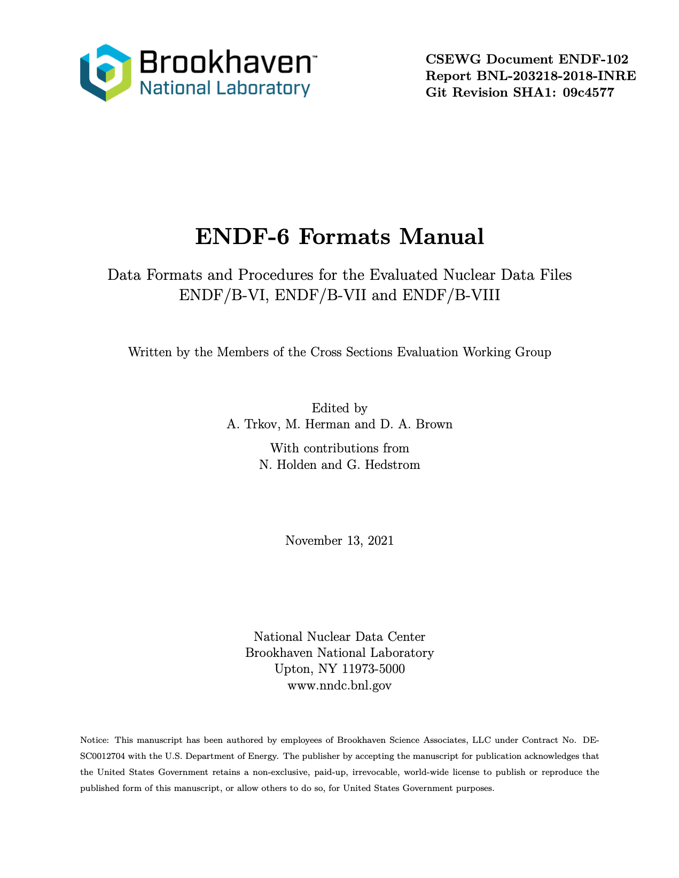
Big change to manual
It builds correctly

Slide 3
Big change to manual
For the last two years, the build was broken and no one noticed
The CI/CD system is down while we figure out configuration issues for Kubernetes
The latex files also had dependencies on many style files included in the source that fought with system versions

Slide 4
It appears all Merge Requests are ready to go
!13: Resolve "Add proper CONTRIBUTING.md file that describes how to make format proposals” https://git.nndc.bnl.gov/endf/format/endf6man/-/merge_requests/13
!6: Replace Fmts-07.tex to implement mixed elastic scattering format proposal. https://git.nndc.bnl.gov/endf/format/endf6man/-/merge_requests/6
!9: Resolve "FORMAT PROPOSAL: ENDF-102 Clarification for Primary Discrete Gammas” https://git.nndc.bnl.gov/endf/format/endf6man/-/merge_requests/9

Slide 5
Missing Merge Requests for 3 recent proposals
#128: FORMAT PROPOSAL: Extend Kalbach-Mann formalism for deuteron breakup
#112: Angular distribution of nucleon emission from deuteron breakup reaction
#123: Format change to use MT=261 for neutron fields in special purposes libraries.
#114: Format proposal defining KRL flag
#113: Format change to include Brune parameters

Slide 6
The format proposal process

Slide 7
Format proposal process modeled on old ENDF-6 manual process, updated for git
Required:
Issue tracker containing need & rationale for format
Merge request implementing manual changes (this is complex, see next slide)
Review of merge request handled using formal process
Preferred:
Example file
Reference implementation in processing code
CONTRIBUTING.md file describes the process

Slide 8
The bug fix process

Slide 9
The bug fix process is the format proposal process with quick informal review
Are you OK with this process, or must it be more formal?
Required:
Issue tracker containing need & rationale for bug fix
Merge request implementing manual changes
Review handled by chair or chair+helpers for more complex fixes
Quick edits to the CONTRIBUTING.md file can describe this process

