Slide 1
Validating Gamma-rays Produced in Nuclear Reactions
Isabel Hernandez
Weapons and Complex Integration/HEDP
Jo Ressler & Bonnie Canion
November, 2021
Notes:
Hello, my name is Isabel Hernandez. I worked with my mentors, Jo Ressler and Bonnie Canion in the Weapons and Complex Integration and the High Energy Density Physics Summer Program. Today, I’ll be talking about my summer project on the process of validating gamma-rays produced in nuclear reactions.

Slide 2


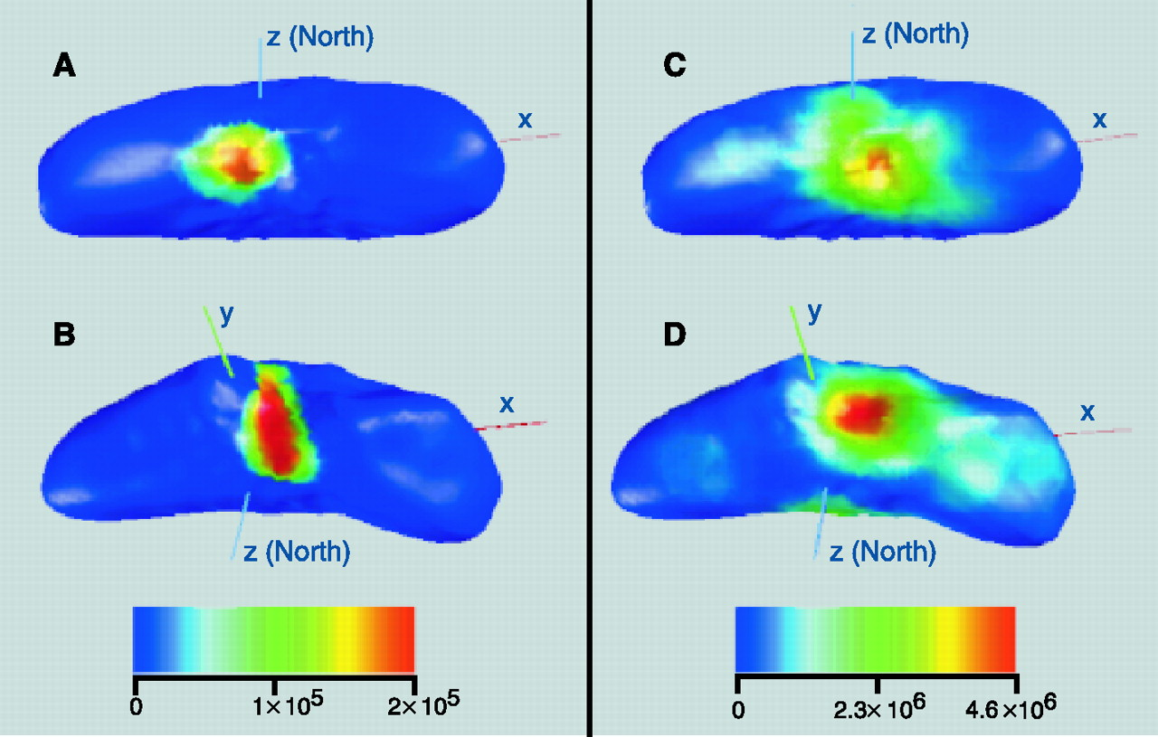
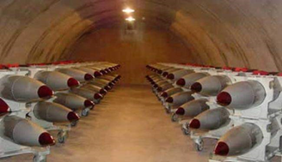

There are many applications using neutron-induced gamma signatures at LLNL
Exploration (earth, planetary)
Verification (warhead monitoring)
Identification (emergency response)
Notes:
One of the questions that many divisions in nuclear science face is the question of “Whats in the Box?”, or what is that unknown material. Understanding the composition of unknown (or known) substances is important to many applications at LLNL. Here, I’ve classified the applications I’ve explored this summer into 3 categories: Exploration, Verification, and Identification. Exploration may include classifying the geochemistry of an asteroid or the hydrocarbon presence in the oil and gas industry. Verification is a large part of non-proliferation and includes monitoring a warhead stockpile in allied or enemy forces. Identification also plays a large part in world-wide non-proliferation and emergency efforts by identifying unknown objects so that we can manage the safety and consequences in a time-sensitive scenario.

Slide 3



Goal: Validate nuclear models for inelastic scatter
Experiment vs Simulation
Simulations require validated nuclear data libraries
Investigate differences between experiment and simulation
  Measurement vs. Evaluation
  Evaluation vs. Simulation
Availability of nuclear data
Accuracy of evaluated data
Interpretation of evaluated data
Mercury
Notes:
Now, the importance of simulated data can not be understated. Simulations may be used as benchmarks or predictions to experiments, and often provide low-cost and fast solutions to real-world problems that wouldn’t otherwise be experimentally measured. In order to provide accurate results, these simulations require validated data in libraries, and differences between simulation and experiment may be a result of availability/accuracy of the data, or the way the simulation code is interpreting the data. This summer, I worked on seeing where and why these discrepancies occur by comparing measurements to the evaluation, and then the evaluation to interpreted simulated data.

Slide 4
Measurement vs Evaluation: Challenges with non-discrete data
Examined gammas produced from 14.5 MeV inelastic scatter with neutrons on common isotopes
  Compared values in data libraries to experimental compilation from IAEA
  Used FUDGE to extract data from ENDFB-VIII.0 in GNDS
  Discrete (MT 51-90) and non-discrete (MT 91) data
  Correct interpretation of non-discrete data was unclear
²⁷Al
⁵⁶Fe

Slide 5
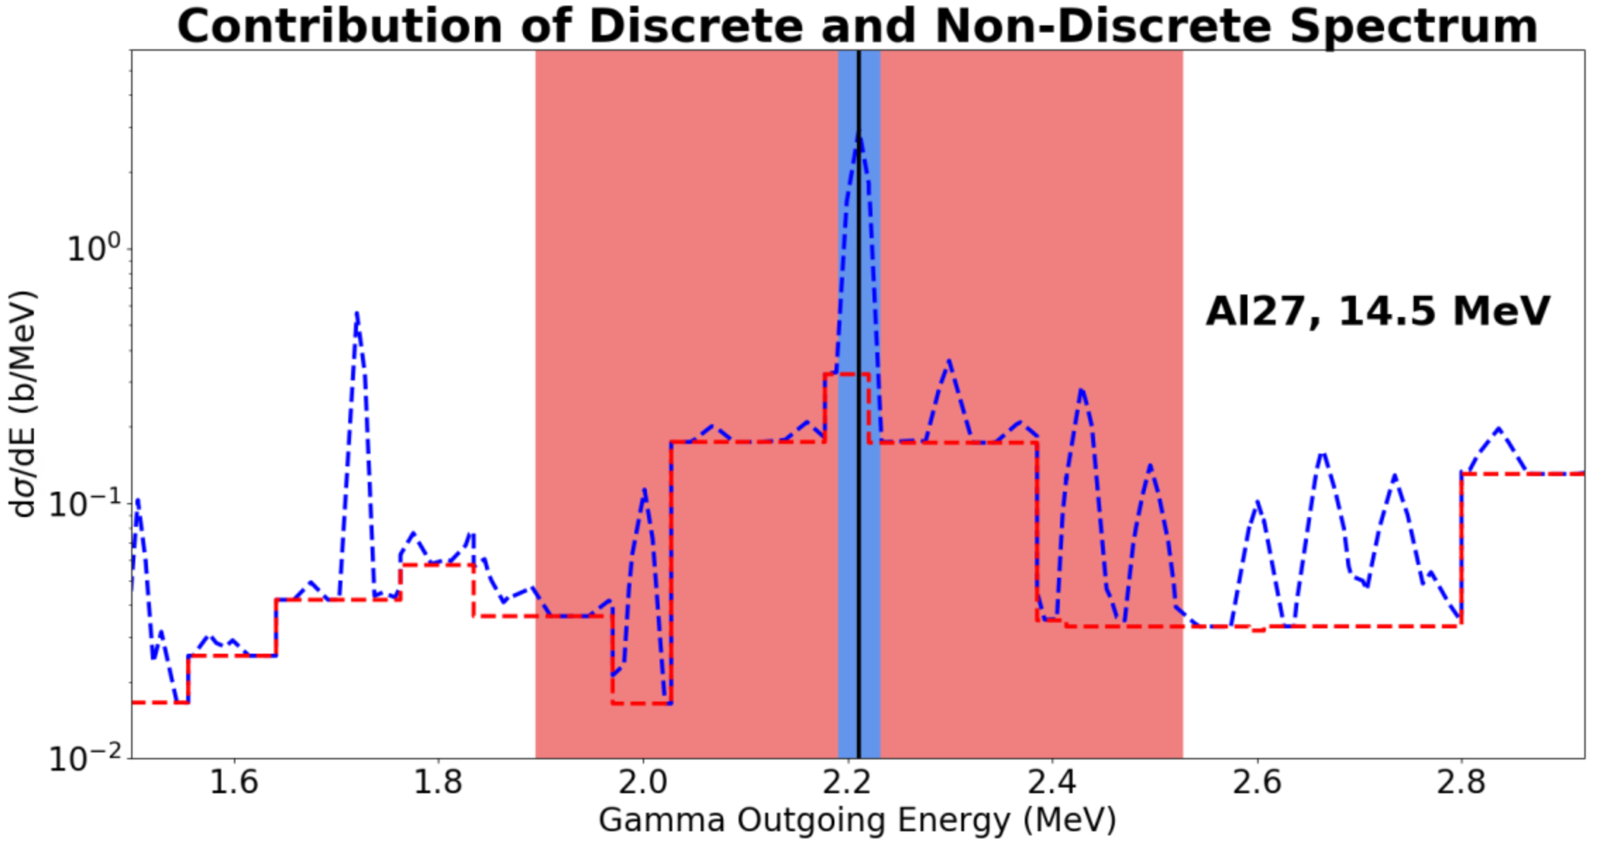
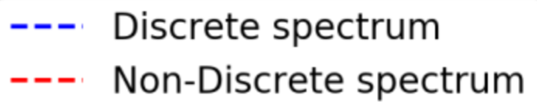

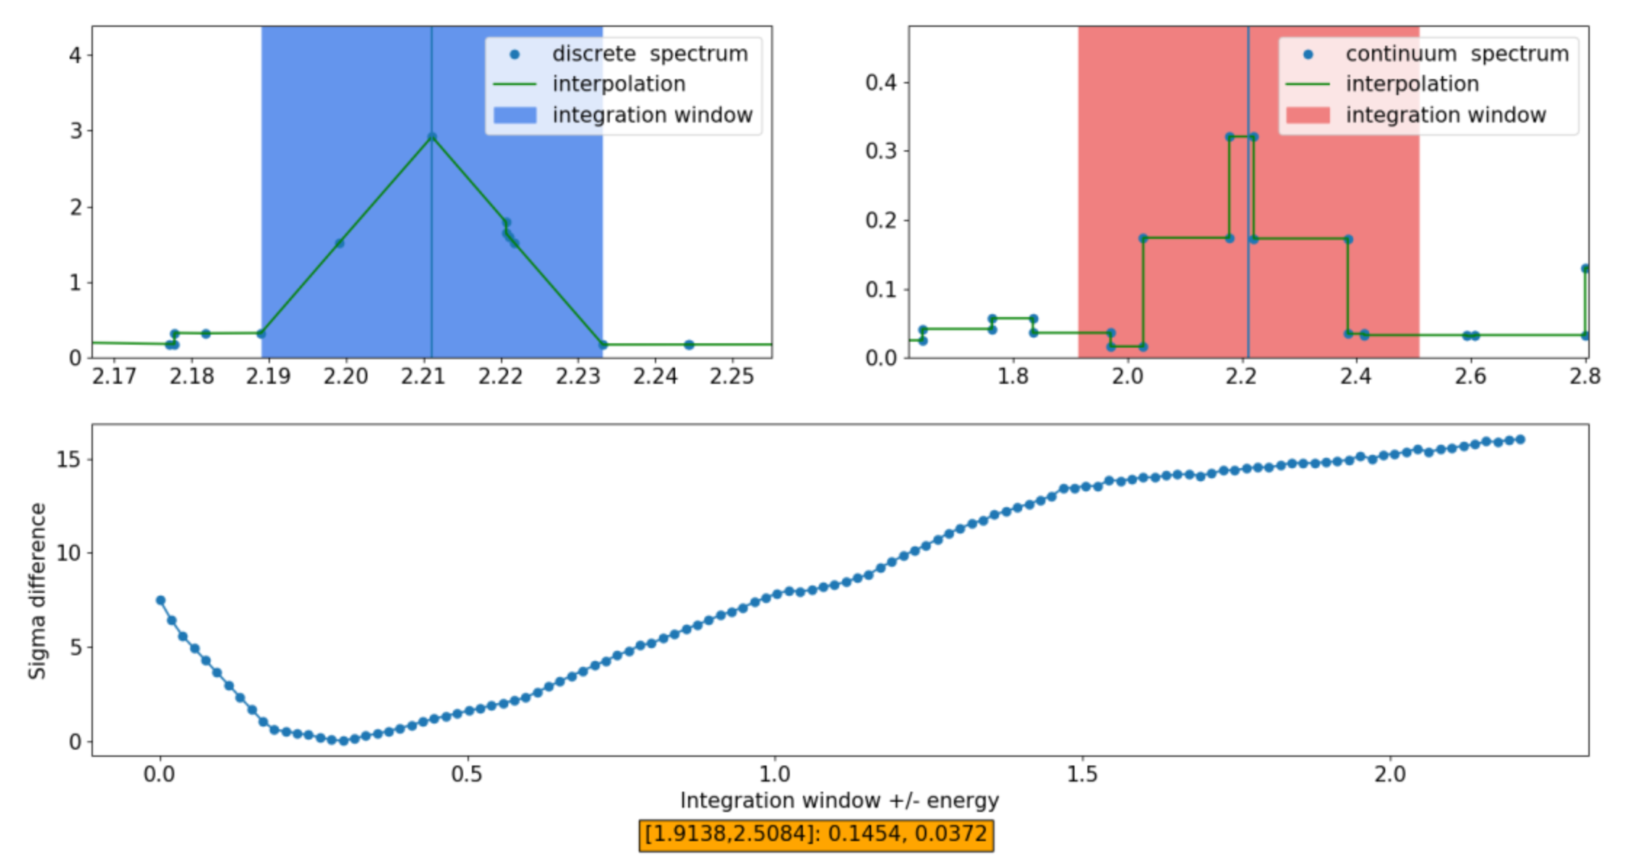
Discrete and Continuum Contributions are Stored Differently in Libraries
Notes:
You can see an example of this in this slide. As shown in this figure, the discrete spectrum to the left clearly shows a peak around a prominent gamma energy released in an inelastic interaction. Moving onto the left figure of the non-discrete data, not only does the continuum data seem to be stored differently in a histogram format, but the range of integration is unclear. The top figure shows the differences between these discrete and non-discrete regions in a like scale. The highlighted region is the optimized region of integration of the continuum spectrum so that the total cross section would be comparable to experiment. Though these figures only show examples for Aluminum, we found the continuum integral window that led to a comparable cross section to experiment was unclear for all isotopes, and often times, the integral window for the continuum (and therefore the continuum contribution to the cross section) was remarkably wider than its discrete counterpart contribution.

Slide 6
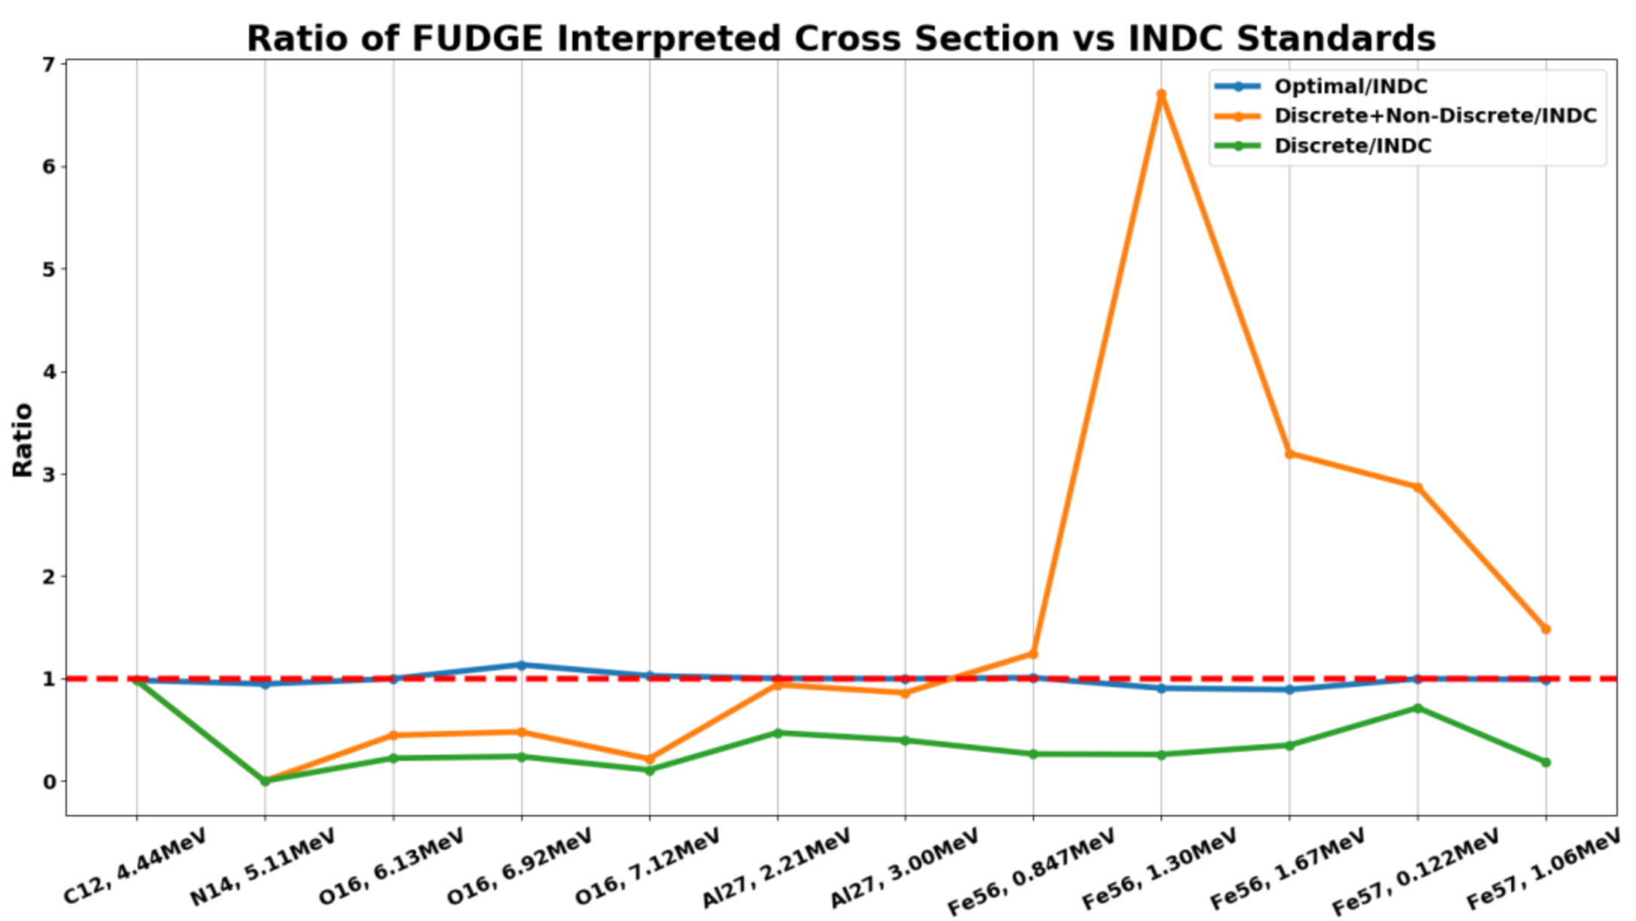
Non-discrete contributions are needed to match experimental data
Explored different integral windows for non-discrete spectrum
For 14 MeV neutrons, non-discrete contributions are needed to match the experimental data (INDC/IAEA)
Notes:
This figure illuminates the importance of the non-discrete contribution to the total calculated cross-section and its comparison to experimental cross-section results. We see that only considering the discrete contribution leads the calculated cross sections to be considerably less than measured cross sections, as seen in the green line in this plot. In addition, it is often difficult to decipher the continuum spectrum and determine how much of that spectrum contributes to each gamma-ray energy cross section, so without optimizing the non-discrete contribution relative to measurements, the total cross section may be wildly different from experiment, as seen from the orange line in this figure.

Slide 7
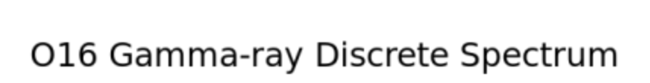


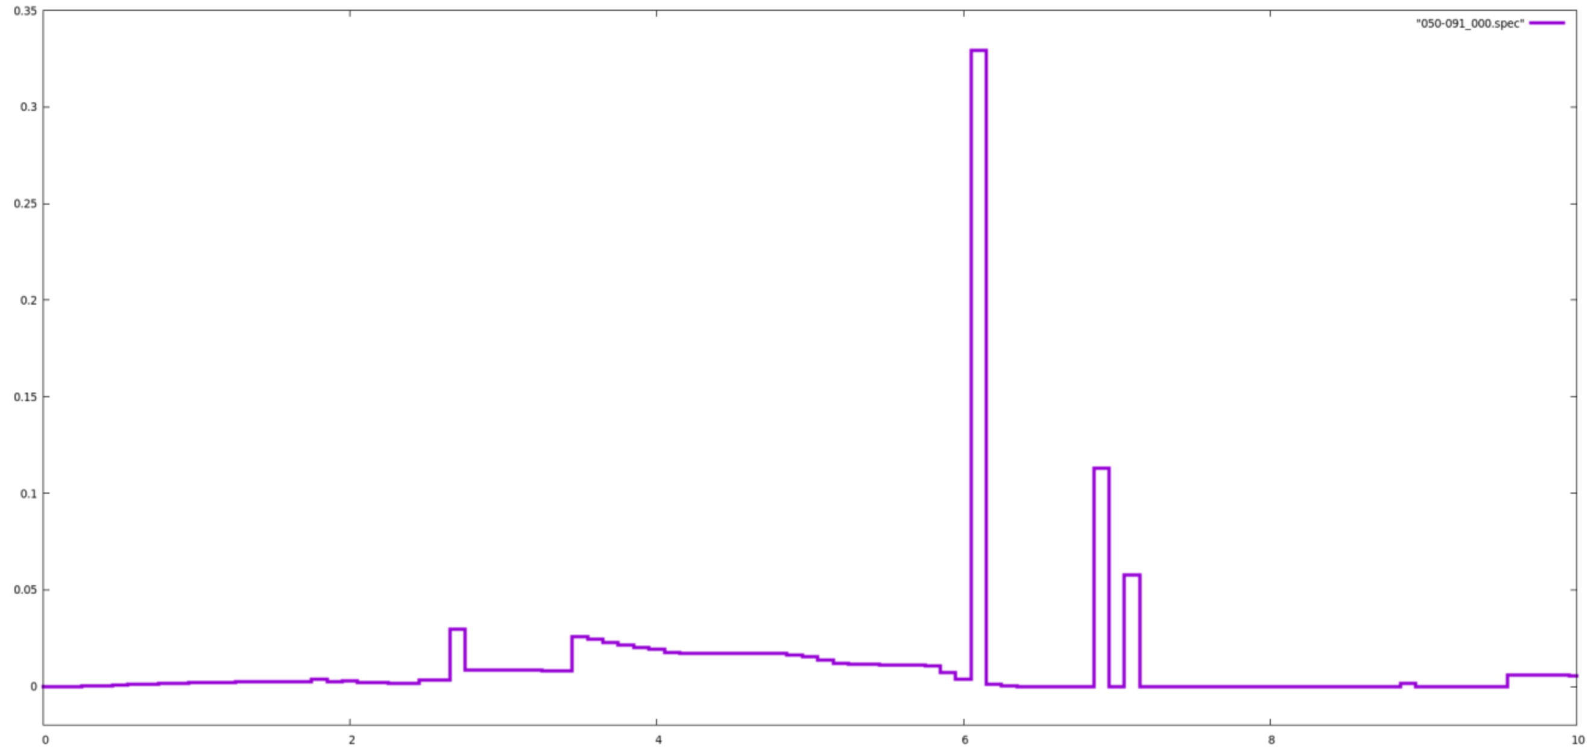


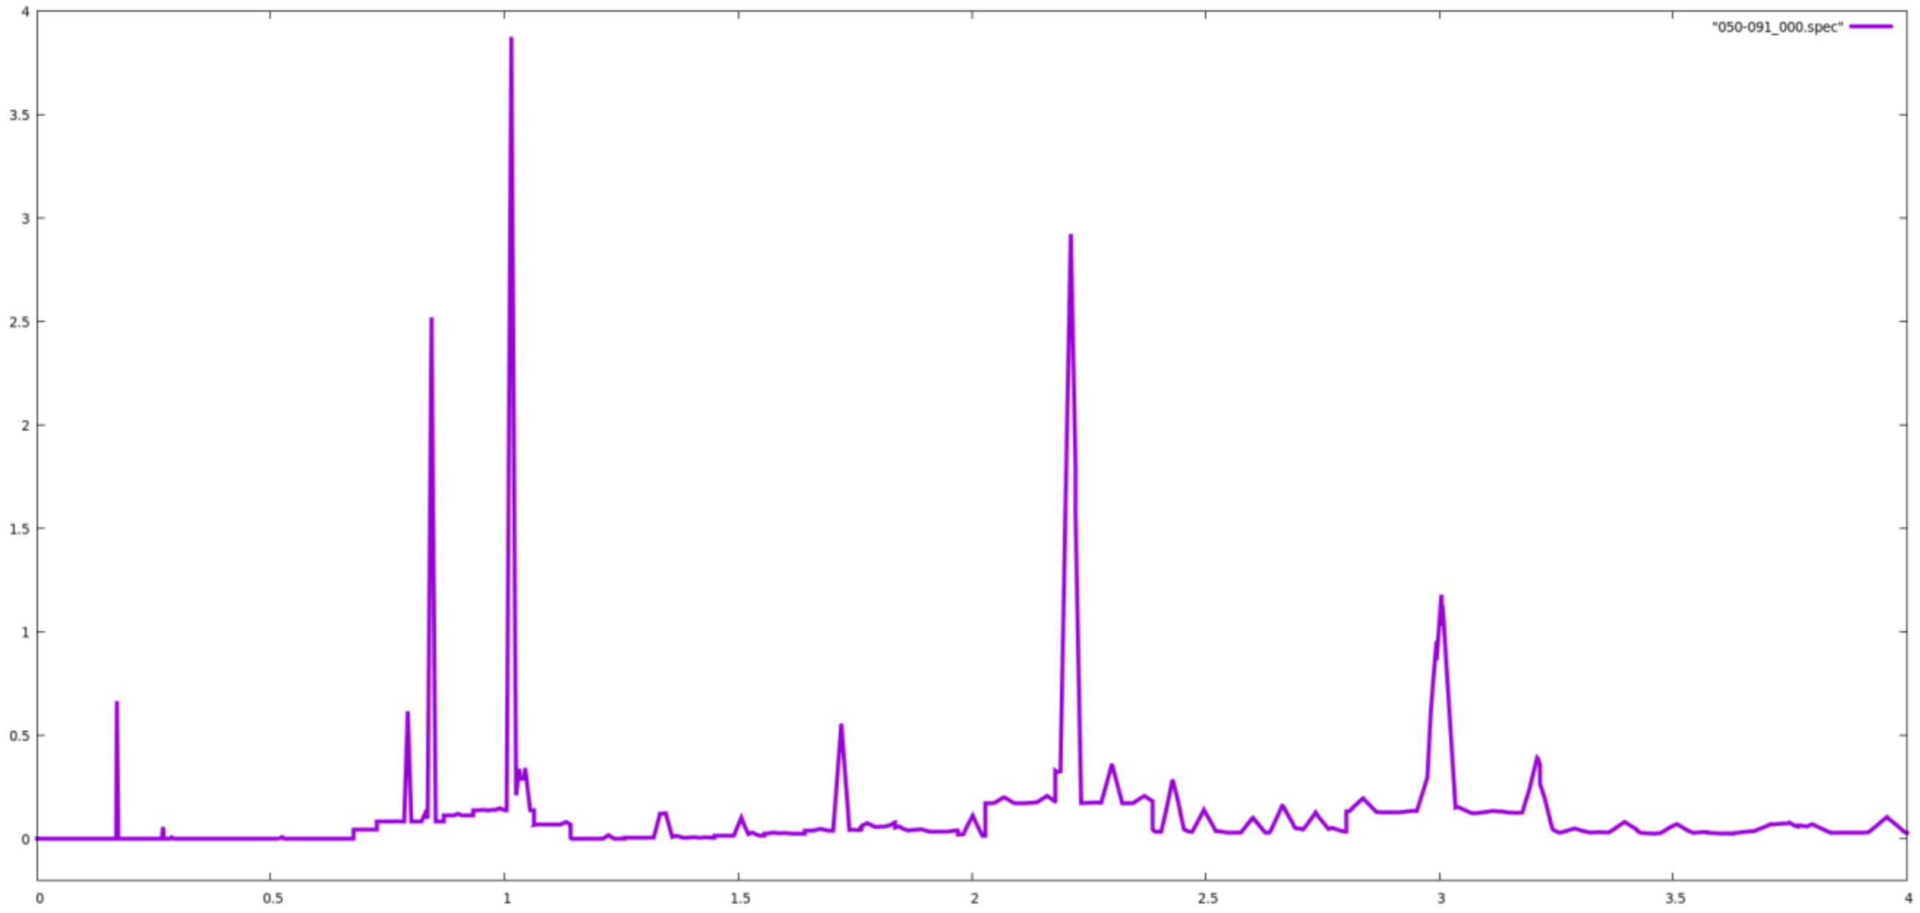
Measurements vs. Evaluation: Some issues also observed with discrete data
¹⁶O Spectrum
  Unique discrete spectrum
    Histogram-like storage
    E_{γ} = 0.97, 1.75, 1.95 MeV not accounted for
¹⁴N Spectrum
  No gamma-ray production FUDGE files for inelastic excitation states
    All inelastic data associated with MT=4
    Cross sections of MT=51-91 matches MT=4
Notes:
Before moving to the next step, it is important to note that we saw issues in evaluated cross section data with 2 prominent isotopes.
Oxygen-16 had a very unique discrete gamma-ray spectrum in that it was in a histogram-like format. As you can see from the two plots on the right, the top plot (O16) has a very non-peak like structure; whereas, the bottom plot with Al27 spectrum, has an expected gamma-ray spectrum with the distinct peaks and no bar-like features. In addition, the discrete spectrum in O16 didn’t show any energy peaks near prominent gamma-ray energies that had relatively important cross sections.
Nitrogen-14 was the second isotope that had some unexpected errors in evaluated inelastic data. Now, FUDGE produces multiple files of all the possible interactions for a specified incident particle on an isotope. FUDGE failed to produce any inelastic data files for N14, and upon further investigation, we saw that even through there was cross section data in MT codes 51-91 (which represent inelastic data), FUDGE was not pulling this data and producing files. In fact, we saw that the total inelastic cross section data was also stored in MT code 4, which was previously reserved for non-elastic interactions.
Discrepancies in data storage in both O16 and N14 compared to other investigated isotopes may lead to interpretation issues in transport codes, which we will see later.

Slide 8
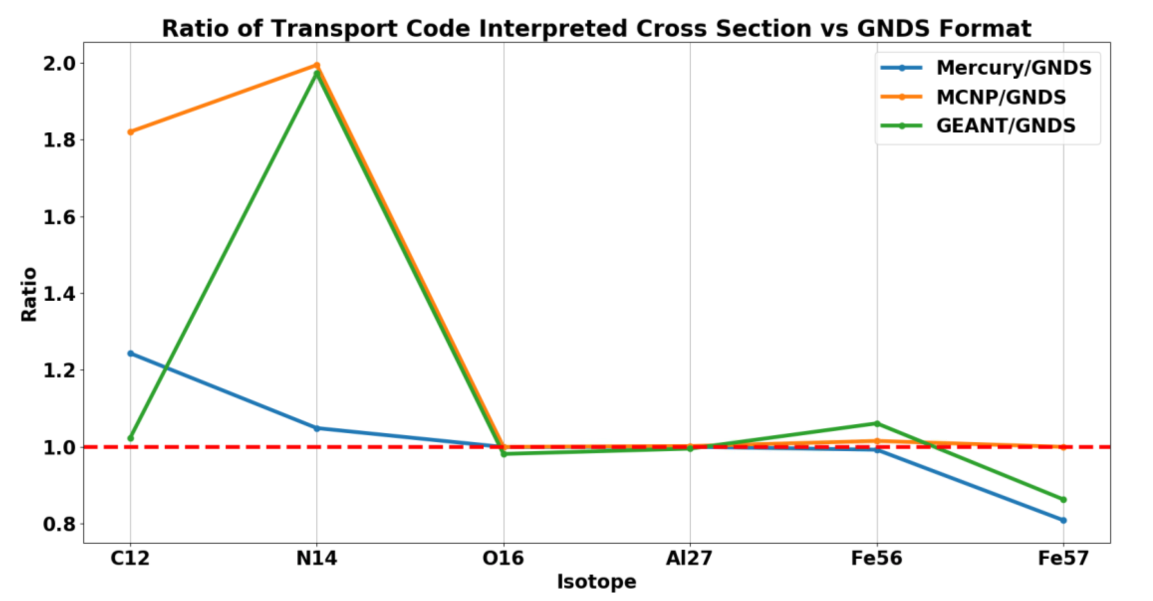
Transport codes also interpreted data differently
Examined how Monte Carlo radiation transport codes interpret data
  MCNP, Mercury, GEANT4 with ENDFB-VIII.0
  Broomstick geometry to tally reactions
  Ratio of (inelastic/total) neutron reactions
Large differences observed for some isotopes: analysis of ¹²C and ¹⁴N are key to non-destructive techniques for cargo screening
Notes:
After our investigation into the evaluated data using FUDGE, we transitioned into comparing this evaluation data to data produced by simulation codes. We worked specifically with Monte Carlo radiation transport codes: MCNP, Mercury, and GEANT4. Running these codes on broomstick models to isolate and tally single inelastic interactions, we extracted the total inelastic cross section produced from each output.
This figure shows the ratio of extracted simulation cross section data over data in the ENDFB/VIII evaluation (specifically in the GNDS library).
We see from this plot that there are several interpretation issues, most notably in N14. GEANT and MCNP both overestimated the inelastic cross section by nearly 2x the evaluated cross section. This may be because of the reasons I discussed earlier with N14 inelastic data being stored inconsistently compared to other isotopes. This issue with Nitrogen 14 is particularly important because 14 MeV neutron interactions with N14 are heavily used in non-destructive cargo screening techniques, so dependable simulation results are key in verifying these gamma-ray spectrums used in time-sensitive, real-world scenarios.
We are still in the process of digging into why these codes are accessing the data differently and where specifically they are pulling inelastic data from.

Slide 9
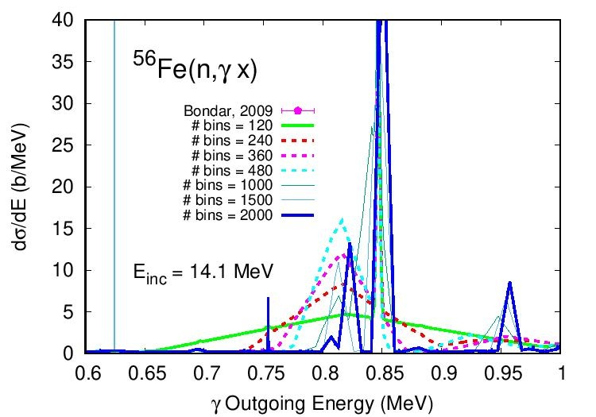
Discussions with data teams suggests improvements for evaluations
Examined the energy binning structure for gamma decays following inelastic scatter
Too few bins suggests unphysical spectra
G. Nobre, U.S Nuclear Data Program
Notes:
As far as next steps go, after consulting with the Nuclear Data team and US Nuclear Data Program on these continuum issues, steps are being implemented to reduce bin size of the continuum spectrum so we may see more recognizable features. One isotope we had an unexpected issue with deciphering the continuum cross section contribution was Fe56. This was particularly surprising because Fe56 is an isotope that was expected to have a very recognizable and clear gamma-ray spectrum, with definite and low-uncertainty cross sections. Now what we saw in the evaluation was that the continuum spectrum and its large bin width led to relatively high errors compared to measured results, which was notable since Fe56 is a common benchmark in inelastic interactions, particularly in the ALTAS database.
An example of the affects of varying bin sizes on the Fe56 continuum spectrum is shown on this figure.
For future work, we are planning on continuing this process with low incident energy neutron data.
(use fe56 to normalize the other inelastics to compare to)

Slide 10
Examined inelastic data: room for improvement
Issues identified for gamma-rays produced with 14 MeV neutrons, particularly for non-discrete data
Encourage further attention to these data - scatter reactions are important for many applications, and accurate data are needed
Simakov, S.P., Pavlik, A., Vonach, H., & Hlavac, S. (1998). Status of experimental and evaluated discrete γ-ray production at E_{n}=145 MeV Final report of Research Contract 7809/RB, performed under the CRP on measurement, calculation and evaluation of photon production data (INDC(CCP)--413). International Atomic Energy Agency (IAEA)
Castaneda, C., Gearhart, D., Gearhart, R., Sanii, B., Englert, P., Dempsey, J., Young, J., Drake, D., & Reedy, R. (2007). Gamma ray production cross sections from the bombardment of Mg, Al, Si, Ca and Fe with medium energy neutrons. Nuclear Instruments & Methods in Physics Research Section B-beam Interactions With Materials and Atoms, 260, 508-512.
El Kanawati, W., Perot, B., Carasco, C., Eleon, C., Valkovic, V., Sudac, D., Obhodas, J., & Sannie, G. (2011). Acquisition of prompt gamma-ray spectra induced by 14 MeV neutrons and comparison with Monte Carlo simulations. Applied radiation and isotopes : including data, instrumentation and methods for use in agriculture, industry and medicine, 69(5), 732–743. https://doi.org/10.1016/j.apradiso.2011.01.010
Notes:
I would like to thank my mentors, Dr. Ressler and Dr. Canion for this experience this summer, as well as Dr. Gert and Dr. Nobre and the rest of the Nuclear Data Team here. I would also like to give a special thanks to the many others that allowed me to sit in in their meetings to explore important nuclear data applications used here at LLNL.
Thank you very much for listening, and I’ll be taking any questions now.

Slide 12
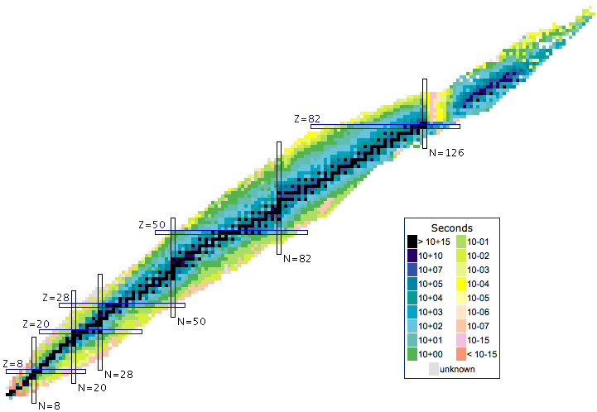


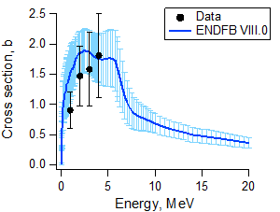
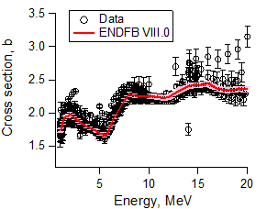
Bookless Libraries
Evaluation:
  Experimental data → theoretical reaction codes → recommended values
    ENDF/B VIII
Processing:
  Recommended values → physics/processing codes → data “library”
    ENDF, ENDL, GNDS
Notes:
Because of the world-wide need of standardized nuclear data, data generated from published experiments must be reduced and compiled into a data base that is accessible to researchers and applications that may find them useful. And well… this is often easier said then done. Issues can arise if there is not enough experimental data (as seen in picture) or if experimental results are too widely skewed. This evaluation step takes experimental data and produces recommended values that the processing step then turns into a data library that may be linked to simulation codes for use. We will be looking at the ENDFB/VIII evaluation and it’s GNDS library format produced from the processing step.

Slide 13
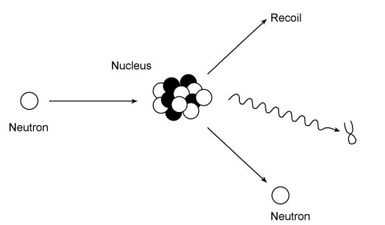
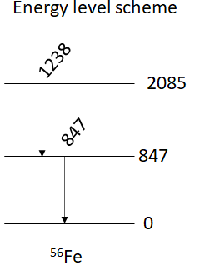


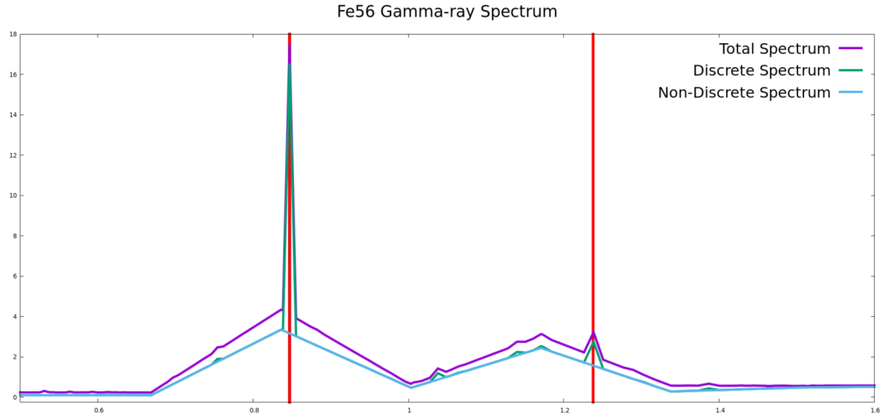
Gamma-rays provide an isotopic “fingerprint”
Inelastic Interactions
14.5 MeV incident neutrons
¹²C, ¹⁴N, ¹⁶O, ²⁷Al, ⁵⁶Fe, ⁵⁷Fe
847 keV
1238 keV
Notes:
These three areas may use different techniques for material identification, but today I will be talking about the method that uses inelastic interactions. Specifically, we are looking at when a 14 MeV neutron hits an isotope nucleus, and instead of just bouncing off, the nucleus absorbs some of the neutron’s kinetic energy and reaches an excited state. A gamma-ray is then emitted from this extra energy in the nucleus. This gamma-ray has a specific energy depending on what excited state it was emitted from and are unique to each isotope, so, by looking at the gamma-ray spectrum from these interactions, we may deduce what material we are looking at.
An example with Fe56 is shown in this figure where the gamma-ray spectrum shows 847 keV and 1.2 MeV gamma-rays being emitted from the first and second excited states.
The probability that this inelastic interaction will occur and release a specific gamma-ray is called an inelastic cross-section, which will be important to my discussion today. The isotopes I worked with this summer are C12 N14 O16 Al27 and Fe56 and 57.

Slide 14
Measurements vs. Evaluation
Extract 14.5 MeV neutron induced inelastic cross sections
Graphical vs non-graphical extraction methods
Unaccounted for “continuum” gamma-ray spectrum
  Contribution towards total cross section
Unidentifiable gamma contribution in non-discrete spectrums
Repeated for all “high-priority” isotopes at each inelastic E_{γ}
Notes:
To start off, we looked at comparing measured data to the evaluated data. To access the evaluated data directly, we used a LLNL tool called FUDGE that extracted the inelastic gamma-ray spectrum determined by the evaluators. Taking this spectrum, the cross-section data can be extracted in 2 ways: non-graphically by taking the gamma energy (b/MeV) and multiplying by the bin width (MeV), or graphically by integrating over a window around the specified gamma energy for the cross section. In the end, we saw that graphical methods produced cross sections that were more similar to experiment than non-graphical methods. Now, we also saw that FUDGE only produces gamma-ray spectrums for the first 40 excited states of each isotope (due to the ENDF library format). You might think that this shouldn’t be an issue because how really how often to we find an isotope in an excited state higher than 40?? Well, it turns out it happens more than we thought. All of the gamma-ray data that occurs in excited states greater than 40 are dumped into one spectrum file (what we call the continuum or non-discrete spectrum) – and so is cross-section contribution from the higher states. The issue is that while the discrete spectrums had very recognizable features anc clear regions to integrate over to find the cross section, the continuum spectrum often had unrecognizable features and unclear regions to for integration.

