Slide 1

Jets for TMD Physics with ECCE
John Lajoie
Iowa State University

Slide 2
Jets for EIC Physics

Slide 3

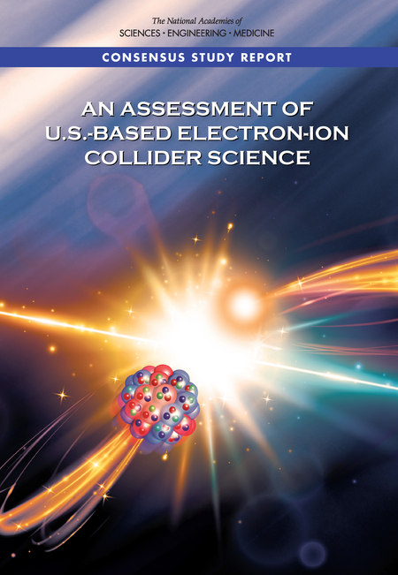

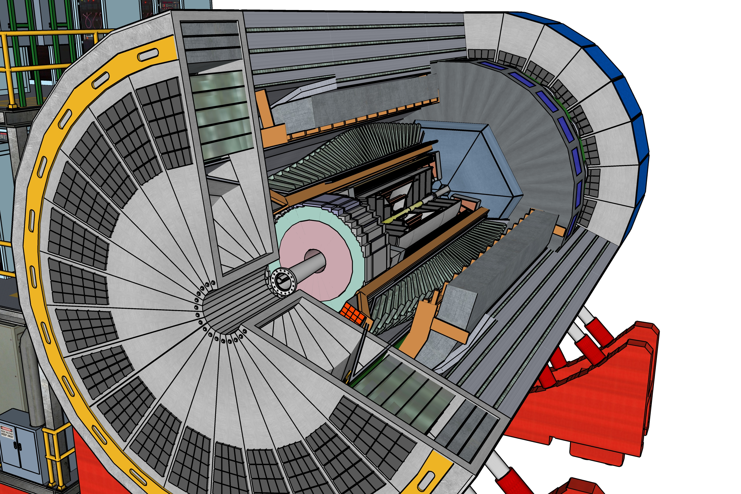
What is ?
Designing
(& building!)
a detector
Scientist from 80 institutions
To deliver on EIC science mission

Slide 4
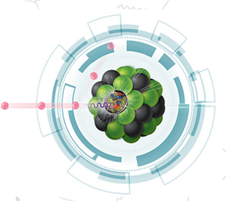
ECCE 101
ECCE is 80 institutions collaborating to design an EIC detector offering full kinematic coverage and an optimized far forward detector system
ECCE will submit a proposal to be the EIC project detector (“Detector 1”), which will address the complete science program outlined in the NAS and Yellow Reports
ECCE is investigating a design which incorporates the existing 1.5T BaBar magnet, which will help reduce cost and risk, to allow it to be ready for first EIC operations (CD-4a)
ECCE is fully supportive of two detectors at the EIC, in both IP6 and IP8, to maximize the scientific output of the EIC. ECCE is also investigating key science measurements in either IP6 with 25 mrad crossing angle, or IP8 with 35 mrad
ECCE is open to everyone in the community to participate, even if they wish to contribute to other proposals.
EIC Comprehensive Chromodynamics Experiment

Slide 5
Consortium
80 Institutions
High engagement from all collaborating institutions!
courtesy of Or Hen

Slide 6




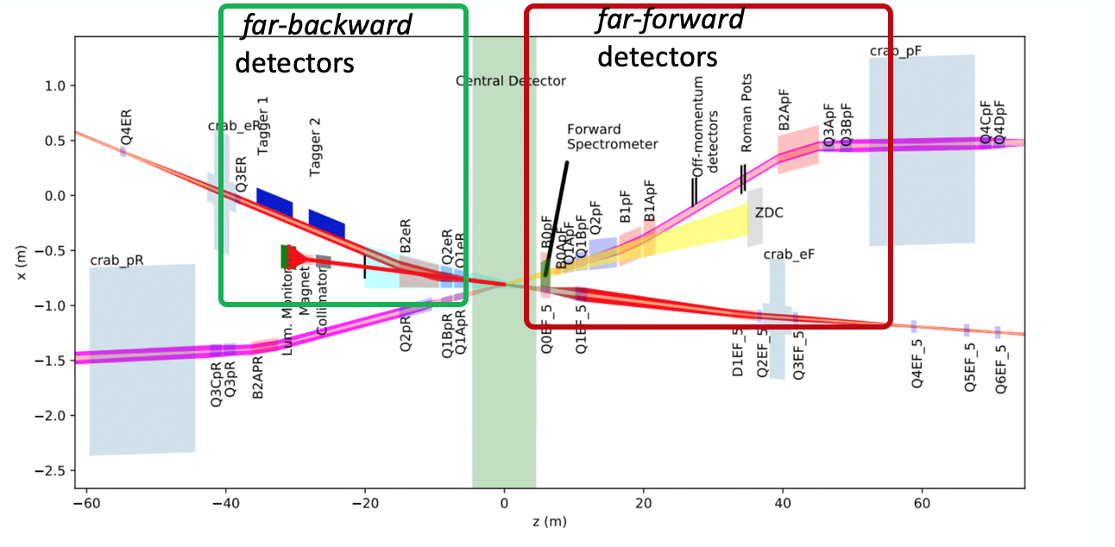
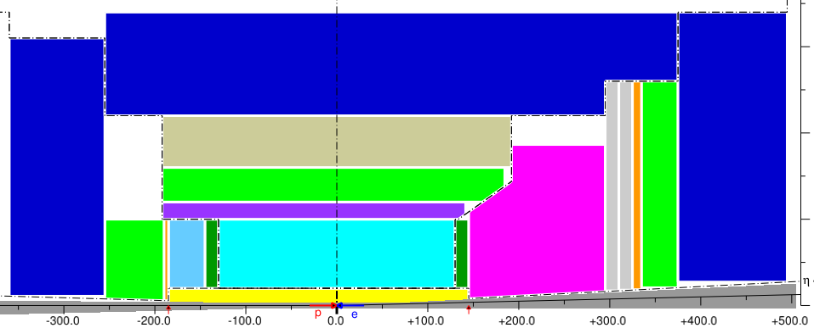








ECCE International
EEEMCal: AANL, CUA, Charles U., FIU, IJCLab, MIT, Lehigh U., UKY, JMU
BGU/Israel, MIT, ORNL, UIUC, IJCLab-Orsay, EIC-Japan, TAU/Israel, UVA, GWU, MIT-BATES, HUIJ/Israel
Polarized Beam and polarimetry: MIT, UNH, SBU
Glasgow U., ODU
Rutgers, ISU, GSU
Electronics: Columbia, ORNL
EIC-Japan
ISU
Ohio U.
ORNL
Sejong U.
KyungpooU
Yonsei U.
Pusan U.
Ohio U.
ORNL
EIC-Japan
ISU
Ohio U.
ORNL,
IMP
DAQ/Trigger: ISU, CU Boulder, OU, ORNL, SBU, UConn, LLNL
UIUC, Charles U.
ODU, CUA, GSI-DIRC
SBU, UConn
GSU
SBU, ORNL, WI.Israel, Wayne State, MIT, Rice, ORNL, Wayne State
Artificial Intelligence: MIT, CNU, Brunel U.
MIT, Rice, ORNL, Czech Tech. U., IMP, SCNU, Tsinghua, USTC
CENTRAL
  Tracking:
  Silicon: China, Czech Republic, Japan
  Calorimetry
  PWO and SciGlass: Czech Republic, Armenia, France
  Forward Calo/Dual Readout: China, Japan, South Korea
  Particle ID
  DIRC: GSI/Germany
FAR FORWARD – FAR BACKWARD
  Roman pots: France
  Off momentum: Israel
  ZDC: Japan
  Luminosity monitors: Israel
  Low Q2 tagger: UK

Slide 7
ECCE Consortium Structure
Website:
https://www.ecce-eic.org/
Mailing Lists:
https://lists.bnl.gov
ecce-eic-public-l
ecce-eic-ib-l
ecce-eic-comp-l
ecce-eic-dei-l
ecce-eic-det-l
ecce-eic-phys-l
ecce-eic-prop-l
Indico:
https://indico.bnl.gov/category/339/

Slide 8
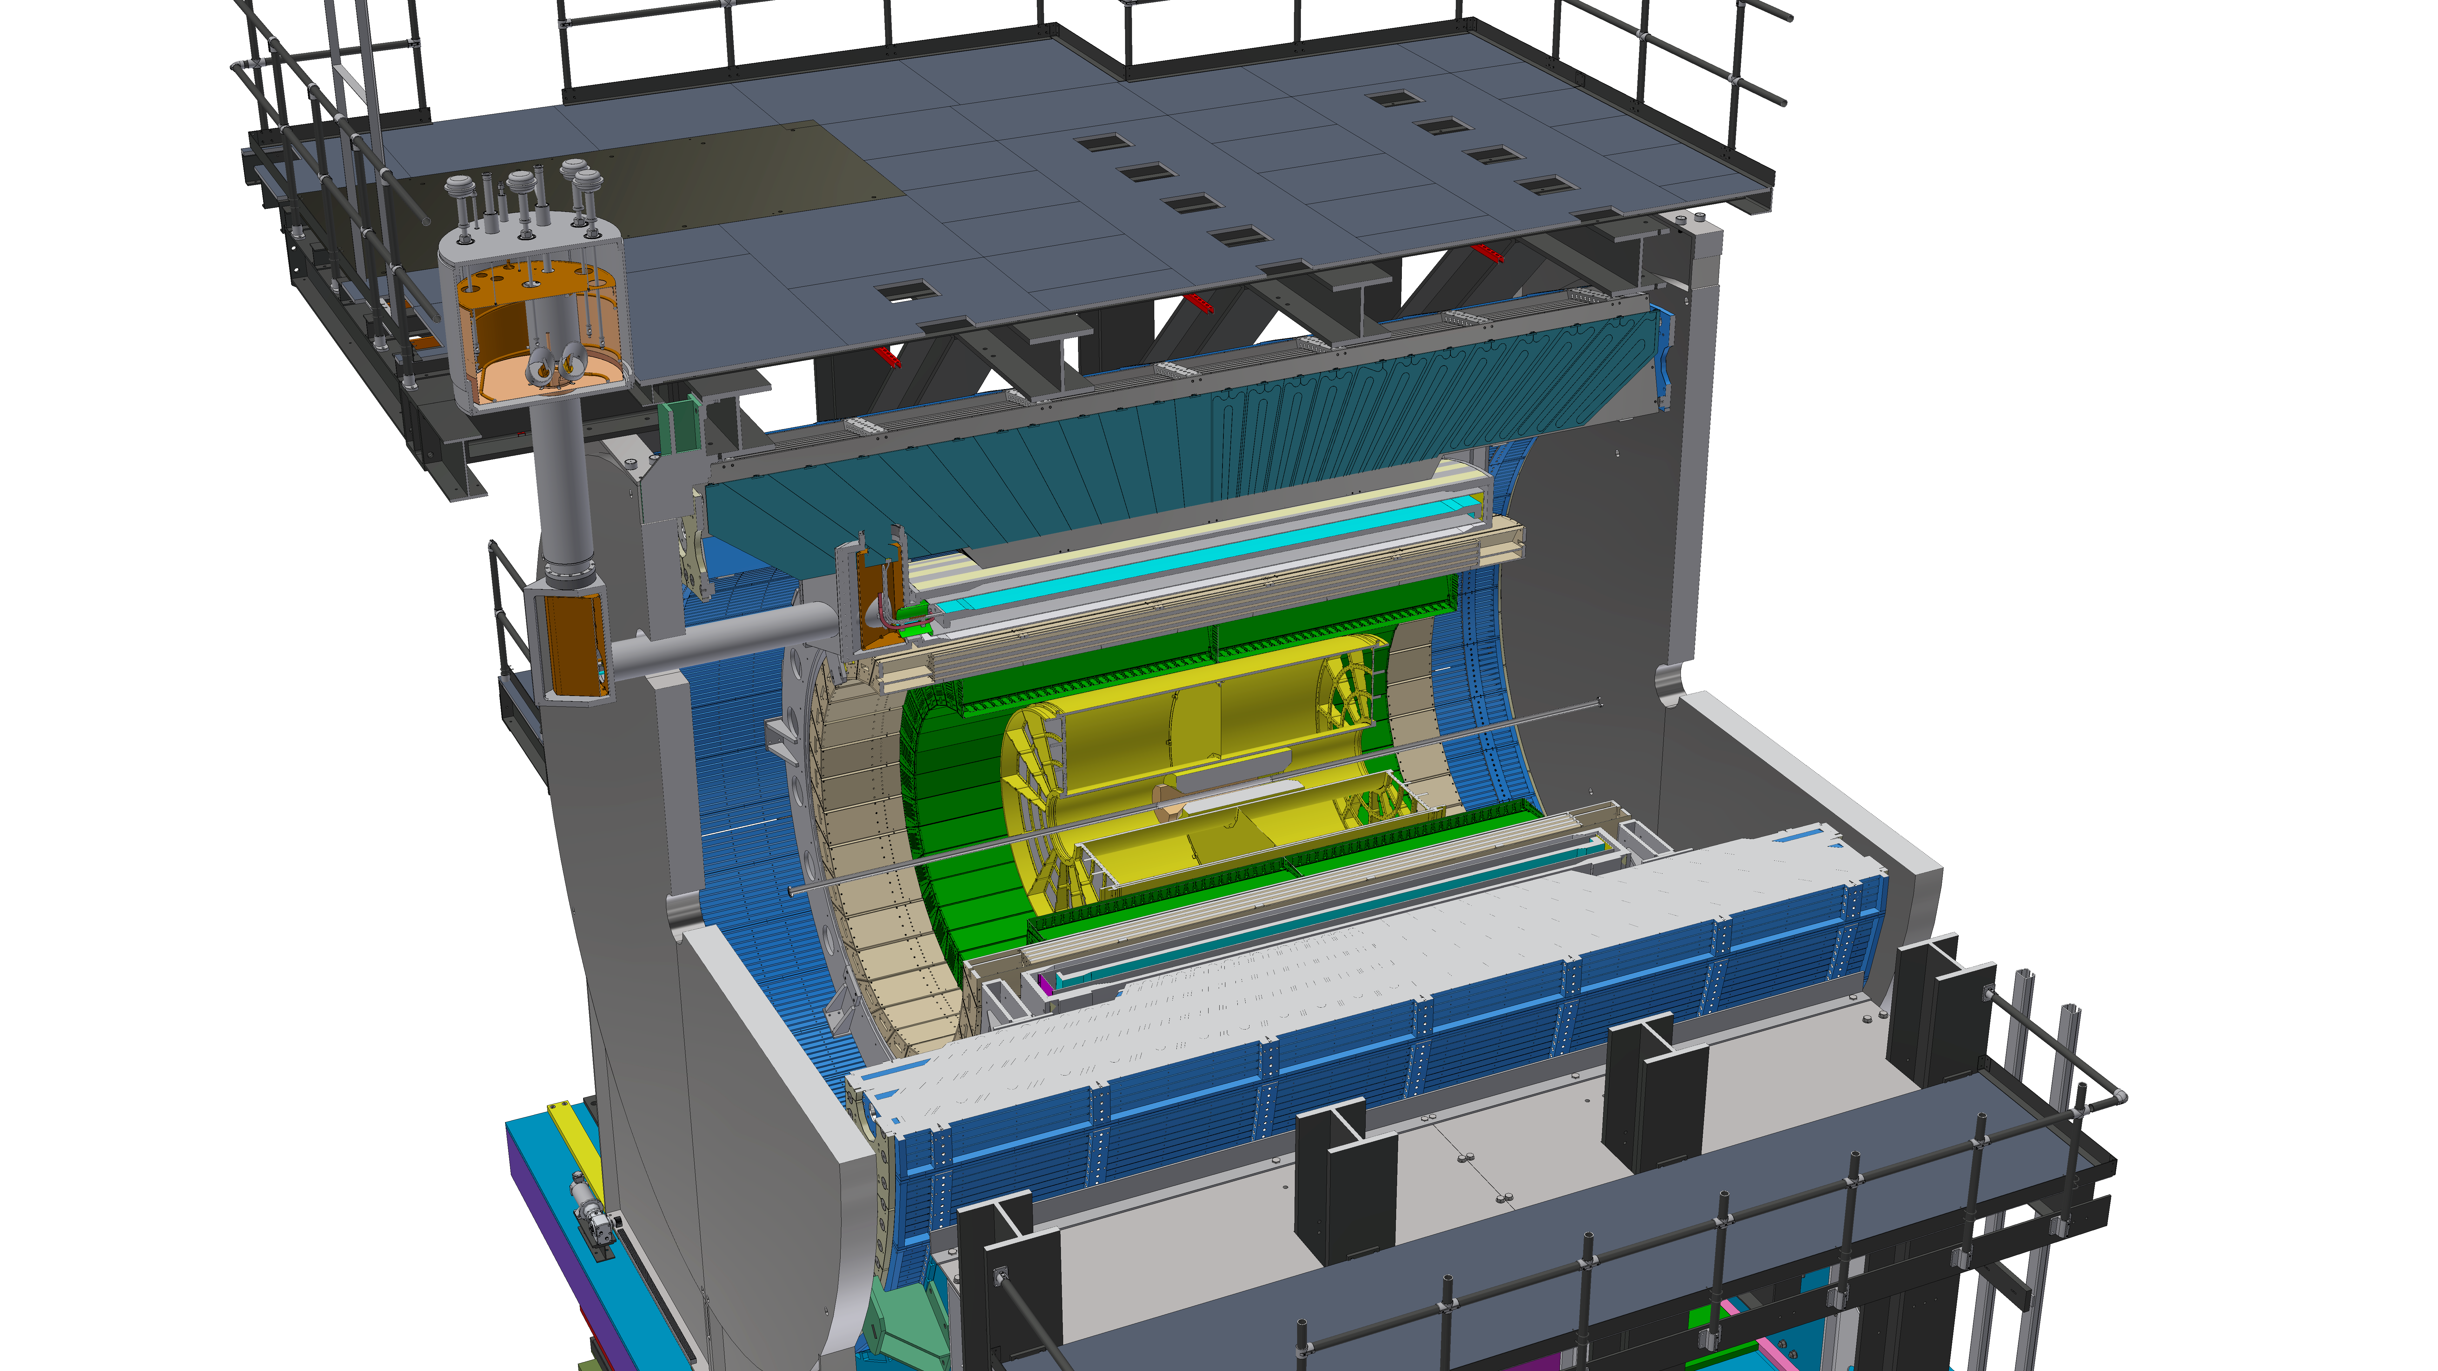
Existing Infrastructure
Existing BaBar solenoid (1.5T), flux return and cradle
  Substantial investment/risk reduction
IP6/8 infrastructure
  Cryogenic connection to RHIC
  Racks, mechanical, safety, electrical, etc.
Potential re-use/refurbish existing
sPHENIX detectors as appropriate
Additional in-kind contributions from DOE
labs and consortium members
ECCE consortium has considerable
recent DOE project experience
Currently under construction, sPHENIX represents a $27M investment by DOE (MIE)

Slide 9
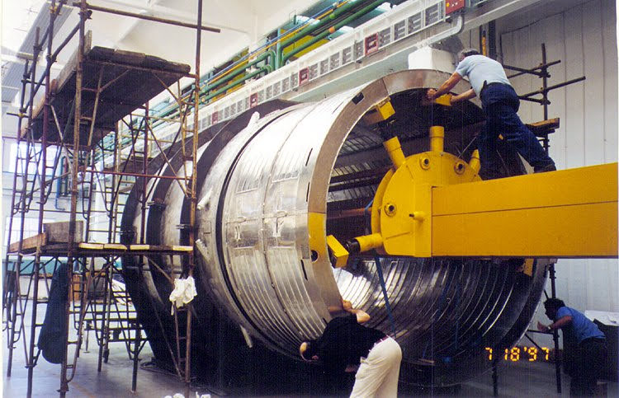
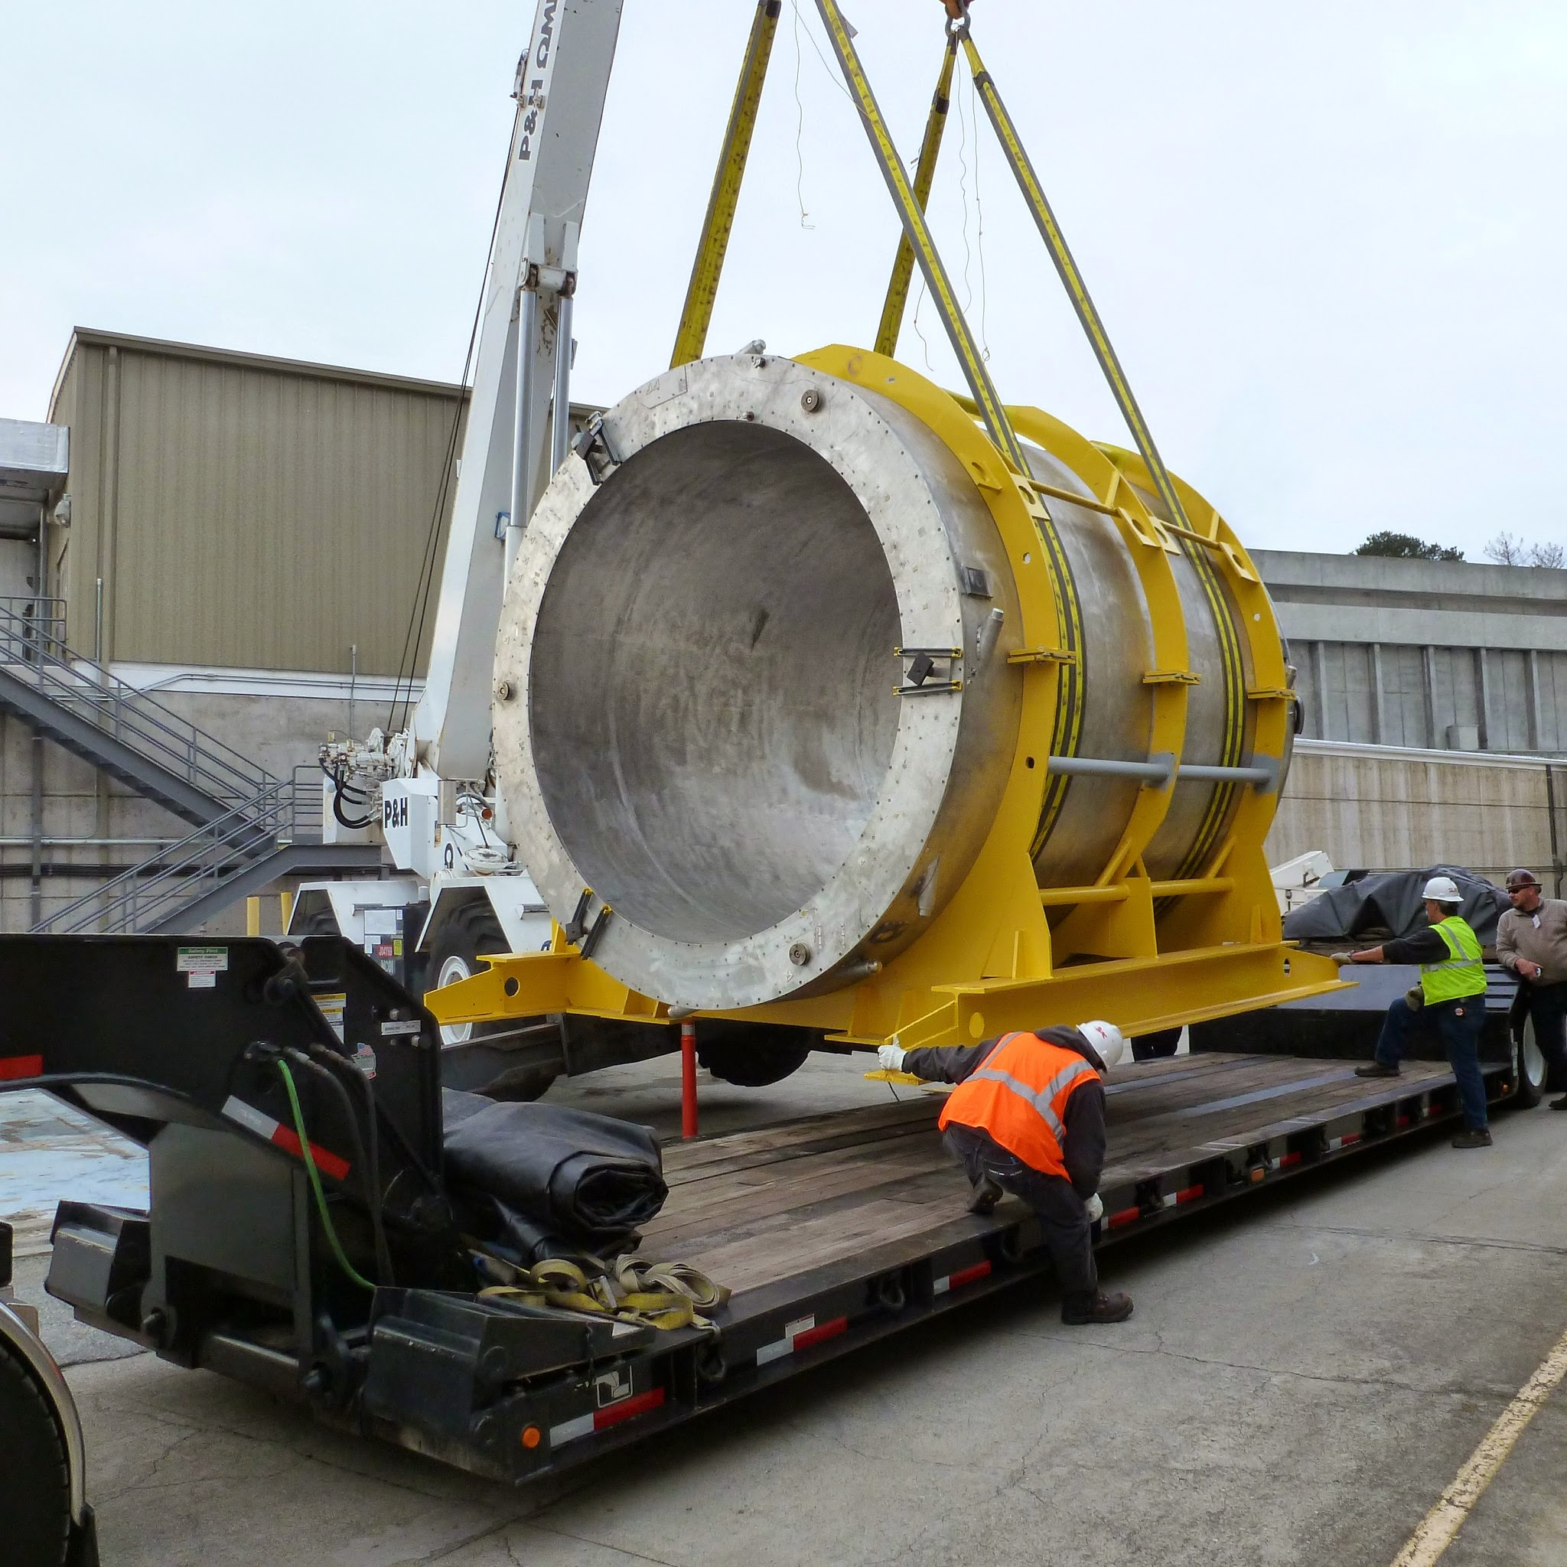
1.5T BaBar Solenoid
under construction
Built in 1997 (Ansaldo)
Very conservative design
3.7m long,
1.4m bore radius
Designed for 1.5T @ 5kA
  27MJ stored energy
Transported to BNL 2015
  Successful low and
  high field tests
Extensive risk analysis shows that the magnet is in excellent shape
  Some refurbishment required
shipping to BNL
Pasquale Fabbricatore
Designed BaBar and CMS 4T superconducting magnets
Recipient of IEEE Award for Continuing and Significant Contributions in the Field of Applied Superconductivity (2020)
Notes:
GlueX solenoid nee' LASS at SLAC 1972 – from Glenn (https://arxiv.org/pdf/2005.14272.pdf). Note also that this magnetic was refurbished, also involving opening the cryostats. Note also this is higher stored energy (24.1MJ) at full field. Ansaldo also made LHC dipoles and the CMS solenoid

Slide 10
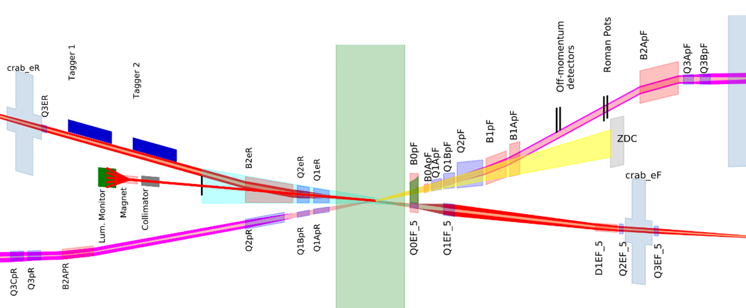
The EIC Interaction Region (IP6)
Hadrons
Electrons
Roman pots
(Complex chamber)
Low Q² taggers
(Beryllium windows)
Off momentum detectors
(Beryllium window)
SR absorber
Luminosity monitor
(Exit window TBD)
Forward spectrometer
(Thin wall exit window)
Rear cryostat
Forward cryostat

Slide 11
ECCE Central Detector Concept
HCAL
fHCAL
eHCAL
fEMC
dRICH
BEMC
MAPS Tracker
EEMC
Solenoid
hpDIRC, TOF, uRWELL

Slide 12
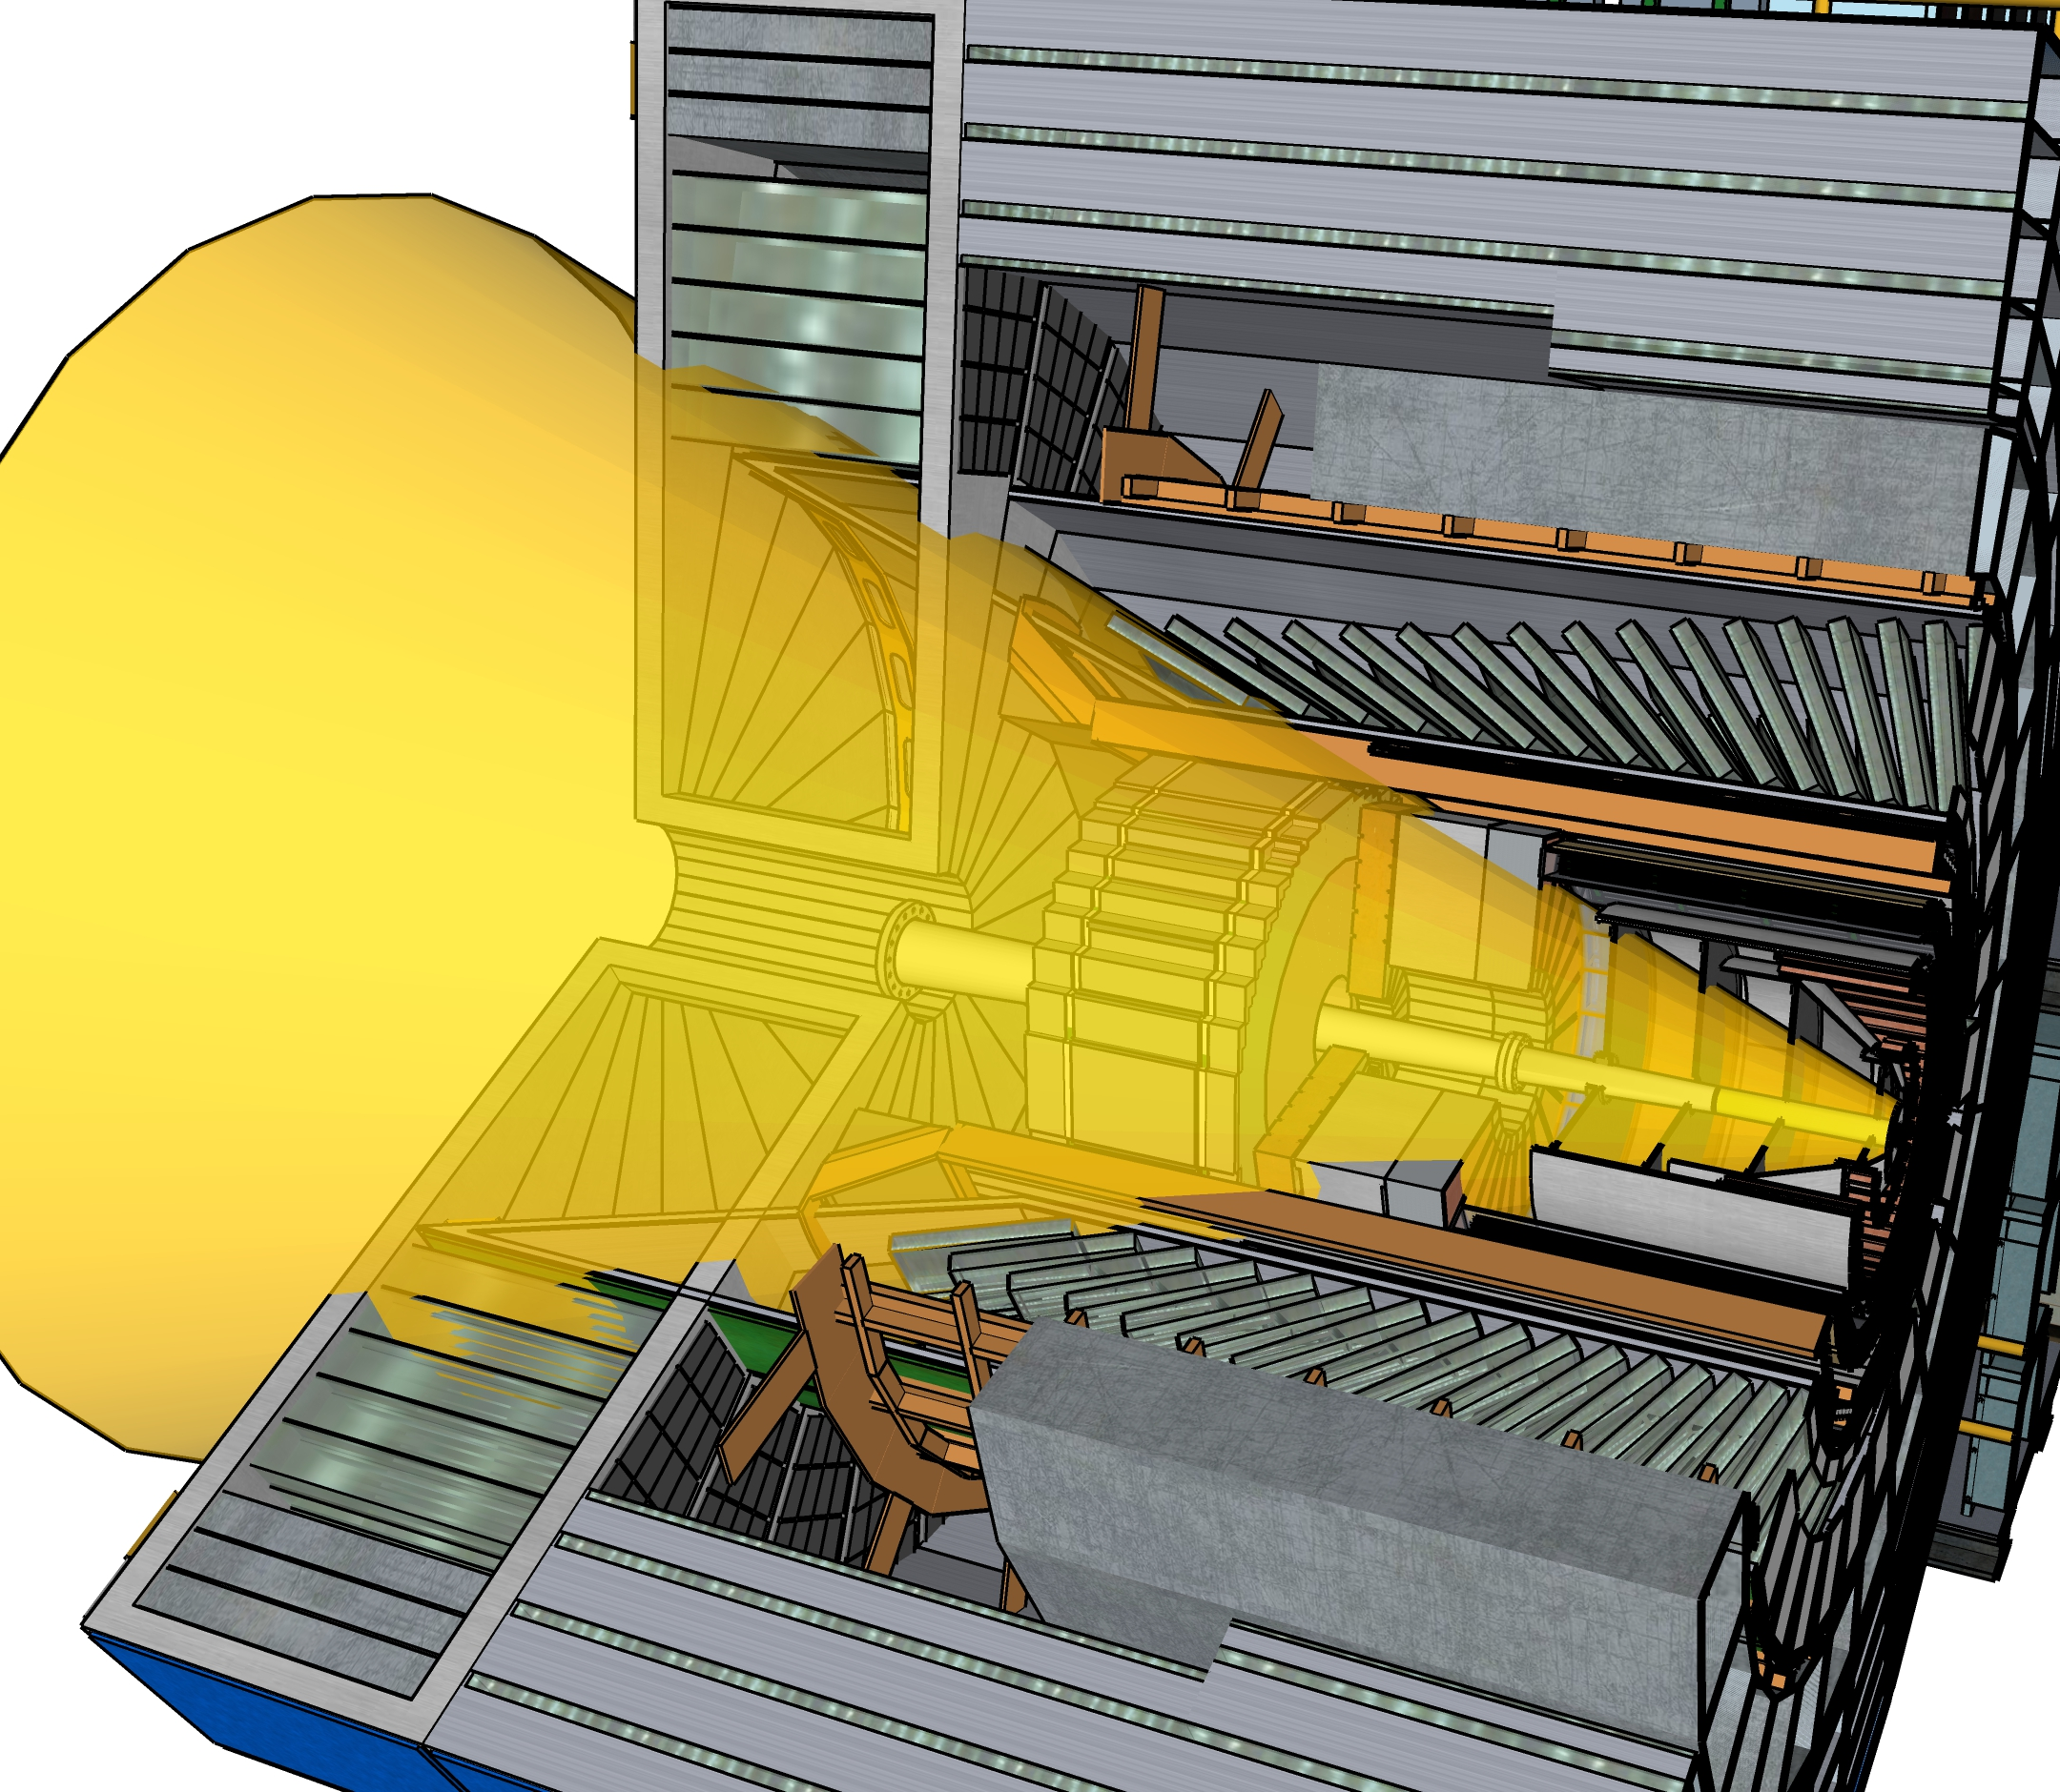
ELECTRON ENDCAP
Tracking: MPGD (large area μRWell)
Electron Detection:
  reference: PbWO4 crystals (reuse some)
  Option to replace outer rings with SciGlass (backup PbGl)
h-PID: mRICH & TOF
HCAL: Fe/Sc (STAR re-use)
eHCAL
(ECE06.10.06.02)
CENTRAL BARREL
Tracking: ITS3 based MAPS Si for vertexing, sagitta, and endcaps; mRWell outer layer (optimization underway)
Electron PID: SciGlass
(alt: PbGl or upgraded W/ScFi)
(plus instrumented frame)
h-PID: hpDIRC & TOF
HCAL: Fe/Sc (sPHENIX re-use)
eEMCAL
(ECE06.10.05.02)
4 discs
mRICH
TOF+tracking
HADRON ENDCAP
Tracking: MPGD (large area μRWELL)
PID: dual-RICH & TOF
Calorimetry:
  reference: standard W/ScFi shashlik (PHENIX re-use) for EMCal and long. sep. HCAL
  Upgrade path: dual readout

Slide 13
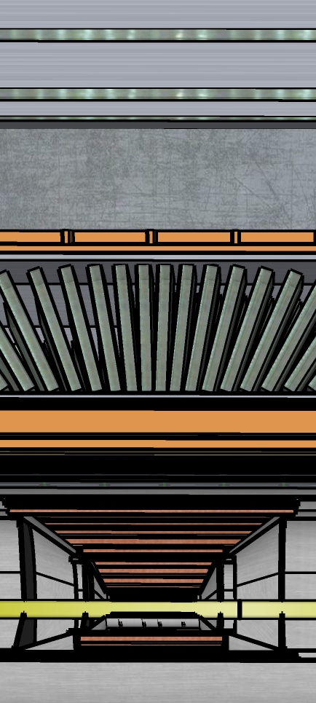
ELECTRON ENDCAP
Tracking: MPGD (large area μRWell)
Electron Detection:
  reference: PbWO4 crystals (reuse some)
  Option to replace outer rings with SciGlass (backup PbGl)
h-PID: mRICH & TOF
HCAL: Fe/Sc (STAR re-use)
bHCAL
(ECE06.10.06.01)
Cryostat
CENTRAL BARREL
Tracking: ITS3 based MAPS Si for vertexing, sagitta, and endcaps; μRWell outer layer (optimization underway)
Electron PID: SciGlass
(alt: PbGl or upgraded W/ScFi)
(plus instrumented frame)
h-PID: hpDIRC & TOF
HCAL: Fe/Sc (sPHENIX re-use)
bEMCAL
(ECE06.10.06.01)
TOF+tracking
DIRC
HADRON ENDCAP
Tracking: MPGD (large area μRWELL)
PID: dual-RICH & TOF
Calorimetry:
  reference: standard W/ScFi shashlik (PHENIX re-use) for EMCal and long. sep. HCAL
  Upgrade path: dual readout
Tracking

Slide 14
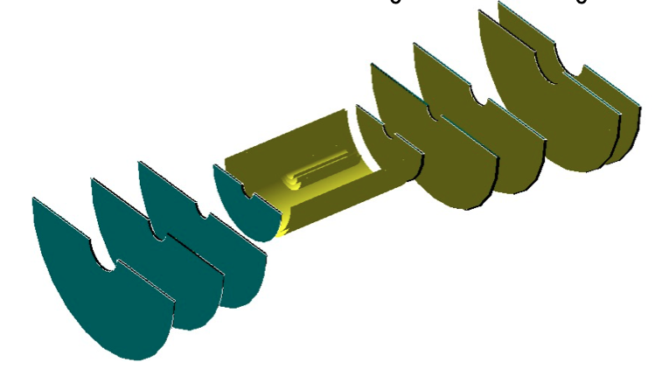
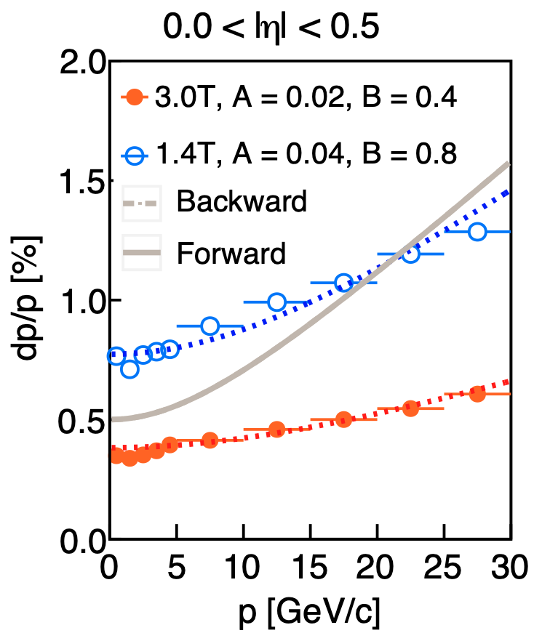
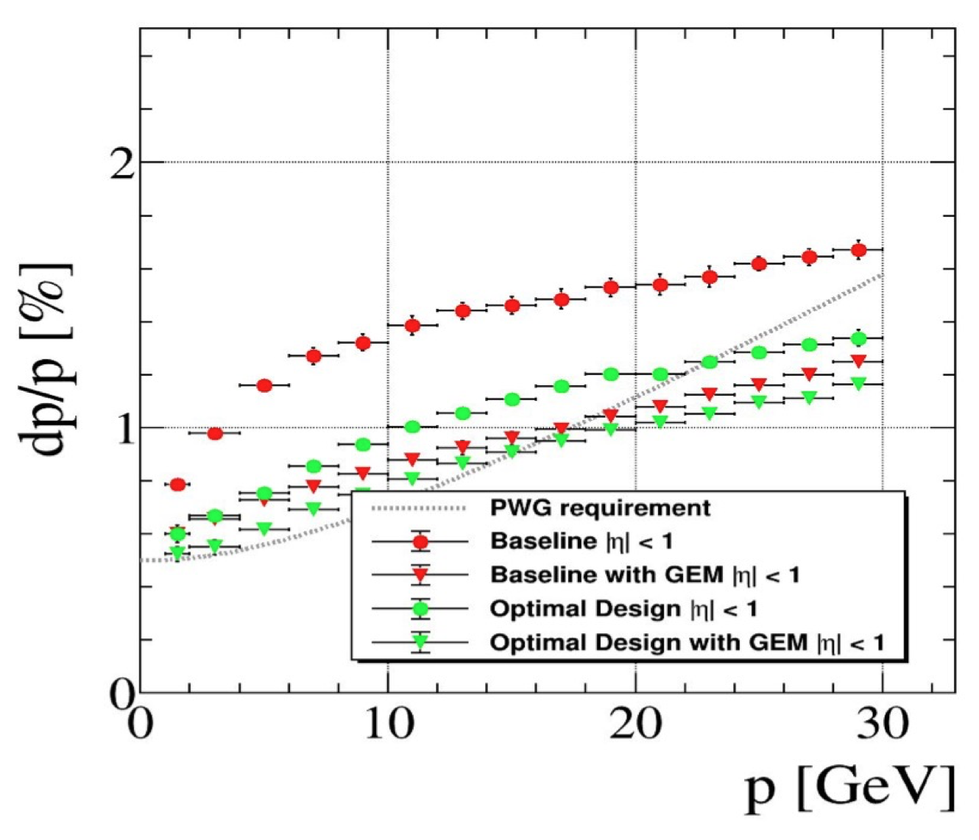
AI-Optimization of Inner Tracker
YR Study
ECCE AI-Optimized Tracker
Getting close to YR specs
Extensive use of AI to optimize inner tracker design to meet YR requirements.

Slide 15
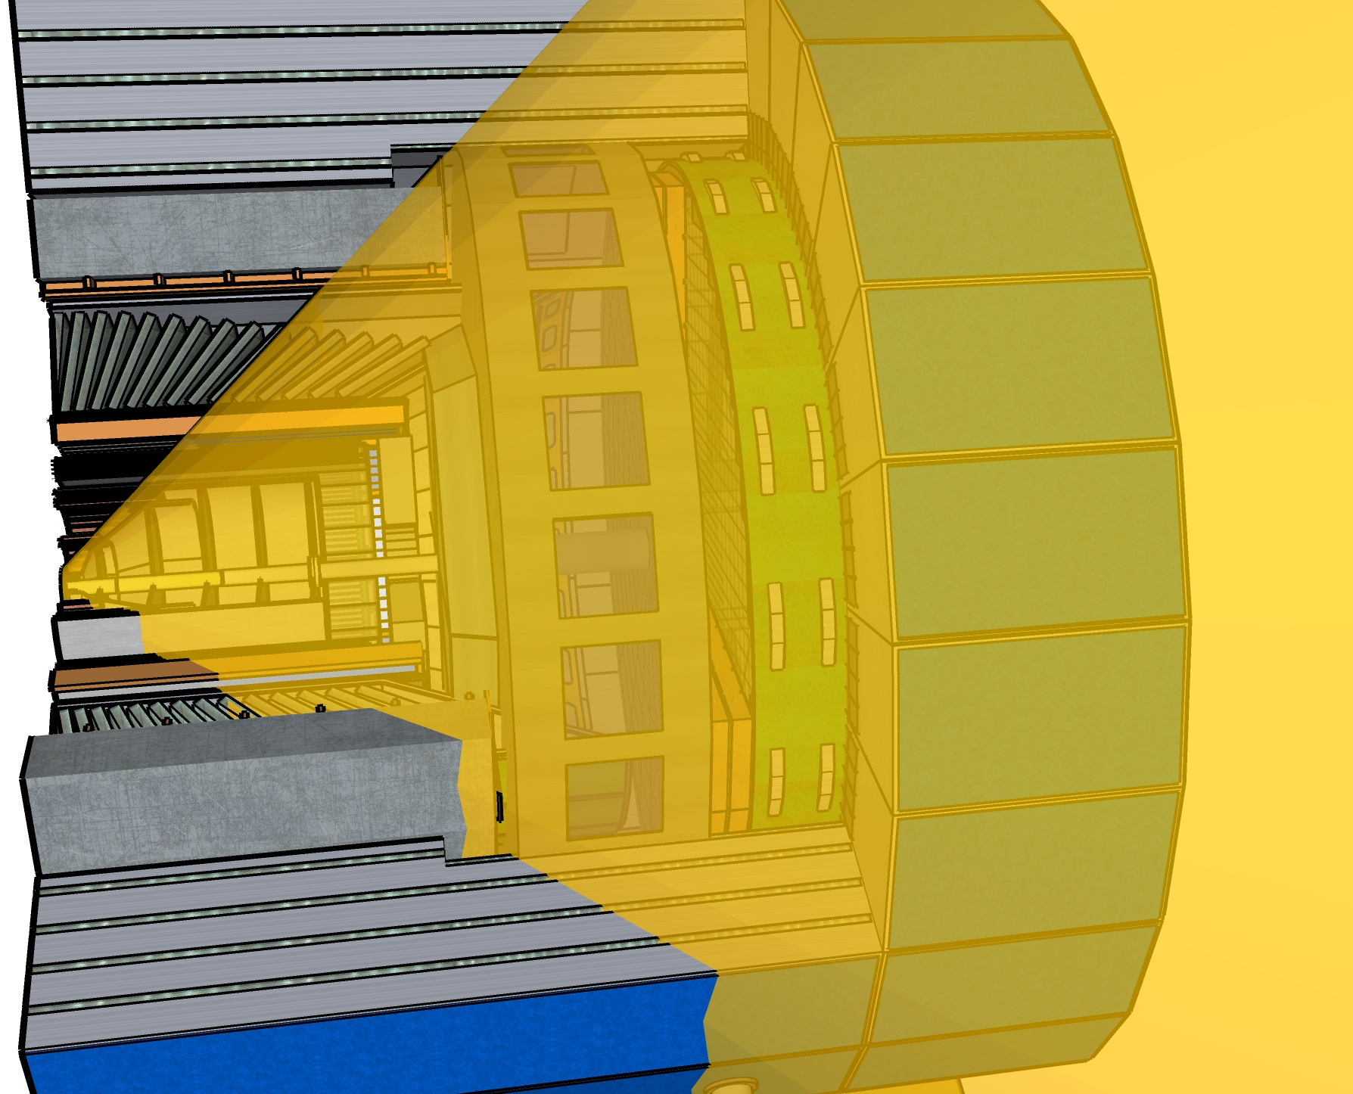
ELECTRON ENDCAP
Tracking: MPGD (large area μRWell)
Electron Detection:
  reference: PbWO4 crystals (reuse some)
  Option to replace outer rings with SciGlass (backup PbGl)
h-PID: mRICH & TOF
HCAL: Fe/Sc (STAR re-use)
hHCAL
(ECE06.10.06.03)
CENTRAL BARREL
Tracking: ITS3 based MAPS Si for vertexing, sagitta, and endcaps; mRWell outer layer (optimization underway)
Electron PID: SciGlass (alt: PbGl or W(Pb)/Sc shashlik)
(plus instrumented frame)
h-PID: hpDIRC & TOF
HCAL: Fe/Sc (sPHENIX re-use)
hEMCAL
(ECE06.10.06.03)
5 disks
TOF+tracking
dRICH
HADRON ENDCAP
Tracking: MPGD (large area μRWELL)
PID: dual-RICH & TOF
Calorimetry:
  reference: standard W/ScFi shashlik (PHENIX re-use) for EMCal and long. sep. HCAL
  Upgrade path: dual readout

Slide 16
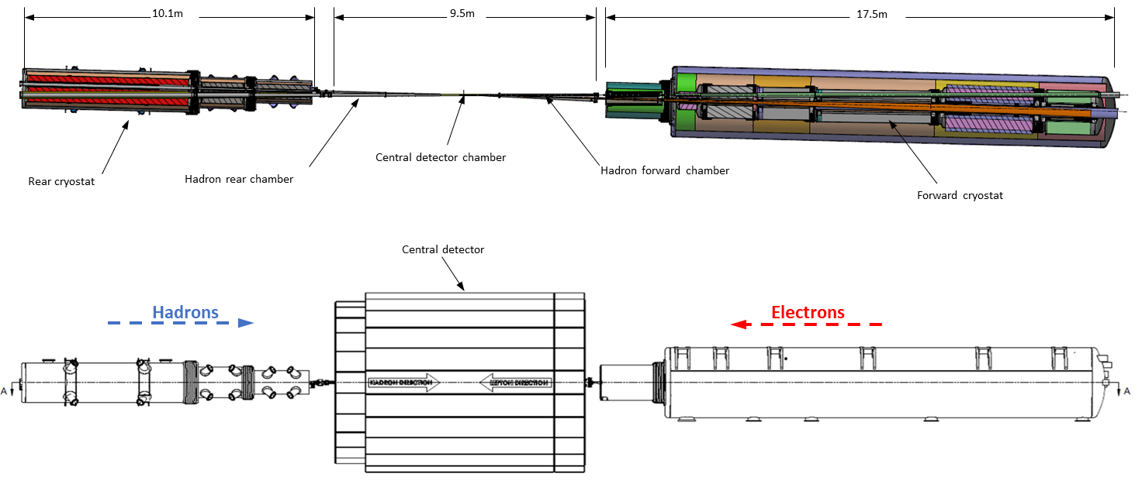
Hadrons
Electrons
Roman pots
(Complex chamber)
Low Q² taggers
(Beryllium windows)
Off momentum detectors
(Beryllium window)
SR absorber
Luminosity monitor
(Exit window TBD)
Forward spectrometer
(Thin wall exit window)
Rear cryostat
Forward cryostat
ECCE Far Backward Scope

Slide 17
Concept is common with other detector proposals – technology choices may differ
From A. Jentsch at EIC PM+Proposal meetings (spring 2021)
ECCE Far Forward Scope

Slide 18
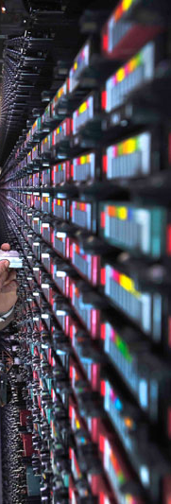
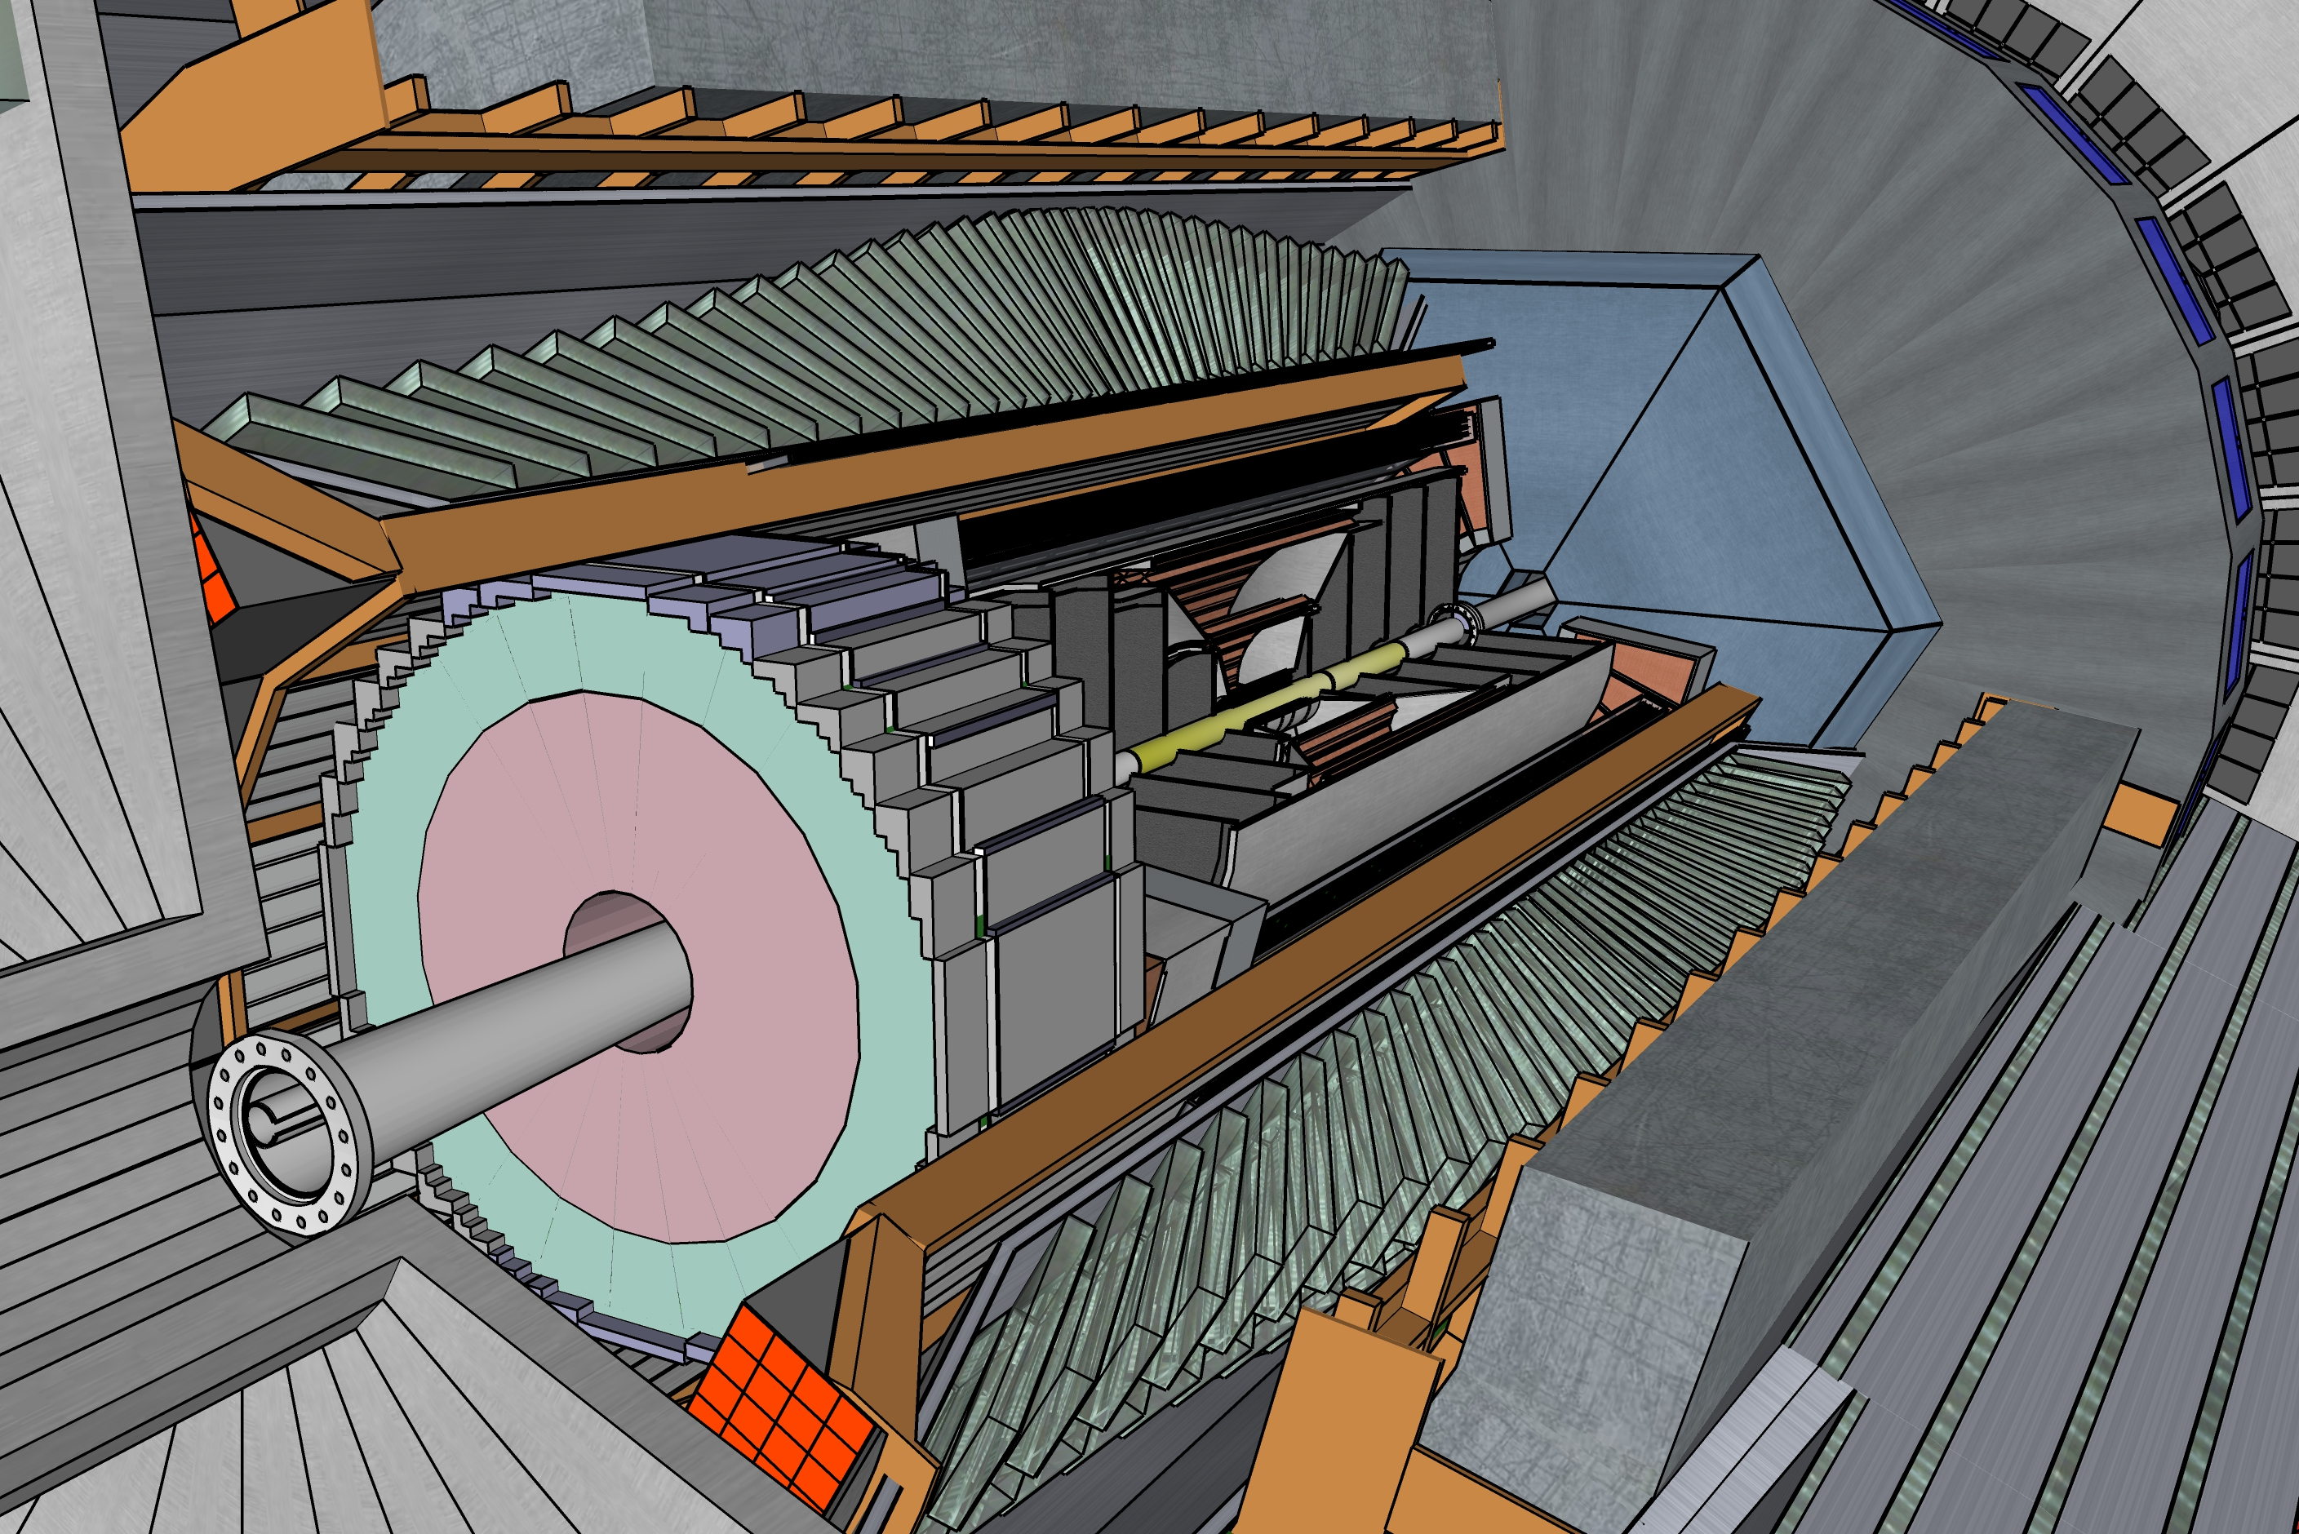
ECCE Streaming Data Acquisition
100Gbit/s
Network
Switch
FEE
Buffer Box
DCM
DCM
FELIX
EBDC
DCM
FEE
Buffer Box
DCM
DCM
FELIX
EBDC
DCM
Buffer Box
To the
SDCC/HPSS
FEE
DCM
FELIX
EBDC
DCM
DCM
Buffer Box
FEE
DCM
DCM
FELIX
EBDC
DCM
Buffer Box
FEE
DCM
DCM
FELIX
EBDC
DCM
Buffer Box
FEE
DCM
FELIX
EBDC
DCM
DCM
On Detector / in IR
In the Rack Room
In the SDCC
Detector-specific Front-end cards
Linux PC with interface card
(FELIX as a proxy for such a card)
O(100) such PCs
High-End Network switch
Linux File servers with large storage
~ 1PB per server (2021)
O(10) such servers
HPSS storage system

Slide 19
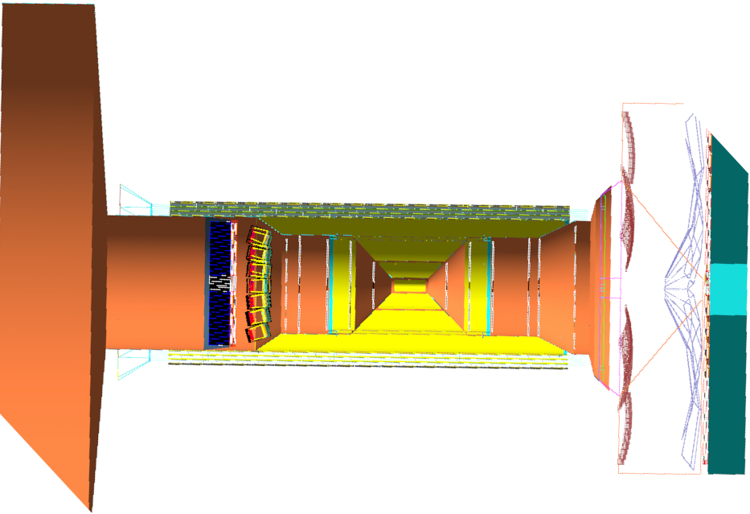
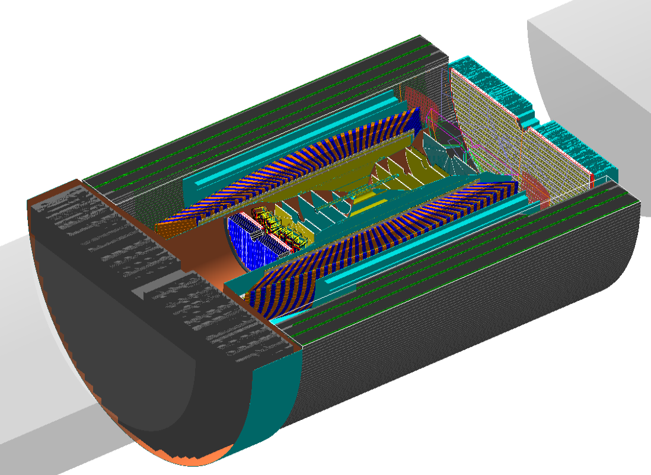
Implementation in G4
Name | z1 | z2 | r1 | r2 | Cu X₀ | Al X₀ | H₂O X₀ | Plastic X₀ | Carbon X₀ | Fe X₀
ETrackingCylinderService_1 | -400 | -310 | 270 | N/A | 9 | 0 | 0.42 | 0.32 | 0.333 | 0
ETrackingConeService_1 | -310 | -295 | 270 | 65 | 9 | 0 | 0.42 | 0.32 | 0.333 | 0
ETrackingCylinderService_2 | -295 | -200 | 65 | N/A | 17 | 0 | 0.56 | 0.64 | 0.333 | 0
ETrackingCylinderService_3 | -200 | -150 | 65 | N/A | 15 | 0 | 0.56 | 0.56 | 0.333 | 0
ETrackingConeService_2 | -150 | -125 | 65 | 48 | 13 | 0 | 0.56 | 0.48 | 0.333 | 0
ETrackingCylinderService_4 | -125 | -107.1 | 48 | N/A | 11 | 0 | 0.56 | 0.40 | 0.333 | 0
ETrackingCylinderService_5 | -107.1 | -80 | 48 | N/A | 9 | 0 | 0.42 | 0.32 | 0.333 | 0
ETrackingCylinderService_6 | -80 | -57 | 48 | N/A | 7.5 | 0 | 0.28 | 0.24 | 0.333 | 0
… | … | … | … | … | … | … | … | … | … | …
July concept includes a very detailed model of all required material for supports and services!

Slide 20
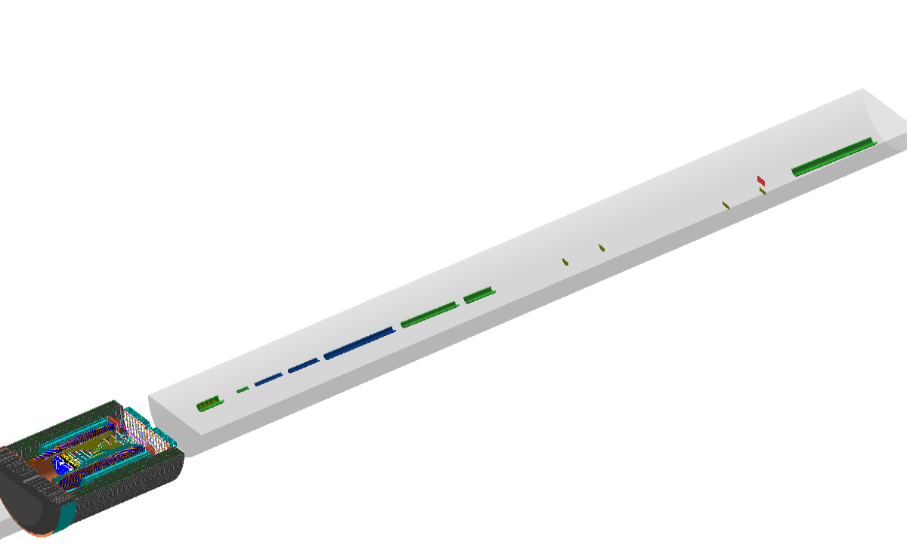
Full Beamline Implementation in G4
G4 Implementation includes forward and backward beamlines, with particle transport through magnet elements as well as detector instrumentation.
Second simulation campaign underway!

Slide 21
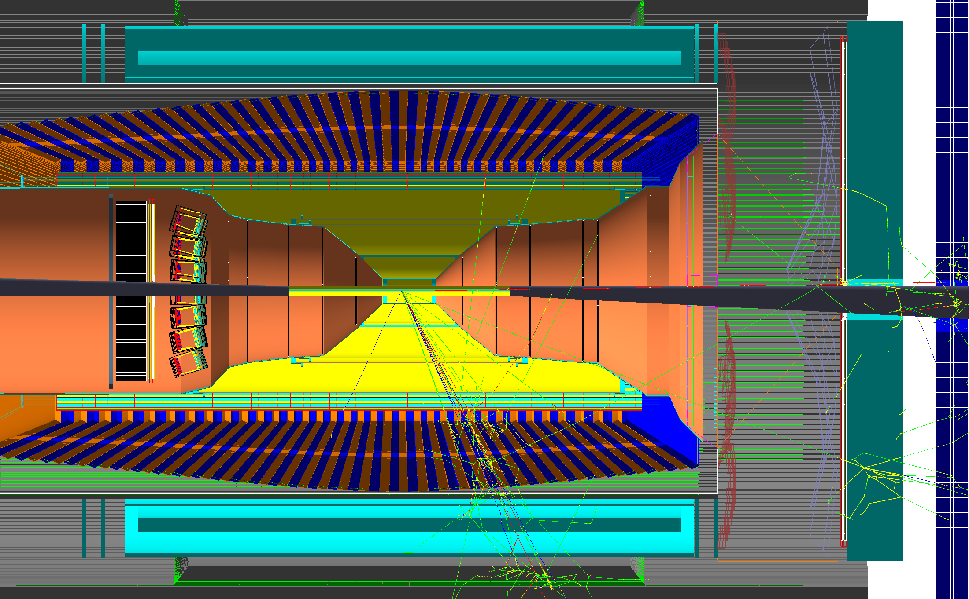
Example DIS Event
Q² = 5000 GeV²
Scattered e⁻
Jet

Slide 22
Kinematic Reconstruction
Good reconstruction of DIS kinematics and recoil hadron for SIDIS.
Leptonic
Reconstruction
Double Angle
Reconstruction

Slide 23
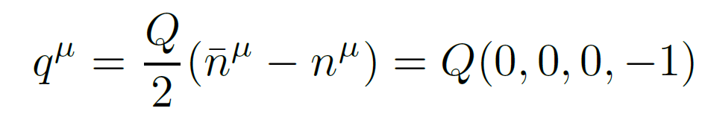
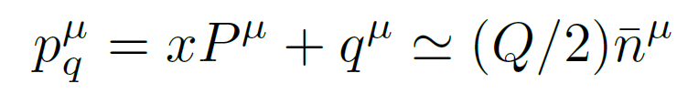
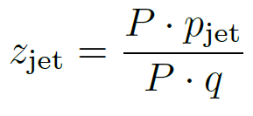
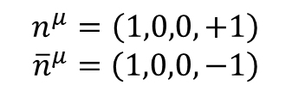
Breit Frame
z-axis
The Breit frame is the frame in which the (spacelike) virtual photon carries only momentum (E=0) along the –z axis.
We can always define this frame in terms of a boost and a rotation based on knowledge of the incoming beam and the scattered electron.
In the Breit frame, the jet associated with the struck quark is at negative rapidity, while jets associated with the target proton are at positive rapidity.
The quantity z_{jet} is the fraction of the scattered quark momentum carried by the jet (good to LL level).
$$n^{μ}=\left(1,0,0,+1\right)$$
$${\overline{n}}^{μ}=\left(1,0,0,−1\right)$$
Fraction of scattered quark momentum carried by jet.
arXiv:2006.10751v2

Slide 24
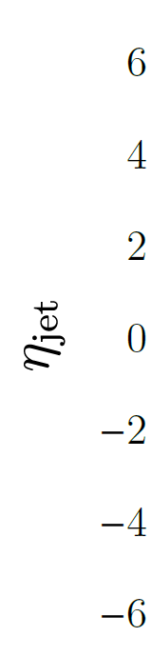
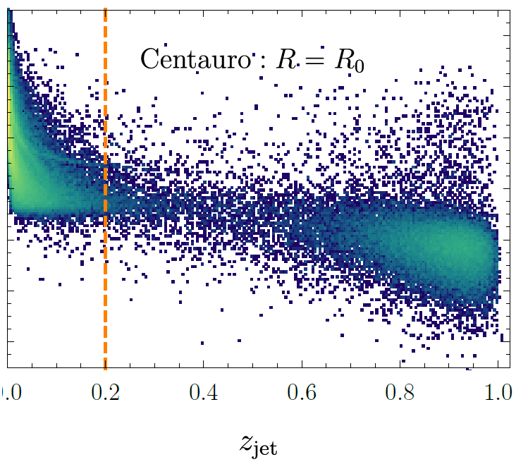
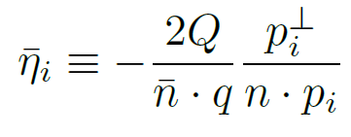
Centauro Algorithm
Pythia8, 10x100, Q>10, R-0.8
A compromise – Longitudinally invariant, but matches the spherical algorithms behavior in the backward hemisphere (negative rapidity). This allows it to properly capture the current jet and separate it from the beam remnant jets.
arXiv:2006.10751v2

Slide 25
Simulation Events
Using high-Q² Pythia6 events from SIDIS WG, 10x100:
  /gpfs/mnt/gpfs02/eic/DATA/YR_SIDIS/ep_10x100/ep_noradcor.10x100highq_run001.root
Using the second campaign (July concept) ECCE-EIC/macros
  One (g4trackfastsim modification for BECAL projections)
Centauro algorithm from fastjet-contrib:
  http://fastjet.hepforge.org/contrib
  Running Fastjet 3.4.0
Look for scattered electron in EEMC and BECAL
Jets constructed from:
  Charged tracks and tracks + neutral clusters
    NOTE: all four-vectors transformed as massless particles at present, PID not used
  Primary (Truth) Jets use full particle id
Jet finding done with R=0.8
  Might be a bit large, but done to match Centauro paper

Slide 26
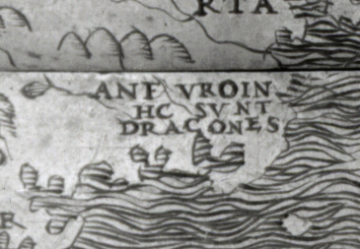
Here be Dragons…
This analysis is unoptimized
  Second campaign has just started
    This is < 48hrs old
  Track matching and neutral cluster cuts not
  optimized
  Standard DST (non-optimized)
  clustering used

Slide 27
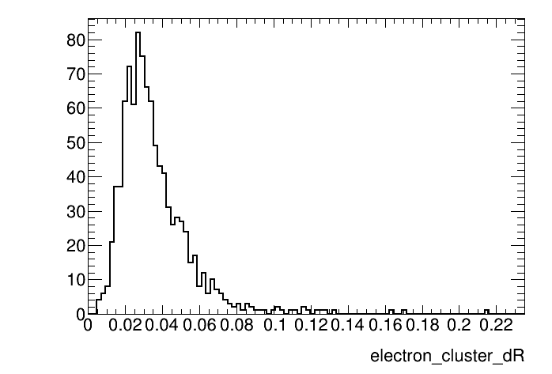
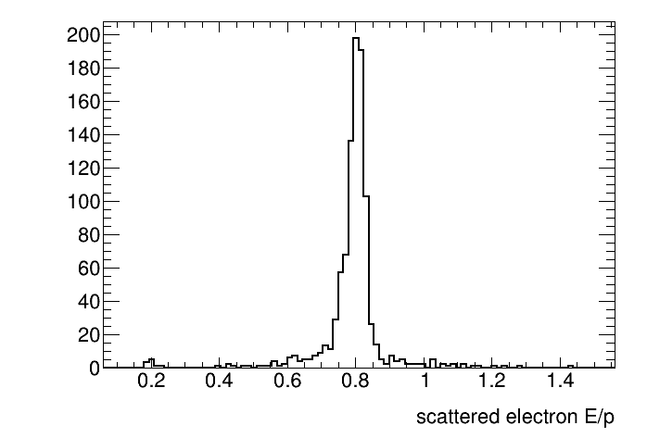
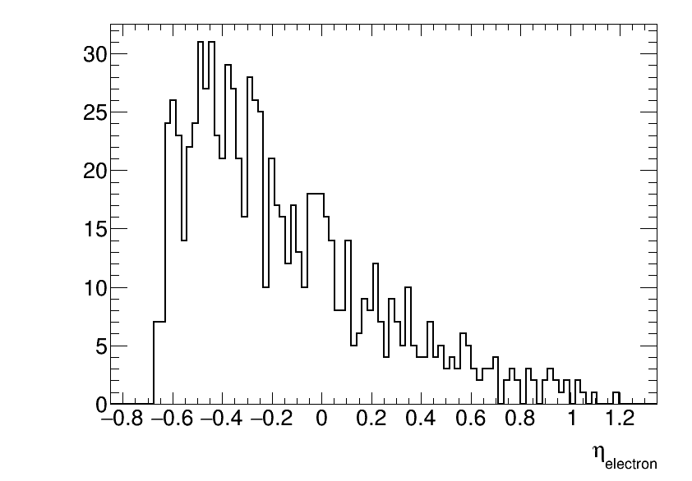
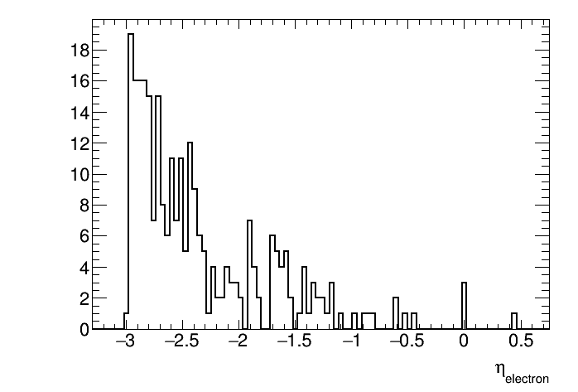
Scattered Electron ID/Kinematics
High-q events (Q²>100):
all in BECAL
Offset in matching to electron cluster?
Low-q² check – electron acceptance makes sense.
most in EEMC

Slide 28
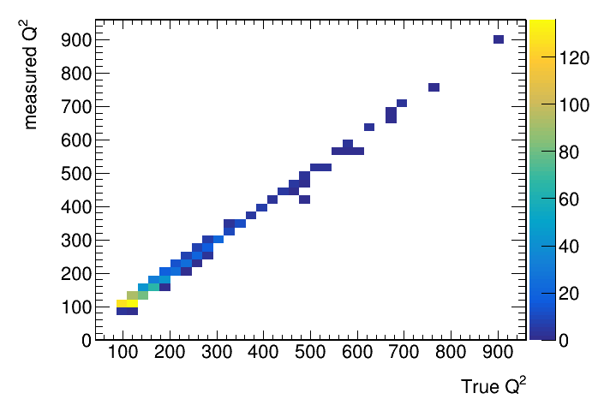
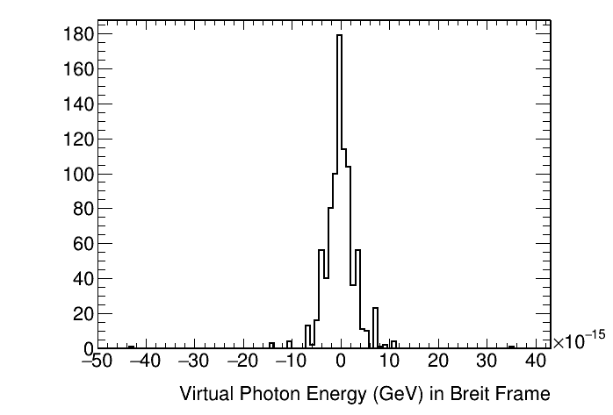
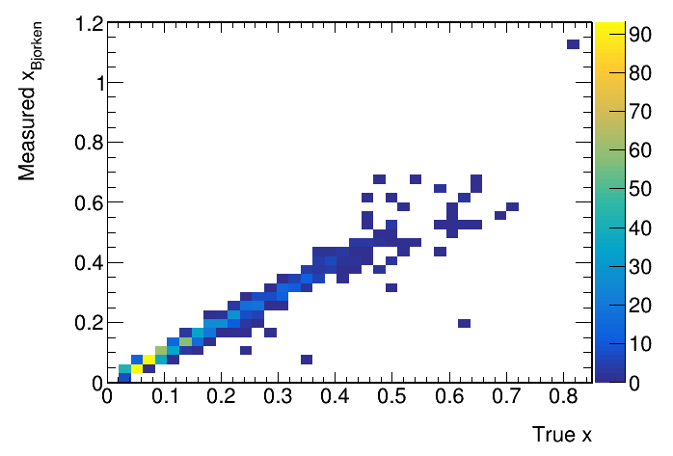
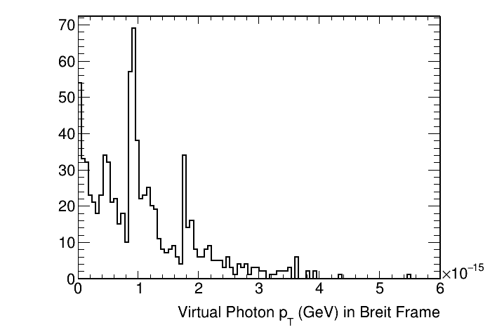
Sanity Checks
Kinematics of the virtual photon after transformation to Breit frame – the energy and p_{T} are zero within round-off error.

Slide 29
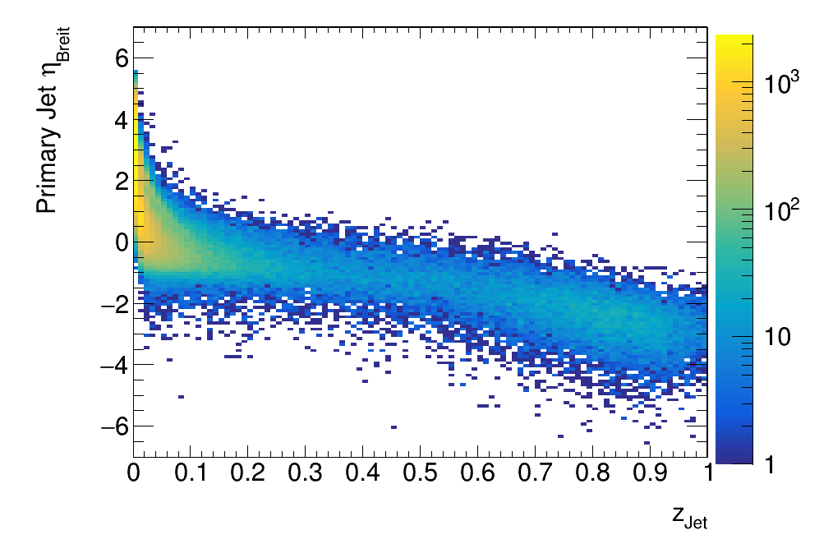
Centauro Truth Jets Comparison
Primary constituents (lab frame):
p_{T}<200MeV
|η|<4.0
Pythia6, 10x100, Q>10, R=0.8 (20k events)
Pythia8, 10x100, Q>10, R-0.8
arXiv:2006.10751v2
Primary Jet
Looks good – same general features as in Centauro paper.
N.B. : Lab frames not identical!
ECCE lab frame includes crossing angle

Slide 30
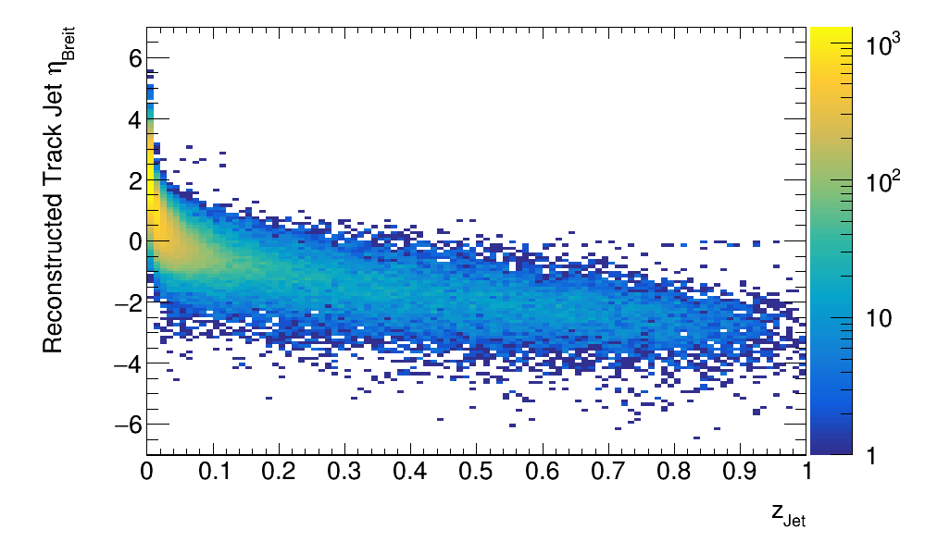
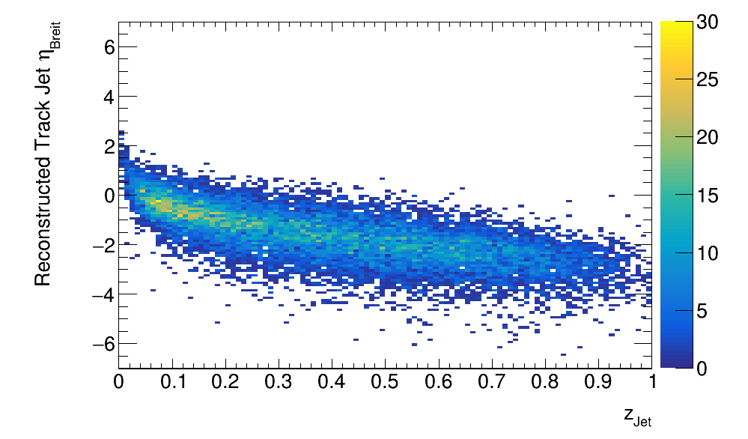
ECCE Centauro Track Jets
Track Jets
Pythia6, 10x100, Q>10, R=0.8 (20k events)
Primary Jets
Track Jets
>1 constituent required
Missing neutral energy causes smearing in zJet.
Requiring >1 constituents suppresses single-particle “jets” in the fragmentation region.

Slide 31
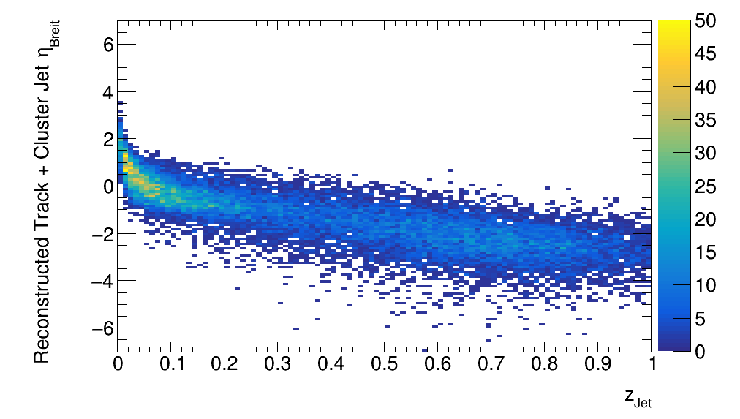
Track + Neutral Cluster Jets
Add in neutral clusters – isolated clusters without a track within 0.1 in Δη,Δφ space.
Track + Cluster Jets
>1 constituent required
0<c_{f}<1
Track Jets
>1 constituent required
Additional constraint – eliminate purely EM or track jets.

Slide 32
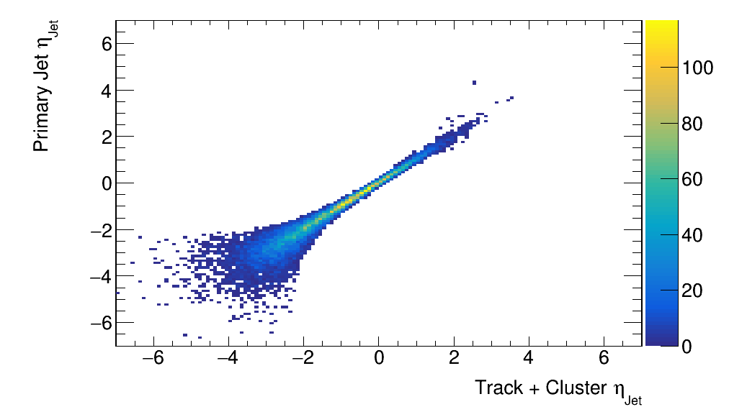
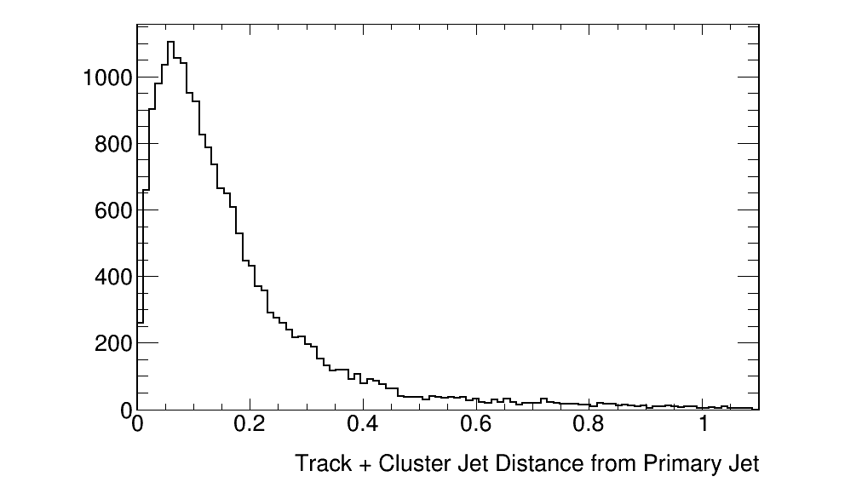
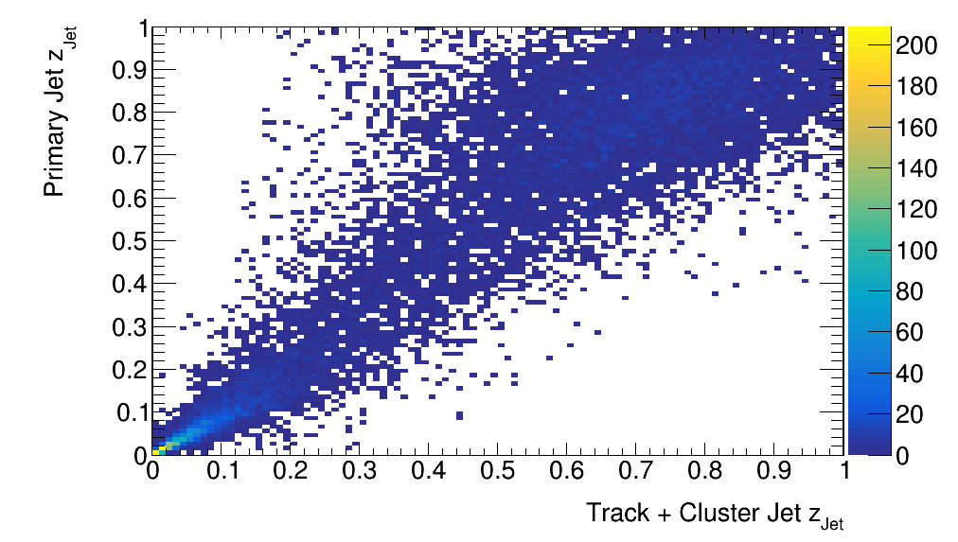
Track + Cluster Jet Matching
Reasonable matching between track + cluster and primary jets.
Correlation seen between jet eta, z in Breit frame – z_{Jet} does show missing energy.

Slide 33
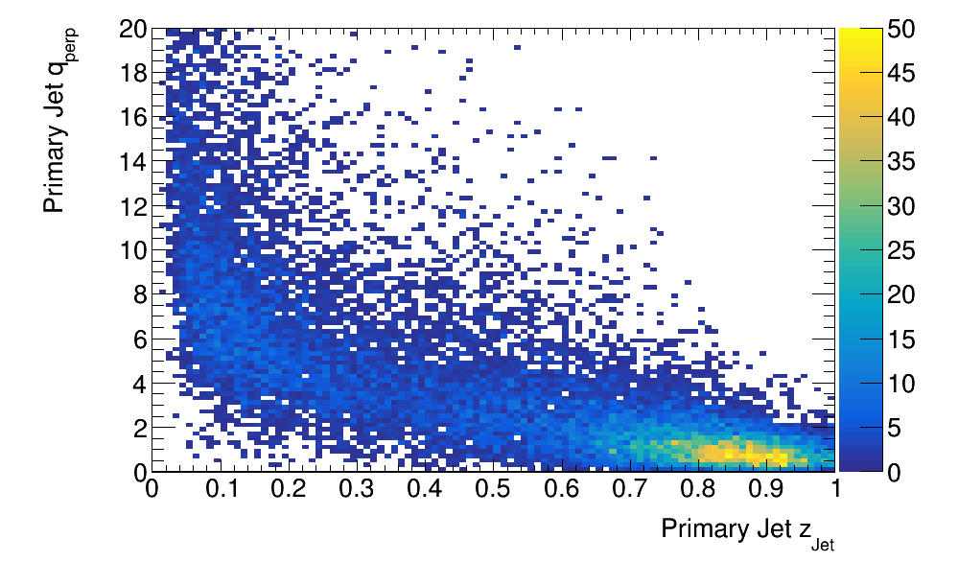
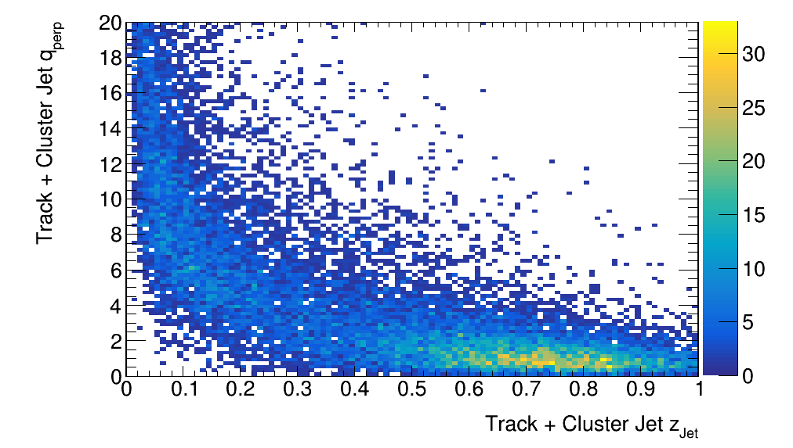

Centauro Jets for TMD’s
Pythia6, 10x100, Q>10, R=0.8 (20k events)
Truth Jets
arXiv:2006.10751v2
ECCE Tracks + Neutral Clusters
$$q_{T}=p_{Jet}^{⊥}/z_{jet}$$
This is the transverse momentum of the jet with respect to the scattered quark direction.

Slide 34
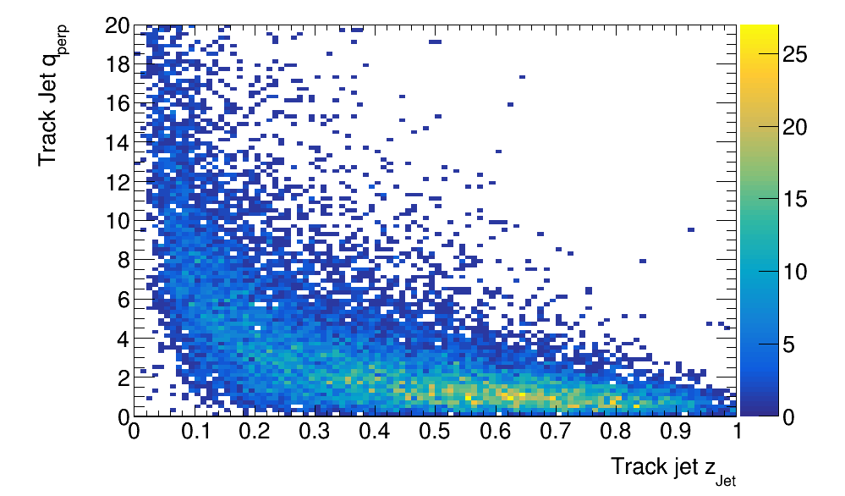
ECCE Jets Compared
ECCE Tracks + Neutral Clusters
Tracks
Including the neutral clusters improves the smearing in z_{Jet}.

Slide 35
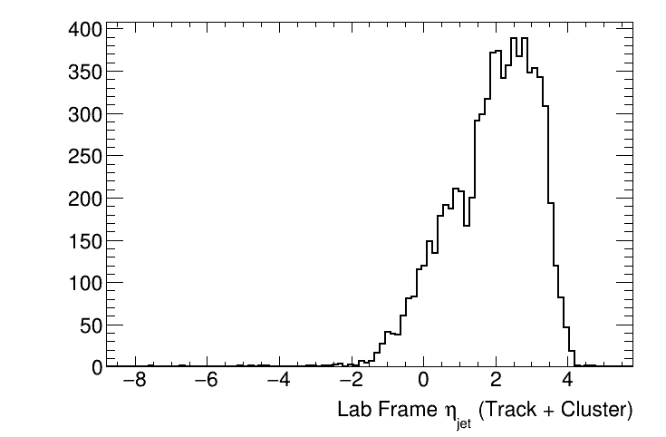
ECCE Track + Cluster Jets in Lab Frame
Most jets are in the forward (hadron arm) acceptance.

Slide 36
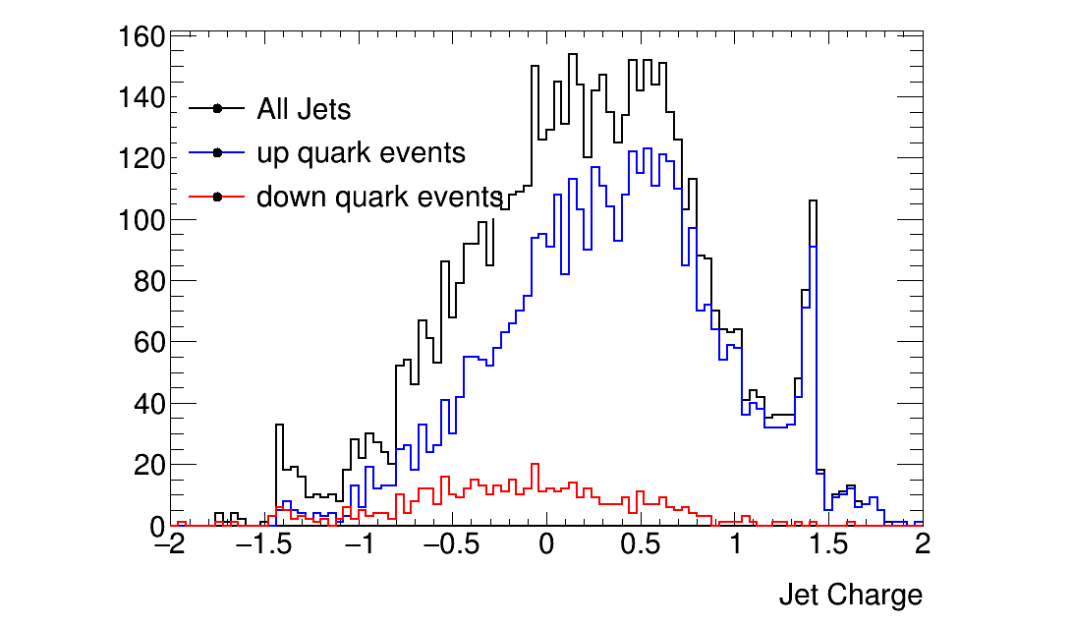



Jet Charge
$$Q_{jet}=\frac{1}{\sqrt{p_{T}^{Jet}}}\sum_{i}{q_{i}p_{i}^{0.5}}$$
Track Jets
Primary Jets
Track + Cluster Jets
Possible to isolate statistically enriched samples of u,d quarks jets

Slide 37
Future Work
Optimize the clustering, cluster matching
  Varies by calorimeter
Ultimate best results obtained by implementing particle flow
  Compensate for track momentum resolution with calorimeter energy?
  Not for the immediate future….

Slide 38
Conclusions
The ECCE consortium is 80 institutions planning to design the EIC project detector based around the BaBar solenoid
By reducing cost and risk, the plan is to be ready for physics by EIC CD-4a, as soon as possible at the start of machine operations.
The physics program spans the entirety of that outlined in the NAS study and the Yellow Report
The detector design process is well underway, in tandem with a wide range of full physics simulations
Lots of opportunity for new groups to get involved!
  https://ecce-eic.org

Slide 39

ECCE Resources
ECCE Website
  https://www.ecce-eic.org/
ECCE Indico
  https://indico.bnl.gov/category/339/
ECCE Indico Calendar
  https://indico.bnl.gov/category/339/calendar
ECCE Wiki
  https://wiki.bnl.gov/eicug/index.php/ECCE

Slide 40
Example of ECCE Physics : Nuclei
Incoherent diffractive J/Ψ production in e-d tagging
di-hadron azimuthal angle correlation, nuclear glue ratio through inclusive and open charm
Inclusive diffraction in e-A
Yellow Report, Volume 2,
Fig. 7.63
Yellow Report, Volume 2,
Fig. 7.73
Yellow Report, Volume 2,
Fig. 7.69
Yellow Report, Volume 2, Fig. 7.30
ECCE – physics reach enhanced in x_{L} and x_{B} with beam focus with dispersion – relevant for diffraction (e-p, e-A) and tagging (e-d, e-³He, etc), and exclusive measurements
40

Slide 41
BACKUP

Slide 42


Physics Drivers and EIC Science
NAS Report Topics | NAS Report Sub-topics | ECCE Measurements | Yellow Report enhancement
Origin of Mass | Tomographic Imaging Quarks and Gluons
Confined motion of partons | Heavy-quarkonia exclusive production at threshold |  | π/K structure
3D imaging of quarks and gluons | 3D Imaging in Momentum Space
Origin of Spin | Gluon spin and orbital motion
High gluon densities in nuclei | Transverse motion in polarized nucleons
Dense Systems of Gluons | Propagation of energetic quarks through matter
 | Properties of Nuclei in QCD | Nuclear SFs and nuclear imaging | Light-ion tagging
 | Diffraction | Dense gluons, saturation
ECCE will fully address the EIC science program with fully simulated examples of performance.
D/D* reconstruction and heavy-flavor in jets.
“Experiments must address the EIC White Paper and NAS Report science case”

Slide 43


Heavy Flavor in ECCE
Study by Wenqing Fan (LBNL)
Fast simulation of PID, based on YR specifications
Parallel effort ongoing with full detector G4 simulations

Slide 44
Example of ECCE Physics : Spin
Scattered Electron Backgrounds
Major requirements:
  Precision calorimetry in lepton endcap
  PID in barrel
ECCE:
  High resolution calorimetry in lepton endcap
  PID in barrel
  PID in forward endcap enables also TMDs
Yellow Report, Volume 2, 1/13/21 snapshot, Fig. 7.17 and 8.11
Yellow Report, Volume 2,
Fig. 7.17 and 8.11
Yellow Report, Volume 2,
Fig. 7.53
Yellow Report, Volume 2, Chapter 7

Slide 45


Example of ECCE Physics : Origin of Hadron Mass
Large reduction in pion (structure) pdfs through EIC
Yellow Report,
Volume 2, Fig. 7.24
Major requirements
  Far-forward detection to tag n and Λ (or Σº) (meson structure)
  Scattered electron detection in electron endcap
  Good hadron endcap and far-forward calorimetry (goal: 35%/E, <50%/E acceptable)
  For pion form factor: pion in hadron endcap
and to tag p (for DVCS/3D).
Yellow Report, Volume 2,Fig. 7.46
ECCE – physics reach enhanced in x_{L} and x_{B} with beam focus with dispersion – relevant for diffraction (e-p, e-A) and tagging (e-d, e-³He, etc), and exclusive measurements
From 4th YR Workshop – talks on complementarity (Y. Zhang, V. Morozov)

Slide 46
Pion Form Factor in ECCE

Slide 47
Why ?
ECCE is a low-risk, cost-effective, flexible and optimized EIC detector!
  Low risk due to re-use of existing magnet and various detectors.
  Cost-effective due international in-kind contributions and
  magnet and detectors reuse
  Flexible and optimized by studying both IRs and using full Geant4.
  Most realistic detector to be ready by CD4a.

Slide 48

From Jim Yeck
3/30/21

Slide 49
Second Simulation Campaign
Has started!
  https://lists.bnl.gov/pipermail/ecce-eic-public-l/2021-September/000220.html
Currently running single-particle checks and debugging
Anticipate full production to start in ~ 1 week
ECCE 4th Simulation Workshop:
  https://indico.bnl.gov/event/13060/
  Will concentrate on details of making use of second campaign output

Slide 50





Other Infrastructure…
Multiple rounds of prototyping to adapt 4140 HT process to thick material:
Initial attempt cracked when machined, required modified treatment and machining
engineering, FEA, reviews, prototyping, material choice, vendor selection, test fitting, and so on
8+ months to engineer and certify “dogbone” plates: reuse brings time and cost savings

Slide 51
Design/Engineering Activities and Integration
Electron Endcap EMCal
Initial concept (Josh Crafts, CUA)
Frame and cooling system (IJCLab-Orsay)
Barrel EMCal Support
Various options EMCal (Josh Crafts, CUA)
Impact on support structure and frame (MIT)
Evaluate available space and detector placement and supports
Next: integrate MPGD between Si and DIRC (work started)
Forward Detectors and barrel timing layer (ORNL)
Si Barrel and disks mechanical
LANL and LBNL in collaboration with JLab
DIRC
Re-use concept (CUA, GSI)
Support structure (GSI)
Si EIC Project :
Support for barrel EMCal and a universal frame that holds the DIRC and detectors "within" (backward EMCAl, mRICH, etc.)
Support of forward Hadron Calorimeter, and how to split it for maintenance mode, looking at similar for the backward HCal side.

Slide 52
ECCE Foundation
Develop a detector capable of delivering the full EIC science mission
  As outlined in the Yellow Report
Appropriate utilization and/or upgrades of existing detectors and infrastructure
  Reduce technical and schedule risks
  Reinvest savings in detectors

Slide 53
Jets in DIS Events
This started as an exercise to try to bring myself up to speed with the requirements for jet finding in DIS events.
My starting goal was to think about how we might calibrate the HCALs in the central barrel.
  In HI we used gamma + jet events, less clear to me what the standard should be at the EIC…
Jets are also highly prized at the EIC for TMD studies
  Access to TMD quantities w/o fragmentation
As it turns out, there are a lot of details that make this substantially more complicated that I anticipated…

Slide 54






Jet Algorithms
Pythia8, 10x100, Q>10, R=0.8
Longitudinally Invariant anti-k_{T}:
Cannot properly capture jets enclosing the y=infinity axis.
Spherically Invariant anti-k_{T}
Developed for e⁺e⁻; not longitudinally invariant, does not fully separate beam remnant and current jets.
arXiv:2006.10751v2

Slide 55
Jet Constituents and Tranformations
Working in the Breit frame requires a number of transformations:
For calorimeter cluster/tower jets:
  Reconstruct x,Q² from the scattered electron in the lab frame
    Get truth electron from event generator by matching Q², then look in SvtxTrack for its measured partner (by truth_track_id())
    Verify electron by |(E/p) – 1.0| < 0.2 with matched cluster in CEMC or EEMC
  Boost to make the virtual photon E=0:
  Rotate so the virtual photon momentum is along the –z axis
  Exclude cluster/towers associated with scattered electron
For truth particles:
  Transform from the event generator frame to the lab frame
    Use transform stored with the data:
    PHHepMCGenEvent->get_LorentzRotation_EvtGen2Lab()
    Exclude particles |η|>4.0, p_{T}<200MeV in the lab frame
    Exclude muons, neutrinos, scattered electron
  Transform to the Breit frame using “measured” transform

Slide 56
The EIC Call for Proposals
A joint BNL/JLab call for Collaboration Proposals for Detectors at the EIC has been issued, deadline December 1, 2021 Call Collaboration Proposals
  With input from DOE and EIC User’s Group
Detector 1 is within the scope of the project. US Federal funds are expected to support most but not all of the acquisition of Detector 1
Detector 2 is not within the Project scope. Routes to make Detector 2 and a second interaction region possible are being explored
Proposals should consider the siting scenario for the detectors described
in the CDR.
  Detector 1 is currently planned to be located at Interaction Point 6 (IP6) on the Relativistic Heavy-Ion Collider.
  Other siting options are welcome but proposals that deviate from the CDR will need to address the implications to the EIC project.

Slide 57
The Science
Detector 1 should be based on the “reference” detector described by the EIC User Group (EICUG) in the Yellow Report (YR) and CDR
  Must address the EIC White Paper and NAS Report science case
  The collaboration should propose a system that meets the performance requirements described in the EIC CDR and EICUG YR
  The design should be compatible with that of the accelerator and interaction region layout of the CDR
  Completion of detector construction must be achieved by Critical Decision CD-4a, the start of EIC accelerator operations.
Detector 2 could be a complementary detector that may focus on optimizing particular science topics or address science topics beyond those described in the White Paper and the National Academies of Science (NAS) 2018 report
  Completion at Critical Decision (CD)-4

Slide 58

Zero-Degree Calorimeter
Strong interest and involvement in ZDC development from RIKEN and EIC-Japan!

