Slide 1

JES and JER for Centauro Jets
John Lajoie
Iowa State University

Slide 2
Centauro Jets in ECCE
Jets reconstructed from tracks and neutral clusters in Breit frame
Code available at:
  https://github.com/johnlajoie/CentauroJets
Using latest July concept, with fix for BECAL projections
  https://github.com/ECCE-EIC/fun4all_eicdetectors/commit/a4d93c4d99283e586a6586b14b7e76f86552377a
  Already merged

Slide 3
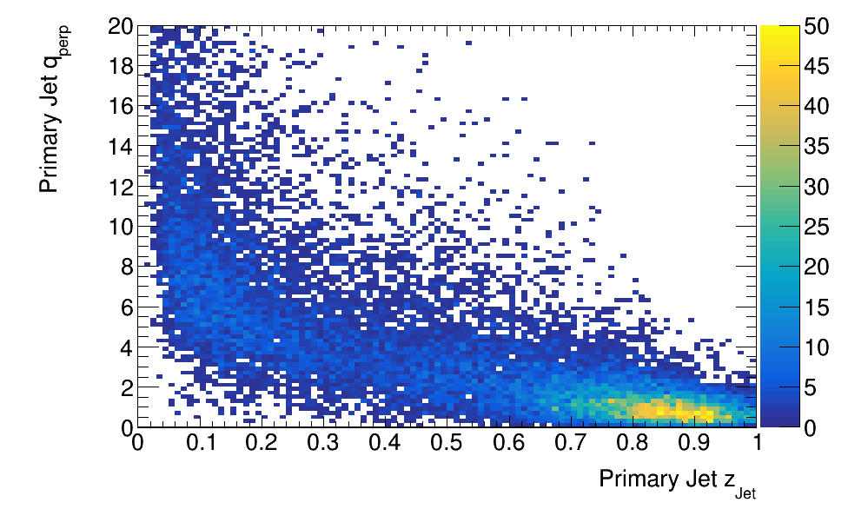
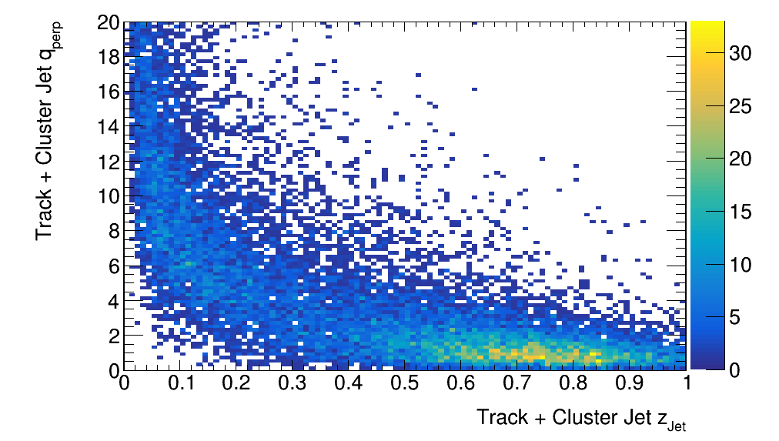

Centauro Jets for TMD’s
Pythia6, 10x100, Q>10, R=0.8 (20k events)
Primary Jets
ECCE Tracks + Neutral Clusters
Tracks + Neutral Clusters
M. Arratia, Y. Makris, D. Neill, F. Ringer, and N. Sato
Phys. Rev. D 104, 034005 (2021)
$$q_{T}=p_{Jet}^{⊥}/z_{jet}$$
This is the transverse momentum of the jet with respect to the scattered quark direction.

Slide 4
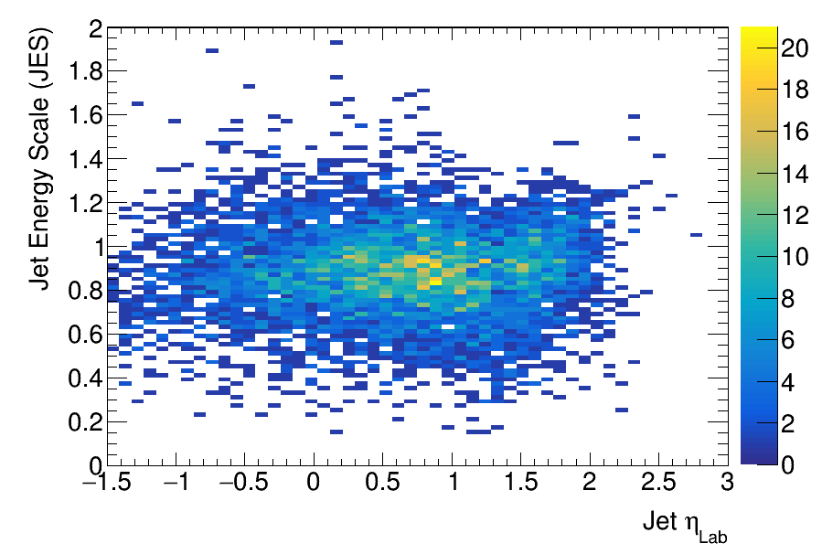
Jet Energy Scale (JES)
z_{Jet}>0.5
Primary Jets
Select reconstructed track + cluster jets, matched to a primary jet within (Δη,Δφ) <0.2

Slide 5
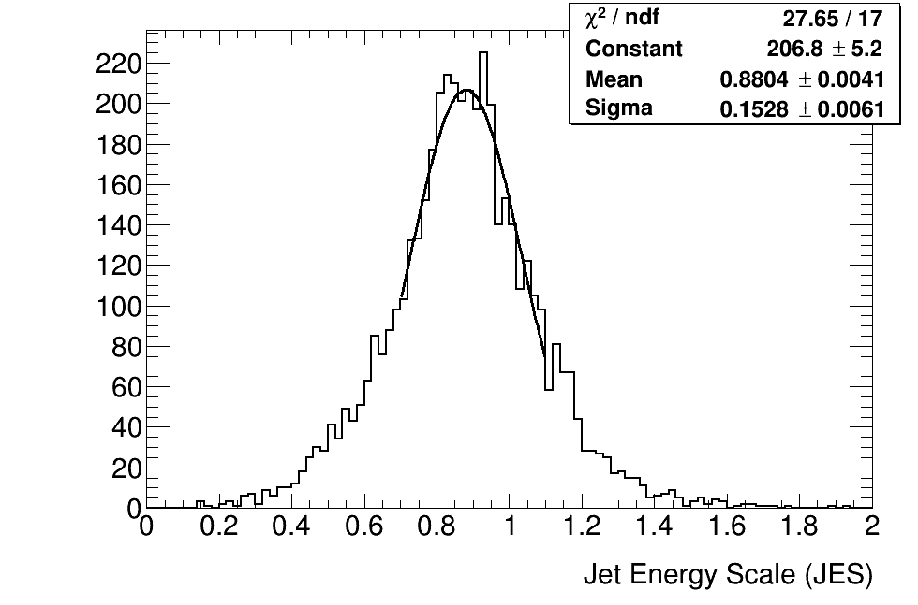
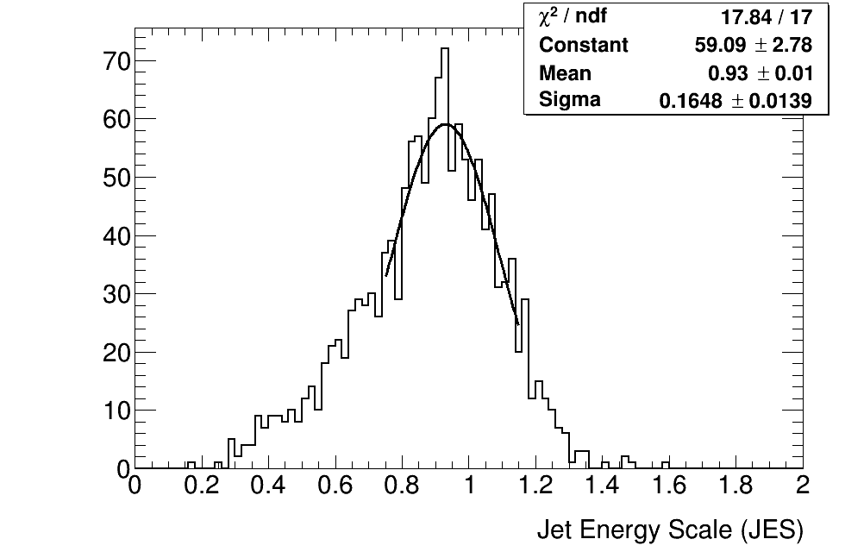
JES By Detector Region
η < 1.25
η > 1.25

Slide 6
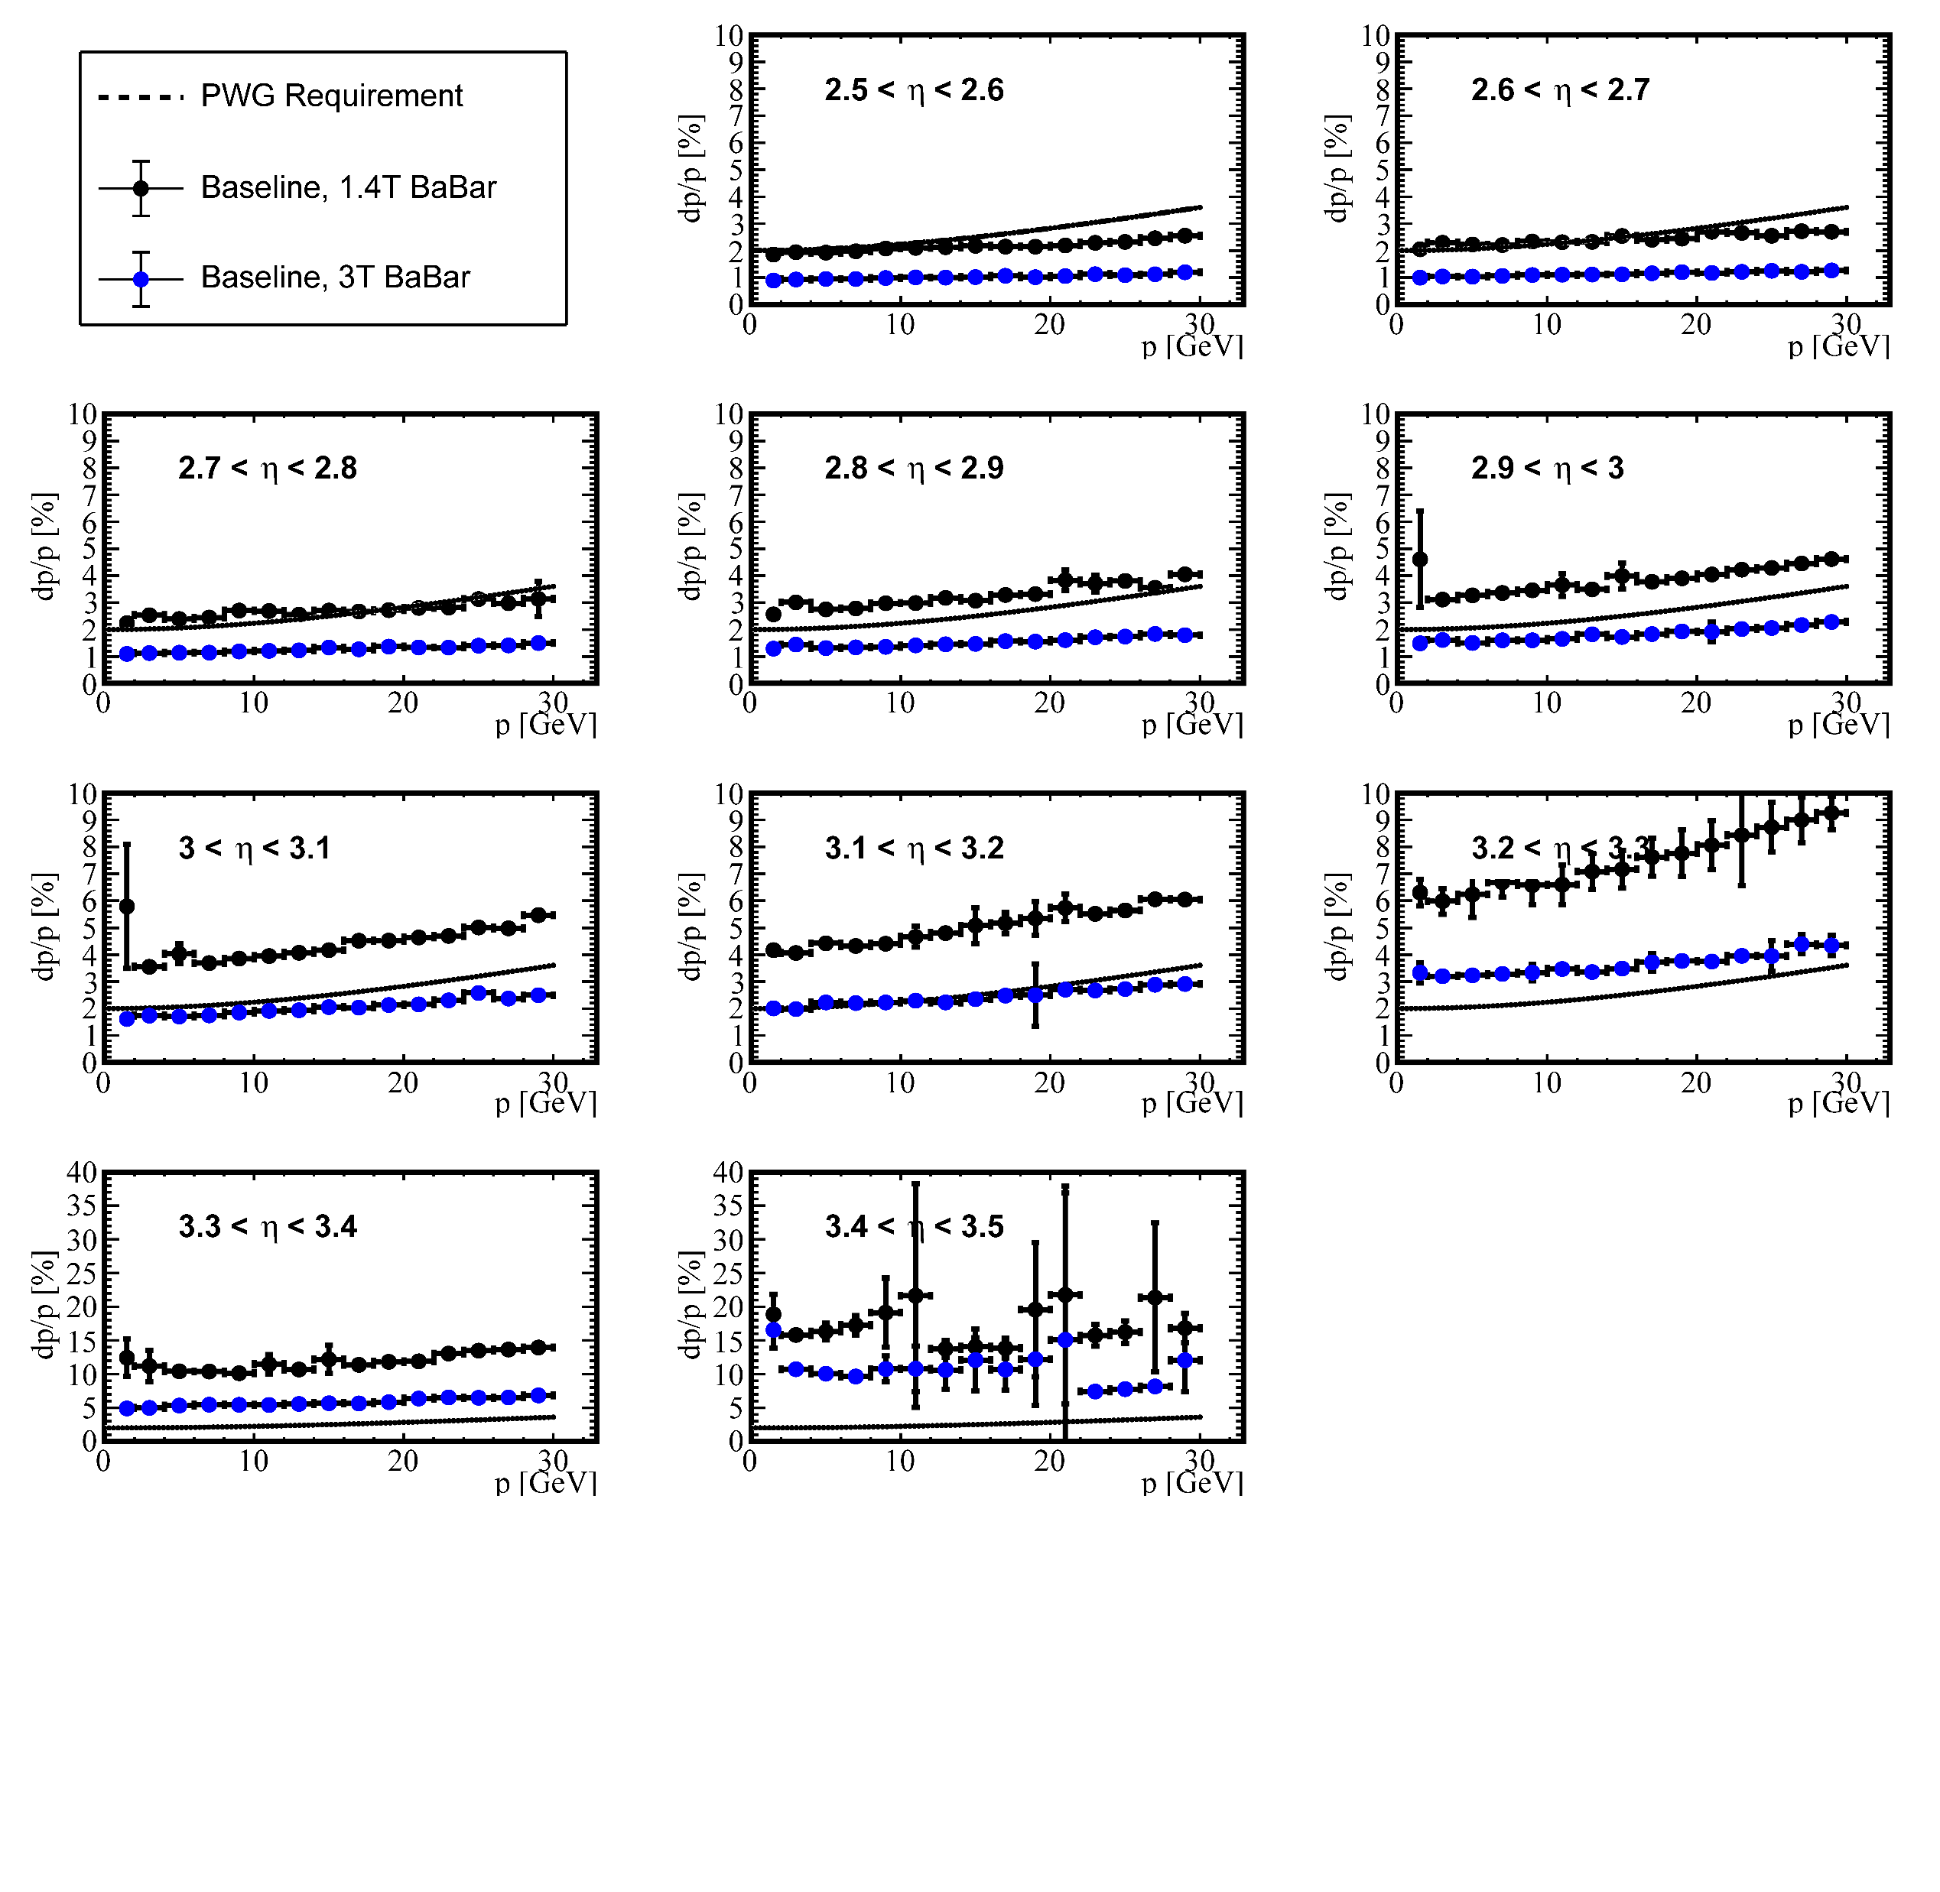
Magnetic Field
Strength
Track momentum resolution improves at 3.0T – can we see this improvement in the JES?
Track resolution study
from C. Fanelli

Slide 7
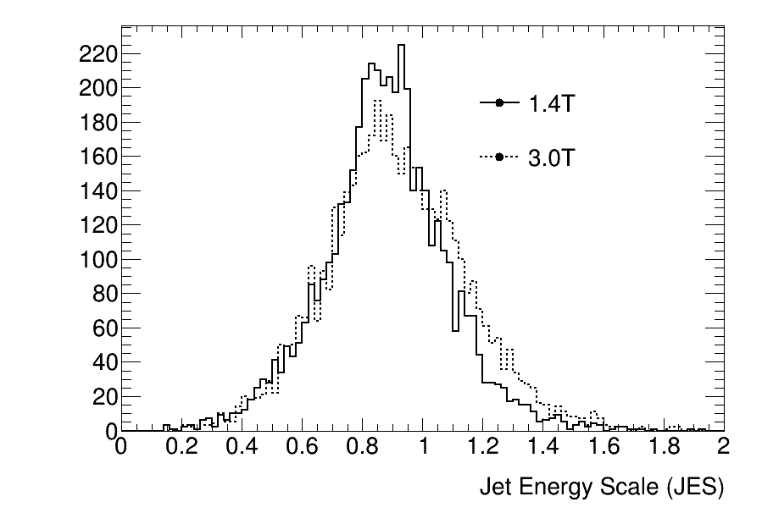
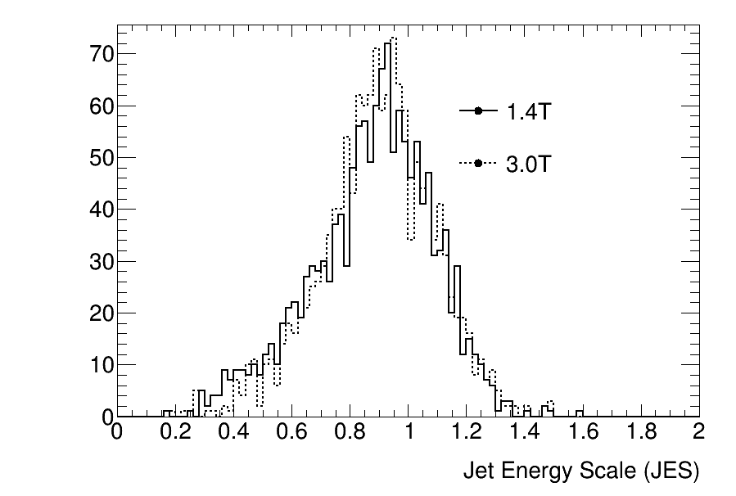
JES By Magnetic Field Strength
η<1.25
η>1.25
At midrapidity the JER seems to get worse at higher magnetic field.

Slide 8
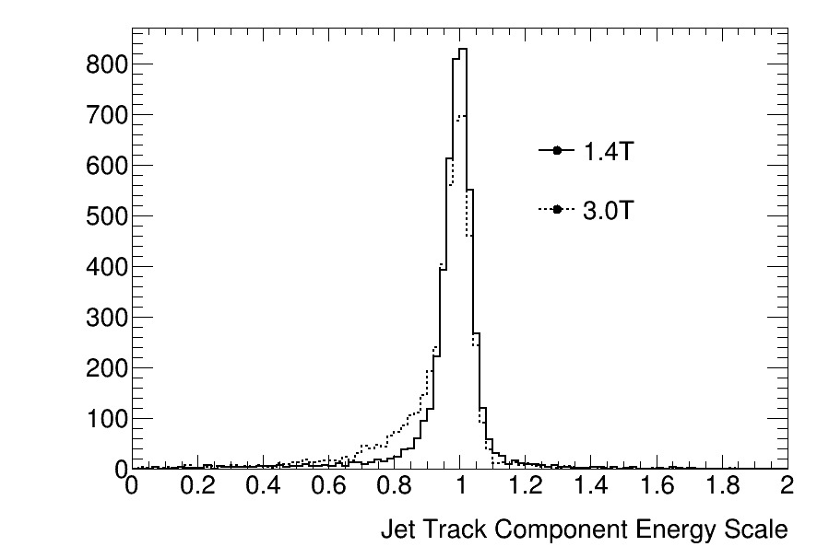
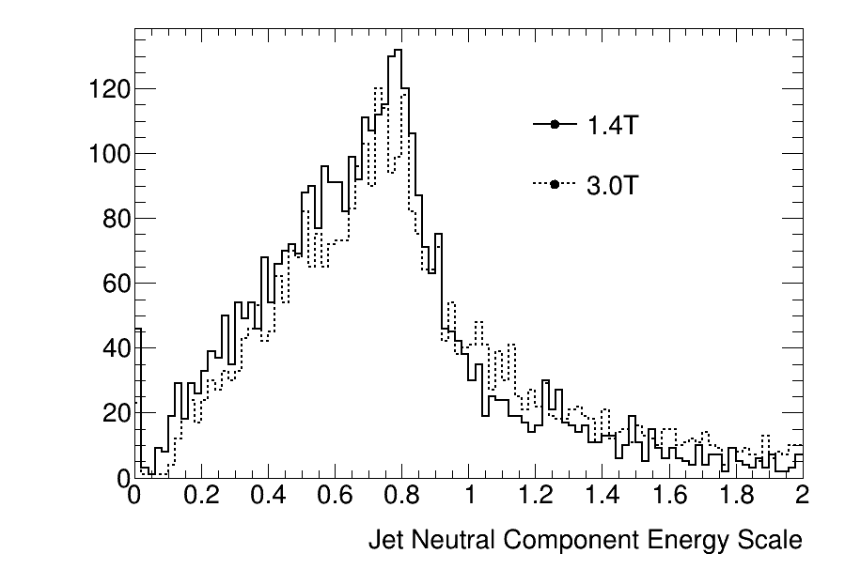
JES Components and Field Strength (η<1.25)
The track component resolution is worse in the barrel, presumably due to low-p_{T} acceptance.

Slide 9
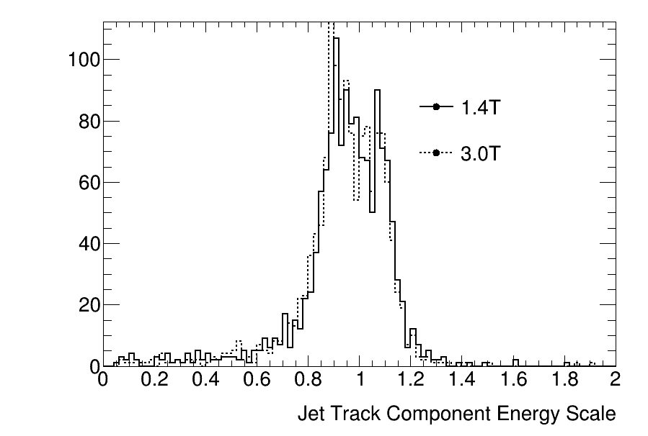
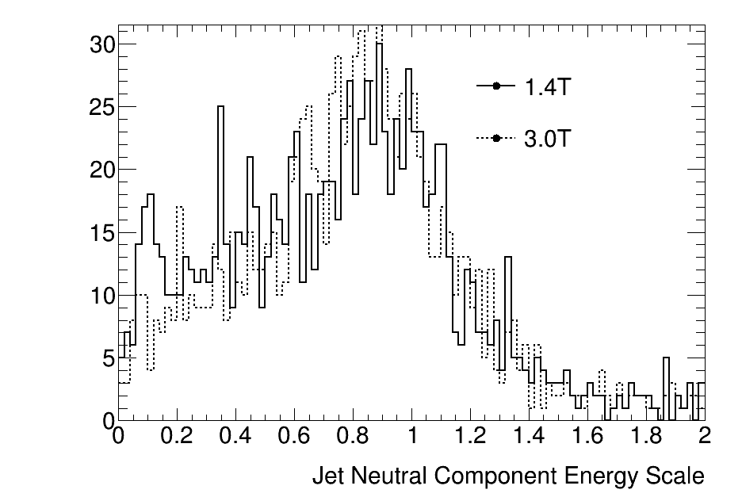
JES Components and Field Strength (η>1.25)
Very little difference as a function of magnetic field in the forward arm – improved track momentum resolution offset by decreased track acceptance?

Slide 10
Conclusions
JES ~0.9, JER ~0.16 for Centauro jets in SIDIS events (Q>10)
  JES scale low primarily due to neutral component
  JER driven by fluctuations in neutral component
1.4T vs. 3.0T comparison
  JER slightly better in the barrel, otherwise little difference
Future work
  Improvements in clustering and cluster matching, should improve JER
    Optimize cluster energy cut (currently 300MeV on all calorimeters)
  Work to quantify quality of neutral reconstruction
  Incorporate PID

Slide 11
BACKUP

Slide 12
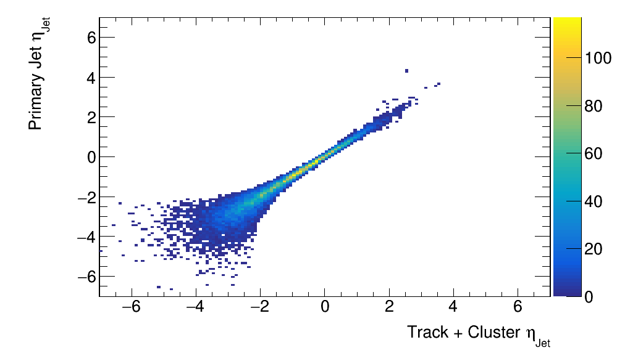
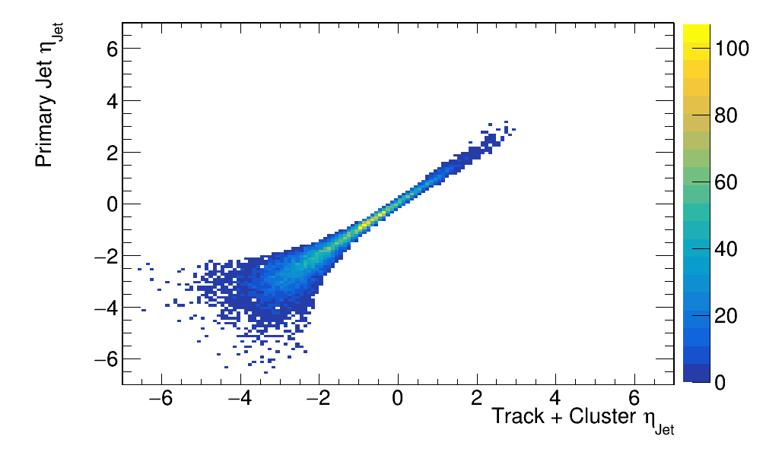
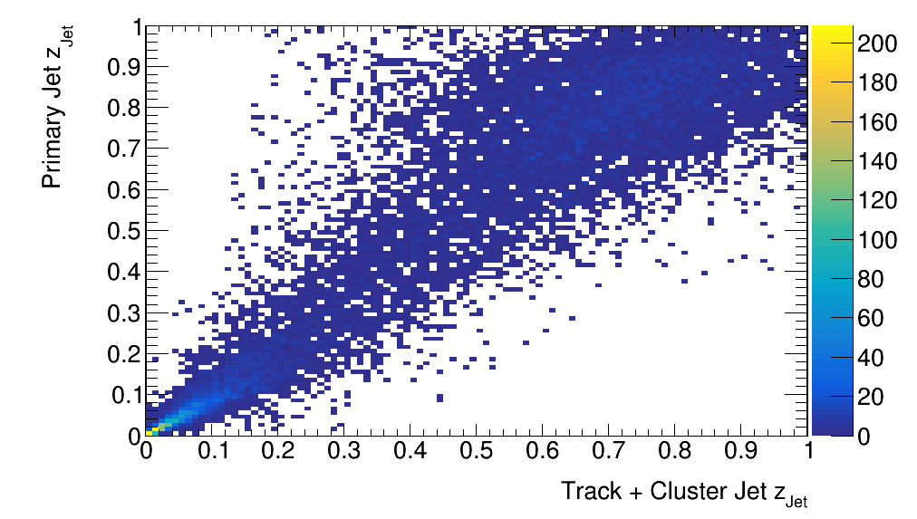
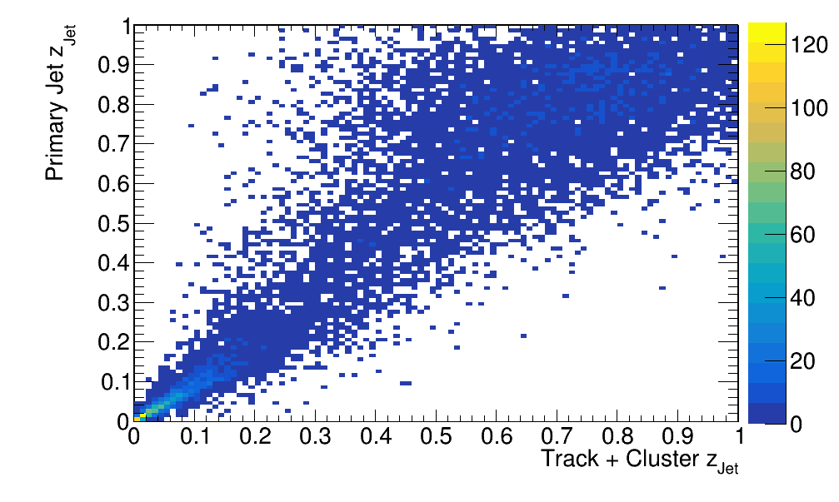
1.4T v. 3.0T (Track + Cluster Jets)
ECCE 1.4T
ECCE 3.0T

Slide 13
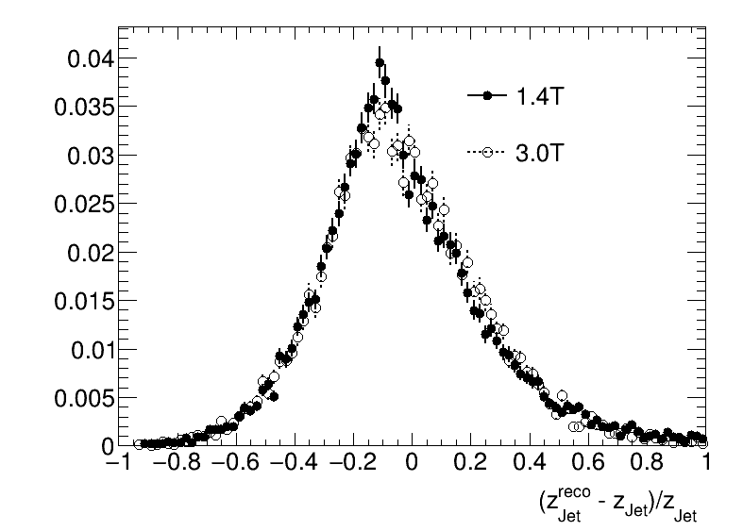
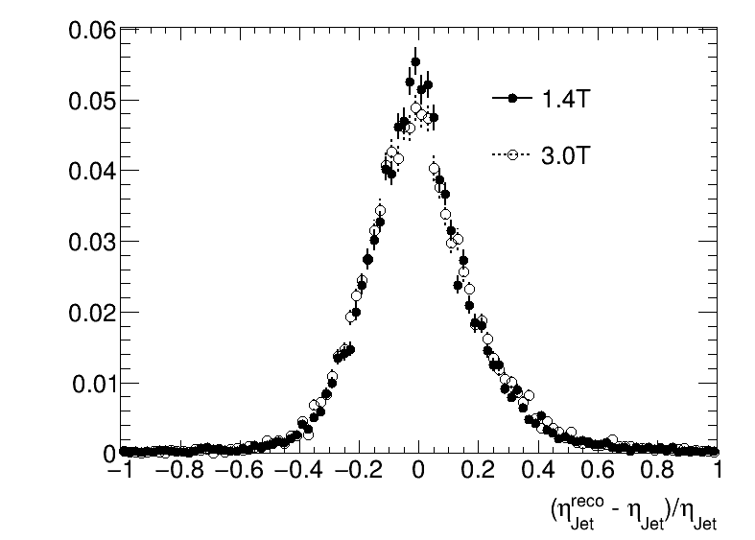
1.4T v. 3.0T (Track + Cluster Jets)
Matched to primary within 0.2 in Δη,Δφ space

Slide 14
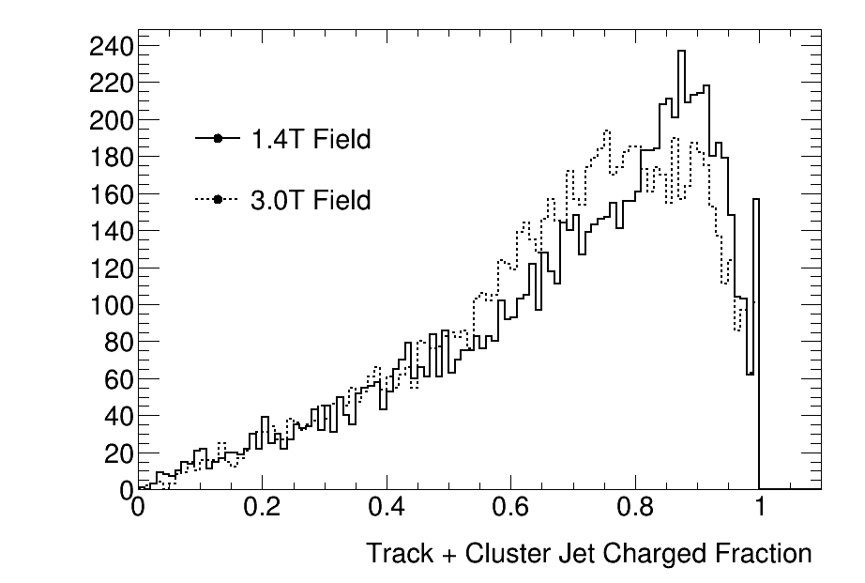
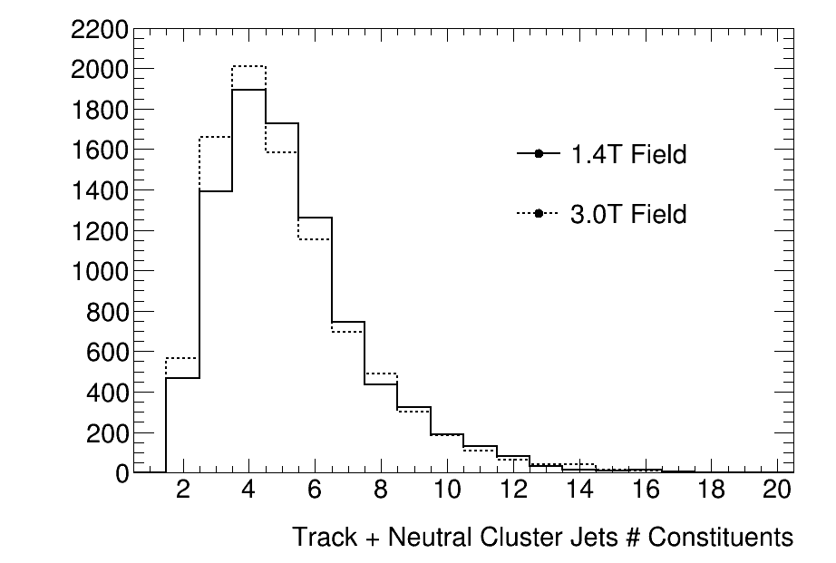
1.4T v. 3.0T (Track + Cluster Jets)
z_{Jet} > 0.5
At higher magnetic field jets have fewer charged constituents.

Slide 15
Calo “Tracks”
Instead of individual clusters, create calo “tracks” by combining clusters in the calorimeter systems.
  All clusters used must not have a matching track projection w/in 0.1
  Barrel: (BECAL, IHCAL, oHCAL)
  Forward: (FEMC, LFHCAL)
  Step 1: seed by EMCal (look in HCAL’s)
  Step 2: seed HCAL1 (look in HCAL2)
  Step 3: seed HCAL2 (barrel only)
  Clusters matched w/in 0.2
  Combined to make calo “track” used as constituent

