Slide 1

Centauro Jets Update
John Lajoie
Iowa State University

Slide 2
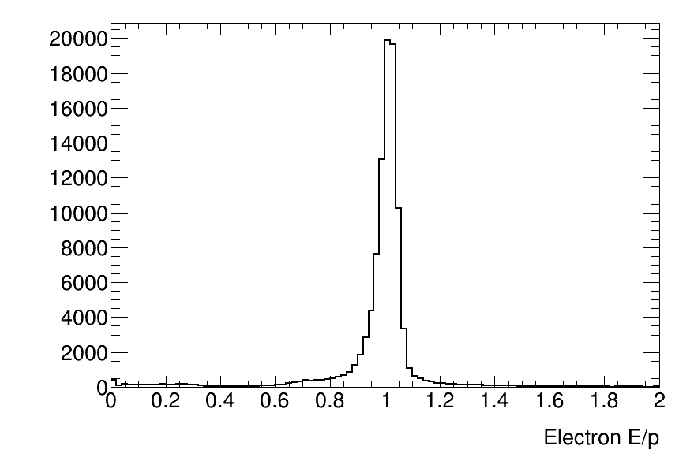
Updates
Improvements neutral hadronic energy component
Relies on understanding of clustering
Current clustering in HCALs seems to break up clusters associated with a single particle.
Compensated by combining clusters in a cone
BECAL energy scale corrected by 1/0.8
Consistent with E/p for scattered electrons

Slide 3
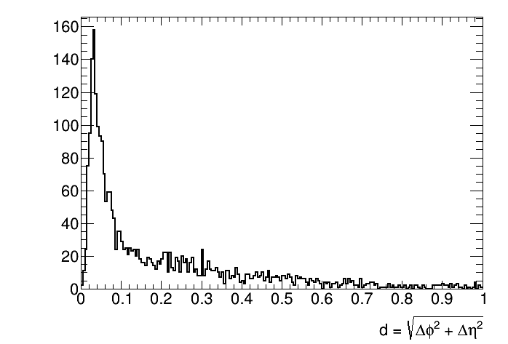
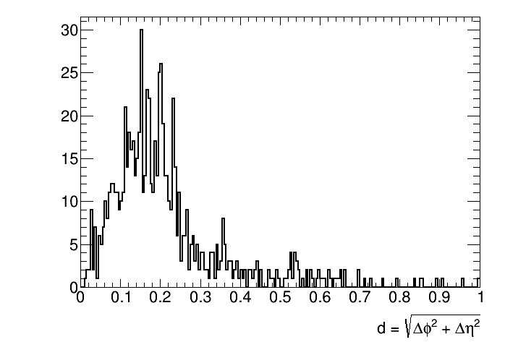
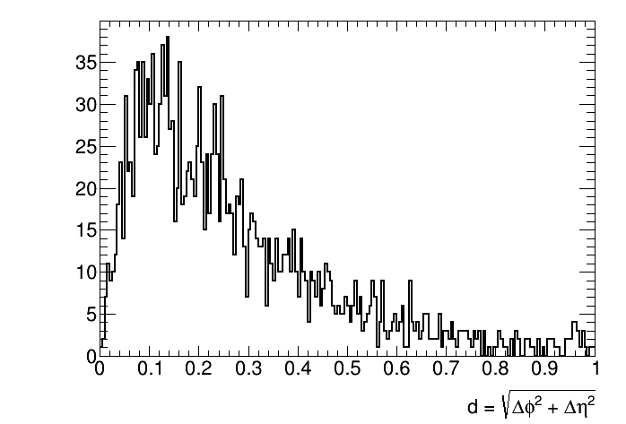
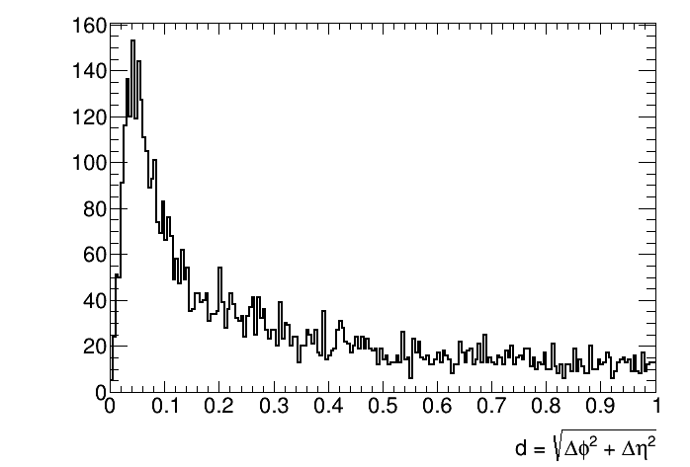
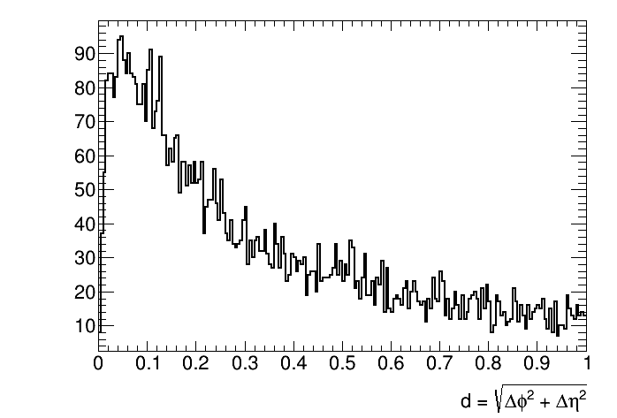
Track-Cluster Matching
BECAL
IHCAL
OHCAL
FEMC
LFHCAL
HCAL’s: need to combine clusters

Slide 4
Neutral Calo “Tracks”
Instead of individual clusters, create calo “tracks” by combining clusters in the calorimeter systems.
All clusters used must not have a matching track projection
Barrel: (BECAL, iHCAL, oHCAL)
Forward: (FEMC, LFHCAL)
Step 1: seed by EMCal (look in HCAL’s)
Step 2: seed HCAL1 (look in HCAL2)
Combine within (Δη,Δφ) < 0.35
Step 3: seed HCAL2 (barrel only)
Combine within (Δη,Δφ) < 0.35
Clusters matched w/in calo-dependent window
Same as used for track matching
Combined to make calo “track” used as constituent

Slide 5
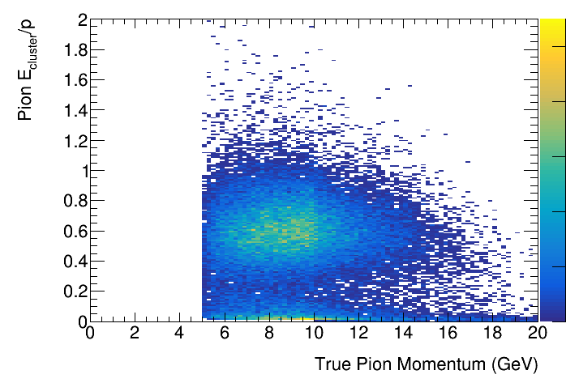
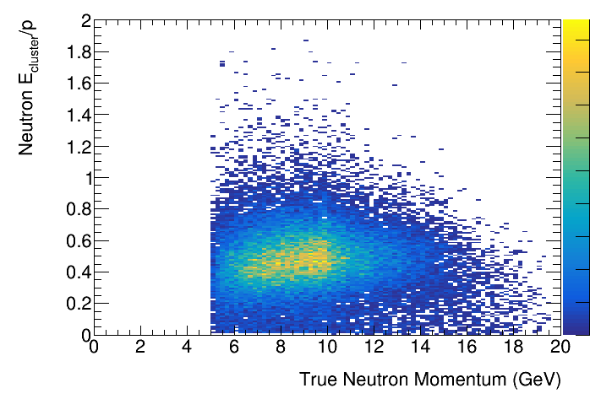
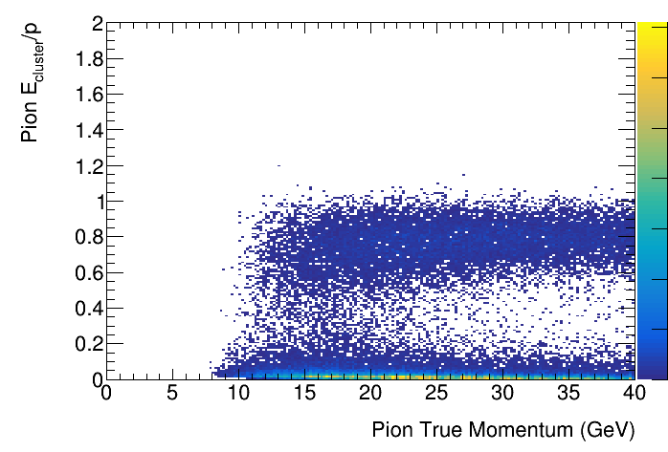
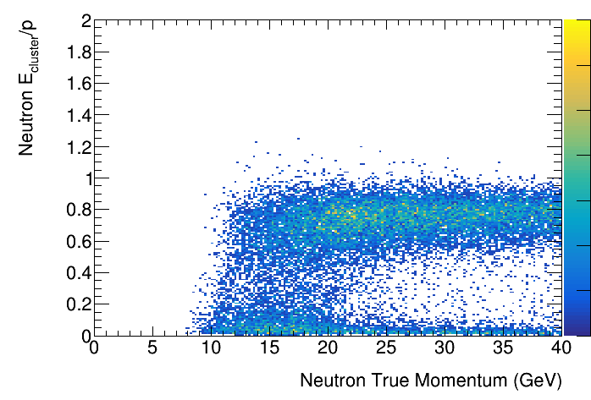
Calo Track Evaluation (Single Particle)
Barrel
<E/p> = 0.58
Barrel
<E/p> = 0.46
Charged pion (seeded by track)
Single neutron (seeded by calo)
Forward
<E/p> = 0.79
Forward
<E/p> = 0.77

Slide 6
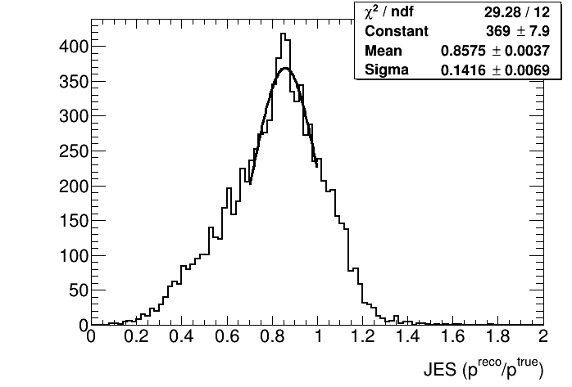
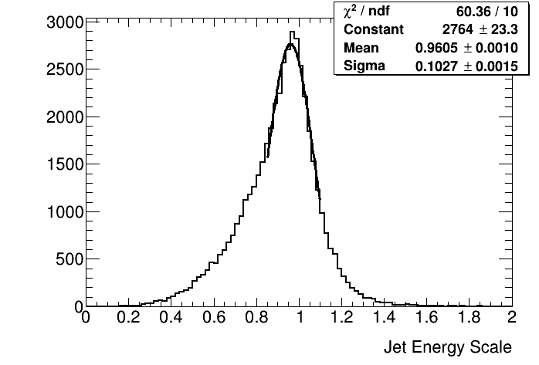
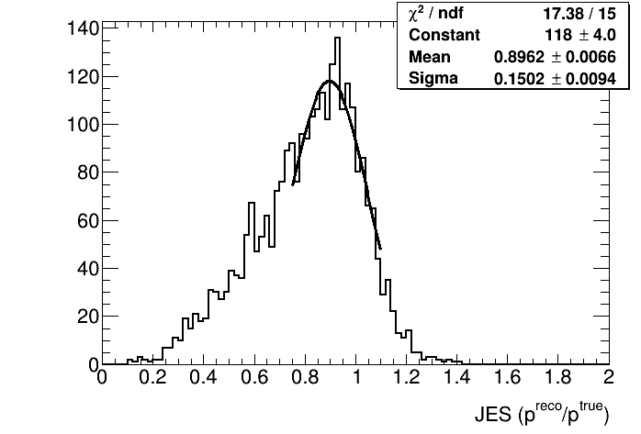
Jet Energy Scale (JES)
1.25<η<1.4
η<1.25
η>1.4

Slide 7
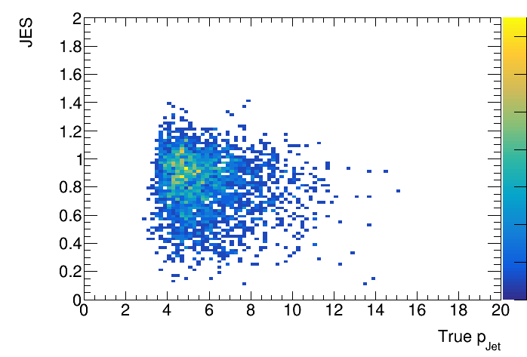
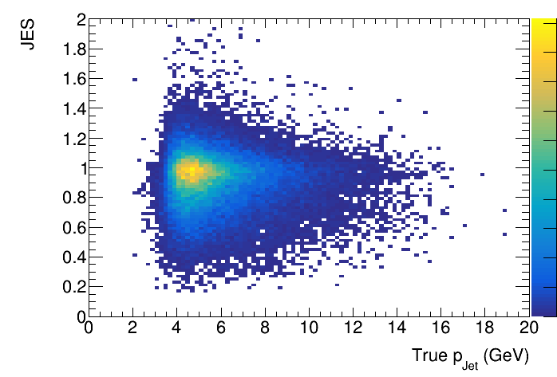
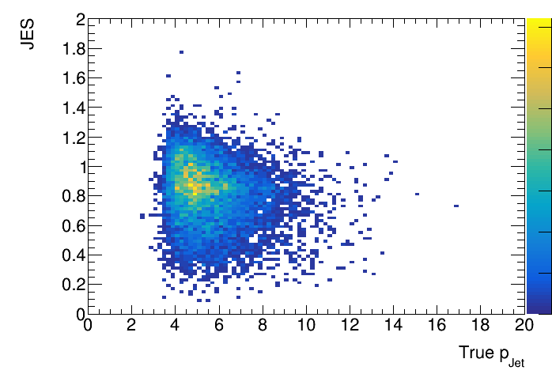
Jet Energy Scale (JES) 2D
1.25<η<1.4
η<1.25
η>1.4
(Jet momentum is in Breit frame.)

Slide 8
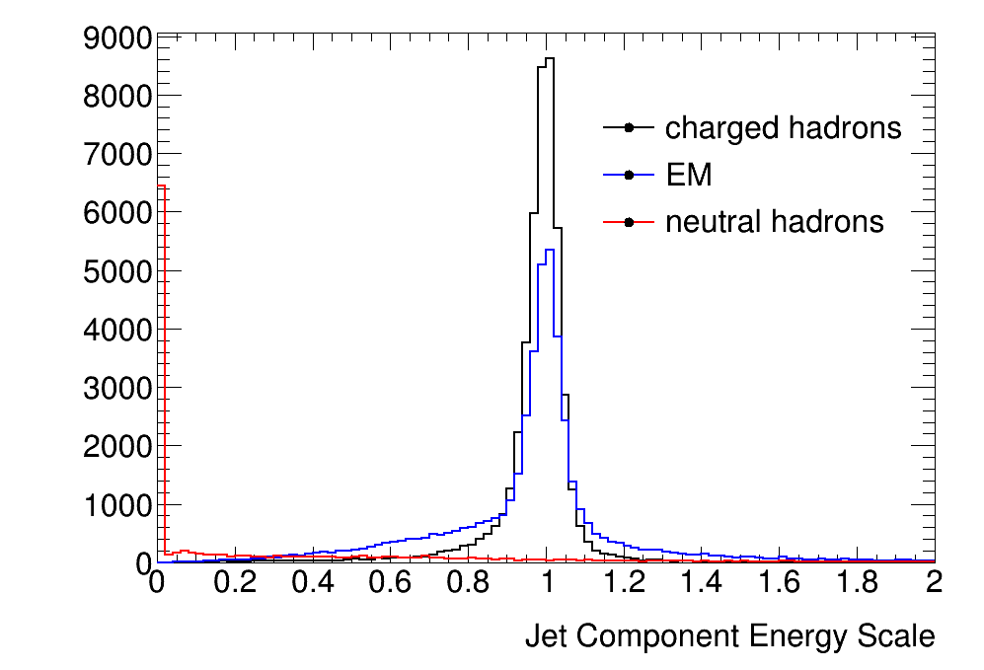
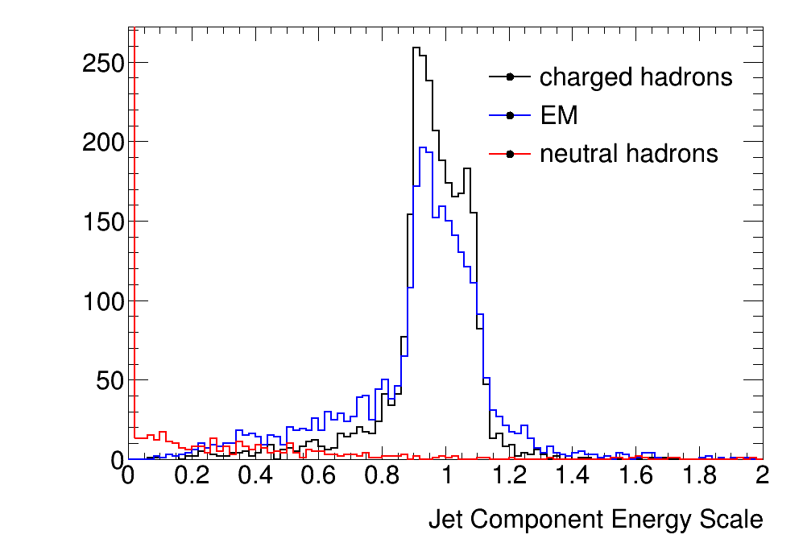
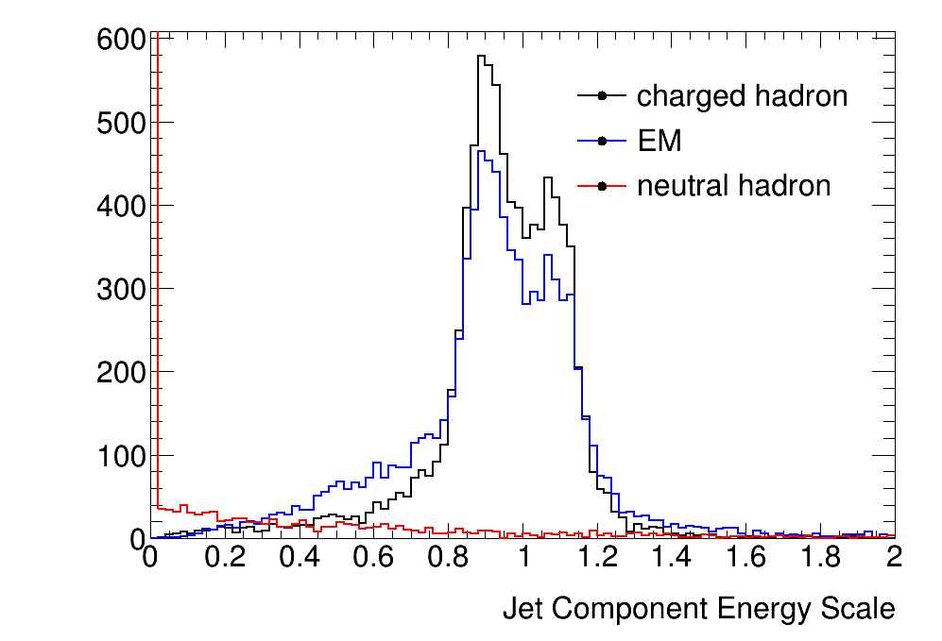
Jet Energy Scale (JES) by Component
EM: electron, positron or photon
1.25<η<1.4
η<1.25
η>1.4
Still a lot to do to understand the JES/JER response, especially in the forward region.

Slide 9
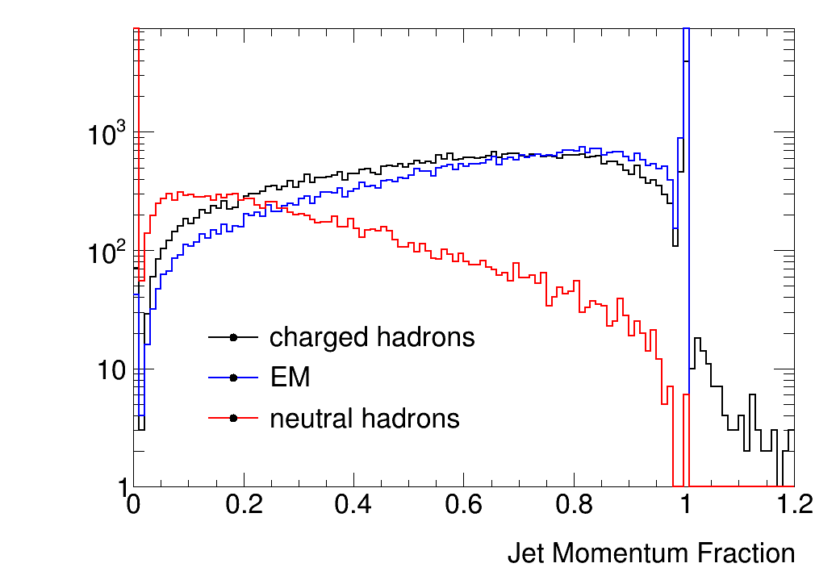
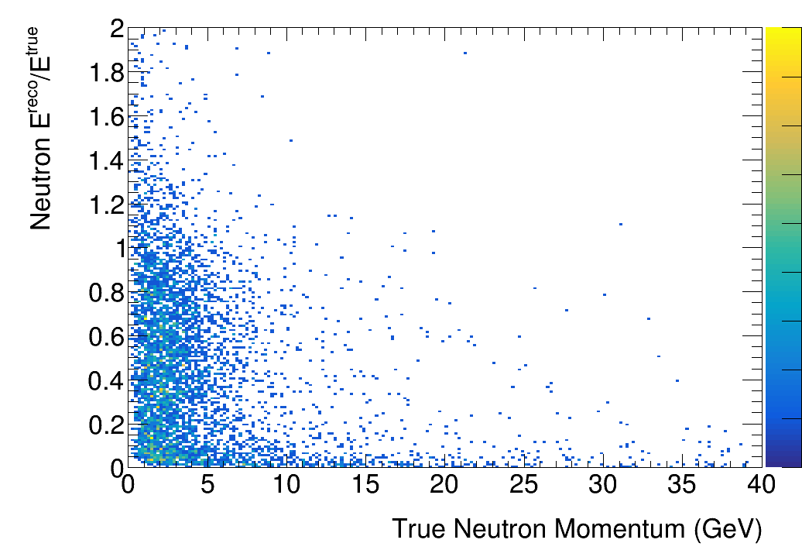
Composition of the jet
Single neutrons
(Lab frame)
Neutrons in SIDIS events
(Breit frame)

Slide 10
Conclusions/Next Steps
Lack of well-developed clustering is the main limitation
Compensated by combining clusters, but that’s a kludge
Split JES in forward region
Shows up in both tracking and EM (tracking)
Need better understanding of tracking response
JES is probably the best we can do at this level
Better neutral response requires complex cluster decomposition (overlapping clusters in jets)
But still a relatively small fraction
Move towards a particle flow approach (important in forward region)

Slide 11
BACKUP

Slide 12
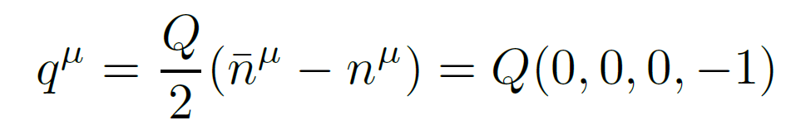
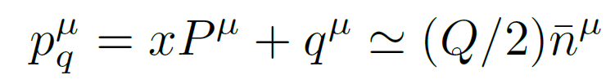
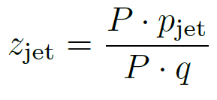
Breit Frame
z-axis
The Breit frame is the frame in which the (spacelike) virtual photon carries only momentum (E=0) along the –z axis.
We can always define this frame in terms of a boost and a rotation based on knowledge of the incoming beam and the scattered electron.
In the Breit frame, the jet associated with the struck quark is at negative rapidity, while jets associated with the target proton are at positive rapidity.
The quantity z_{jet} is the fraction of the scattered quark momentum carried by the jet (good to LL level).
Fraction of scattered quark momentum carried by jet.
arXiv:2006.10751v2

Slide 13
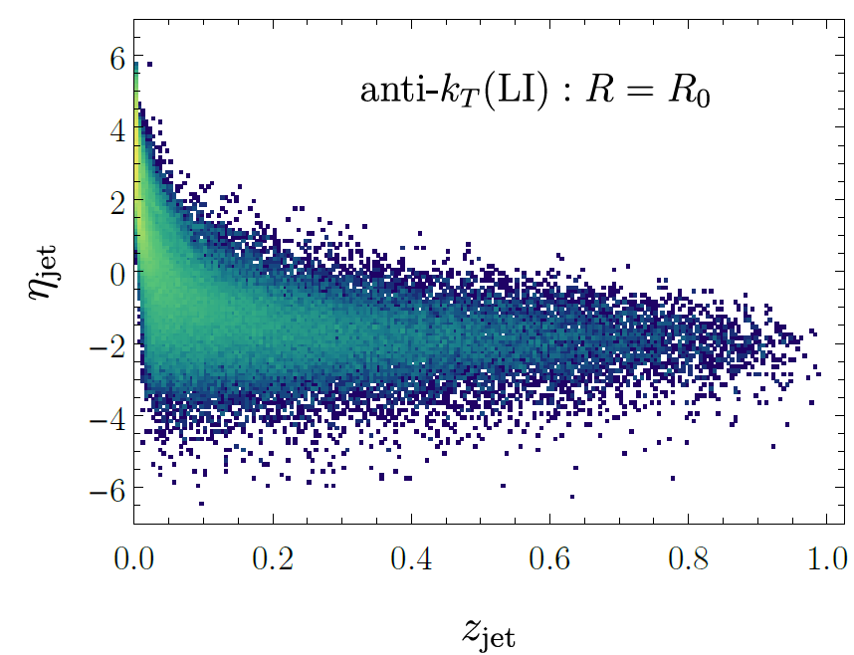
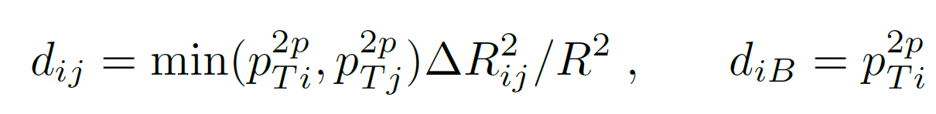
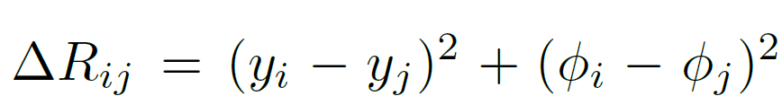
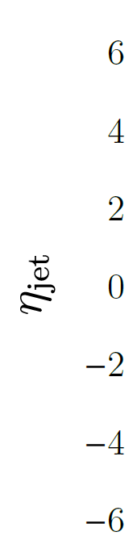
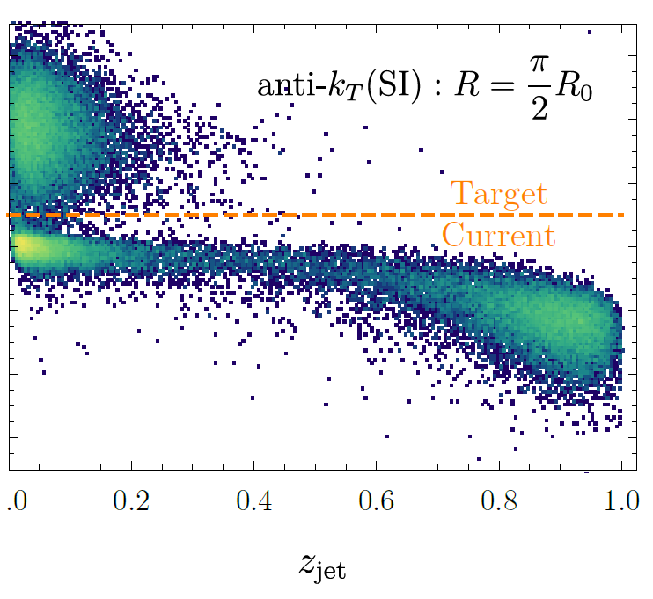
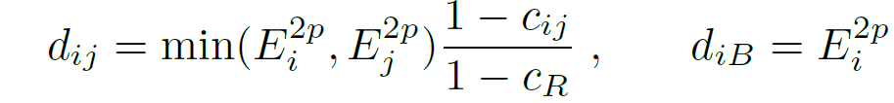

Jet Algorithms
Pythia8, 10x100, Q>10, R=0.8
Longitudinally Invariant anti-k_{T}:
Cannot properly capture jets enclosing the y=infinity axis.
Spherically Invariant anti-k_{T}
Developed for e⁺e⁻; not longitudinally invariant, does not fully separate beam remnant and current jets.
arXiv:2006.10751v2

Slide 14
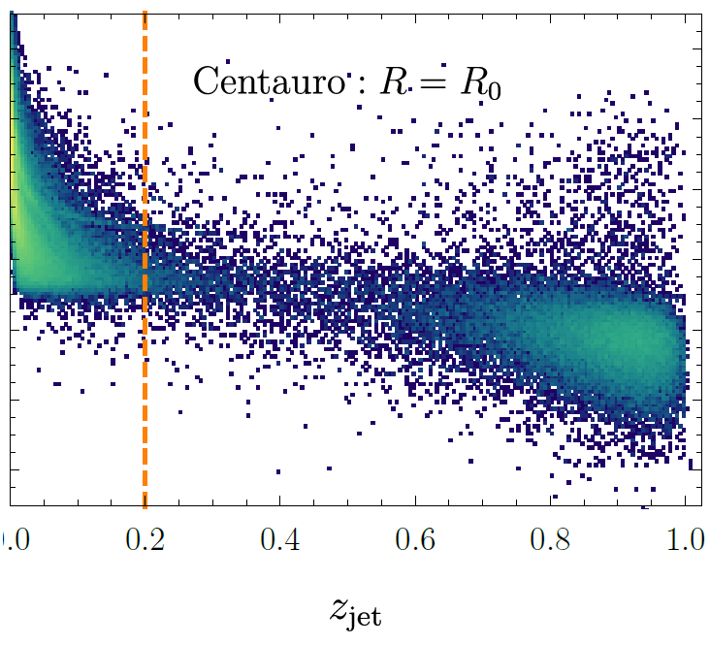
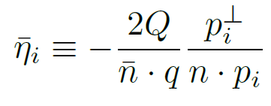
Centauro Algorithm
Pythia8, 10x100, Q>10, R-0.8
A compromise – Longitudinally invariant, but matches the spherical algorithms behavior in the backward hemisphere (negative rapidity). This allows it to properly capture the current jet and separate it from the beam remnant jets.
arXiv:2006.10751v2

Slide 15
Jet Constituents and Tranformations
Working in the Breit frame requires a number of transformations:
For calorimeter cluster/tower jets:
Reconstruct x,Q² from the scattered electron in the lab frame
Get truth electron from event generator by matching Q², then look in SvtxTrack for its measured partner (by truth_track_id())
Verify electron by |(E/p) – 1.0| < 0.2 with matched cluster in CEMC or EEMC
Boost to make the virtual photon E=0:
Rotate so the virtual photon momentum is along the –z axis
Exclude cluster/towers associated with scattered electron
For truth particles:
Transform from the event generator frame to the lab frame
Use transform stored with the data: PHHepMCGenEvent->get_LorentzRotation_EvtGen2Lab()
Exclude particles |η|>4.0, p_{T}<200MeV in the lab frame
Exclude muons, neutrinos, scattered electron
Transform to the Breit frame using “measured” transform

