Slide 1
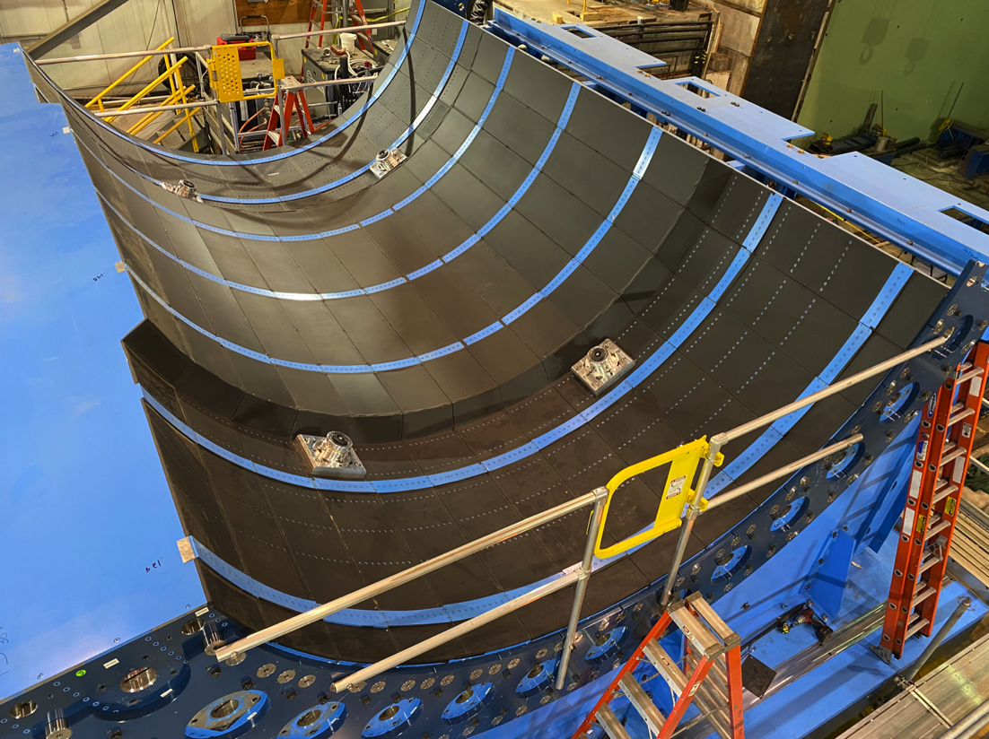
Status of sPHENIX Installation in 1008
We are preparing for the installation of the sPHENIX SC-Magnet in the sPHENIX detector beginning next week. Once the SC-Magnet is installed we will complete the Outer HCal installation. This work will take us into December.

Slide 2
High Priority Issues
Complete 1008 IR work for this shutdown
The IR Track reinforcement and cryo work dominate the IR activities
Keep the EMCal sector and IHCal on schedule.
Keep 1008 installation progressing forward.
Place Remaining procurements
Complete TPC Fee slice test, begin TPC Fee production board assembly and prep for testing 700+ production boards. First 5 TPC Fee boards expected 9/30.
Keep Nevis electronics on schedule (Cal Digitizers, LL1, MBD D/S, extra DCMIIs)
Complete remaining engineering design tasks and order components
We must finish the designs and move our attention to assembly, installation and testing.
Schedule and hold remaining reviews
Maintaining staff in order to keep to schedule

Slide 3
Key Remaining Orders
MIE
DCMII’s + crates + backplanes + controllers
TPC diffuse lasers (submitted to PPM)
TPC fibers
GL1/GTM boards
JACK board
1008 I&F
IHCal installation stanchions
TPC installation fixtures and bracketry
Beam pipe + MBD + sEPD supports
Magnet Mapping contract w/ CERN
Fiber Optics trunk cables
HVAC Improvements
MVTX+INTT brackets and installation fixtures
Vesda interface
Seismic restraints

Slide 4
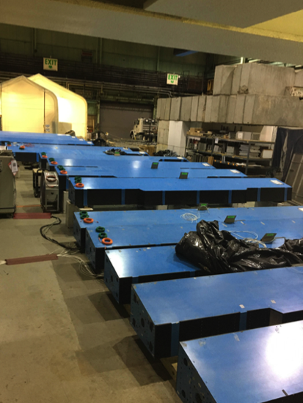
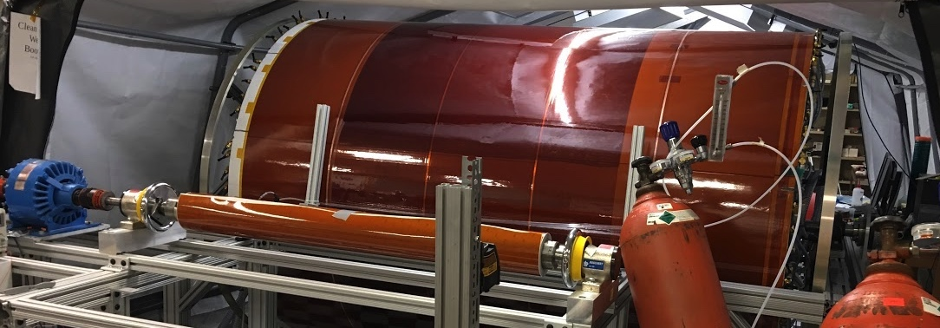
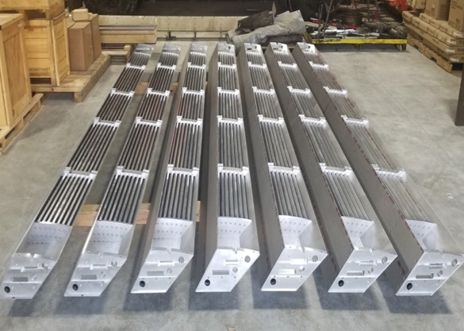
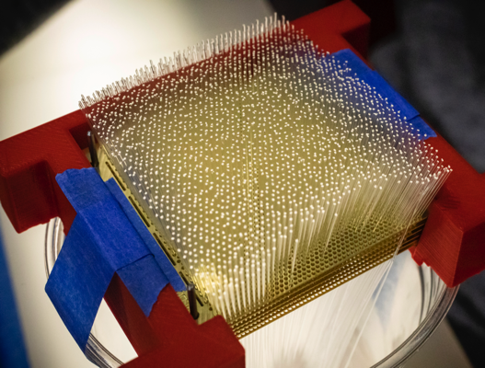
sPHENIX MIE Status
sPHENIX Assembly continues in the 1008 Assembly Hall
The Outer HCAL Sectors are complete. Electronic burn in tests continue prior to installation.
EMCal blocks 82% complete at UIUC. Fab of all remaining MIE blocks are started. EMCal Sectors 56% complete at BNL.
All TPC ASICs complete, tested and at BNL. First production TPC Fee board assembled and tested good. Parts at assembly house for stuffing of 700 boards.
All EMCal and OHCal on-detector electronics received at BNL. Calorimeter digitizer components continue to arrive at Columbia University (>90% received to date)
All GEM framing for TPC complete except for spares. Spare framed GEM production ongoing at WSU, WIS, Vanderbilt, Temple. GEM module assembly about to start at SBU
Inner HCal mechanical sectors 50% complete. Next 25% shipped by vendor, at BNL next week
Major DAQ/Trigger orders: Large switch at BNL. DAQ computers and Buffer Boxes at BNL.
Outer HCal sectors going through final testing/burn-in
TPC Outer field cage at SBU
Inner HCal sectors at vendor
EMCal block fab @ UIUC

Slide 5
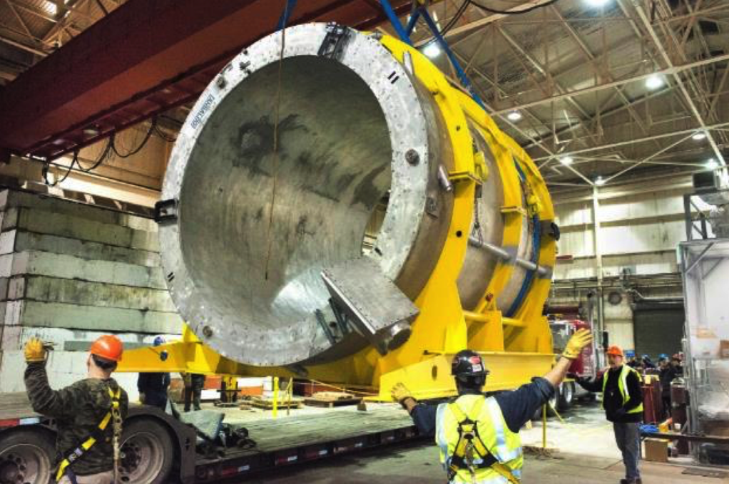
1008 Infrastructure and Facility Upgrade Progress
Carriage/Cradle assembled in 1008
XY Carriage tables, Carriage Hydraulics installed
SC- Magnet being prepped for move to 1008 by mid-September
EMCal Installation fixture complete
Magnet flux return Pole tip/end cap in production
sPHENIX Beam Pipe at vendor for modification.
Large Support Rings in production
Rack Platform in production
Work on IR track reinforcement underway. On schedule for completion prior to start of RHIC Run-22.
90% of IHCal assembly installations fixtures designs complete and awarded. Remaining fixture designs ongoing.
EMC
LHe cryo components IR installation ongoing.
LN2 and warm piping, in production or at BNL.
Observing significant cost increases on raw materials.
sPHENIX SC-Magnet (formerly BaBar) being delivered to 912
Made possible by many people in Physics, CAD, SMD, IO and F&O

Slide 6
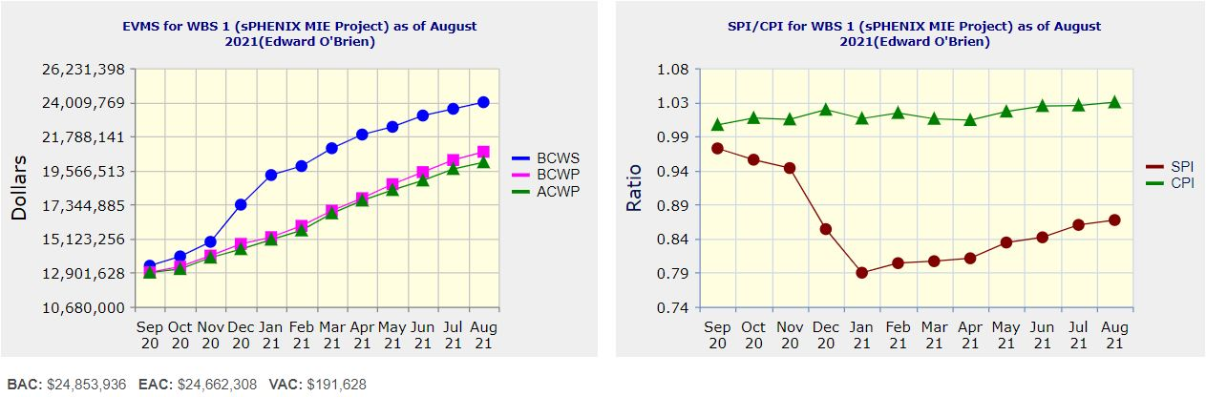
Performance Indices – sPHENIX MIE
Cumulative SPI | Cumulative CPI
0.87 | 1.03
Cumulative BCWS (Scheduled) | $24,018,003
Cumulative BCWP (Performed) | $20,786,006
Cumulative ACWP (Actual) | $20,099,791
DOE SPI or CPI Value Thresholds
0.90 to 1.15
0.85 to 0.89 or 1.16 to 1.25
<0.85 or >1.25

Slide 7
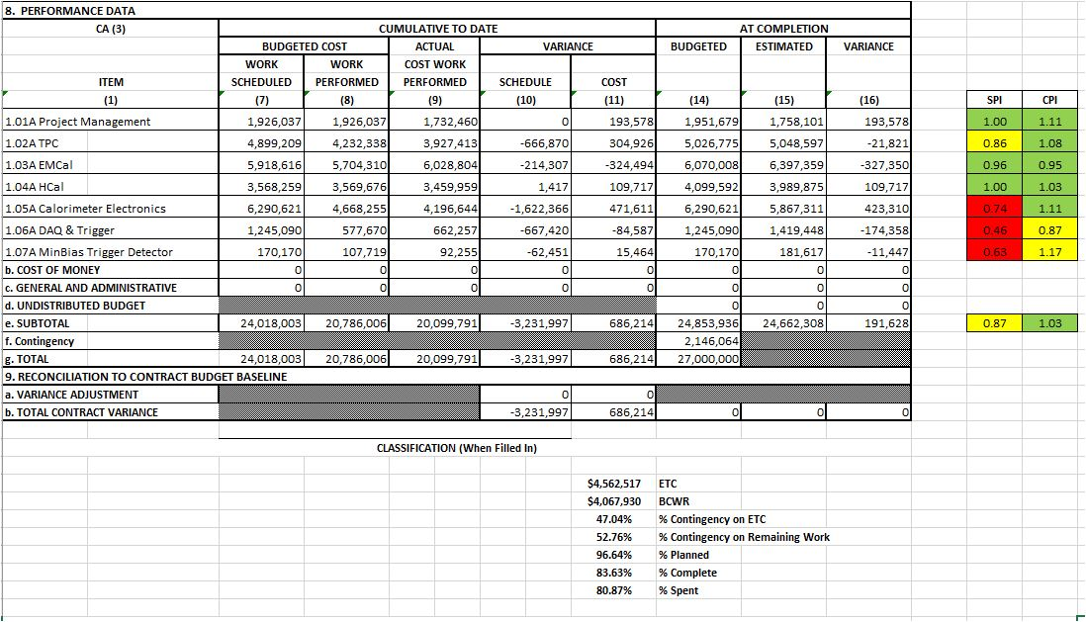
Cost Performance Report (CPR) – sPHENIX MIE
DOE SPI or CPI Value Thresholds
0.90 to 1.15
0.85 to 0.89 or 1.16 to 1.25
<0.85 or >1.25
*Highlights in table above takes variance $ into consideration, not just Indices

Slide 8
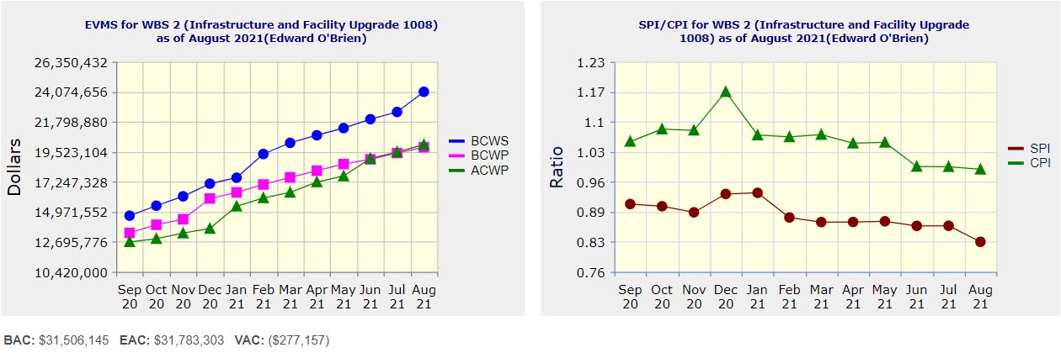
Performance Indices – 1008 Infra and Facility Upgrade
Cumulative SPI | Cumulative CPI
0.83 | 0.99
Cumulative BCWS (Scheduled) | $24,074,764
Cumulative BCWP (Performed) | $19,867,897
Cumulative ACWP (Actual) | $20,065,970
DOE SPI or CPI Value Thresholds
0.90 to 1.15
0.85 to 0.89 or 1.16 to 1.25
<0.85 or >1.25

Slide 9
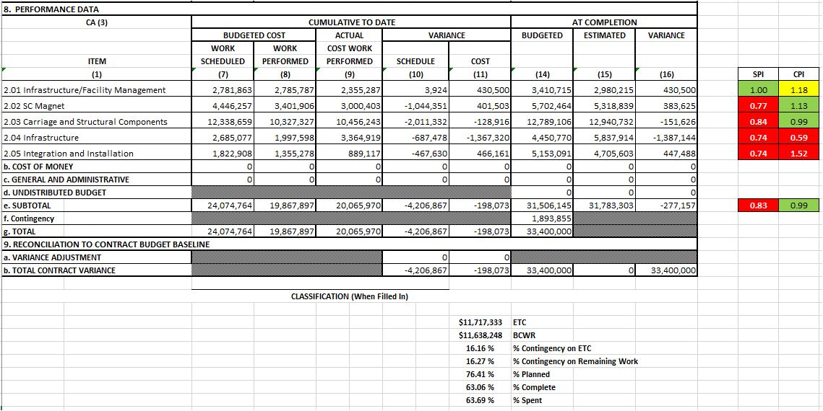
Cost Performance Report (CPR) – 1008 Infra and Facility Upgrade
DOE SPI or CPI Value Thresholds
0.90 to 1.15
0.85 to 0.89 or 1.16 to 1.25
<0.85 or >1.25
*Highlights in table above takes variance $ into consideration, not just Indices

Slide 10
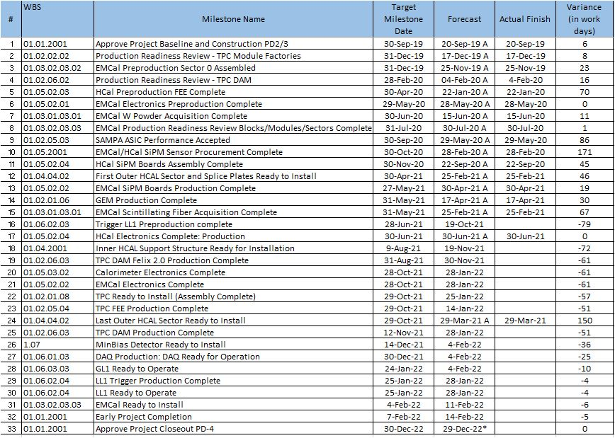
Milestones Status – sPHENIX MIE

Slide 11
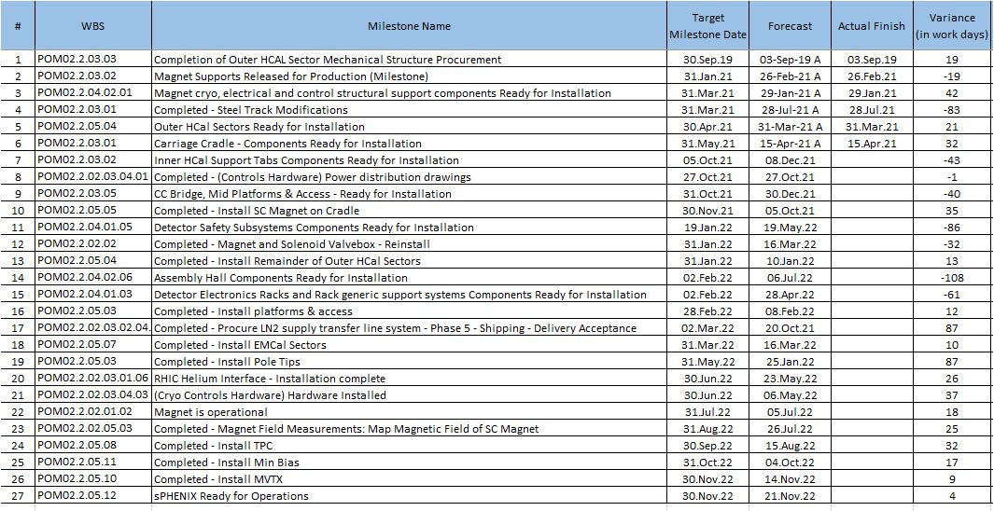
Milestones Status – 1008 Infra and Facility Upgrade

Slide 12
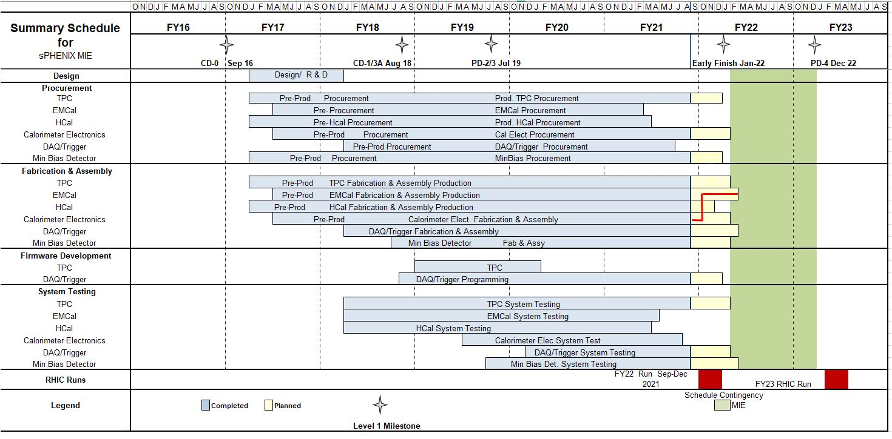
Summary Schedule – sPHENIX MIE

Slide 13
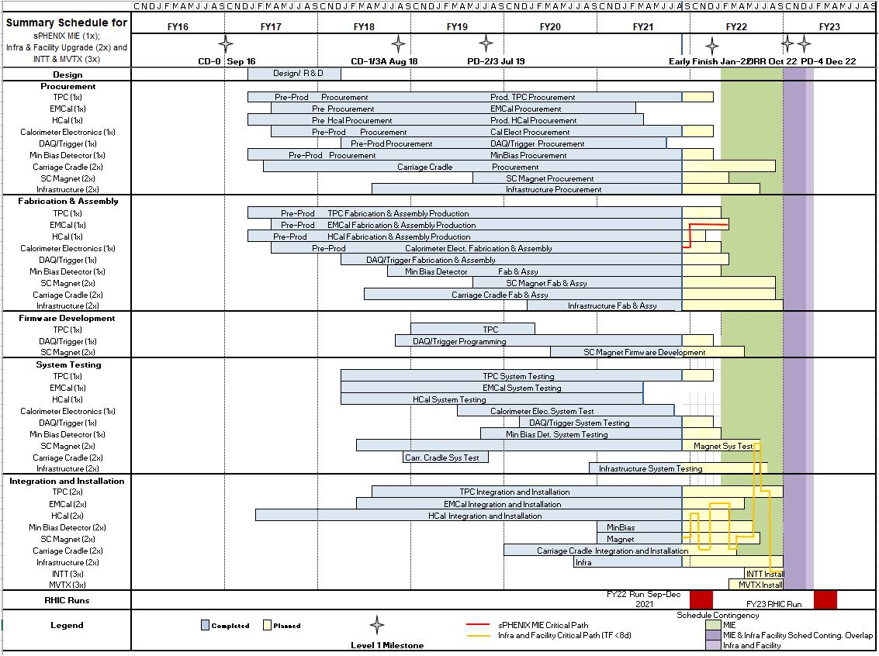
Summary Schedule – sPHENIX MIE and 1008 Infra and Facility Upgrade

Slide 14
Issues
Global economic issues may affect the cost and schedule of the project going forward
Long lead time on certain electronics components may impact the schedule on the outstanding MIE orders.
Significant cost increases have been seen on ceetain raw material and machine shop work
We need to maintain staff size, especially technicians, and increase visiting scientists, students and postdocs on site to have the workforce necessary to maintain schedule.

Slide 15
Summary
sPHENIX Assembly continues to make good progress in 1008.
Installation of SC-Magnet starts next week.
Excellent progress in sPHENIX factories: OHCal sectors complete, 82% of EMCal Blocks and 56% EMCal sectors complete. All TPC ASIC chips tested and delivered to BNL. MVTX staves completed and assembly has begun. Electronic, DAQ/Trigger, MBD, INTT, IHCal all making good progress.
Excellent progress on 1008 I&F upgrade: Majority of I&F parts are complete or on order.
This includes the barrel and end cap flux return steel, LHe and LN2 components, cryo controls and power, carriage/cradle, the beam pipe modification, XY carriage tables, carriage hydraulics, carriage platform, Large Support Rings, various installation fixtures.
We have a large team of engineers and designers working remotely, and effectively on the design of the sPHENIX MIE.
We are on schedule for a completion of installation in late CY 2022 in preparation for the start of the RHIC 2023 run.

Slide 16
Back Up

Slide 17
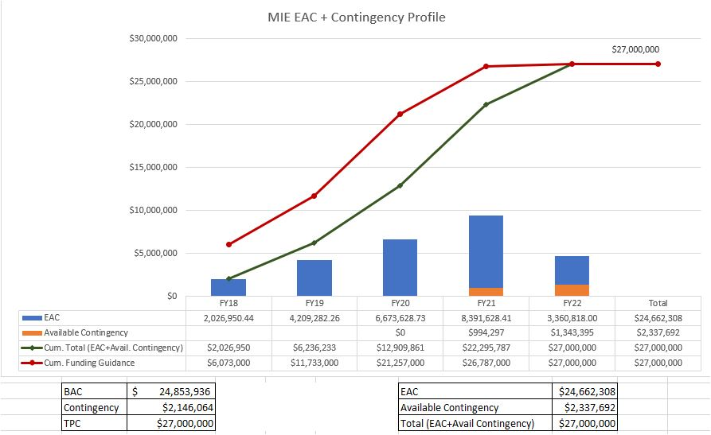
EAC and Contingency Profile – sPHENIX MIE

Slide 18
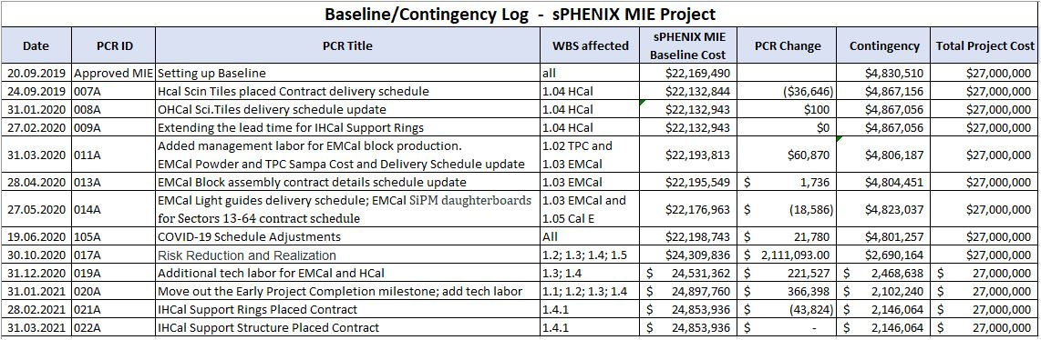
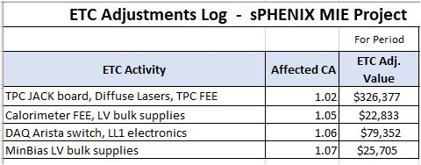
Baseline/Contingency Log and ETC adjustment Log - MIE

Slide 19
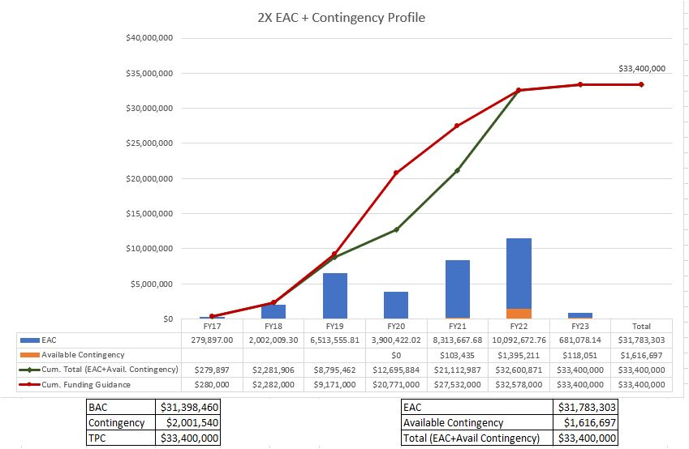
EAC and Contingency Profile – 1008 Infra and Facility Upgrade

Slide 20
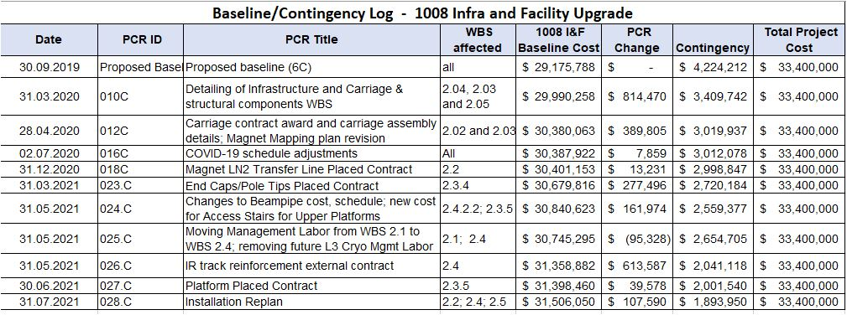
Baseline/Contingency Log - 1008 Infra and Facility Upgrade

Slide 21
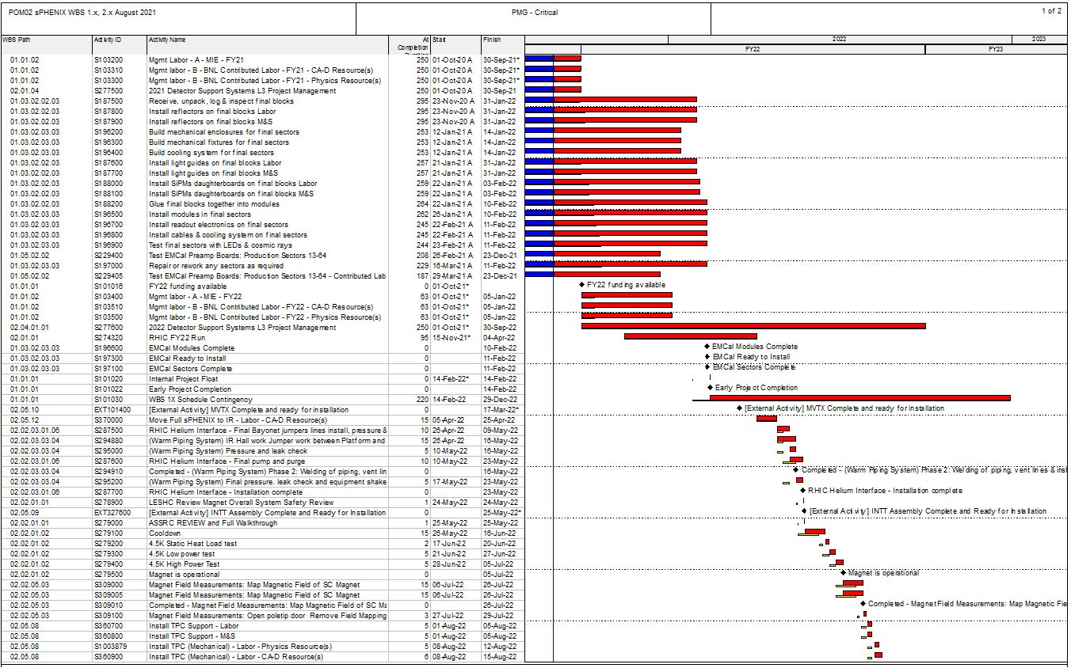
Critical Path (1x, 2x and 3x Combined)

Slide 22
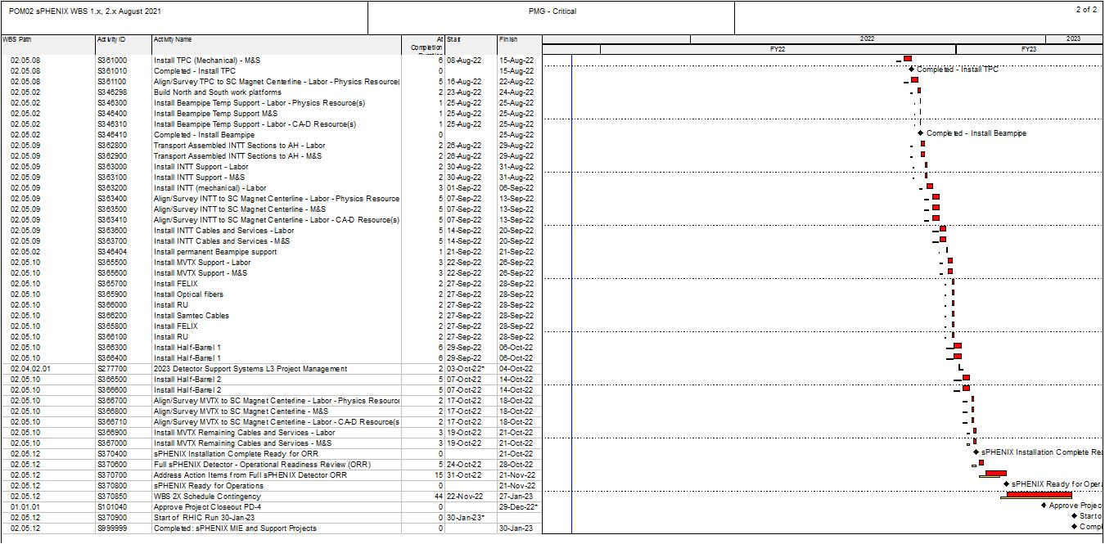
Critical Path (1x, 2x and 3x Combined)

Slide 23
Variance Analysis
sPHENIX MIE Project (Edward O'Brien [18368]) Reporting Period: 8/1/2021 - 8/31/2021
August 2021 Cumulative BCWS $24,018,003 Cumulative BCWP $20,786,006 Cumulative ACWP $20,099,791
SV = -$3,231,997 CV = +$686,214
SPI = 0.8654 CPI = 1.0341
The following report discusses the major sources of schedule variance, including all items comprising 1% of the total schedule variance, plus a few select other items, and discusses the impact as well as the corrective actions taken. The analysis is done at level 3 of the Work Breakdown Structure. An accompanying Excel file shows BCWS, BCWP, SV and status for the various item noted in the following text.
WBS 1.2.1 TPC Mechanics
Description – None. Impact – None. Corrective – None.
WBS 1.2.2 TPC GEM Modules R1
Description – None. Impact – None. Corrective – None.

Slide 24
Variance Analysis-continued
WBS 1.2.5 TPC Front End Electronics.
Description – There are four activities with significant SV. They are: activity S136500 TPC FEE Cooling System, SV = -$57,393, activity S141800 TPC FEE Production Components, SV = -$9,286, activity S142500 TPC FEE Low Voltage Power system, SV = -$30,883, and
activity S143200 TPC FEE Production boards and assembly, SV = -$175,244. The net SV is -$272,806. Impact – None as yet. Corrective – All the items covered by these activities are on order. The cooling system requires a series of machined parts, for which the procurement is placed, and manufacturing is ongoing. First articles of the cooling system parts were test fit with the initial FEE cards and cooling supply/return lines onto padplanes fitted to the main TPC support end-wheel. Cooling performance and FEE card temperatures measured met specifications. The TPC FEE production components are on order and around 97% in hand; a specific timing crystal remains to be acquired but is on allocation and may require several months to obtain. Fortunately, this is a simple 6-pad part that could be added later to otherwise assembled boards. The TPC FEE Low Voltage power supplies are delivered, with the remaining work being procurement of conductor wire and connectors and the fabrication of the cable assemblies for the LV system, all of which are on order. The contract for the TPC board production and assembly is awarded. The first revised boards built under this contract have arrived and have been tested and found to work properly.

Slide 25
Variance Analysis-continued
WBS 1.2.6 TPC Data Aggregator Modules
Description – One activity contributes to the SV: activity S147370 FELIX 2.0 board optical components, SV =-$93,719. Impact – None Corrective – The FELIX optical components are fiber optics and specialized connectors to group and route signals from the TPC FEE cards (WBS 1.2.5) to the FELIX boards. The topology of these connectors must accommodate a board used to reprogram the FEE cards in case of radiation-induced single event upsets (SEUs); this board’s architecture was determined at the beginning of March and the board’s layout is now complete. The fiber topology was updated, the bill of materials for the fiber optic components was revised, and submissions started to Procurement in April. This production will require first articles be built and tested prior to releasing the full production. A first article arrived at the beginning of August and is being tested.

Slide 26
Variance Analysis-continued
WBS 1.2.7 TPC Support Systems
Description – There are three areas of effort. The TPC Lasers delivery has started but only the first articles have been delivered, SV =-$243,311. The TPC Gas System has procured and received some 60% of the components but still needs to place requisitions for the balance, SV =-$44,121. The TPC Cooling system has not started installation of equipment or controls, SV =-$13,542.
The total SV for these key items is -$300,974. Impact – These are all items being procured well ahead of their needed installation to allow for more time to test them on the bench and adjust settings. Corrective – The Final Design Reviews are complete. The Procurement Readiness Reviews for cooling and gas systems are complete and the initial PRR for the laser system, specifically for the Line laser, is complete. All three of these subsystems have moved to acquiring the needed items. Operation of the first Line laser under the necessary field conditions was demonstrated. The Procurement Readiness review for the Diffuse laser system, which has the remaining items with multi-month procurement lead times, was held in August. Potential vendors for the Diffuse laser indicate they can meet our requirements. A bid package is being prepared. A quantum efficiency measurement was completed for the deposited metal on the TPC Central Membrane and gave a result showing that achievable Diffuse laser power is adequate to give the needed electron yield from the Central Membrane to support TPC calibrations.

Slide 27
Variance Analysis-continued
WBS 1.3.1 EMCal Blocks
Description – There are four main items causing the SV. The S171800 Epoxy is only 69% complete, SV =-$32,618. Molds S172500 are behind schedule, SV =-$7,611. The S176700-S178000 Blocks for Sectors 50-63 are not complete, SV =-$71,417, nor is their shipping to BNL, SV =-$10,083. The total SV for these items is -$114,118.
Impact – None. The EMCal block production remains near but just over 3 weeks ahead of the critical path. We note that the fiber filling task, which was the most demanding of student labor at UIUC, is now complete. Corrective – The Epoxy must be bought within a few weeks of use, due to shelf-life issues. It is a commodity item and is purchased on an as-needed basis. The delayed Blocks were caused by personnel absences in Spring 2020 due to the COVID-19 pandemic. Block production resumed over the summer of 2020 and returned to planned production rates in the Fall of 2020. This particular SV will persist until about 1 month before the Project is complete, at which time Block production will be complete. The Early Completion date for the MIE project was adjusted in January 2021 to reflect this.
WBS 1.3.2 EMCal Modules and Sectors
Description – The S187400 Production Light Guide contract is only 92% complete, SV = -$19,210. The S196100 Cooling System for Final Sectors is only 59% complete, SV = -$33,737. The total of these SVs is -$52,947. Impact – None. The EMCal sector production remains the critical path for the MIE. Corrective – The light guide vendor has continued to have several outside machine shops supplying him to maintain his delivery rate. This contract is now over 90% complete. The cooling system components are being manufactured by a local small company at a pace about 2 months ahead of need-by date. Labor to complete sectors remains a key aspect of holding the critical path schedule.

Slide 28
Variance Analysis-continued
WBS 1.4.1 Inner HCal Mechanics
Description – None. Impact – None. Corrective – None.
WBS 1.4.2 Outer HCal Mechanics
Description – None. Impact – None. Corrective – None.
WBS 1.4.3 Outer HCal Scintillating Tiles
Description – None. Impact – None. Corrective – None.
WBS 1.4.4 Outer HCal Sector Assembly and Testing
Description – The S209800 – S210200 assembly and testing of the production Outer HCal Sectors was completed ahead of schedule, SV = +$1,417. Impact – None. Corrective – None needed, work is complete ahead of schedule. The last part of the positive schedule variance goes to zero September 2021 which is the planned completion date for this effort.

Slide 29
Variance Analysis-continued
WBS 1.5.2 Calorimeter Front End Electronics
Description – Four separate activities contribute substantially to this SV. All consist of cable orders. The electronics board orders are all complete. They activities are: activity S233200 EMCal external cables are not complete, SV = -$72,049, activity S233250 EMCal trunk signal cables are not complete, SV = -$770,066,
activity S244400 HCal External cables are only 50% complete, SV = -$50,970, and activity S244450 HCal trunk signal cables are not complete, SV =-$147,817. The total SV for these activities is -$1,040,902. Impact – None.
Correctives – Potential vendors for these remaining cables indicate they can meet the requested delivery schedule for these cables. The remaining cables are catalog items built to order to a custom length. The largest of the procurements for these were finally placed the first week of August. These remaining cables are all for
installation external to the calorimeters and thus do not impact the progress in the rest of the MIE project. The main vendor indicates delivery by the end of CY2021 is planned now that they have contracts and confirmation in hand from their own vendors.

Slide 30
Variance Analysis-continued
WBS 1.5.3 Calorimeter Digitizers
Description – There are three activities contributing to this SV. They are: activity S252700 Digitizer Parts, now 65% complete, SV = -$237,488, activity S252800 Digitizer Boards, now 10% complete, SV = - $134,807, and
activity S252900 Digitizer Assembly, also now 10% complete, SV = -$207,959, for a total SV = -$580,254, an 11% improvement over the prior month. Impact – None presently. The EMCal and OHCal sector production lines have an adequate number of digitizers to perform all needed QA during remaining detector construction. Therefore, the remaining digitizers are only needed by the completion of the MIE project. Corrective – The contract for the production digitizers is placed. The vendor indicates they are placing orders for production quantities of all parts but that world-wide supply chains have led to more lead time than foreseen pre-COVID. Supply chains for electronics parts continue to experience 6-9 months delays in parts availability. Parts arrivals have now reached 65% of required deliveries. The parts vendors used by the digitizer vendor now have accepted all remaining parts orders. Board orders are now placed with PCB vendors. Full assembly kits have been delivered to electronics assembly houses for three of the seven required board types.

Slide 31
Variance Analysis-continued
WBS 1.6.1 Data Acquisition
Description – Four activities contributed to this SV, including: activity S255900 Production Boards not complete, SV = -$121,503, activity S256700 Crates not complete, SV = -$74,284, activity S258700 jSEB Slow Control Boards not complete, SV = -$19,181, and activity S259500 Buffer Box procurement not complete, SV = -$166,054, for a total SV = -$381,021. Impact – None. These items do not affect the production schedule for any other MIE items. Corrective – Procurement documents are being prepared but are not yet complete for the first three items. These activities construct more of existing designs from the PHENIX experiment thus needed no development or preproduction cycle. The order for the buffer boxes has been placed with a vendor and the associated racks have been delivered. The international market for computer disk drives is experiencing significant delays which will continue to delay completion of the Buffer Box activity.
WBS 1.6.2 Local Level-1 Trigger
Description – Activity S263600 Preproduction Local Level-1 trigger, is not complete, SV = -$69,641, and activity S264900 Production LL1 trigger is not complete, SV = -$135,800, for a total SV = -$205,441. Impact – None Corrective – The prototype Local Level-1 trigger board has been under full-speed testing for several months. Results to date indicate it will meet all requirements, completing the first above activity i.e. the prototype activity. A review held in late February determined that a few small revisions to the board are needed. These revisions are proceeding. The production manufacture is still expected during 2021 based on the existing board assembly house and Bill of Materials. That production will complete this level-3 WBS. The contract with the vendor was finally placed in August. There is now some concern about electronics parts availability to complete this order by the Early Finish date.

Slide 32
Variance Analysis-continued
WBS 1.6.3 Global Level-1 Trigger
Description – Activity S267600 Production of final GL1 is not complete, SV =-$32,673. Impact – None Corrective – The prototype Global Level-1 Trigger is being used as part of an extended test of electronics for sPHENIX. This test requires multiple front-end cards to operate, respond to triggers and timing signals, and send data to the production DAQ computers correctly over an extended period. This test is continuing as of the end of July. Assuming a positive outcome, the production Global Level-1 Trigger will be assembled using the existing blueprints.
WBS 1.6.4 Timing System
Description – Activity S270300 Production of Timing System is not complete, SV =-$48,284. Impact – None Corrective – The prototype Timing System is being used as part of an extended test of electronics for sPHENIX. This test requires multiple front-end cards to operate, respond to triggers and timing signals, and send data to the production DAQ computers correctly over an extended period. This test is continuing as of the end of July. Assuming a positive outcome, the production Timing System will be assembled using the existing blueprints.
WBS 1.7 Min Bias Trigger Detector
Description – Activity S273500 Min/Bias production digitizers is not complete, SV = -$8,572, and activity S273600 MBD Shaper/Disc Board is not complete, SV = -$53,879, for a total of -$62,451. Impact – None Corrective – The digitizers needed for the MBD are part of the larger digitizers order noted above for WBS 1.5.3 A final design review and production readiness review were held for the MBD shaper/discriminator board in February, no required changes were identified, and the board approved for production procurement. This procurement finally has been placed with the vendor who prepared and tested the prototype versions. Completion by December 2021 is anticipated.

