Slide 1
Uproot & Pandas Tutorial
September 15, 2021
Robinpreet Dhillon

Slide 2
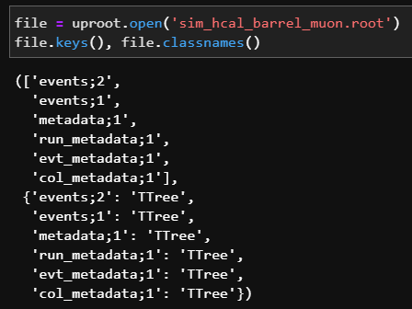
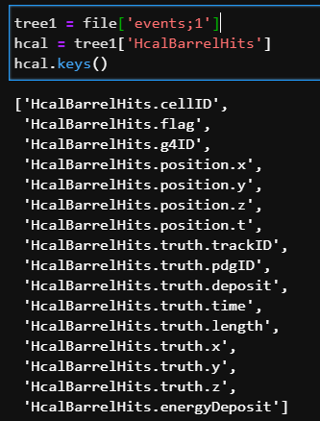

Basics of uproot
Install uproot using pip or conda. Allows us to work with .root files in Python.
Using uproot to open files, we can see the data contained within.

Slide 3
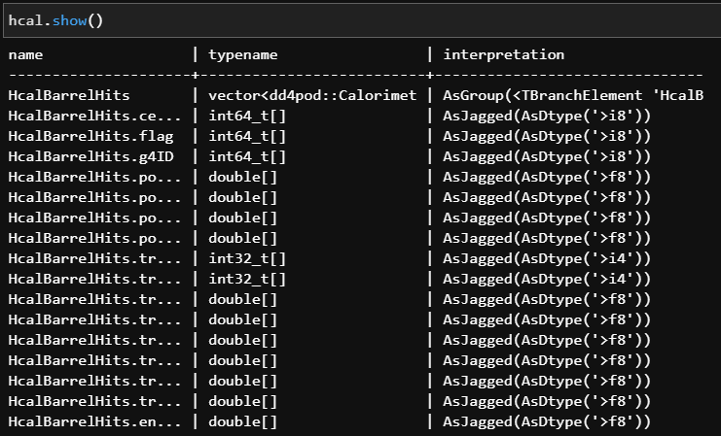
Must flatten jagged arrays to plot. Once flattened, we can carry out regular mathematical operations for each data point.
Use the Awkward package: import awkward as ak

Slide 4
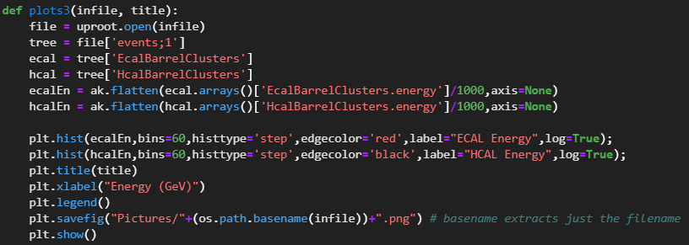
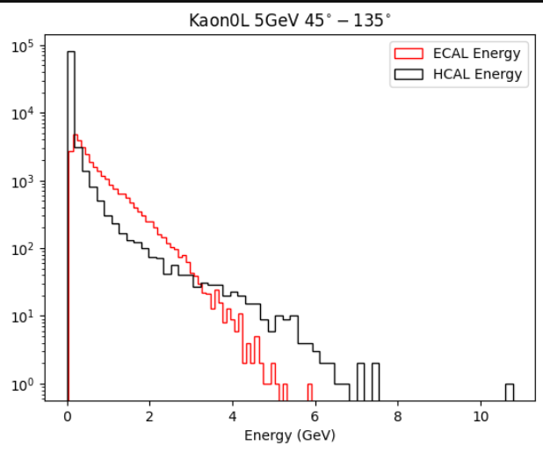

Slide 5
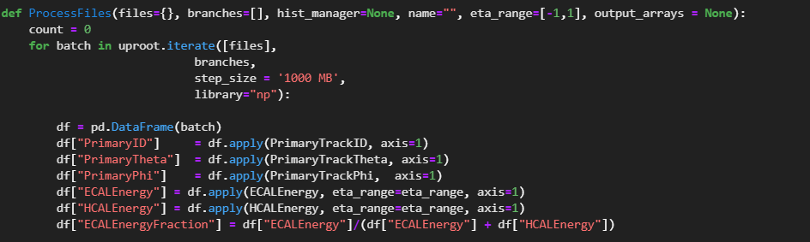
uproot.iterate and pandas dataframes
When determining the energy deposition of various particles and their corresponding energy resolutions, there are two paths:
Iterating through portions of entries of a file’s Ttree using uproot.iterate
Creating a pandas dataframe (which can be viewed at any time for debugging) for the analysis.

Slide 6
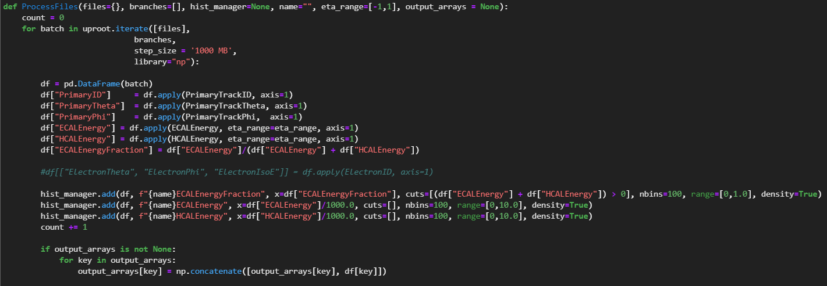
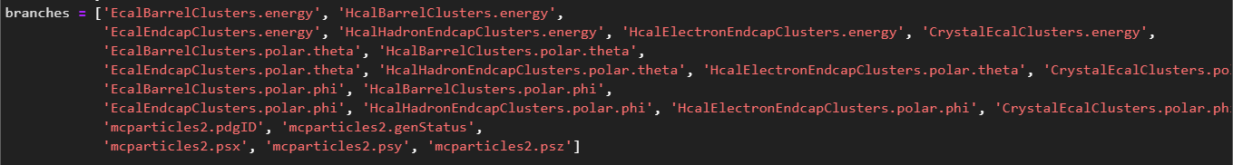

Slide 7

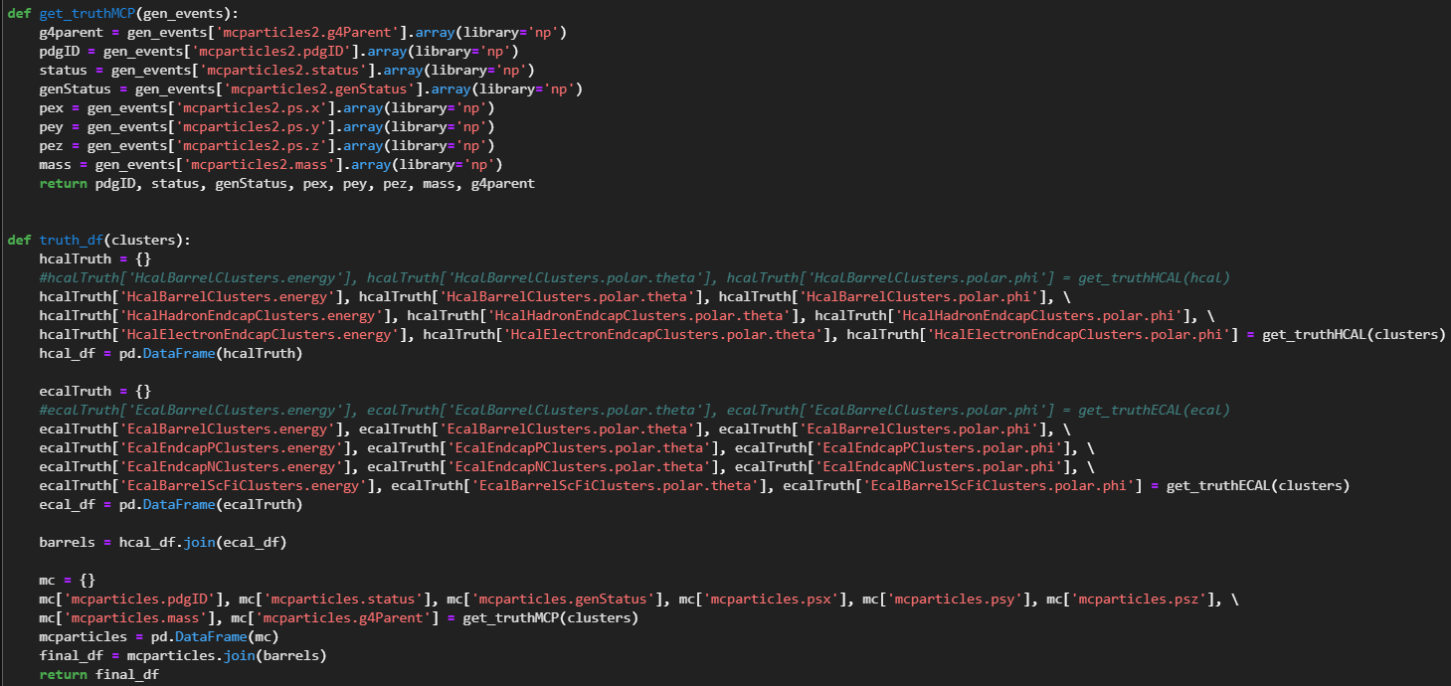
Instead, we can extract the desired data and save it to a pandas dataframe.

Slide 8
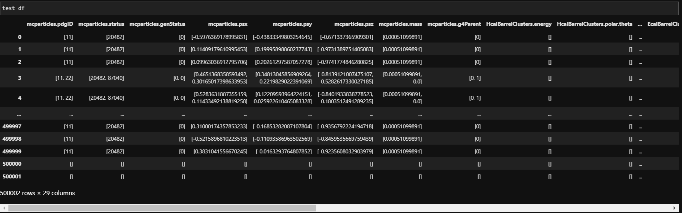
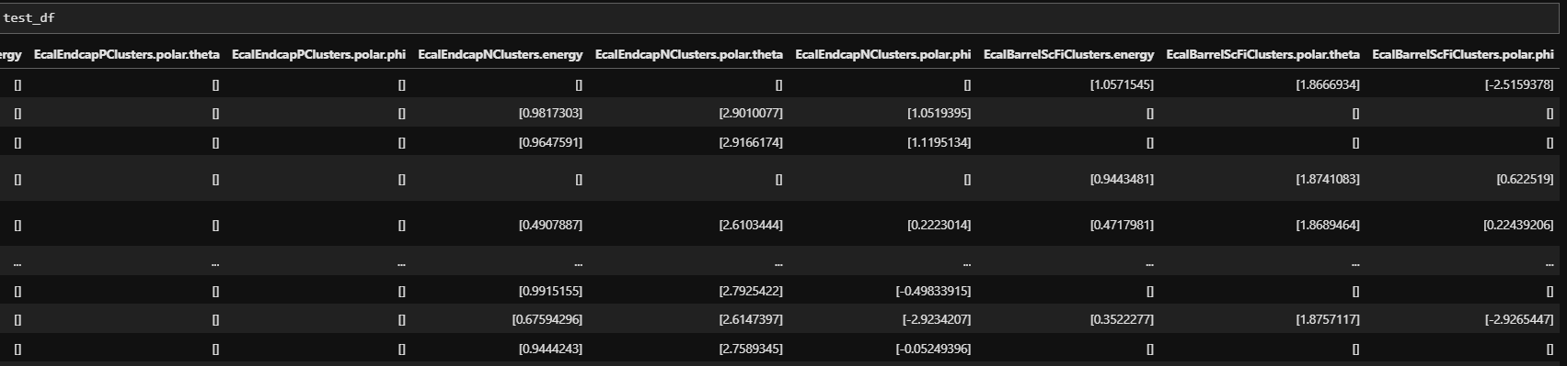

Slide 9
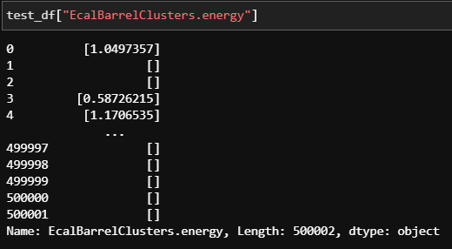
Advantage over uproot.iterate is that we can see every column and debug as required.
We can also extract specific columns; simply specify the column as shown:
Now, we can simply pass the complete dataframe to the ProcessFiles function for the same analysis.

Slide 10
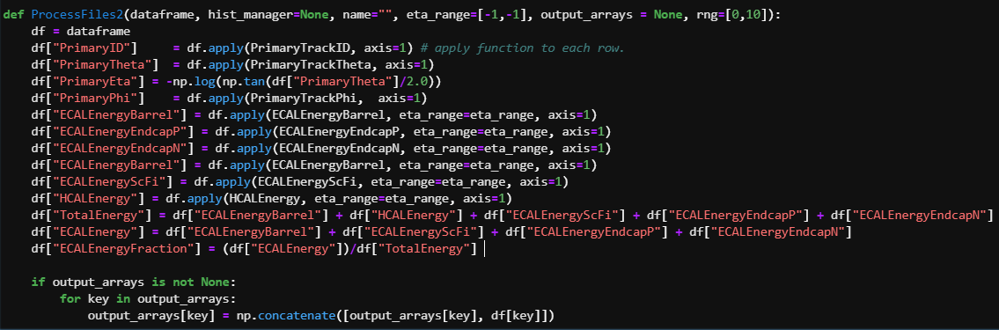
To calculate the energy deposition in any ECAL component, use the [dataframe].apply operation:
dataframe.apply(function, row)
Applies the desired function to each row of the dataframe and returns the result. The results are then saved in the output array of choice for further use (plotting, fitting for energy resolutions, and more).

Slide 11
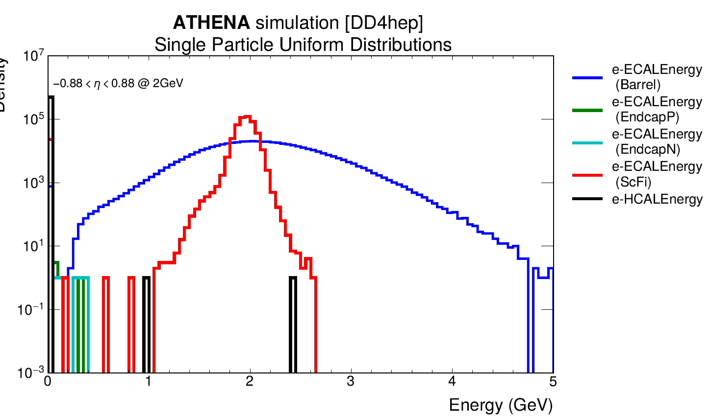
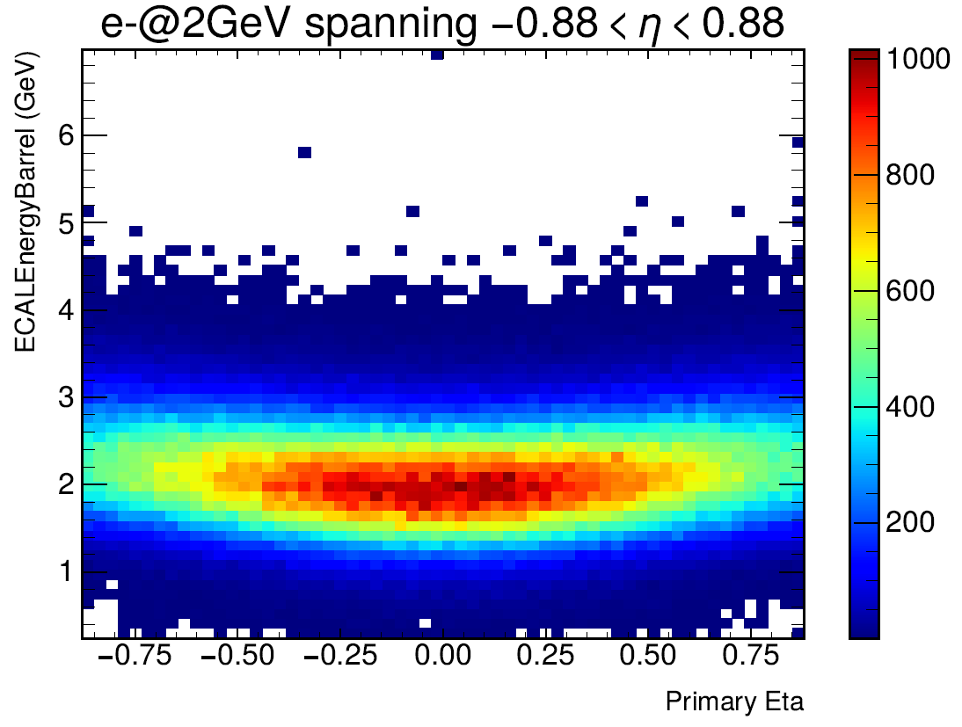
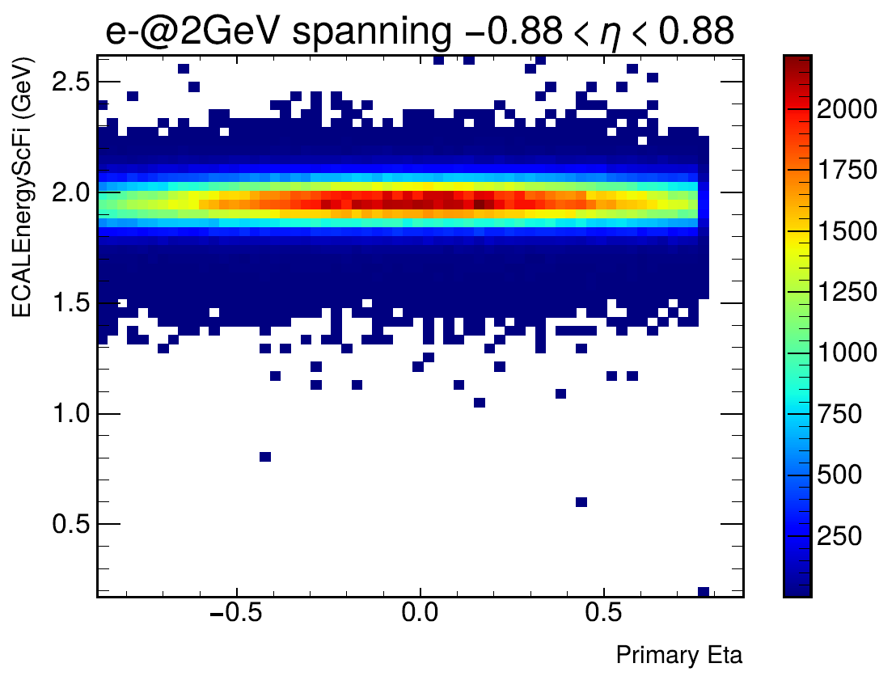

Slide 12
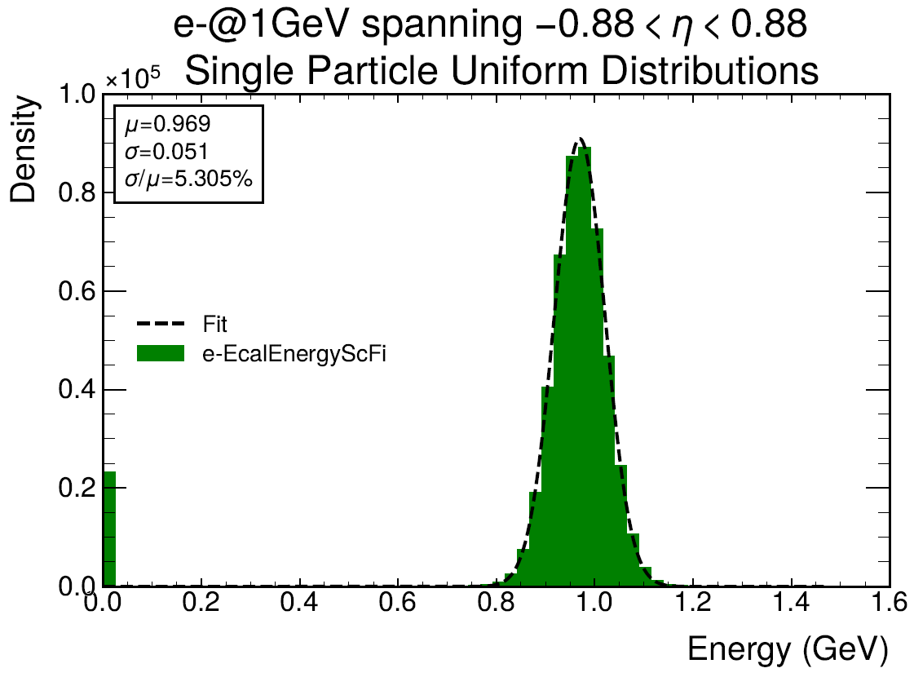
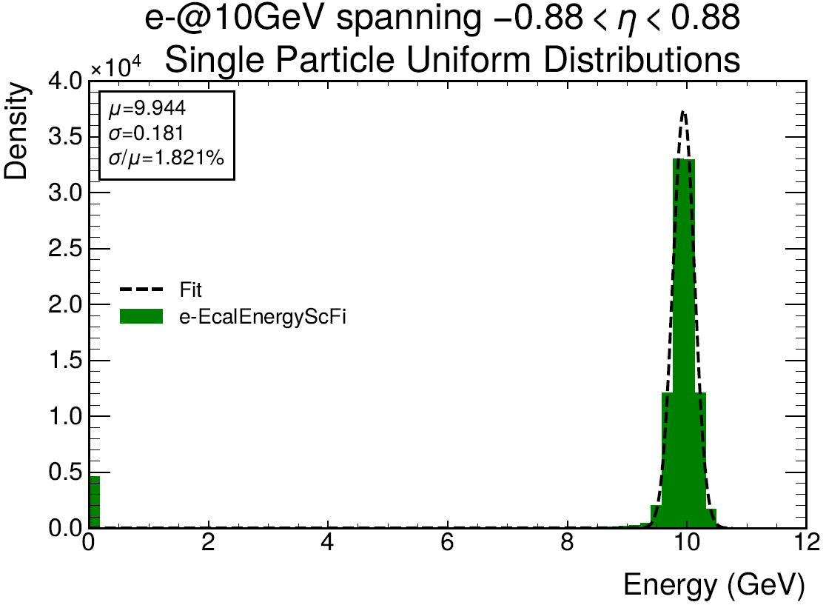

Slide 13
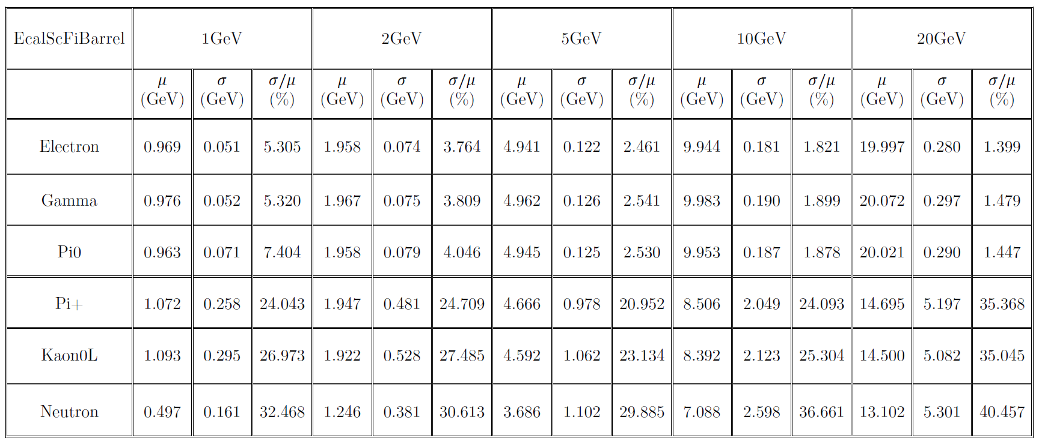
Energy Resolutions of various particles

Slide 14
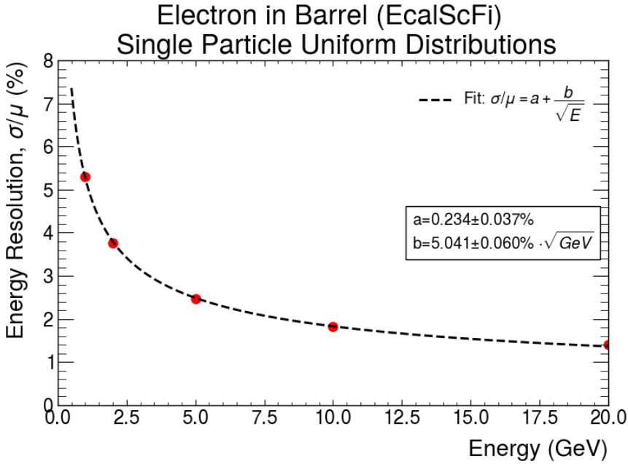

Slide 15
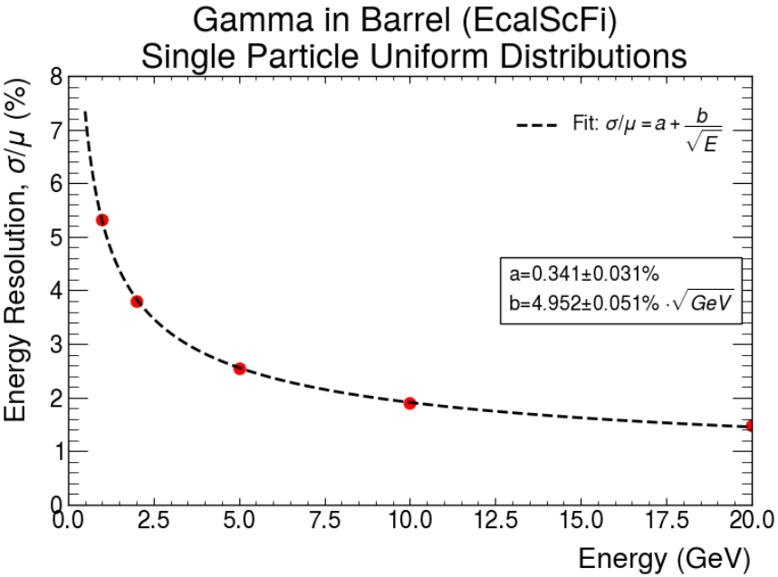

Slide 16
Thanks for listening!

