Slide 1
Stellar Evolution
The Plot
Pile of Gas and Dust Fights Back Against
Gravity and External Pressure (maybe)

Slide 2
The Story
Gravity and External Pressure Cause Density to Increase
PV=nRT and variations
Unlike the Ideal Gas Law, the Particles are
Not Idealized Spheres
NOT Adiabatic, Energy lost (mostly) via Radiation

Slide 3
Energy Output because
Temperature at the Surface and Black Body Radiation Laws Govern Energy Output as Photons
Kelvin (cooling) time scale governs the total output, unless energy source available
Internal Nuclear Reactions and Gravitational Potential Energy
Provide the Energy over the long term
Compression by Gravity Causes High Temperature and Pressure
which strips the electrons from the nuclei
Nucleosynthesis proceeds as a result of collisions and radioactive decay
Electrostatic repulsion limits the reactions that occur

Slide 4
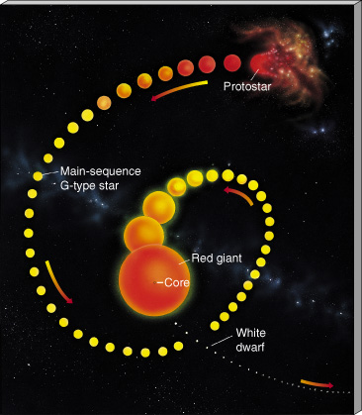
Gas
Very bright,
But cold
E=σT⁴
Governs the amount
of light emitted
per unit area of the
“surface”

Slide 5
Getting Born
Growing Up

Slide 6
Growing Old and Dying
Life after core hydrogen burning

Slide 7
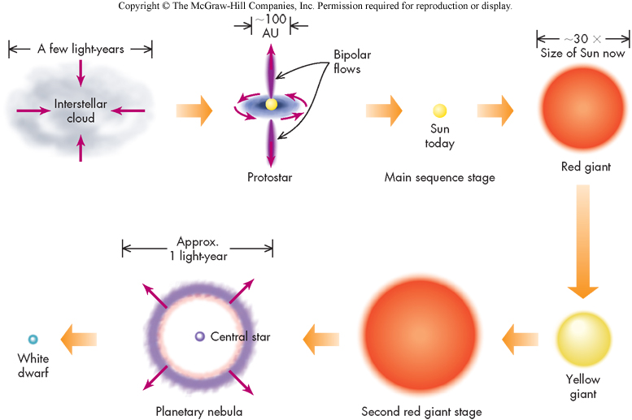
Life Stages of a Low Mass Star
Figure 59.01, Pathways

Slide 8
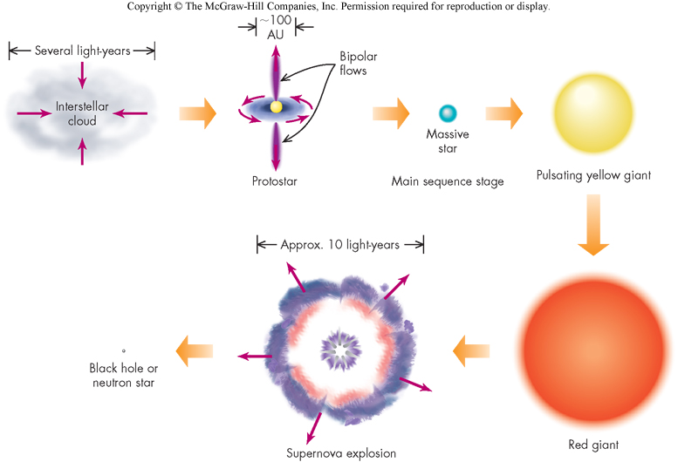
Life Stages of a High Mass Star
Figure 59.02, Pathways
Which are the different parts compared to the low mass stars?

Slide 9
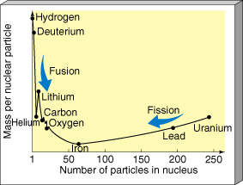
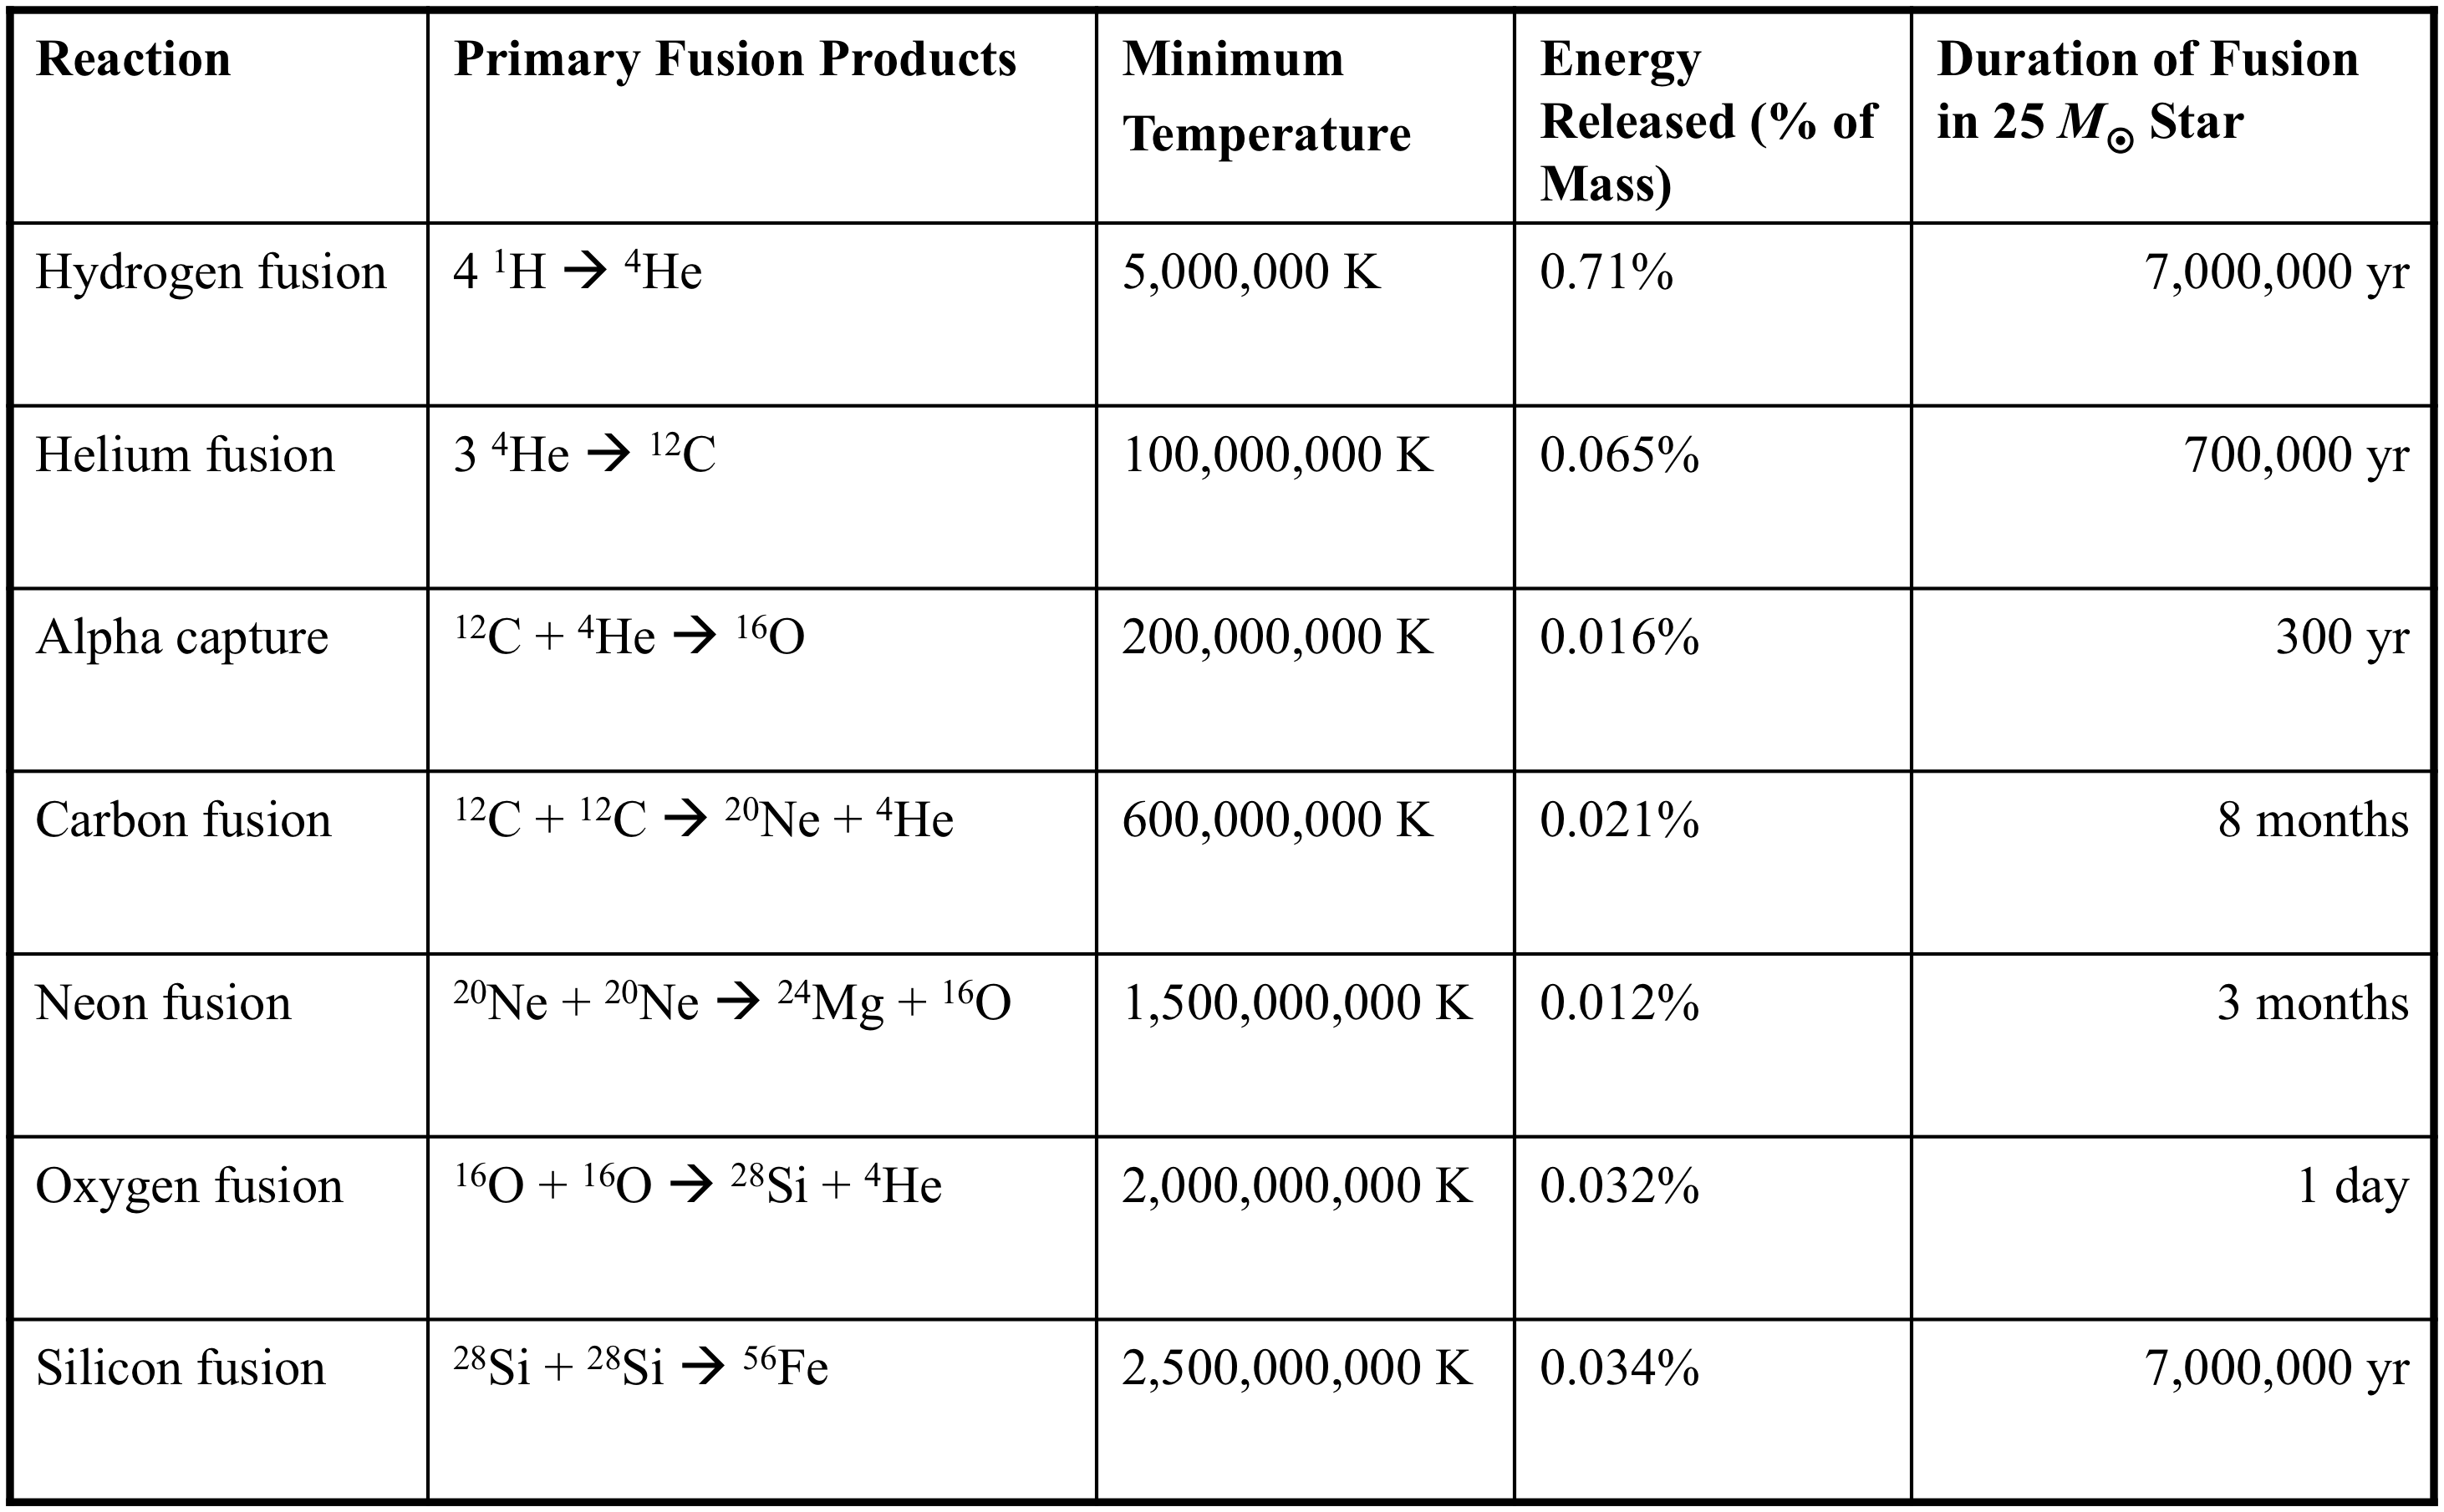
What Happens to High Mass Stars?
Their interiors get hot enough to fuse other elements
Silicon reacts, but not this way,
Time looks wrong kgc

Slide 10
Regardless of Process,
Hydrogen Conversion to Helium Makes MOST of the Energy
The LOWER the Mass per Nucleon, The More Mass Released
Fusion – fusing together of nuclei from smaller into more massive ones
Fission- breaking apart nuclei into smaller ones or pieces

Slide 11
The Higher the initial Mass of an Object,
The Hotter and denser the Interior
The More Different Nuclear Processes Occur
Models Use Rate Equations (functions of T, ρ, number fraction of the relevant nuclei)
and Energy transfer, radiative, convective, conductive
to establish what is happening in the interior
Hydrogen has lowest charge, largest percentage of nuclei, so
4 H -> He
is the dominant source of energy and occurs at lowest temperature, lasts the longest time (Main Sequence)

Slide 12
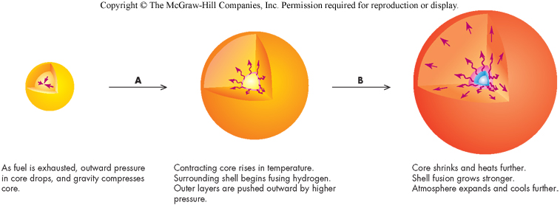
As Hydrogen is Depleted The Core Contracts, Surface Expands
Layers Outside the Core Heat and Can Fuse H,
Core Contracts and Can Fuse He
Figure 62.01, Pathways

Slide 13
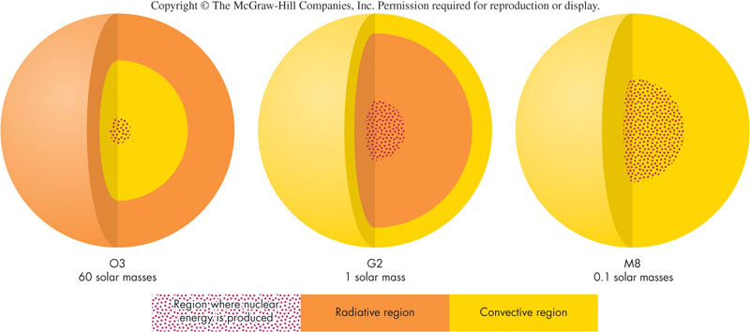
Main Sequence Stars convert Hydrogen to Helium
ONLY in the Core
Convective Mixing Lets Low Mass Stars Use More of the Hydrogen
Stars Roughly 0.6-8 Solar Masses Don’t Mix Well, Stratify

Slide 14
Convection can Extend to the Surface, Can Bring Up Heavy Elements
The first dredge-up occurs when a main-sequence star enters the red-giant branch. As a result of the convective mixing, the outer atmosphere will display the spectral signature of hydrogen fusion: The ¹²C/¹³C and C/N ratios are lowered, and the surface abundances of lithium and beryllium may be reduced.
The second dredge-up The second dredge-up occurs in stars with 4–8 solar masses. When helium fusion comes to an end at the core, convection mixes the products of the CNO cycle.^{[1]} This second dredge-up causes an increase in the surface abundance of ⁴He and ¹⁴N, whereas the amount of ¹²C and ¹⁶O decreases.^{[2]}
The third dredge-up The third dredge-up occurs after a star enters the asymptotic giant branch, after a flash occurs in a helium-burning shell. The third dredge-up brings helium, carbon, and the s-process products to the surface, increasing the abundance of carbon relative to oxygen; in some larger stars this is the process that turns the star into a carbon star.^{[2]}

Slide 15
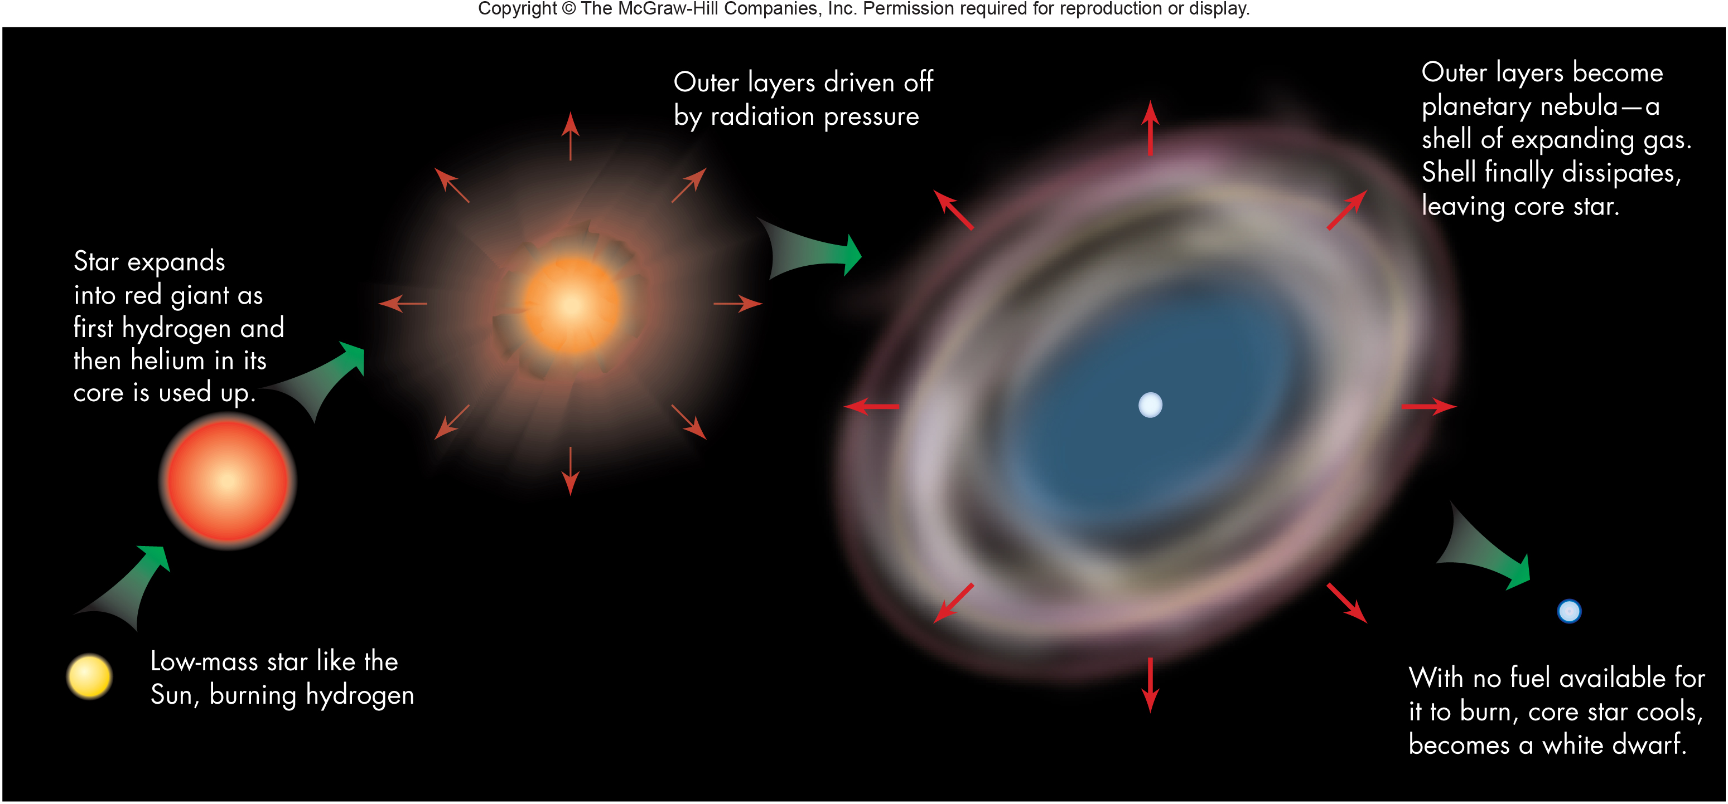
Stars of about 0.6 – 8 Solar Masses Swell when they Exhaust a type of fuel in the core.
Can build elements as high as Oxygen at the higher masses,
Eventually Puff Off outer layers as a “Planetary Nebula’, leaving a white dwarf as the remainder

Slide 16
White Dwarfs Types– DO, DB, DA, DF, DG, DM, DC
Classifications NOT analogous to MS – reflect compositions, not temperature
DA – hydrogen lines (no other lines, pure H atmosphere)
DB – neutral He lines (no hydrogen at all, pure He) DO – ionized He lines (no hydrogen at all, hotter DBs)
DC – continuous spectrum, no lines
DF, DG, DM (can’t discriminate DA or DB) Heavier atoms sink in gravitational field
Above 15,000 K, 15% are non-DA, below 15,000 K, half are non-DA. How do the stars do that? NO DB stars between 30,000 and 45,000 K
Various mixing schemes can alter surface composition

Slide 17
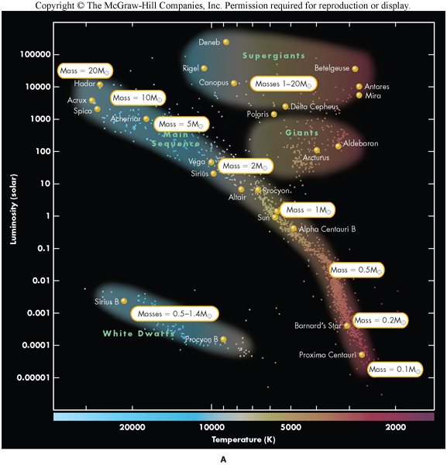
Main Sequence Position Depends on Stars’ Original Mass
Giant and Supergiant Stars Are Swollen Phases of
Stars’ Later Lives
White Dwarfs are
Remnants of
Low Mass Stars
White Dwarf Masses
are PART of the original
Figure 58.05a, Pathways

Slide 18
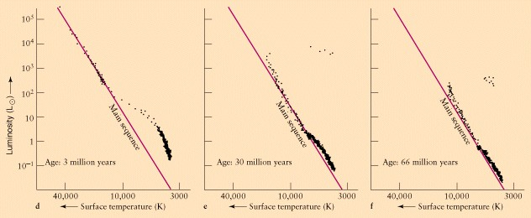
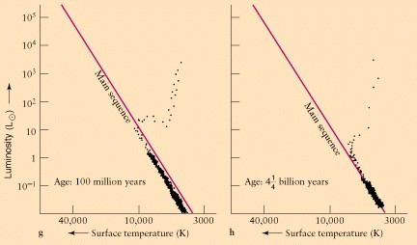
HR diagrams for Clusters show stars of different Masses
Same Age in years

Slide 19
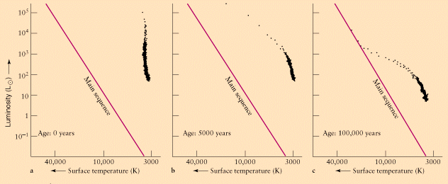
Stars Evolve onto the Main Sequence, Most massive ones fastest

Slide 20
Stars on Color Magnitude Diagram for Various Star Clusters
http://abyss.uoregon.edu/~js/ast122/lectures/lec15.html

Slide 21
Evidence for White Dwarfs Burning H on Surface
Slowly cooling white dwarfs in M13 from stable hydrogen burning
Jianxing Chen1,2, Francesco R. Ferraro1,2*, Mario Cadelano2, Maurizio Salaris3, Barbara Lanzoni1,2,
Cristina Pallanca1,2, Leandro G. Althaus4,5 , Emanuele Dalessandro2

Slide 22
Stars on Color Magnitude Diagram
For a Globular Cluster
http://abyss.uoregon.edu/~js/ast122/lectures/lec15.html
White Dwarfs

Slide 23
White Dwarfs (mass < 1.4 solar masses) – expected to just cool off Isochrons shown
The Astrophysical Journal, 901:93 (26pp), 2020 October 1

Slide 24
The Q branch indicates something other than just cooling going on. These are White Dwarfs within 250 pc of Sun. This paper suggests mergers of white dwarfs could account for this effect or N²² sinking and releasing energy.
arXiv:1905.12710

Slide 25
M13 has ΔY₀∼0.08 and (m−M)_{V}=14.42
M3 has ΔY₀∼0.01 and (m−M)_{V}=15.02,
from
arXiv:1706.05454
Extended Horizontal Branch,
Toward Blue
(m − M)₀ = 14.43 this paper
Blue stragglers
Blue stragglers
Mean photometric errors
Main
Sequence
Main
Sequence
Detections above
23.5 only used
More white dwarfs than M3,
More small mass wd’s

Slide 26
M 13 has more WD compared to the number of Red Giants than does M3
This could be because WD’s in M 13 cool more slowly than in M3 and are visible for longer.
jjkk
Hydrogen Fusion in the atmosphere for about 70% of the white dwarfs can delay cooling and account for the larger population of WD’s (~1.5 x as many as in M3, compared to red giants). Hydrogen burning with about 10-4 of the
The excess number of WD’s is at low mass.
The hydrogen burning, in about 30% of the white dwarfs is consistent with the stars NOT having the third dredge up and NOT altering the surface H content. So some H remains and burning it keeps the surface hotter and brighter for longer. This is consistent with 0.56 solar mass WD model. An atmosphere of about 1.7x 10⁻⁴ solar masses will suffice to lengthen the cooling time by about 75%

Slide 28
Cooling time is extended with H burning

Slide 29
Completeness as a Function of Apparent Magnitude
Probability of detection based on simulated star populations . Vertical Blue line shows magnitude cut off

Slide 30
Hertzsprung Russell (HR) Diagram
Brighter
(lower
magnitude
numbers)
Hotter
(“earlier” spectral type)

Slide 31
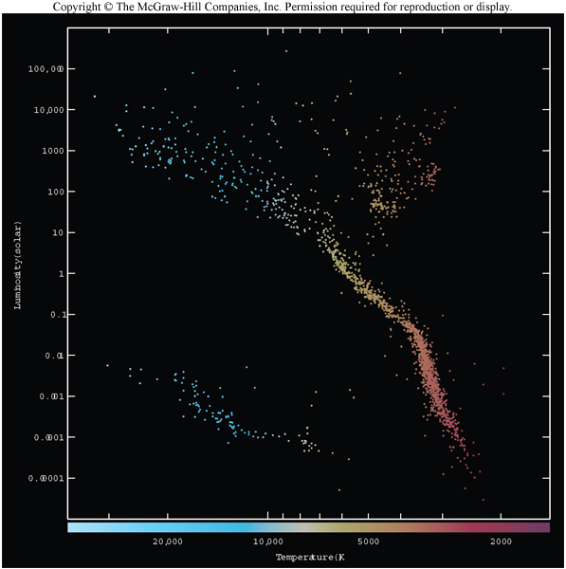
Hertzsprung Russell Diagram
Luminosity↑
←Temperature
Figure 58.02, Pathways

Slide 32
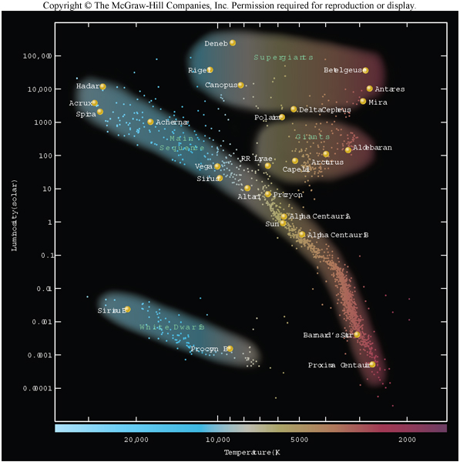
Stars Fall in Several Areas of HR Diagram
Supergiants
Giants
Main Sequence
White Dwarfs
Figure 58.03, Pathways

Slide 33
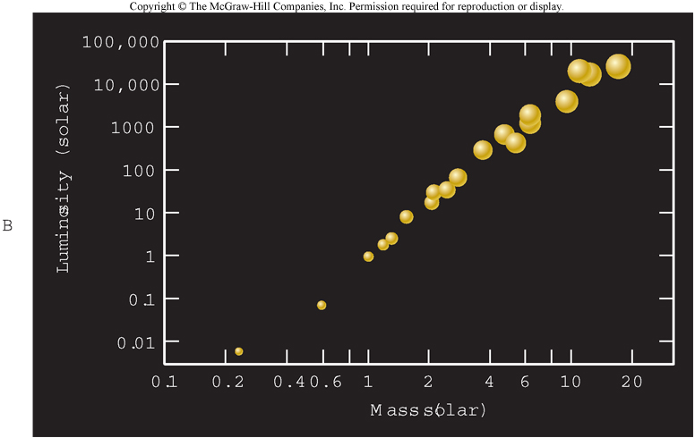
Mass Luminosity Relationship for main sequence
Figure 58.05b,Pathways

Slide 34
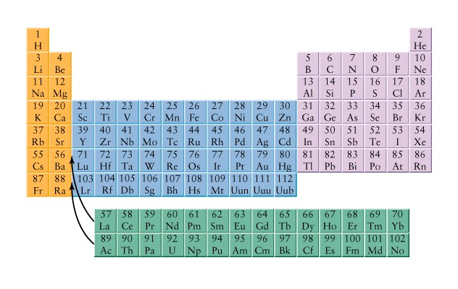
Number of Protons Determines which Element
So Heavier Elements with More Protons, More Charge
Are harder to fuse, they repel more strongly.

Slide 35
Proton-Proton Cycle Converts Hydrogen to Helium at lowest temperature
electron
Particles annihilate
producing gamma rays
positron
1
neutrino
H
6
1
H->
4
He
Neutron
Gamma Ray
Proton
+2 positrons
Deuterium,
Helium
+2 neutrinos
1
H
2
3
He
+2 gamma rays
H
+2
1
H
Helium
4
He
1
H
Neutron
Proton
Gamma Ray
1
Deuterium,
H
2
H
neutrino
Particles annihilate
producing gamma rays
positron
electron

Slide 36
Carbon Nitrogen Cycle H-He at higher temperatures
p
Gamma ray
Gamma ray
positron
Gamma ray
neutrino
¹²C
¹³N
¹³C
¹⁴N
¹⁵O
p
p
p
4
positron
neutrino
Upper Main Sequence Stars
Convert 4H to ⁴He This way
Same net energy
¹⁵N
From¹⁵N form either
¹²C and ⁴He
or
¹⁶O
4
He
¹²C
¹⁶O

Slide 37
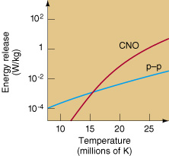
Hydrogen Converts to Helium Via Two Processes
Proton-Proton Cycle – lower temperature way
Carbon- Nitrogen Cycle
Proton proton
Works at lower temperature
Because Electrical Charge Repulsion is Less

Slide 38
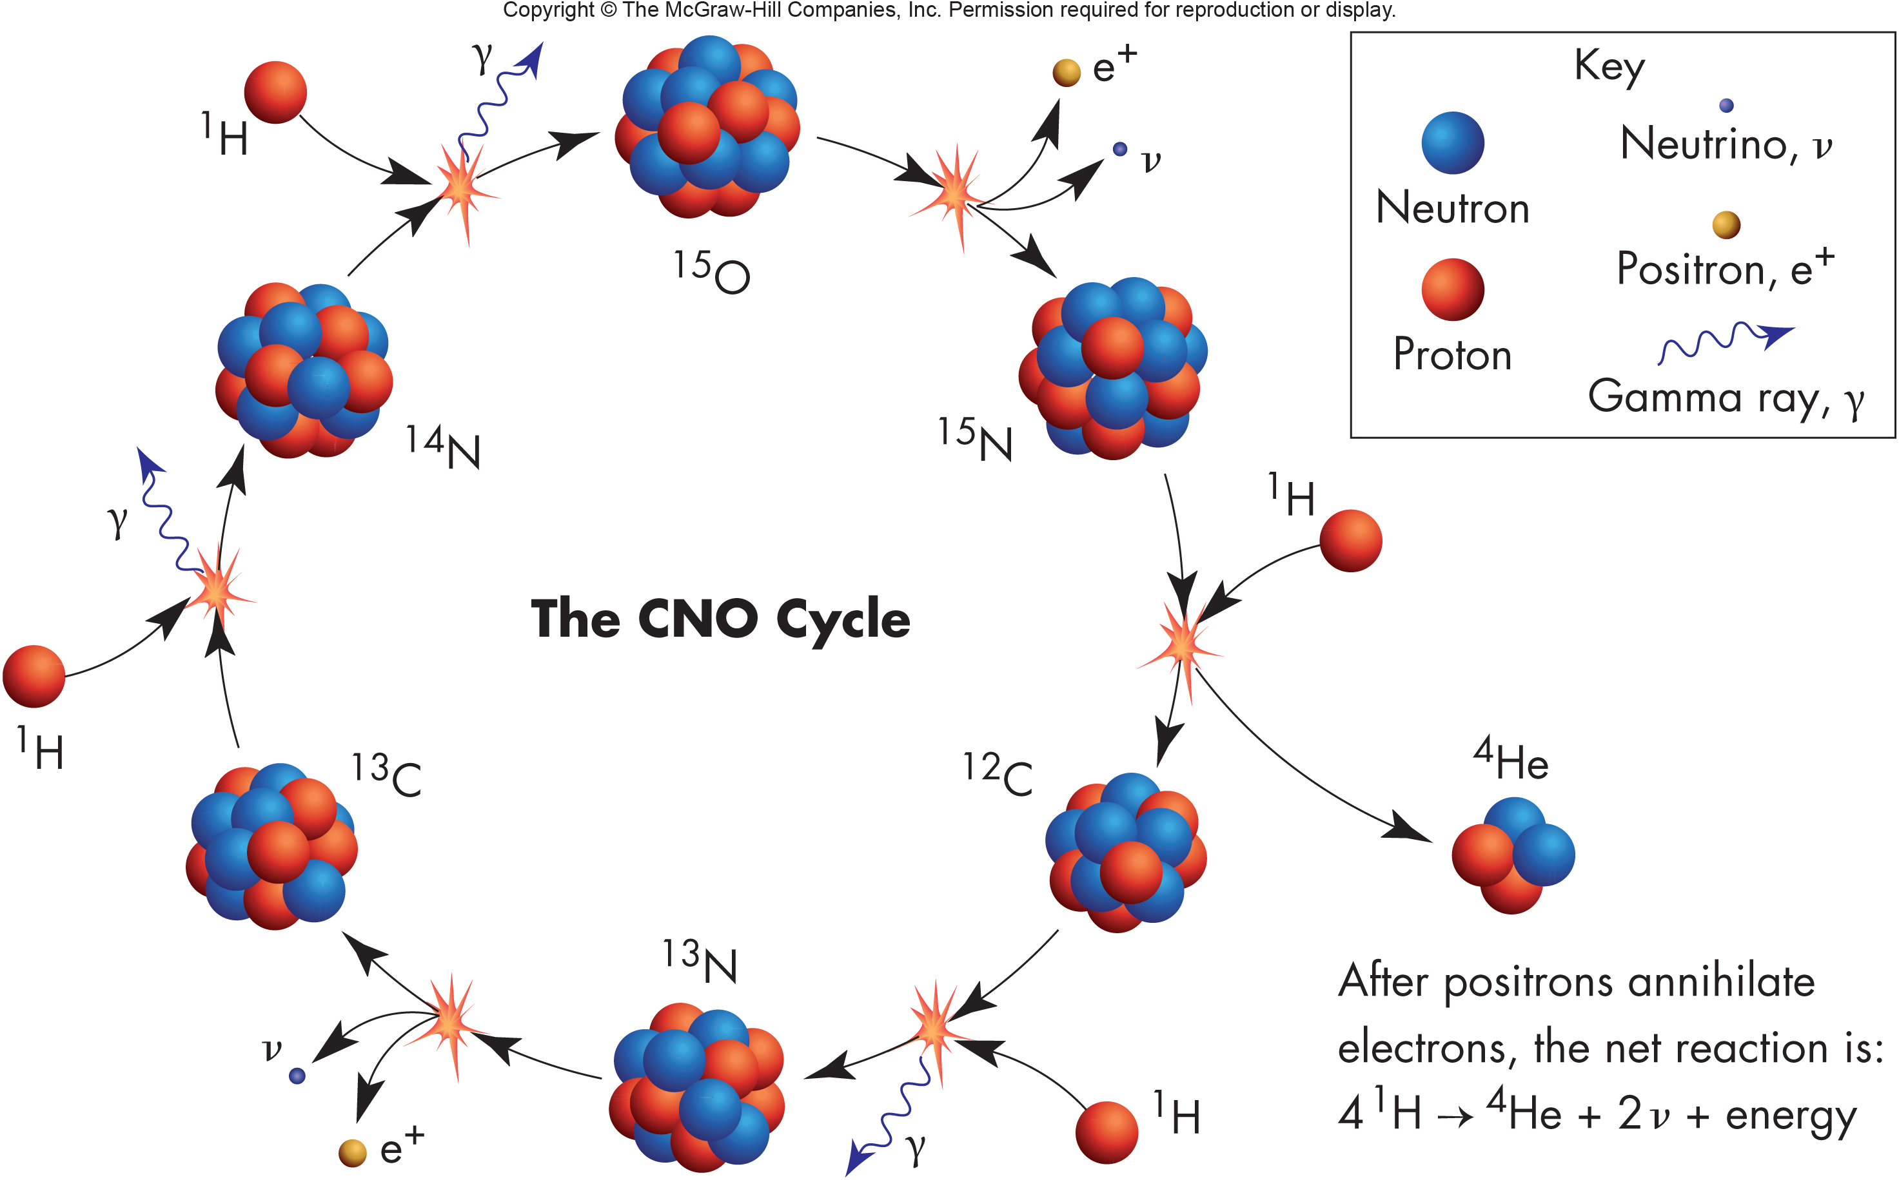
Fig. 62.2

Slide 39
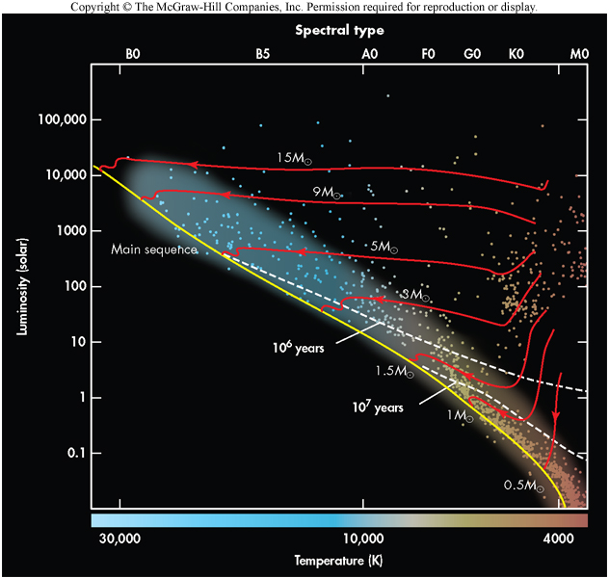
Approaching the Main Sequence Early Stages
Figure 60.09, Pathways

Slide 40
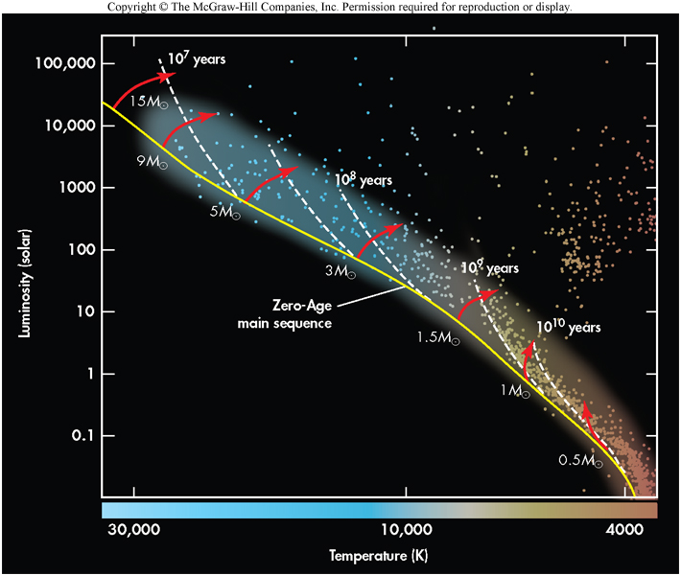
Stars Leave Main Sequence When Core Hydrogen is Depleted
The BIG
Die Young
Figure 61.05, Pathways

Slide 41
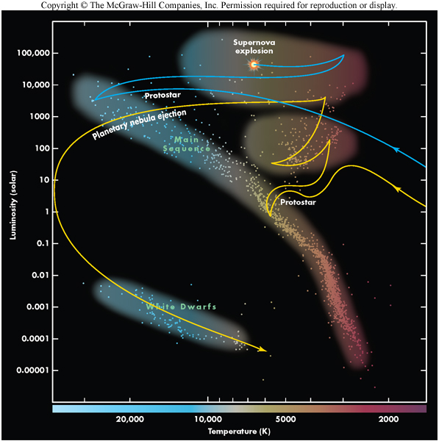
Evolutionary Tracks on HR Diagram
Figure 59.04, Pathways

Slide 42
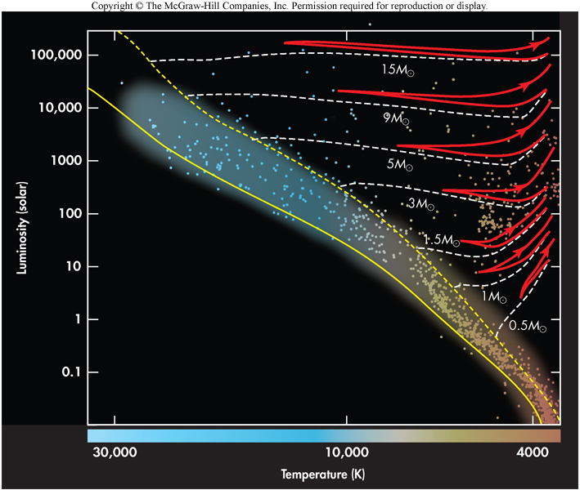
Post Main Sequence Evolution
Helium
Ignition

Slide 43
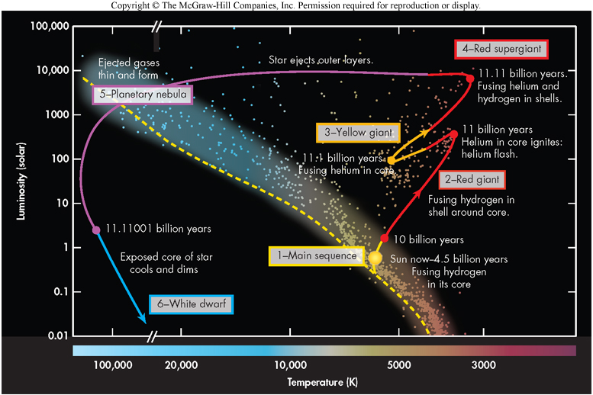
Sun’s Life Cycle on the HR Diagram
Figure 64.02b, Pathways

Slide 44
Alpha Particle Capture
Helium Nuclei, 2 protons, 2 neutrons called Alpha Particles
¹²C
¹⁴N
¹⁶O
He
He

Slide 45
Radioactive Nuclei Decay (fall apart)
0
Every second, there is a probability that a nucleus will break up
After Break-up the material becomes a daughter nucleus and “crumbs”

Slide 46
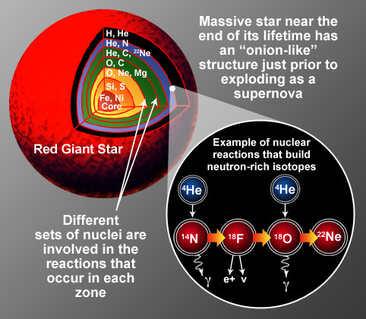
Nucleosynthesis in High Mass Stars at End of Life

Slide 47
SAHA Equation
describes ionization state
So n is not constant
https://en.wikipedia.org/wiki/Saha_ionization_equation

Slide 48
Boltzmann’s Equation
– Describes the distribution of electrons in energy levels for a given ionization state
N_{j} is number of particles in the jth energy level
N₀ is the number of particles in the 0th energy level (ground state)
E_{j} energy level of the jth state above the ground state
ϖ_{j} is the statistical weight of the j^{th} energy level
k Boltzmann’s constant
T temperature K
from https://phys.libretexts.org/Bookshelves/
Astronomy__Cosmology/Book%3A_Stellar_Atmospheres_(Tatum)/
08%3A_Boltzmann%27s_and_Saha%27s_Equations/8.04%3A_Boltzmann%27s_Equation

Slide 49
Excitation into even the n=2 level for H peaks at around 85,000 K, but the lines are not strong because H is ionized

