Slide 1
Status of MRPC design and cost estimates
Very productive Tsinghua – Vanderbilt meeting this morning
MRPC with ~3 cm thickness can meet timing resolution requirements
Zhihong provided several design examples (see next slides)
  MRPC segmentation and number of readout channels TBD based on the concrete ECCE geometry
Julia will work with Vanderbilt technician to propose the support structure and layout for the individual modules , and the associated cost
  Q: does a support frame/carriage in ECCE already exist or do we need to include it ?
Julia is in contact with BNL gas experts to estimate gas system cost. We’ll use sealed MRPCs → low flow rate
FEE – the most uncertain part, but we have identified who to contact
HV – Sourav will contact CAEN for a quote after we figure out the MRPC segmentation
Zhihong has provided some cost tables from SoLID → good starting point
We’ll get started on the cost tables asap

Slide 2
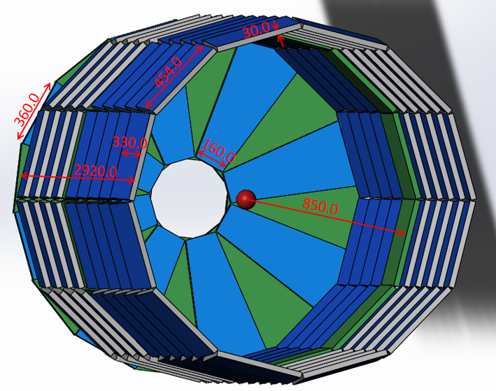
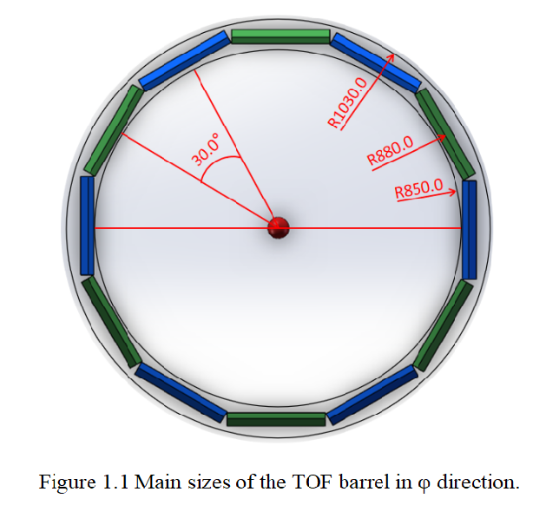
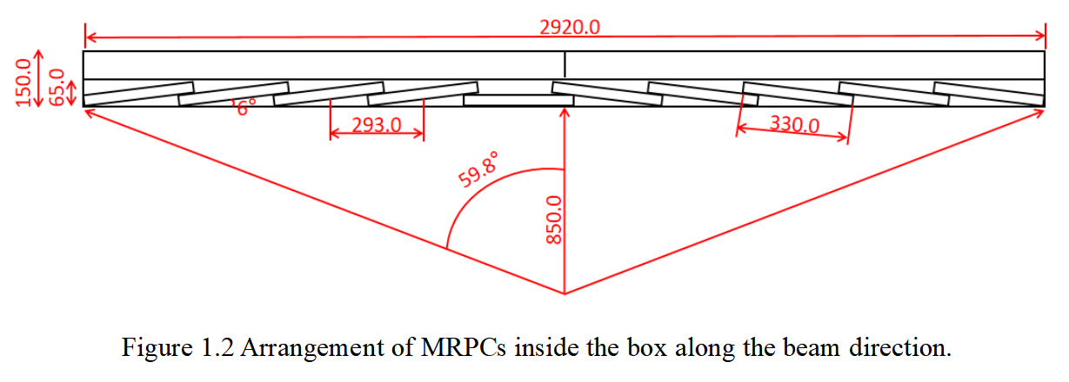
Barrel MRPC-TOF
12 module for
one circle
Each module consists of
10 sealed MRPC

Slide 3
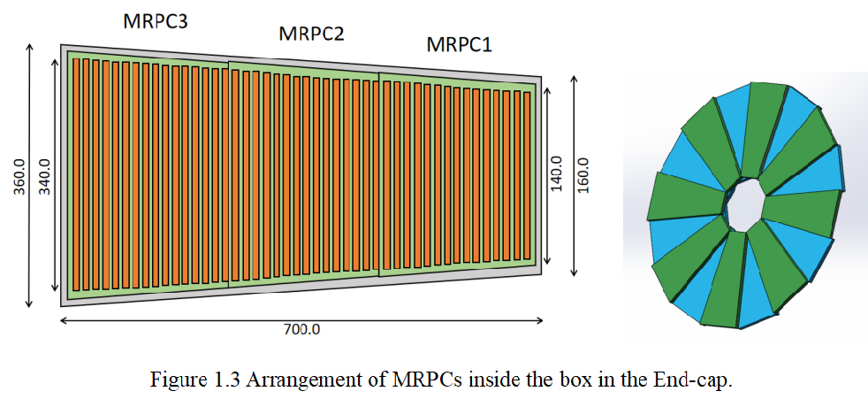
End-cap MRPC-TOF
eTOF consists of 16 modules and each module consists of 3 sealed MRPC.
Total overlapped thickness= 60mm

Slide 4
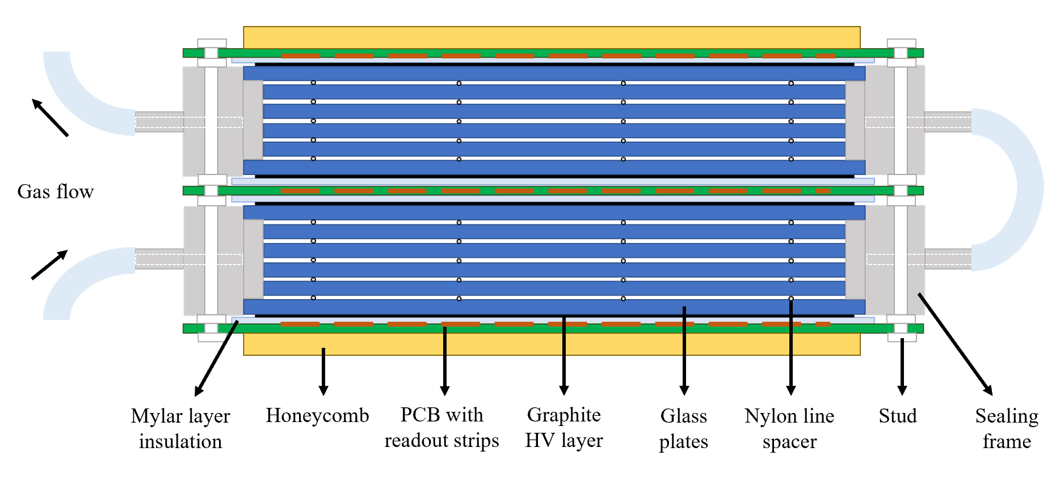
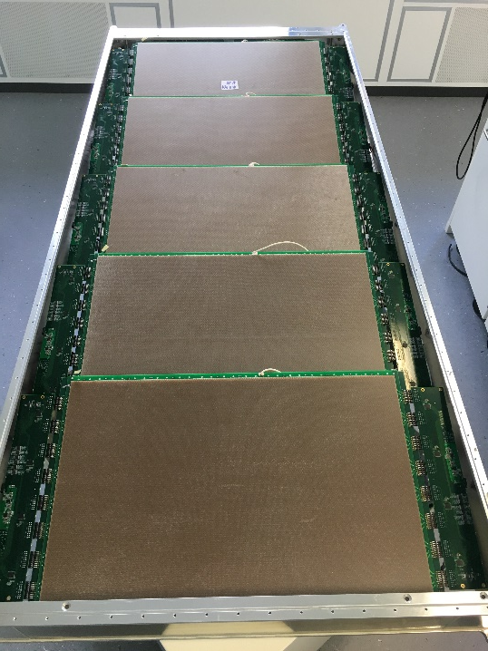
Advantage of sealed MRPC
Performance: fast gas exchange
Economy: save gas
Environmental protection

Slide 5
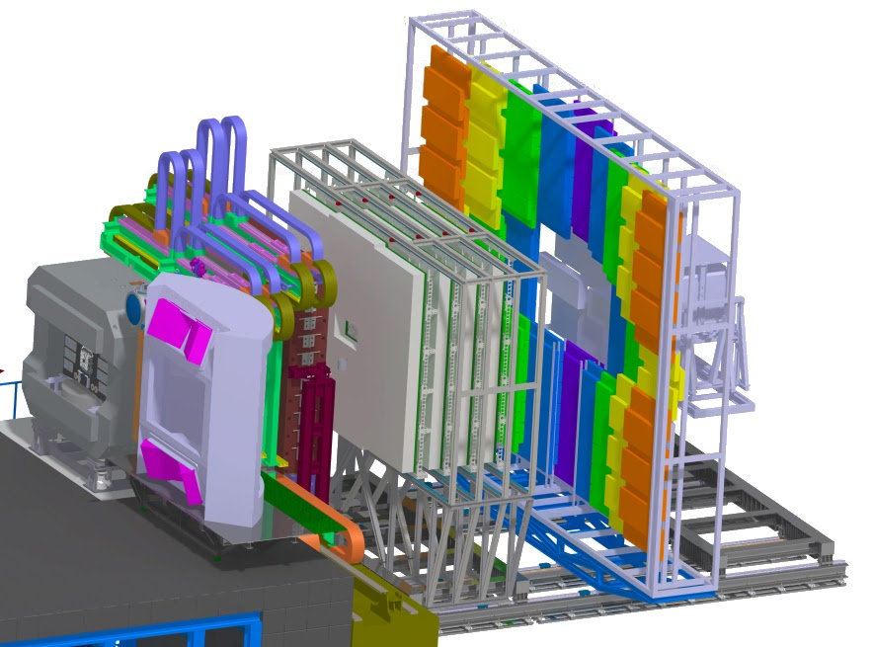
sealed MRPC has been used in CBM-TOF at GSI
Compressed Baryonic Matter (CBM) Experiment
MVD: Micro Vertex Detector*
STS: Silicon Tracking System*
* inside magnetic field
MuCh or RICH
Muon Chamber System /
Ring Imaging Cherenkov Detector
TRD: Transition Radiation Detector
ToF: Time-of-Flight Detector
PSD: Projectile Spectator
Detector
TOF
MuCH
TRD
Dipole magnet
PSD
MVD +
STS
RICH

