Slide 1
Where we should propose to place forward TOF? Two layers behind dRICH probably won’t fly (too expensive)
Option 1: two layers in front of dRICH (L ~2m), area ~ 6.28 m²
Option 2: one layer behind dRICH (L ~3.5m), area ~ 9.6 m²
Option 3: one layer in front of dRICH (L ~2m), area ~ 3.14 m²

Slide 2
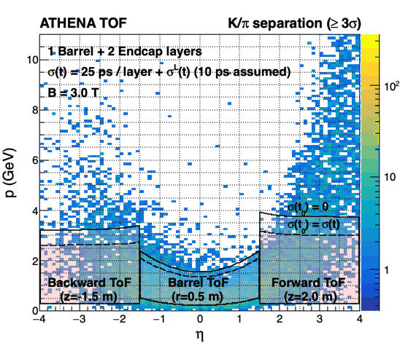
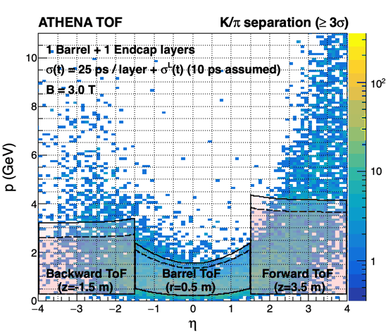
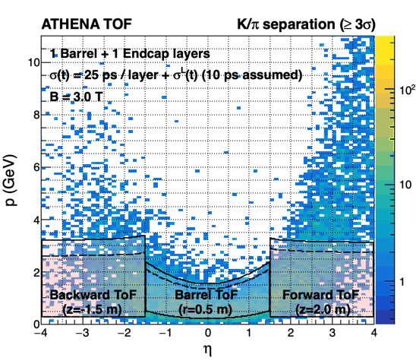
Kaon distribution in MB PYTHIA 8
Option 1
Option 2
Option 3
mRHIC
dRICH
mRHIC
dRICH
mRHIC
dRICH
DIRC
DIRC
DIRC
t₀ self-determined

Slide 3
Physics cases:
Heavy flavor reconstruction: Lambda_C -> pi+k+p
Exclusive: rho->K+K-
SIDIS:
Minimum P
1.66 – 0.15 GeV
0.15 – 0.1 GeV
1.66 – 0.15 GeV
Which observable to demonstrate it? Contact SIDIS group?
https://indico.bnl.gov/event/13161/contributions/54449/attachments/37146/61331/etaVsPcov_all_ymin.pdf

