Slide 1
Cost and Schedule estimates
In support of the EICSC silicon tracking detector models
The document images provided In these slides are obviously too small to read easily, please follow along using the pdfs uploaded to the indico site.

Slide 2
What has been generated – Cost estimates
Two DRAFT cost estimates
All-silicon model as per YR
Hybrid base (all-silicon with the outer layers removed and the appropriate changes propagated through the rest of the estimate) to be used as a basis for hybrid configurations.
Attributes
These are full bottom-up cost estimates in excel format broken out into simple labor categories and materials.
They are not yet ready for release (some important numbers such as the expected silicon cost are not yet validated). We expect to be able to do a release this week. What is distributed today (pdf) is intended to show the structure and level of development in order to get feedback, but not to be used until the final release.
Caveats, explanations and assumptions are shown in the comments and introductory table cells.
These estimates are being provided as input for the proto-collaboration internal cost estimation process.
These estimated are not fully “scrubbed”, but as our state of knowledge about the final configuration is not yet well developed, they are, in my opinion, the best level of estimation appropriate to this stage of the project.

Slide 3
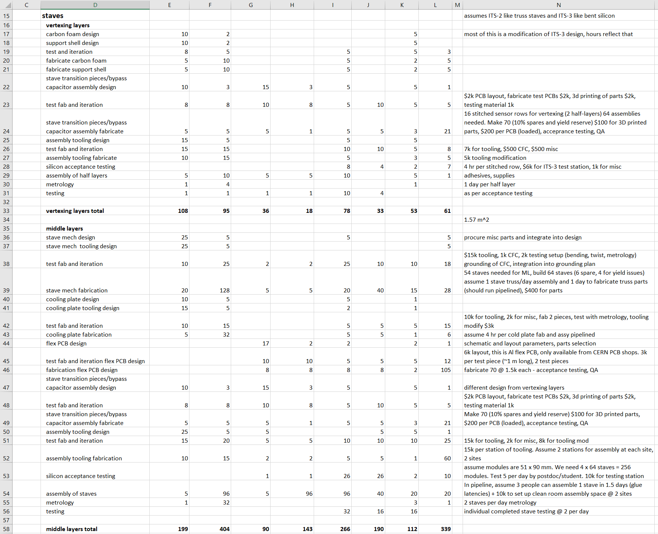
Cost estimates - Structure
These are large documents (all-silicon is 448 lines)
The upper level WBS elements are chosen to be localized detector elements to facilitate the easy removal or increase in numbers to match a configuration requested by a proto-collaboration.
Each of the major subsystem task (red) has a rollup row (blue) that gives a total for the tasks in that category (bold)
It is intended that these sub-task rollups be used as a set of task summaries to represent the full estimate if desired.
These rollups are summed at the end of the table to provide the full cost estimate.
All estimates in todays dollars (no escalation) and todays exchange rates.

Slide 4
Cost estimates – Summary, Comments and questions
Some items listed in the cost estimates may belong in other WBS. E.g. power supplies and travel may be covered in an integration WBS. These items may be deducted from the cost estimate as presented.
The design of the spreadsheet is intended to make the scaling (in quantity) and addition/removal of components as easy as possible within a reasonable creation time.
Scaling up or down with disc or stave sizes in not recommended without a reanalysis of the feasibility, mechanics and propagation of material changes into the simulations. As one can see from the difference between the hybrid and the all-silicon estimates, simple scaling by area for silicon tracking detector costs is not accurate.
Does this meet the needs of the proto-collaborations and the project? Are there any obvious omissions or problems?
Are there any suggestions that can be implemented in a short timeframe that would be helpful?

Slide 5
Schedule estimates
The rollup task lines of the all-silicon cost estimate were transferred into a MS project document as tasks.
The durations of these tasks were estimated by me. They are not a simple convolution of the hours in the task lines but rather an experience based estimation.
Simple dependencies are added to give a reasonable approximation of what can be expected.
This is NOT a resource loaded schedule, which is the only real way to answer questions about labor force needs in a timeframe or assess true in-rollup task dependencies.
The results are consistent with previous experience.
This estimate will be provided as an .mpp document (of pdf if desired)
The construction phase only is provided. The R&D phases that lead to this need to be updated, this will happen in the next weeks.
If the hybrid design is selected, it can likely be fabricated in less time, but this is not explicitly explored.

Slide 6
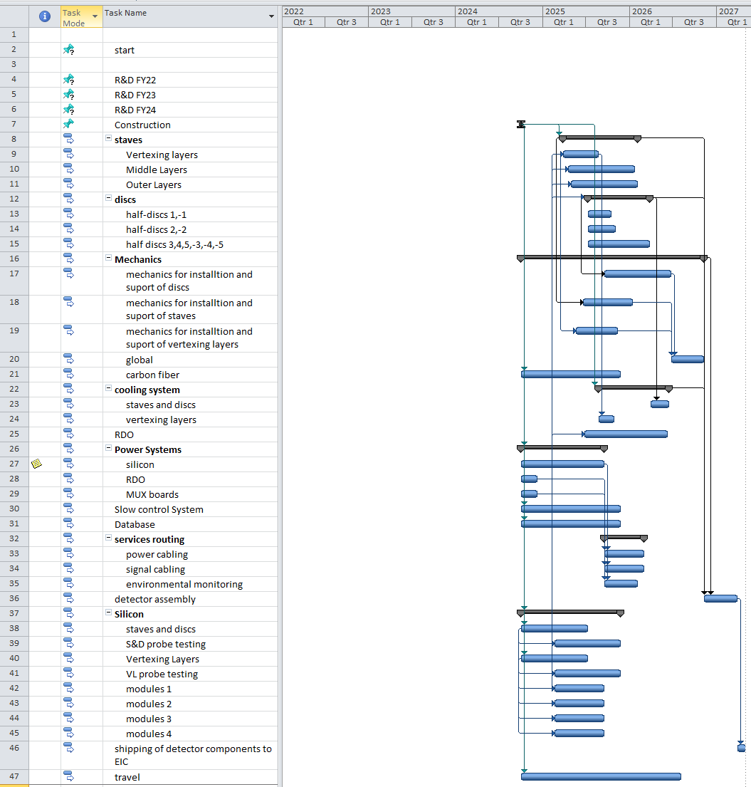
Schedule estimates
Start time is arbitrary, but listed as October 1, 2024 in this estimate.
The construction project completes in ~2.5 years.
This is roughly consistent with other construction projects of this complexity and technology.
There is, of course, no slack estimates or contingency in this formulation.
Future exercises with a resource loaded schedule doing resource leveling may extend the timeframe, but this is outside of the scope of this estimate.

Slide 7
Schedule estimates – Summary, Comments and questions
Does this meet the needs of the proto-collaborations and the project? Are there any obvious omissions or problems?
Are there any suggestions that can be implemented in a short timeframe that would be helpful?

