Slide 1
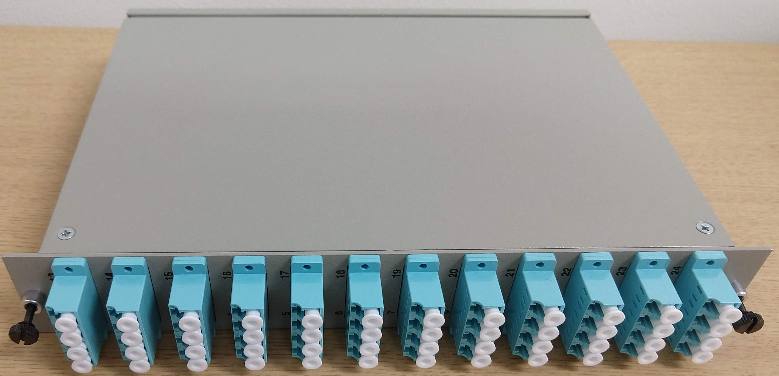
MVTX Fiber Routing Plan, 1 of 6 EBDC shown
sPHENIX
East Platform
DAQ Room patch sPHENIX IR
12 MTP-MTP(48F)
1U Feedthrough
Panel
MTP (F)
MTP (M)
MTP (F)
2E1 Rack
DAQ Racks
LC (M)
15m
...
~3m
MTP (F)
3-10 m
RU
x8
Custom Fiber
Fanout Cassette
EBDC
FELIX
58m MTP (F)
MTP (M)
Patch panel (1E2)
Exp. disconnect
1x 1U space
48F MTP Cable MTP coupler LC coupler LC cable VTxx Transceiver
One-way optical loss: 1.5dB

Slide 2
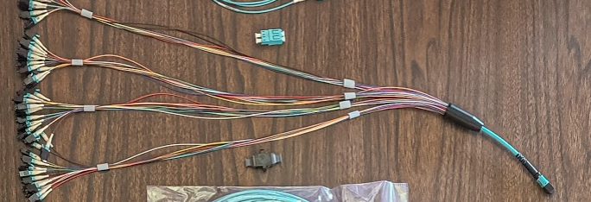
Custom Fanout Cassette
2x 48F MTP(M)
2x 48F
Cassette
24
24
Custom Fiber Cassette:
2 (48F) MTP (M) in back
4 x 12 LC (F) connectors in front
2 (48F) Hydra fanout cables MTP-LC
24 24 = 48x LC
2x 24F LC(F)

Slide 3
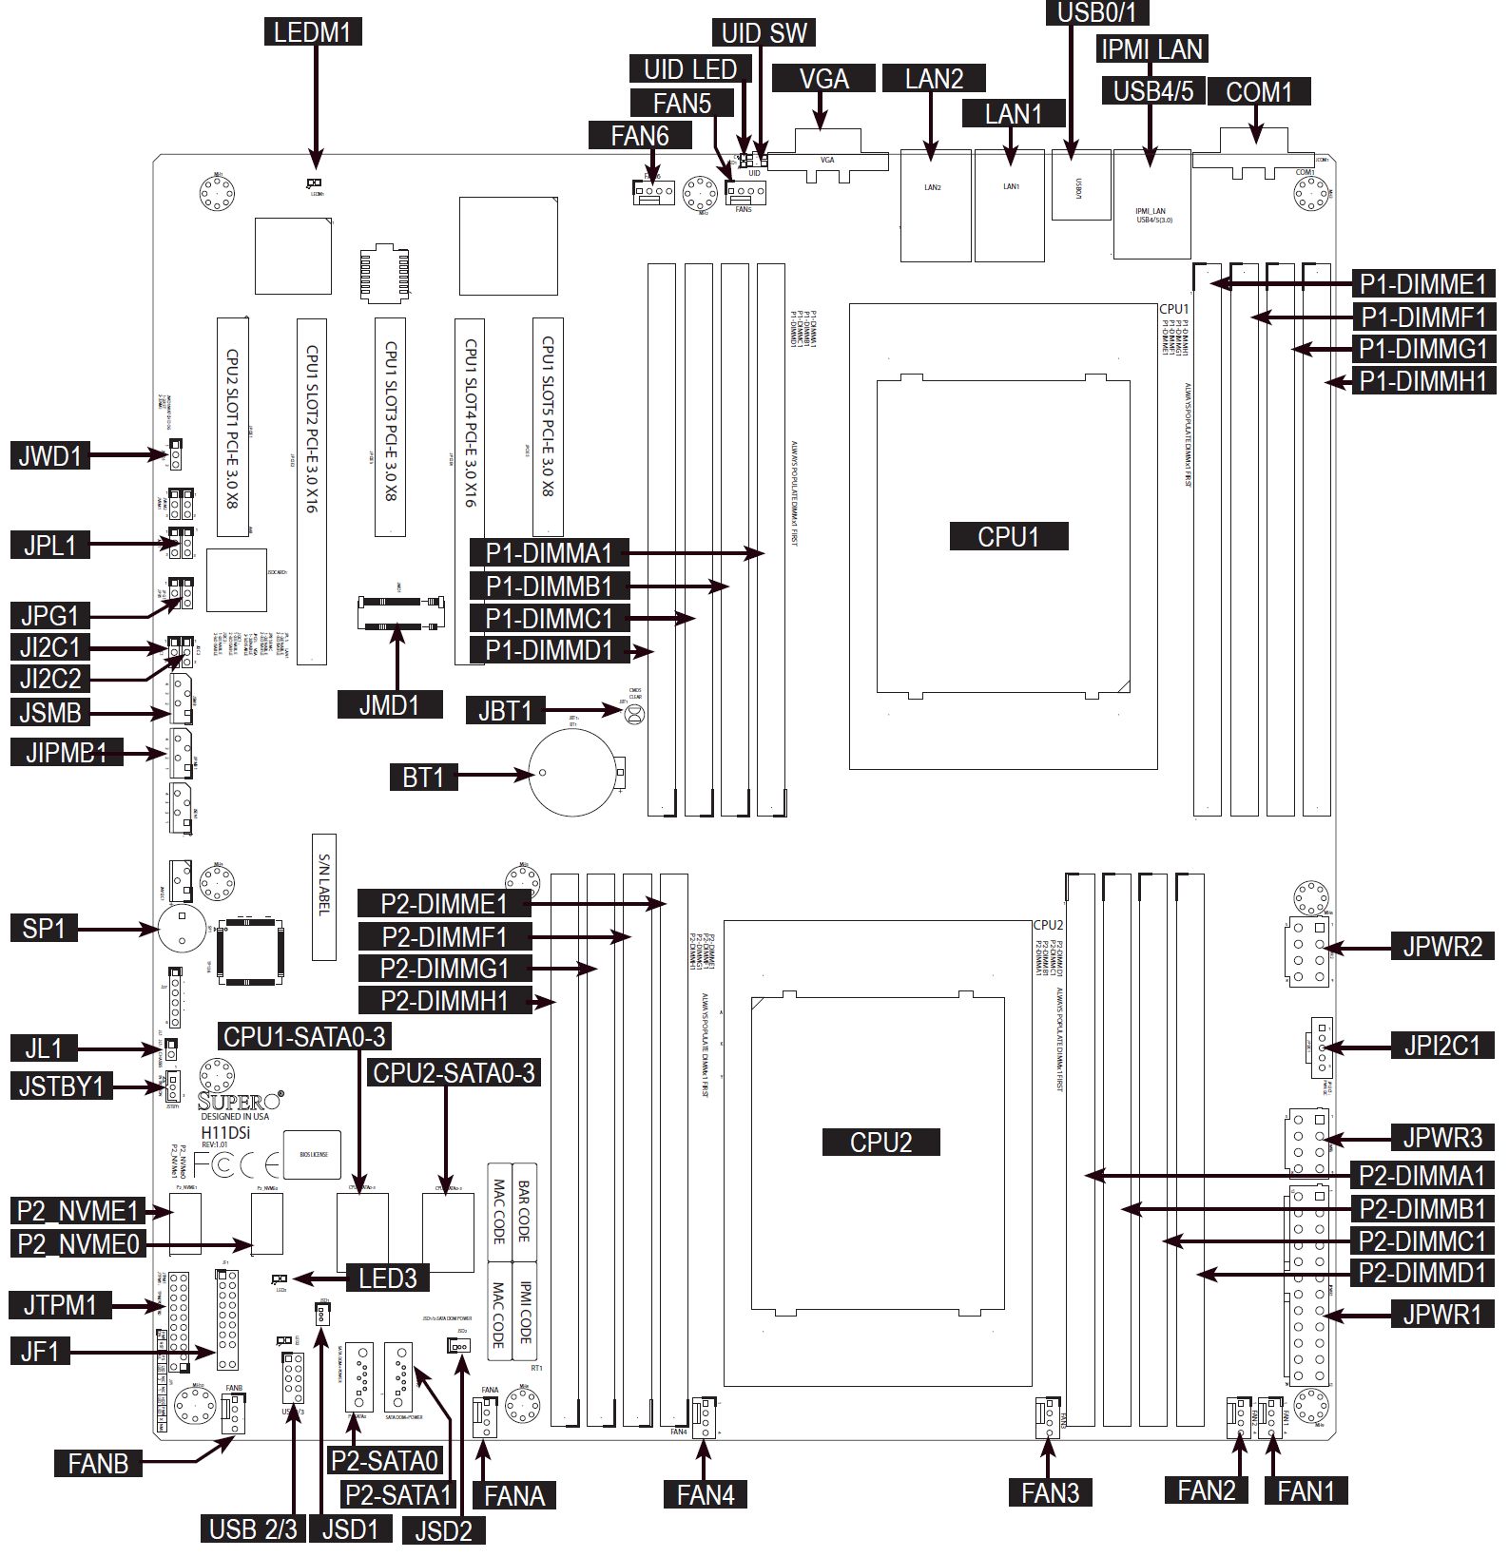
EBDC setup
FELIX1
FELIX2
NIC
Supermicro A+ Server 4023S-TRT as in Martin’s 20x server pilot racks
Support 2x PCIe Gen3 x16 full length full height slots on CPU1
Each for one FELIX
3x PCIe Gen3 x8 slots, one used for high speed data network (Mellanox ConnectX-5 EN MCX512A-ACAT - 25Gb 2-Port SFP28 PCIe3.0 x8 NIC)

