Slide 1
The electron-ion collider --
A world-wide unique collider to unravel the mysteries of visible matter
Elke-Caroline Aschenauer (BNL)

Slide 2

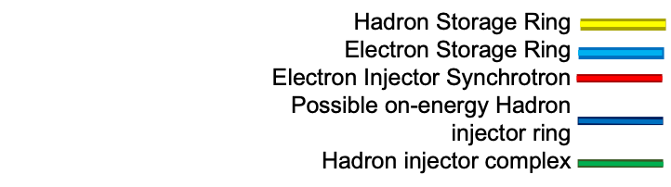
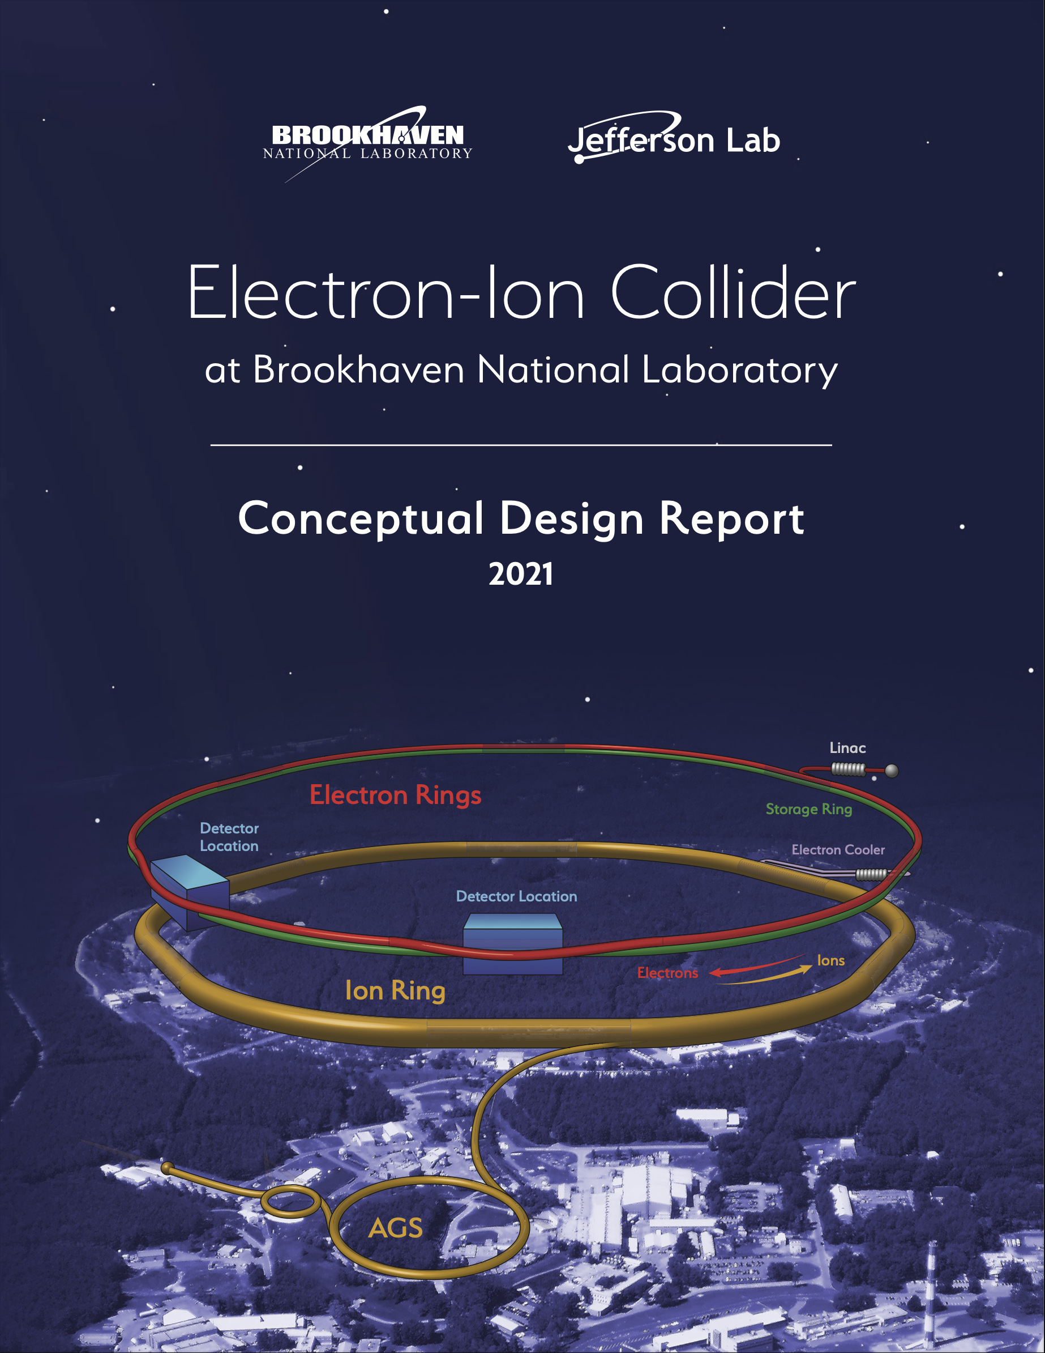
Facts about the EIC
What is the EIC:
A high luminosity (10³³ – 10³⁴ cm⁻²s⁻¹) polarized electron proton / ion collider with √s_{ep} = 28 – 140 GeV
EIC at BNL
What is new/different:
factor 100 to 1000 higher luminosity as HERA
both electrons and protons / light nuclei polarized,
nuclear beams: d to U
Fixed Target Facilities i.e.:
at minimum > 2 decades increase in kinematic coverage in x and Q²
Possible
2nd Detector
Location
Double Ring Design Based on Existing RHIC Facilities
Hadron Storage Ring: 40 - 275 GeV | Electron Storage Ring: 5 - 18 GeV
RHIC Ring and Injector Complex: p to Pb | 1160 bunces, Large Beam Current - 2.5 A
1160 bunces @ 1A Beam Current | 9 MW Synchrotron Radiation
9 ns bunch spacing
Light ion beams (p, d, ³He) polarized (L,T) | Polarized electron beams
Nuclear beams: d to U | Electron Rapid Cycling Synchrotron
Requires Strong Cooling: new concept →CEC | Spin Transparent Due to High Periodicity
High Luminosity Interaction Region(s)
25 mrad Crossing Angle with Crab Cavities
https://www.bnl.gov/ec/files/EIC_CDR_Final.pdf

Slide 3
EICUG: Yellow Report (YR) Initiative
The EIC Users Group: EICUG.ORG
Report: https://arxiv.org/abs/2103.05419
Detector requirements and design driven by EIC Physics program and defined by EIC Community
Physics Topics ➝ Processes ➝ Detector Requirements
Physics Working Group:
Inclusive Reactions
Semi-Inclusive Reactions
Jets, Heavy Quarks
Exclusive Reactions
Diffractive Reactions & Tagging
Detector Working Group:
Tracking + Vertexing
Particle ID
Calorimetry
DAQ/Electronics
Polarimetry/Ancillary Detectors
Central Detector: Integration & Magnet
Far- Forward Detector & IR Integration
  Provides critical input for detector proposals

Slide 4


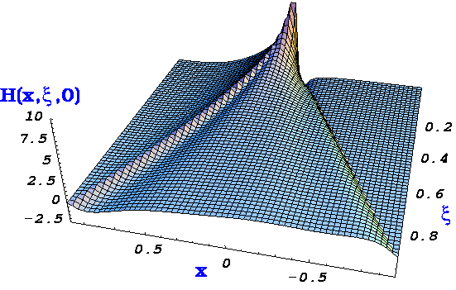

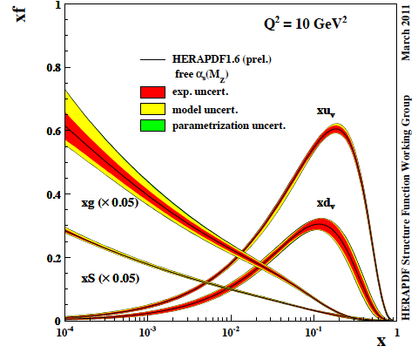
The Path to Imaging Quarks and Gluons
Wigner function
QCD genetic map of nucleons
4+1-D
not related by
Fourier transf.
2+1-D
transv. mom. dep. PDF
impact par. dep. PDF
generalized PDF
semi-inclusive DIS
exclusive processes
1-D
parton densities
form factor
MCs will be critical to extract the physics from the EIC data
need MC, which integrate the beam effects, i.e. crossing angle,
and physics we want to measure to provide unbiased/unfolded data
to theory community

Slide 5
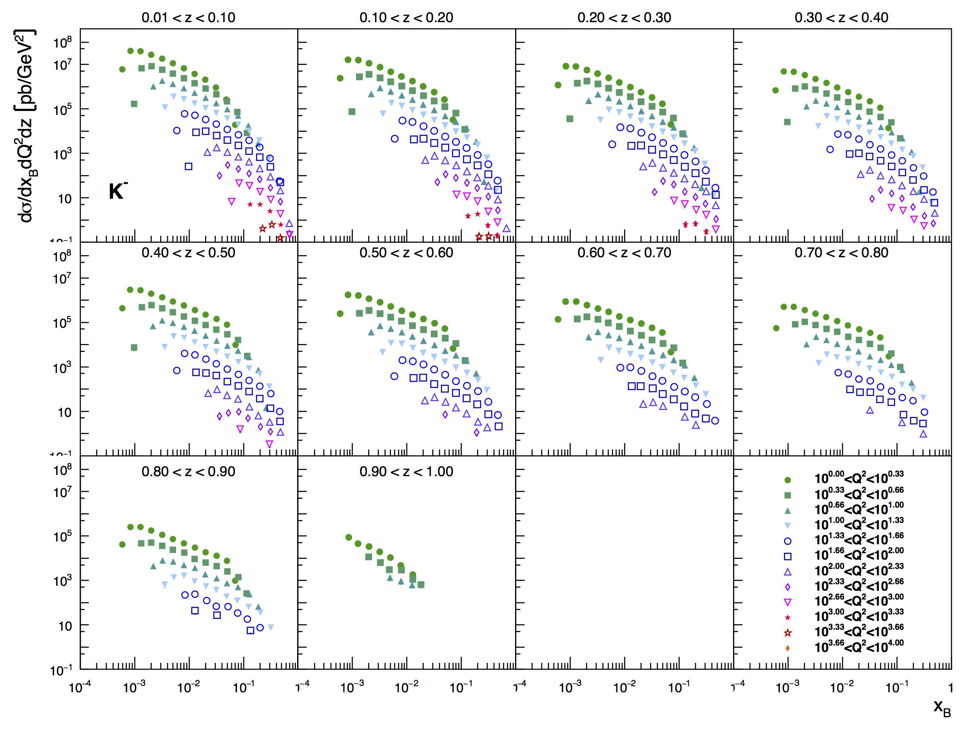
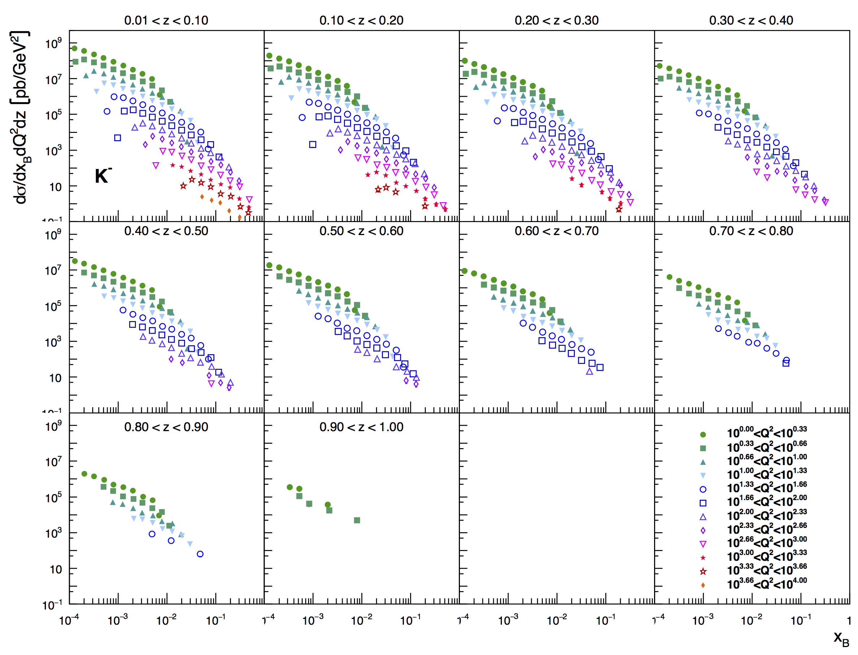
What SIDIS@EIC Can Teach Us
(SI)DIS:
5 GeV x 100 GeV
very precise 3d cross section
covering a wide kinematics in
z,x,Q²
20 GeV x 250 GeV

Slide 6
PDF Constrain from SIDIS@EIC
√s=45 GeV
Use reweighting method to define EIC SIDIS data impact on collinear unpolarized PDFs and Fragmentation functions
Correlation factor of observable 𝓞 to a flavor i
account for
uncertainties
Needs from MC:
precise QED corrections to lepton
precise modeling of initial & finale state
& hard interaction
can we extract PDFs and FF from MC
less bias than what we do now?
δ𝓞 : exp. uncertainty
Observable
Δ PDF in Observable
√s=145 GeV
If you want to know
s-PDF ask the EIC
→ impact grows with √s

Slide 7





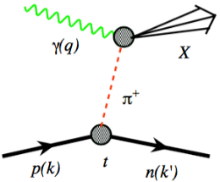
What do we know: Mass of the Proton, Pion, Kaon
Visible world: mainly made of light quarks – its mass emerges from quark-gluon interactions.
Density of quarks or gluons
inside the proton
Proton
gluon ocean
GeV
MeV
quark sea
nucleon
quark
Quark structure: uud
Mass ~ 940 MeV (~1 GeV)
Most of mass generated by dynamics.
Gluon rise discovered by HERA e-p
q,g Density
Fraction of overall proton momentum carried by q,g
Pion
Kaon
Quark structure: ud
Mass ~ 140 MeV
Exists only if mass is dynamically
generated.
Empty or full of gluons?
Quark structure: us
Mass ~ 490 MeV
Boundary between emergent-
and Higgs-mass mechanisms.
More or less gluons than in pion?
For the proton the EIC will allow determination of an important term contributing to the proton mass, the so-called “QCD trace anomaly”
For the pion and the kaon the EIC will allow determination of the quark and gluon contributions to mass with the Sullivan process.

Slide 8
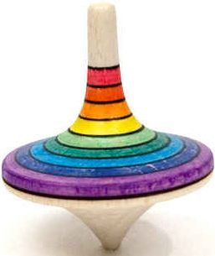
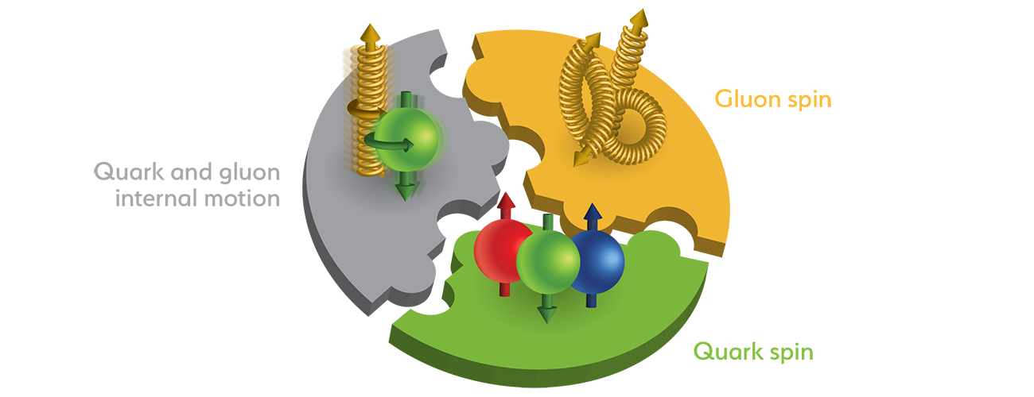
The Spin of the Proton
SPIN is one of the fundamental properties of matter
all elementary particles, but the Higgs carry spin
Spin cannot be explained by a static picture of the proton
It is more than the number ½ ! It is the interplay between
the intrinsic properties and interactions of quarks and gluons
What do we know:
total
quark spin
gluon
spin
angular
momentum

Slide 9
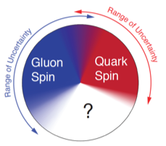
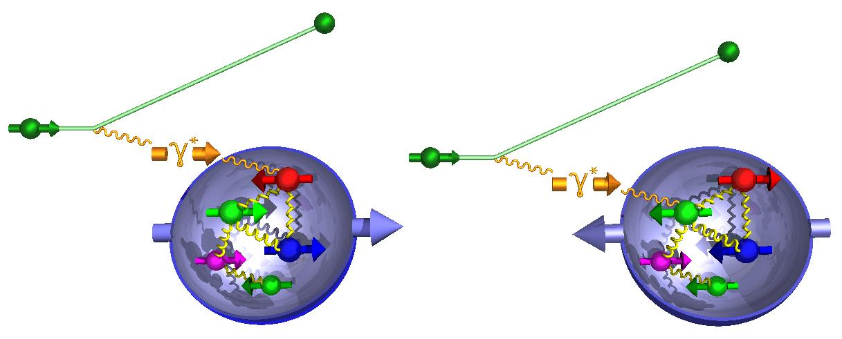
How to decompose the Spin of the Proton
To determine the contribution of quarks and gluons
to the spin of the proton, one needs to measure
the cross-section difference g₁ as function of x and Q²
The current knowledge about g₁
as function of x at Q²=10 GeV²
The current knowledge about g₁
as function of x at Q²=10 GeV²
Needs from MC:
polarization included in all stages of simulation
initial state, hard-scattering,
parton showers, QED corrections
same goal less bias in the final results
g₁ ~
-
quark contribution:
The integral of g₁ over x from 0 to 1
gluon contribution:
dg₁(x,Q²)/dlnQ² → Δg(x,Q²)

Slide 10
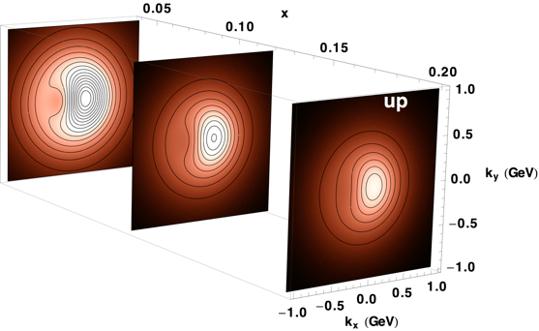
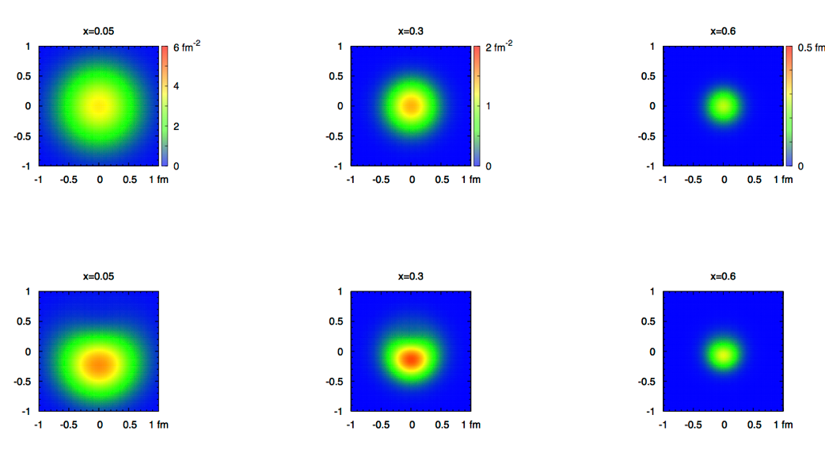
2+1 dimensional Imaging of Quarks & Gluons
Wigner function
W(x,b_{T},k_{T})
→ QCD genetic map
Momentum
space
Coordinate
space
∫d²b_{T}
∫ d²k_{T}
f(x,k_{T})
f(x,b_{T})
Quarks
Quarks
down quark
x
Spin-dependent 3D momentum space
images from semi-inclusive scattering
Spin-dependent 2+1D coordinate space images from exclusive scattering

Slide 11
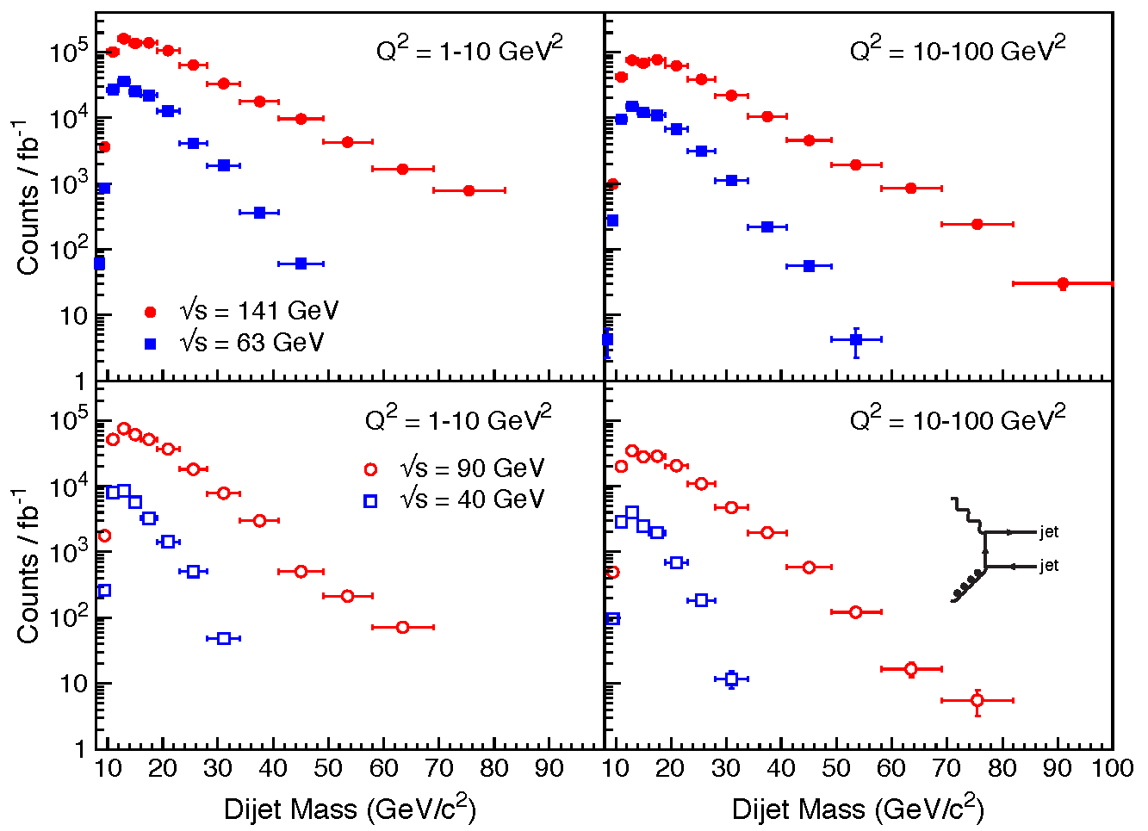
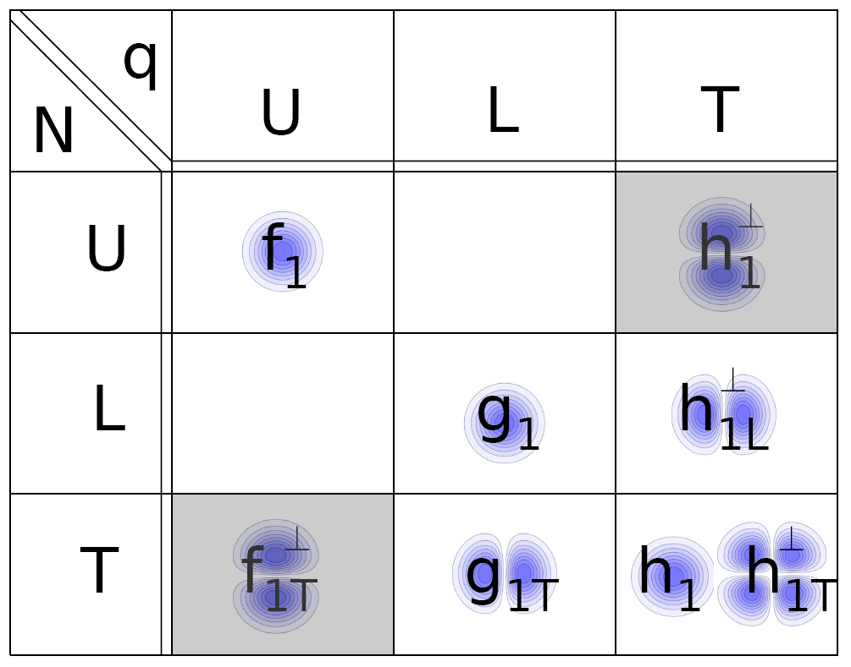
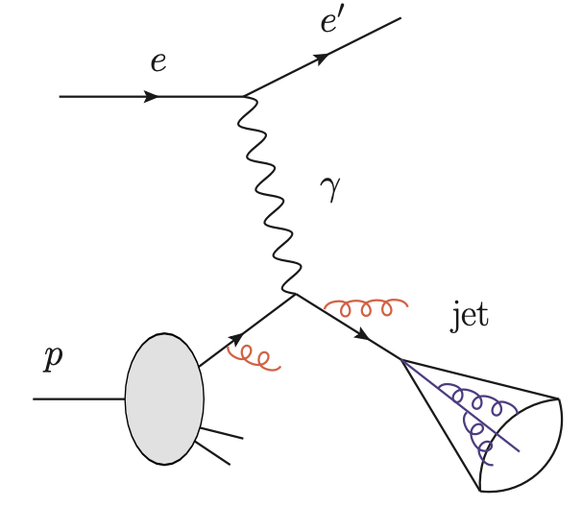
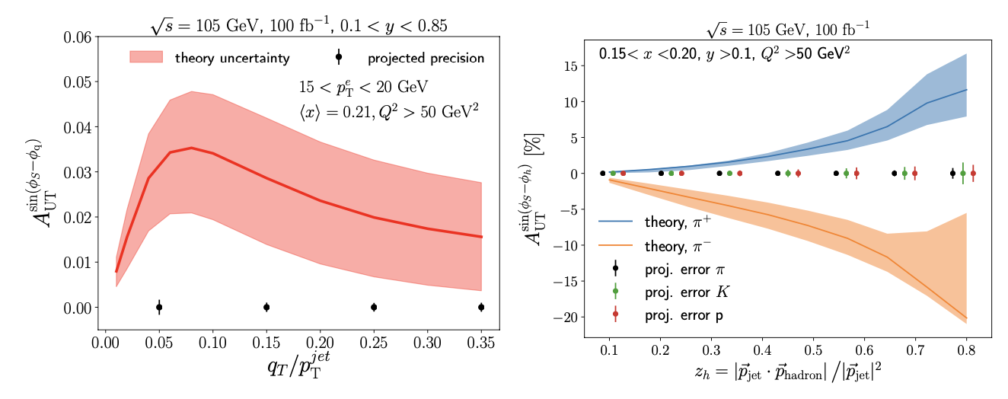
Momentum Imaging: Jets at EIC
Experimental Aspects of Jet Physics at a
Future EIC arXiv:1911.00657
What is the dynamic structure of the proton and nuclei
2D+1 picture in momentum space
Visualize color interactions in QCD
collective phenomena and correlations in fragmentation
New physics due to confined motion
Observable: Di-jets
Needs from MC:
polarization included in all stages of simulation
initial state, hard-scattering, hadronization,
transverse momentum dependence
parton showers, QED corrections
jets very low p_{T} and low charged and neutral hadrons
jet
h

Slide 12
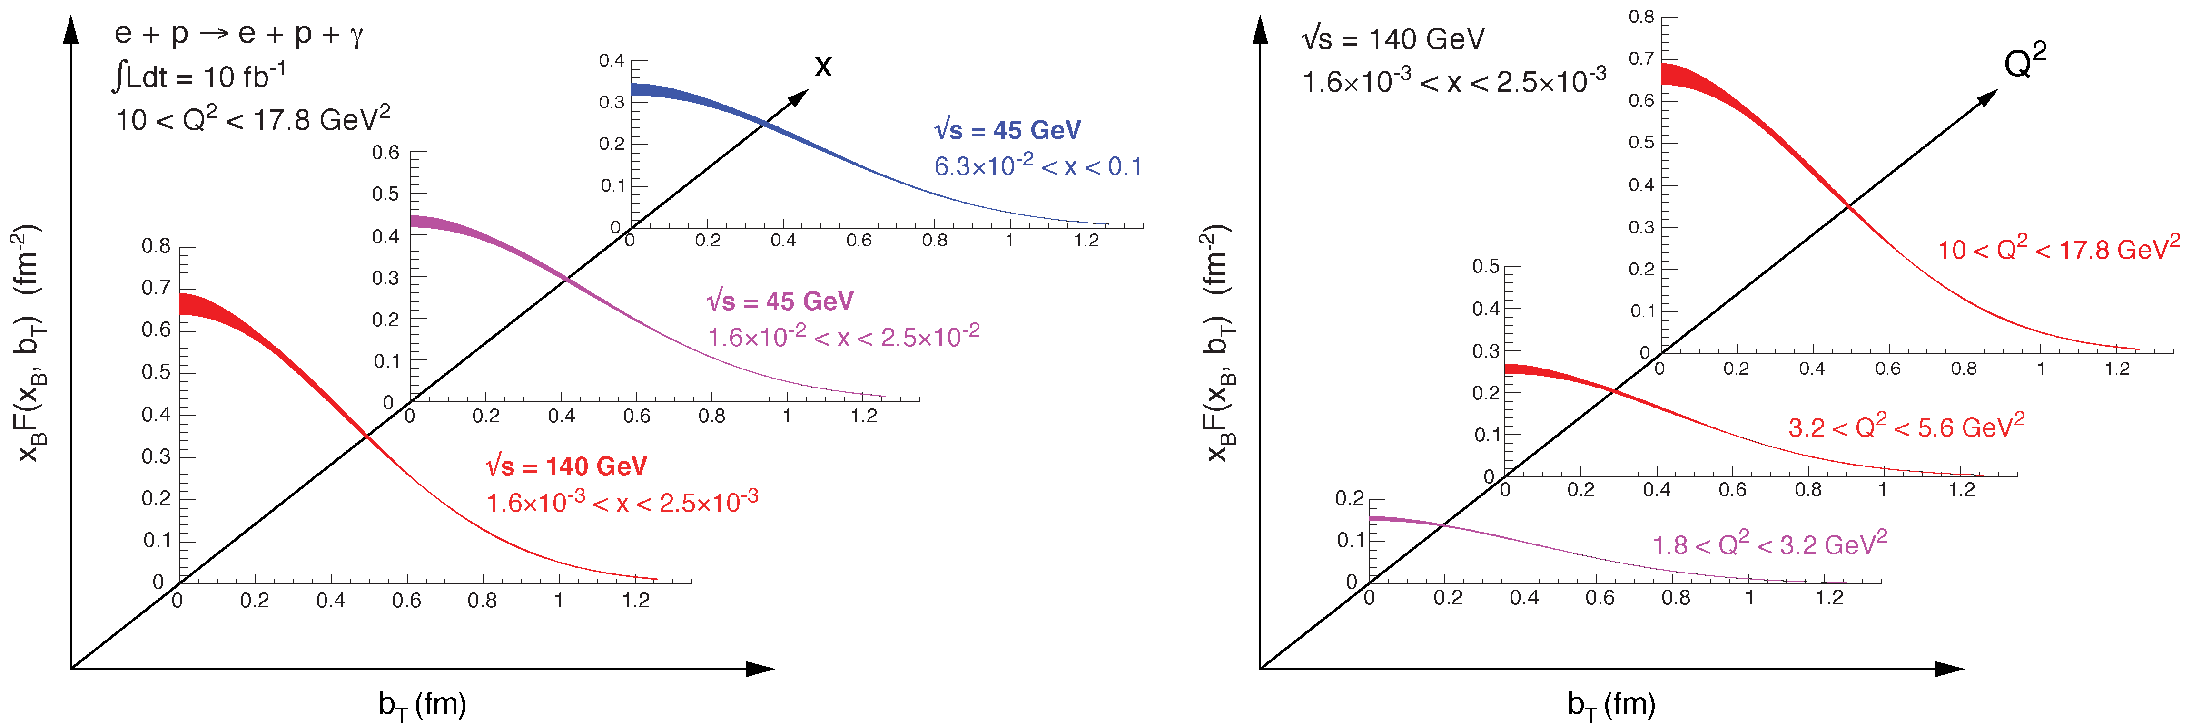

2+1d-Imaging in coordinate space
High precision
imaging at EIC
at low and high x
Golden channel:
DVCS
e’
e
γ_{L}*
γ
(Q²)
x+ξ
~
x-ξ
~
p
H, H, E, E (x,ξ,t)
p’
t
pion cloud
effects seen
at high b_{T}

Slide 13
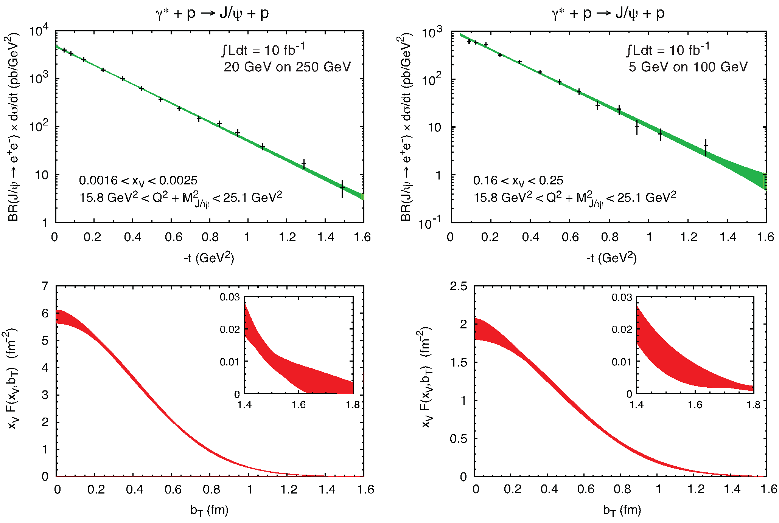
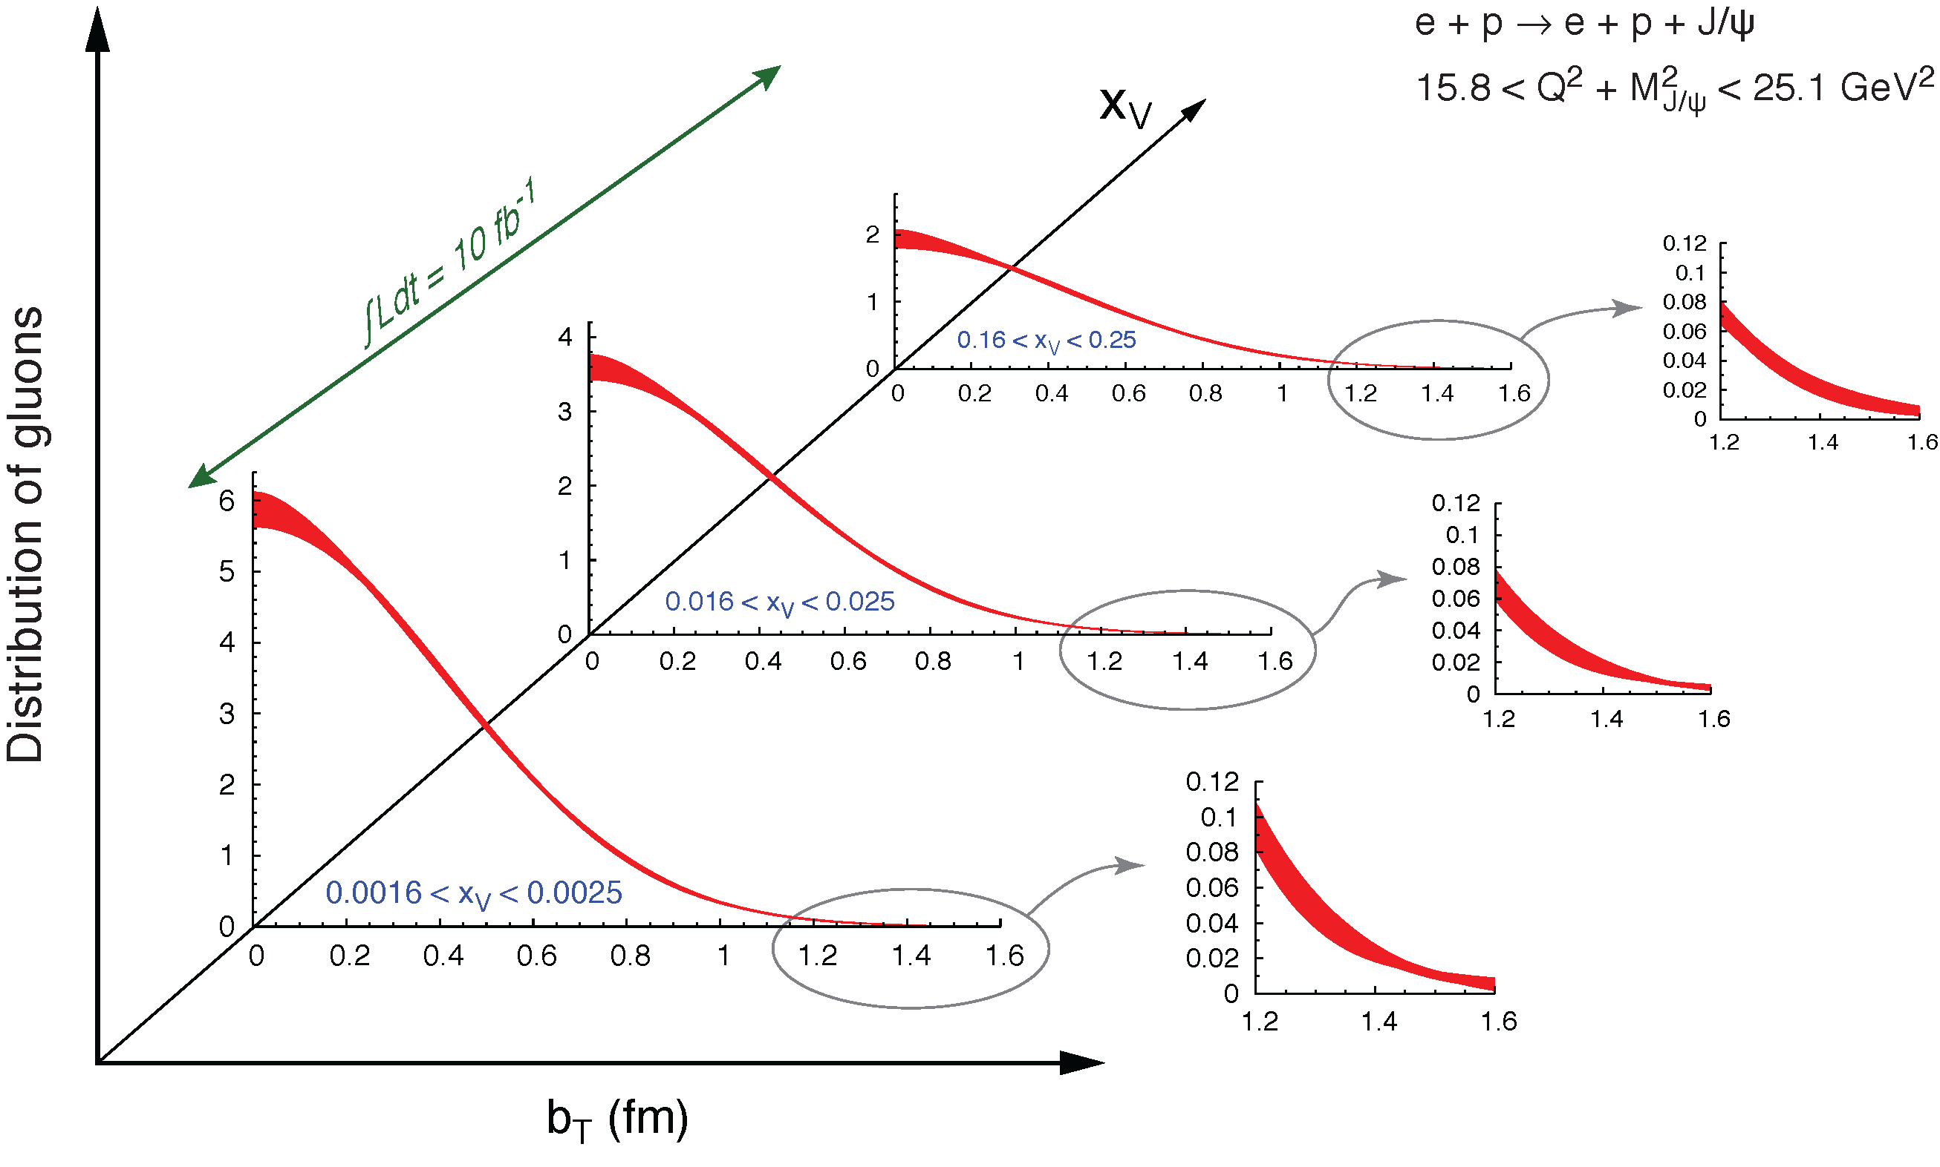
What about the gluon: J/ψ
To improve imaging on gluons
add J/ψ observables
cross section
A_{UT}
…..
Needs dedicated MC:
ePIC fully based on GPDs
need to continue to improve as we go forward
  more channels, higher orders, ….

Slide 14
What about Nuclei?

Slide 15
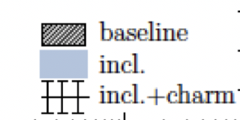
nPDFs before and after EIC
Ratio g(x,Q²)_{pb} /g(x,Q²)_{p}
√s < 45 GeV
√s < 90 GeV
LHC
RHIC
Measure different structure function in eA → constrain nPDF:
arXiv:1708.05654
quark+anti-quark
momentum distributions
gluon momentum distribution
or tag on charm → F₂^{C}
Gluon distribution ~ dσ(x,Q²)/dlnQ²

Slide 16

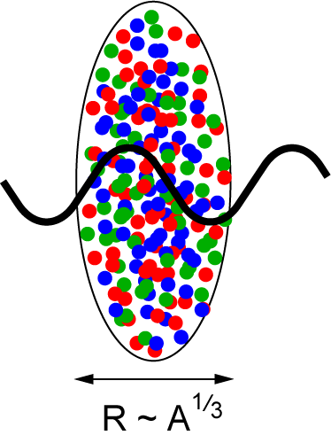
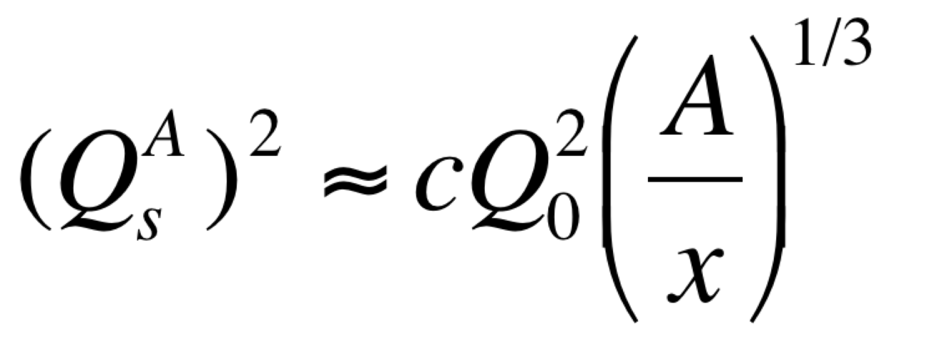
Studying non-linear effects
Does the rise of g(x,Q²) get tamed ?
Important to understand the initial condition for heavy ion collisions
Scattering of electrons off nuclei:
Probes interact over distances L ~ (2m_{N} x)⁻¹
For L > 2 R_{A} ~ A^{1/3} probe cannot distinguish between nucleons in front or back of nucleon
Probe interacts coherently with all nucleons
Nuclear “Oomph” Factor
Pocket Formula:
Enhancement of Q_{S} with A ⇒ non-linear QCD regime reached at significantly lower energy in nuclei than in proton

Slide 17

can EIC discover a new state of matter
EIC provides an absolutely unique opportunity
to have very high gluon densities
→ electron – lead collisions
combined with an unambiguous observable
counting experiment of
Di-jets in ep and eA
Saturation:
Disappearance of backward jet in eA
EIC unambiguously
maps the transition from a non-saturated to saturated regime
→ evolution of Q_{s} with x
e
p
e
A
#backward jets in eA / ep
increased √s → increased suppression

Slide 18
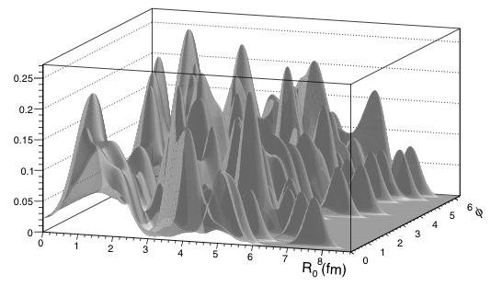
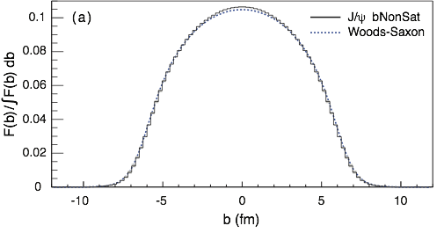
EIC: Spatial Gluon Distribution from dσ/dt
1950-60: Measurement of charge (proton) distribution in nuclei
Ongoing: Measurement of neutron distribution in nuclei
EIC ⇒ Gluon distribution in nuclei
Diffractive vector meson production:
e + Au → e′ + Au′ + J/ψ, φ, ρ
Method:
Fourier Transform
Diffractive vector meson production:
possible Source distribution with b_{T}^{g} = 2 GeV⁻²
e + Au → e′ + Au′ + J/ψ, φ, ρ
Momentum transfer t = |pAu-pAu′|² conjugate to bT
  Hot topic:
      Lumpiness?
      Just Wood-Saxon+nucleon g(b_{T})
      coherent part probes “shape of black disc”
      incoherent part (large t)
      sensitive to “lumpiness” of the source
      (=proton) (fluctuations, hot spots, ...)
PRC 87 (2013) 024913
Converges to input F(b) rapidly: |t| < 0.1 almost enough
Recover accurately any input distribution used in model used to generate pseudo-data (here Wood-Saxon)
  Systematic measurement requires ∫Ldt >> 1 fb⁻¹/A
  dσ/dt: diffractive pattern known from wave optics
  φ sensitive to saturation effects, smaller J/ψ shows no effect
  J/ψ perfectly suited to extract source distribution
Notes:
spin-dependent gluon distribution

Slide 19
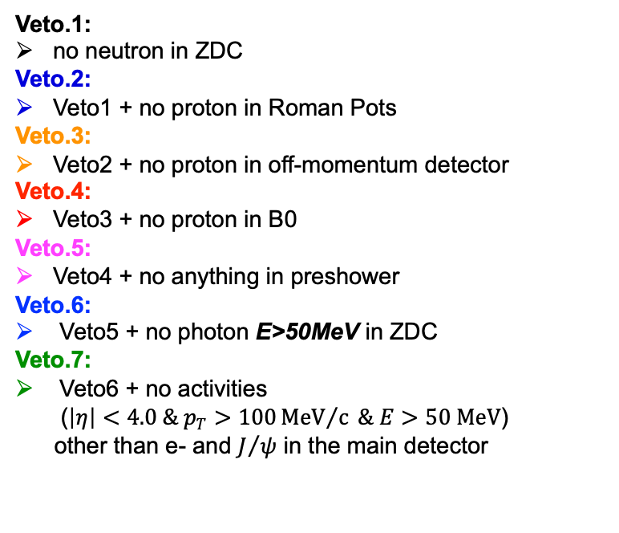
Vetoing Incoherent Events
Veto.1:
no neutron in ZDC
Veto.2:
Veto1 + no proton in Roman Pots
Veto.3:
Veto2 + no proton in off-momentum detector
Veto.4:
Veto3 + no proton in B0
Veto.5:
Veto4 + no anything in preshower
Veto.6:
Veto5 + no photon E>50MeV in ZDC
Veto.7:
Veto6 + no activities
($\left|η\right|<4.0 \& p_{T}>100{MeV}/c \& E>50 MeV$)
other than e- and $J/ψ$ in the main detector
With these requirements, the rejection power is found to be not enough to reach the three minimum positions.
Beam pipe design and material critical to vetoing power

Slide 20
Needs for eA MC
Need a general purpose eA MC
  nuclear effect in the initial state and hadronization
  smooth transition to non-linear QCD regime
  modeling of nucleus and its breakup
  → critical for to experimentally identify diffractive and coherent scattering
  → vetoing of incoherent scattering
  how to integrate polarization effects in eA MC → TMDs and hadronization
Current eA generators
Beagle nPDFs + modeling of nucleus and its breakup
SATRE based on dipole model
  focus on VM production and diffraction
  no modeling nucleus breakup
Would be excellent to have Angantyr also for eA

Slide 21

Summary
Monte Carlo Generators will be crucial to
fully realize the scientific promise of the
diverse EIC physics program

Slide 22


Slide 23

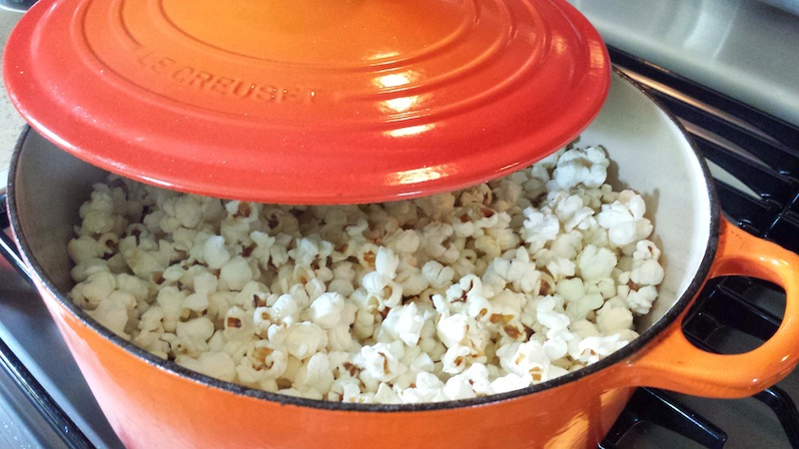
can EIC discover a new state of matter
Is the proton a runaway popcorn machine?
?
gluon
gluon
gluon
gluon
gluon
gluon
gluon
gluon
gluon
gluon
gluon
gluon
gluon
gluon
gluon
gluon
gluon
gluon
gluon
gluon
gluon
gluon
Does this rise get tamed ?
Important to understand the initial condition for heavy ion collisions
till today only ambiguous hints

Slide 24
EIC: Impact on the Knowledge of 1D Nuclear PDFs
√s < 45 GeV
√s < 90 GeV
Ratio of PDF of Pb over Proton
Without EIC, large
uncertainties
→ With EIC significantly
reduced uncertainties
Complementary to RHIC
and LHC pA data.
Provides information on
initial state for heavy ion
collisions.
Does the nucleus behave
like a proton at low-x?
→ relevant to very
high-energy cosmic
ray studies
→ critical input to AA
arXiv:1708.05654

Slide 25
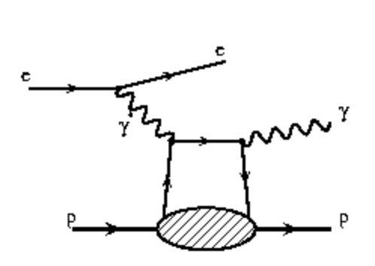
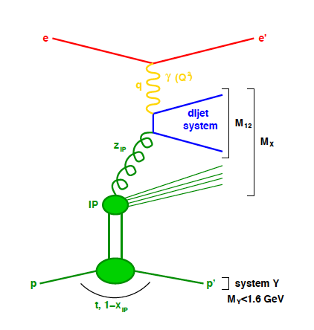
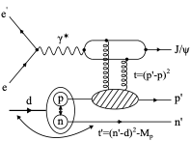
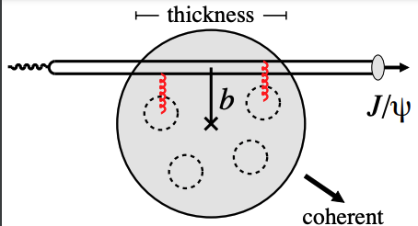
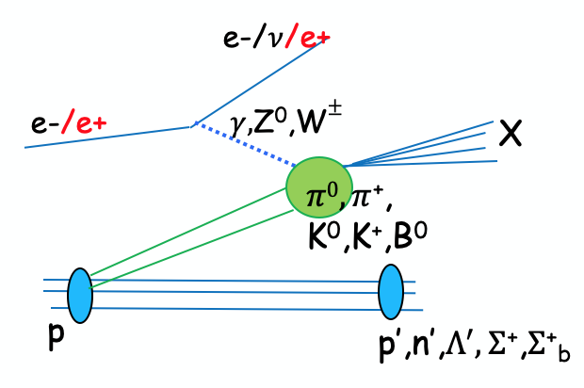
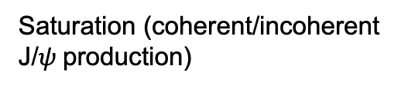
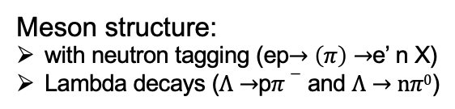
Far-forward physics at EIC
e+p DVCS events with proton tagging.
e+d incoherent J/Psi events with proton or neutron tagging
Diffraction
Rapidity
gap
Saturation (coherent/incoherent
J/$ψ$production)
Meson structure:
with neutron tagging (ep$→\left(π\right)→$e’ n X)
Lambda decays ($Λ→$p$π−$ and $Λ→nπ0$)
e+He3 with spectator proton tagging.
Tagging of coherent light ions (d, He3, He4) from coherent scattering.
e+Au events with neutron tagging to veto breakup and photon acceptance.
….

Slide 26
The EIC: A Unique Collider
EIC
LHC /RHIC
collide different beam species: ep & eA
consequences for beam backgrounds
  hadron beam backgrounds,
  i.e. beam gas events
  → synchrotron radiation
asymmetric beam energies
boosted kinematics
  high activity at high |η|
Small bunch spacing: >= 9ns
crossing angle: 25mrad
wide range in center of mass energies
factor 6
both beams are polarized
→ stat uncertainty: ~ 1/(P₁P₂ (∫L dt )^{1/2})
collide the same beam species: pp, pA, AA
→ beam backgrounds
  hadron beam backgrounds,
  i.e. beam gas events, high pile up
symmetric beam energies
kinematics is not boosted
  most activity at midrapidity
moderate bunch spacing: 25 ns
no crossing angle yet
LHC limited range in center of mass energies
factor 2
RHIC wide range in center of mass energies :
→ factor 26 in AA and 8 in pp
no beam polarization
→ stat uncertainty: ~1/(∫L dt )^{1/2}
Differences impact detector acceptance and possible detector technologies

Slide 27
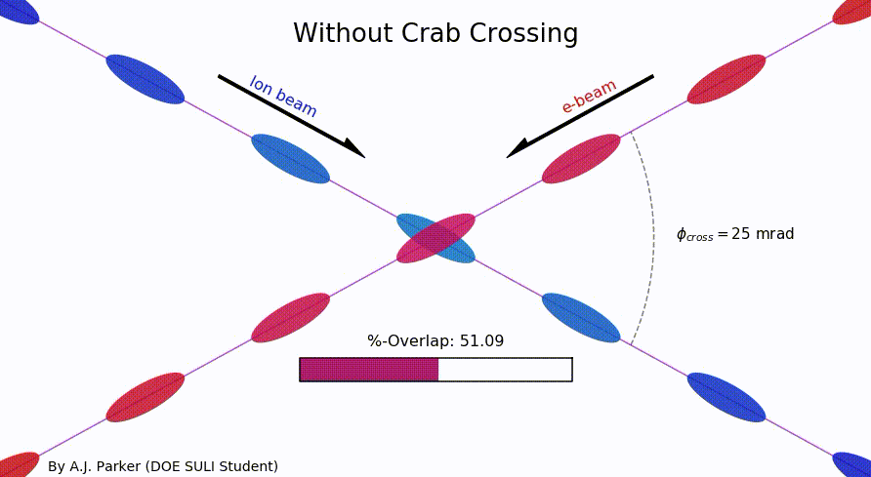
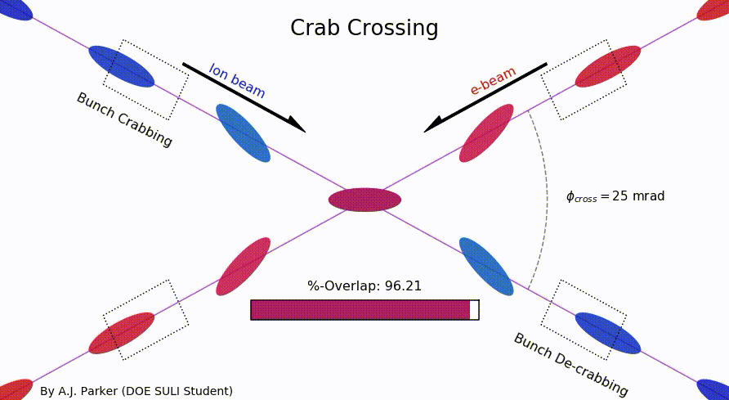
Why a Crossing Angle
Brings focusing magnets close to IP
→ high luminosity
Beam separation without separation dipoles
→ reduced synchrotron radiation
But significant loss of luminosity
Solution: Crab crossing
Head-on collision geometry is restored by rotating the bunches before colliding (“crab crossing”)
Bunch rotation (“crabbing”) is accomplished by transversely deflecting RF resonators (“crab cavities”)
Actual collision point moves laterally during bunch interaction
Challenges
    Bunch rotation (crabbing) is not linear due to finite
    wavelength of RF resonators (crab cavities)
    Severe beam dynamics effects
    Physical size of crab cavities
Significant impact on main and
forward detector acceptance

Slide 28
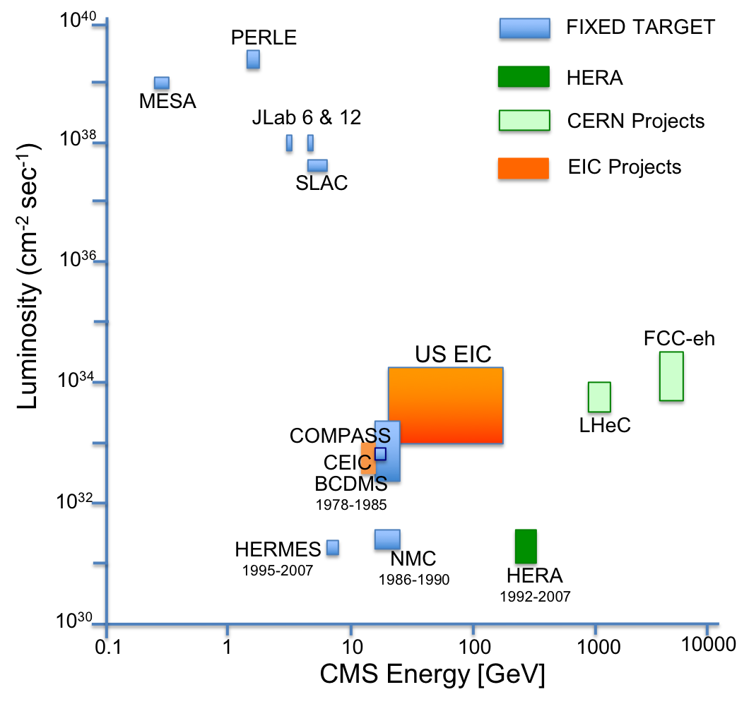
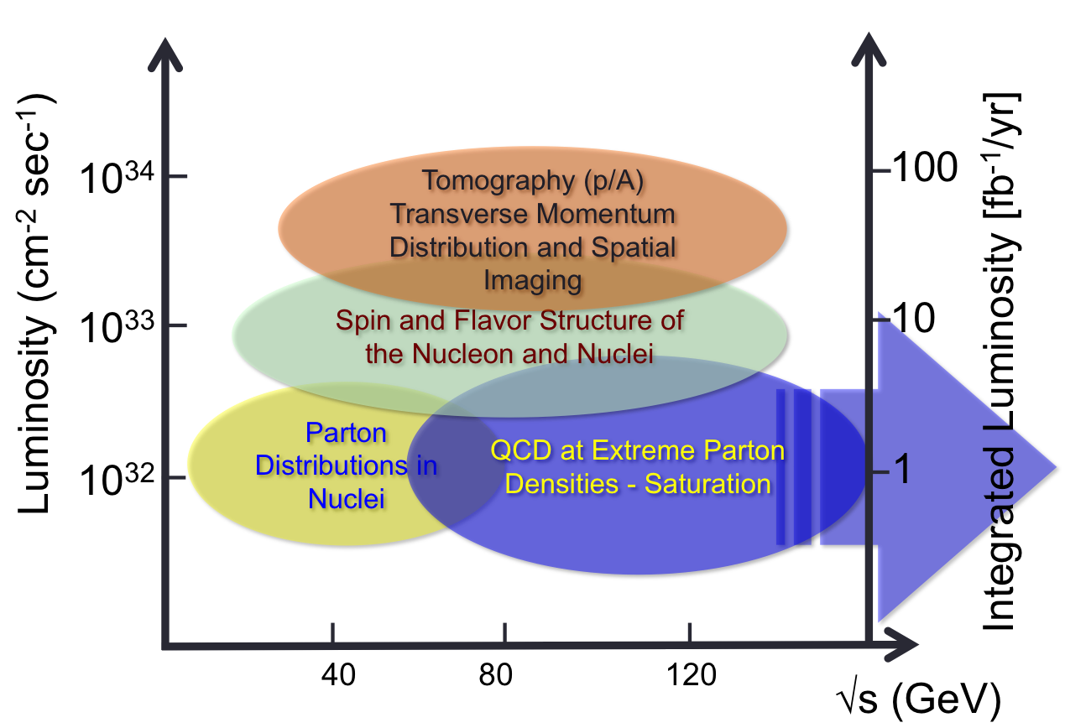
What is needed experimentally?
Luminosity - √s Energy and EIC Physics:
US-EIC:
polarization, ion species together with
its luminosity and √s coverage makes
it a completely unique machine world-wide.

Slide 29
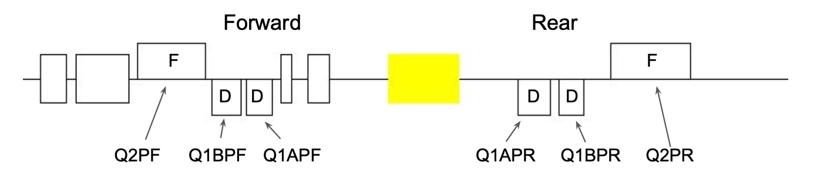
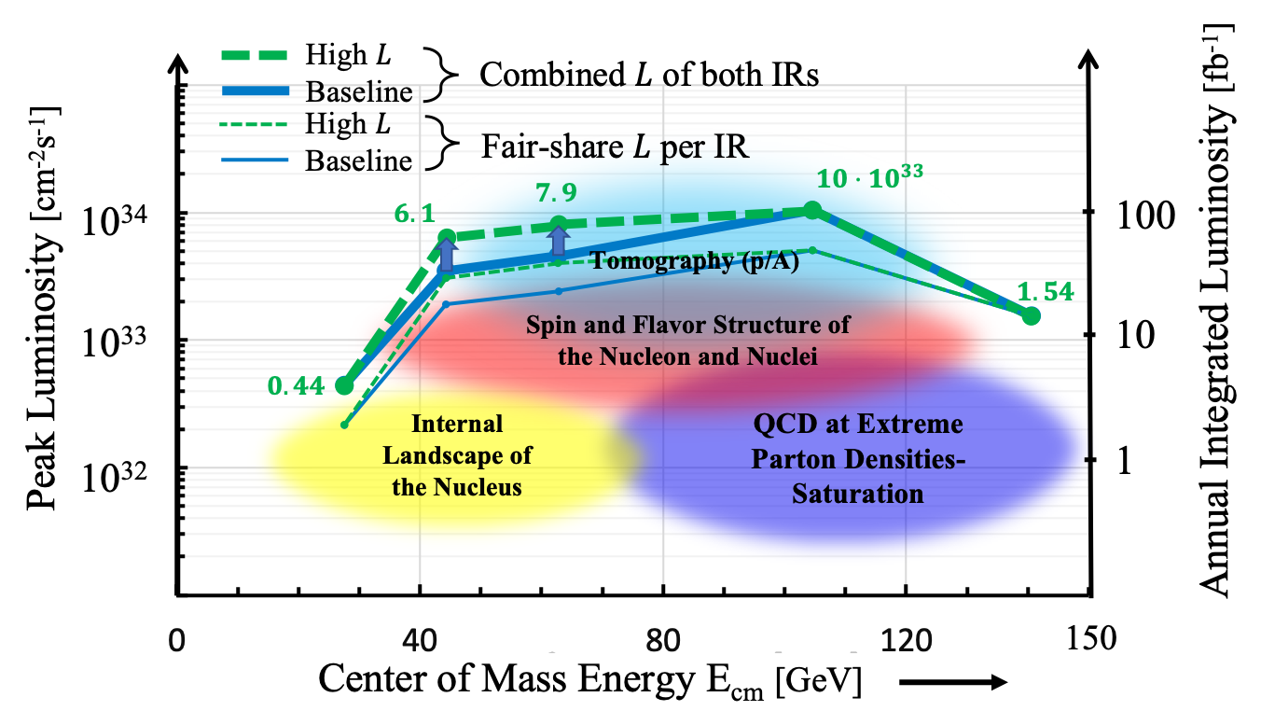
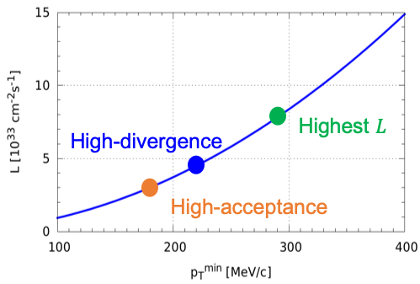
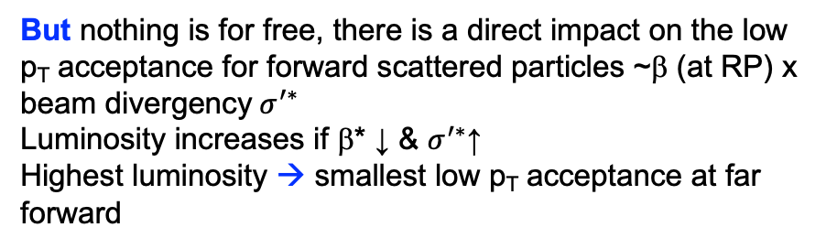
Progress: Luminosity at lower E_{cm}
Simplest way change focusing scheme of final focusing quads
  Advantage independent of Interaction Region → can be done both at IP-6 and/or IP-8
change polarity of quads DDF to FDF
→ needs to be done only on the rear side (incoming hadron beam) hadron quads
→ change polarity of quads at low E_{CM}
hadron beam
But nothing is for free, there is a direct impact on the low p_{T} acceptance for forward scattered particles ~β (at RP) x ${\text{beam} \text{divergency} σ}^{′∗}$
Luminosity increases if β* ↓ & $σ^{′∗}$↑
Highest luminosity → smallest low p_{T} acceptance at far forward

Slide 30
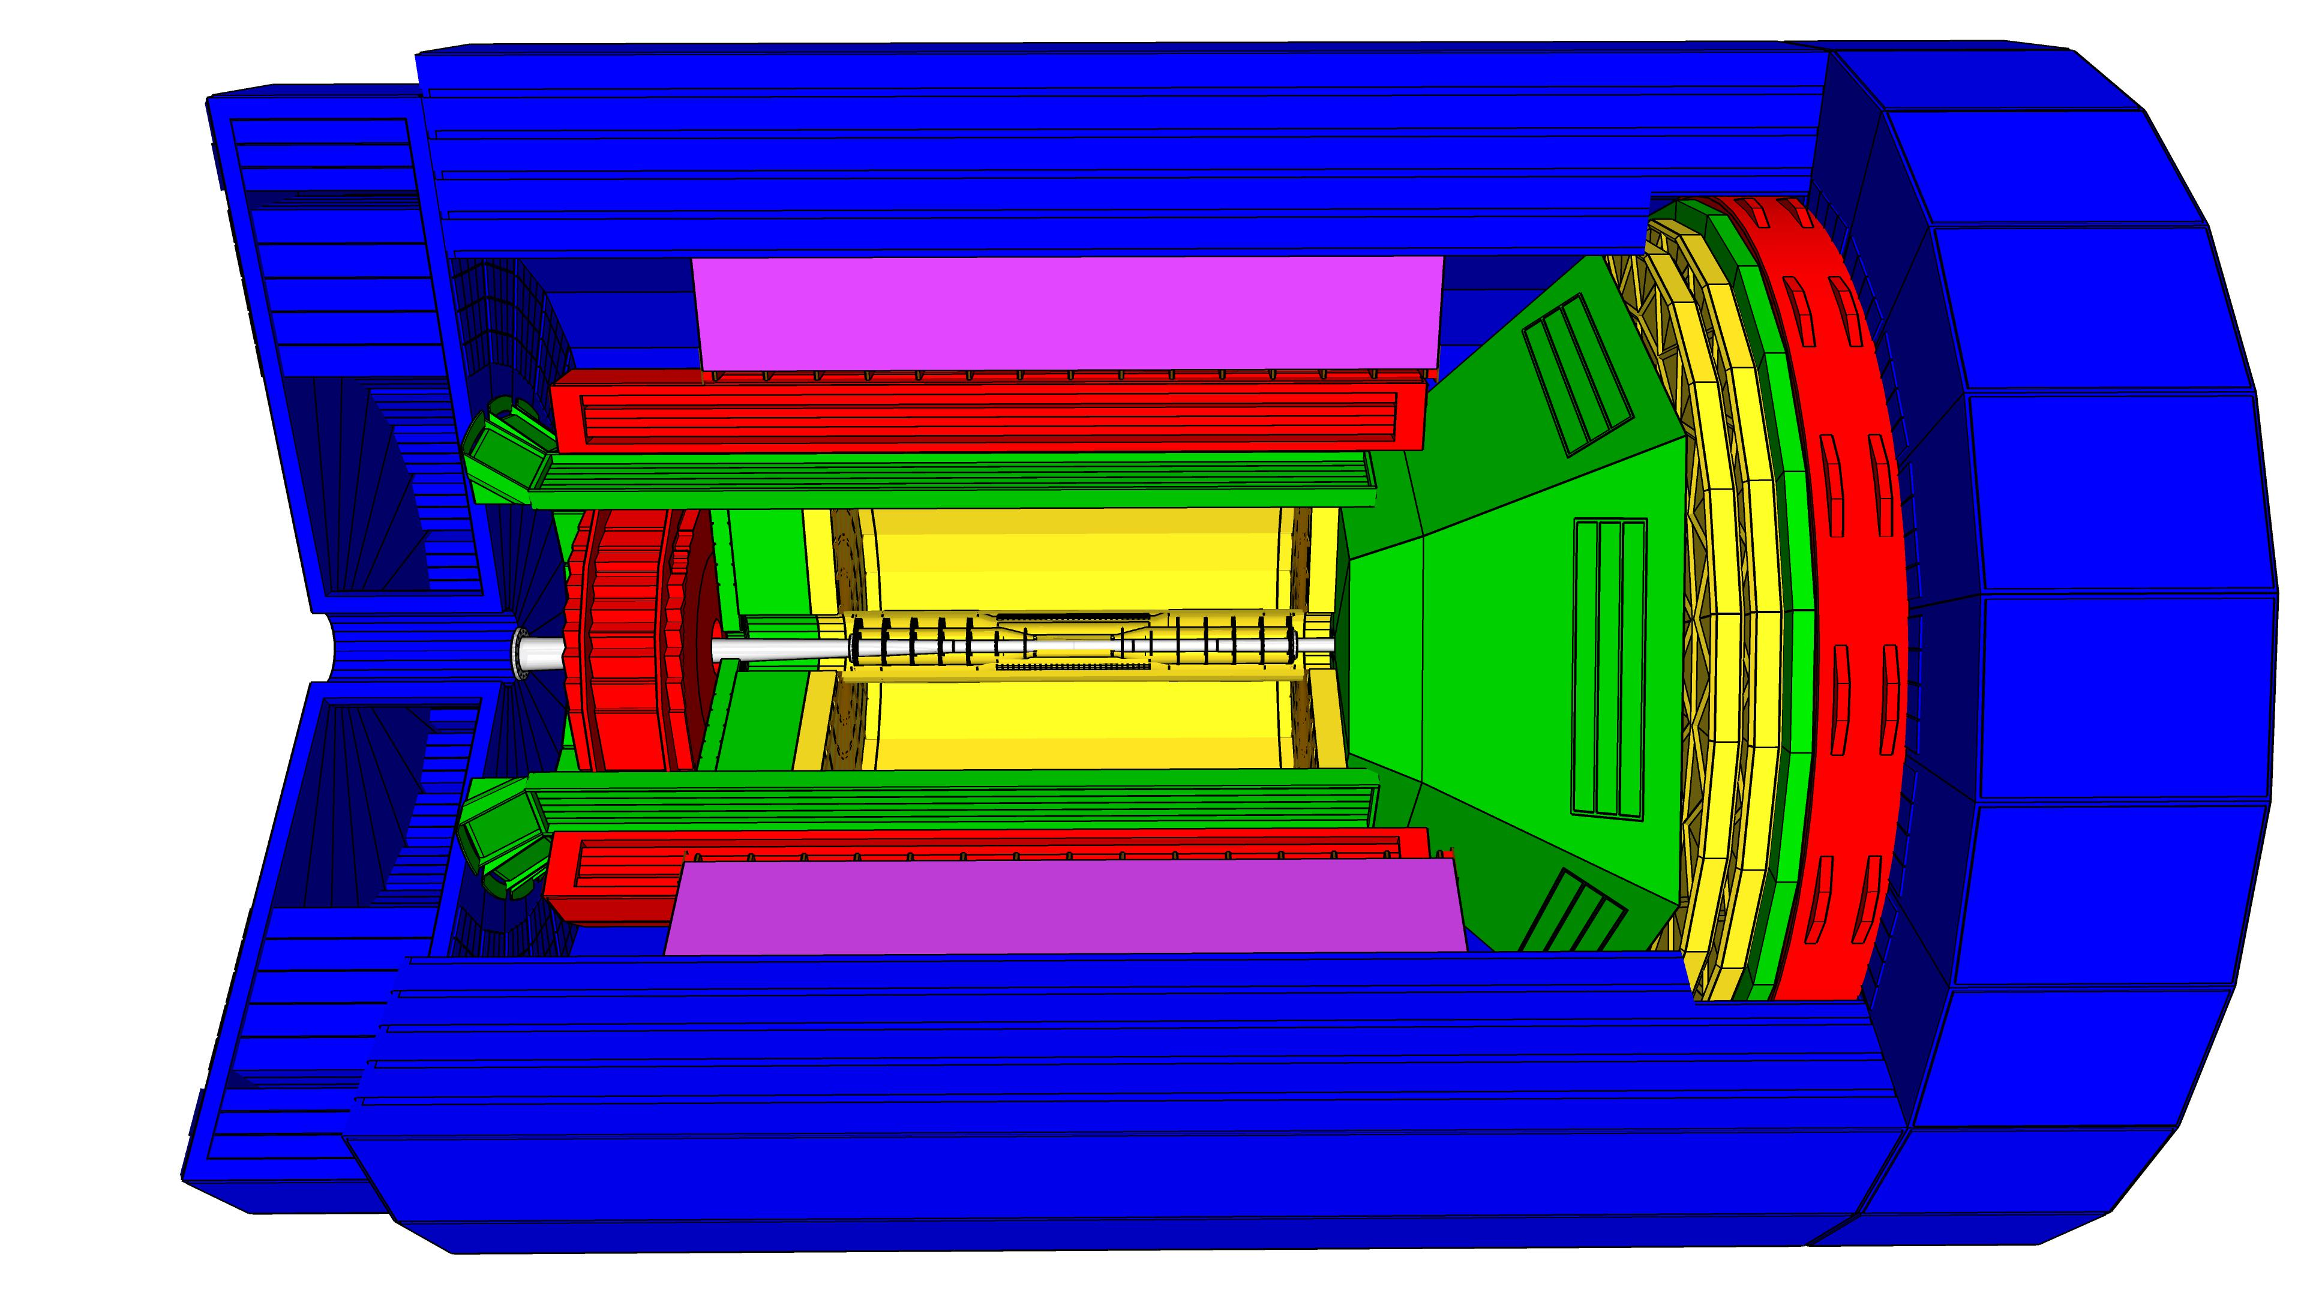
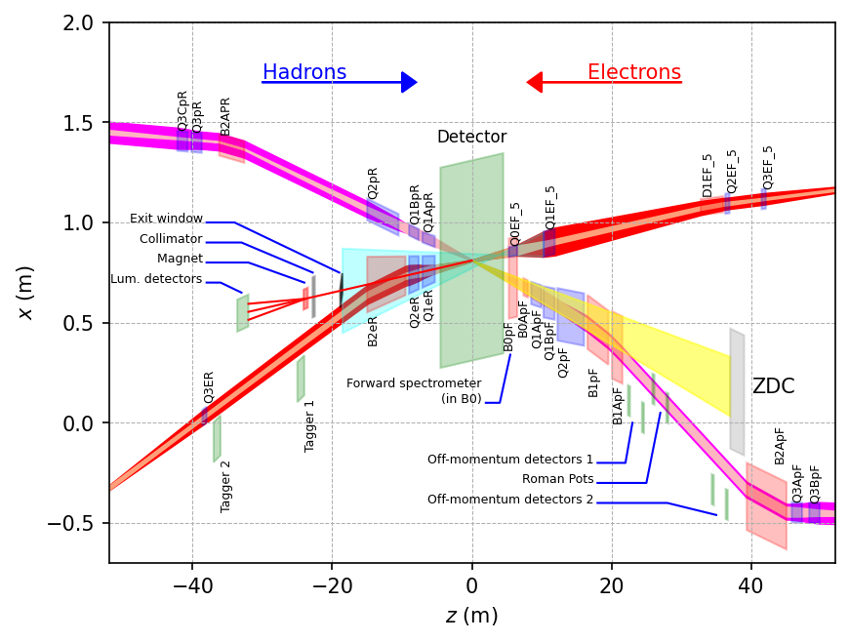
EIC General Purpose Detector
9.5 m
hadronic calorimeters
solenoid coils
e/m calorimeters
MAPS tracker
MPG trackers
ToF, DIRC, RICH detectors
Overall detector requirements:
Large rapidity (-4 < η < 4) coverage; and far beyond especially in far-forward detector regions
  Large acceptance for diffraction, tagging, neutrons from nuclear breakup: critical for physics program
  → Integration into IR from the beginning critical
  Many ancillary detector along the beam lines:
  low-Q² tagger, Roman Pots, Zero-Degree
  Calorimeter, ….
High precision low mass tracking
  small (μ-vertex Silicon) and large radius (gaseous-based) tracking
Electromagnetic and Hadronic Calorimetry
  equal coverage of tracking and EM-calorimetry
High performance PID to separate e, π, K, p on
track level
  good e/h separation critical for scattered electron identification
Maximum scientific flexibility
  Streaming DAQ → integrating AI/ML
High control of systematics
  luminosity monitor, electron & hadron Polarimetry

Slide 31
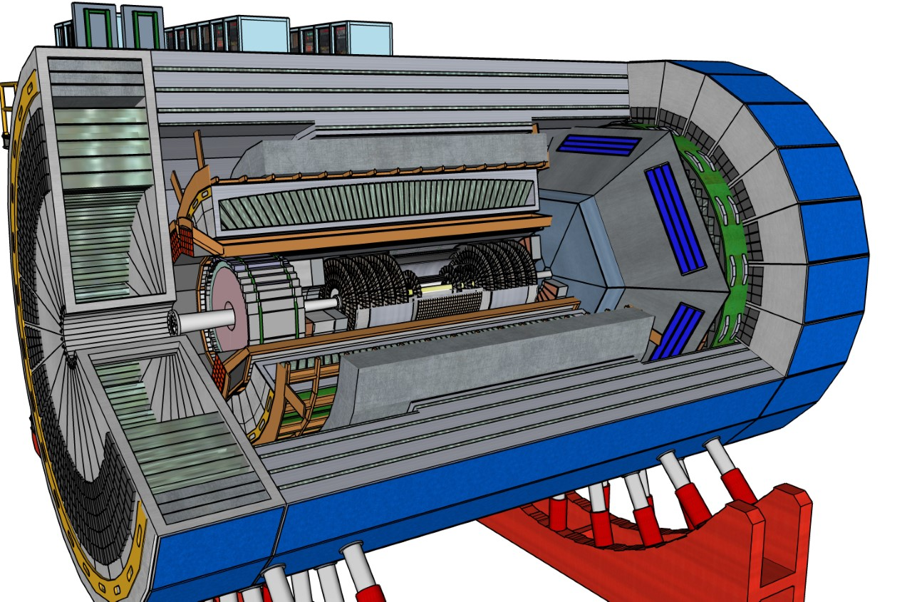
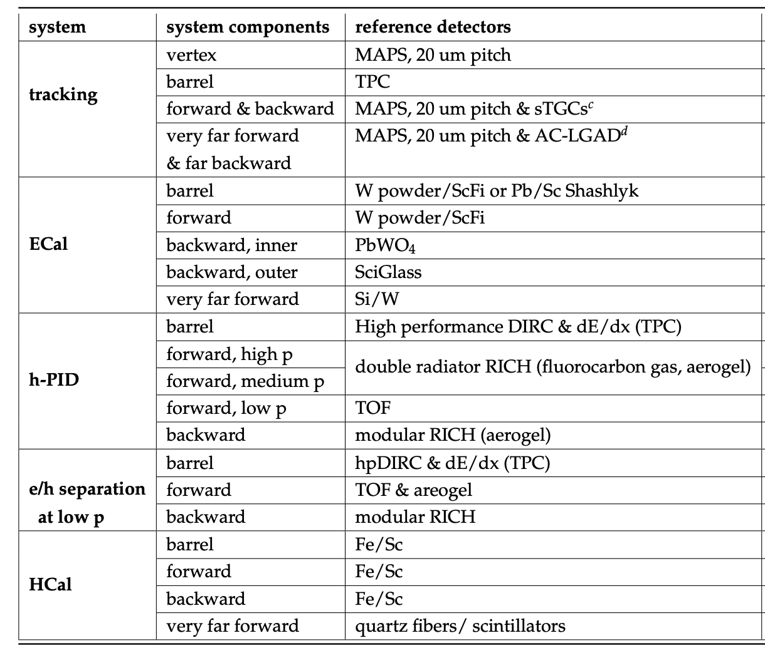
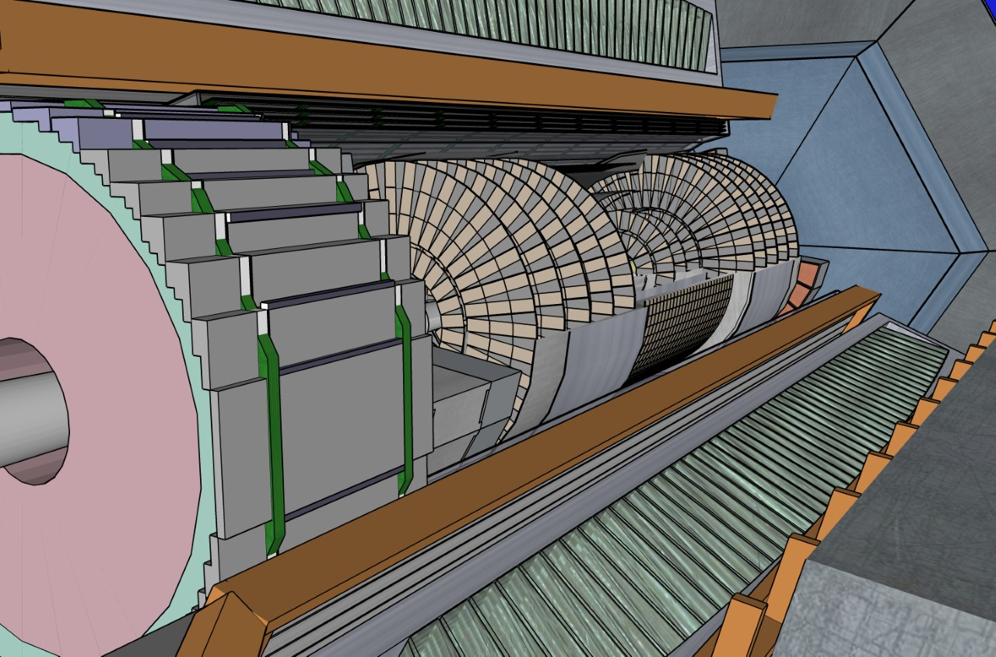
EIC General Purpose Detector
YR: EIC general purpose Detector around
a new 3T Solenoid
Hermetic coverage:
2º < Θ < 178º (-4<η<4 ) with full Φ coverage
→ as close as possible to 4π
electrons
hadrons
Most likely detector technologies further refined by current detector proposal process
https://www.bnl.gov/eic/CFC.php
Technologies based on Generic EIC Detector R&D developed by EIC-UG members
https://wiki.bnl.gov/conferences/index.php/EIC_R%25D

Slide 32
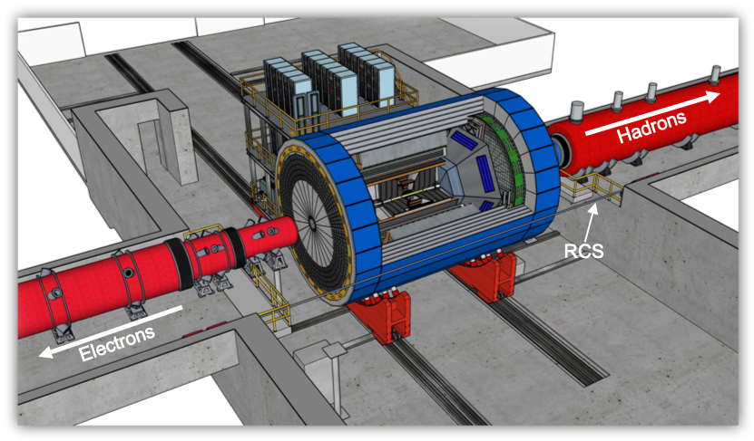
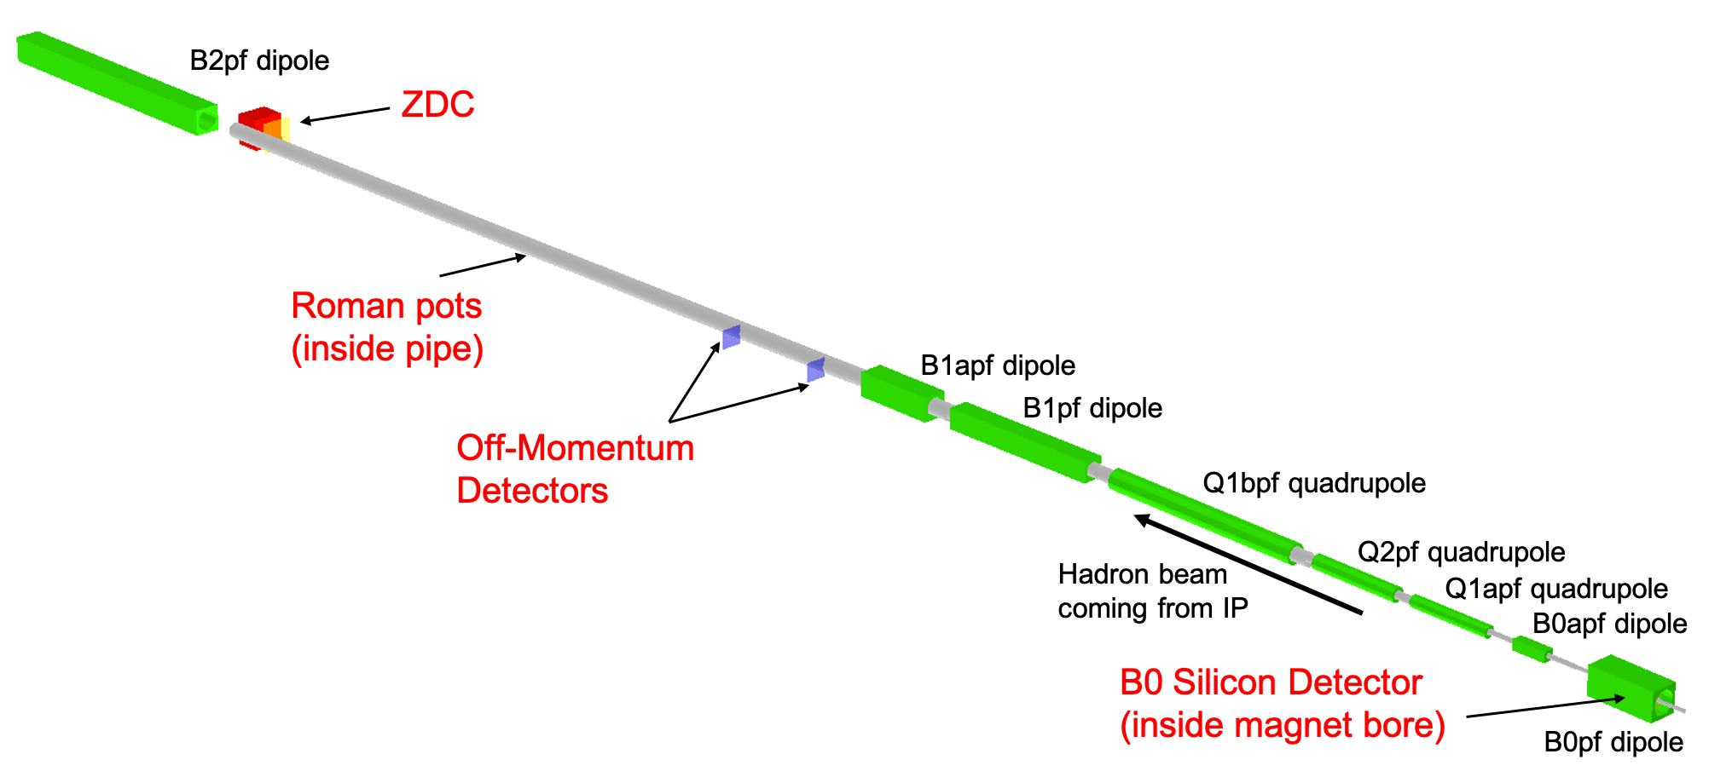
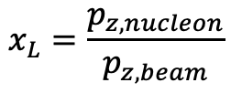

Far forward (hadron going) region
Detector | Angular accept. [mrad] | P_{T} coverage
ZDC @ ~30m | $θ$<5.5 ( $η>6)$ | pT<1.3 GeV
Roman Pots | 0*<$θ$<5.0 ( $η>6)$ | *Low p_{T}(t) cutoff (beam optics)
Off-Momentum Detectors | 0.< $θ$ < 5.0 ( $η>6)$ | Low-rigidity particles from nuclear breakups
B0 forward spectrometer | $$5.5<θ<20.0$$ (4.6< $η<5.9)$ | High p_{T}(t)
p/A
IP
$$x_{L}=\frac{p_{z, nucleon}}{p_{z, beam}}$$

Slide 33

Progress: IR-Integration and Interfaces
Space Constrains:
-4.5 m – IP – +5m not negotiable
50 cm space to 1st IR-magnet occupied by vacuum pumps, valves, …..
IP moved 81 cm towards ring inside compared to RHIC; y: 432 cm above floor
no installation possible in collider hall
Hadrons
RCS
Electrons
9.5 long detector does not fit through the door
  Door-Size: 823 cm x 823 cm
  endcap hadron calorimeters need to stay in collider hall, if detector rolls in
  assembly hall
RCS to IP: radial distance 335.2 cm at a height of 372 cm from floor
  Maximum outer radius ~ 3.2 m
Fringe field requirements for solenoid
  the fringe field at both endcaps impacting the IR magnets: < 5 gauss
  and the fringe field radial along z to impact the RCS: < 0.007 Tm

Slide 34



2ndDetector: Complementary is Key
What do we want from “Complementary”
Cross-checking important results (obvious!)
  Many examples of wrong turns in history of nuclear and particle physics.
  Independent cross checks (detector, community, analysis tools) are essential for timely verifications and corrections
Cross Calibration
  Combining data gave well beyond the √2 statistical
  improvement …
  Different dominating H1, ZEUS systematics…
  Effectively use H1 electrons with ZEUS hadrons
  … not all optimal solutions have to be in one detector…
Technology Redundancy
... by applying different detector technologies and philosophies
to similar physics aims
  mitigates technology risk vs. unforeseen backgrounds
  differently optimises precision and systematics
Different primary physics focuses
... EIC has unusually broad physics program
(from exclusive single particle production to high multiplicity
eA or gA with complex nuclear fragmentation)
→ Impossible to optimize for the full program in a single detector.
ATLAS
CMS

Slide 35
Complementarity for 1st-IR & 2nd-IR
Since CD-1 we made significant progress in the preliminary design for the 2nd IR with a focus on complementarity
1st IR (IP-6)
2nd IR (IP-8)
Geometry:
ring inside to outside
ring outside to inside
tunnel and assembly hall
are larger
Tunnel: ⦰ 7m +/- 140m
tunnel and assembly hall are smaller
Tunnel: ⦰ 6.3m to 60m then 5.3m
Crossing Angle:
25 mrad
35 mrad
secondary focus
different blind spots
different forward detectors and acceptances
different acceptance of central detector
Luminosity:
more luminosity at lower E_{CM}
optimize Doublet focusing FDD vs. FDF
→ impact of far forward p_{T} acceptance
Experiment:
1.5 Tesla or 3 Tesla
different subdetector technologies

Slide 36

Progress – Interaction Region
1st IR (IP-6)
2nd IR (IP-8)
0.5 m
Solenoid
Dipole
p Quad
e Quad
Forward acceptance not azimuthally symmetric because of electron quad
IR-8: pre-conceptual design with 35 mr crossing angle and secondary focus passed on to proto-collaborations for science complementary checks.
Initiated with accelerator colleagues change request to shift forward IR magnets by 0.5 m to provide more space to detector → -4.5 m to +5m
  approved and now new baseline
2nd focus enables:
enhanced low P_{T} acceptance, DVCS on nuclei, Light ion tagging, Diffraction, improved Gluon imaging by detection of (A-1) nuclei

Slide 37

EIC Project Status
January 2020: CD-0 & site selection → BNL
June 28th 2021: EIC received CD-1
Accelerator Technical Reviews | Spring -- Autumn 2021
Start Preliminary Design | April 2021
Detector Proposals Submitted | December 2021
Selection of Project Detector | March 2022
Start Earned Value Tracking | Summer 2022
Clarify In-kind Deliverables - Agreements | Summer/Fall 2022
Goal for CD-2 Approval | April 2023 | Baselining the project
Goal for CD-3 Approval Goal for CD-4 Early Project Completion | July 2024 July 2031 | Start of Construction Early Start of Operation

Slide 38


Worldwide Interest in EIC Physics
The EIC Users Group: EICUG.ORG
Formed 2016
November 2021: 1298 collaborators 36 countries, 264 institutions (Exp. 799, Theorists 324, Acc. Sci. 161),
Size of EICUG has continuously grown since its formation, especially after the award of CD0 / site-selection.
Expect growth to continue through the phases
of the EIC project.
25%
31%
9%
35%
Experimental Program Activities:
BNL and TJNAF Jointly Leading Process to Select Project Detector
2020:
  Call for Expressions of Interest (EOI) https://www.bnl.gov/eic/EOI.php
2021:
  March 2021:
  Call for Collaboration Proposals for Detectors https://www.bnl.gov/eic/CFC.php
  Deadline: 1st of December
  Decision on Project Detector March 2022
Formation of 3 proto-collaborations started right after call was issued
  ATHENA (https://sites.temple.edu/eicatip6/)
  CORE (https://eic.jlab.org/core/)
  ECCE (https://www.ecce-eic.org)
Map of institution’s locations

