Slide 1
Monte Carlo Data Comparisons and Validation
MC Software Working Group, India
Vaibhavi Gawas
Indian Institute of Technology Madras

Slide 2
Motivation
Content
Validate the electron-proton collision MC-data generated by three MCEGs
Determine which MCEG tunings explains the e-p collision physics the best
Why Monte Carlo Studies?
The Monte Carlo event generators
Experimental e-p collision data: HERA
Deep Inelastic Scattering Kinematics
Analyses and Results
Summary, Outlook
Notes:
Combine 2 and 3 slides

Slide 3
Why Monte Carlo studies
Underlying physics models for highly complex systems
Event selection and Background estimation
Theory Predictions: discoveries of new particle and interactions
Testing the capabilities of current MCEG
Predictions for future experiments

Slide 4
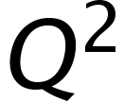
Monte Carlo Event Generators: Pythia8
A generator written in modern program language: C++
Mainly built for for needs of LHC experiments
For EIC related analyses
Default parton shower for DIS-type events: dipole showers
Completely new parton-shower model: DIRE.
New Photoproduction model
Hadronization: Lund string fragmentation
Generating events in intermediate
Heavy ion model
Pythia8
Herwig7
Sherpa2
https://pythia.org/documentation/
Notes:
. Borrowing from the basic ideas of dipole cascades,
Firstly, the ordering variable should exhibit a symmetry in emitter and spectator momenta, such that the dipole-like picture can be reinterpreted as a dipole picture in the soft limit. At the sametime, the splitting functions are regularized in the soft anticollinear region using partial fractioning of the soft eikonal in the Catani–Seymour approach. They are then modified to satisfy the ordinary sum rules in the collinear limit. This leads to an invariant formulation of the parton-shower algorithm, which is in complete analogy to the standard DGLAP case.

Slide 5
The Monte Carlo Event Generators: Herwig7
Focus on
QCD dynamics for parton shower algorithms
Improving the hard processes
Two different parton shower modules
Angular-ordered (’QTilde’) algorithm
Dipoles stretched by colour charges.
Multi parton interaction
Cluster hadronization model
Pythia8
Herwig7
Sherpa2
https://herwig.hepforge.org/

Slide 6
The Monte Carlo Event Generators: Sherpa2
Two built-in matrix element generators, AMEGIC and COMIX: Merging of leading-order matrix elements with parton showers
For the simulation of parton-level events within the Standard Model and beyond,
For the decay of heavy resonances
Default parton-showering algorithm: CS shower
DIRE shower
Cluster Hadronization
Pythia8
Herwig7
Sherpa2
https://sherpa.hepforge.org/doc/SHERPA-MC-2.2.5.html

Slide 7
Experimental e-p Collision Data: HERA
H1, ZEUS experiments: Testing the MCEG data against these experimental datasets
100+ papers published since 1994 by H1 and ZEUS collaborations
H1: Five Rivet Analysis
H1+ZEUS: One Rivet Analysis
ZEUS: Three Rivet Analysis
HERA: electron-proton collisions
Proton structure at small x and high
QCD tests provided new insights into strong force
Study of charm and beauty production
Diffractive scattering

Slide 8
DIS Kinematics

Slide 9
Parton Shower Tests
Average transverse energy in central and forward regions
Transverse energy in low and high bjorken x, high and low Q regions
Transverse energy-energy correlation in high and low bjorken x regions
Event Selection and Kinematics

Slide 10
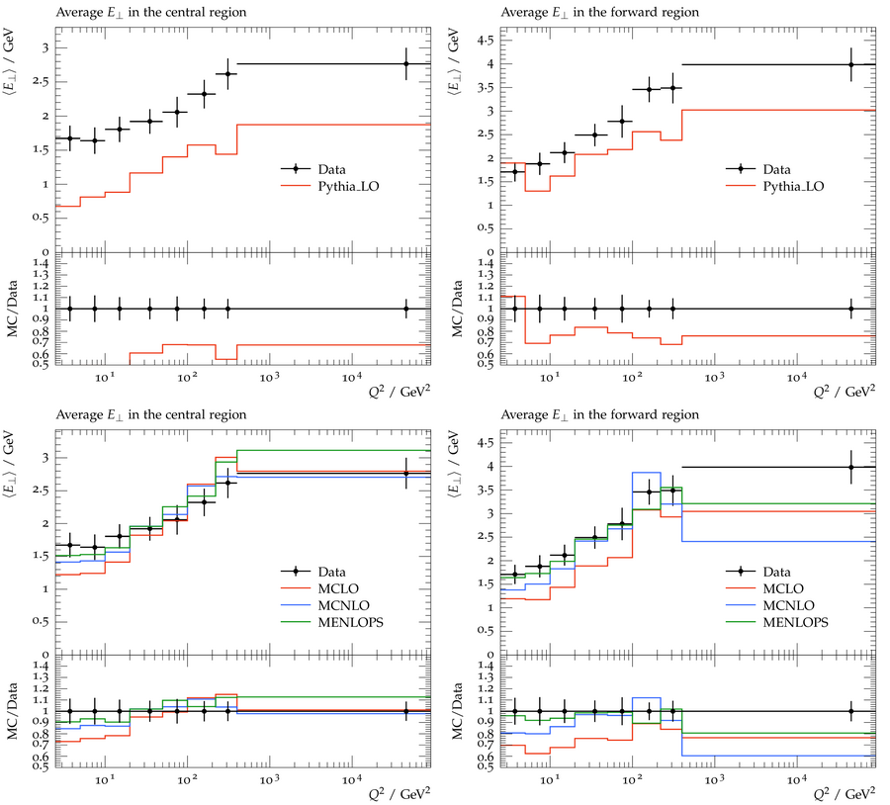
Average Transverse Energy Flow
Characterize the system at extreme conditions of temperature and energy density.
Central region:
Forward region:
(photon fragmentation region
Top panel: Pythia8
Bottom Panel: Sherpa2
Notes:
Depending on the collision energy the source of transverse energy production could be soft multiparticle production or hard scattering Jets.

Slide 11
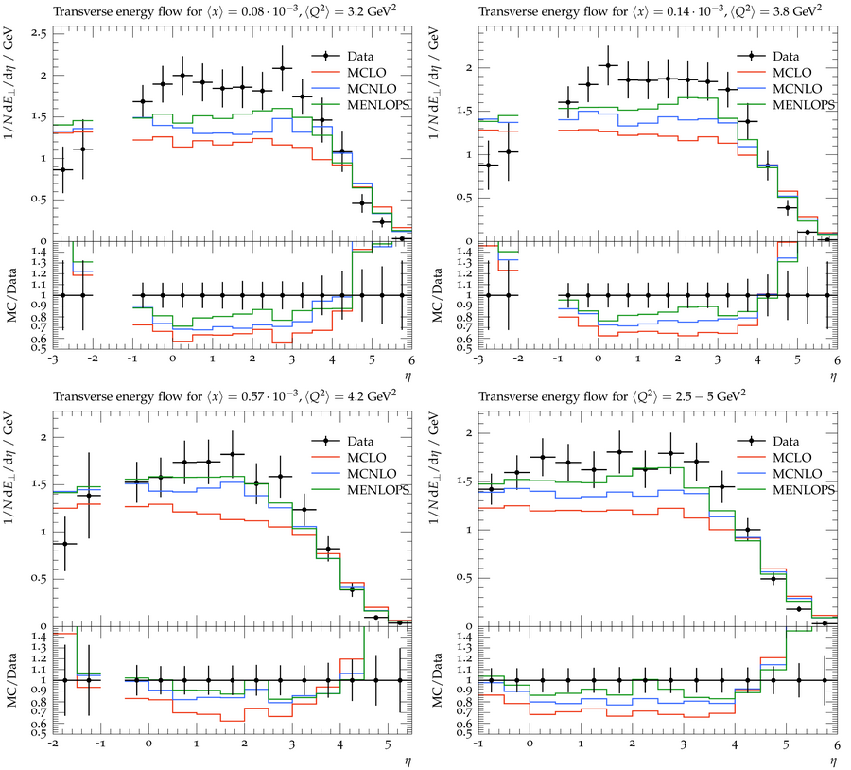
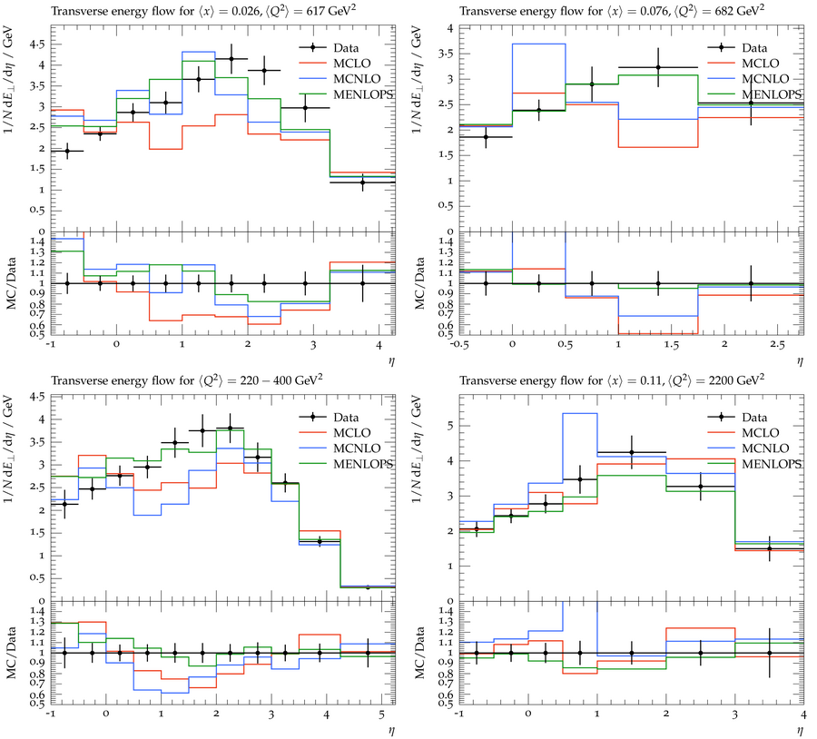
Transverse Energy Flow
Source of transverse energy production:
Soft multiparticle production
Hard scattering jets
Defines the ‘explosiveness’ of
collision event
Sherpa2 tunings

Slide 12
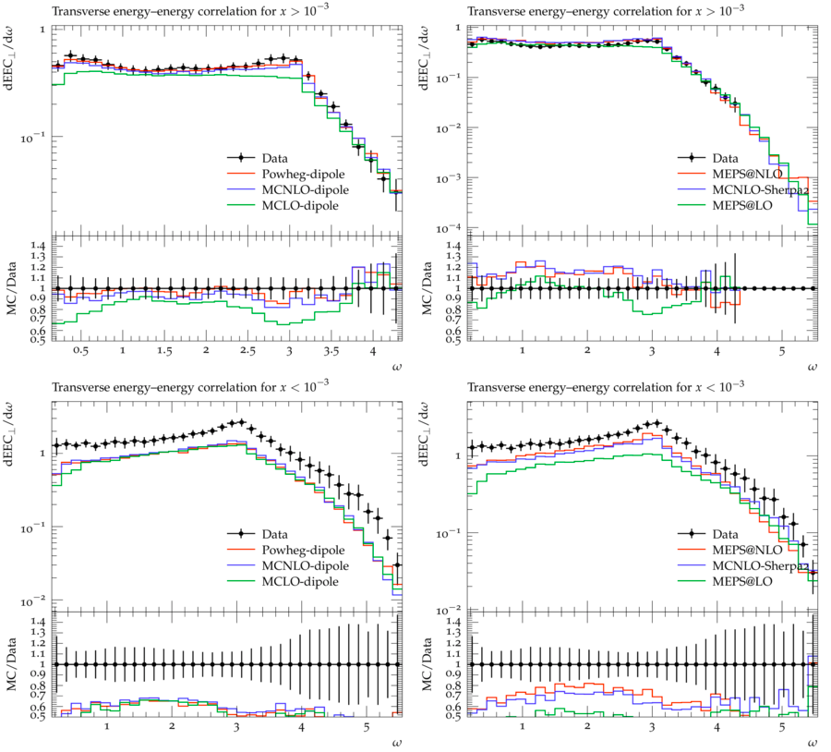
Transverse Energy-Energy Correlation
An event shape observable- for QCD tests
The measurements of energy weighted angular distributions of hadron pairs.
Independent of hadronization of the primary partons
Left panel: Herwig7
Right Panel: Sherpa2

Slide 13
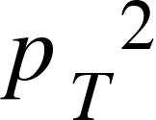
Hadronization Tests
Charged Particle Multiplicity and
Associated Observables
Scaled charged particle spectra
Average Distribution
D* Meson Cross section
Meson Cross section
Event selection kinematics

Slide 14
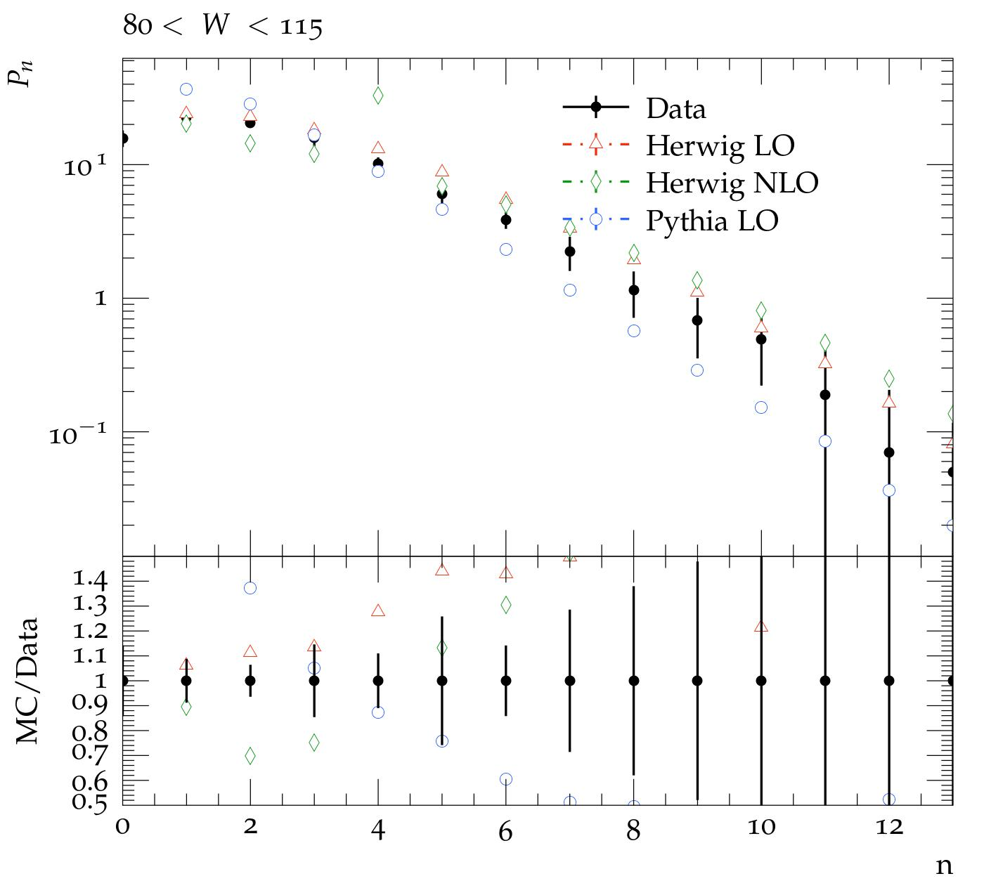
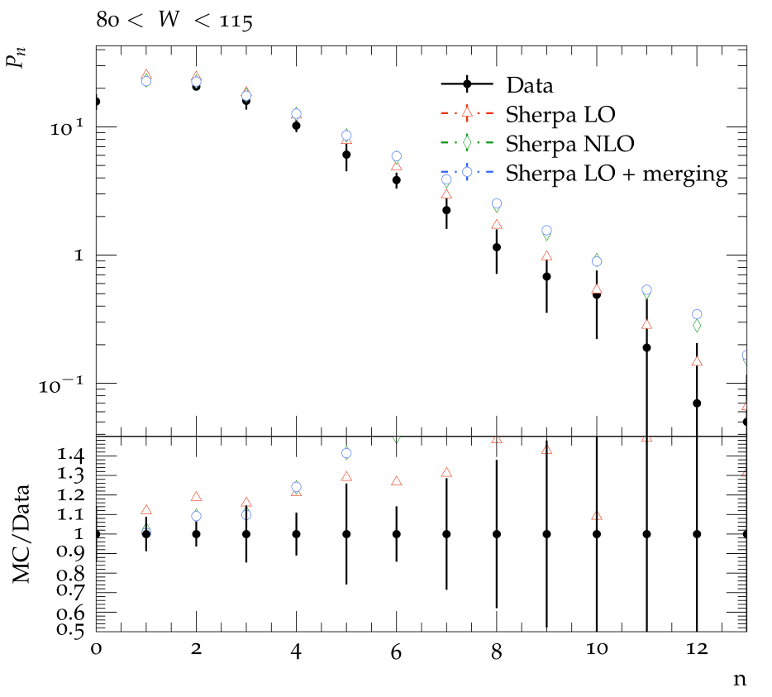
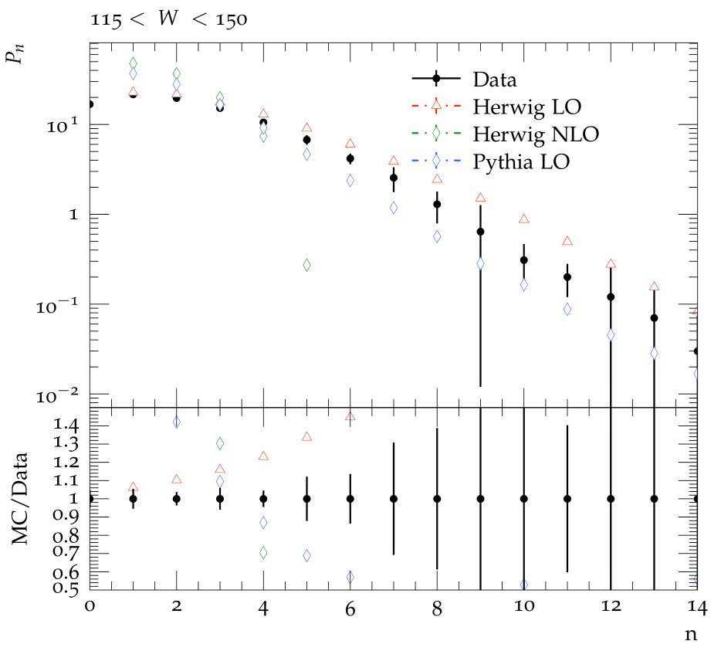
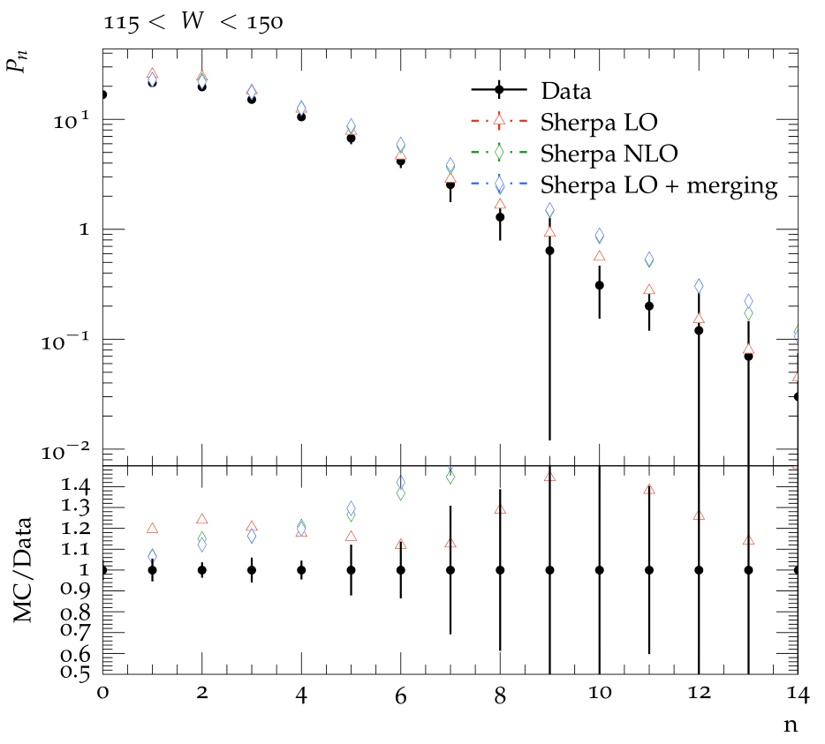
Charged Particle Multiplicity
Set of probabilities(Pn) associated with the occurrence of the number of hadrons, n, in the phase space region under observation.
Left panel: Pythia8, Herwig
Right Panel: Sherpa2

Slide 15
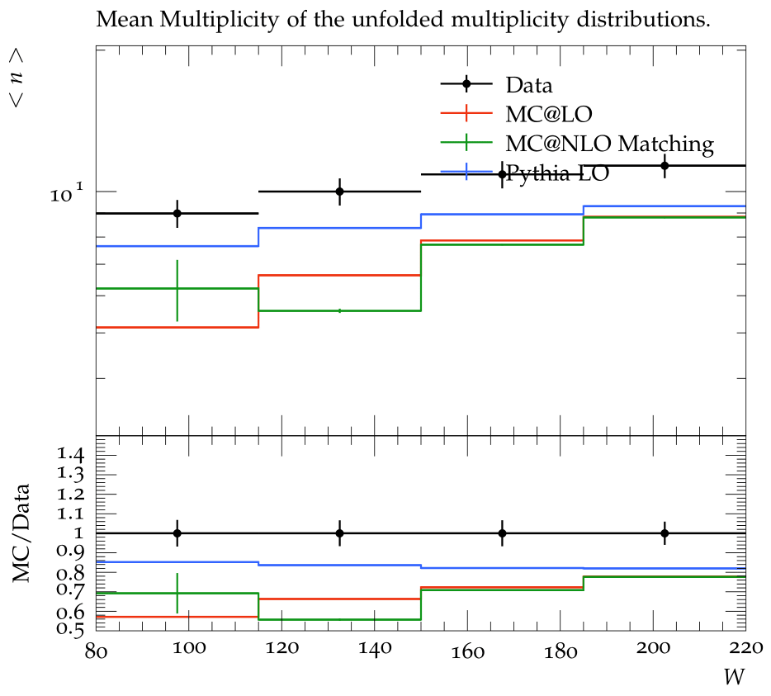
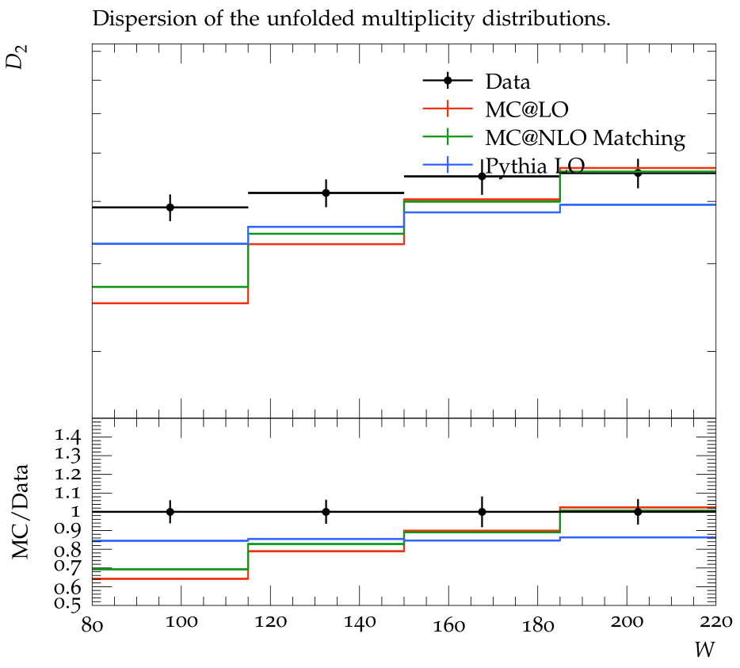
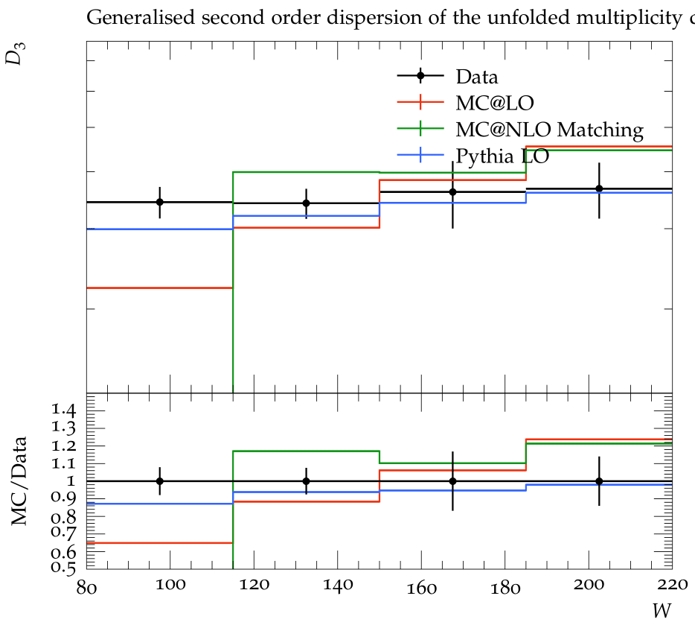
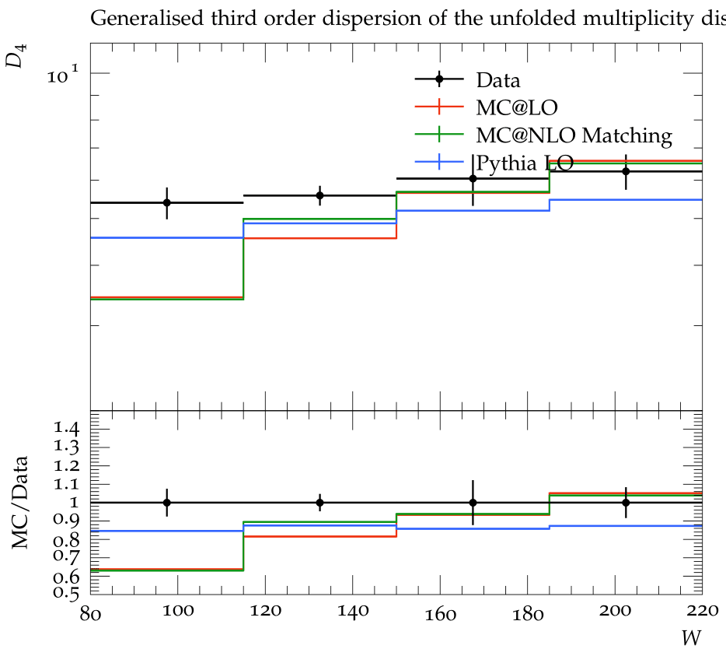
Mean of Charged Particle Multiplicity
<n> is mean charged multiplicity
Generalised Dispersions upto 4th order
These observables can directly measure the correlation strength among particles
Pythia8, Herwig7

Slide 16
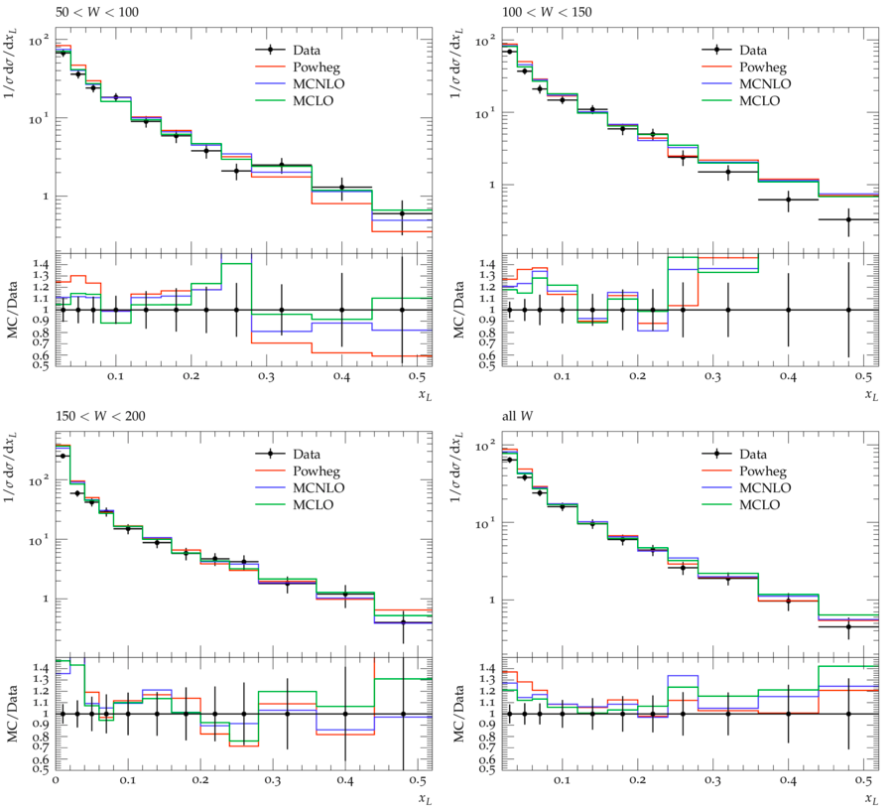
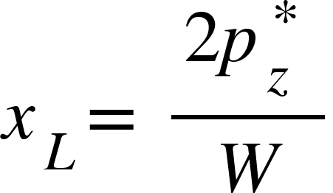
Scaled Charged Particle Spectra
This observable is presented in hadronic CoM frame
Minimised effect of transverse boost from virtual photon
z* is direction of the virtual photon
Herwig7

Slide 17
Average Distribution
Hadronization is expected at lower pT values
Higher pT- hard parton radiation
Left:Herwig7
Rightl: Pythia
Notes:
Hadronisation is expected to be more relevant at small transverse momenta, while the hard parton radiation is expected to contribute more significantly at high p∗T

Slide 18
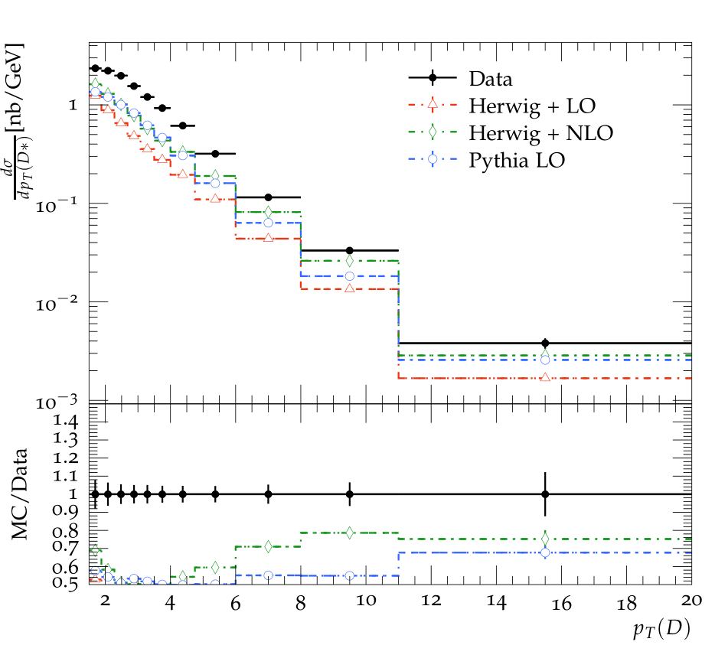
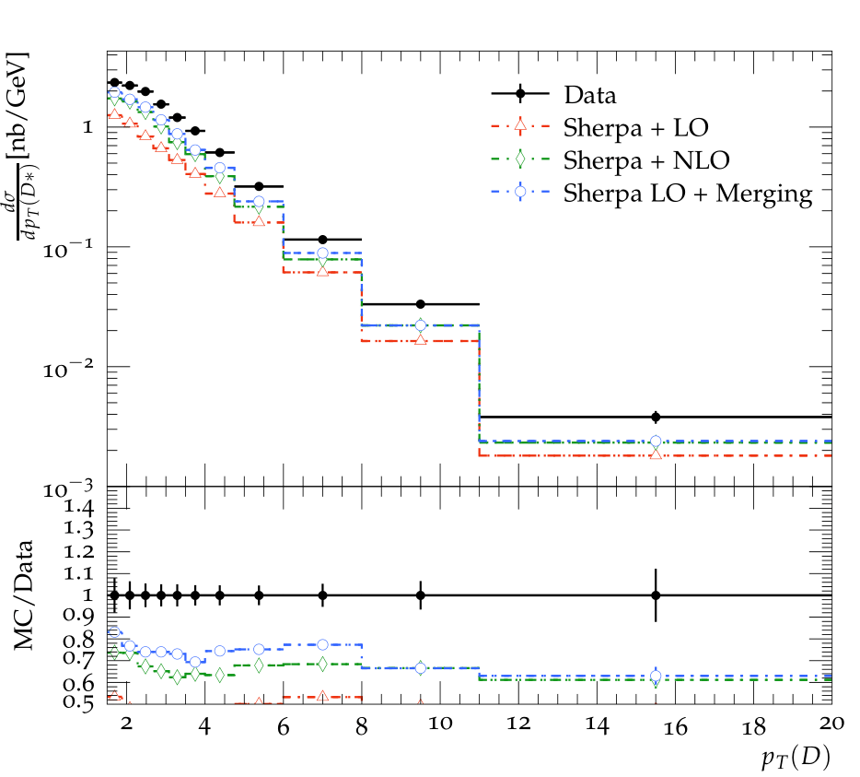
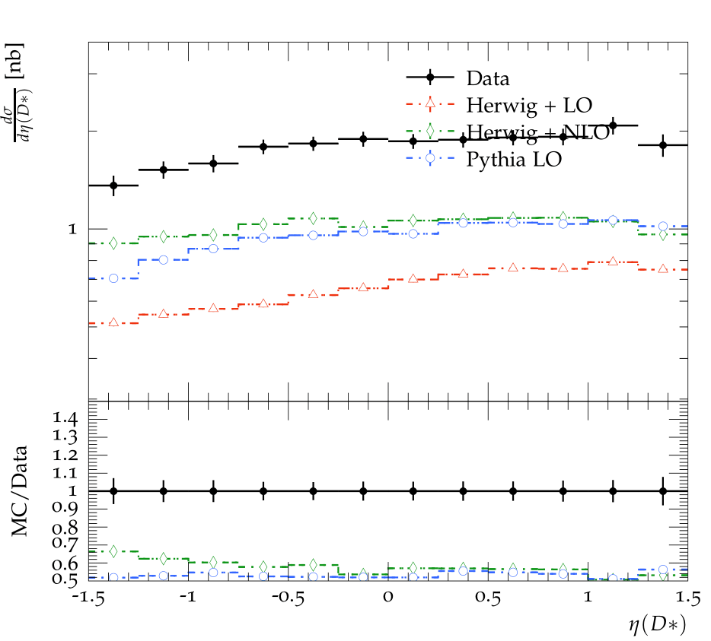
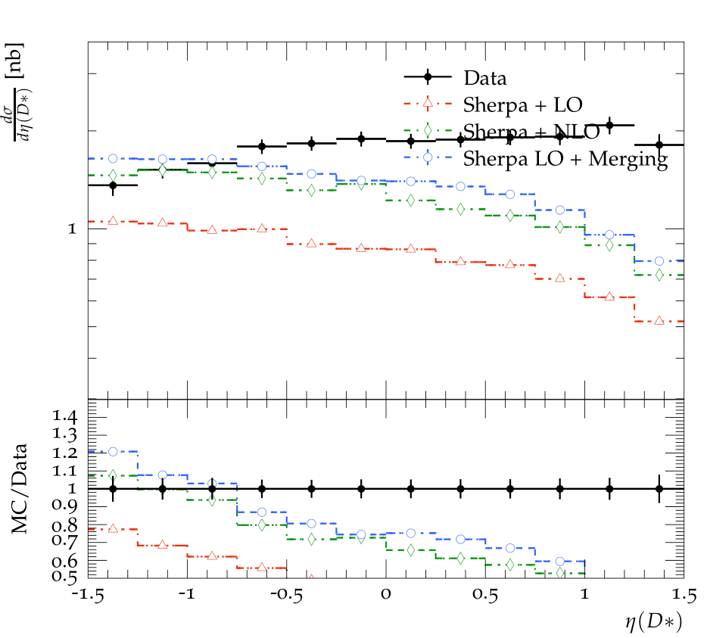
D* Meson Cross-section
Charm production: involves gluon-gluon fusion
Studying gluon distribution inside proton
Testing QCD predictions
Left panel: Pythia8, Herwig
Right Panel: Sherpa2
Notes:
This is because the main process by which charm quarks are produced involves boson gluon fusion process, → cc̄ which in turn depends on the gluon distribution inside the proton.

Slide 19
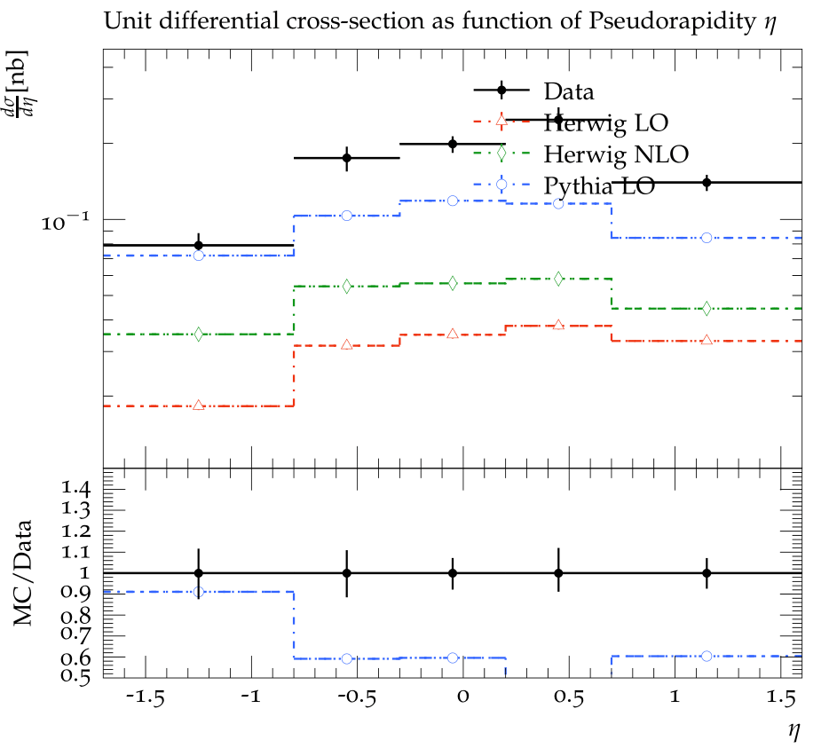
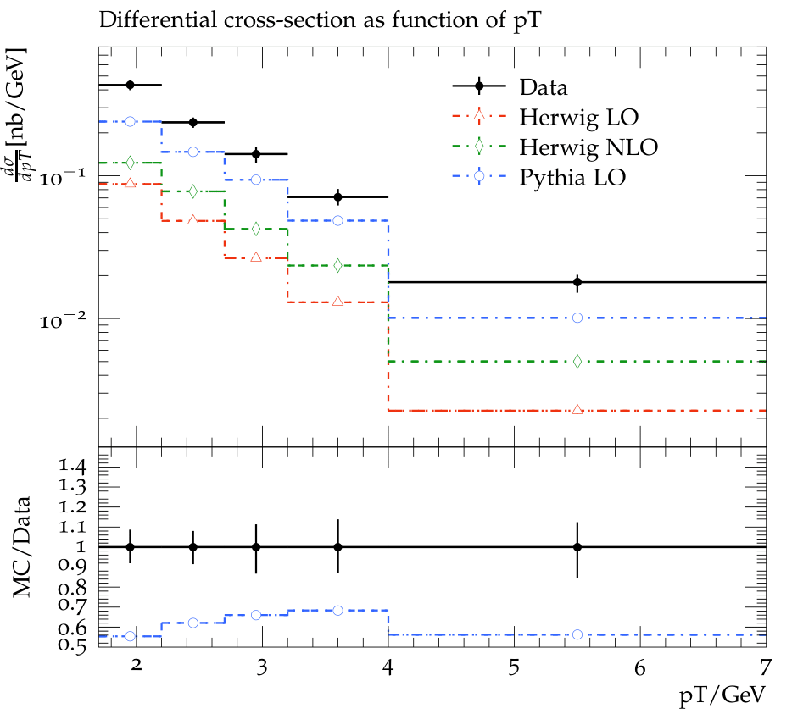
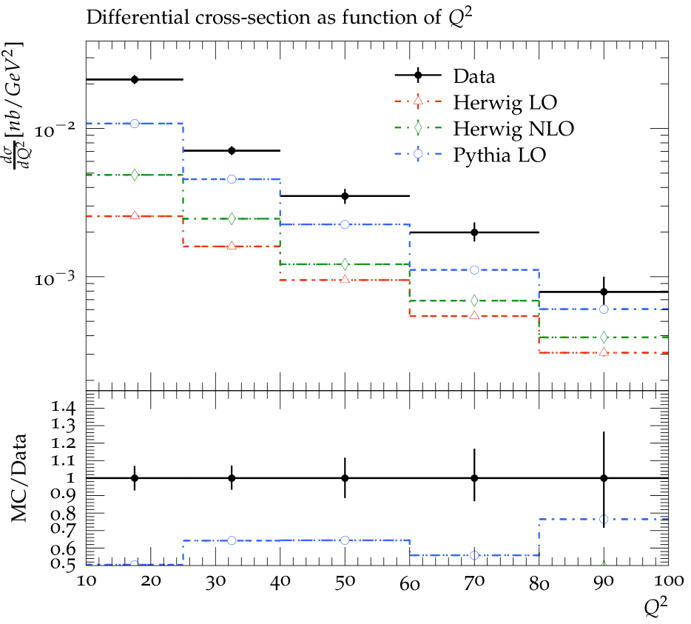
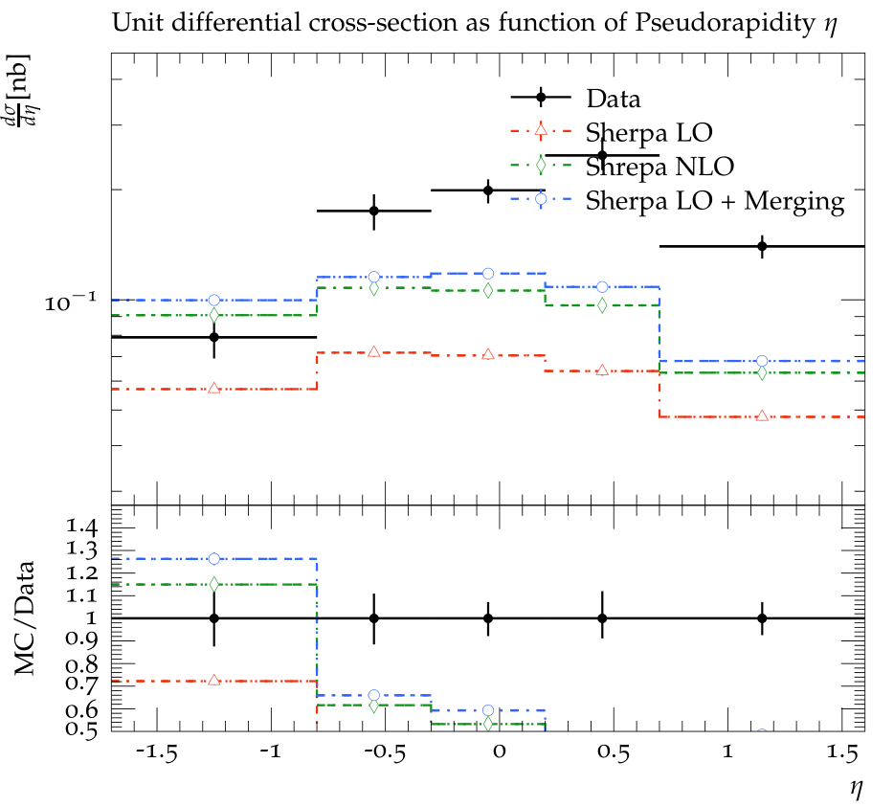
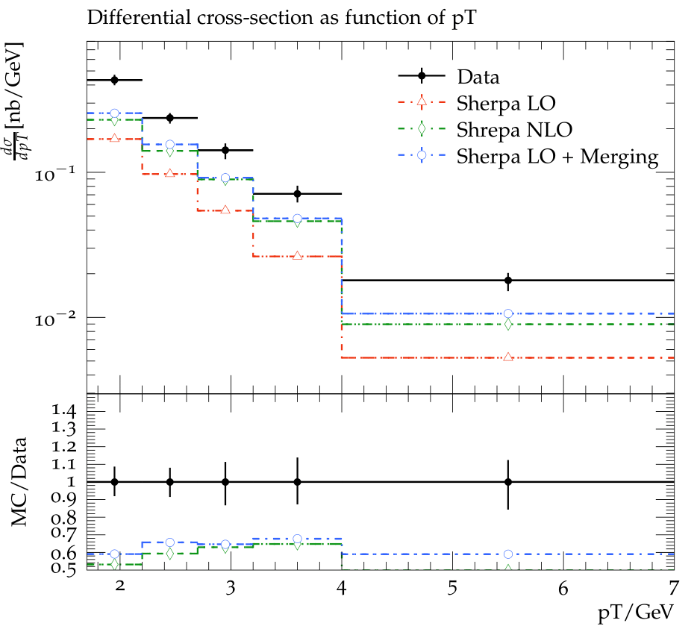
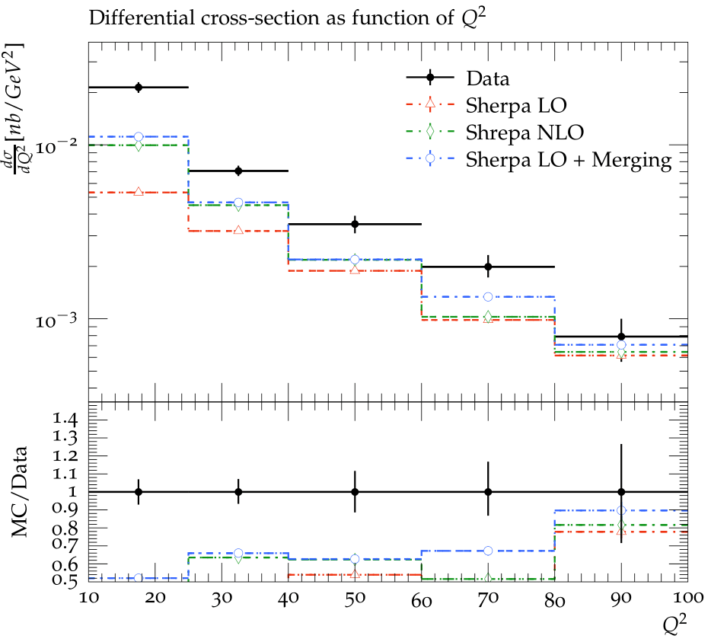
Meson Production
Strange quark production and hadronization
Production through gluon-gluon fusion also possible
Testing QCD theories in neutral current DIS
Top panel: Pythia8, Herwig
Bottom Panel: Sherpa2

Slide 20
Photoproduction
Photoproduction
Diffractive dijet production
Event selection kinematics

Slide 21
Diffractive Photoproduction of Dijets in ZEUS

Slide 22
Diffractive Dijet in Photoproduction in H1
Total Crossection of photoproduction
Transverse energy of leading jet
Invariant mass of the remnant
H1: 237 pb
Pythia: 200 pb

Slide 23
Summary
Transverse Energy Flow and Correlation
Sherpa and Herwig shows better results compared to Pythia
All MC tunings perform relatively better in the higher bjorken x than in lower x regions
D Meson Production
Relatively, Herwig NLO best explains the data.
Sherpa tunings deviates from the data structure for certain measurements
Charged Particle Multiplicity
Pythia-LO shows better results in comparison to Herwig NLO and LO tunings for mean multiplicity and generalised dispersion measurements
.
Meson Production
The shape of the data is explained well by all MCs, but none of the MCs fit the data exactly well.
PhotoProduction
Pythia-LO model performs quite well in terms on explaining the values and structure of Photoproduction related measurements
Scaled Charged Particle spectra
Herwig NLO and Powheg comes closest at explaining the HERA data
Average Momentum distribution
Sherpa tunings shows a large scaling difference between MCEG data and HERA data

Slide 24
Outlook
The HERA analyses have been compared to different MCEGs
Several comparisons studies are now available and would be published very soon
Interpretation of these analyses
Explaining the performance of different MCEGs
Consecutive improvements in MCEGs’ performance for ep collisions remains

Slide 25
Acknowledgement
References
annurev.nucl.012809.104458
Eur. Phys. J. C (2013) 73:2406
Eur.Phys.J.C55:177-191,2008
arXiv:1502.01683
Eur.Phys.J.C23:615,2002
Eur.Phys.J.C 61 (2009) 185-205
Z.Phys.C63:377-390,1994
Eur.Phys.J.C12:595-607,2000
RIVET Analysis
H1_1994_S2919893
H1_2000_S4129130
H1_2007_I746380
H1_2009_I810046
H1_2013_I1217865
H1_2015_I1343110
HERA_2015_I1353667
ZEUS_2001_I568665
Akhil Mithran (IIT Bombay)
Chinmay Seth (IIT Madras)
Dr. Christian Berliech (Lund University)
Dr. Ilkka Helenius
(University of Jyväskylä )
Dr. Markus Diefenthaler (Jefferson Lab)
Dr. Prabhakar Palni (Goa University)
Dr. Prabhat Pujahari (IIT Madras)
Pranjal Verma (IIT Madras)
Dr. Sadhana Dash (IIT Bombay)
Dr. Simon Plaetzer (University of Graz )

Slide 26
THANK YOU!

Slide 27
BACKUP

Slide 28
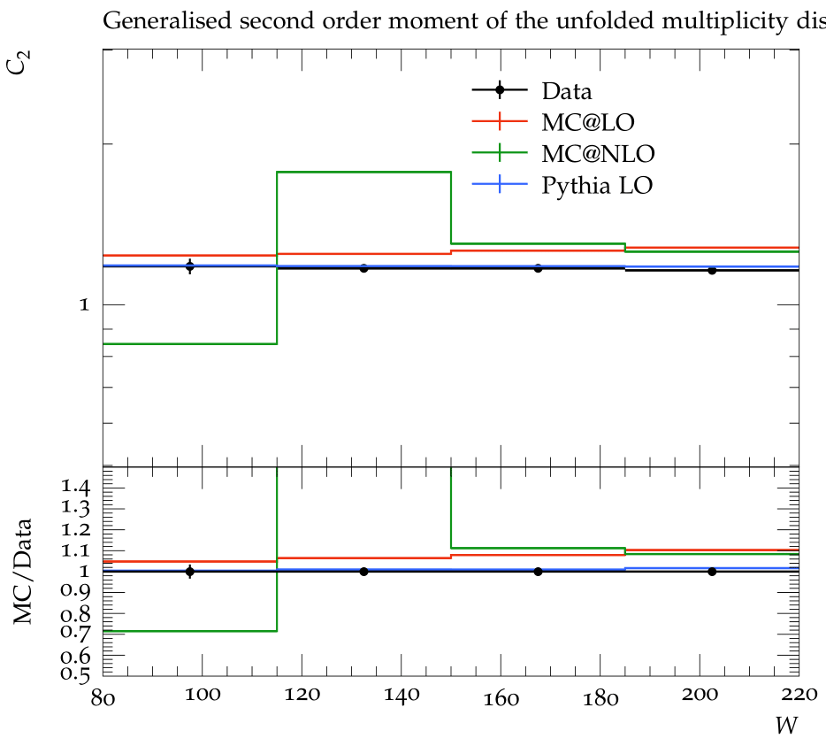
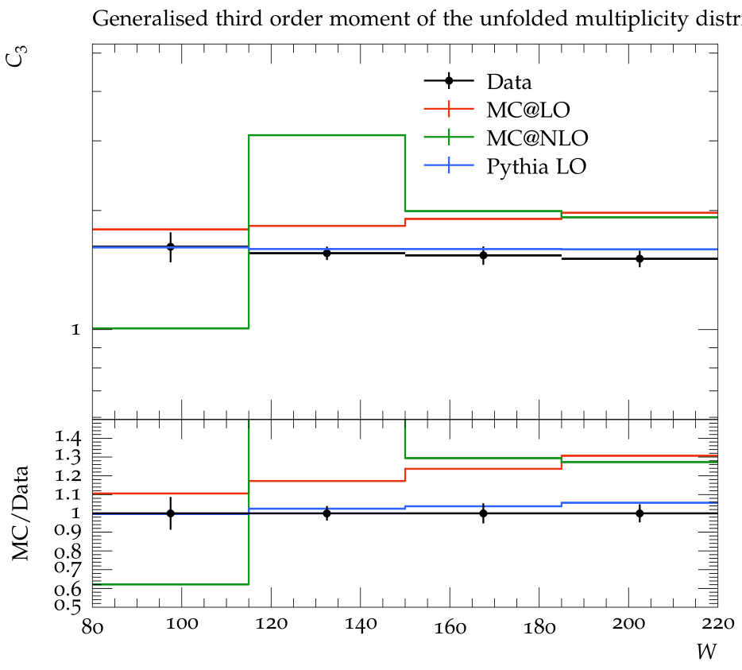
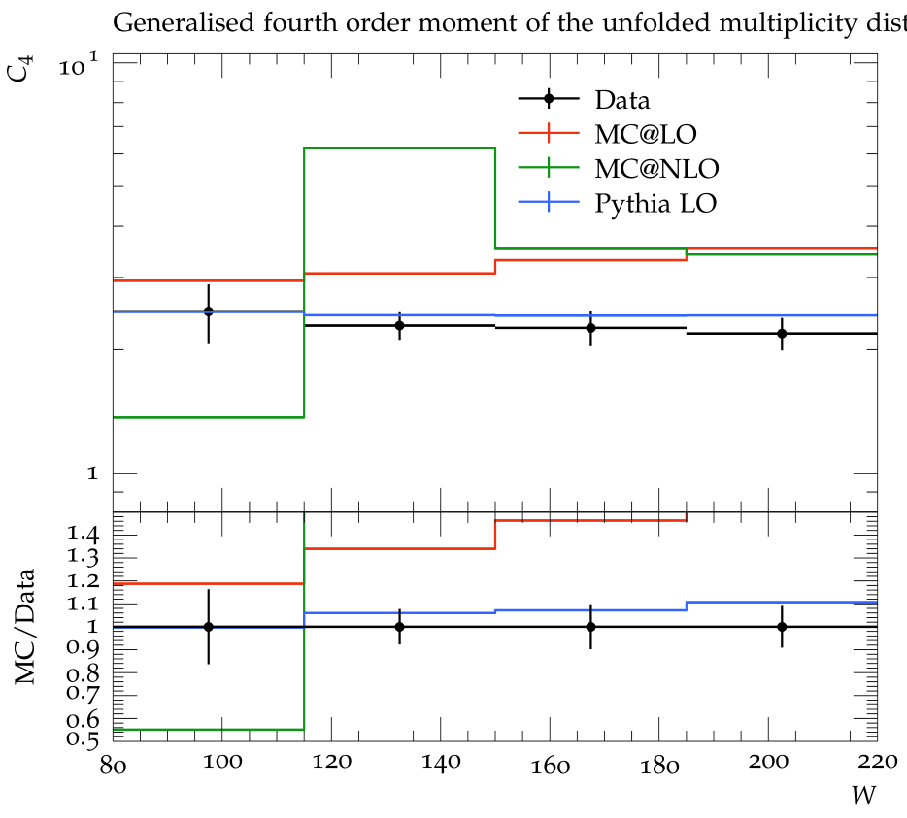
Generalised Moments Distribution
Notes:
Multiplicity distribution refers to set of probabilities(Pn) associated with the occurrence of the number of hadrons, n, in the phase space region under observation.

Slide 29
Average Transverse Energy Flow

Slide 30
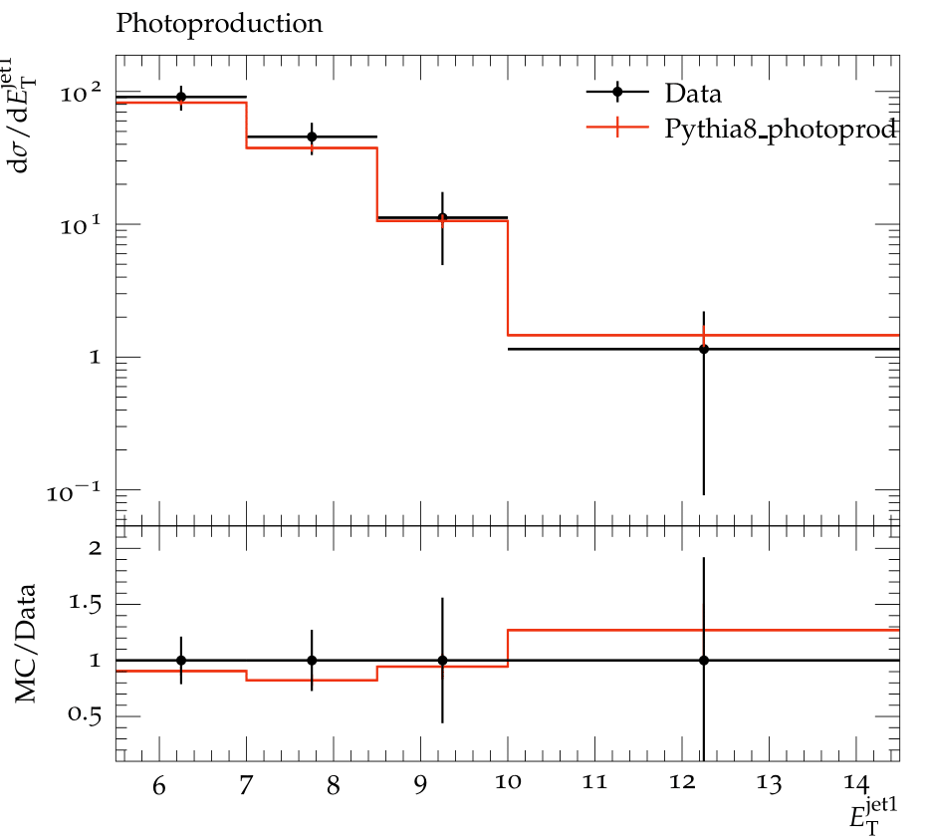
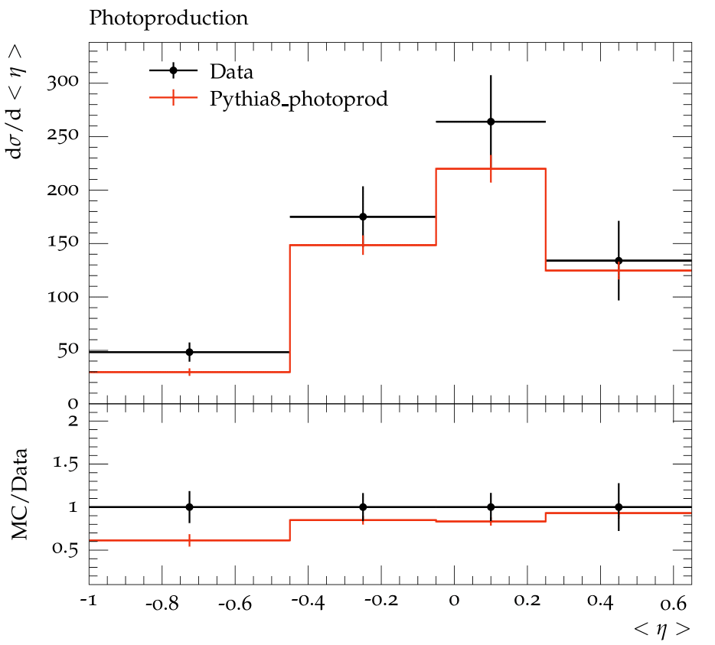
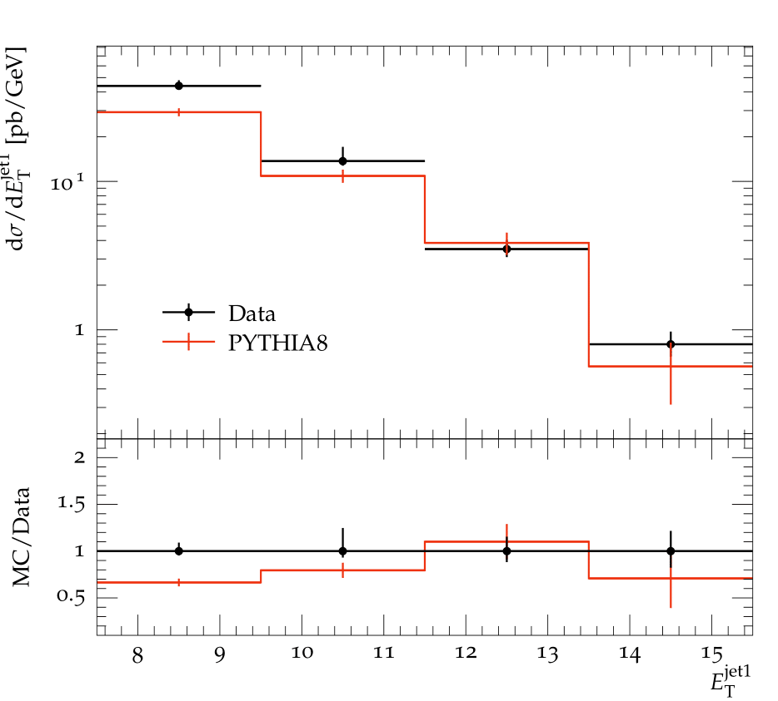
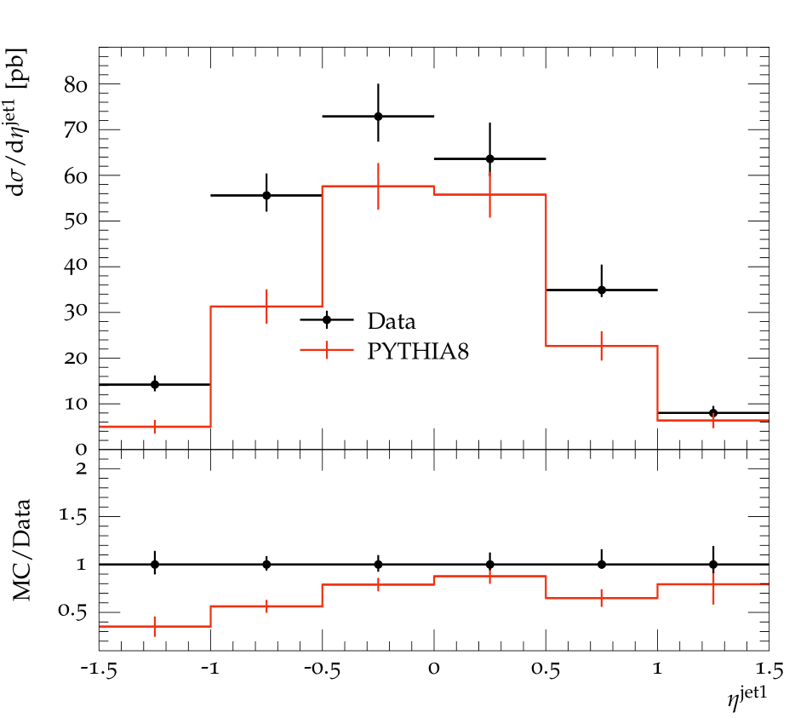
Photoproduction and Diffractive Dijet Production in H1 and Zeus

