Slide 1
EIC Project Overview
Jim Yeck, EIC Project Director
Discussion with NSF
September 29, 2021

Slide 2
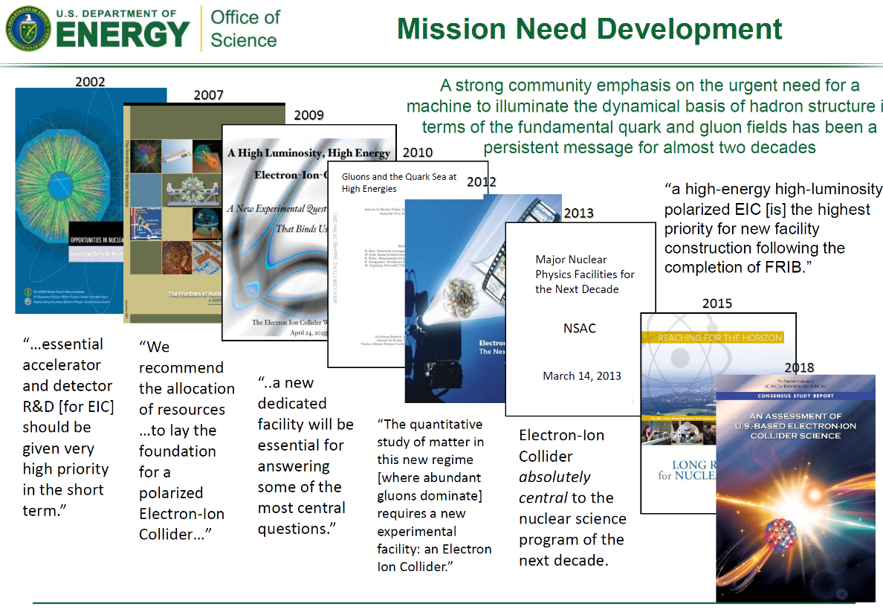
Bringing the Electron-Ion Collider to Realization

Slide 3
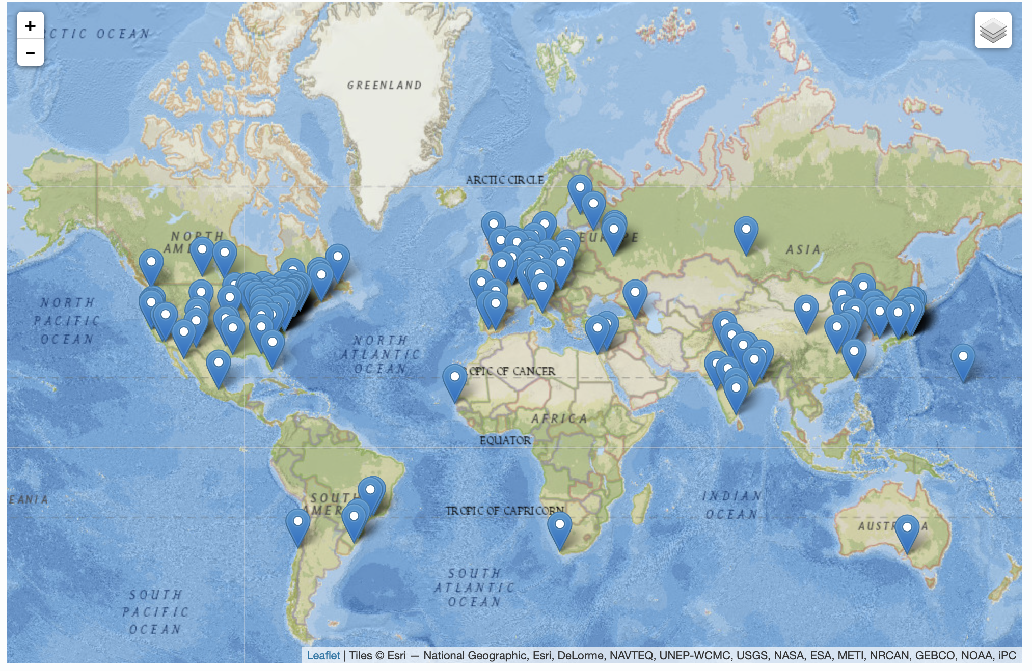
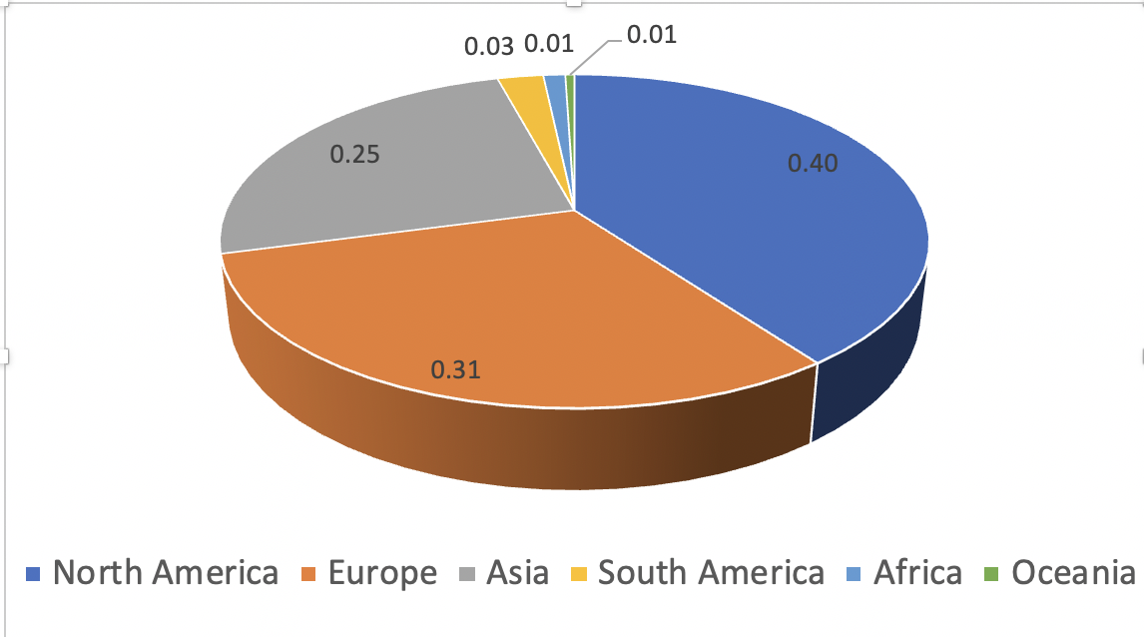
Worldwide Interest in EIC Science
The EIC User Group: EICUG.ORG, Formed 2016
May 9, 2021: 1278 collaborators, 34 countries, 257 institutions
Map of institution’s locations
The EICUG membership has continuously grown since its formation
Strong international representation

Slide 4

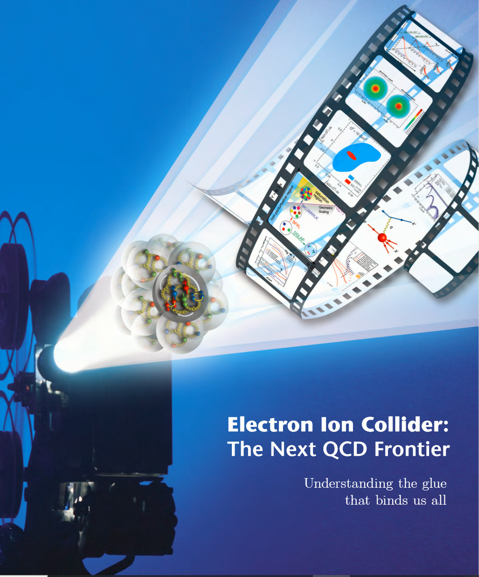
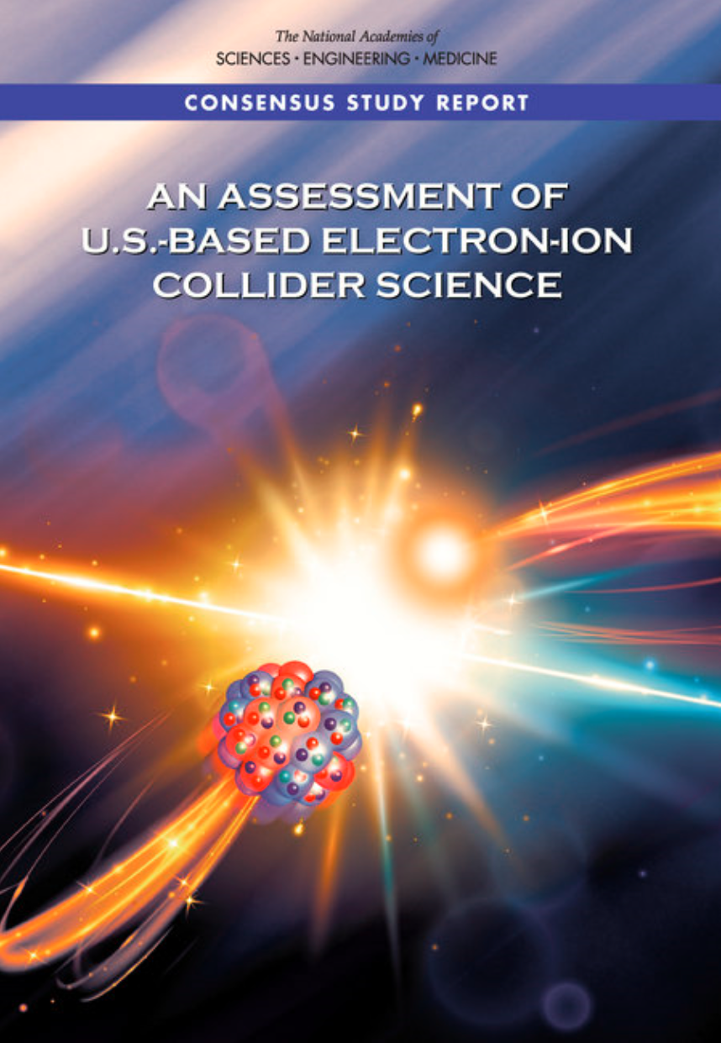
Project Requirements
Project Design Goals
High Luminosity: L= 10³³ – 10³⁴cm⁻²sec⁻¹, 10 – 100 fb⁻¹/year
Highly Polarized Beams: 70%
Large Center of Mass Energy Range: E_{cm} = 20 – 140 GeV
Large Ion Species Range: protons – Uranium
Large Detector Acceptance and Good Background Conditions
Accommodate a Second Interaction Region (IR)
Conceptual design scope and expected performance meets or exceed NSAC Long Range Plan (2015) and the EIC White Paper requirements endorsed by NAS (2018)

Slide 5
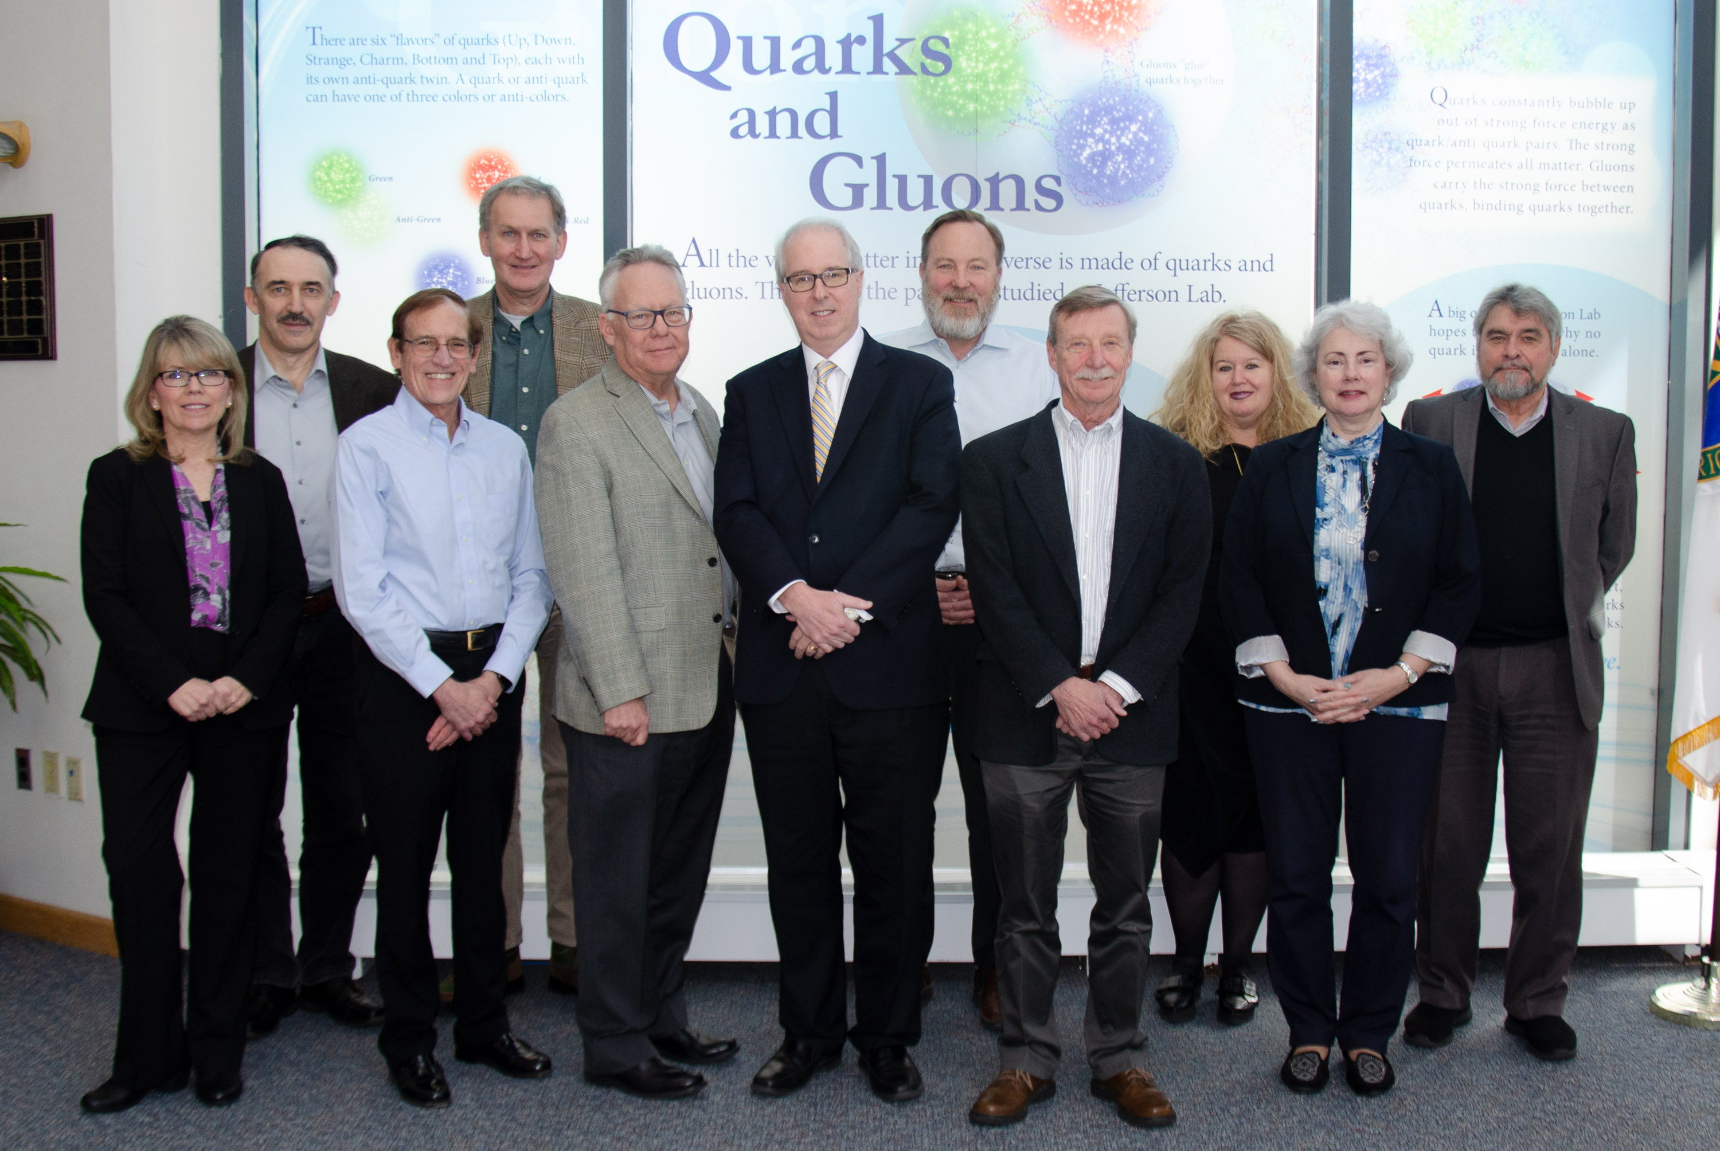
BNL & TJNAF
Partnership established between Brookhaven National Laboratory and Thomas Jefferson National Accelerator Facility

Slide 6
EIC Partnerships
International and Domestic Partners
  EIC is actively promoting a culture of interdisciplinary and multi-institutional collaboration for both the accelerator and experimental program.
  International and domestic partners are being pursued. Bi-lateral meetings with potential partners are underway to discuss opportunities in the accelerator and experimental areas.
  Accelerator Partnership Activities (Assume ~5% In-kind, pursuing 10% goal).
    In-kind contributions to the accelerator design and hardware expected
  Detector Partnership Activities (Assume ~30% In-kind)
    Expressions of Interest (EoI) submitted
    Call for Collaboration Proposals for Detector(s) - March 2021
    Collaboration Proposals Due – December 2021
    EIC Project Detector Defined – March 2022

Slide 7
EIC Partnerships
New York State
  New York State committed $100M for EIC infrastructure
  Support will be provided by the Empire State Development (ESD) Corporation whose overall objective is to promote a vigorous and growing state economy, encourage business investment and job creation, and support diverse, prosperous, local economies across New York State.
    Application submitted
    ESD Board approved
    Preparing final agreement (BNL, DOE, NYS)

Slide 8
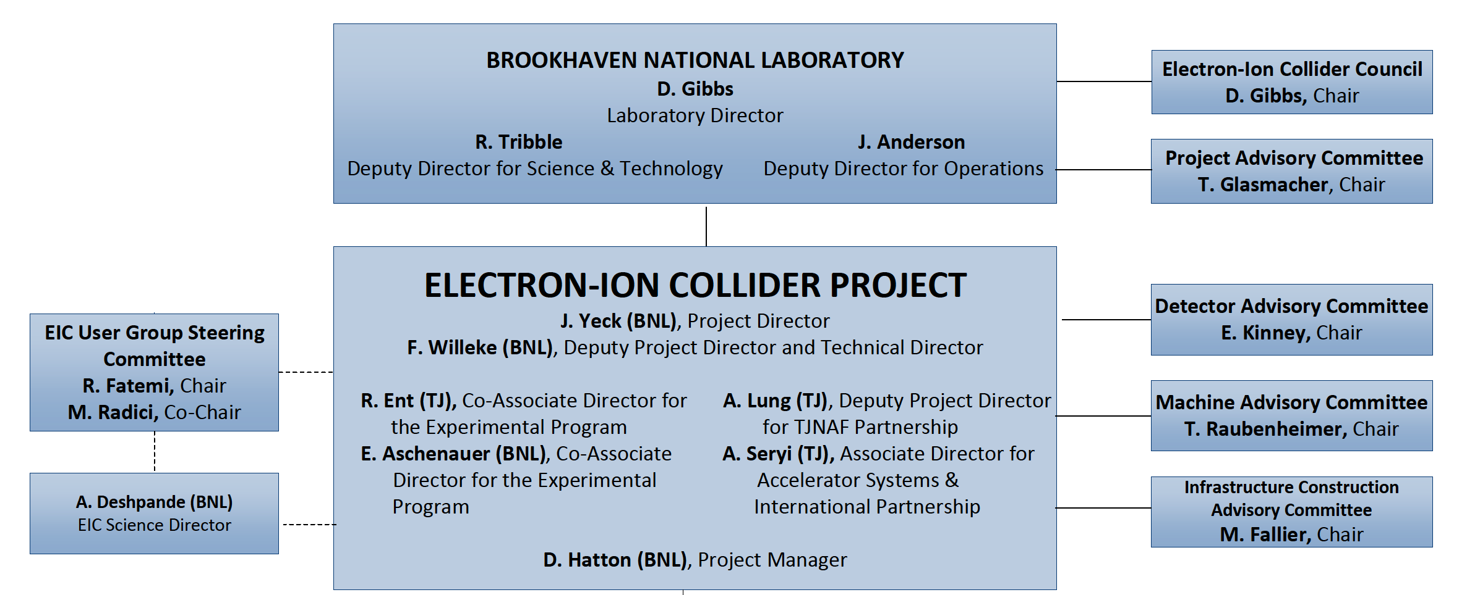
EIC Project Organization

Slide 9
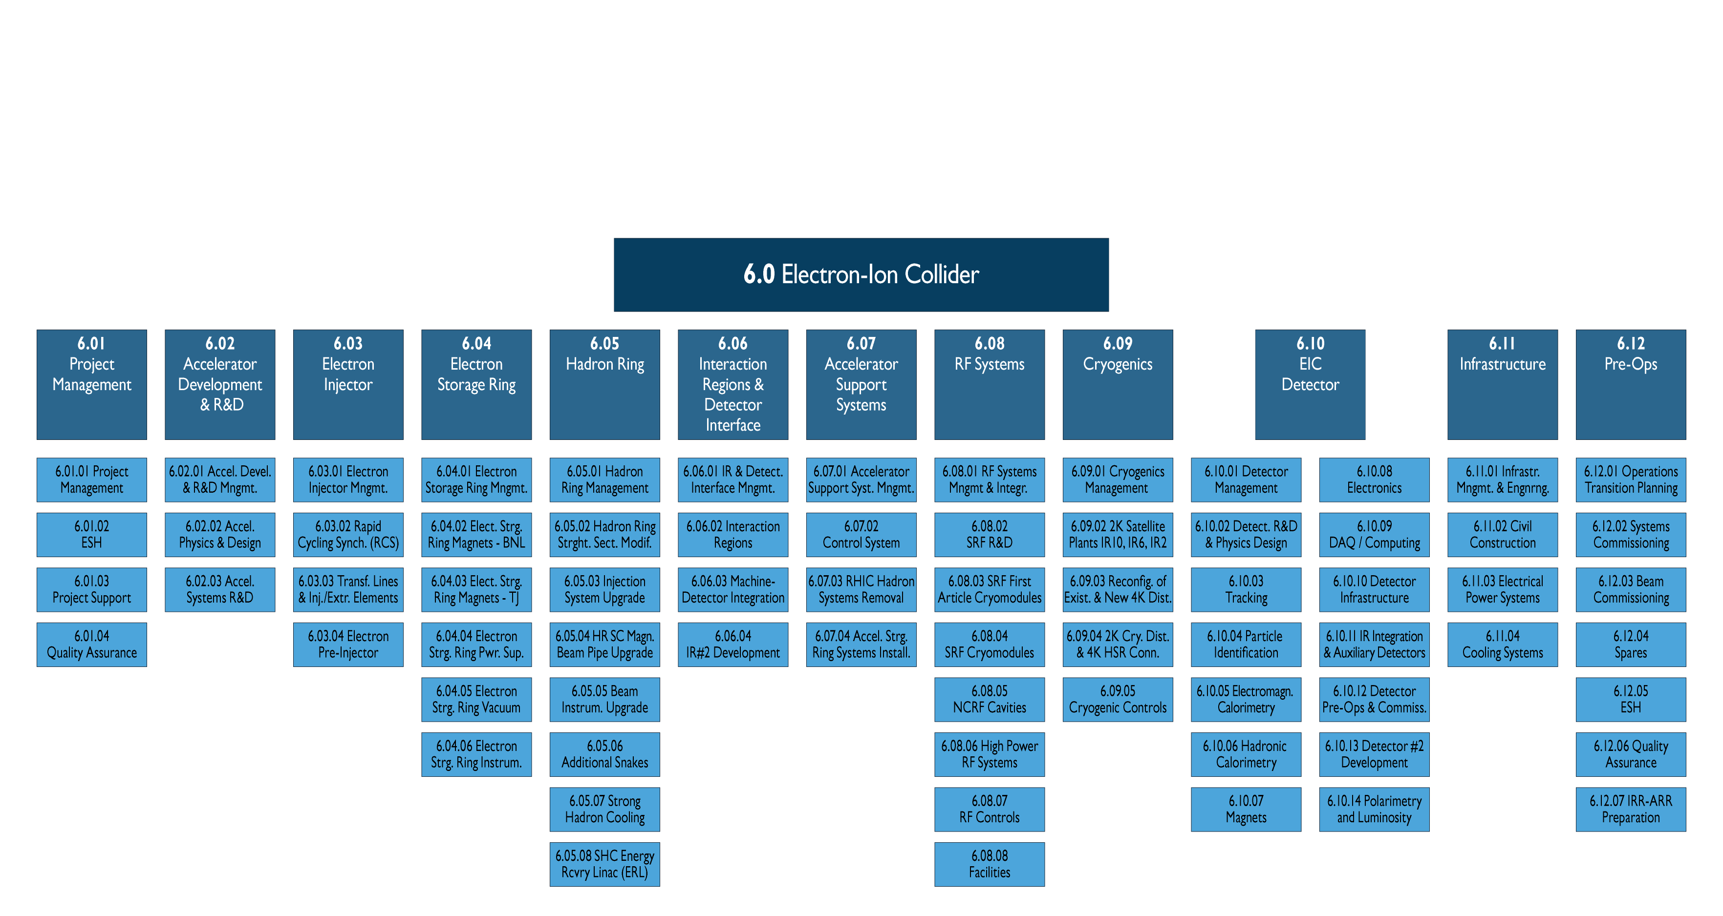
EIC Scope

Slide 10
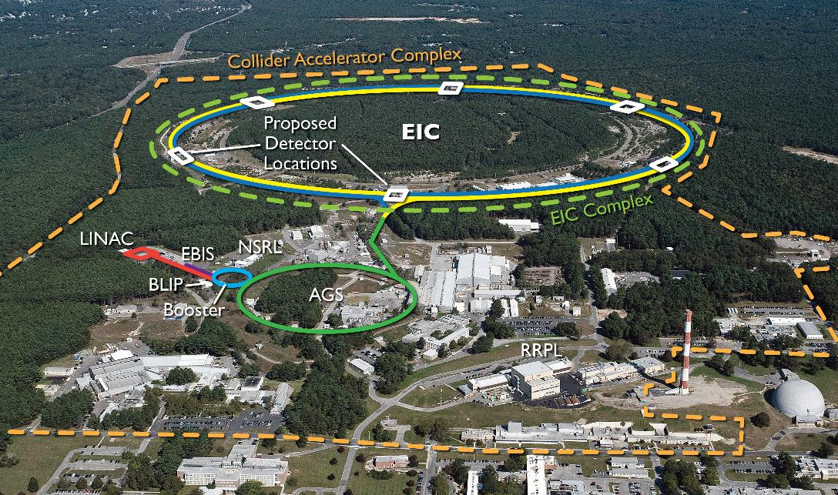

Slide 11
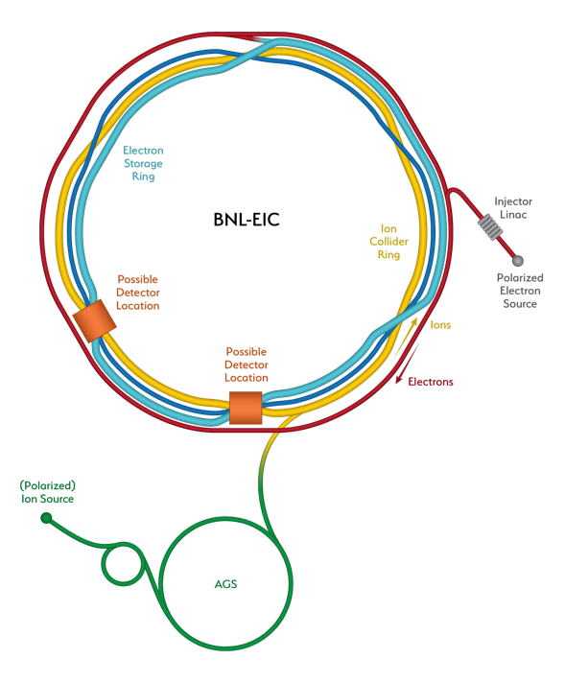
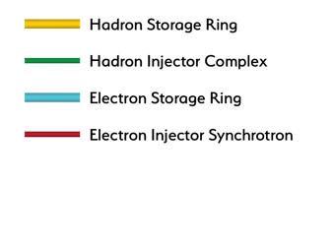
Relativistic Heavy Ion Collider (RHIC) Transformed into an Electron-Ion Collider
Hadron Storage Ring
Electron Injector Complex with Rapid Cycling Synchrotron
Electron Storage Ring
Strong hadron cooling completes the facility

Slide 12
CD-1 Total Project Cost
WBS | Description | WBS Manager | Total M$ | DOE M$
6 | Electron-Ion Collider | J. Yeck | $ 1,751 | $ 1,509
6.01 | Project Management | D. Hatton | $ 97 | $ 97
6.02 | Accelerator Dev & R&D | M. Blaskiewicz | $ 66 | $ 66
6.03 | Electron Injector | V. Ranjbar | $ 186 | $ 161
6.04 | Electron Storage Ring | C. Montag | $ 293 | $ 268
6.05 | Hadron Ring | V. Ptitsyn | $ 187 | $ 187
6.06 | Interaction Regions & Detector Interface | G. McIntyre | $ 183 | $ 183
6.07 | Accelerator Support Systems | J. Tuozzolo | $ 216 | $ 216
6.08 | Infrastructure | C. Folz | $ 203 | $ 103
6.09 | Pre-Operations | W. Fischer | $ 75 | $ 75
6.10 | EIC Detector | R. Ent | $ 245 | $ 152
  $100M contribution from New York State
  $ ~93M anticipated detector in-kind
  $ ~49M anticipated accelerator in-kind

Slide 13
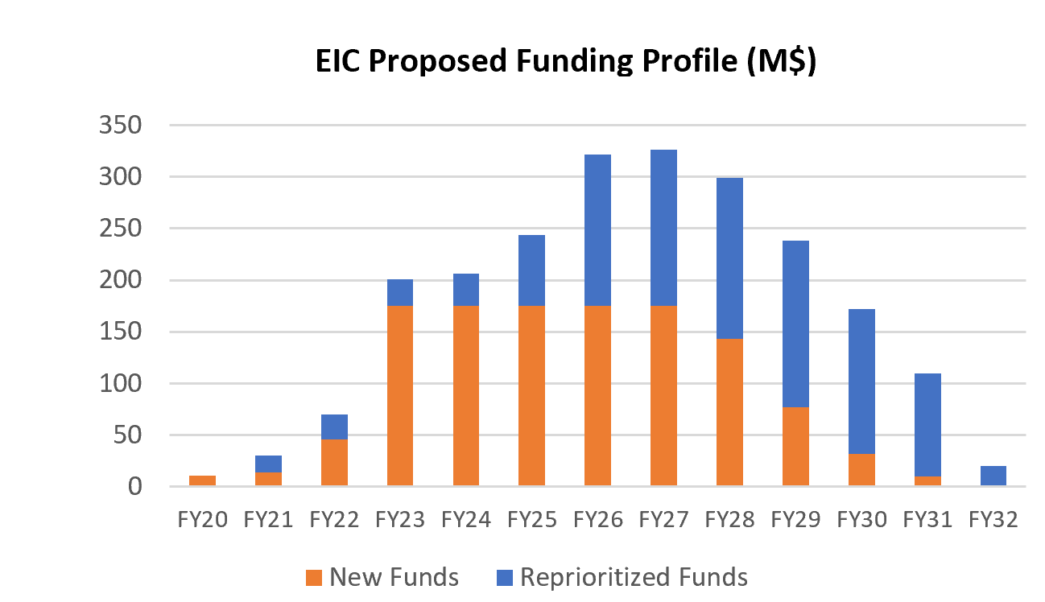
DOE Funding Profile

Slide 14
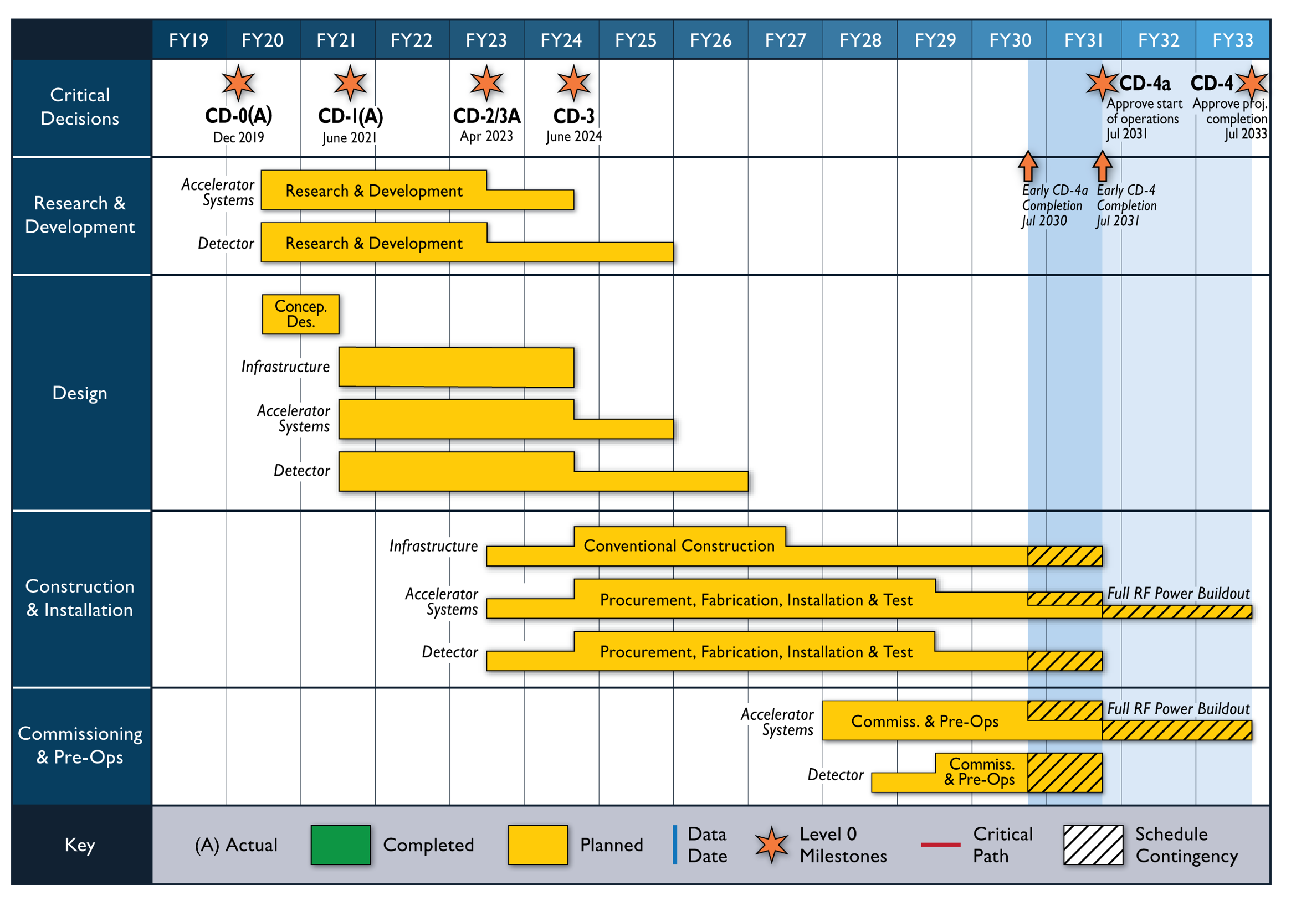
Reference Schedule

Slide 15
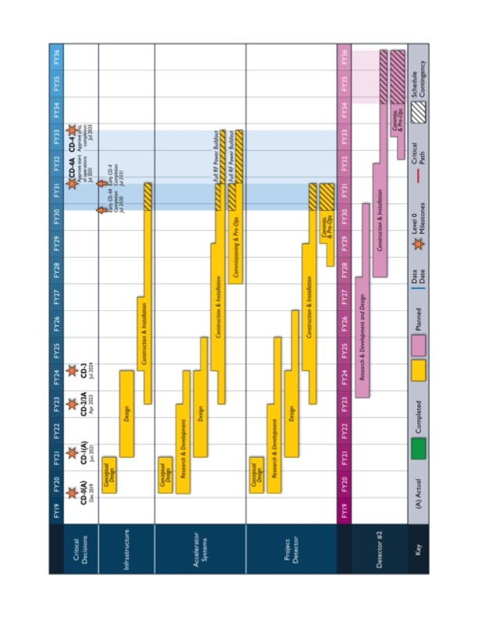
Reference Schedule
Notional
Generic Detector R&D
Schedule

Slide 16
CD-2/3A Approval Timeline – January → April 2023
Assumptions
Funding ($70 million in FY2022,…)
Resources (people, purchases, contracts)
Schedule
DOE Mini Review (confirm CD-2/3A goal) October 19-21, 2021
DOE Status Review (confirm plans for OPA/ICR reviews) April TBD 2022
First Draft Baseline/Start EVMS (practice w/ August data) September 2022
Preliminary Design Complete November 2022
Final Design/Maturity Readiness for CD-3A Items November 2022
Freeze Data for CD-2 Reviews November 2022
Preliminary Design Review November 2022
Director’s Review Early December 2022
Director’s Review Feedback/Corrections December2022
DOE OPA Review and ICR Late January 2023

