Slide 1
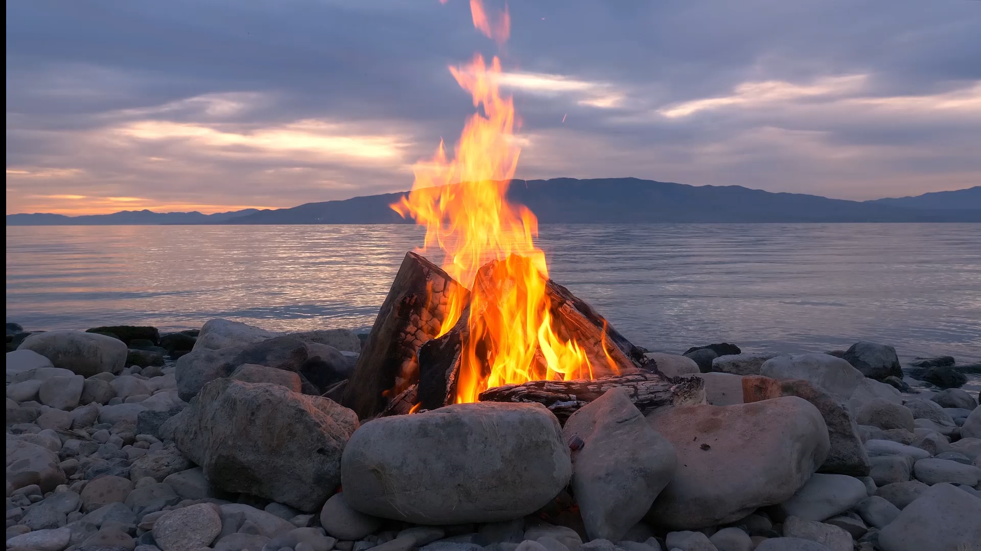

Next steps
Implementation of detector components
Separate file (either C++ or GDML) for each component
→ Individual region
ATHENA, ECCE or a conceptual design detector
→ Calorimeter is in particular demanded for fast simulation studies
Associated sensitive detector is preferred but not mandatory
Test-beam setup
→ To be implemented as a component (either C++ or GDML)
After-burner
→ Also an option to turn off pre-assigned decay procedure
Physics list options
→ Neutron HP, optical photon processes, cut-per-regions

Slide 2
Next steps
Implementation of detector components
Separate file (either C++ or GDML) for each component
→ Individual region
ATHENA, ECCE or a conceptual design detector
→ Calorimeter is in particular demanded for fast simulation studies
Associated sensitive detector is preferred but not mandatory
Test-beam setup
→ To be implemented as a component (either C++ or GDML)
After-burner
→ Also an option to turn off pre-assigned decay procedure
Physics list options
→ Neutron HP, optical photon processes, cut-per-regions

