Slide 1
Update from Tracking WG:
Converging on tracker baseline 2.0
F. Bossu, D. Elia, L. Gonella, M. Posik
with input from Ernst, Nick, Rey, Shujie
ATHENA bi-weekly meeting
30 September 2020

Slide 2
Introduction
Aspects that have been considered to converge on the detector concept for the ATHENA proposal (baseline 2.0) are
  Physics
  Integration
  Cost
Plus… all the knowledge and technology developments from many years of eRD6 and eRD16/18/25
Thomas Ullrich, https://indico.bnl.gov/event/13175/contributions/54419/

Slide 3
Barrel layout
Si pixel pitch 10 um for vtx and barrel layers
Si Vertex | Radius (mm) | Length (cm) | % X/X0
Layer 1 | 33 | 28 | 0.05
Layer 2 | 44.1 | 28 | 0.05
Layer 3 | 55.1 | 28 | 0.05
Three vtx layers for redundancy and low pT-threshold
Radii from 1st engineering CAD model release based on possible stitched sensor size in phi
Length = 28 cm: max length of a single sensor on wafer, allows for services on one side only; helps low material in negative direction
Barrel MPGD Tracker (MM) | Radius (cm) | Length (cm) | Area (m^2) | Resolution (um) | % X/X0
Layer 1 | 47.72 | 127.47 | 3.82 | 150 | 0.4
Layer 2 | 49.57 | 127.47 | 3.97
Layer 3 | 75.61 | 201.98 | 9.59
Layer 4 | 77.47 | 201.98 | 9.83
Thomas Ullrich, https://indico.bnl.gov/event/13175/contributions/54419/
Si Barrel | Radius (cm) | Length (cm) | % X/X0
Layer 1 | 13.38 | 35.74 | 0.55
Layer 2 | 18 | 48.08 | 0.55
0.55% X/X0 might be conservative; Rey showed significant performance improvement for lower material in these layers; material optimisations to be looked into considering RD104 services reduction, inputs from engineers, etc. not necessarily for the proposal
Cheaper than silicon, no detrimental effect on performance
Further optimisation of number of layers requires pattern recognition in presence of background, not for the proposal

Slide 4
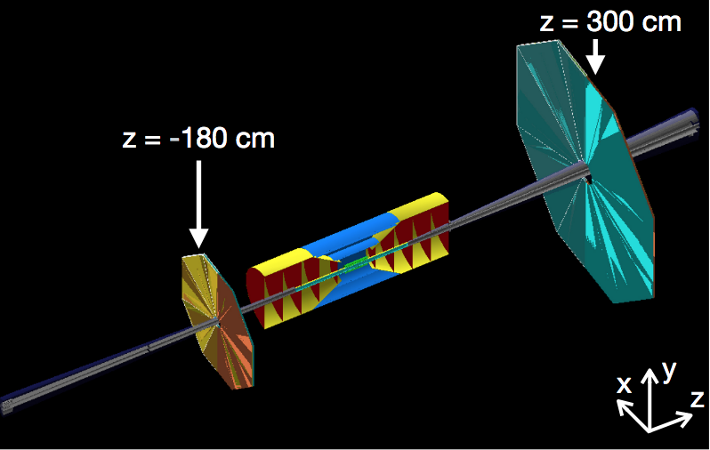
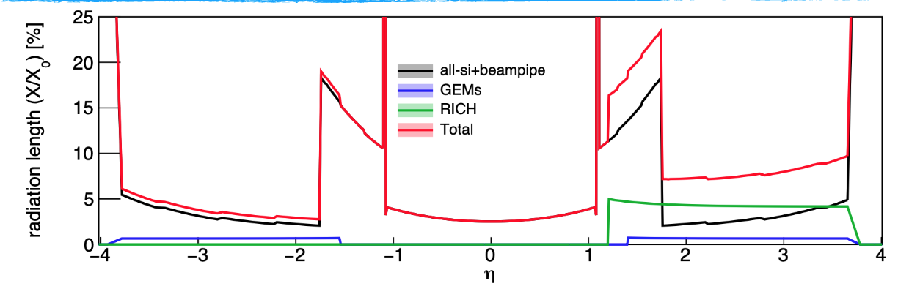
Forward/backward regions: a bit of history
Critical to reduce material in front of EMCal, especially in the backward direction
The concern with all-silicon was the material 1 < |eta| < 2
  Otherwise, good for performance, cost and integration
GEM

Slide 5
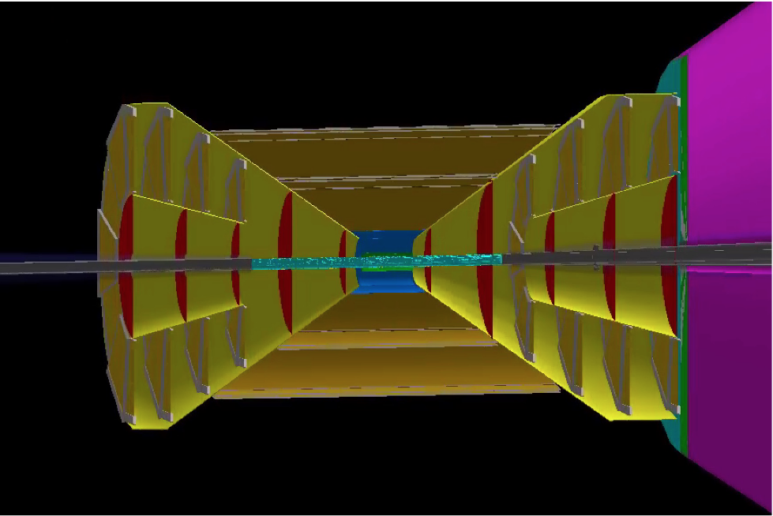
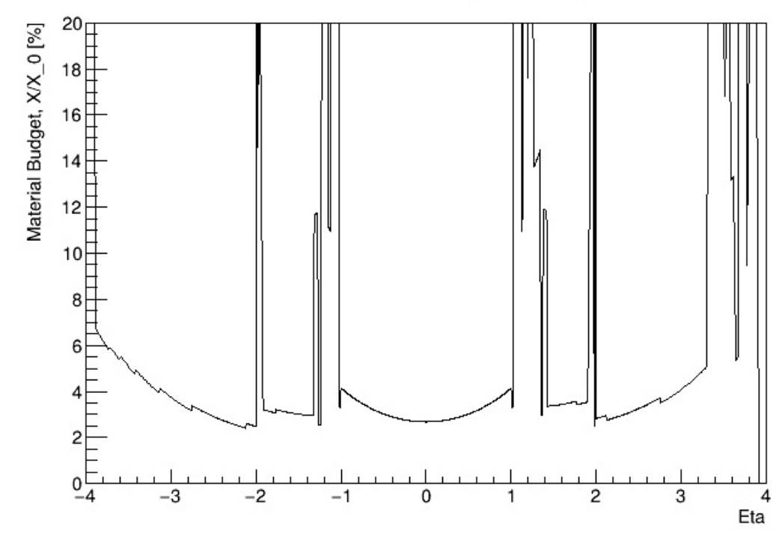
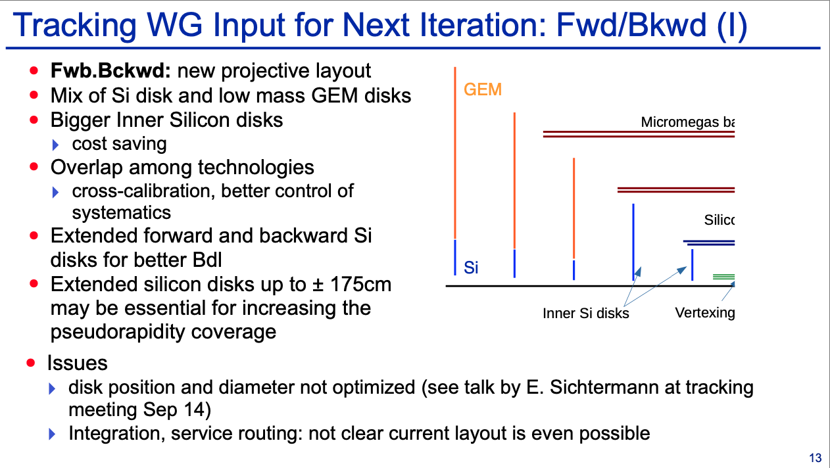
Forward/backward regions: a bit of history
A projective configuration was introduced to reduce material over broad eta range
  An all-Si projective tracker would do an excellent job meeting the physics requirements, but may get too expensive (~1+ meter disks at large |z|)
  An all MPGD projective tracker will not meet the physics requirements
  A hybrid Si-MPGD is best compromise though it will still have some services and support material in front of ECAL but it has to be as projective as possible for the two technologies to concentrate the high material thickness in clearly identified regions in phi rather than spread all across large eta range.
Thomas Ullrich, https://indico.bnl.gov/event/13175/contributions/54419/

Slide 6
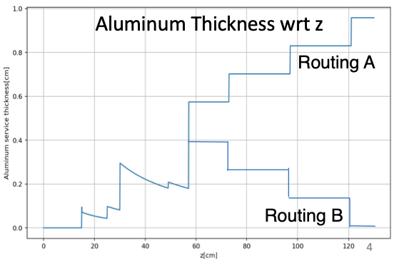
Forward/backward regions: last week developments/findings
Projective configuration
  Meeting with engineers on 23 September; integration and service routing far from trivial, it would require significant engineering work to establish integration feasibility, not possible on the timescale of the proposal; the cost for integration could also become significant; different support materials could be needed for different structures
All-silicon configuration
  See Ernst’s talk at Tracking WG meeting 28 September https://indico.bnl.gov/event/12601/
  Bottomline: material in the all-silicon for 1 < |eta| < 2 can be reduced by choosing a different routing configuration for the services (use routing B instead of A)
    Also remember that RD104 addresses further services reduction so that will help further

Slide 7
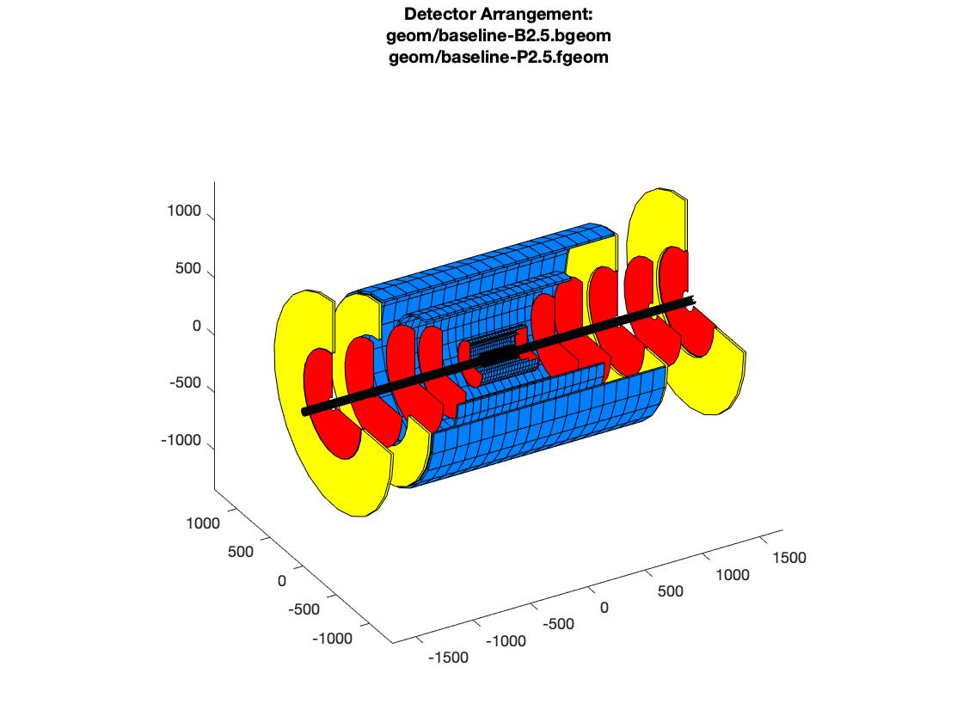
Forward/backward regions: new configuration
Backward region
  Five silicon disks, 10 um pixel pitch
  Disks 1 to 3 in the same position as all-silicon
  Disk 5 at -145 cm* (was -121cm in all-silicon)
    Better Bdl
    Increased the pseudorapidity coverage
  Disk 4 equidistant from 3 and 5
  2x GEM rings to increase number of points in 1.1 < |eta| < 1.7
    Z position chose to cap / close up the MPGD barrel and the overall tracking volume
    No overlap needed between Si and GEM
Si Disks | Z Position (cm) | Inner Radius (cm) | Outer Radius (cm) | % X/X0
Rear Disk 5 | -145 |  | 43.23 | 0.24
Rear Disk 4 | -109 |  | 43.23 | 0.24
Rear Disk 3 | -73 | 3.5 | 43.23 | 0.24
Rear Disk 2 | -49 | 3.18 | 36.26 | 0.24
Rear Disk 1 | -25 | 3.18 | 18.5 | 0.24
* -150 cm should be possible, checking position of mRICH
** Resolution can be improved for this small size GEMs
GEM Rings | Z Position (cm) | Inner Radius (cm) | Outer Radius (cm) | % X/X0 | Resolution [um]**
Rear Disk 1 | -102 | 43.5 | 75.5 | 0.4 | 250 x 50
Rear Disk 2 | -144.5 | 43.5 | 88.5 | 0.4 | 250 x 50

Slide 8
Forward/backward regions: new configuration
Forward region
  Six silicon disks, 10 um pixel pitch
  Disks 1 to 3 in the same position as all-silicon
  Disk 6 at +165* cm (was +121cm in all-silicon)
    Better Bdl
    Increased the pseudorapidity coverage
  Disks 3 to 6 equidistant
  2x GEM rings to increase number of points in 1.1 < |eta| < 1.7
    Z position chose to cap / close up the MPGD barrel and the overall tracking volume
    No overlap needed between Si and GEM
Si Disks | Z Position (cm) | Inner Radius (cm) | Outer Radius (cm) | % X/X0
Fwd Disk 6 | 165 |  | 43.23 | 0.24
Fwd Disk 5 |  |  | 43.23 | 0.24
Fwd Disk 4 |  |  | 43.23 | 0.24
Fwd Disk 3 | 73 | 3.5 | 43.23 | 0.24
Fwd Disk 2 | 49 | 3.18 | 36.26 | 0.24
Fwd Disk 1 | 25 | 3.18 | 18.5 | 0.24
* +170 cm should be possible, checking position of dRICH
** Resolution can be improved for this small size GEMs
GEM Rings | Z Position (cm)*** | Inner Radius (cm) | Outer Radius (cm) | % X/X0 | Resolution [um]**
Fwd Disk 1 | +102 | 43.5 | 75.5 | 0.4 | 250 x 50
Fwd Disk 2 | +164.5 | 43.5 | 88.5 | 0.4 | 250 x 50

Slide 9
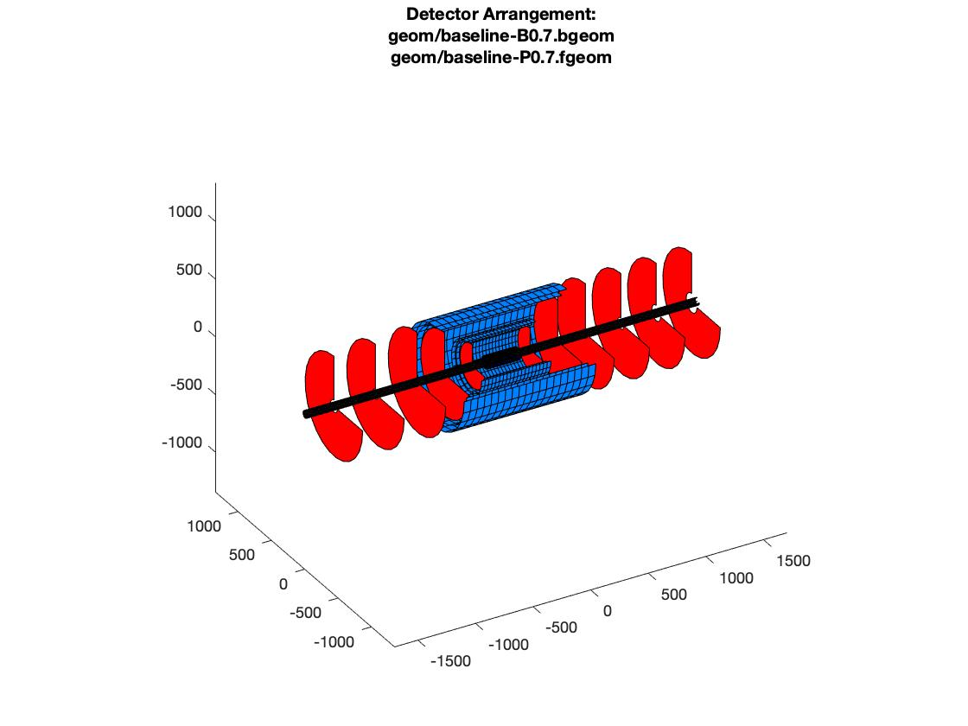
Baseline Tracking Configurations for ATHENA
E. Sichtermann
Hybrid Tracker Concept has been updated for
  overall length, now -1.45m < z < 1.65m,
  vertexing barrel, still 3 layers but now 280mm length,
  cylindrical inner silicon subsystem(s),
  2x4 GEM disks to complement tracking at large radii,
  2+2 MM in the barrel
All Silicon Tracker Concept has been updated for
  overall length, now -1.45m < z < 1.65m, 1 addtl. disk at large z,
  vertexing barrel, now 3 layers and 280mm length,
1

Slide 10
Baseline Tracking Configurations for ATHENA
E. Sichtermann
Vertexing layers and inner disks are identical; single-track DCA performance is near-identical:
filled symbols – hybrid
open symbols – all-silicon
Note, these fast-simulations are obviously very, very preliminary.
2

Slide 11
Baseline Tracking Configurations for ATHENA
E. Sichtermann
Tracking layers and disks are, obviously, somewhat different; performance is comparable.
filled symbols – hybrid
open symbols – all-silicon
Note, these fast-simulations are obviously very, very preliminary.
3

Slide 12
Baseline Tracking Configurations for ATHENA
E. Sichtermann
6 disks in the hadron direction appears favorable (all-silicon results only):
filled symbols – 5-disks
open symbols – 6-disks
Note, these fast-simulations are obviously very, very preliminary.
4

Slide 13
Conclusion – Action items
We believe the current design works for physics, integration and cost (and keeps everybody happy)
What is missing before giving the configuration to the SW WG
  Benchmark plots in Fun4All
    Consider also large GEM behind mRICH and behind dRICH
  (Hopefully brief) Check with engineers about integration of the two GEMs rings
  Define support and services thickness along cone and cylinders with optimised routing
  Test with the shifted magnetic field
We expect we can be ready by mid of next week, that should be in time for when the SW WG plans to work on the next configuration

Slide 14
Outcome of the yesterday’s Integration meeting
Barrel and forward region – OK
For backward region – to check
  Adding GEM rings adds material in the negative direction
  How much larger would a silicon disk need to be to give the extra tracking points in 1.1 < |eta| < 1.7? And what material would this larger disk have?
  If we keep the GEM rings, would the material to support the silicon disks in front of the GEM be tolerable?
  If we do not converge within one week, no GEM disks in the backward region (for the proposal)

