Slide 1
Source test for
Silicon sensor checking
NWU
Yumika namimoto

Slide 2
About source test
At September 16th, Yumika presented “Performance evaluation for sPHENIX-INTT detector with a radiation source” in JPS annual meeting.
In the presentation, we propose Dead channel rate calculation and sufficient measurement time.

Slide 3
Dead channel rate calculation①
Do source measurement and non-source(=noise) measurement.
Normalizing source and non-source measurement result in time and make statistic subtraction.
Count up the number of channel which net hits 0 or less(=dead channel) and calculate its rate in all 128 channels.

Slide 4
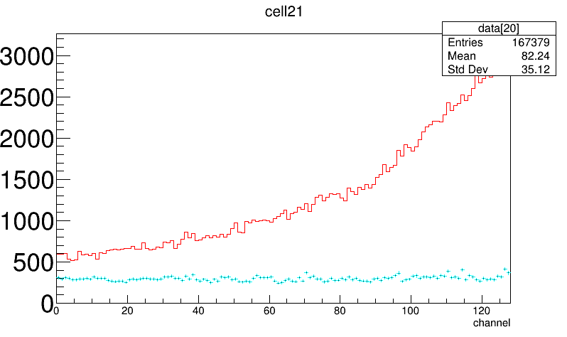
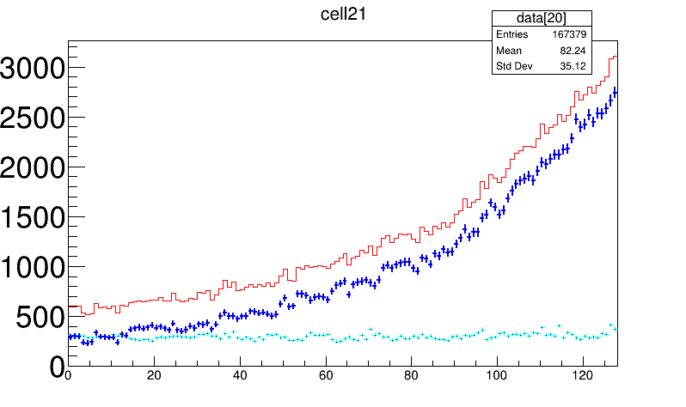
Dead channel rate calculation②
Red = source measurement (measurement time 1157min, about 20h)
light blue = noise measurement (measurement time 1184min, about 20h)
Normalized these results in time and did statistics subtraction.
Blue = statistic subtraction result, net hits.
Statistic subtraction

Slide 5
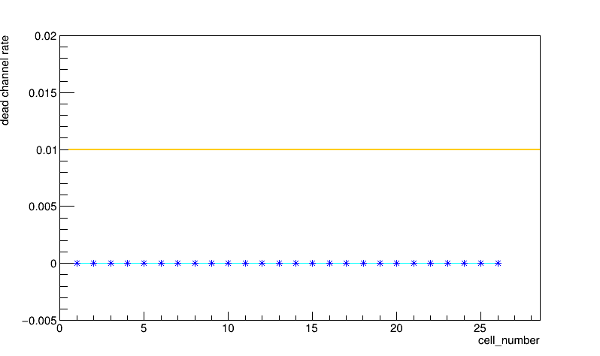
Dead channel rate calculation③
Do statistics subtract for all 26 chips and calculate dead channel rate.
X axis is chip number, Y axis is dead channel rate.
Yellow line denote 1%.
About 20h measurement shows dead channel rate 0% in all chips.

Slide 6
Sufficient measurement time①
20 hours are too long to evaluate half ladder.
Compare dead channel rate accuracy in 20h and 4h.
Using 90Sr for source test and radioactivity is 3.7kBq.

Slide 7
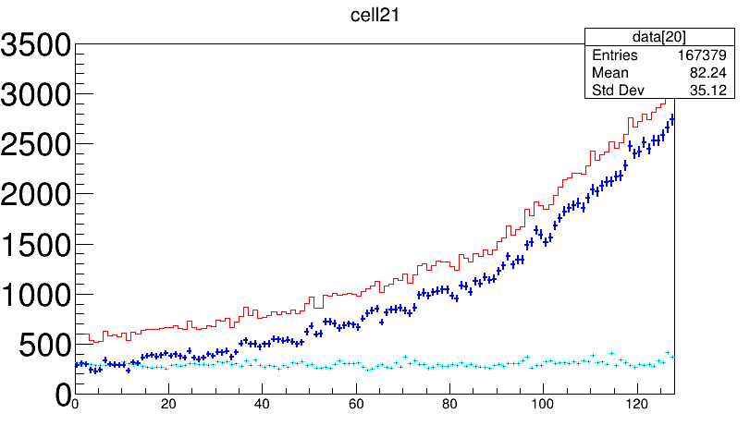
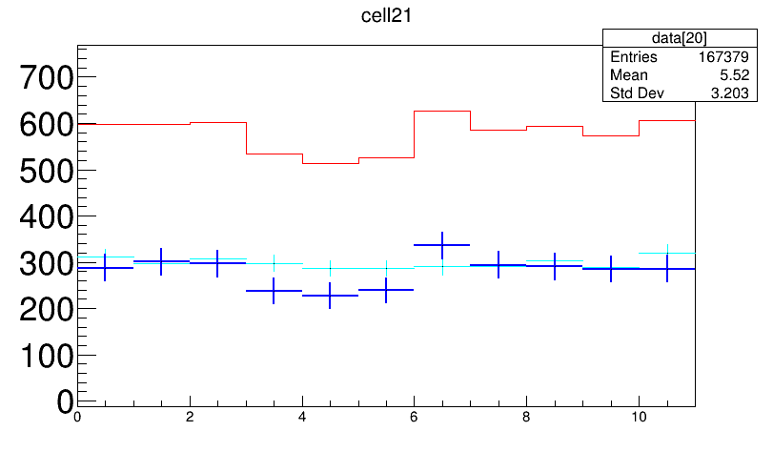
Sufficient measurement time②
20h
514 is minimum source hits at channel 4 and noise hits are 287.
Source hits and noise hits are separated more than 8σ.
514
287

Slide 8
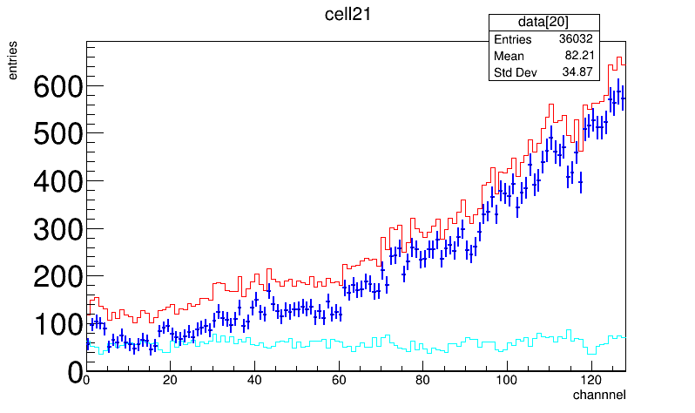
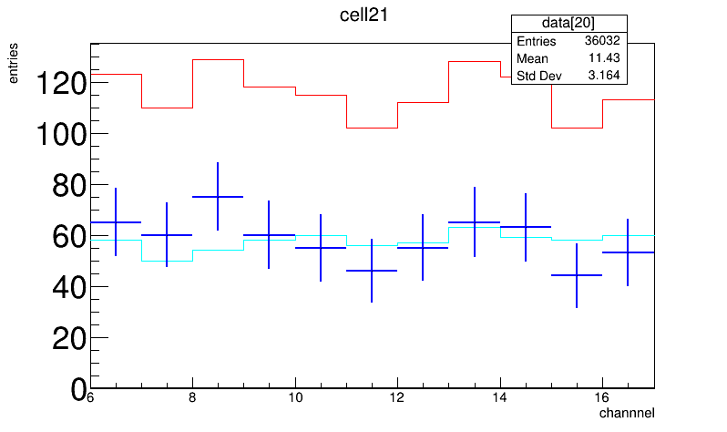
Sufficient measurement time③
4h
102 is minimum source hits at channel 11 and noise hits are 56.
Source hits and noise hits are separated more than 3σ.
To evaluate half ladder, 4h is sufficient time.
102
56

Slide 9
Sufficient measurement time③
4h
If measurement time are 4h, dead channel rate is 0% in all chips.
Yellow line denote 1%.

