Slide 1
Effects of ion-electron focusing on cooling performance, ion heating and lifetime
D. Kayran, A. Fedotov, P. Inacker, K. Mernick, S. Seletskiy, He Zhao, others
APEX workshop
November 9, 2021
BNL

Slide 2
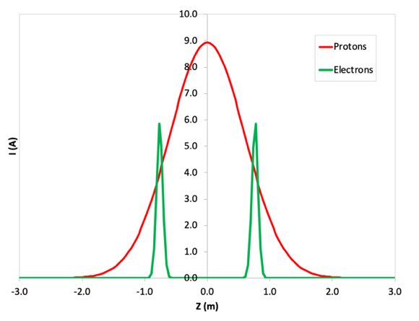
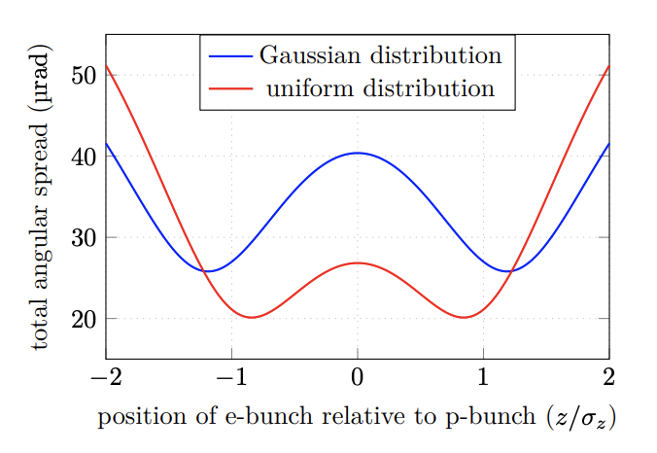
Motivation:
In high energy bunched electron coolers, the electron bunches are typically much shorter than the hadron bunches
In order to more equally redistribute cooling several electron bunches per one hadron bunch is considered
For example,
At LEReC we used 30-36 bunches between equally distributed along the 10 ns rms ion bunch
a schema of using two electron bunches located at +/- rms length of the proton bunch is proposed to pre-cool protons at energy 25 GeV for EIC
Hadron bunch intensity is higher than electron bunch intensity. Hadron space charge focusing to the electron bunch could be significant during interaction on the cooling section
Due to non uniform longitudinal distribution different parts of the ion bunch effect differently to the different electron bunches
This experiment is important to learn how to optimize the cooling of high-intensity high-energy ions (or protons) by finding the proper balance between cooling/heating/lifetime
Time structure of two electron bunches synchronized with a single proton bunch
Electron angles in the cooling section produced by beam emittance and proton space charge for cooling at 23.8 GeV for two possible electron bunch profiles. *)
*A. Fedotov., Low energy cooling for Electron Ion Collider. BNL-220686-2020-TECH EIC-HDR-TN-01 https://technotes.bnl.gov/PDF?publicationId=220686

Slide 3
Some system limitations:
LEReC pulse selection system cannot produce the MB or gap length shorter than 9b (<12.6 ns)
If shorter (5b) MB is desirable It requires significant development time (may be after RHIC run at this energy)
We could compare 36b vs 20b with the about the same bunch charge 30pC*36*56%=35pC*20*88%
Or 10b-10g-10b (49% efficiency) vs 10b (~100% efficiency)
In order to run 10b in the center we can shift 10-10-10 configuration by 10b then the second MB of 10b will not interact with RHIC bunches
Could be done through LLRF laser-timing pet page.
Proposed for the APEX
36 bunches, interaction efficiency ~56%
20 bunches, interaction efficiency ~88%
10b-10g-10b, interaction efficiency ~49%
10b-10g-10b (shifted by10), interaction efficiency ~50%

Slide 4
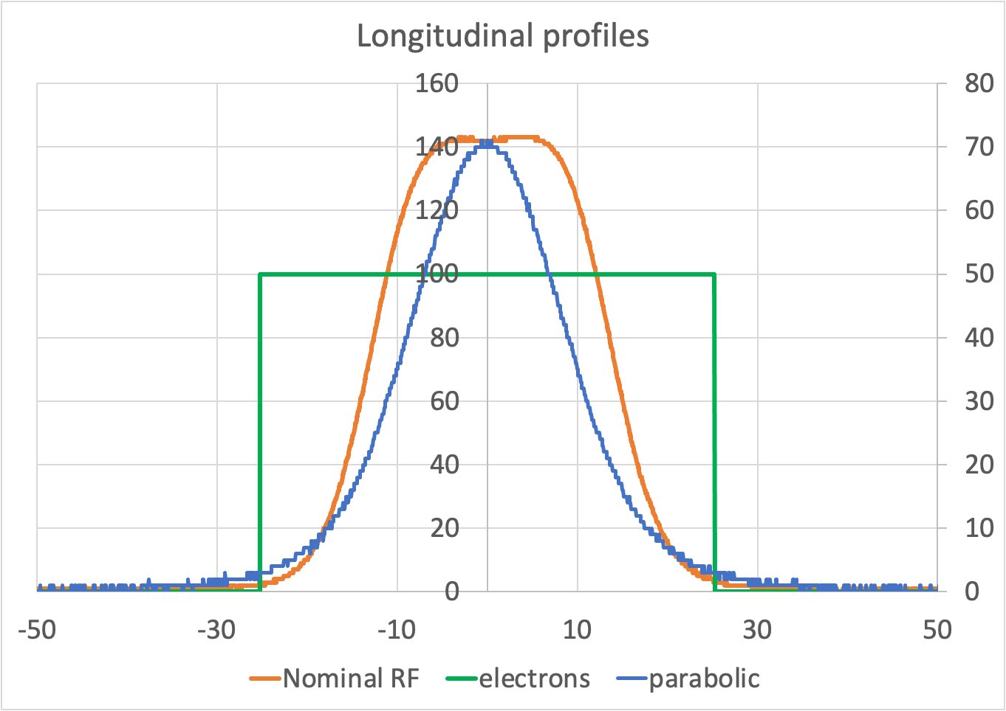
APEX on June 24, 2021
Before APEX time prepare necessary laser pulse structure
RHIC was setup to use only 9MHz due to limited time we used only parabolic RHIC longitudinal profile
In pulsed mode check MB energy distribution (energy spread) of all configurations: 36b, new 20b and 10b-10g-10b.
At low intensity conduct cooling/heating/lifetime measurements for 20b, 10b-10g-10b and 10b-10g-10b shifted
Using regular parabolic ion bucket with close to nominal RHIC operation intensity, optimize CS solenoids to reduce overfocusing of e-bunches setting at the rms size of the ion.
Compare results for : centered position vs 10ns shifted position cooling efficiency
In green is shown longitudinal area of 50.4 nsec covered by LEReC nominal operation (36b per 1 MB)
We used about 2 hours 6pm-7:45pm
http://www.cadops2.bnl.gov/elogs/entryList.jsp?DATABY=day&ELOG=LEReC&DATE=06/24/2021&DIR=none#1481294

Slide 5
Experiment timeline
Bunch pattern setup,
bunch quality measurements
in pulsed mode
Back to nominal 12mA, 36b
6mA, 20b
IBS only
12mA, 20b
IBS only
12mA
10b10g10b
IBS only
12mA/2
10b centered

Slide 6
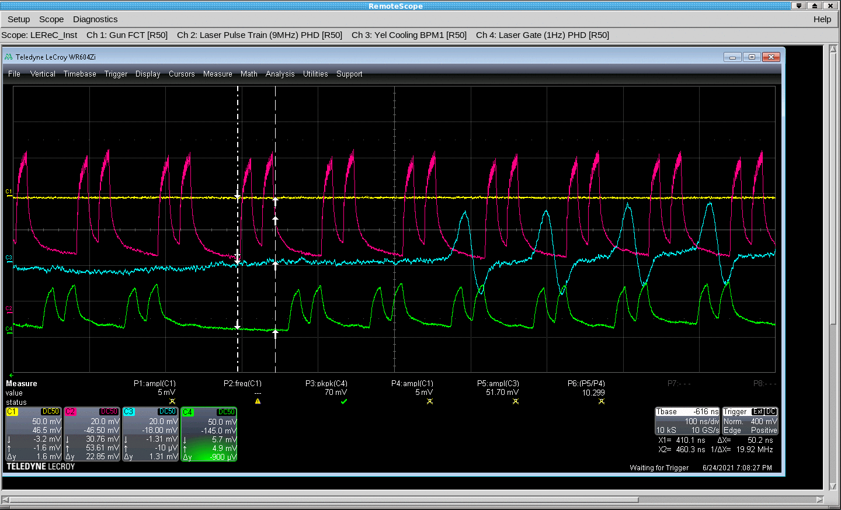
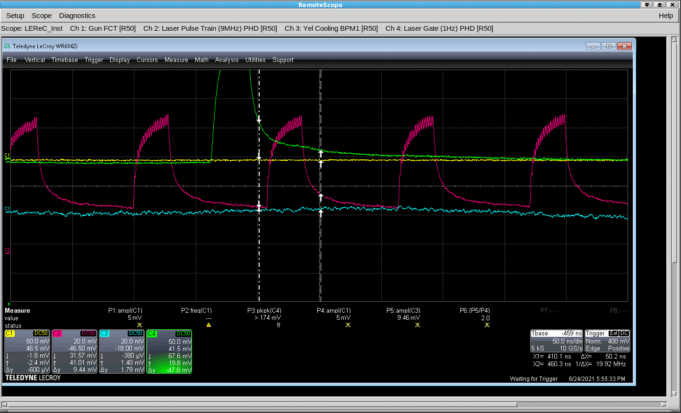
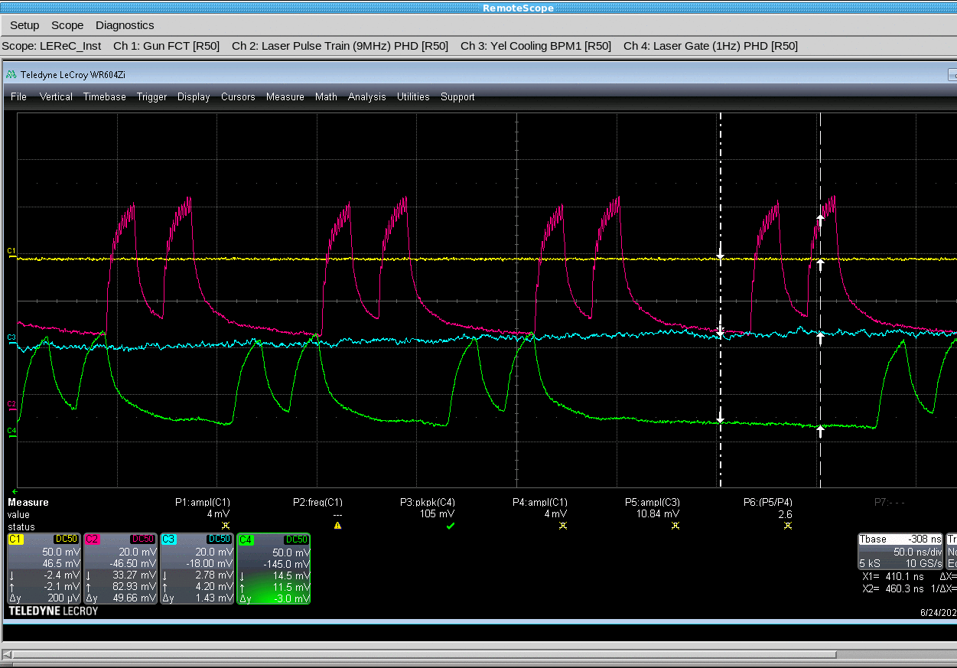
Laser/timing system setup
Magenta trace: IR laser photodiode envelope signal. It defines LEReC CW operation bunches time structure.
Green trace: Green laser photodiode signal.
Cyan trace: Yellow Cooling section BPM signal to check RHIC vs LEReC bunches longitudinal alignment
Yellow trace: GunFCT signal. It shows 0 since no LEReC beam was generated during the setup shutter was closed.
10b10g10b gap is centered
36b
10b10g10b one half of the MB is centered
20b

Slide 7
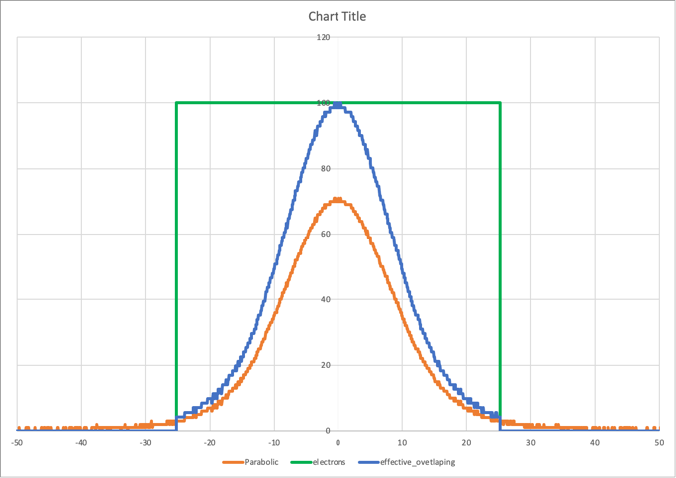
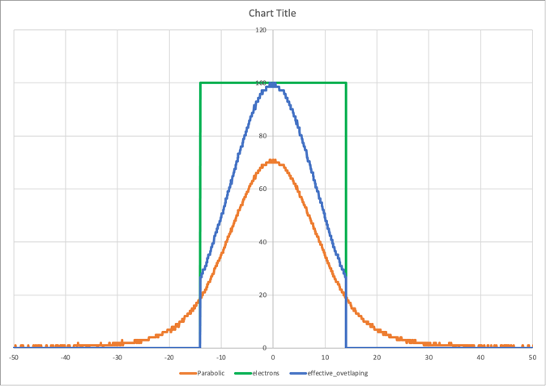
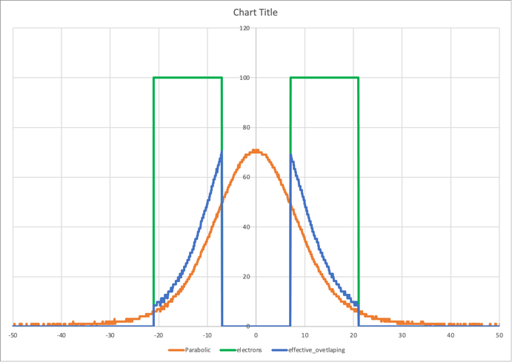
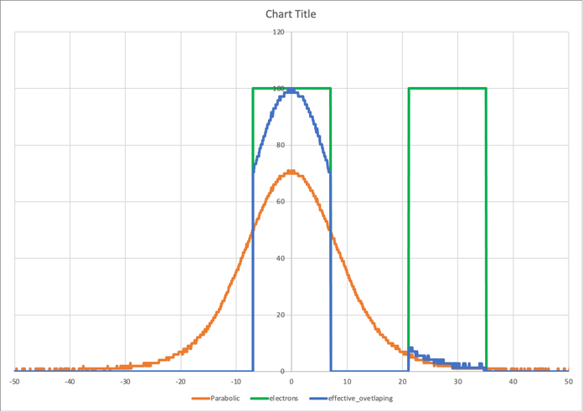
Original Propose for the APEX 9MHz +28MHz
36 bunches, interaction efficiency ~56%
20 bunches, interaction efficiency ~88%
10b-10g-10b, interaction efficiency ~49%
10b-10g-10b (shifted by10), interaction efficiency ~50%
APEX June 24, 20219 MHz only
36 bunches, interaction efficiency ~43%
20 bunches, interaction efficiency ~68%
10b-10g-10b, interaction efficiency ~31%
10b-10g-10b (shifted by10), interaction efficiency ~46%

Slide 8
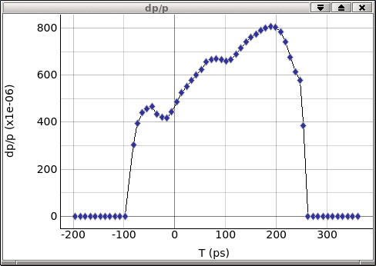
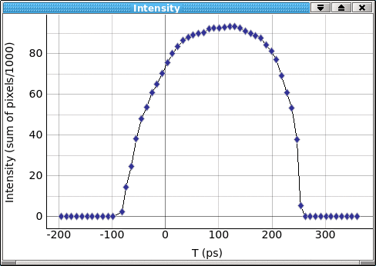
Longitudinal phase space measurements
For the same average laser power (or beam current) the individual bunch charge using 20b/MB is 1.8 times higher then during optimum operation using 36b/MB.
As a result, beam quality was not as good as at the optimized LEReC operation condition
We didn’t have time to optimize beam quality for the higher than nominal operation charge. Instead, we decided to proceed with APEX studies.
APEX settings
Nominal 36b per MB, 1.2 nC
20b per MB, 2 nC
20b per/ MB, 1.2 nC
Time
Time
Time
Time
Energy
Energy
Energy

Slide 9
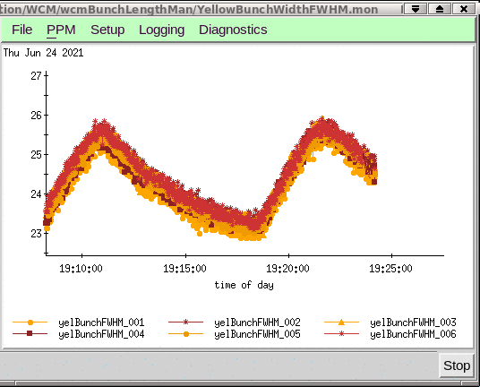
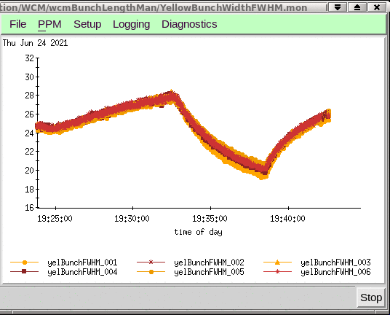
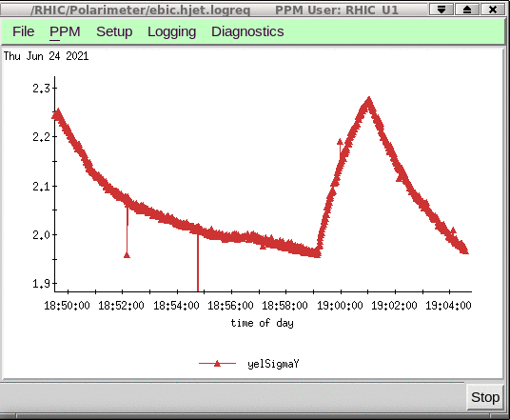
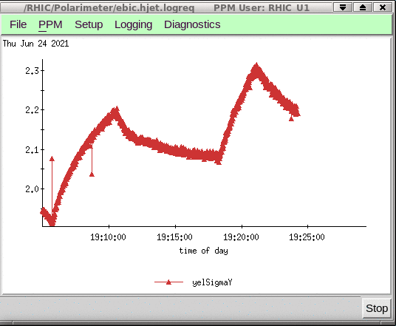
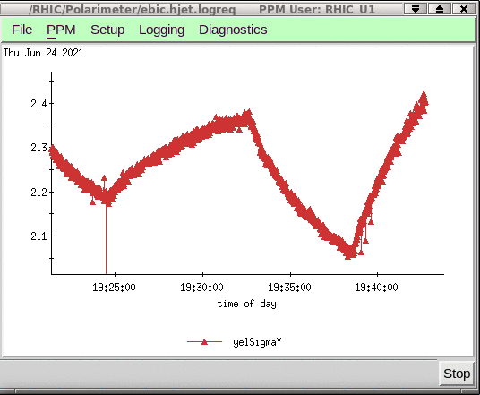
Heating, cooling comparison for different LEReC bunch time structure
We used ion bunches at low intensity and LEReC at average current of 12 mA (it corresponds to 1.3 nC per MB or 64pC per single bunch )
20b
10b10g10b gap is centered
10b10g10b 10b is centered
FWHM bunch Length
WCM
Transverse bunch size Size
H-jet
Heating
Heating
Cooling
Heating
IBS
Cooling
IBS
Weaker cooling
Cooling

Slide 10
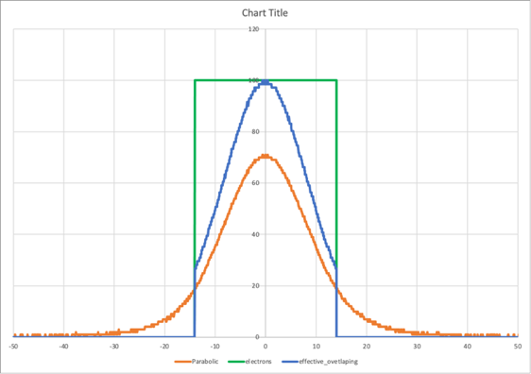
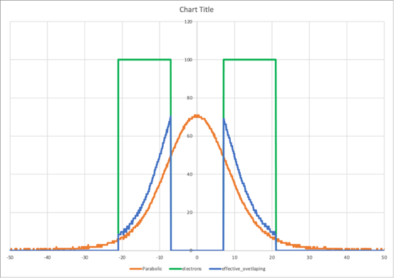
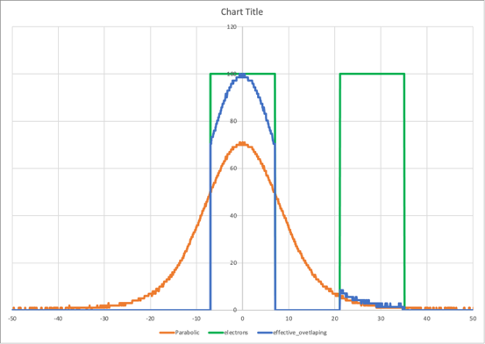
Recombination signal observations
Recombination signal 3 times stronger in case of 20b
heating
cooling
heating
cooling
cooling
heating
No LEReC
cooling
20 bunches, interaction efficiency ~68%
10b10g10b and 10b in the center give the same recombination signal
10b10g10b
Matched/mismatched energy
4keV
20b
10b10g10b
10b centered
10b-10g-10b, efficiency ~31%
10b-centerd efficiency ~46%

Slide 11
Closer look to the last two settings
10b10g10b
Half of the MB (10b) centered
10b-10g-10b, interaction efficiency ~31%
10b (centered), interaction efficiency ~46%
Heating
Cooling
IBS
Cooling
Heating
Cooling and heating rates are comparable for these two cases

Slide 12
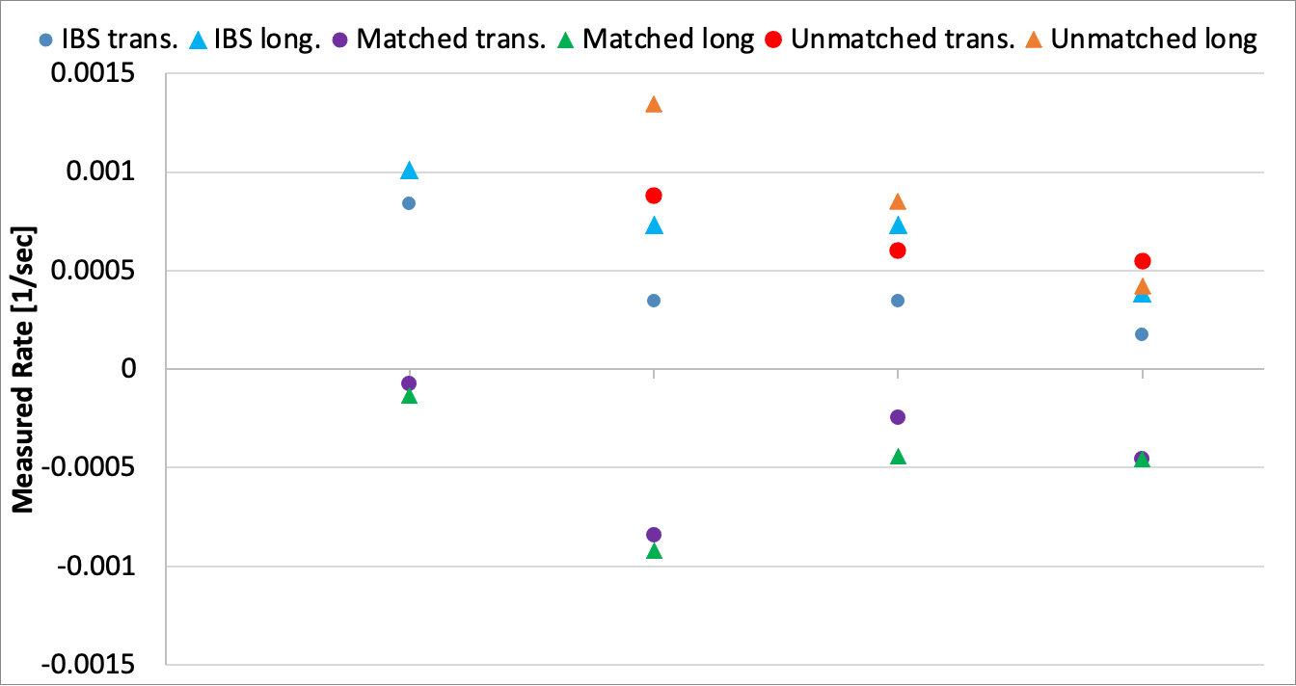
Measure rates
Observation:
Energy Unmatched (4keV) LEReC bunch has:
significant effect on transverse ion bunch size growth (“heating” previous talk)
Cooling by using hollow MB is weaker then regular 20b pattern due to less effectively LEReC/RHIC bunches overlapping
Transverse cooling is less efficiently in case of using 10b with offset vs 10b centered to theion bunch.
Ions at smaller longitudinal amplitude less likely interacts with electrons
10b10g10b, 12 mA
10b centered, 12 mA
20b, 6 mA
20b, 12mA

Slide 13
Cooling rates
$$\frac{1}{t_{cool}}={rate}_{matched}−{rate}_{unmatched}$$
LEReC current | MB charge | MB pattern | Overlapping efficiency | Effective charge | $t_{cool}$ [min]
 |  |  |  |  | Trans. | Long.
6 mA | 645 pC | 20b | 68% | 438.7 pC | 18.2 | 14.6
12 mA | 1290 pC | 20b | 68% | 877.4 pC | 9.7 | 7.3
12 mA | 1290 pC | 10b10g10b | 31% | 400.0 pC | 19.7 | 12.9
12 mA | 1290 pC | 10b centered | 46% | 593.5 pC | 16.6 | 19.1
Transverse cooling is more efficient for centered pattern (long or short MBs)
Longitudinal cooling is more efficient for hollow MB

Slide 14
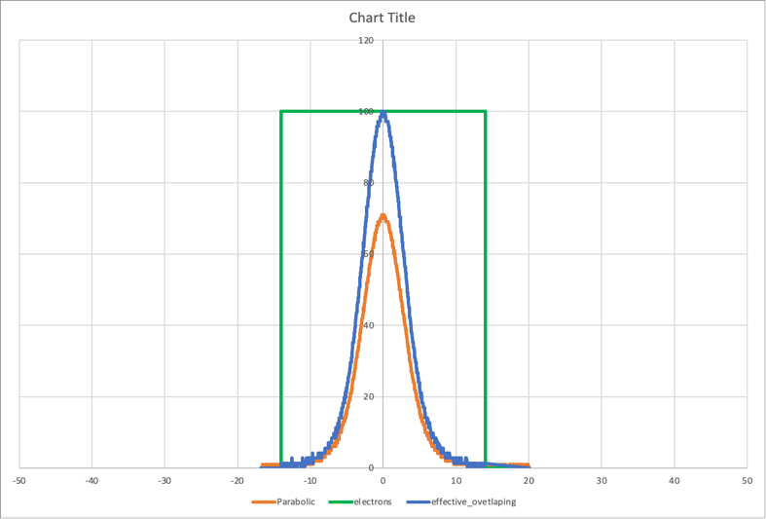
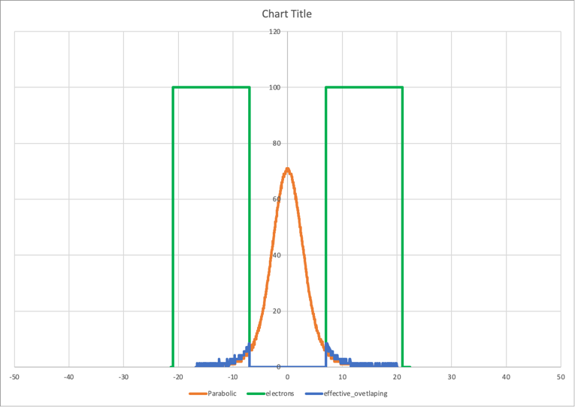
Plans
Setup RUN22 with 28MHz only
28 nsec
14nsec
14nsec
During run 2022 only 28 MHz is available.
Expected Ion bunches are 3 times shorter (<5 ns RMS) than it was during the run 2021
20 bunches, interaction efficiency ~26%
10b-10g-10b (shifted by10), interaction efficiency ~25%
10b-10g-10b, interaction efficiency ~1%
Then MB length (numbers of pulses per MB) should be reduced in order to have good setup for the “two bunches” experiment or “short bunch at the sigma distance from the center”
Significant modification of the laser pulse picking system is needed in order to produce shorter MBs (~5b per MB )
We might consider such modification after all other LEReC relative experiments are finished

Slide 15
Summary
We were able to cool ions using significantly shorter MBs than length of the ion bunches in two configurations : 2 short MBs at the edges of the Ion bunch and one short MB aligned with center of the ion bunch
Cooling rate is well correlated with effective overlapping charge
As expected, cooling was stronger when we use the same intensity long MB due to better bunches overlapping

Slide 16
Back-up slides

Slide 17
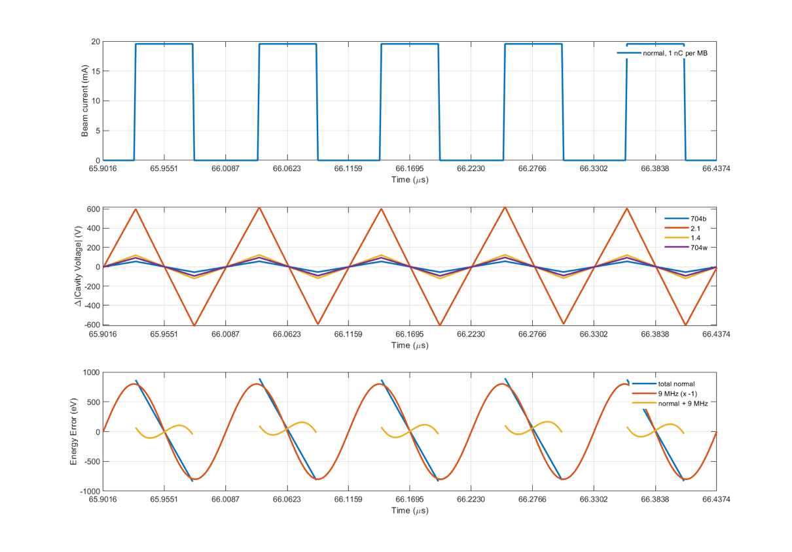
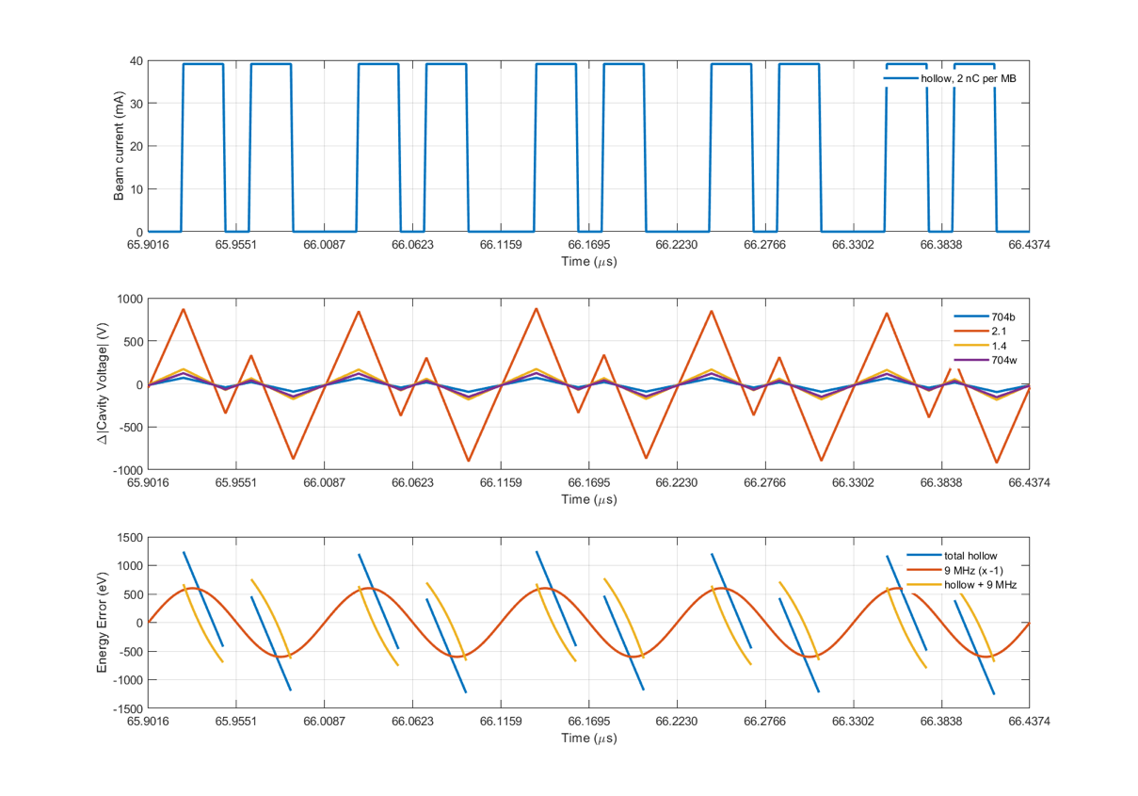
Beam loading effect difference: normal 36b per MB vs hollow MB (by K. Mernick)
Using just 9MHz cavity, we cannot compensate hollow MB energy spread as effective as in case of the normal 36b per MB.
For this pattern, we would really need a combination of harmonics (9, 18, 28 MHz) to compensate the beam loading well.

