Slide 1
Low Energy RHIC electron Cooling (LEReC): Dispersive Cooling
A. Fedotov, D. Kayran, S. Seletskiy, J. Kewisch, H. Zhao, V. Schoefer, G. Robert-Demolaize, Al Marusic, others
October 22, 2021
APEX workshop
BNL

Slide 2
Goals of experiment
In many high-energy cooling applications, such as for the EIC, the strongest demand is on the transverse cooling. The transverse cooling can be enhanced at the expense of the longitudinal cooling using dispersion in the cooling section.
There are several possibilities which can provide such redistribution:
use of ions dispersion function with non-uniform electron density distribution
use of ions dispersion in combination with the electrons dispersion
transverse offset of electron beam with respect to ion beam providing gradient of longitudinal cooling force in the cooling section.
The goals of “Dispersive Cooling” experiment is systematic study all of these possibilities (1, 2, 3) and details of the redistribution process.

Slide 3
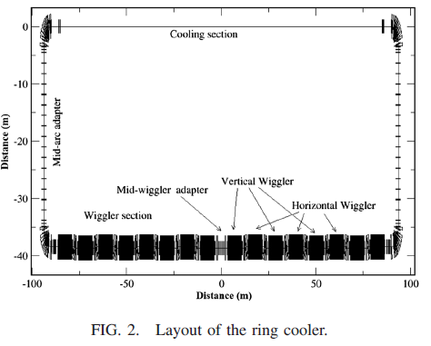
High-energy electron cooling for EIC
Electron Storage Ring cooler is proposed for cooling of protons at 275 GeV in EIC:
H. Zhao, J. Kewisch, M. Blaskiewicz, A. Fedotov,
“Ring-based electron cooler for high energy beam cooling”, PRAB 24, 043501 (2021)
Redistribution of longitudinal cooling to the transverse direction is effectively used in the design.
Storage ring cooler
for EIC
Simulation for ring-based cooler for EIC for protons at 275 GeV
Horizontal rate
Vertical rate
Longitudinal rate

Slide 4
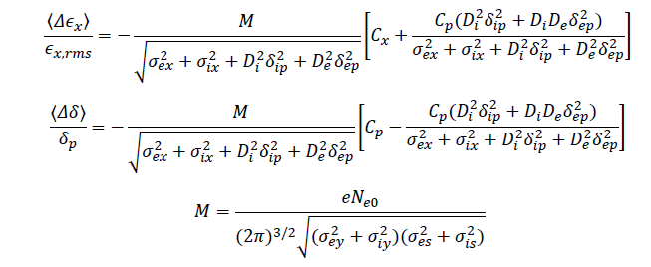
Dispersive cooling for LEReC parameters
Due to electron density distribution
(second order effect)
Due to gradient of longitudinal force
Transverse cooling rate:
Longitudinal rate:
Redistribution
coefficient
H. Zhao, M. Blaskiewicz, “Rate redistribution in dispersive electron cooling”, Phys. Rev. Acc. Beams 24, 083502 (2021).

Slide 5
Dispersive cooling for LEReC parameters
a) Baseline measurement:
- Energy spread of ions dp/p_i=3e-4 (rms),
- RHIC lattice with ions dispersion function (Di) in the cooling section.
- Energy spread of electrons dp/p_e=1e-3 (rms), electron beam dispersion De=0.
b) Redistribution due to electron dispersion De:
Introducing electron dispersion should decrease longitudinal cooling rate and
increase transverse cooling rate.
For De=5m - > expected redistribution coefficient k – 30%
For De=2.7m - > k – 10-20% effect compared to a), depending
on electron and ion beam sizes and energy spread.

Slide 6
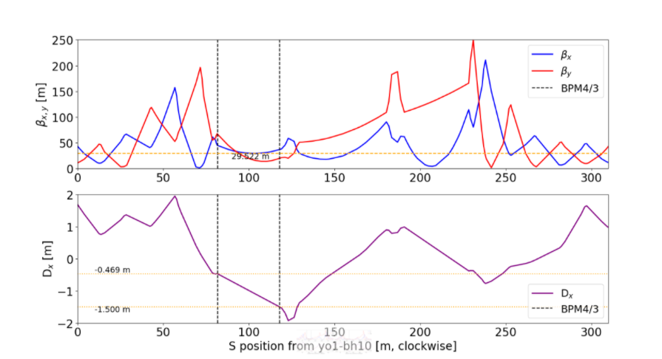
RHIC lattice with 1.5m ions dispersion in cooling section
Cooling
section

Slide 7
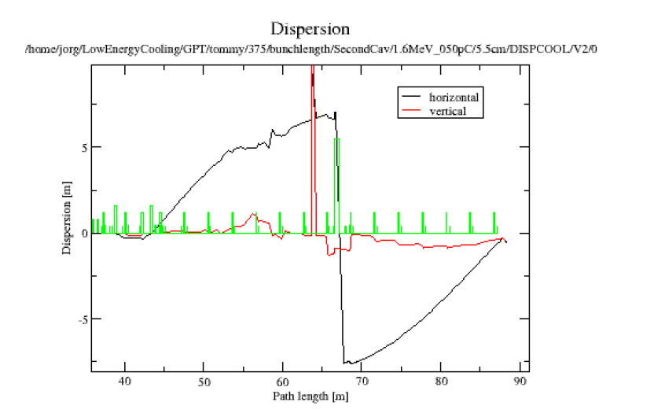
LEReC lattice with 5m electrons dispersion in cooling section
Blue cooling
section
Yellow cooling
section

Slide 8
We had three short sessions to setup experiment and explore some parameters
1. June 11:
Developed ion beam lattice with 1.4m dispersion.
Developed electron beam lattices with dispersions of 2.7 and 8 meters.
Measured electron beam parameters.
2. June 18:
Implemented electron beam lattice with 2.7m dispersion.
Established high-current electron beam operation with De=2.7m lattice.
Performed first measured of heating/cooling with electron
dispersion and without electron dispersion
3. June 24:
Measured electron beam parameters with introduced electron energy spread, needed to enhance observation of redistribution effect. Performed first heating/cooling measurements.

Slide 9
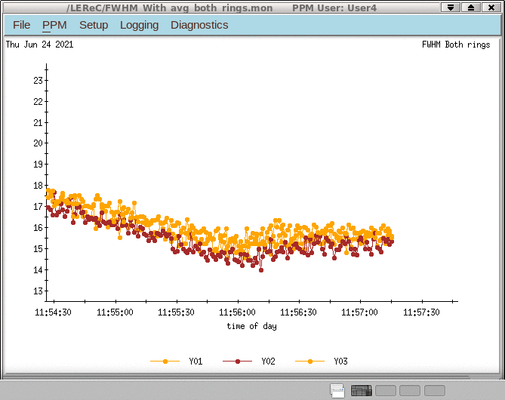
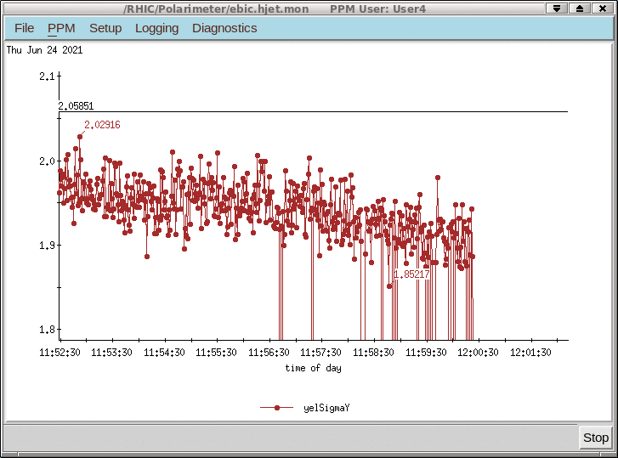
APEX June 24, 2021: Di=1.4m, De=2.7m
To enhance observation of redistribution we introduced such
transverse angles in cooling section that transverse cooling is suppressed while
there is still some longitudinal cooling.
Introducing longitudinal energy spread which decreases longitudinal
cooling one should expect to see increase in transverse cooling, if there is redistribution.
Bunch length
Transverse size
Longitudinal Phase space changed

Slide 10
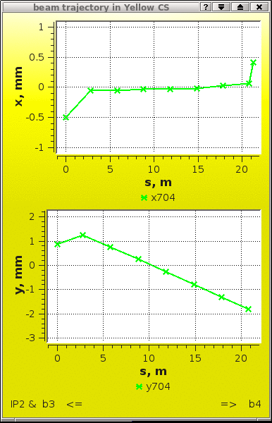
Large transverse angle to suppress transverse cooling was introduced at 11:42

Slide 11
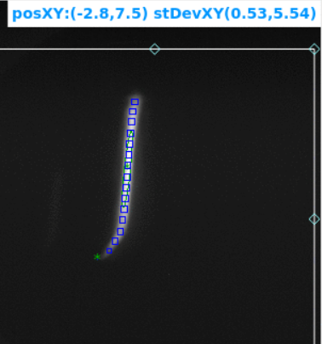
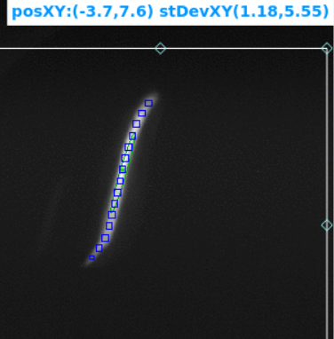
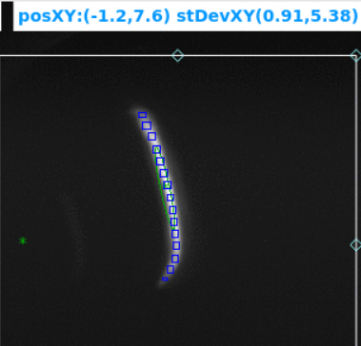
June 24: introducing various energy spreads
nominal
Positive chirp
Negative chirp

Slide 12
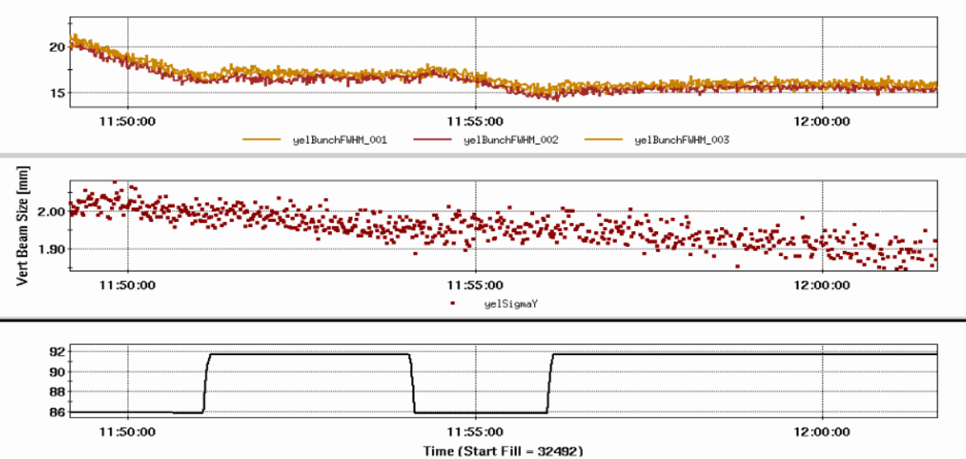
Experimental data, June 24 (with and without negative energy chirp)
Longitudinal bunch length
Vertical beam size
No chirp
chirp

Slide 13
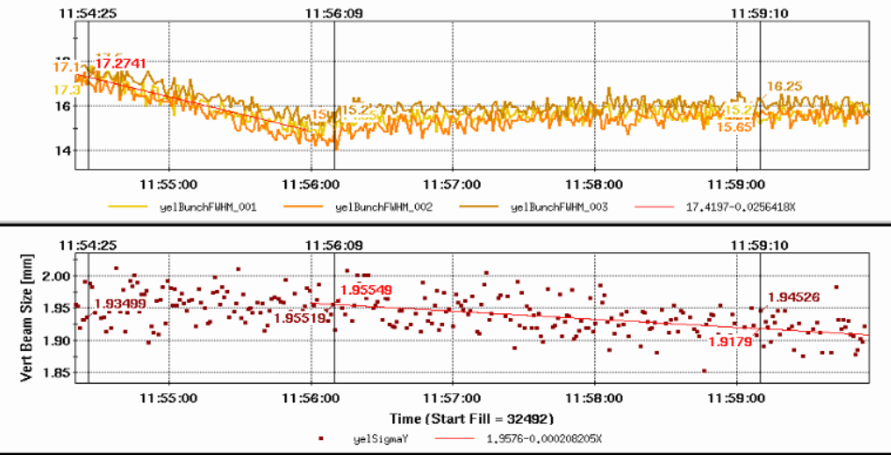
Without and with energy chirp
longitudinal
No chirp
With chirp
transverse
Longitudinal cooling rate before energy chirp: 0.0018
Transverse cooling rate after energy chirp: 1.5e-4
Longitudinal rate after energy chirp = IBS rate

Slide 14
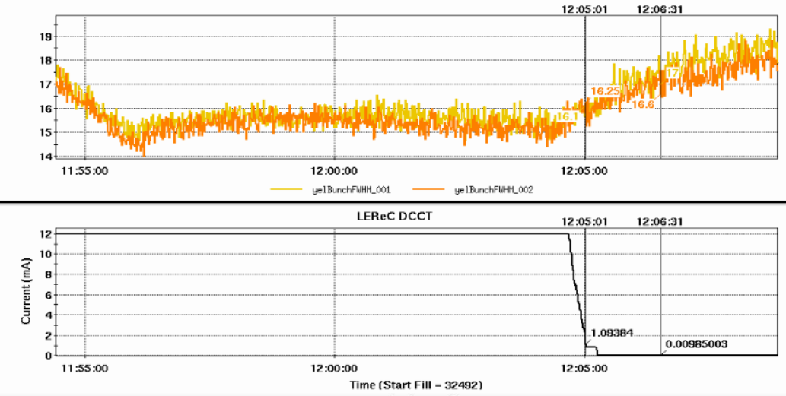
Longitudinal cooling rate and IBS
Long. Cooling=IBS (with energy chirp)
IBS
IBS rate: 5.5e-4, which means new longitudinal cooling coefficient Cp2=5.5e-4, since longitudinal cooling exactly compensates IBS.

Slide 15
Preliminary results:
Redistribution coefficient (k)
Measured longitudinal cooling rate with introduced transverse angles and
energy chirp was 5.5e-4 [1/s].
Transverse rate after energy chirp (measured): Cp2*k=1.5e-4
New longitudinal cooling coefficient is then:
Cp2-Cp2*k=5.5e-4 -> Cp2-1.5e-4=5.5e-4-> Cp2=7e-4
Resulting redistribution coefficient k=1.5e-4/Cp2=1.5e-4/7e-4=0.2:
Measured redistribution 20% (expected redistribution: 10-20%)

Slide 16
Future plans
Establish new setup and parameters using 28MHz RHIC RF (9MHz was used in 2021)
Establish stronger dispersive cooling with larger electrons dispersions (if possible, larger dispersion of ions as well)
Systematic study of dispersive cooling for various setting and parameters
Exploring cooling with offset of electron beam
Comparison of experimental data with theory

Slide 17
Summary:
Dispersive cooling is critical part of electron cooler design based on electron storage ring for cooling protons at the top energy in the EIC.
LEReC offers unique capability to study this approach experimentally.
Initial setup to study dispersive cooling was promising.
Redistribution of cooling decrements was observed.
Detailed study of dispersive cooling is planned.

