Slide 1
APEX on Recombination studies at LEReC
D. Kayran, A. Drees, A. Fedotov, P.Harvey, R. Hulsart , A. Marusic,
P. Thieberger, S. Seletskiy and others.
APEX workshop, Nov 9, 2021
BNL

Slide 2
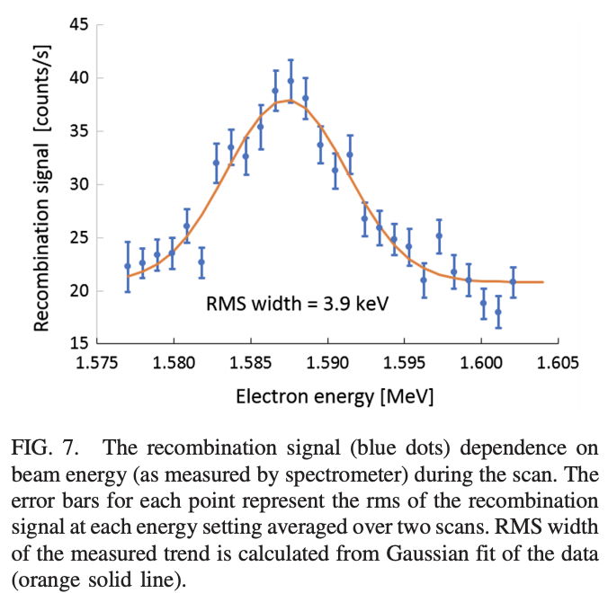
Introduction and Motivation
Recombination signal was used to match RHIC and LEReC beams velocities during LEReC coimmisioning in 2019
Radiative recombination of ions was extensively studied experimentally. Perfect agreement between measurements and theoretical prediction for the recombination coefficient was found in a wide range of relative energies between the electrons and ions (>10meV).
However, in the region of extremely small relative energies (which is the region typically used for electron cooling), the measured recombination coefficient for experiments with bare ion was found significantly higher than predicted by standard theory of radiative recombination.
At RHIC during LEReC setup in 2019 the recombination enhancement was observed first time without continues solenoidal field. The goal of this experiment is the systematic study beam losses due to recombination for different energy offsets and energy spread.
http://www.cadops2.bnl.gov/elogs/entryList.jsp?DATABY=day&ELOG=LEReC_2019&DATE=04/11/2019&DIR=none#968776
Phys. Rev. Accel. Beams 22, 111004 – Published 27 November 2019
Bunch by bunch loss signal data. The best matched energy MB
© P. Thieberger

Slide 3
Summary of April 2019
It seems that bunch by bunch loss rate near recombination monitor location is well correlated with:
Presents of electrons
Energy of electrons
For this RHIC/LEReC parameters the loss rate was about 10-15 events/minute.
The energy dependance distribution of the losses looks not exactly Gaussian.
Should try to scale with ion bunch intensity to get more accurate curves
Plan for APEX June 2021:
Use more intensity per bunch RHIC and LEReC
Try LEReC 76kHz mode with 6MB (or 10MB if possible)
Preferable configuration: several bunches in RHIC overlapping with one (or two) less numbers of the LEReC Mbunches.
Initial Question
Should we restore Au19-4GeV-25m rec. lattice or try regular RHIC run21 Au21?
We decided to keep regular RUN21 lattice and apply local bump, instead.

Slide 4
Slides from Gang Wang’s presentation on Aug 27, 2021:
http://case.physics.stonybrook.edu/images/f/f9/Dependance_of_recombination_rate_on_energy_deviation.pdf

Slide 5
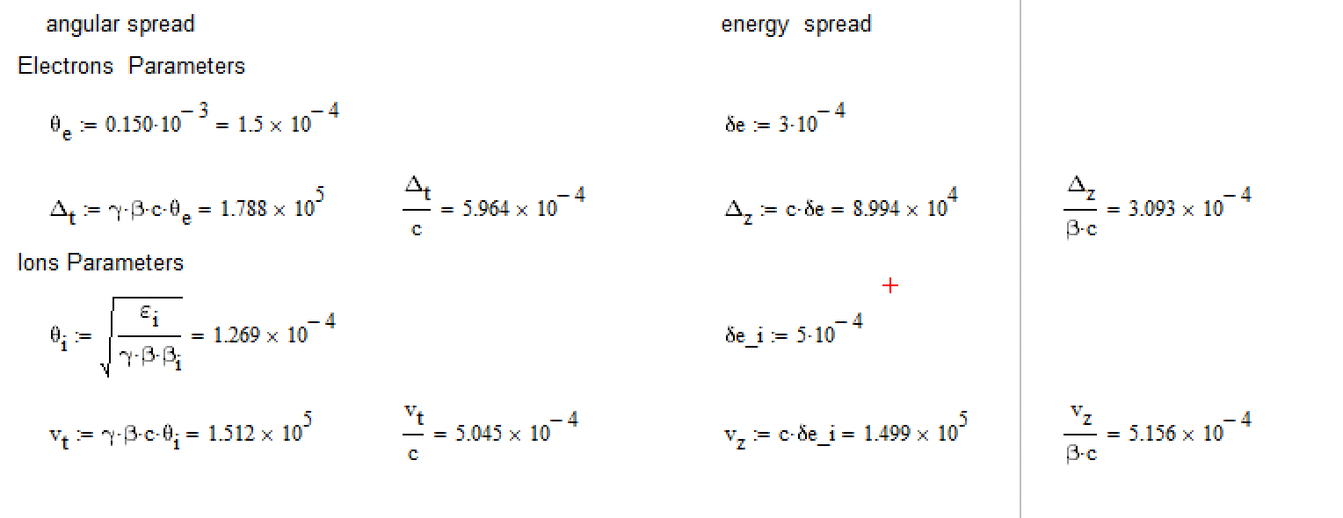
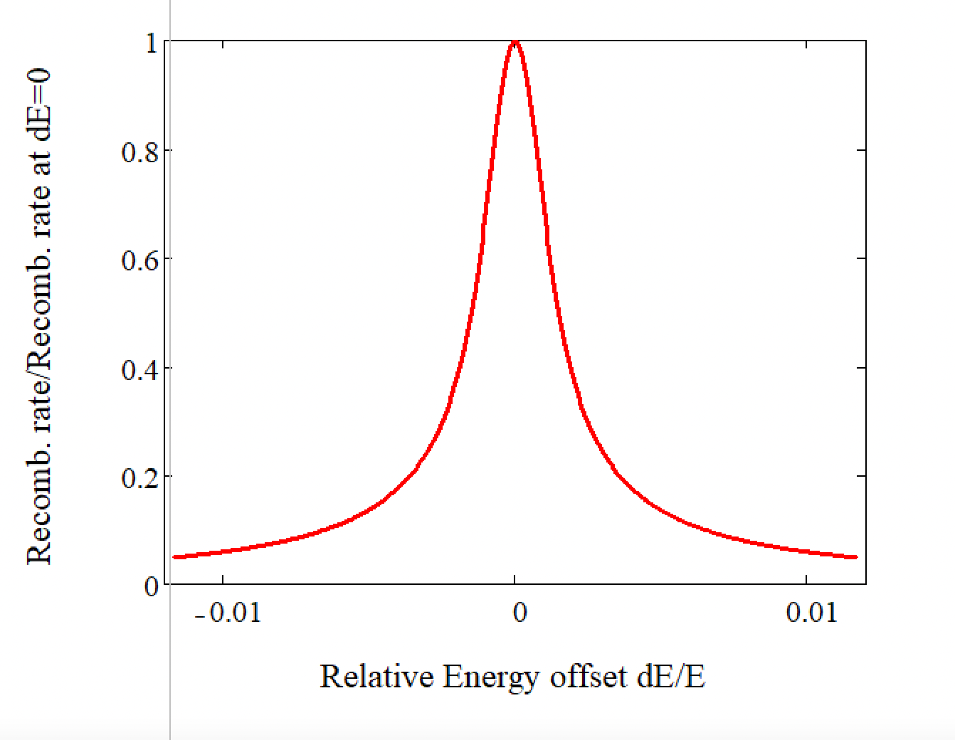
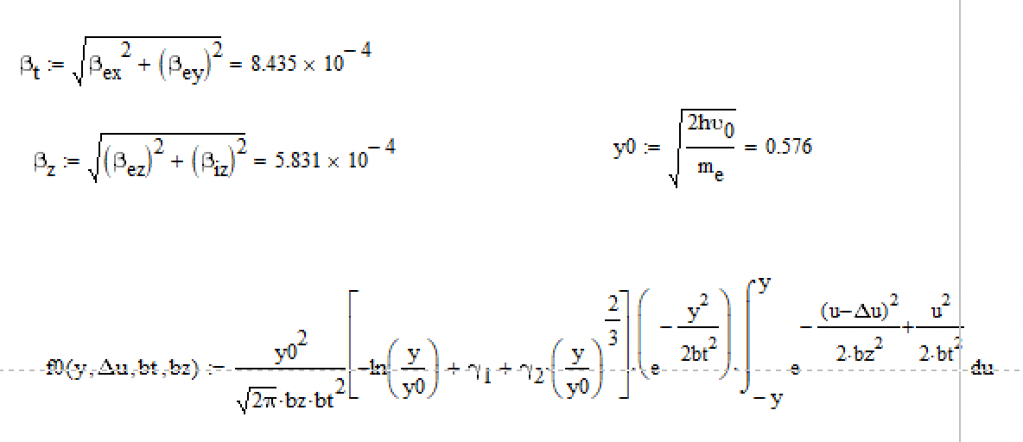
Recombination calculated curve for LEReC setup
Transvers and longitudinal velocities in COF are about the same
FWHM=3x10⁻⁴
Rec. rate

Slide 6
Side by side comparison of CeC and LEReC
LEReC rec. signal is significantly more sensitive to energy mismatch then for CEC setup
Using LEReC setup
FWHM=3x10⁻⁴
FWHM=1.8x10⁻³
300 urad of angular spread
5e-4 energy spread of electrons
1.3e-3 energy spread of ions
150 urad of angular spread
3e-4 energy spread of electrons 5e-4 energy spread of ions
Plot from Gang’s presentation for optimum expected CEC-X parameters

Slide 7
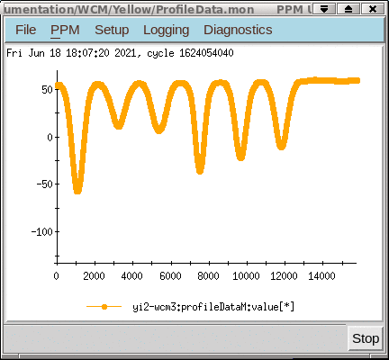
RHIC/LEReC setup:
On June 18
We used regular RHIC lattice with and without local bump
6 bunches per store with intensity 0.4-1.5e9 per bunch
For LEReC we used regular 5 MB with 3 and 2nC per MB
beam loading per MB 3.3keV for charge of 3nC per MB
Bunch profiles WCM
Cyan trace is signal from BPM in the cooling section
1st RHIC bunch is not overlapping with LEReC bunches
5 followed bunches are overlapped with LEREC bunches

Slide 8
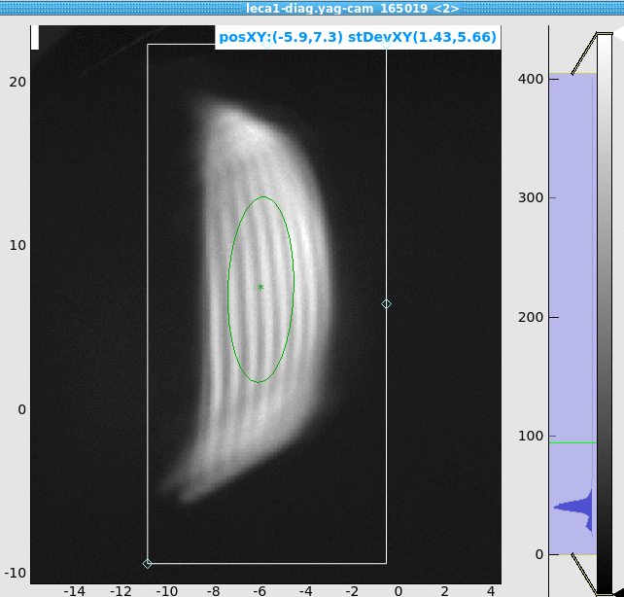
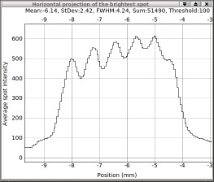
Bunch to bunch energy difference due to beam loading effect
MB profiles image at PM in RF diagnostic line
Train of 5 MBs with charge of 1.3 nC per MB
Distance between 4 peaks =3 mm, dispersion= 800 mm
MBunch by MBunch energy shift ΔE/E=3/800/4=9.4E-4
3mm
http://www.cadops2.bnl.gov/elogs/entryList.jsp?DATABY=day&ELOG=LEReC_2021&DATE=06/24/2021&DIR=none#1481011

Slide 9
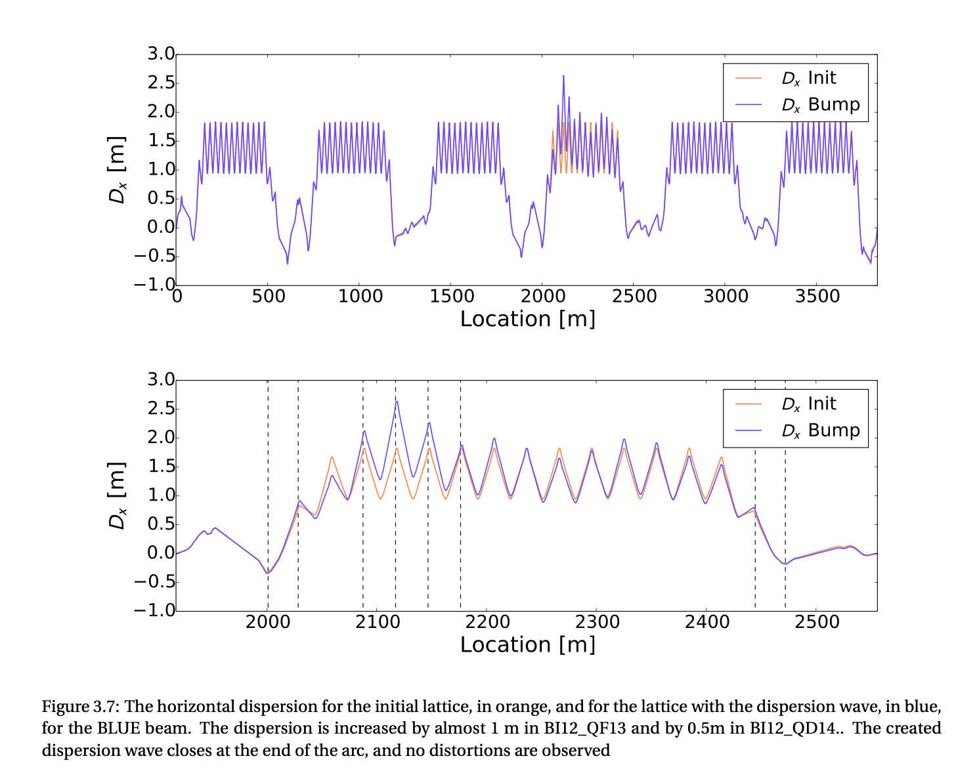
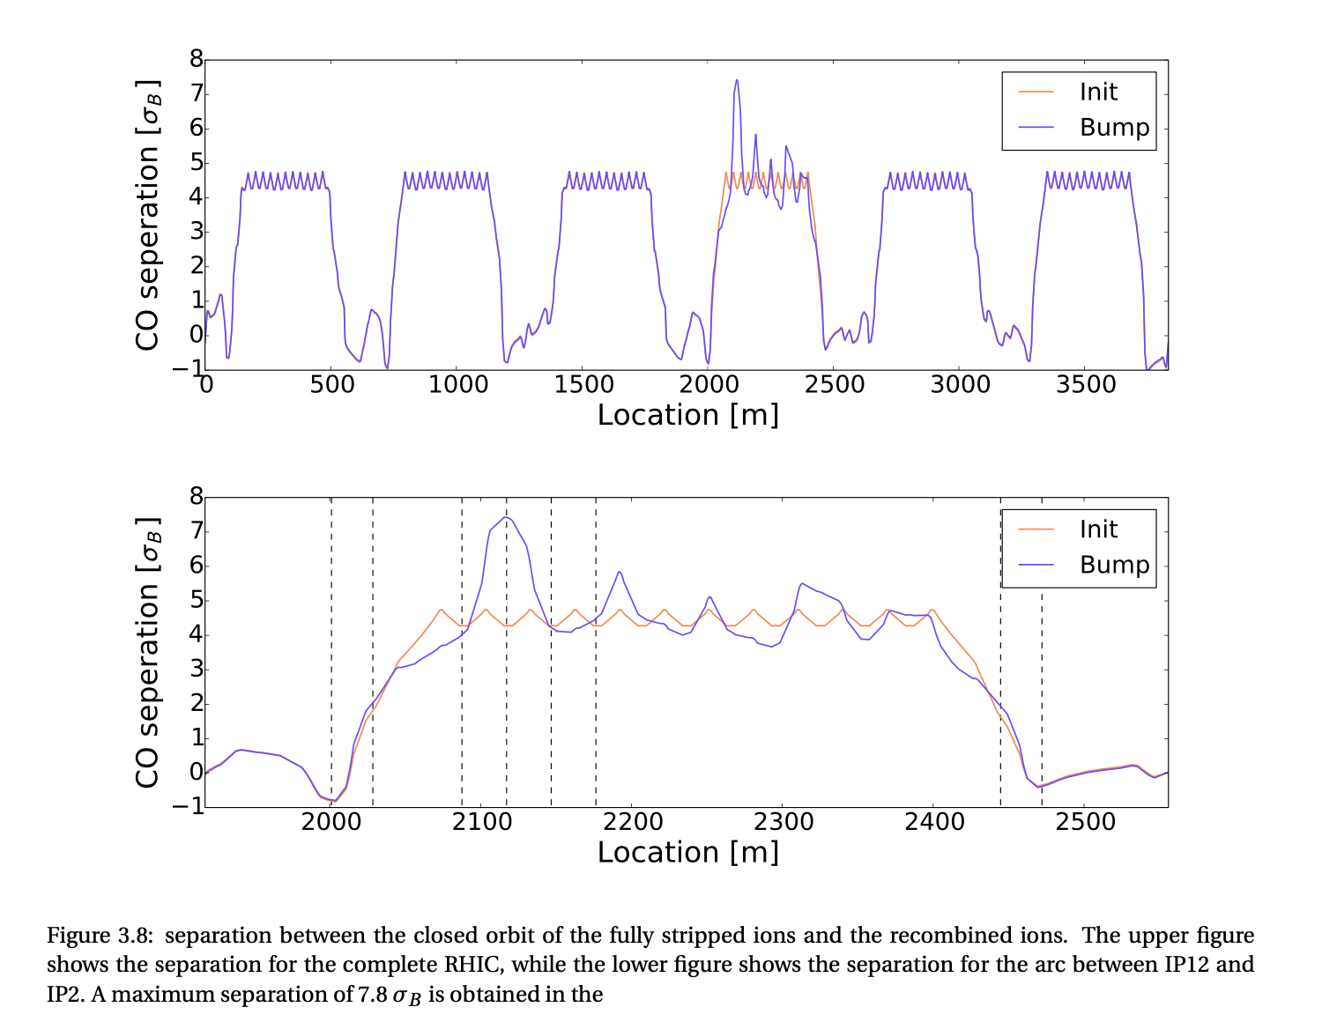
RHIC dispersion and resulted bunch separation
RHIC dispersion
Au79 vs Au78 bunch separation in Arcs
5 sigma separation without dispersion bump
F.S. Carlier “Detectors for low energy electron cooling in RHIC” C-A/AP/557 February 2016

Slide 10
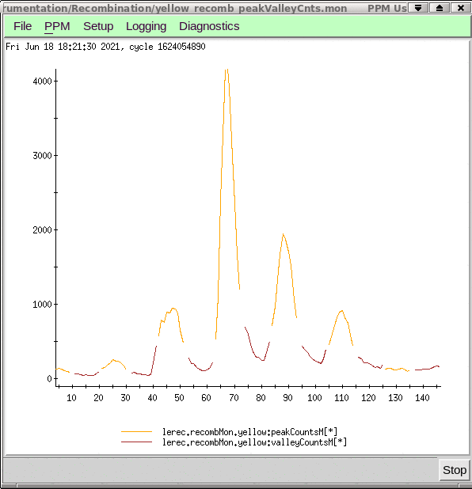
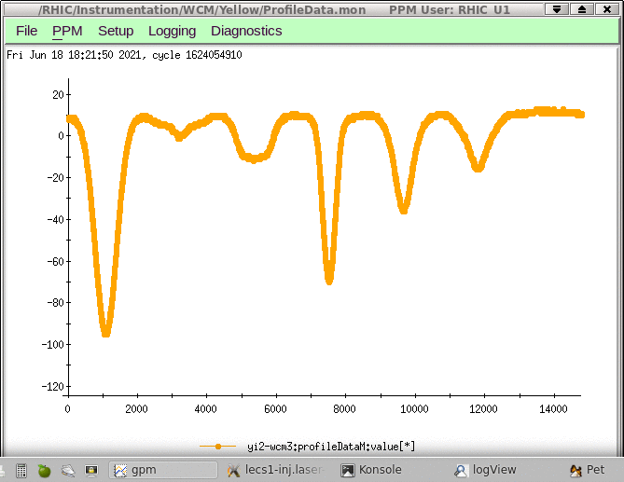
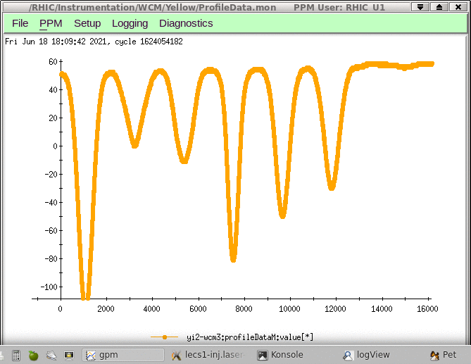
Bunch by bunch recombination loss signal
With local bump
Without local bump
Local bump (8.5mm at yo1-bh14) helped to increase recombination signal/noise level significantly
Overlapped with optimized energy e-bunch
dE/E=9e-4
dE/E=-9e-4
Non interacted bunch #1
WCM profiles

Slide 11
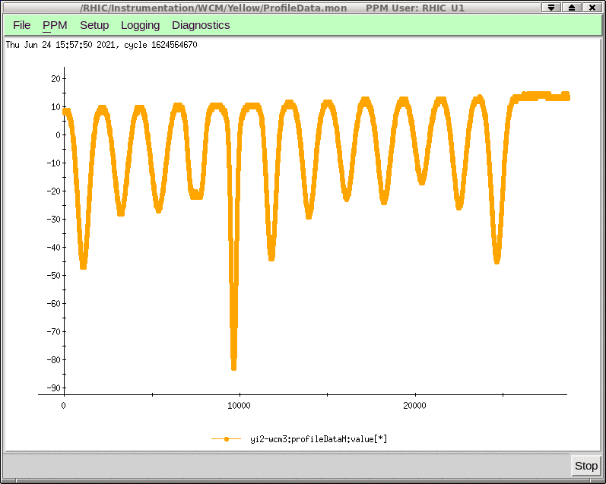
APEX June 24
We used regular RHIC lattice with local bump:
12 bunches per store with intensity 0.4-1.5e9 per bunch
For LEReC we used regular 10 MBs with 1.3 nC per MB
beam loading ~2 keV per MB
Non interacted bunch #1, #12
Non interacted bunch #1, #12
Overlapped with Optimized energy
WCM signal
Recombination monitor signal

Slide 12
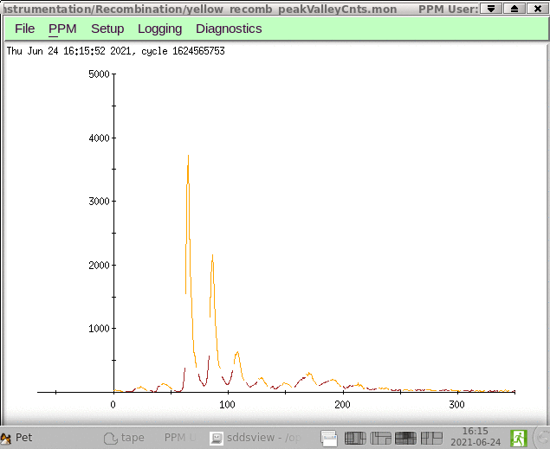
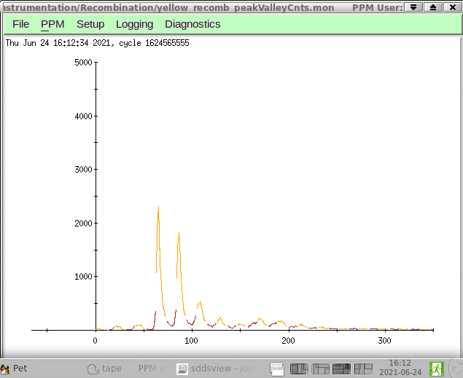
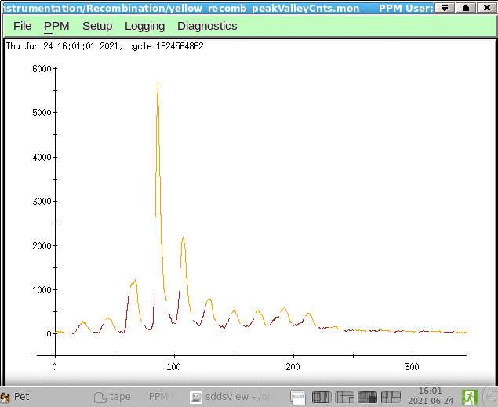
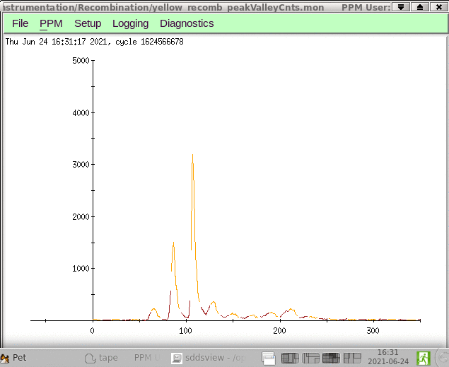
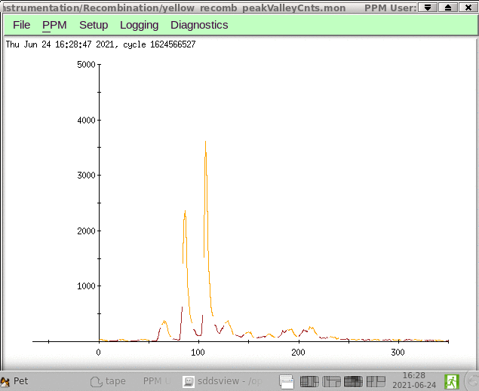
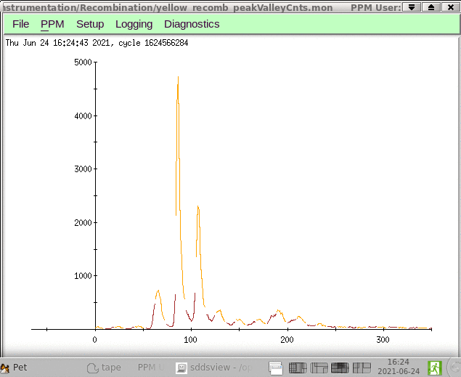
Small steps energy scan ~200eV (dE/E=1e-4)
-400ev
Close to 0ev
-800ev
+800ev
+400ev
+600ev

Slide 13
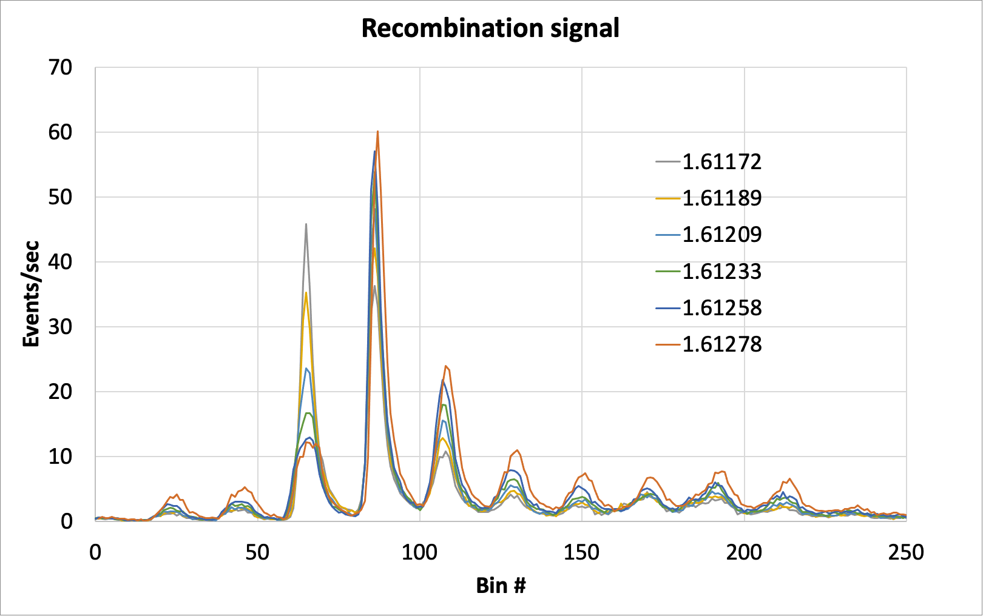
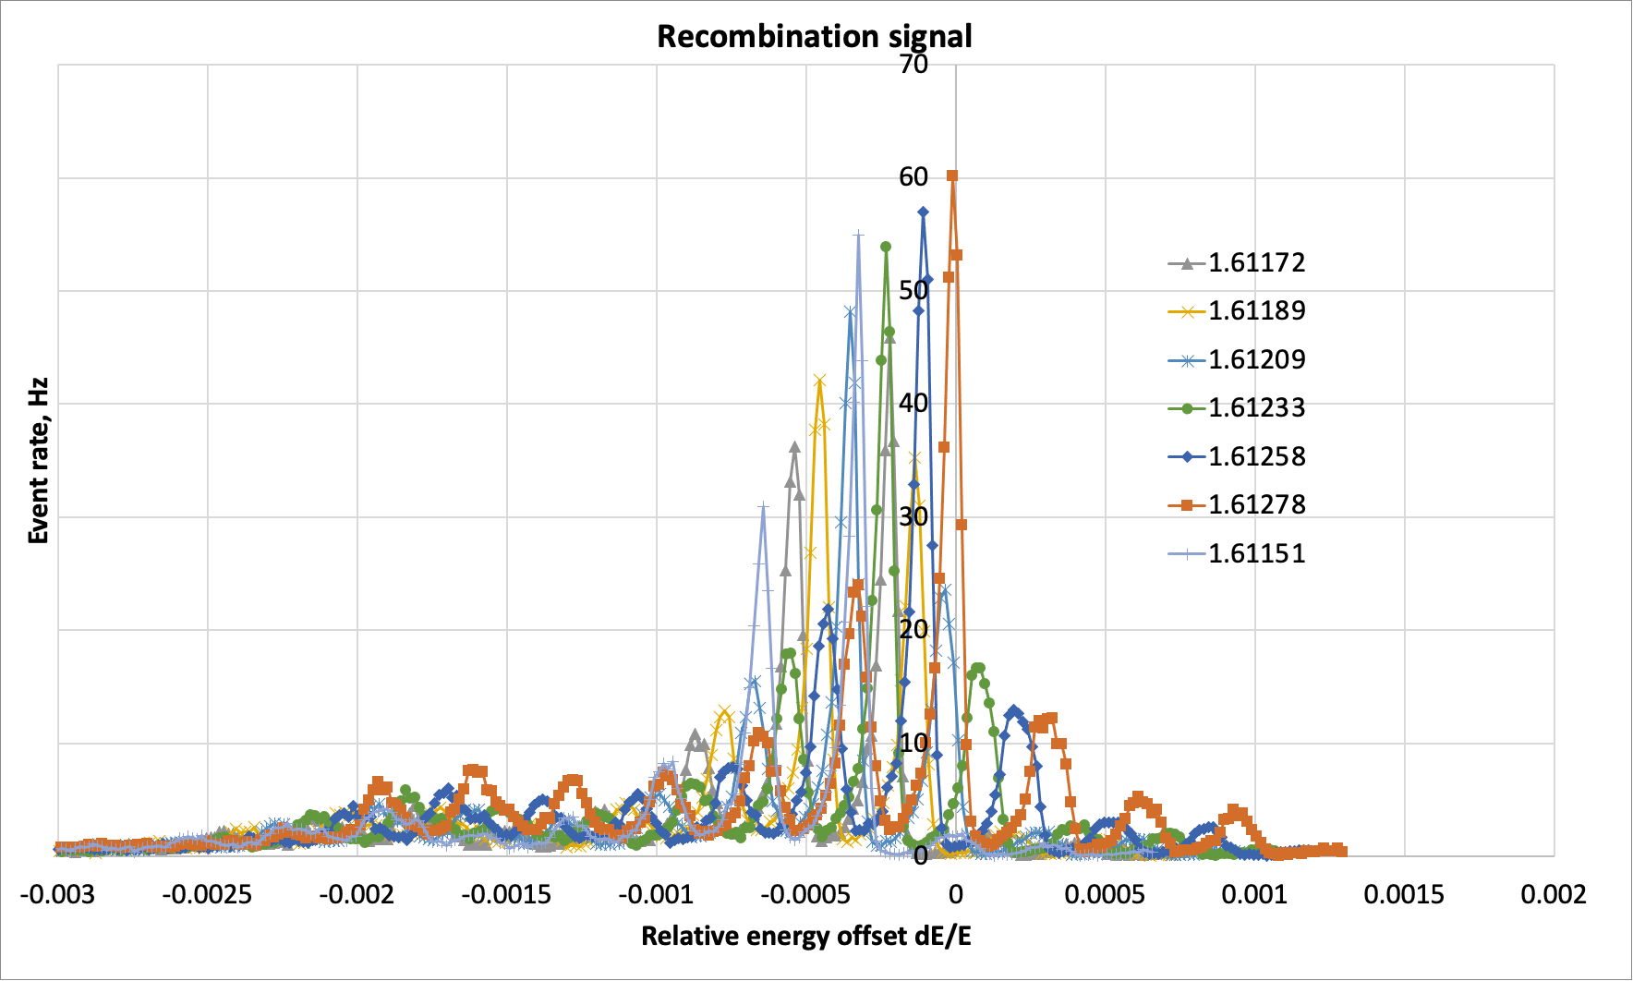
Loss event rate per seconds for different LEReC average energy (200 eV step)
Raw data
Function of energy offset
Very low losses from non interacted bunches
Regular losses dueto LEReC –RHIC interaction and results of signal reflection

Slide 14
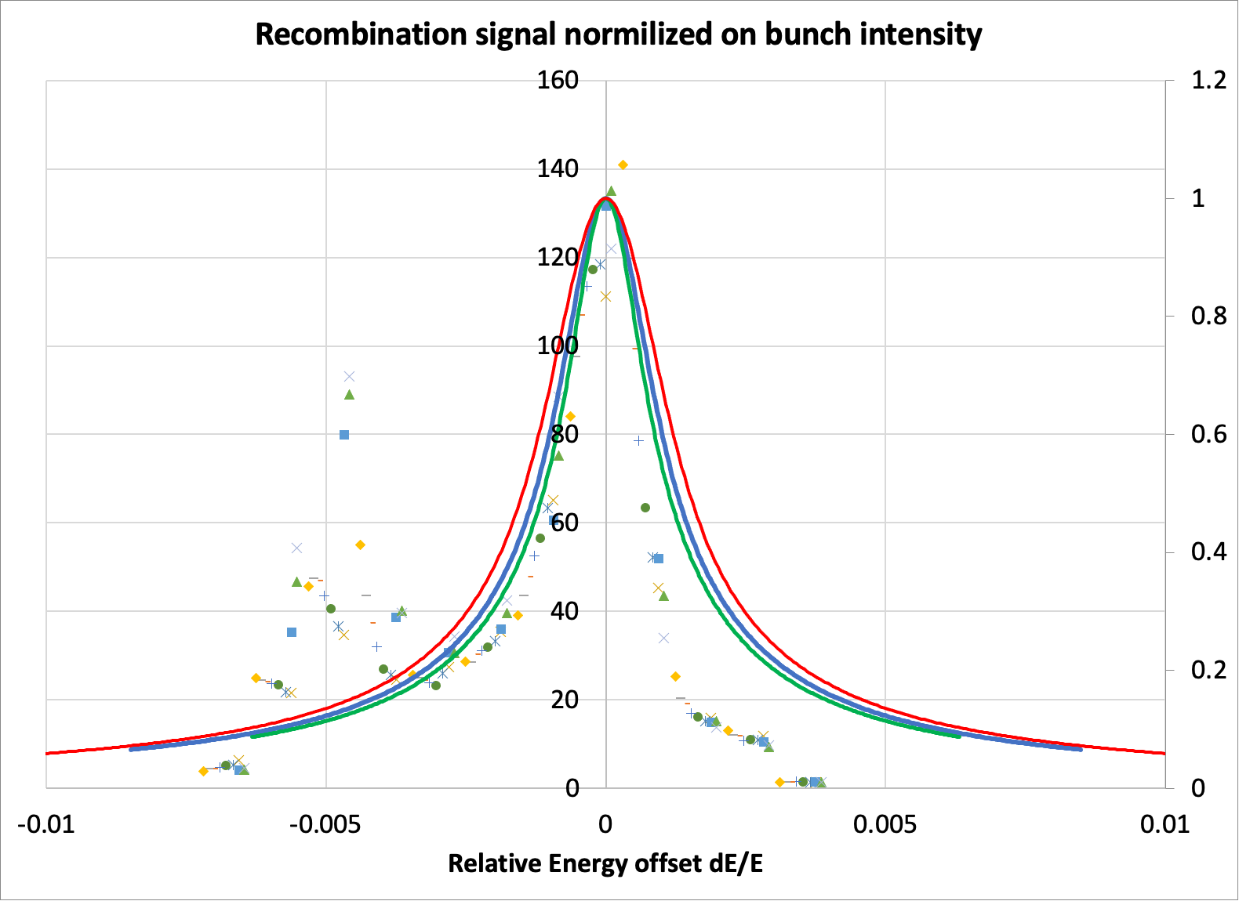
More data from each bunch normalized to the individual i-bunch intensity
Markers are for measured data points at different average LEReC energy settings
Lines are calculated recombination signal
These data points are artificial result of “other losses” divided by low intensity i-bunch
Red both energy spread 5e-4
Blue both energy spread 3e-4
Green e-energy spread 1e-4, ion energy spread 3e-4
Background signal from non interacted bunches is very small

Slide 15
LEReC Recombination studies summary
We observed and measured energy dependence of recombination signal
Introducing local bump significantly improved statistic
Measured energy dependance of recombination signal is well matched with textbook formulas for LEReC bunch energy spread ~ 1e-4

Slide 16
Back-up material

Slide 17
LEReC layout
e-beam
RF diagnostic line
i-beam
e-beam
Recombination monitor in ARC
The e-bunches are produced at the photo-cathode illuminated by a green 704 MHz laser modulated with the 9 MHz frequency to match the frequency of RHIC ion bunches.
The electrons are accelerated to 375 keV in the dc gun followed by a 704 MHz superconducting rf accelerating cavity bringing the beam energy to 1.6–2. MeV.
The e-beam is transported in a 40 m long transport line and merged to the cooling section (CS) in the “Yellow” RHIC ring . After passing the Yellow CS, the beam is sent to the cooling section in the “Blue” RHIC ring by a 180° bend.
Finally, the electron beam is extracted and sent to the beam dump.

Slide 18
LEReC parameters
gamma= 4.1
e-bunch energy spread is <3e-4
average e-bunch angular spread ~150 urad
I-bunch energy spread 3e-4
I-bunch angular spread 130 urad

Slide 19
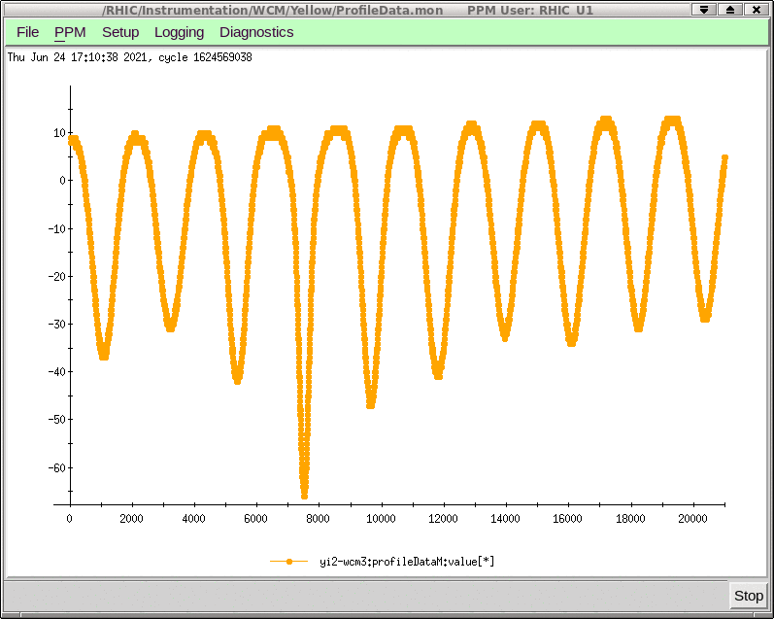
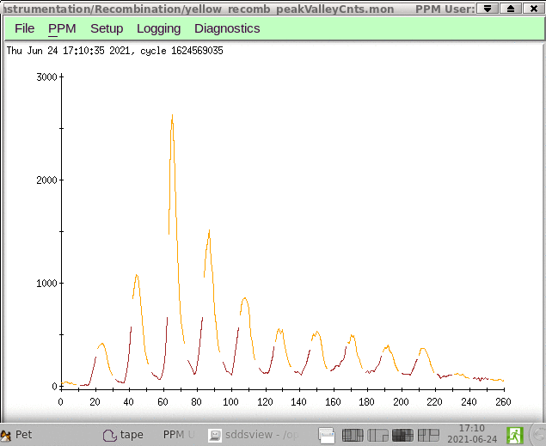
Fine energy tuning by optimizing cooling
WFHM bunch length of several bunches
WCM signal
Recombination monitor signal
RHIC Bunch #4 is optimally cooled while two neighbor Bunches #3 and #5 are weaker but equally cooled as well
http://www.cadops2.bnl.gov/elogs/entryList.jsp?DATABY=day&ELOG=LEReC&DATE=06/24/2021&DIR=none#1481257

