Slide 1
Radial Shift APEX Results
G. Robert-Demolaize for the RS Team

Slide 2
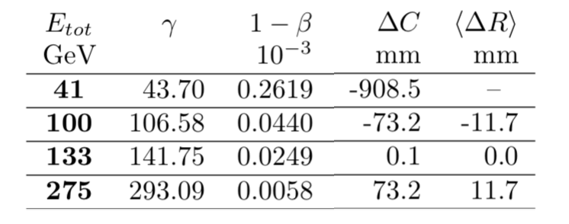
I – Context
EIC hadron lattice design studies focus on the implementation of a transverse orbit displacement, or radial shift, to generate the required circumference change to match the length of the electron lattice independently of the energy of the circulating hadron beam (100 or 275 GeV).
Previous APEX experiments were designed as “proof of principle” and therefore aimed at establishing a radial shift in RHIC using a small momentum offset δp to the circulating beam – with the most recent and successful attempt done in 2018 (see Proc. Of NA-PAC 2019, Off-Momentum Optics Correction in RHIC, TUPLO12).
However, for the EIC the circulating beam must remain on-axis inside of (a large extent of) each straight section, making the δp method too cumbersome to implement operationally. Beam time was therefore requested during Run21 APEX to test an alternative where a small offset δB is applied to the magnetic field of arc dipoles. Both δp and δB methods are equivalent, since a dipole field offset translates into a dispersive orbit when matched appropriately.

Slide 3
I – Context II – Run21 preparations
Due to the RHIC PS configuration for dipoles, all dipoles from DH5 to DH5 stretching over a given arc are given a magnetic offset dB/B.
More than one approach for finding a shifted closed orbit can be studied:
by targeting a specific value of circumference change: this is the scenario closest to “EIC operations;”
by establishing the required orbit for a given δB: this requires dedicated lattice design/rematching.
Goal: push the orbit at fixed energy, maintain the tunes & chromaticities, rematch the linear optics at the IPs.
Method: using a staged approach, RS lattices are designed and ramped into using dedicated ramps (similar to storage ramps) in order to get to the new settings in a controlled way.
Variables:
for OUT arcs: th4, th6, th8, th10, th12;
for IN arcs: th5, th7, th9, th11, th13;
individual quadrupole shunt supplies in each IR.

Slide 4
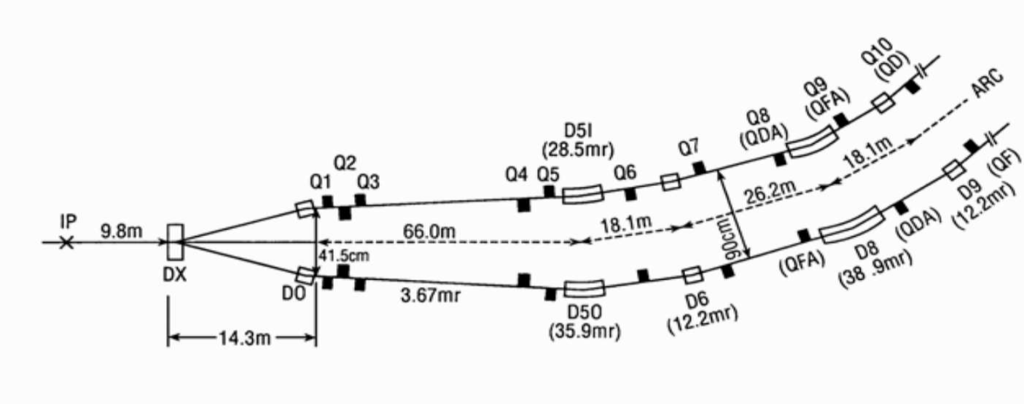
I – Context II – Run21 preparations III – Radial Shift lattices
The RHIC power supply wiring scheme is such that all bending magnets are powered in series, with the only exceptions being DH0 and DHX. These dipoles have dedicated add-on shunt power supplies that allow adjusting the crossing angle of the bunches through the collision point, therefore making it possible to keep the DH0/DHX strengths constant even if the current on the main bus is changed.
The RHIC arcs are made by all magnets located between two Q10 quadrupoles within an inner or outer sextant which means that there are eight bending magnets (DH5-9 on each side of the IP) inside of each IR that will receive the same δB applied to the arc dipoles to generate the radial shift. This leaves two options for designing a new closed orbit with a radial shift in the arcs only:
let the radial shift start at D5 and close the shift at the next D5 in the downstream IR - the short IR option, handled with MAD-X;
force the beam to stay on-axis until D10 and use orbit correctors located between Q4 and Q10 to do so - the long IR option, assigned to Bmad.

Slide 5
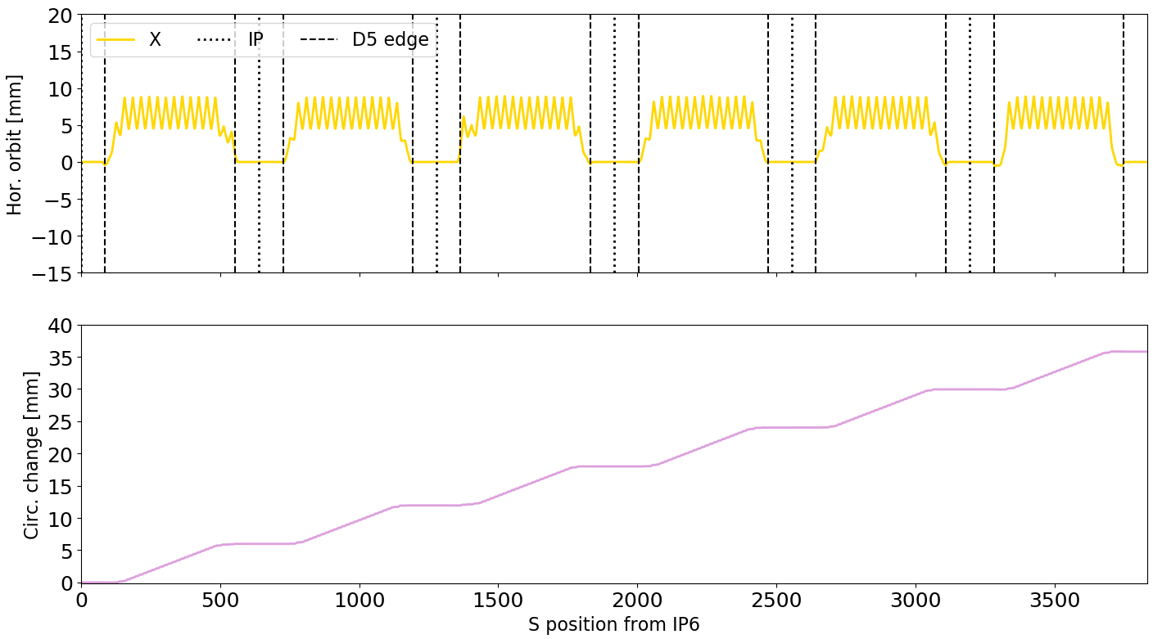
I – Context II – Run21 preparations III – Radial Shift lattices
With MAD-X, δB = -0.5%:
Beam direction

Slide 6
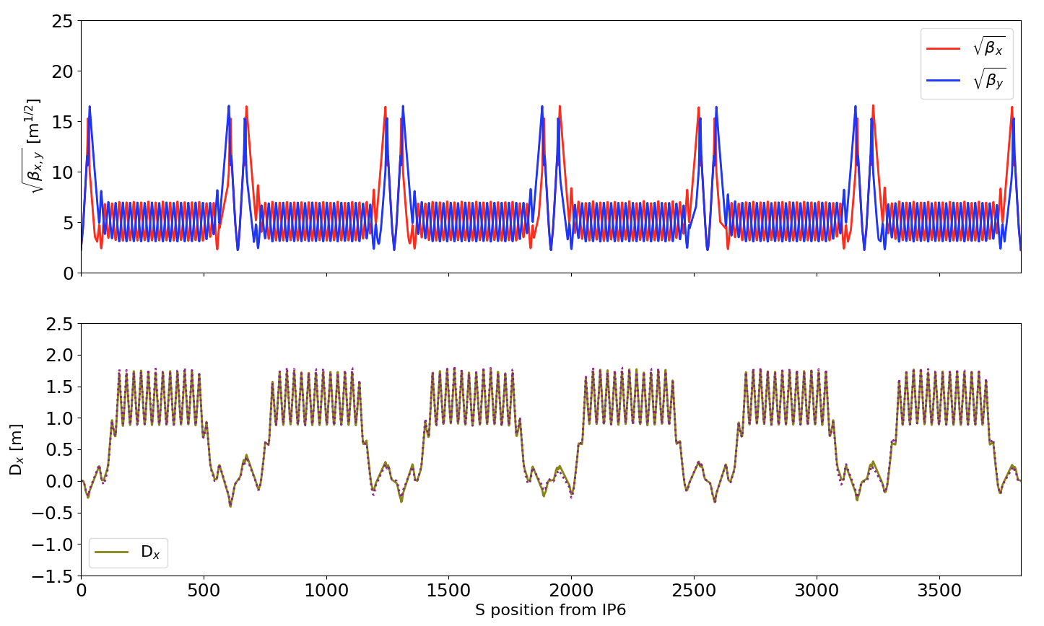
I – Context II – Run21 preparations III – Radial Shift lattices
Linear optics with MAD-X and δB = -0.5%:
Beam direction
Q_{x} = 28.234 Q_{y} = 29.228
β*_{x,y} [IP6-4] = 5.00 m

Slide 7
I – Context II – Run21 preparations III – Radial Shift lattices
Same setup with Bmad:

Slide 8
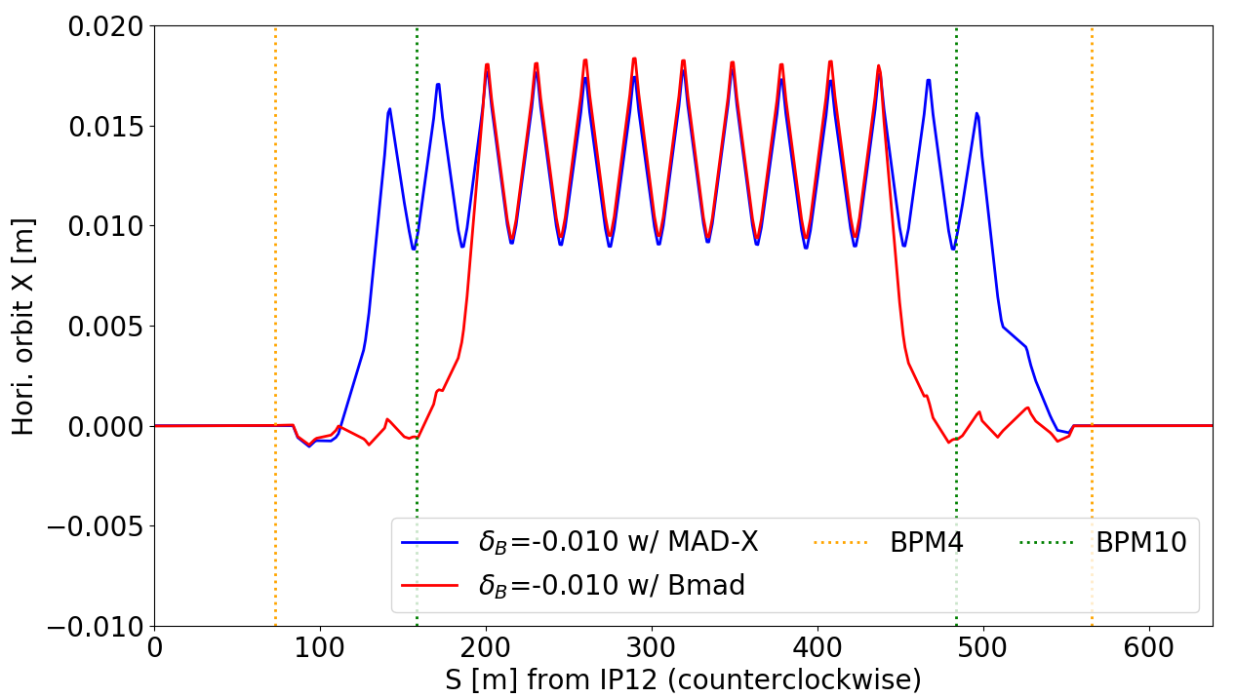
I – Context II – Run21 preparations III – Radial Shift lattices
Comparing Short/Long IR for δB = -1.0%:

Slide 9
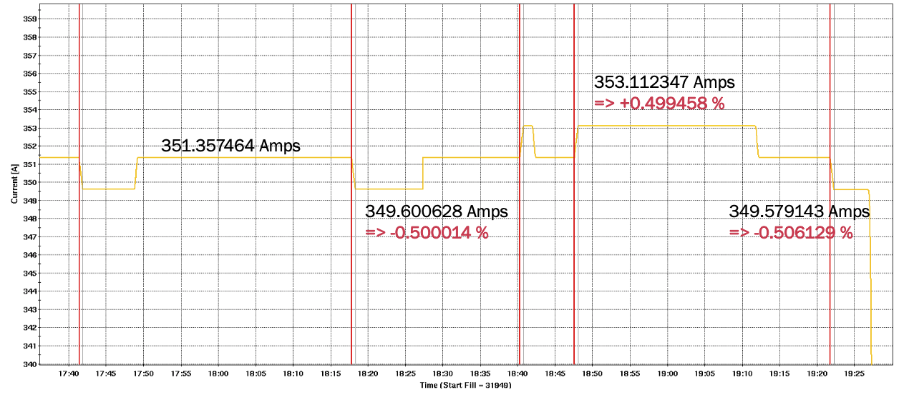
I – Context II – Run21 preparations III – Radial Shift lattices IV – Experimental results
First time request was dedicated to testing the RF control using Au20-7GeV-10m (wiggle low energy ramp).
Experiments are designed to shift the radius of the beam path while maintaining the momentum constant. The implication for the required frequency change is:
$$\frac{dp}{p}=γ^{2}\frac{df}{f}+γ^{2}\frac{dR}{R}⇔ \frac{df}{f}=−\frac{dR}{R}$$
In RHIC, applying a frequency change is done via controlling X_{mean} – and there was trouble initially calculating that change the appropriate way.

Slide 10
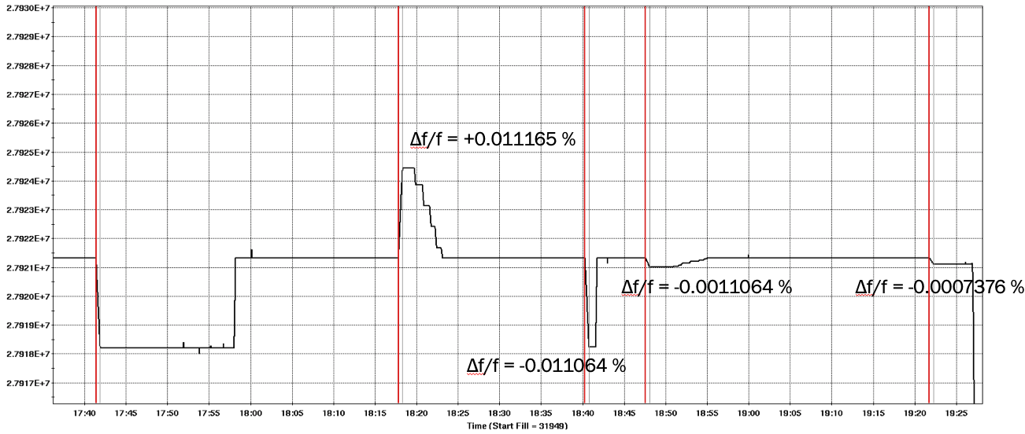
I – Context II – Run21 preparations III – Radial Shift lattices IV – Experimental results
First time request was dedicated to testing the RF control using Au20-7GeV-10m (wiggle low energy ramp).
Experiments are designed to shift the radius of the beam path while maintaining the momentum constant. The implication for the required frequency change is:
$$\frac{dp}{p}=γ^{2}\frac{df}{f}+γ^{2}\frac{dR}{R}⇔ \frac{df}{f}=−\frac{dR}{R}$$
In RHIC, applying a frequency change is done via controlling X_{mean} – and there was trouble initially calculating that change the appropriate way.

Slide 11
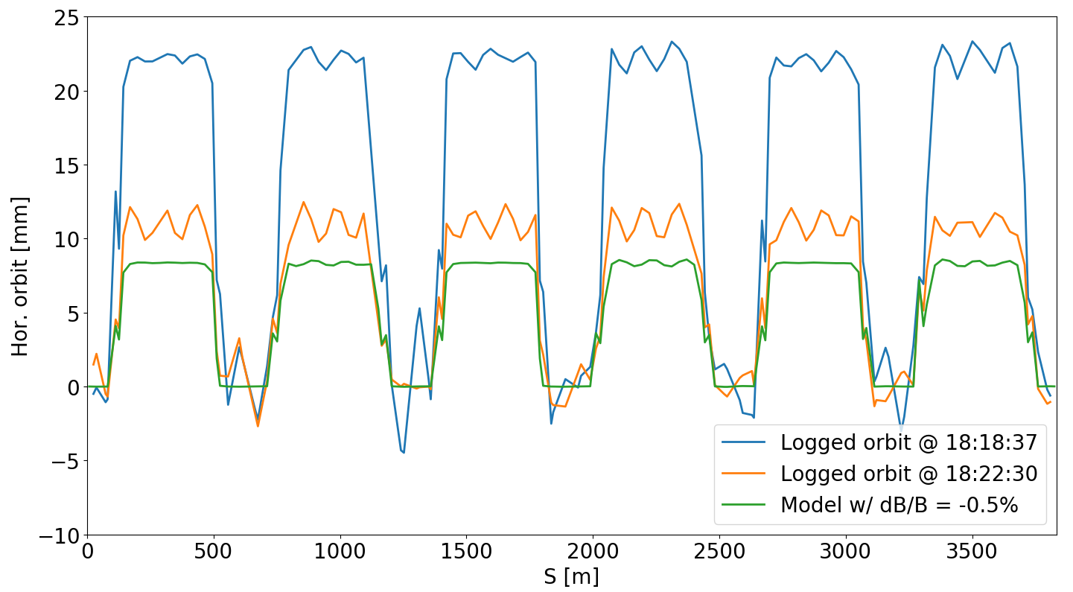
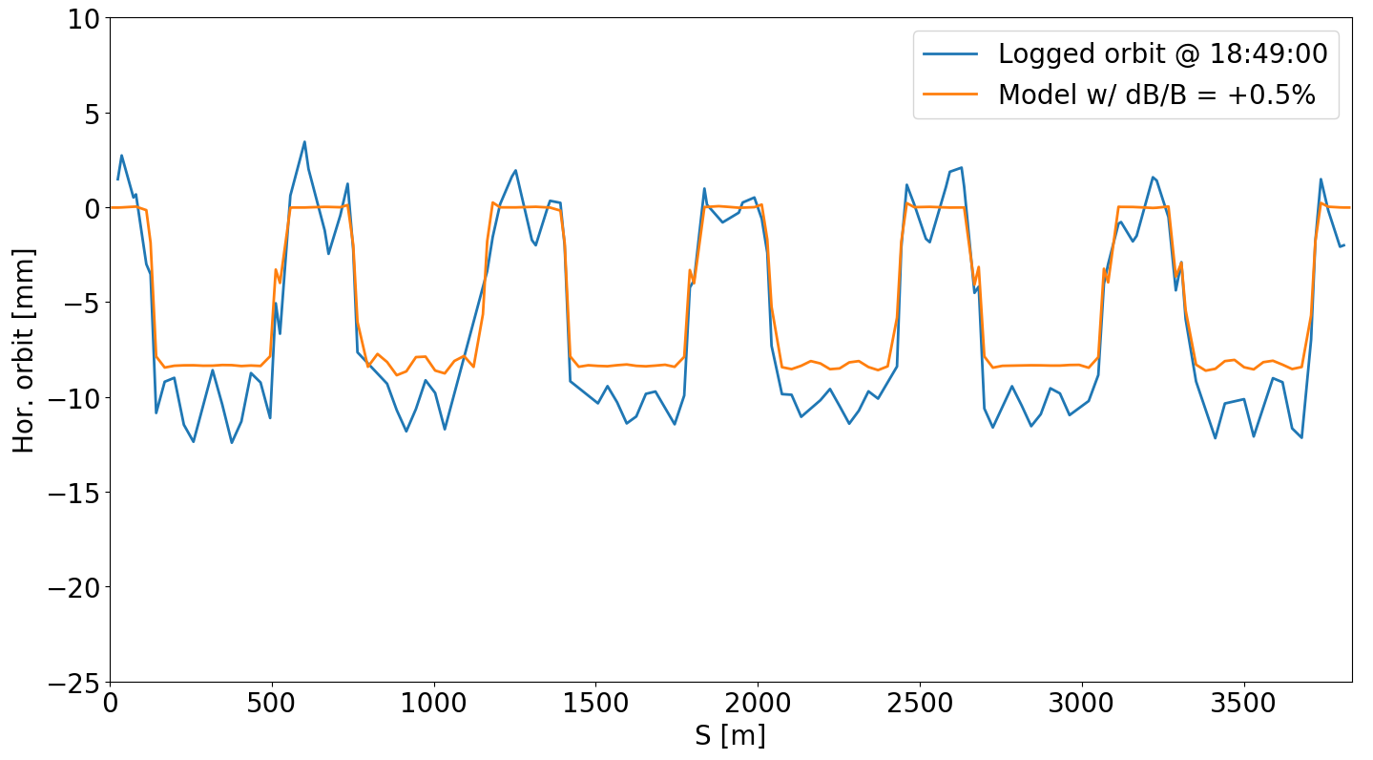
I – Context II – Run21 preparations III – Radial Shift lattices IV – Experimental results
First time request was dedicated to testing the RF control using Au20-7GeV-10m (wiggle low energy ramp).
Experiments are designed to shift the radius of the beam path while maintaining the momentum constant. The implication for the required frequency change is:
$$\frac{dp}{p}=γ^{2}\frac{df}{f}+γ^{2}\frac{dR}{R}⇔ \frac{df}{f}=−\frac{dR}{R}$$
In RHIC, applying a frequency change is done via controlling X_{mean} – and there was trouble initially calculating that change the appropriate way.

Slide 12
I – Context II – Run21 preparations III – Radial Shift lattices IV – Experimental results
Following our initial attempts at 7.3 GeV, we resolved the question of RF frequency change to match δB.
Next attempts were split as such, each time using 6-bunch ramps with tune/coupling feedback:
5/12: 21:00 – 00:00, 12.2 GeV/u [O21-100GeV-e0::injection], δB = ±0.8% (Short), ±1.0% (Long);
5/14: 13:30 – 16:00, 100 GeV/u [Au21-100GeV::store] , δB = ±1.0% (Short and Long) => ABORTED
5/17: 21:30 – 01:15, 100 GeV/u [Au21-100GeV::store] , δB = ±1.0% (Short and Long);
5/20: 14:30 – 17:30, 100 GeV/u [Au21-100GeV::store] , δB = -1.0% (Short and Long).
The aborted session on 5/14 was due to BLM thresholds set to the tight “store” configuration; additionally, the second ramp had the collimators fully retracted, leaving Q21 in the middle of the 10-to-12 arc as the limiting aperture…
Total time spent testing at 100 GeV/u: 7 hours, with no ramp lost to a bad lattice configuration – including our last attempt with 28 bunches (δB = -1%, Long IR)!

Slide 13
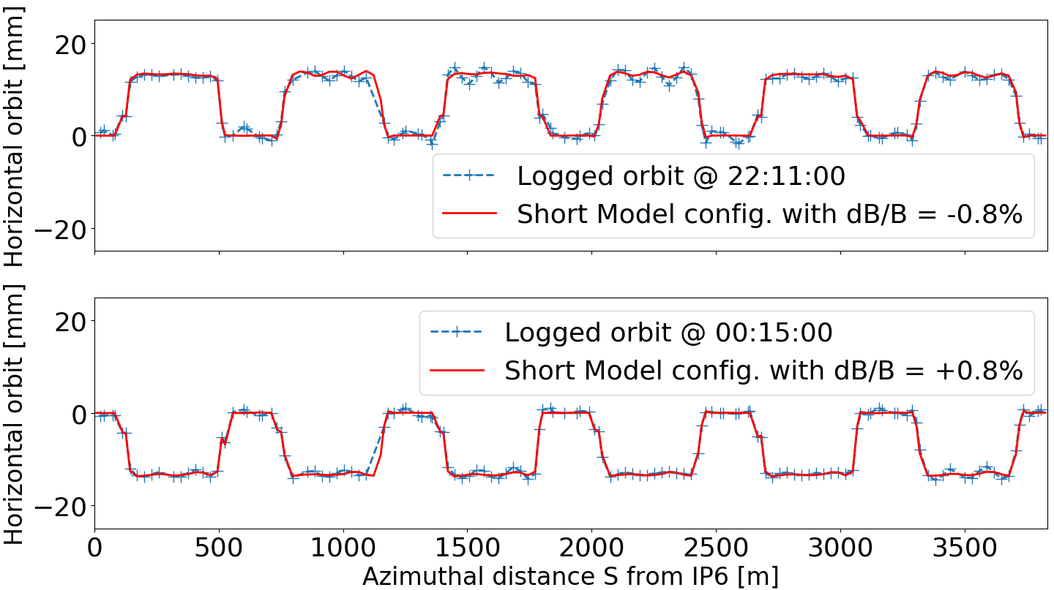
I – Context II – Run21 preparations III – Radial Shift lattices IV – Experimental results
Short IR, Oxygen beam @ 12.2 GeV/u

Slide 14
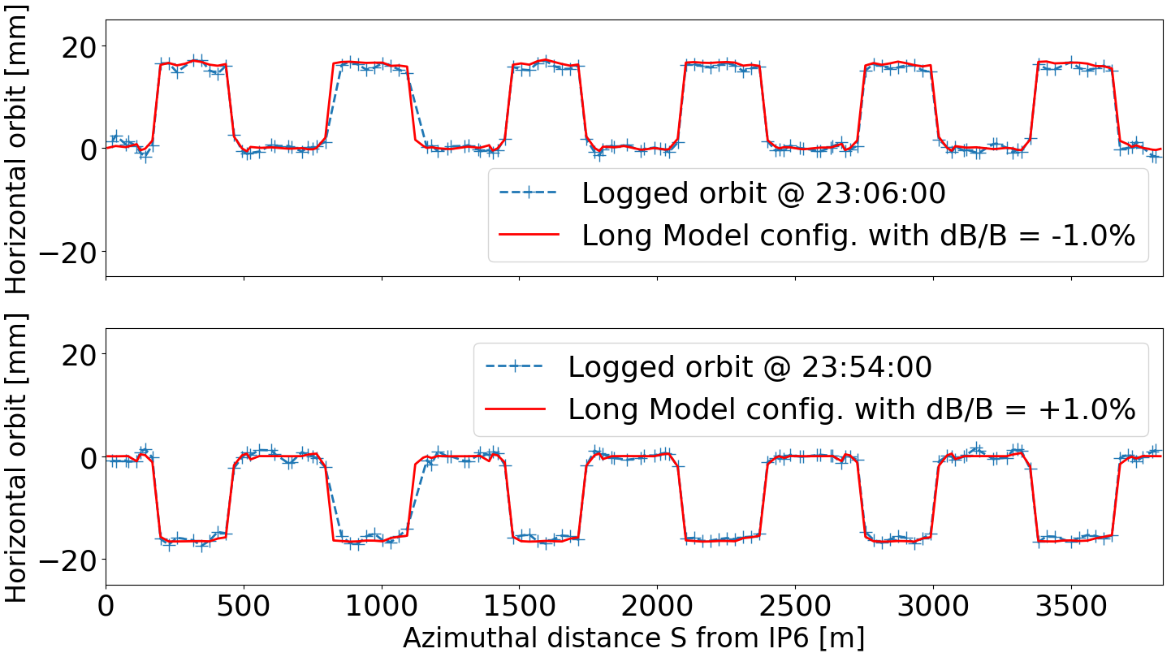
I – Context II – Run21 preparations III – Radial Shift lattices IV – Experimental results
Long IR, Oxygen beam @ 12.2 GeV/u

Slide 15
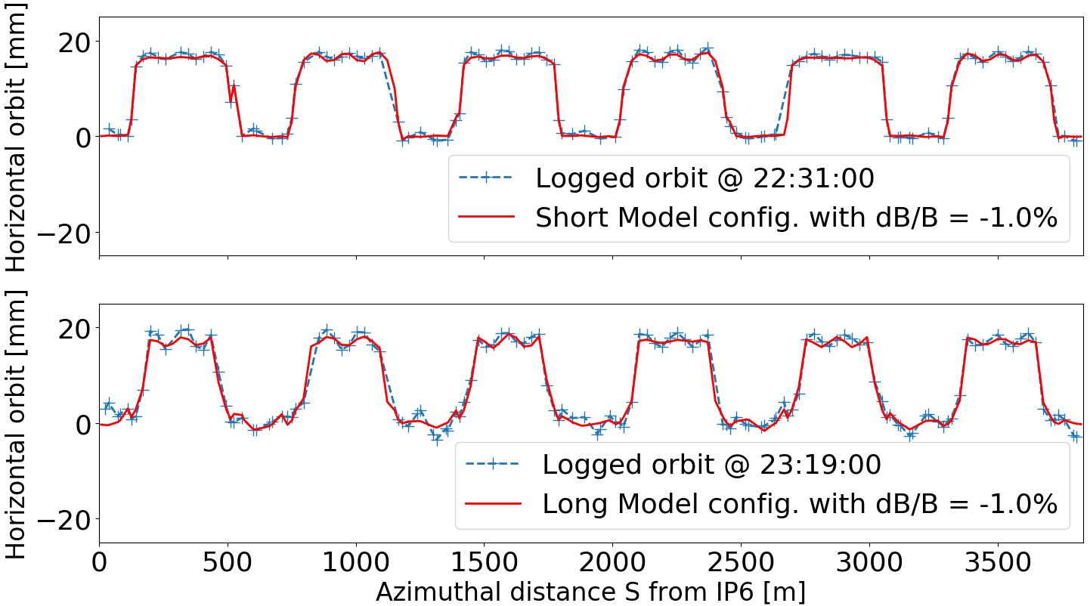
I – Context II – Run21 preparations III – Radial Shift lattices IV – Experimental results
Gold beam @ 100.0 GeV/u, δB = -1.0%

Slide 16
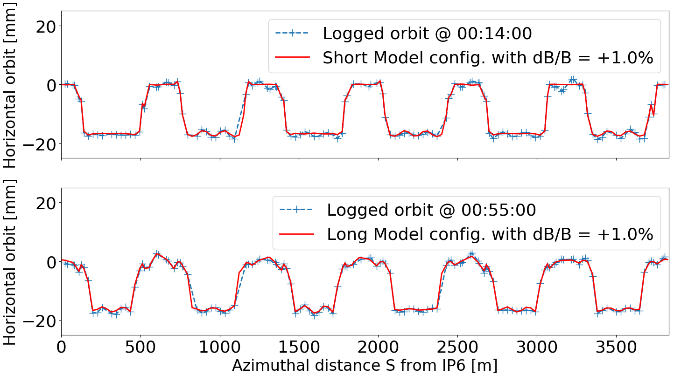
I – Context II – Run21 preparations III – Radial Shift lattices IV – Experimental results
Gold beam @ 100.0 GeV/u, δB = +1.0%

Slide 17
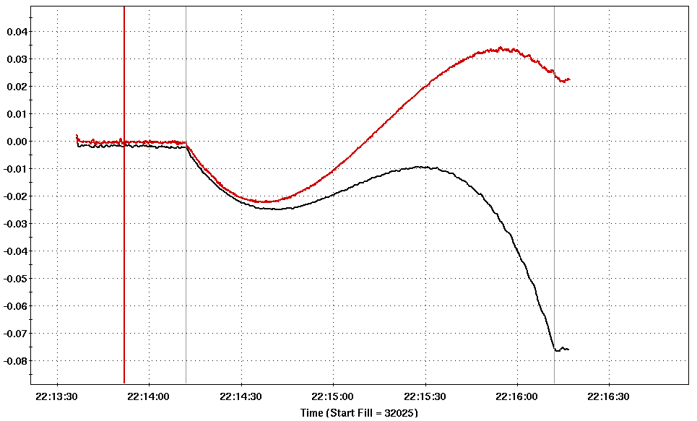
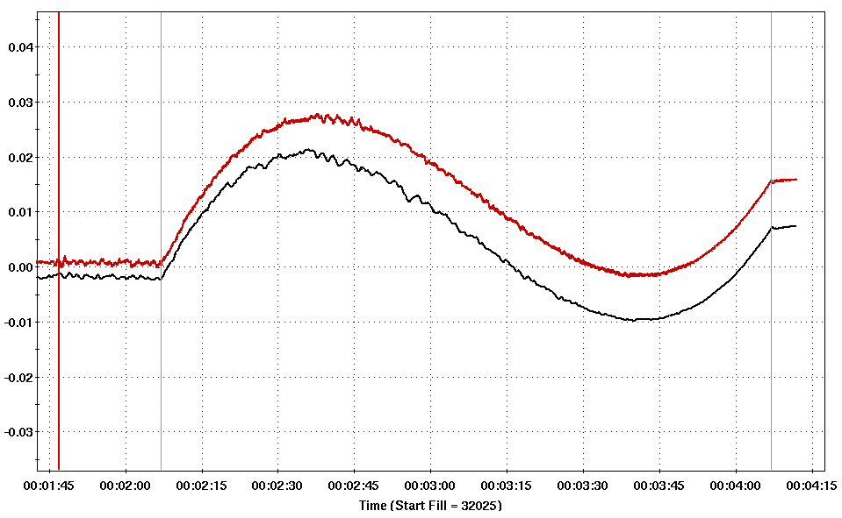
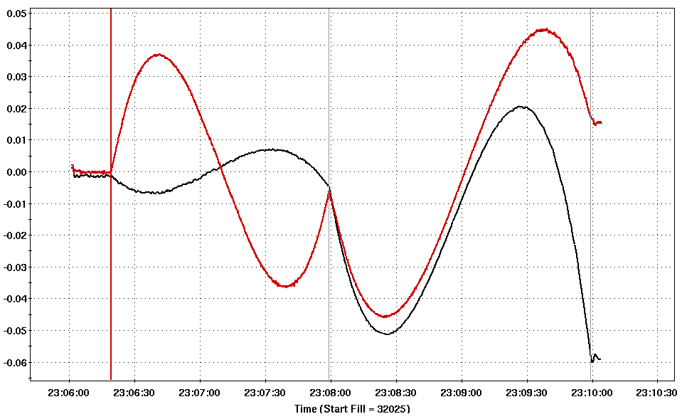
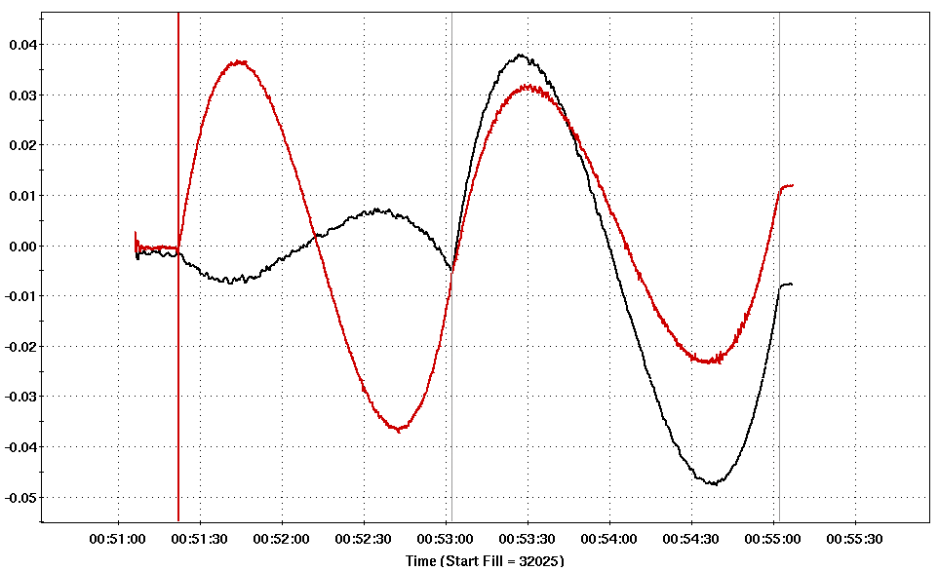
I – Context II – Run21 preparations III – Radial Shift lattices IV – Experimental results
Comparing the efforts of the tune feedback system at 100 GeV/u
RSm1
RSp1
RSm1long
RSp1long

Slide 18
I – Context II – Run21 preparations III – Radial Shift lattices IV – Experimental results
In order to try and adjust chromaticities for the -1% configurations, two methods can be tested:
the offline models can be asked to generate “design” chromaticities shifted by the difference measured during the 5/17 attempts;
use the “traditional” RampEditor knob to check whether the on-axis response matrix is still valid.
Rematched ramps:
new RSm1: ChromX = -8.0, ChromY = 12.0
new RSm1long: ChromX = -15.0, ChromY = 8.0
RampEditor knob:
RSm1: requested ΔC_{x} = -5, ΔC_{y} = +1; measured ΔC_{x} = -4, ΔC_{y} = +0.6.
RSm1long: requested ΔC_{x} = +1, ΔC_{y} = +4; measured ΔC_{x} = +0.8, ΔC_{y} = +2.6.

Slide 19
I – Context II – Run21 preparations III – Radial Shift lattices IV – Experimental results V - Conclusion
Fully demonstrated the concept of radial shift as intended for EIC at 100 GeV/u - with two different straight section configurations.
Successfully used tune/coupling feedback during each attempt, which helped keeping the beam loss rate to very low levels; however, there were issues with chromaticity control for δB = -1.0%, putting extra strain on tune feedback and generating beam losses.
To address this, the response matrix for chromaticity control in RHIC (i.e. for on-axis operations) was tested with the orbit fully shifted, and the measured changes were on par with what was requested. On the other hand, redesigning the shifted lattices with offline models did not improve the chromaticities as much as anticipated => current assumption is that there is an issue with some magnet parameters, most notably the multipole components of the field, not modeled appropriately.
A ramp with the -1.0% configuration using only an “up” sequence was also used, which quadrupoles go to their intended strengths but cap the dipoles to the shifted field setting. Similar chromaticity errors were seen.
Further analysis is still needed to fully understand the difference in behavior between the -1% and +1% setups, the latter being pretty much spot on compared to the lattice design from offline models for both Short and Long configurations.
Run22: more APEX time will be requested, notably to study the potential effects of Radial Shift on polarization. This could help determine which configuration is best between Short and Long.

