Slide 1
Decoupling Test for EIC
Al, Christoph, Derong, Ian, Travis, Yun
2021 RHIC APEX workshop, Oct.22, 2021

Slide 2
Introduction
EIC HSR design proton H/V emittances are ~10 /1 nm at 275GeV. The large initial emittance ratio will be provided by injector chain to HSR. Here we focus on how to maintain this large ratio.
Betatron coupling will mix horizontal and vertical emittances. To achieve 10:1 emittance ratio, we need a very good betatron decoupling method and tools.
Goals of this experiment: 1) demonstrate 10:1 emittance ratio in RHIC, 2) test RHIC decoupling tool if it is efficient for EIC purpose.

Slide 3
Experiment Design
From beam-beam simulation, we would like to have Hadron Storage Ring’s tunes ~(0.228, 0.210) at this moment. Originally, we projected them to (0.310, 0.305), which with an even smaller tune split.
Ways to create possible 10:1 emittances in RHIC : 1) stochastic cooling to reduce vertical emittance, 2) scrape vertical plane to reduce vertical emittance, 3) offset injection to increase horizontal emittance, 4) IPM/Artus to blow up horizontal emittance, any other ways?
In run 2021, we did not have stochastic cooling, then we carried out this experiments at Au injection. Horizontal IBS will blow up horizontal emittance, while vertical will keep constant if Yellow ring is well decoupled. At the same time, we tried to blow up horizontal emittance with BBQ, Artus tune meter and offset injection to obtain a large emittance ratio.

Slide 5
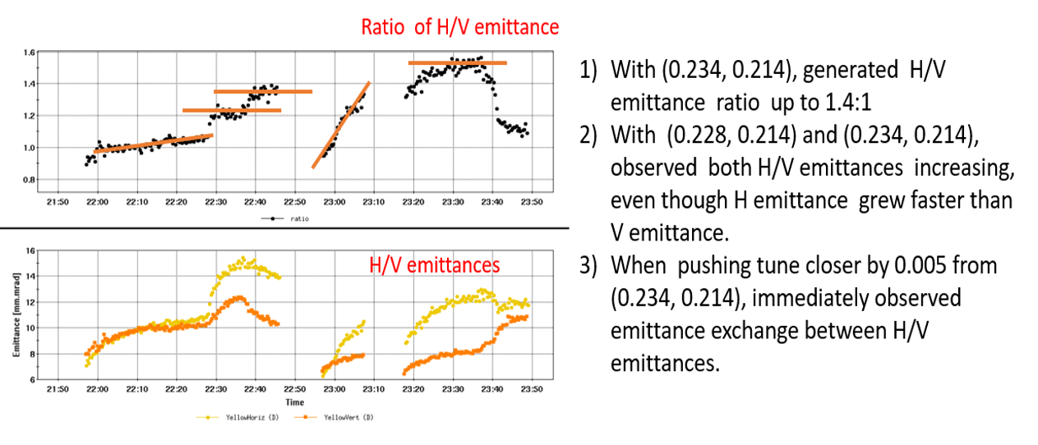

Slide 6
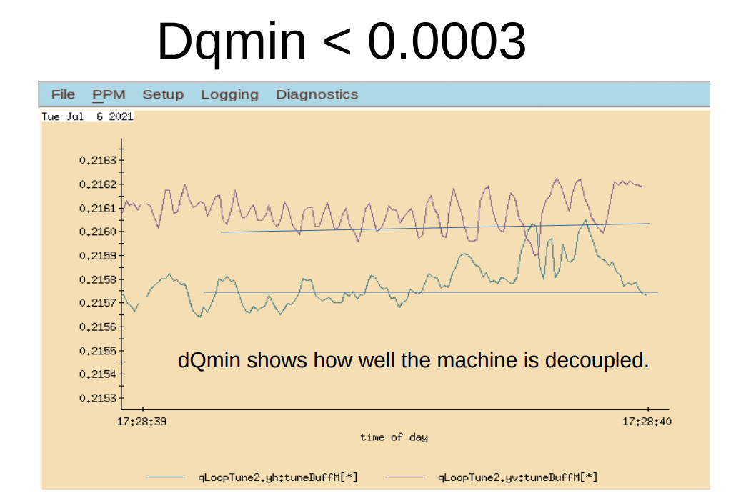
Experiment on July 6, 2021. 4-7pm ( cut short by thunderstorm )
Note: It should be the smallest tune split I had ever seen in RHIC.

Slide 7
Maximum H/V emittance ratio obtained: 1.8
2) With tunes (0.241, 0.208), vertical emittance basically kept flat.
Kicking H plane
Measure
dQmin
H offset Inj.

Slide 8
Summary of experiment
1) We obtained the smallest dQmin = 0.0003 in RHIC. Small dQmin means small globe betatron coupling. ( local coupling is still there)
2) By increase horizontal emittance with BBQ, tune meter, and horizontal offset injection, we only obtained 1.8:1 emittance ratio at Au injection.
3) Previous experiment and operational data: maximum ratio of 2:1 was demonstrated, by staying at 100GeV Au store for almost 2.5 hours ( Christoph, 2019), or only with vertical plane stochastic cooling ( Wolfram, 2016).

Slide 9
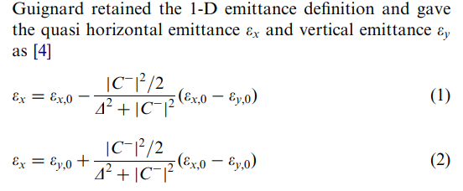
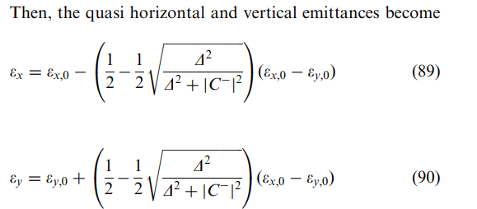
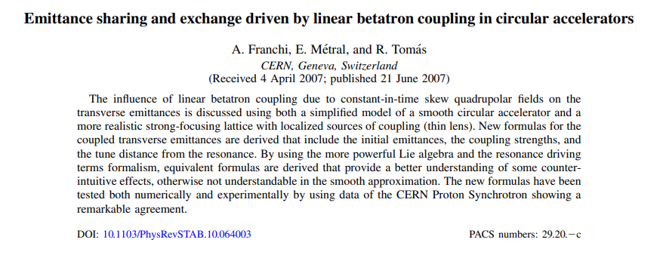
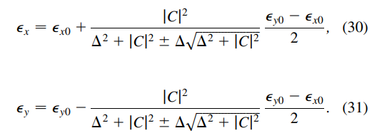
Theory: Emittance exchange with coupling
Y. Luo

Slide 10
Requirement to maintain 10:1 emittances
Based on Guignard’s equations, with H/V emittance equal 10nm and 1nm. If we tolerate only 5% increase in vertical emittance, we have |C⁻/Δ| < 0.1. For (0.228, 0.210) tunes, we need |C⁻|=dQmin < 0.0018; For Tunes (0.310, 305), we need |C⁻|=dQmin < 0.0005.
Based on Yun’s equation, for same condition, we need |C⁻/Δ| < 0.15.
Based on CERN people’s new equation: to be checked
Therefore, generally speaking, we need have |C⁻/Δ| < 0.1. For HSR, we need have |C⁻|=dQmin < 0.001 with tune split 0.01. and
|C⁻|=dQmin < 0.0005 with tune split 0.005.
dQmin < 0.001 can be easily reached with decoupling feedback in RHIC.
dQmin < 0.0005 needs some careful decoupling work or even improvement
to current decoupling system / method (local coupling?) .

Slide 11
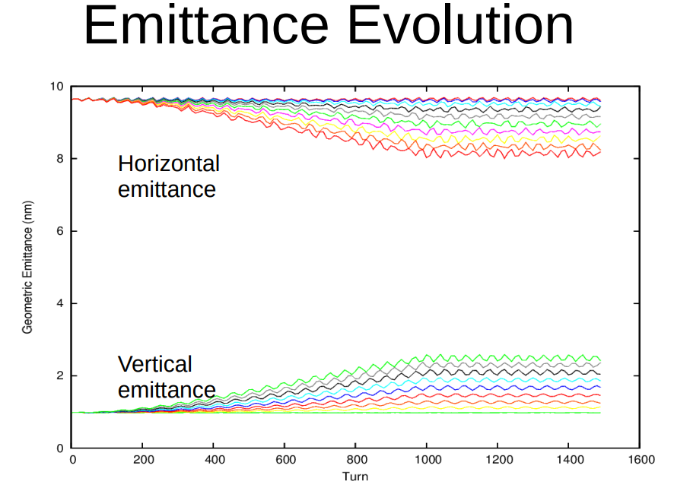
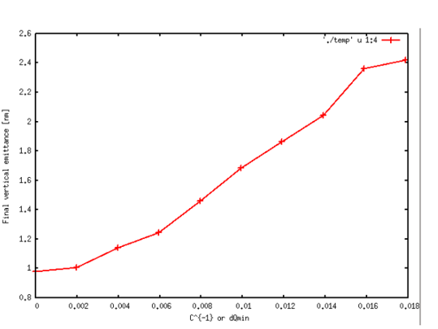
Numerical Simulation for RHIC
Final vertical emittance as function of dQmin
Slowly rolling in coupling
Equilibrium emittances

Slide 12
Summary & Plan
1) Limited by the ways to reduce vertical emittance, we only obtained 1.8:1 emittance ratio at Au injection.
2) We obtained dQmin as small as 0.0003 in RHIC with current decoupling tools.
3) Analytical prediction: For (0.228, 0.210) tunes, we need |C⁻|=dQmin < 0.0018; For Tunes (0.310, 305), we need |C⁻|=dQmin < 0.0005 to maintain 10:1 emittance ratio. ( this requirement applies to ramp too. )
4) Numeric simulation with RHIC lattice: with (0.228, 0.210) tunes, dQmin=0.002 can keep vertical emittance at 1nm + 5%.
5) We will re-visit this experiment in future 100GeV Au run with stochastic cooling. Numeric simulation with EIC HSR lattice is going on.

