Slide 1
EIC ESR and HSR RF Challenges and Possible Reverse Phasing Experiment
Kevin S. Smith
APEX Workshop 2021
November 9, 2021

Slide 2
Outline
Very Brief Overview of EIC RF Systems
Challenges for EIC Ring RF (HSR and ESR)
Detuning
Transient Beam Loading
Reverse Phasing Technique
Summary

Slide 3
Overview – EIC RF Systems
IR-10: SRF Systems
RCS SRF
Electron Storage Ring SRF
Hadron Ring SRF
IR-2: Strong Hadron Cooling
Energy Recovery Linac (ERL)
Many new RF locations and lots of new SRF systems
IR-4: Warm RF Systems
IR-6: Crab Cavity SRF Systems
197 MHz and 394 MHz Hadron Crab Cavity Systems
394 MHz Electron Crab Cavity Systems
Current location for all RHIC RF systems
Hadron RF Systems (Hadron SRF at IR-10)
RCS Warm RF Systems (Bunch Merging)
3

Slide 4
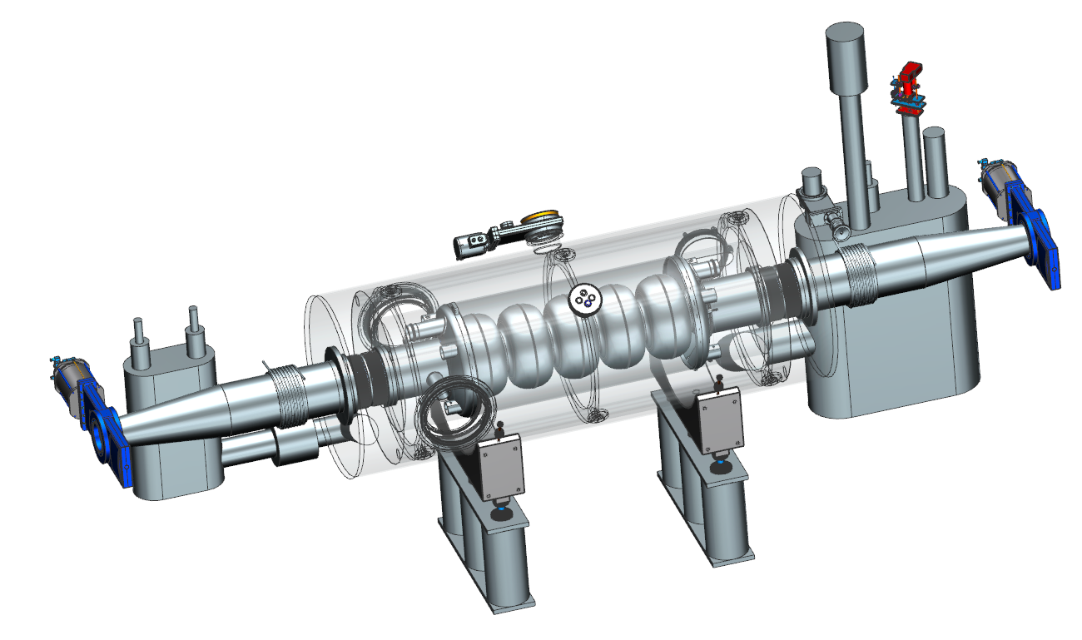
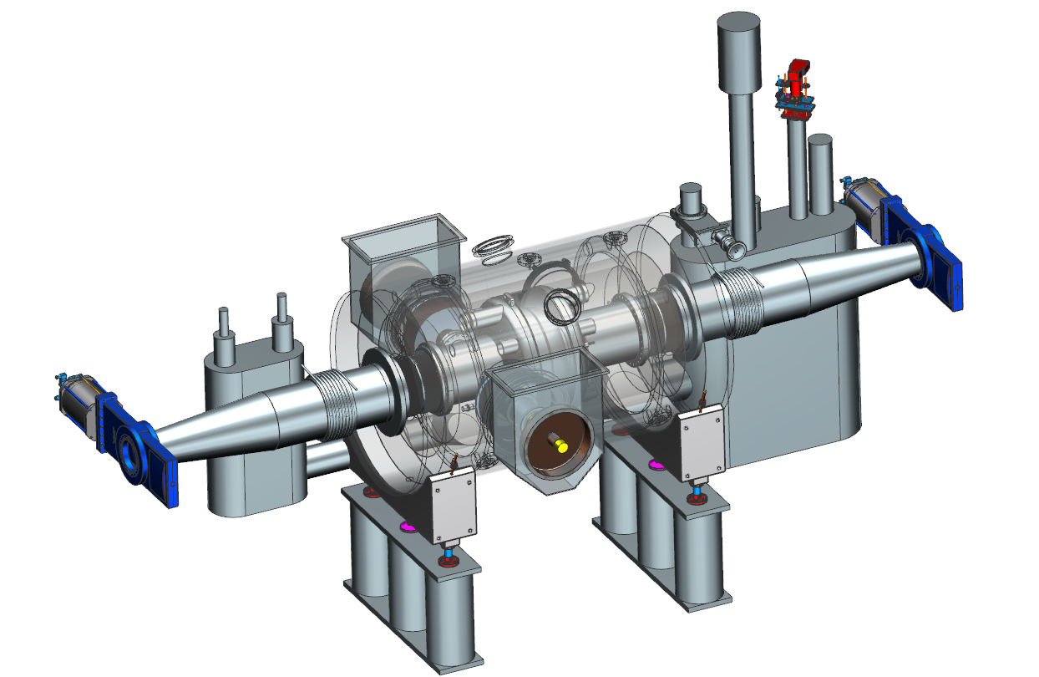
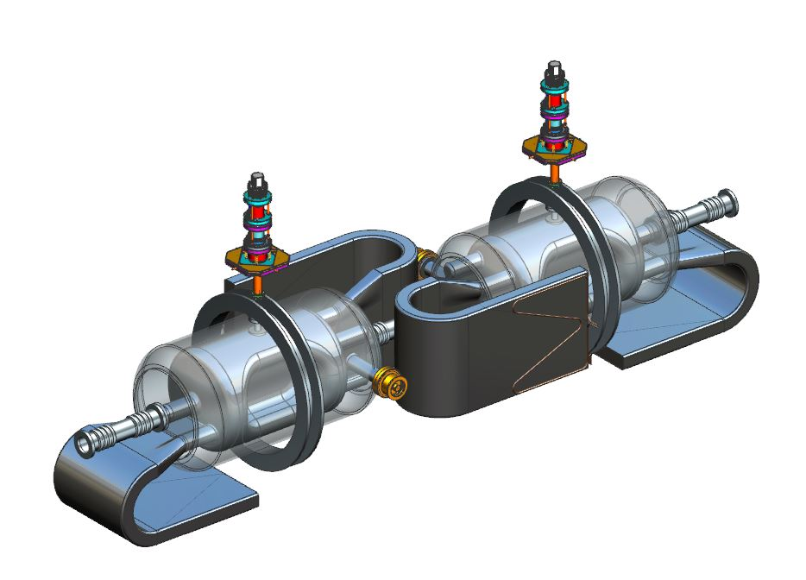
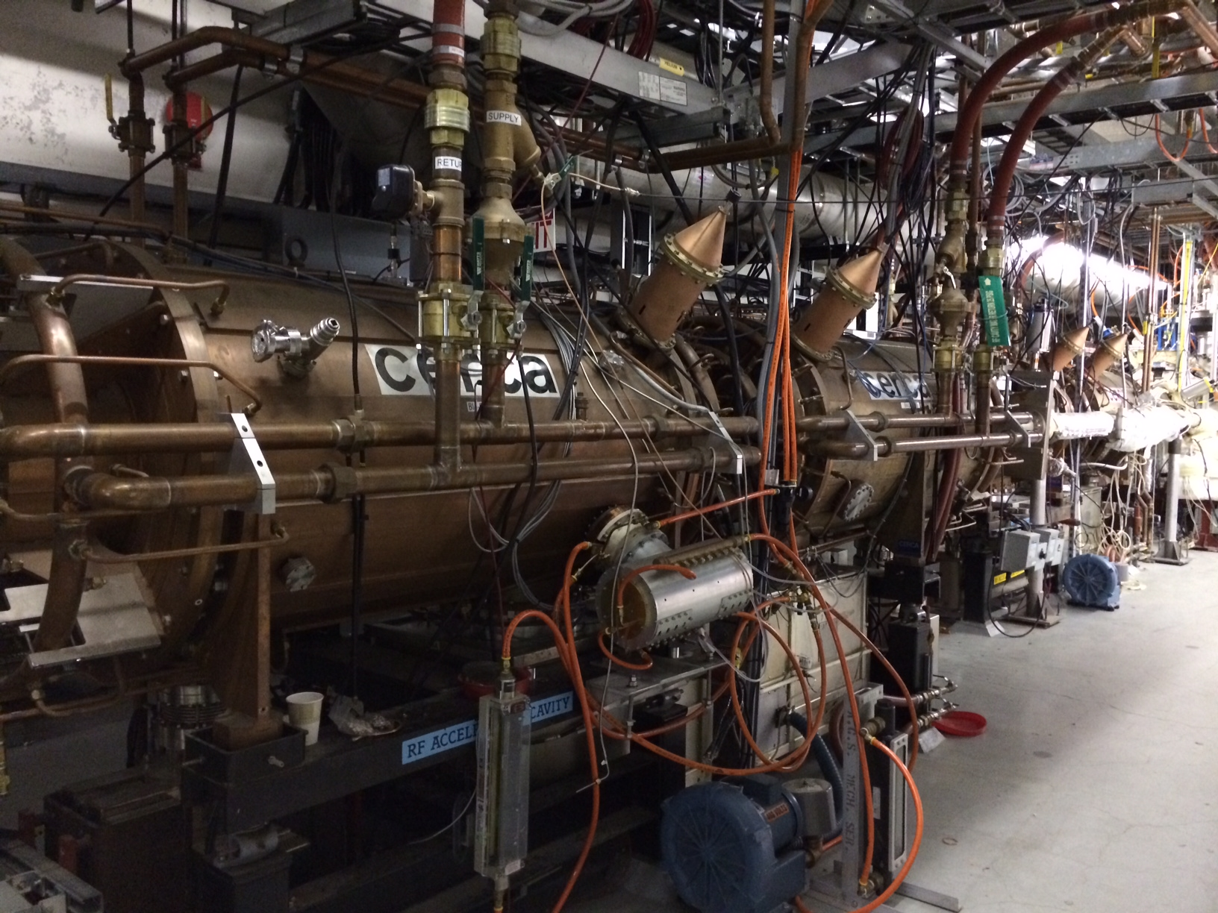
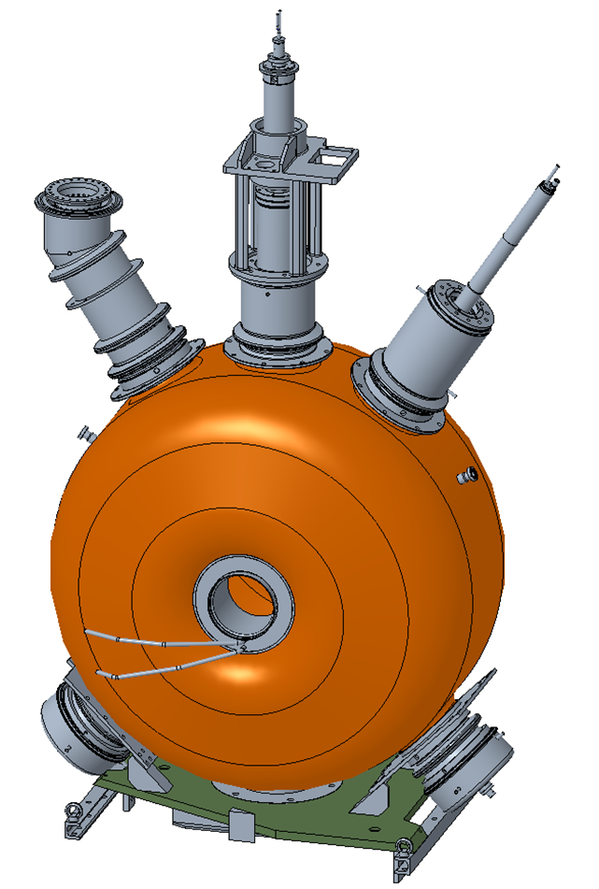
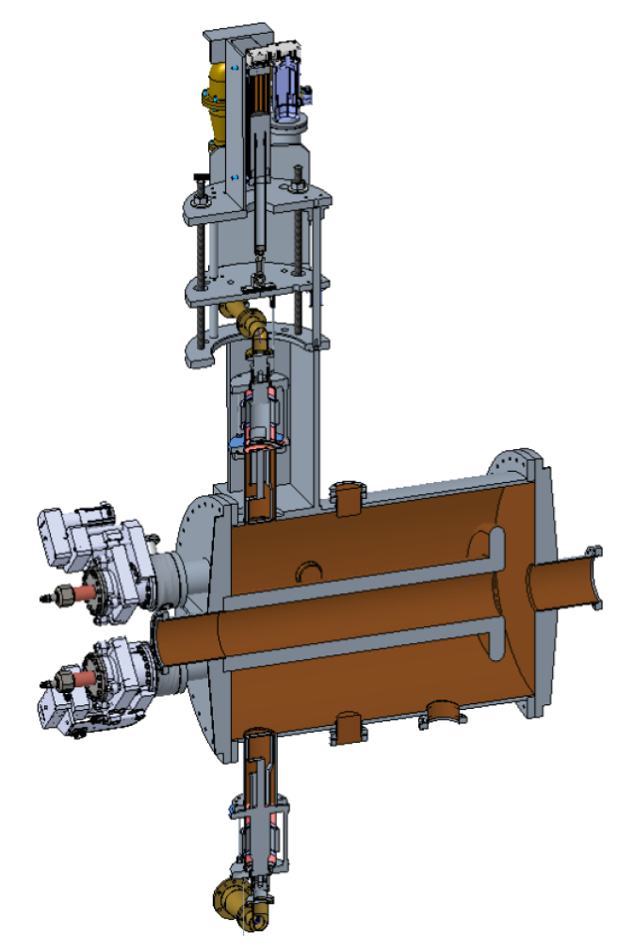
Scope Overview – SRF and NCRF Systems
HSR - 591 MHz 5-Cell Cavity
Bunch Compression
RCS - 591 MHz 5-Cell Cavity
Acceleration Cavity
SHC- 591 MHz 5-Cell and
1773 MHz 5-Cell ERL Cavities
SRF Cavity R&D Focus
591 MHz ESR 1-Cell Cavity
Crab Cavities – HSR & ESR
HSR – 24.5 MHz Capture & Acceleration
Reuse 28 MHz system with Modifications
HSR - 197 MHz Bunch Compression
Reuse with Modifications
HSR – Bunch Splitting (New)
RCS – Bunch Merging (New)

Slide 5
Cavity Detuning
The high beam currents and low voltages in some operating scenarios require large detuning of cavities to compensate reactive beam loading.
Detuning is necessary in that it reduces required RF power.
But too large a detuning can lead to coupled bunch instabilities.
Generator current 90 deg out of phase with voltage. Reactive power reflects back to generator.
Generator current is in phase with voltage, delivering real power to cavity and beam.
Can make this term zero by choice of detuning.

Slide 6
ESR 591 MHz Parameters and Detuning
Parameter | Units | 18 GeV | 10 GeV | 5 GeV
# Cavities |  | 17 | 17 | 17
V_{sync} | MV | 37 | 3.75 | 1.17
V_{total} | MV | 61.5 | 21.6 | 9.8
φ_{s} | Deg | 142.9 | 170.0 | 173.1
Bucket Height | 1E-3 rms | 10 | 10 | 10
I_{beam} | A | 0.227 | 2.50 | 2.50
P_{beam} | MW | 8.4 | 9.4 | 2.9
Detuning | kHz | -1.1 😎 | -42.4 😨 | -94.2 🤢
Note that in the next parameter table, the 5 GeV detuning is even larger.
Due to reduction in required bucket height from 1E-2 to 5E-3.
This leads to a reduction in required voltage and φ_{s}.

Slide 7
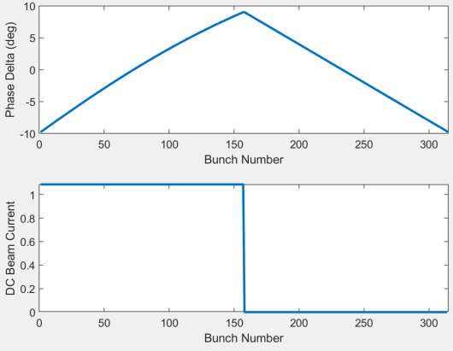
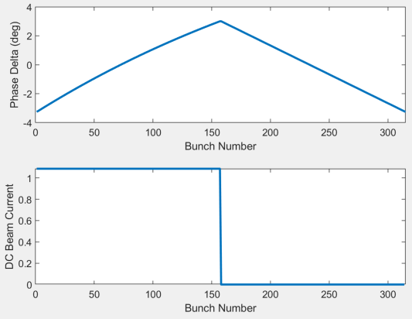
HSR 24.5 MHz Cavity Transient Beam Loading
Add in the presence of a partially filled ring, and transient beam loading becomes an added challenge.
Transient beam loading leads to a progressive phase (time) shift in bunches along the turn, leading e.g. to bunch by bunch crabbing errors, collision point shifts.
Half filled ring (worst case TBL for RF, store/collision is milder with just a 1us abort gap but that matters to collision timing), 24.6 MHz, h = 315
V_{cav} = 100 kV, dφ = 18.8°
V_{cav} = 300 kV, dφ = 6.3°

Slide 8
ESR TBL and Detuning Mitigation
A possible mitigation is to operate cavities at as high a voltage as practical, which minimizes required detuning and transient beam loading.
But operating with high voltage in a conventional “all cavities in phase” mode results in short bunches and high synchrotron tunes – neither of which are desirable.
Possible alternative – operate individual cavities as high in voltage as practical, but use a “Reverse Phasing” (KEK) technique so that:
Beam sees a vector sum which is the minimum voltage needed to provide required beam power and bucket height.
Maximum bunch length and minimum synchrotron tune
All cavities provide the same real power to the beam.
All cavity power couplers share the power load equally.

Slide 9
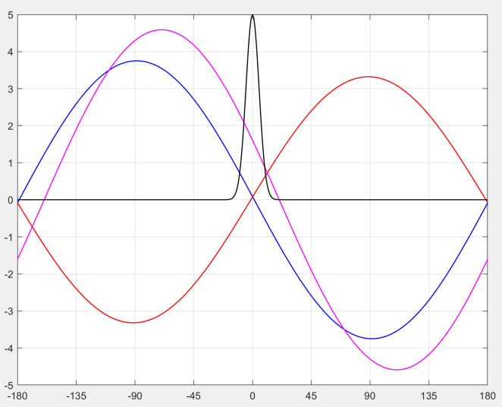
What Does Reverse Phasing Look Like?
4.6 MV
Magenta = Vector Sum
Y-Axis = V_{tot}
37.5 MV
33.2 MV
1.6 MV
MV
RED = Defocusing Family
8 cav * 4.15 MV = 33.2 MV
Y-Axis = V_{D} / 10
BLUE = Focusing Family
9 cav * 4.17 MV = 37.5 MV
Y-Axis = V_{F} / 10
ESR requires 17 591 MHz, 1-cell cavities
Degrees

Slide 10
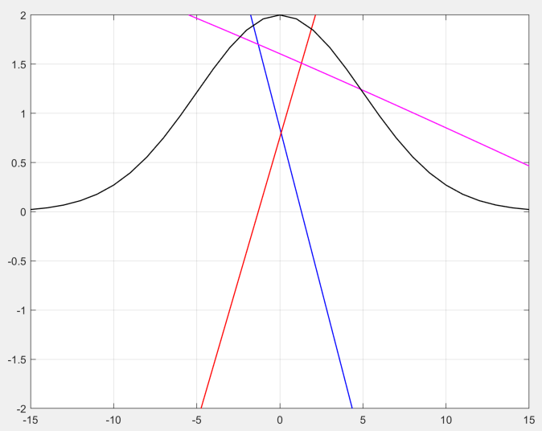
What Does Reverse Phasing Look Like? (Zoom)
Magenta = Vector Sum
Y-Axis = V_{tot}
1.6 MV
0.8 MV
MV
RED = Defocusing Family
Y-Axis = V_{D}
BLUE = Focusing Family
Y-Axis = V_{F}
Degrees

Slide 11
18 GeV and 5 GeV Detuning (Std and RP)
Parameter | Units | 18 GeV (Std) | 5 GeV (Std) | 5 GeV (RP)
I_{beam} | A | 0.227 | 2.50 | 2.50
P_{beam} | MW | 10.0 | 4.42 | 4.42
Bucket Height | 1E-3 rms | 10.8 | 5.5 | 5.5
# Cavities (F) |  | 17 | 17 | 9
V_{sync} | MV | 37 | 1.55 | 0.82
V_{total} [V_{cav}] | MV | 64.5 [3.70] | 4.6 [0.27] | 37.5 [4.17]
φ_{s} | Deg | 144.9 | 160.3 | 178.7
P_{beam} | MW | 10.0 | 4.42 | 2.34
Detuning | kHz | -1.3 😎 | -216.0 🤮 | -14.9 😅
# Cavities (D) |  | 0 | 0 | 8
V_{sync} | MV |  |  | 0.73
V_{total} [V_{cav}] | MV |  |  | 33.2 [4.15]
φ_{s} | Deg |  |  | 1.3
P_{beam} | MW |  |  | 2.08
Detuning | kHz |  |  | +15.0 😅

Slide 12
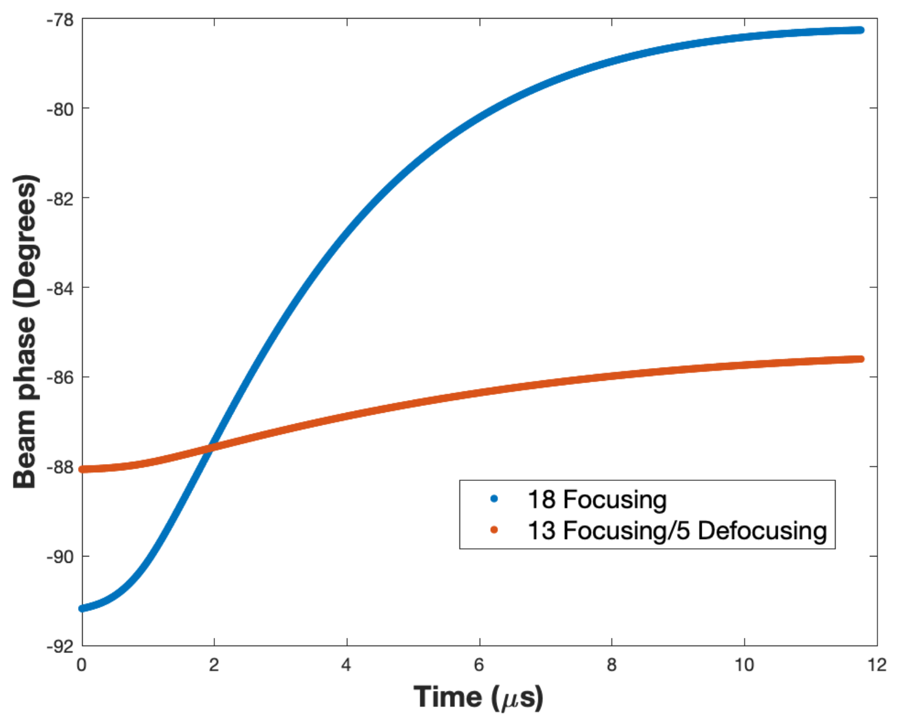
ESR 10 GeV Transient Beam Loading (Std and RP)
Standard Cavity Phasing: 13 deg pk-pk phase shift along the bunch train.
Reverse Phasing: 2.5 deg pk-pk phase shift along the bunch train.
T. Mastoridis

Slide 13
Summary
Reverse Phasing Operation
Developed and demonstrated at KEK but not used operationally.
Proposed for RF systems in the EIC ESR to ameliorate transient beam loading and required detuning.
18 GeV vs 5 GeV standard phasing shows the extreme range of parameters we’ll be dealing with.
5 GeV standard phasing (std) vs 5 GeV reverse phasing (RP) shows potential benefit of reverse phasing.
Not a formal proposal yet, but we will likely want to experiment with the RHIC RF system to verify operational aspects and look for unanticipated behaviors.

