Slide 1
ATF Status and Plans
Mark Palmer for the ATF Operations Team
24th ATF Users Meeting
January 18, 2022
The Accelerator Test Facility

Slide 2
Welcome
I and the ATF team want to welcome everyone who can join us at this year’s virtual meeting
The ATF Program Advisory Committee will be evaluating another interesting group of new proposals

Slide 3
A Special Thanks...
Program Advisory Committee:
  Sandra Biedron (Chair), University of New Mexico
  Felicie Albert, Lawrence Livermore National Lab
  Jianming Cao, Florida State University
  Jean-Pierre Delahaye*, CERN
  Louis DiMauro*, Ohio State University
  Ernest Fontes, Cornell University
  Bjorn Manuel Hegelich, University of Texas at Austin
  Patric Muggli, Max Planck Institute for Physics & CERN
  Craig Siders, Lawrence Livermore National Lab
  * Final year

Slide 4
Approach to this Users Meeting
Unfortunately, this Users Meeting is once again Virtual
We were also faced with threading it among multiple other assessments and activities
a Taking a somewhat streamlined approach
  Focus on:
    New proposals – to be presented Thursday afternoon & Friday afternoon
    Status reports from experiments that received running time in 2021
    We will organize a meeting with users who have not received beam time in the upcoming weeks to discuss options for accommodating them this year
  Facility Plans
    Will briefly summarize progress on the work that is underway
    The currently planned efforts will saturate the program through the current year
    The more important issue is the R&D results that will help determine the subsequent steps

Slide 5
ATF Introduction

Slide 6
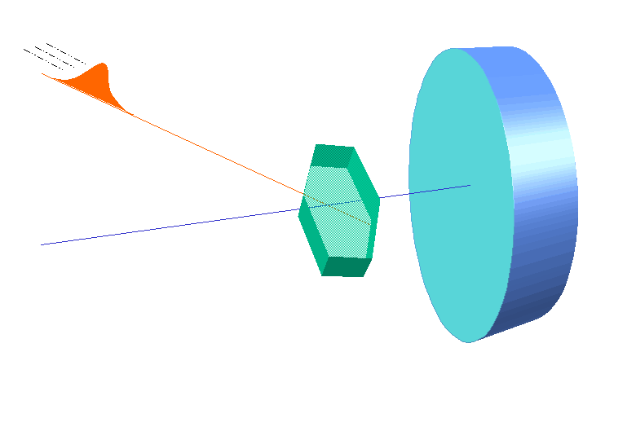
The ATF
3 Facility Capabilities Presently Operating for Users:
High brightness 75 MeV electron beam lines (B820)
NIR and LWIR lasers (B820)
  Long wavelength infrared (LWIR) CO₂ laser system - a unique tool world-wide
  Near-IR Ti:Sapph and Nd:YAG systems for users
Ultrafast electron diffraction facility (B912)
>20 active user experiments and feasibility studies
Optimal target: 2500 user hours/year
Beamline 1
Experimental stations
CO₂ Laser Area
New Location for the ATF Strong Field Laser (Ti:Sapph), BNL/NRL Collaboration
Single Crystal UED Experiments
Bunch compressor
Pump
Detector
Sample
Photocathode gun
Probe
Accelerator sections
Time Delay
The ATF Experimental Hall and Beam Lines
Beamline 2
Experimental stations
Deflector cavity

Slide 7
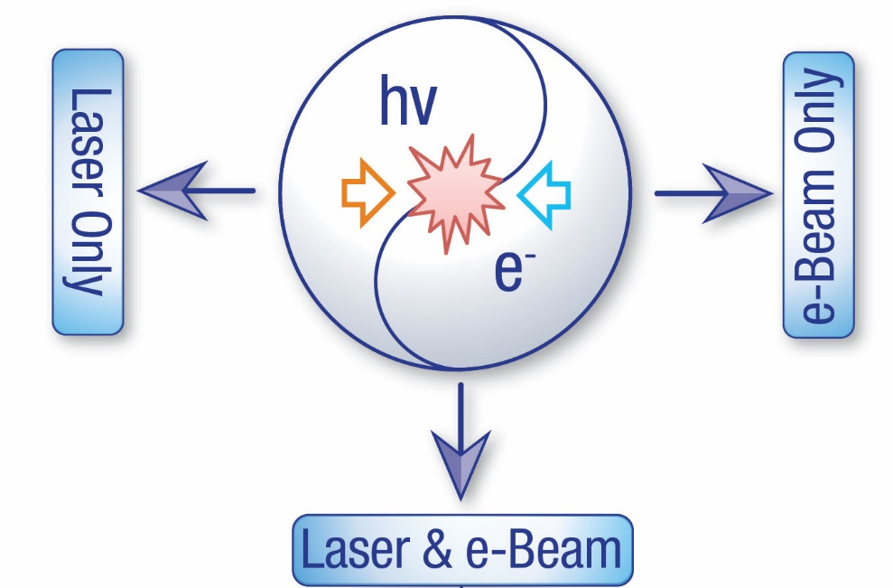
The ATF User Program
Designated a DOE National User Facility in 2015
Accelerator Stewardship Program
User Research Thrusts:
  Novel particle acceleration techniques
  R&D for smaller, more cost-effective accelerators including:
    Plasma and dielectric wakefield acceleration
    Direct laser acceleration
    Inverse free-electron lasers…
  High-brightness radiation sources
  New techniques to produce electromagnetic radiation
  from THz to X-rays:
    FEL R&D
    Inverse Compton scattering
    THz radiation from dielectric structures…
  Beam manipulation and beam instrumentation
  Sophisticated longitudinal and transverse beam manipulation capabilities
    Wide range of beam parameters enabling development and testing of advanced accelerator hardware, beam diagnostics and detectors
  Ion generation and acceleration
    Experimental hardware for producing supersonic hydrogen gas jets provides capabilities for generating mono-energetic multi-MeV proton beams
  Ultrafast Electron Diffraction/Microscopy
  Technique for characterizing materials that is complementary to x-ray sources
    Developmental beam line and experimental station for diffraction and imaging
    studies with MeV-class electron beams
CO₂ long-wave infrared (LWIR) laser system
λ = 9.2 μm
>5 TW peak power
(~2 TW to users)
5-10 J @ 2.0ps width
0.05 Hz repetition rate
New near IR capabilities
High-brightness photocathode linac: 20-75 MeV
Emittance: 1μm
Energy spread: 0.1%
Charge: ~1 nC
Single bunch:
10 ps – 200 fs
Multi-bunch trains

Slide 8
Electron Beam Parameters
Parameter | Units | Typical Values | Comments
Beam Energy | MeV | 50-65 | Full range is ~15-75 MeV with highest beam quality at nominal values
Bunch Charge | nC | 0.1-2.0 | Bunch length & emittance vary with charge
Compression | fs | Down to 100 fs (up to 1 kA peak current) | A magnetic bunch compressor available to compress bunch down to ~100 fs. Beam quality is variable depending on charge and amount of compression required. NOTE: Further compression options are being developed to provide bunch lengths down to the ~10 fs level
Transverse size at IP (σ) | μm | 30 – 100 (dependent on IP position) | It is possible to achieve transverse sizes below 10 um with special permanent magnet optics.
Normalized Emittance | μm | 1 (at 0.3 nC) | Variable with bunch charge
Rep. Rate (Hz) | Hz | 1.5 | 3 Hz also available if needed
Trains mode | --- | Single bunch | Multi-bunch mode available. Trains of 24 or 48 ns spaced bunches.

Slide 9
CO₂ Laser Parameters
Configuration | Parameter | Units | Typical Values | Comments
CO₂ Regenerative Amplifier Beam | Wavelength | μm | 9.2 | Wavelength determined by mixed isotope gain media
 | Peak Power | GW | ~3
 | Pulse Mode | --- | Single
 | Pulse Length | ps | 2
 | Pulse Energy | mJ | 6
 | M² | --- | ~1.5
 | Repetition Rate | Hz | 1.5 | 3 Hz also available if needed
 | Polarization | --- | Linear | Circular polarization available at slightly reduced power
CO₂ CPA Beam | Wavelength | μm | 9.2 | Wavelength determined by mixed isotope gain media
Note that delivery of full power pulses to the Experimental Hall is presently limited to Beamline #1 only. | Peak Power | TW | 2 | ~5 TW operation is planned within the next year (requires further in-vacuum transport upgrade). A 3-year development effort to achieve >10 TW and deliver to users is in progress.
 | Pulse Mode | --- | Single
 | Pulse Length | ps | 2
 | Pulse Energy | J | ~5 | Maximum pulse energies of >10 J will become available within the next year
 | M² | --- | ~2
 | Repetition Rate | Hz | 0.05
 | Polarization |  | Linear | Adjustable linear polarization along with circular polarization can be provided upon request

Slide 10
NIR Laser Parameters
Ti:Sapphire Laser System | Units | Stage I Values | Stage II Values | Comments
Central Wavelength | nm | 800 | 800 | Stage I parameters are presently available and setup to deliver Stage II parameters should be complete during FY22
FWHM Bandwidth | nm | 20 | 13
Compressed FWHM Pulse Width | fs | <50 | <75 | Transport of compressed pulses will initially include a very limited number of experimental interaction points. Please consult with the ATF Team if you need this capability.
Chirped FWHM Pulse Width | ps | ≥50 | ≥50
Chirped Energy | mJ | 10 | 200
Compressed Energy | mJ | 7 | 100
Energy to Experiments | mJ | >4.9 | >80
Power to Experiments | GW | >98 | >1067
Nd:YAG Laser System | Units | Typical Values | Comments
Wavelength | nm | 1064 | Single pulse
Energy | mJ | 5
Pulse Width | ps | 14
Wavelength | nm | 532 | Frequency doubled
Energy | mJ | 0.5
Pulse Width | ps | 10

Slide 11
ATF FY21 Status Report

Slide 12
Availability
Resource | Planned Hours | Delivered Hours | % of Planned Hours
Electron Beam | 750 | 917 | 122%
Laser (NIR + LWIR) | 750 | 1378 | 184%
UED | 550 | 703 | 94%
Total | 2250 | 2998 | 94%
2021
2022
Resource | Planned Hours
Electron Beam | 400
Laser (NIR + LWIR) | 450
UED | 950
Total | 1800

Slide 13
FY21 Hours Summary

Slide 14
General Updates

Slide 15
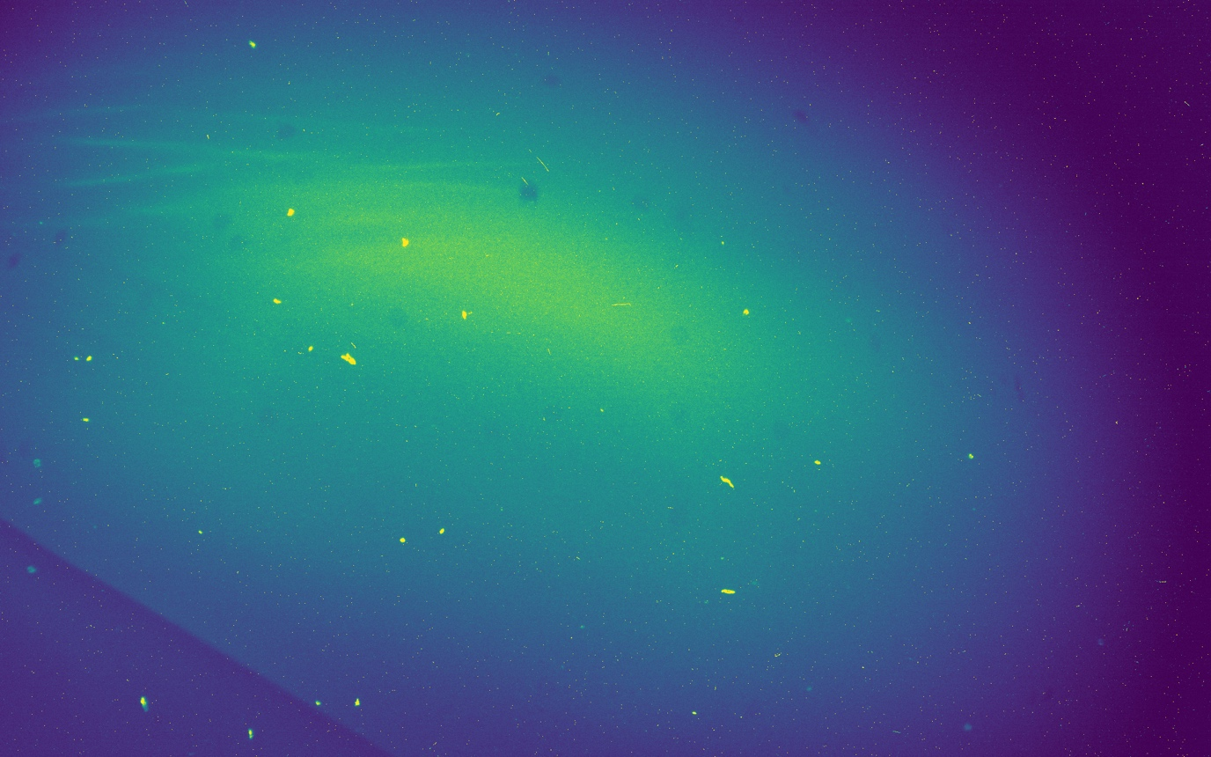
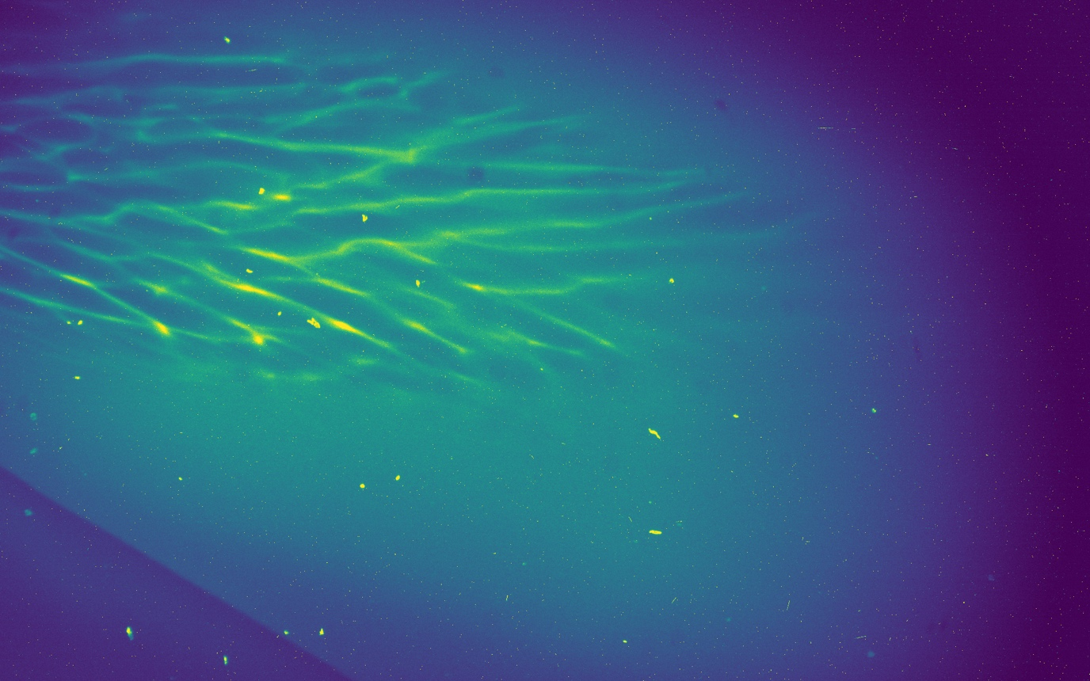
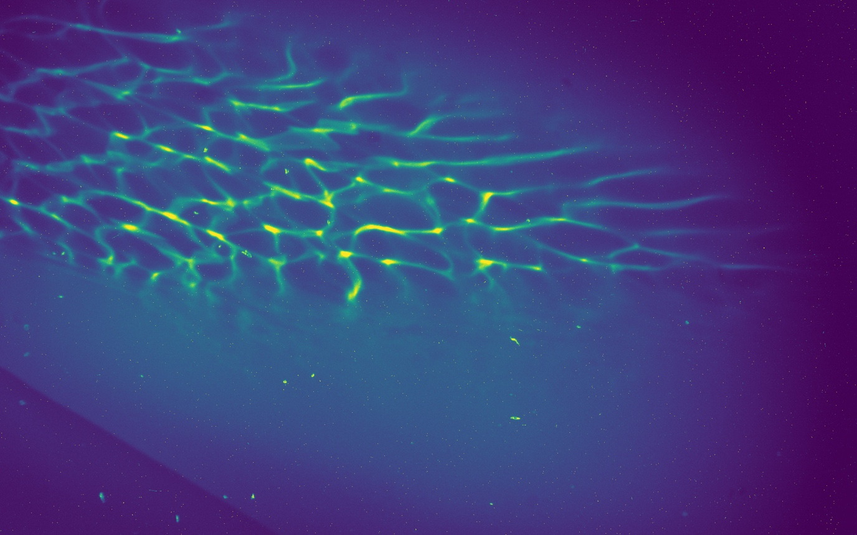
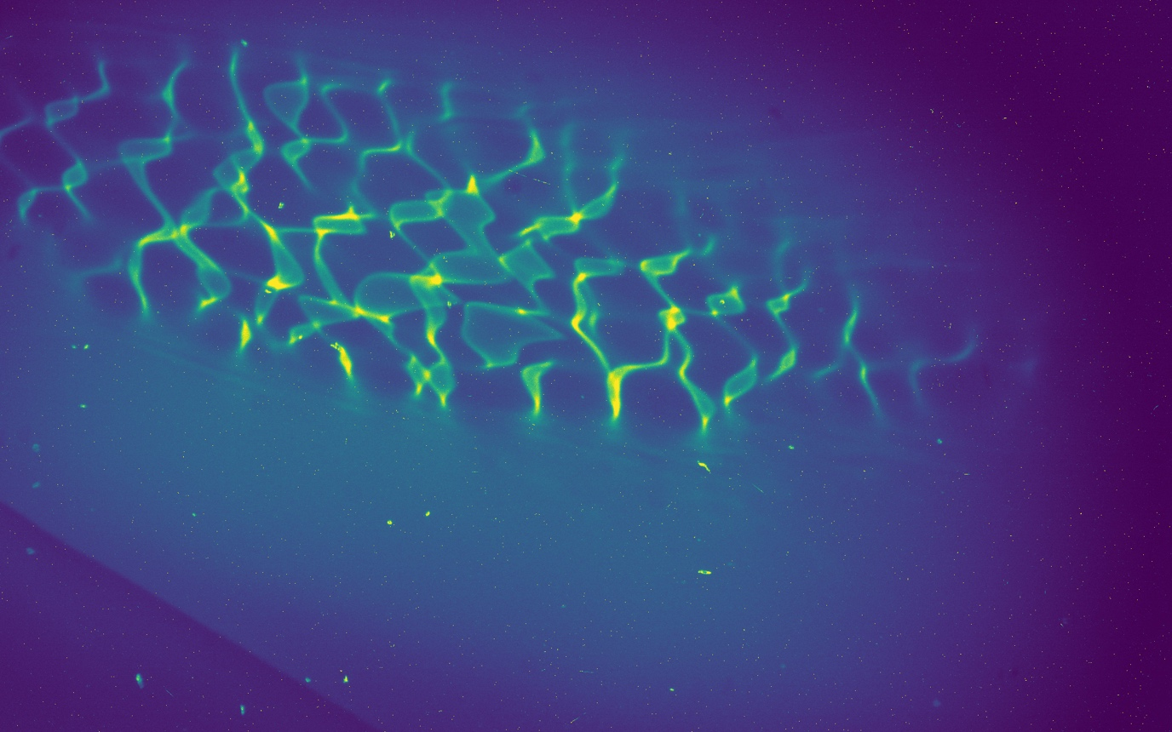
Some Recent ATF Updates
0 ps
Major activities and challenges –
  Major laboratory-funded improvements to B820 are underway
    Extended down period limits FY22 User Operations
  IRR/ARR Preparations in progress
    Radiation Shielding evaluation being supported by SLAC
    Major code compliance effort underway at B820 during current down period
    Process to impact user operations schedule through FY23
  Supply chain issues limiting the pace of key research upgrades
  Continuing Resolution driving constrained FY22 funding
  3 electrical substation failures in 2021 significantly impacted facility capabilities
Accomplishments –
  Strong 2021 user performance with 120% of facility baseline user hours delivered
  Completed the 2nd ATF Operations Review by DOE
  Key research results delivered by 2021 user program
  B820 HVAC improvements will enhance facility availability in future years
  Buildout of new shielded research space for strategic partners at B912 is underway
  New accelerator development partnerships now active
  Vacuum transport upgrades underway at B820 to deliver significant performance improvements to users
1.44 mm
3.3 ps
10 ps
23.3 ps
AE98 (UCLA): Probing the
Weibel Plasma Instability

Slide 16
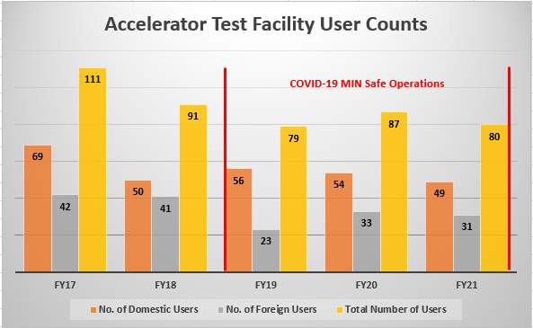
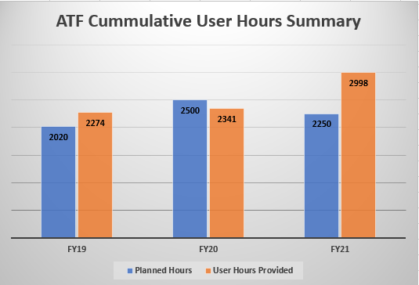

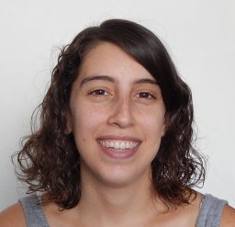

Some ATF Operational Metrics
ATF User
Highlights
Irina Petrushina (SBU), postdoctoral researcher in the Department of Physics and Astronomy at Stony Brook University
Mariana Fazio (postdoc, UNM),
elected to Member-at-Large Role for the
APS Forum on Diversity and Inclusion
Sandra Biedron (ATF PAC Chair, UNM)
elected to Member-at-Large Role for the APS Division of Physics of Beams

Slide 17
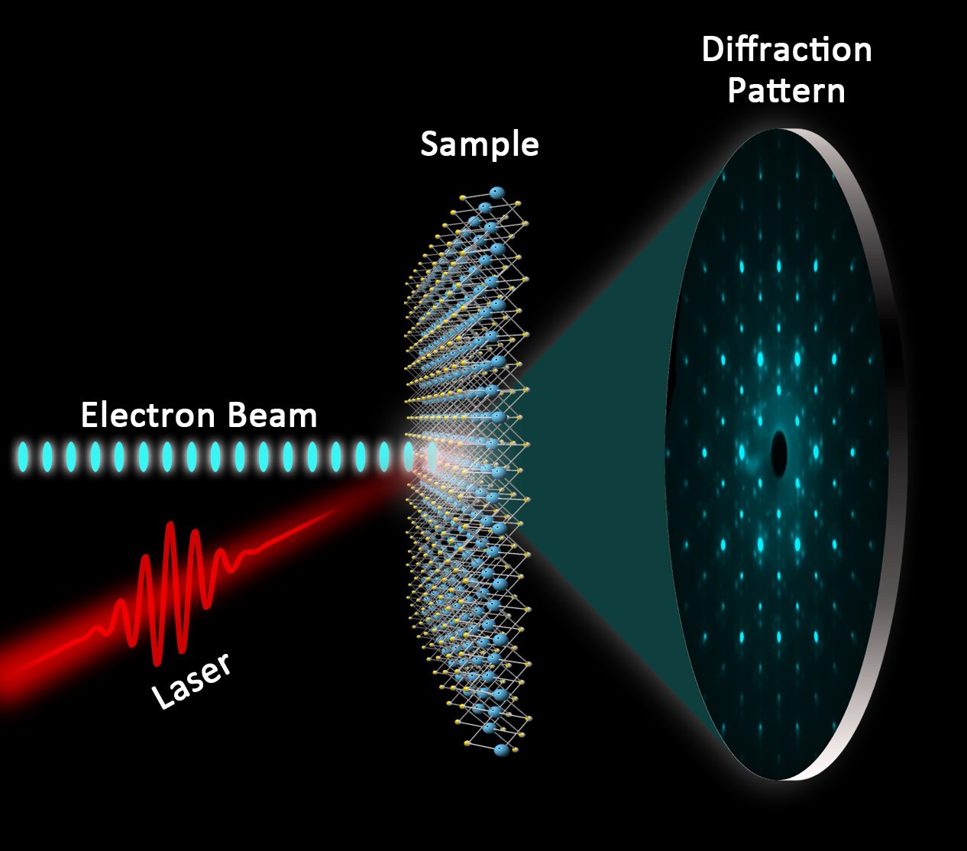
Major Facility Development Thrusts
Upgrades to maintain and grow the ATF’s role in deploying advanced accelerator and laser technologies - guided by the ATF Science Planning process
  LWIR Laser R&D program
    Now benefitting from multiple research grants
    First steps have delivered a factor of 4-5x in peak power available to users
    Ongoing R&D program sets the stage for an additional factor of >5x
    Goal: Delivery of ≥25 TW peak power with pulse-width <500 fs for user experiments on the 5-year timescale
    This would enable a world-leading research program into advanced particle acceleration techniques
  Electron Beam
    Continue to move towards providing more highly compressed beams (~10 fs bunch lengths)
    Exploit and expand short bunch diagnostic capabilities
    Enable complete flexibility in primary and secondary beams
  UED/UEM
    Focus on unique UED measurement options for users
      Wavelength flexible OPA pump laser
      Improved system performance
    Apply AI/ML techniques to both beam line tuning and real-time
    structural analysis
    Support the UEM development program being pursued for BES use
    Implement a new plan to steward the UED by end of 2022
      Plan further discussions with our user community in the coming months

Slide 18
ATF’s LWIR Laser Research Program
Major effort over the last 3 years to secure the necessary research funding to
enable a set of validated facility upgrades
  Currently Funded Technology Research Activities
    Nonlinear Materials Research Program (DOE) – Collaboration with UCF and industry to deliver materials for use at high intensities in the LWIR
      Develop a nonlinear pulse compressor concept based on best-matched LWIR materials (LDRD)
    New LWIR seed laser (LDRD) – Develop a seed laser based on newly available materials to deliver a 10mJ-class seed
      Replace the OPA and regenerative amplifier in our present system and enable operation at ~15 TW with ~1 ps pulse width
    Develop a mid-IR laser capable of optically pumping a CO₂ Amplifier for energy extraction (DOE) – collaboration with U. Alabama and UCLA
      Route to Hz to kHz operation of CO₂-based LWIR laser systems
      Required for next-generation accelerator development
Position the ATF for an operating extension and upgrade starting in FY24

Slide 19
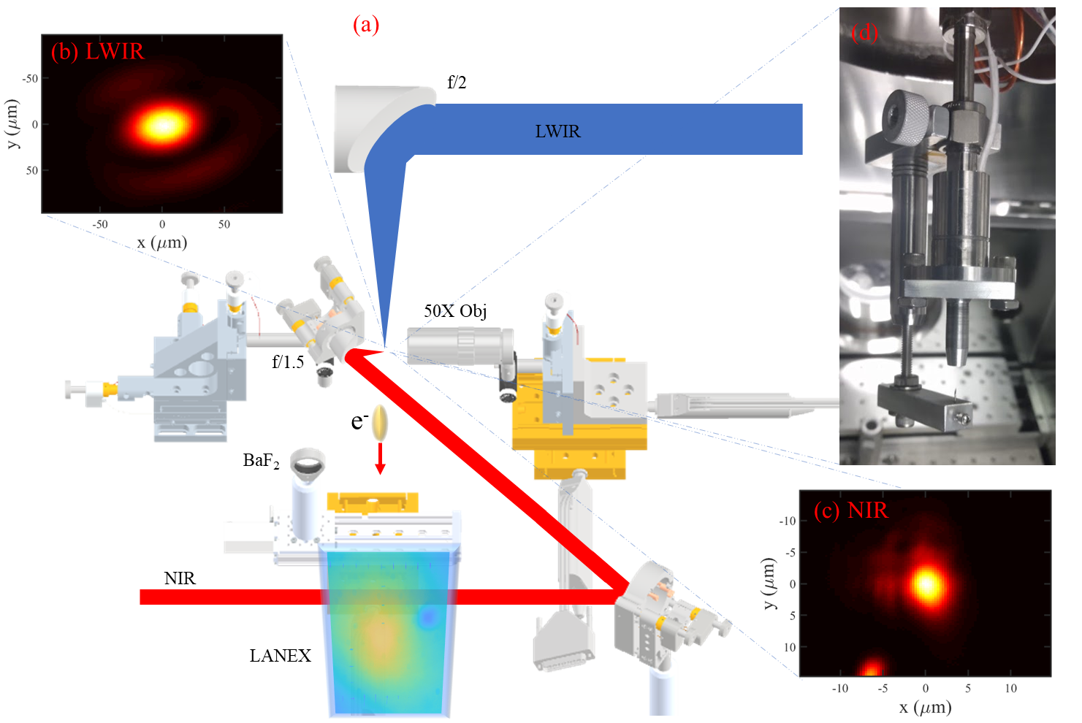
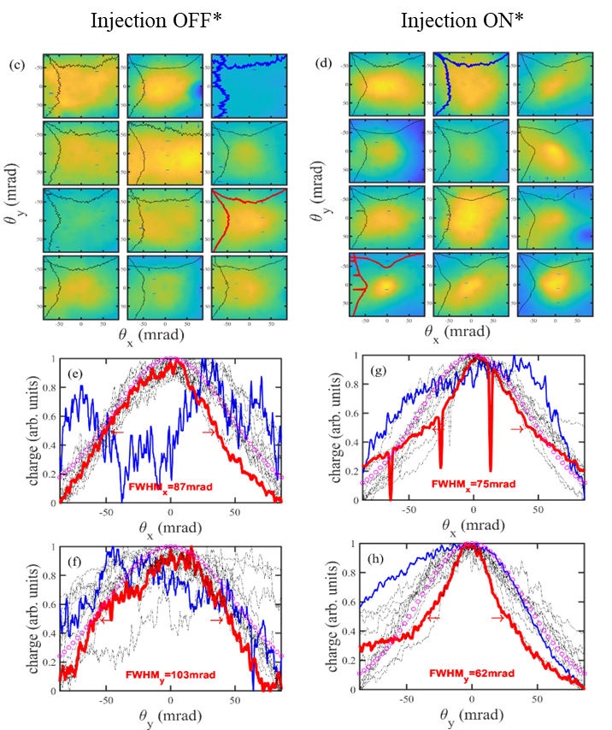
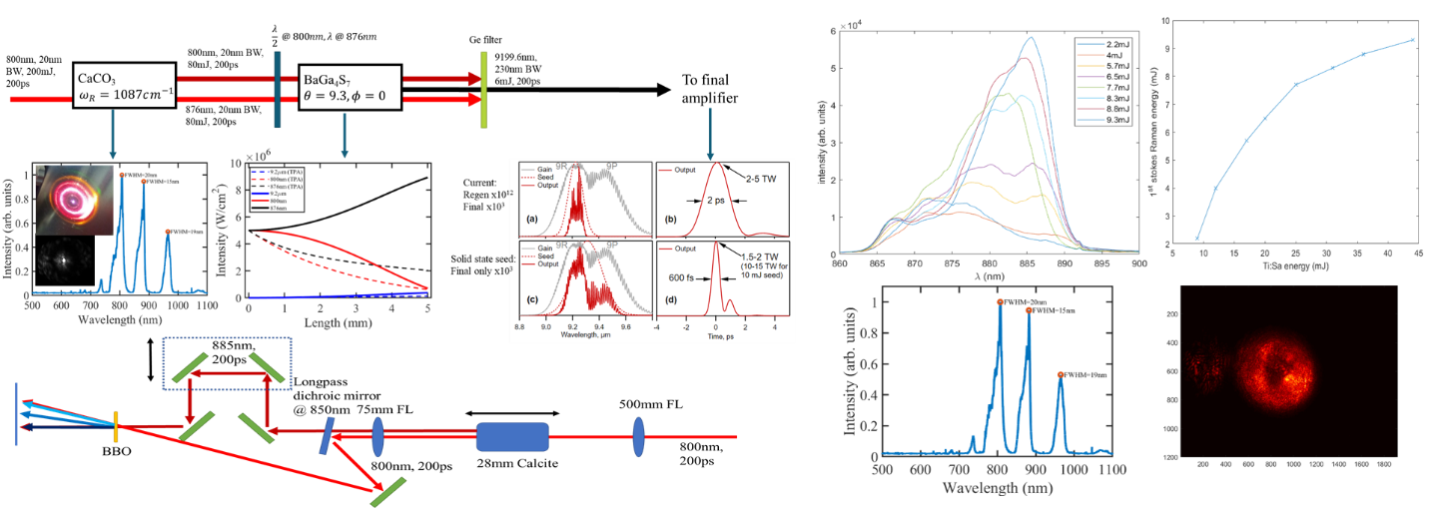
ATF Laser Research Thrusts
Progress Towards a High Beam Quality All-Optical Electron Injector System
LDRD 18-026 2-color Injection:
NIR laser produces electrons from a high Z gas in the
wakefield structure generated by a LWIR laser pulse
Raman Conversion Process to Deliver a Next Generation
9.2μm Seed Laser for LWIR Capabilities
LDRD 21-001
ATF/IO/Chemistry

Slide 20
ATF Research
& Upgrades
LWIR/NIR Vacuum Transport Upgrades – Underway
Vacuum Transport
Upgrade Effort:
Deliver higher peak powers and
better beam quality for users
Provides a research platform to develop LWIR non-linear pulse
compression:
100s fs pulse lengths
10s TW peak power
Proof of Principle Demonstration of Nonlinear Pulse Compression

Slide 21
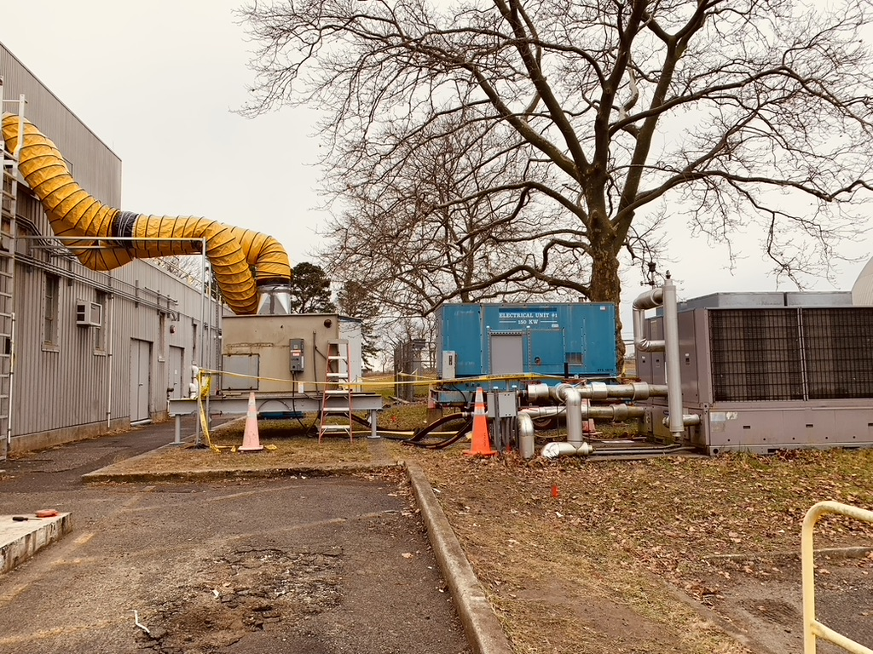
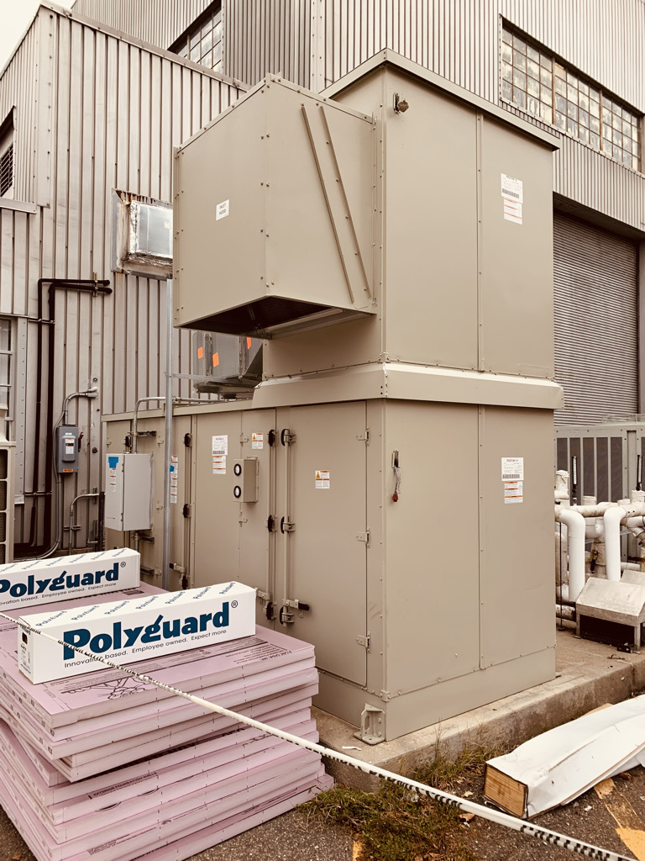
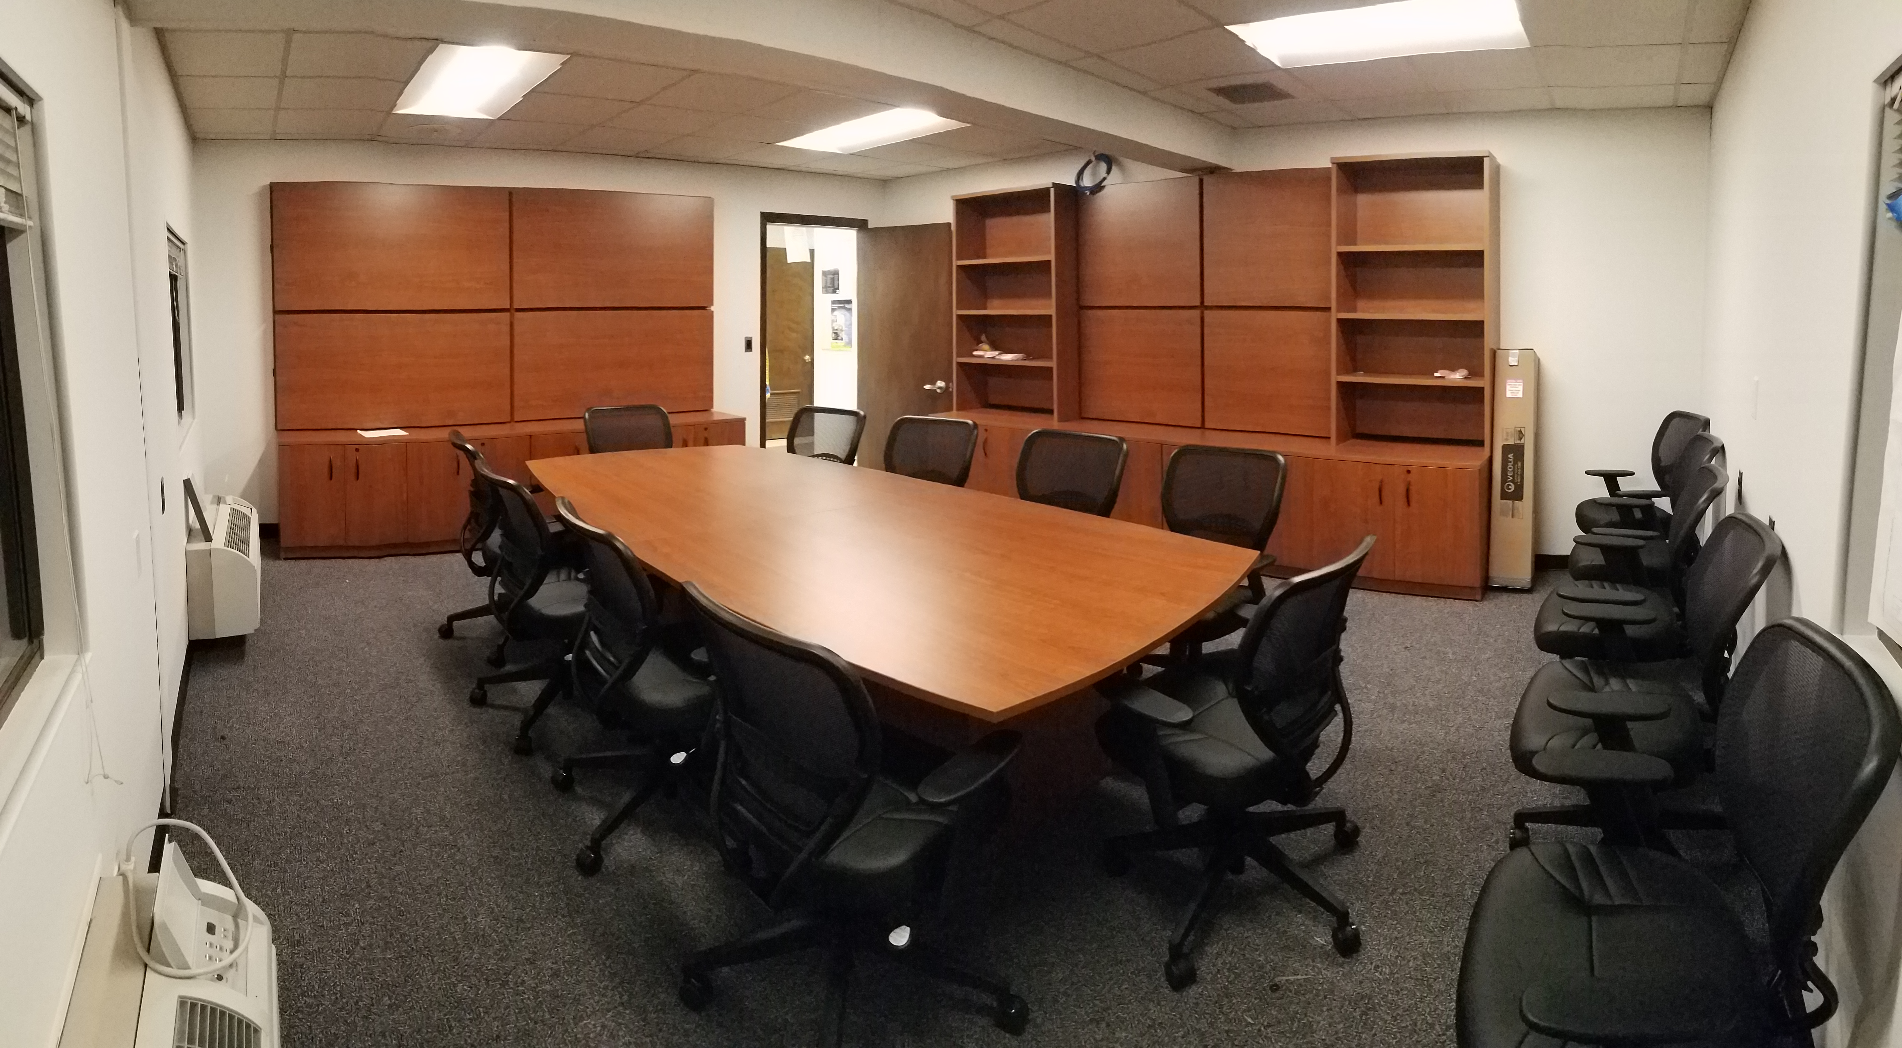
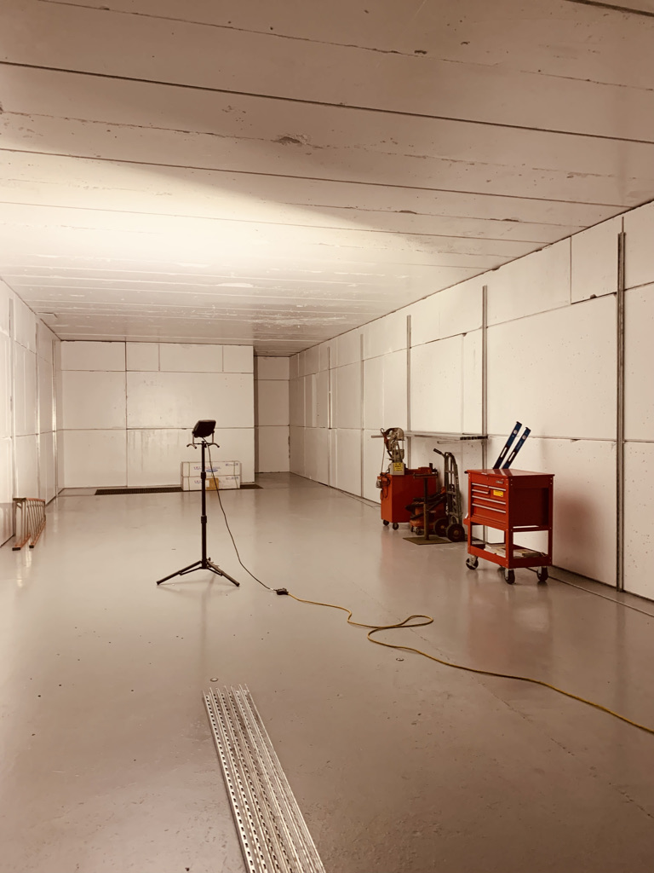
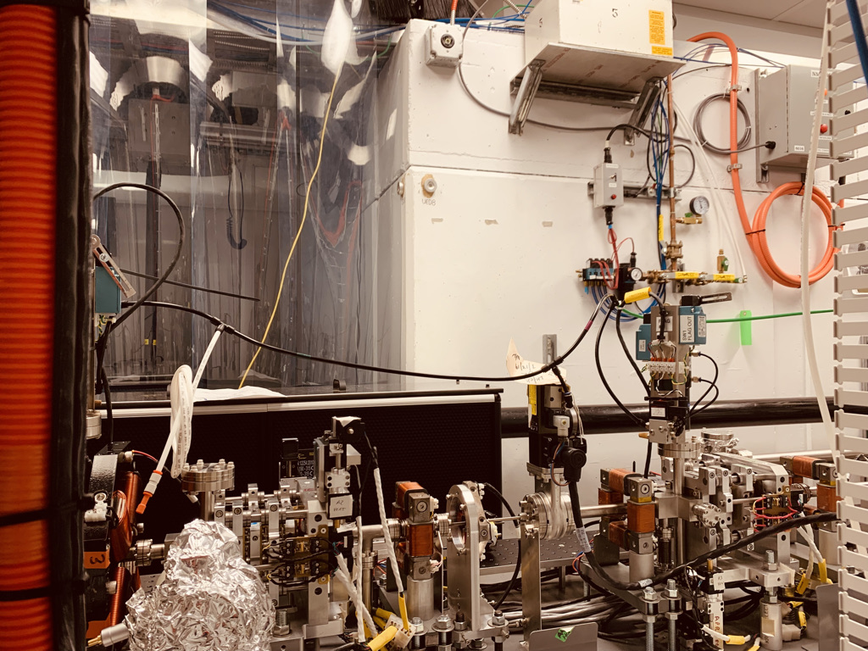
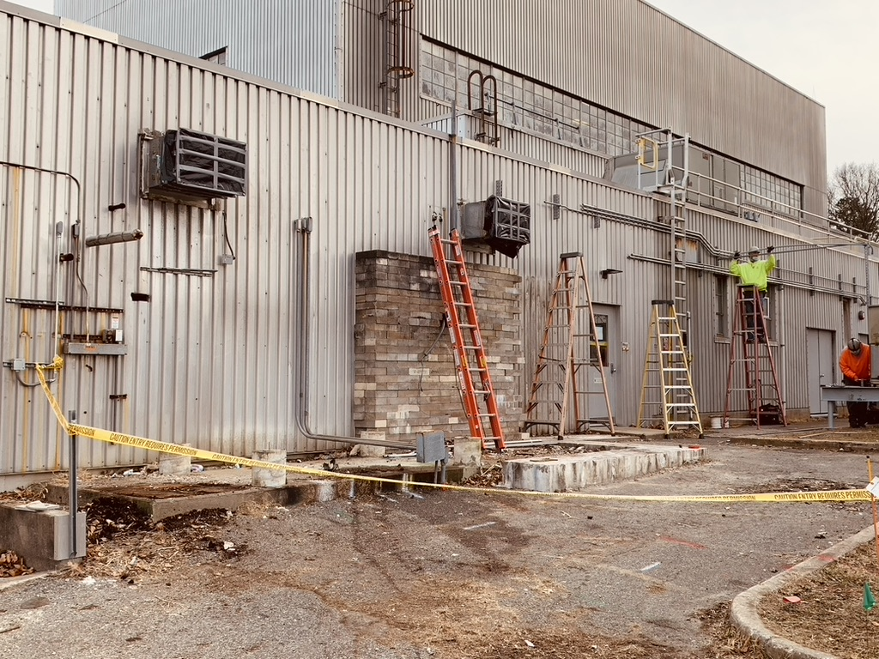
ATF Down Period Activities
EH & CO2 Areas:
Air Handler (AHU1)
Replacement
New B820M Conference Room
NIR Laser Systems:
Air Handler (AHU2)
Replacement
Deployment of Ultrafast Electron Microscopy Beamline @B912
EH & CO2 Areas:
Air Handler (AHU1)
Replacement
New Radiation Shielded Research Space @B912

Slide 22
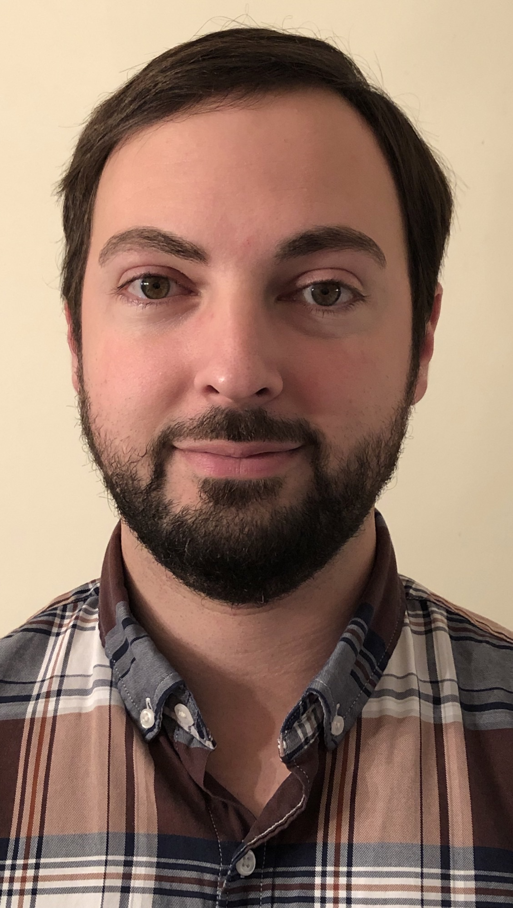
Key Personnel Transitions
Andrew Simmonds
Taking over from Chris Cullen as ATF Facility Engineer
Graduated with a Mechanical Engineering degree from SUNY Stony Brook in 2013.
Worked for 9 years in aerospace Engineering
  Manufacturing Engineer
  Engineering Manager
  Quality Manager
  Focus on RF and Mil spec circular connectors
Hobbies include biking, cars and boating

Slide 23
 | FY17 |  | FY18 |  | FY19 |  | FY20 |  | FY21 |  | FY22 |  | FY23 |  | FY24
ATF User Program
ATF CO₂ Power Upgrade R&D
NLPC Proof-of-Principle Demonstration
Building 820 Remedial Maintenance Program I
Remedial Maintenance & Improvements
Ti:Sapphire Laser System (TW-Class)*
Near-term Laser Power Upgrades (NIR/LWIR)
Electron Beam Upgrades
Non-Linear Materials R&D Program
LWIR Power and Rep. Rate Improvements
Extended User Program
Approved ATF Operations
Plasma Shutter
Isotopic Mixtures
~0.5 TW to Users
CPA
Config
5TW Demonstration, Air Transport a ~2.5TW to Users w/good beam quality
NLPC PoP
0.6 ps
Demo
Facility Reliability, Env. Systems, LINAC Refurb., MPS, etc.
Reliability & Efficiency Improvements
Procure, Deploy, Commission
*BNL/NRL Collaboration
COVID Delays/
Funding Limitations
Full In-Vacuum
Transport System
>5TW to Users w/good beam quality
Improved Compression (a~10fs), Diagnostics (BL1 TCAV?), & Laser Delivery to EH
Non-linear Materials Development &
NLPC Engineering Design
>10TW, sub-ps LWIR to Users w/ Compressed e-Beam
Pursue capability improvements with greatest impact for user program
Proposal
Extended Ops

Slide 24
Setting Priorities

Slide 25
Setting Priorities
Current facility priorities are driven by:
  Safety
  Operational Needs
  Science Thrusts
The facility’s science thrusts are determined through a continuing dialogue with our user community through a series of Science Planning Workshops:
Report from the 2019 Science Planning Workshop
  Process is overseen by the ATF Facility Scientist
  In consultation with the ATF Program Advisory Committee, these priorities are evaluated and sequenced in the ATF plans
  Funding realities mean that all priorities cannot be executed simultaneously

Slide 26
ATF Priorities
Ensure safe operations for Staff and Users consistent with DOE’s
  Accelerator Safety Order
  Conduct of Operations
Basic Maintenance & Operations
  Review and overhaul of the weekly maintenance program since the 2017 review
  FMEA approach to optimizing operational implementation of key systems
  Cross-train and provide a cross-organizational safety net wherever possible
  Implement and utilize SharePoint tools for maintaining robust operations
Remedial Maintenance
  Capabilities
    Targeted critical hardware replacements
    Integrate with ongoing capability upgrades where possible
  Facility
    Work with Facility and Operations Directorate (F&O) to provide a robust maintenance
    program
    Impress on the laboratory, the need for continued infrastructure investment
Deliver a responsive Science & Technology Mission
  An ongoing Science Planning process led by the ATF Facility Scientist
  Obtain dedicated R&D funding for key technology and research thrusts
    Laser FWPs via FOAs
    Facility Development FWPs
    LDRD
    Other collaborative efforts
  Request dedicated upgrade funding when possible
    Integrate a detailed and comprehensive design approach with external technical reviews
Deliver effective
user operations
Advance the ATF
Capabilities efficiently
and in coordination with
our user community

Slide 27
ATF Priorities (cont’d)
Ensure a productive environment for staff and users
  Work with F&O on office and conference room refreshes
  Improve work and prep areas (e.g., machine shop upgrade
  funded by CURL)
  Provide student area for workforce development
Support a vigorous workforce development program
  AE63
  CUNY
  Ernest Courant Workforce Development program
AS&T Diversification – consistent with the accelerator stewardship mission
  Engage with the broader community reliant on accelerator/laser capabilities
  Current engagements with: NNSA, MDA, NASA, IAEA, SBIR/STTR businesses

Slide 28
2018 Accelerator Safety Order Review
2018 review of several BNL accelerator facilities resulted in the requirement that all facilities that were approved before establishment of the Accelerator Readiness Review process would need to undergo a full ARR to continue operating
ATF is part of an extensive list and the draw on laboratory resources is significant
The ATF ARR is now planned for FY23
  This will put to the test improvements to the ATF configuration control effort that have been underway since 2017
  This is forcing particular attention on quickly addressing aging facility issues a impacting facility prioritizations
  Thankfully, we have seen strong support from the laboratory to execute this effort
There are challenges and risks with our approach:
  Move to ATRO has provided a team with more dedicated focus and enables adoption of improved tools for our approach
  Other facilities have required significant updates in order to pass their ARRs (a delays)
  Finally, revisions to the Accelerator Safety Order are being implemented as we are going through the ARR process

Slide 29
User Impacts
FY22 and FY23 operating schedules will be constrained by ongoing ARR preparation activities
  Current FY22 projection is 1800 user hours total for the facility
    We are requesting adjustments to the assessment schedule that we hope will let us do better than this
  Significant FY23 impacts will also apply
    Again, we are working hard to minimize the net impact on user hours
Infrastructure improvements have impacted the FY22 operating schedule
  Current down was designed to accommodate significant infrastructure improvements that prevent facility operations
  Expectation is that more efficient operations will be possible in subsequent years

Slide 30
Conclusion

Slide 31
Conclusion
The ATF Team is looking forward to a strong user program this year
  User hours will be somewhat constrained
  However, facility improvements aim to make the available hours as effective as possible
Current down activities include
  A significant set of facility infrastructure improvements that are strongly supported by the laboratory
  Addressing issues associated with the laboratory’s Corrective Action Plan after the 2018 Accelerator Safety Order Review
  Executing key elements of the facility’s Vacuum Transport Upgrade
    Improved performance for both NIR and LWIR capabilities at B820
    Rate of upgrade, in part, limited by COVID supply chain issues
    Aim to complete the current phase of the upgrade later in the year

Slide 32
Backup Slides

Slide 33
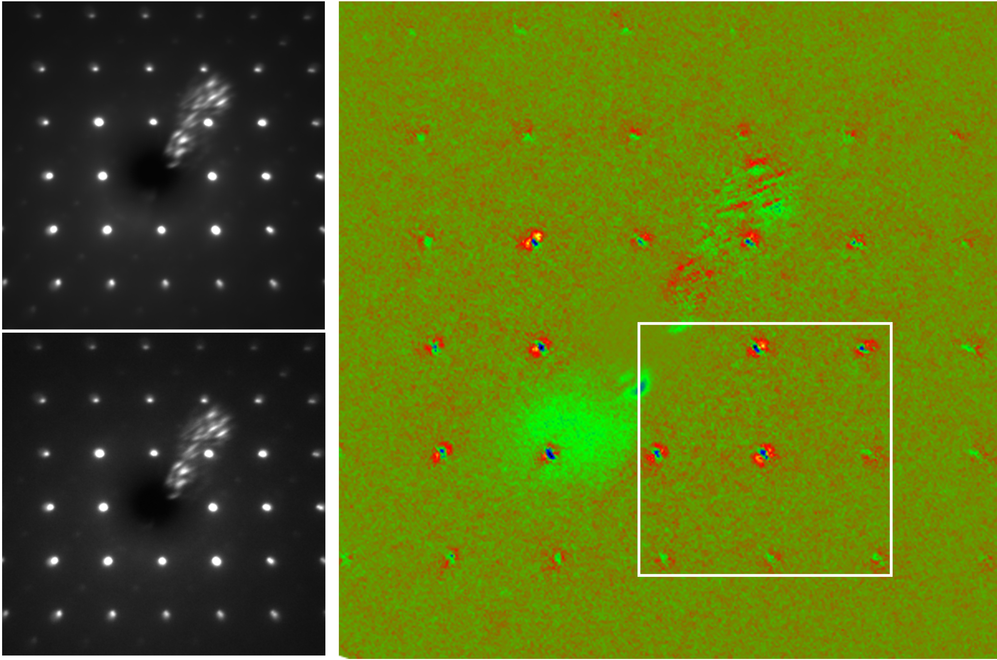
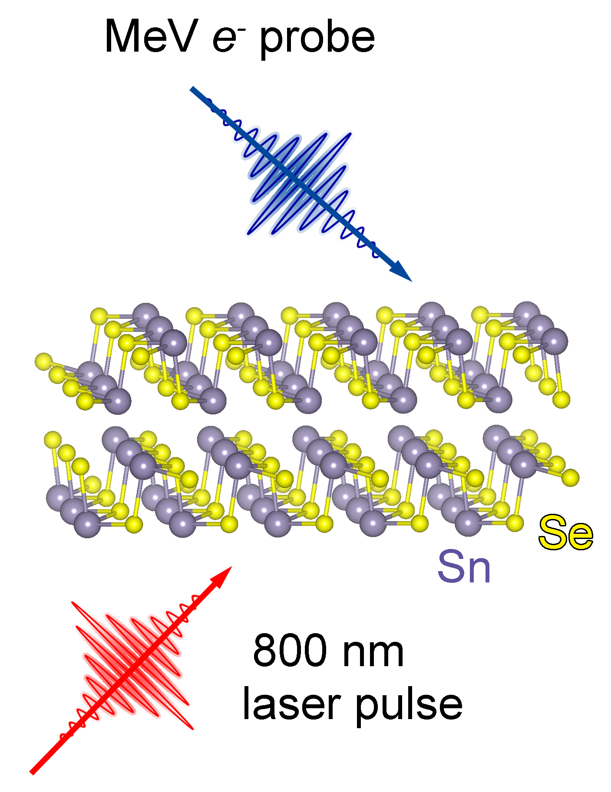
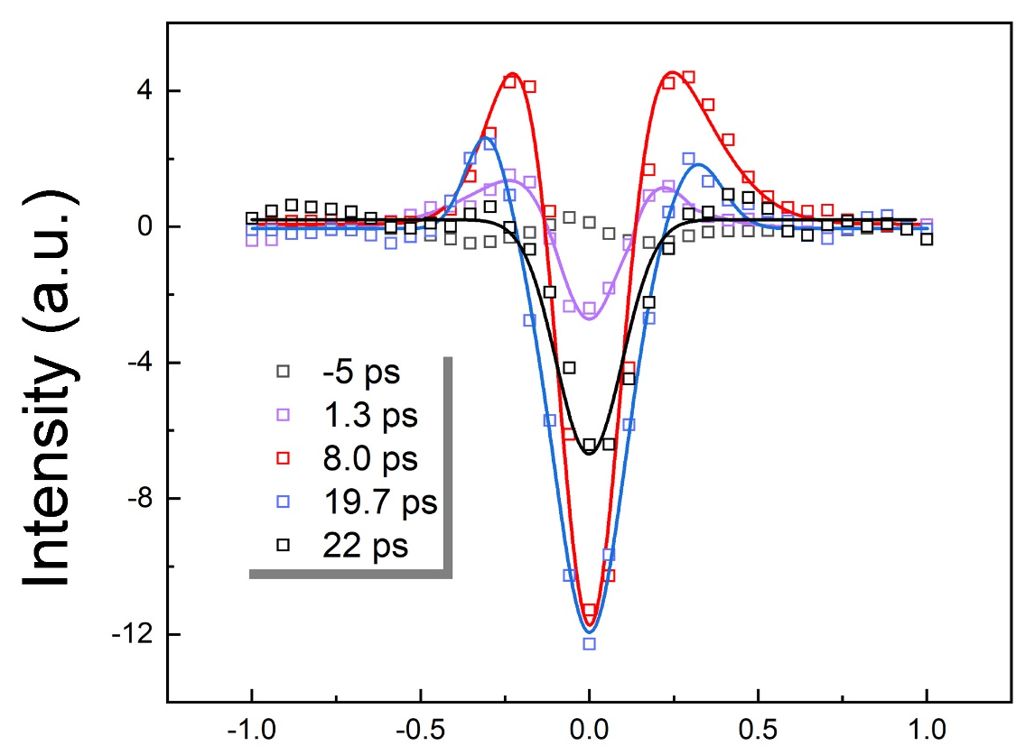
Photoinduced anisotropic lattice response in SnSe
MeV UED patterns @ 90 K
Intensity difference
t ≤0 ps
Γ-Z
t =1.7 ps
Z
020
002
Γ
Y
The intensity difference of ultrafast electron diffraction (UED) patterns taken before and after time zero shows anisotropic intensity distribution around Bragg peaks.
A photoinduced domain structure evolution model is proposed to suggest strong anharmonicity of A_{g} phonon mode, which is highly excited by laser pulses.
The UED experiment provide a direct observation of strong anharmonicity of phonon modes, which is critical to the understanding of ultralow thermal conductivity in SnSe.
Wei Wang et al.

Slide 34
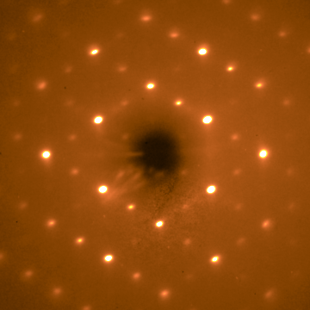
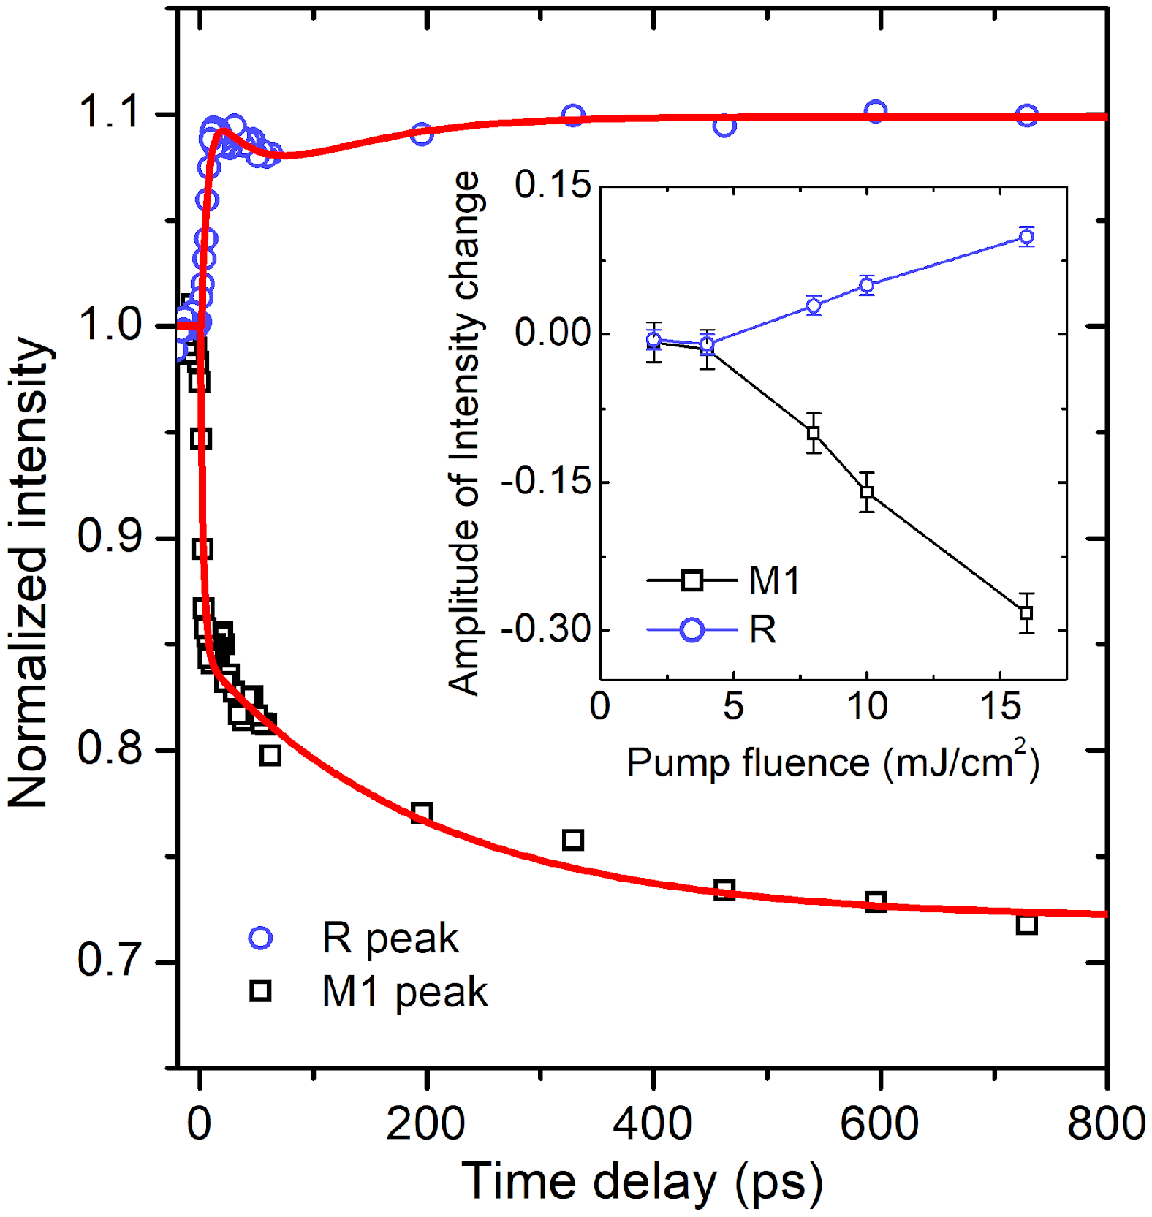
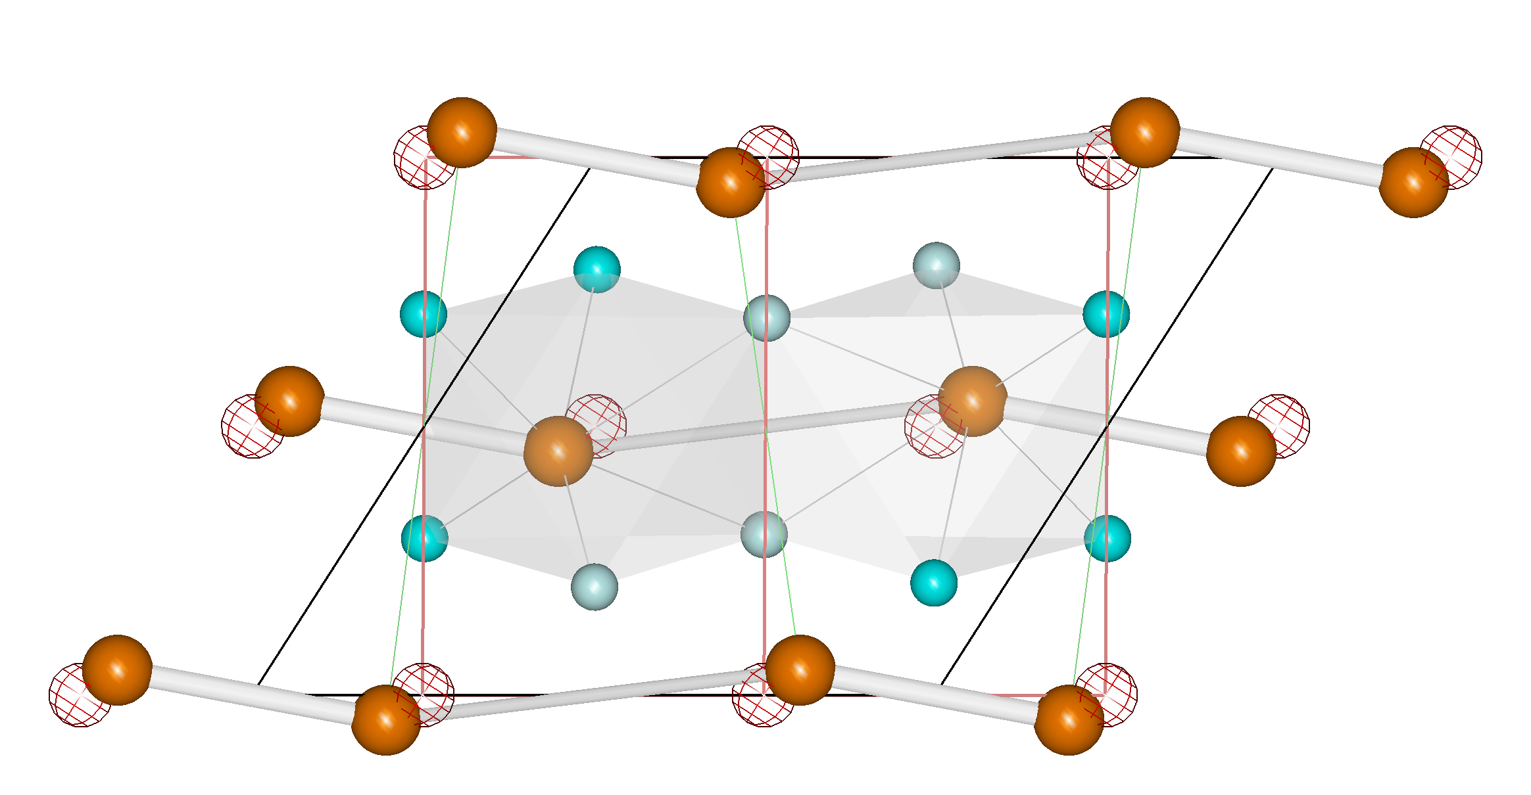
Direct detection of transition pathways during ultrafast photoexcitation in VO₂
MeV UED pattern
obtained from single-crystal VO₂
Crystal structure and phase transition of VO₂
Peak intensity vs. ultrafast time
a_{M1}
c_{R}
00-3
c_{M1}
a_{R}
10-2_{T}
20-2(-101_{R})
30-2_{T}
K_{R}
30-2
-302
200(101_{R})
40-2
(002_{R})
-504
002(200_{R})
300
∆r₀
003
0
2000 a. u.
Using MeV ultrafast electron diffraction (UED) on single-crystals, we quantitatively reveal the photoinduced lattice distortion of the monoclinic M1 phase of VO₂.
Our results overturn previous reports of decoupled distortion components, as well as a proposed M2 intermediate phase.
Our study provides the critical and previously missing precise 3D and time resolved structural evolution of the crystal structure of photoexcited M1 VO₂.
Junjie Li et al.

Slide 35

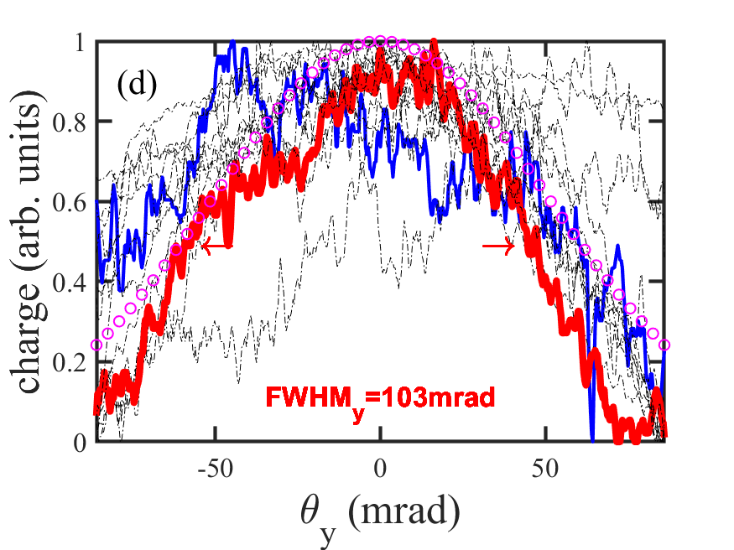
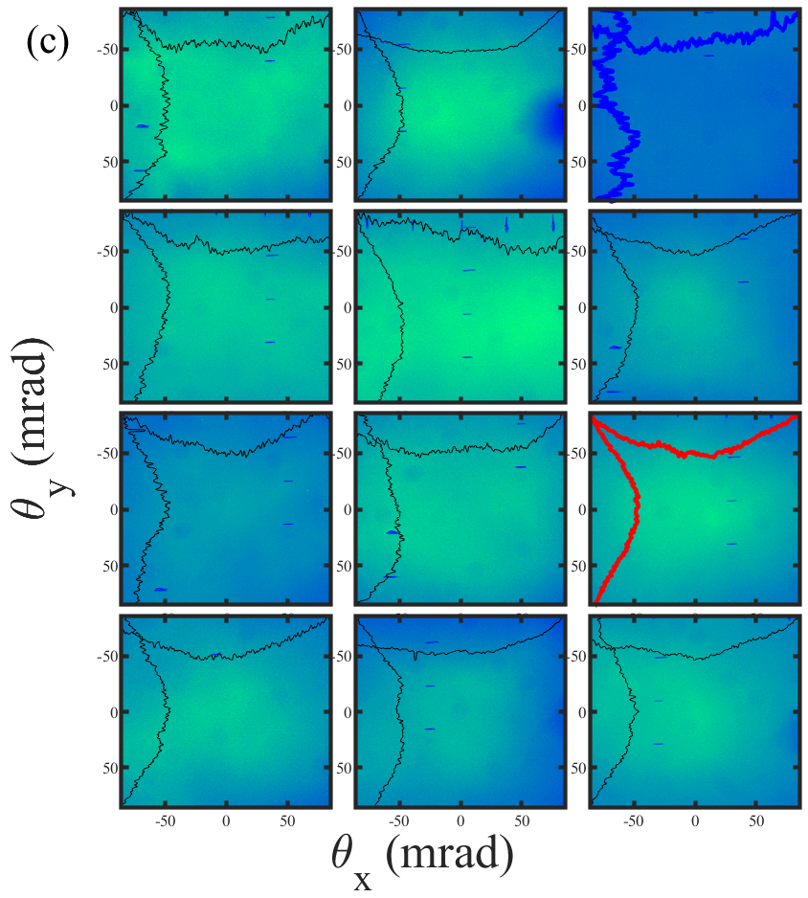
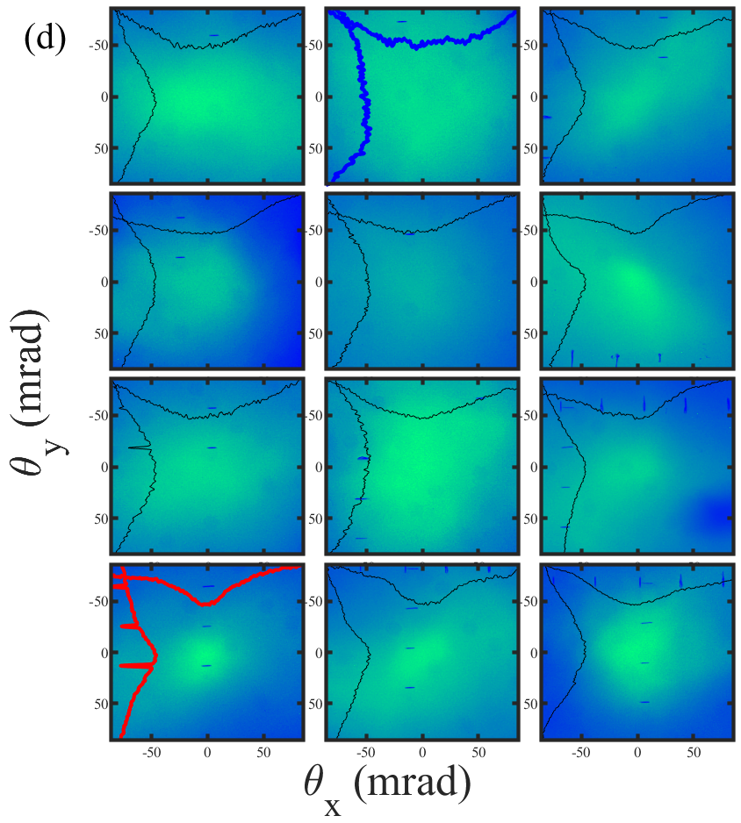
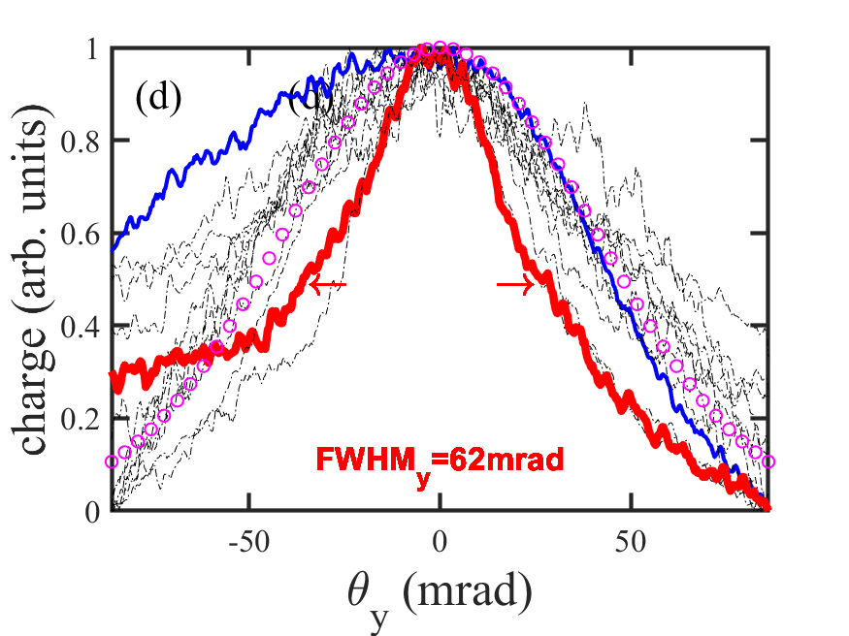
Electron Beam Formation via Ionization Injection
Seeding Next Generation Accelerator R&D
Objective: To use a high a₀, low intensity LWIR laser to drive a wake and a low a₀, high intensity NIR injector to introduce charge into the wake for efficient acceleration of high quality electron bunches.
Status: We performed the first attempt to optically inject charge into a LWIR driven LWFA using a transverse, tightly focused, near infrared injector laser and Kr gas target and observed improvement in electron bunch divergence.
Outlook: To stabilize and improve the injection regime. To measure the complete electron bunch parameters.
Unseeded (3.75<E_{LWIR}<4.3J)
Seeded (3.75< E_{LWIR} <4.3J, E_{NIR}=3mJ, t=t₀-4ps)
(e)
(f)

Slide 36
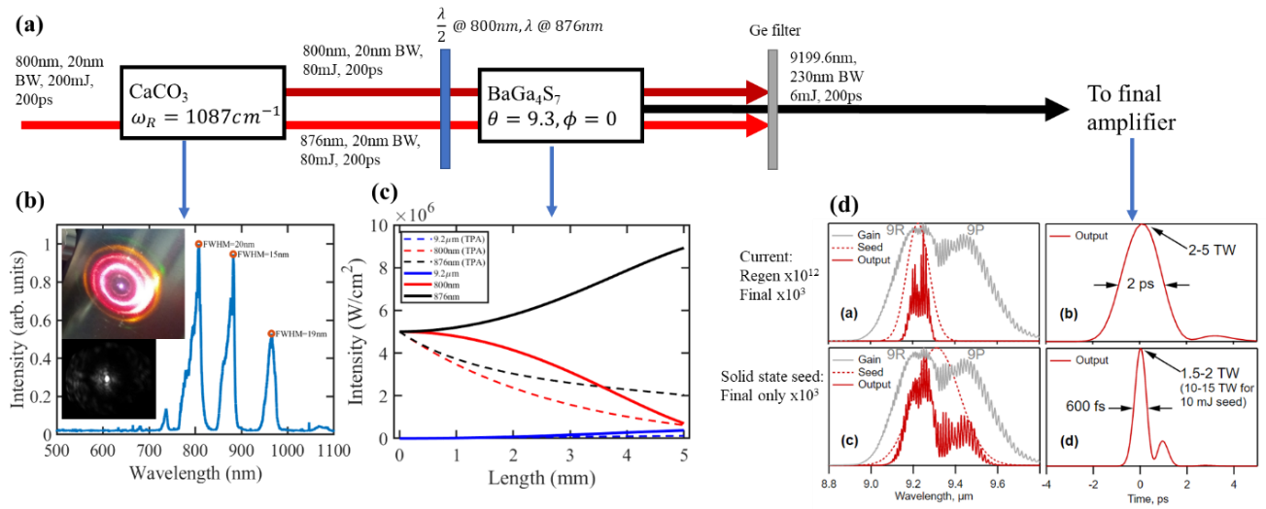
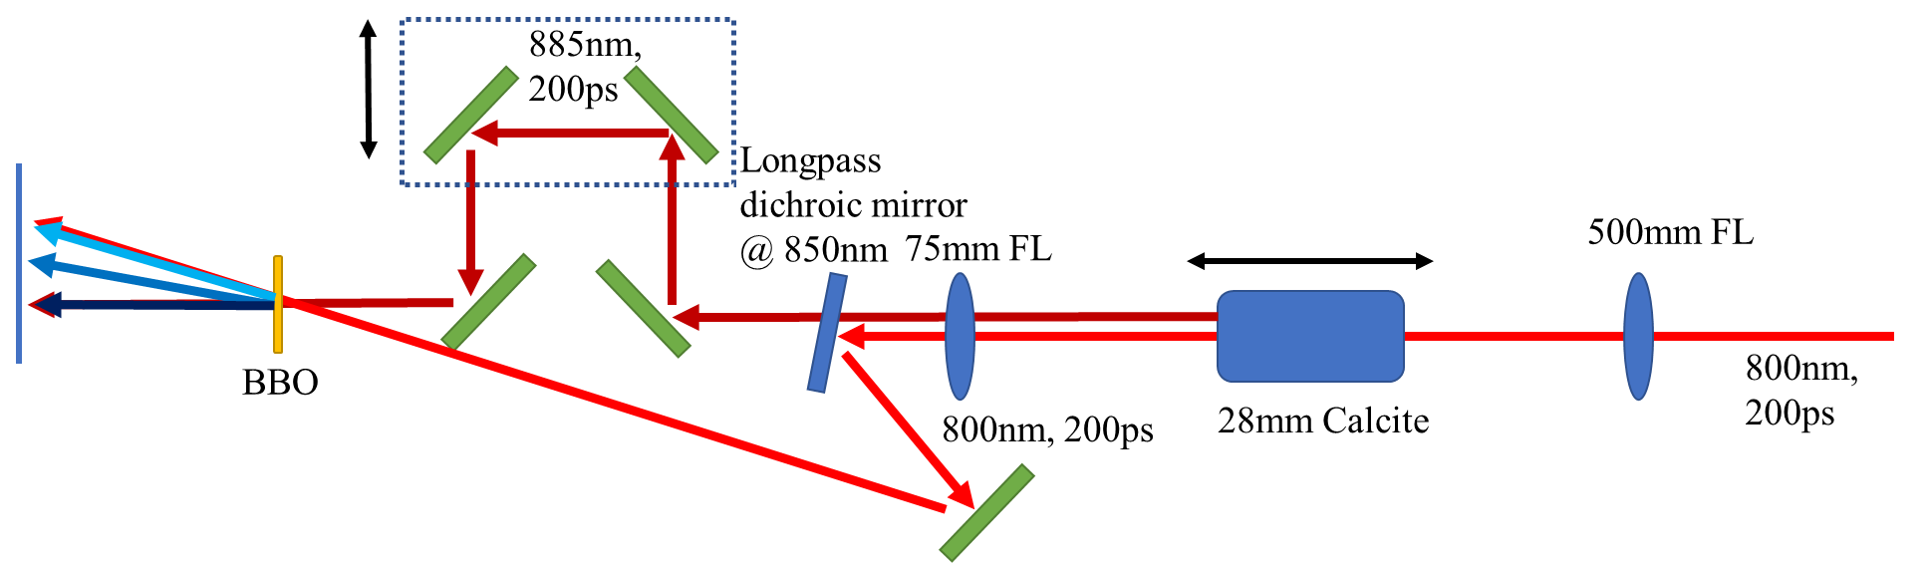
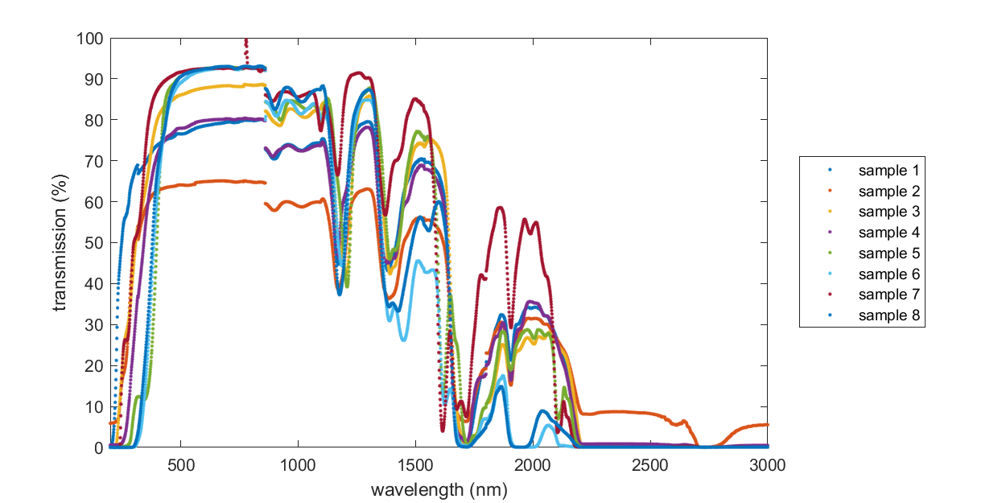
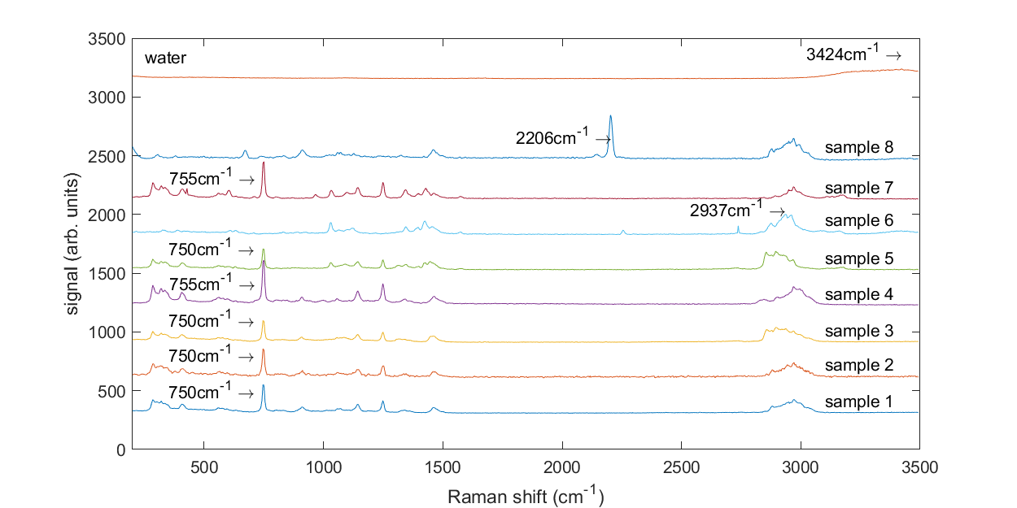
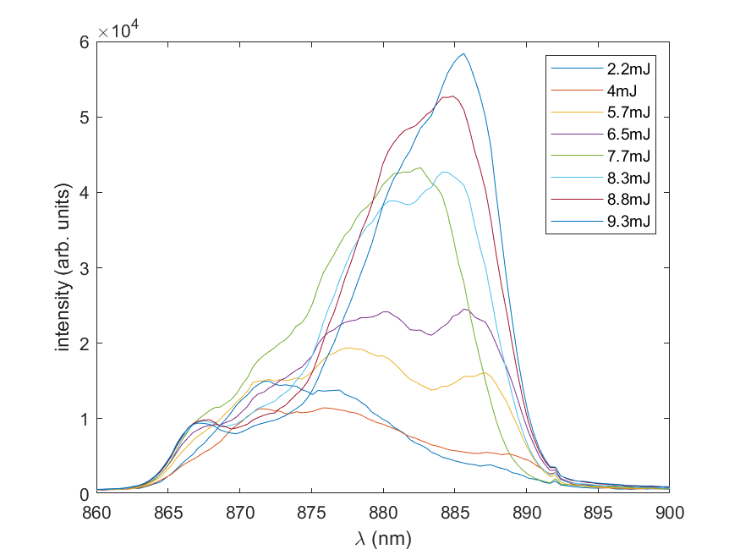
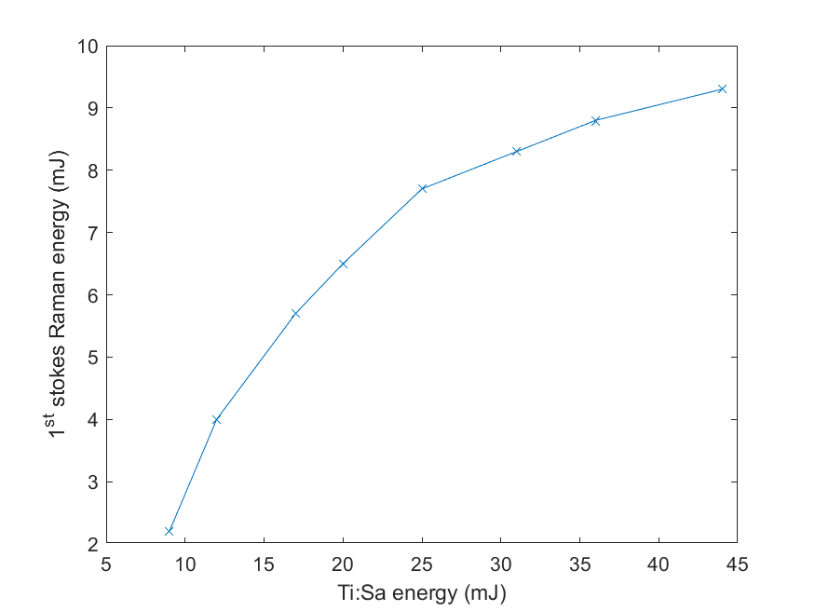
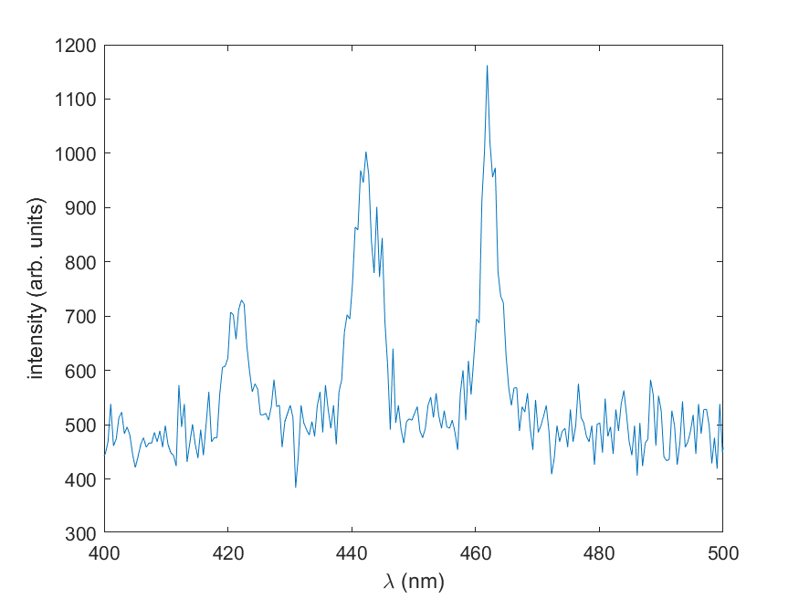
Development of wavelength conversion techniques for generation of coherent radiation at the XUV to LWIR
Objectives:
ATF – Develop a solid state, broadband, mJ level, 9.2µm seed source for generation of sub-picosecond (ps), multi-Joule, compressed pulses after further amplification by a single-stage, conventional CO2 multi-pass amplifier.
Chemistry – Survey the optical properties of ionic liquids in a search for a Raman conversion medium to the SWIR with the goal of generating multi-mJ, ns pulses at 4.3µm for optical seeding of CO₂ amplifiers.
Instrumentation Division - Develop a high brightness, low divergence, coherent photon source, discretely tunable up to XUV and soft X-Ray and characterize it up to 40 eV
Status and outlook:
Energy scaling and timing experiments of Raman conversion in calcite with chirped NIR pulses were performed. We measured up to 9mJ of converted light with 25-30% conversion efficiency. Red shift was observed due to saturation at the higher energy range. BGS crystals are expected to arrive next month so we can begin conversion to the LWIR.
First round of survey of optical properties of ionic liquids completed. We got some sense of the desired chemical structure, and the next survey is ongoing. We expect to identify a suitable liquid for conversion from 1µm to the SWIR before winter.
An XUV spectrometer was ordered. We expect to begin experiments on HHG with LWIR driver next year

