Slide 1
AE-101
Optical Materials for Ultrahigh-Power​ Long-Wave Infrared Lasers
(status report)
Misha Polyanskiy
2022-01-18
Notes:
Very special instrument
Novel methods of particle accel.
All the important things

Slide 2
AE-101
Title | Optical Materials for Ultrahigh-Power​ Long-Wave Infrared Lasers
Status | Active (reporting completion of year 2 out of 3)
PIs | Mikhail Polyanskiy Igor Pogorelsky
Collaborators | BNL: M. Polyanskiy, I. Pogorelsky, M. Babzien, R. Kupfer UCF CREOL: K. Vodopyanov, A. Muraviev II-VI Infrared: A. Argondizzo
Funding | DOE Accelerator Stewardship grant KA2601020 (PI: M. Polyanskiy) BNL LDRD grant #20-010 (PI: I. Pogorelsky)
Funding Status | Received
Notes:
Accelerators & ultrafast lasers
How lasers
Unique features
Techniques
Overview of history
Plans

Slide 3
“We propose a systematic study of the properties of a wide range of materials under the action of ultra-intense long-wave infrared (LWIR) laser pulses. The information that will be obtained during the proposed effort is critically needed for the development of the next-generation multi-terawatt LWIR lasers.”
(Acc. Stewardship proposal)
Goals
Systematically study properties of infrared materials under the action of intense LWIR laser irradiation
Develop a concept of nonlinear post-compression of picosecond LWIR pulses to a sub-picosecond
Notes:
Large and complex machines
Applications in
Two bunches of e-
Polygon pattern
Nuclear reaction
Combination e-hv
--- 3 ---

Slide 4
Experiment overview

Slide 5
Nonlinear properties of LWIR materials
Opt. Lett. 46, 2067, 2021
Opt. Express 29, 31714 (2021)

Slide 6
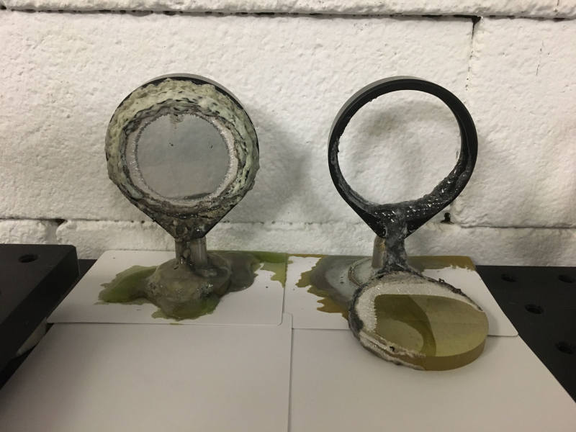
Lessons learned
Micro-
filamentation
Chemistry
in action
AgCl
Al
AgBr

Slide 7
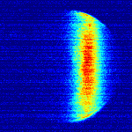
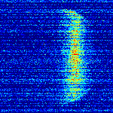
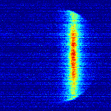
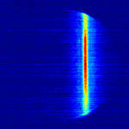
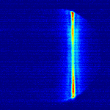
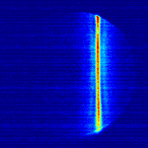
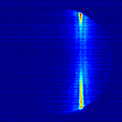
Post-compression demo at sub-TW level
Strong nonlinearity,
weak dispersion
Weak nonlinearity,
strong dispersion
KCl
BaF₂
2 ps
<0.5 ps
Input
149 mJ
213 mJ
278 mJ
314 mJ
320 mJ
332 mJ
Opt. Express 29, 31714 (2021)

Slide 8
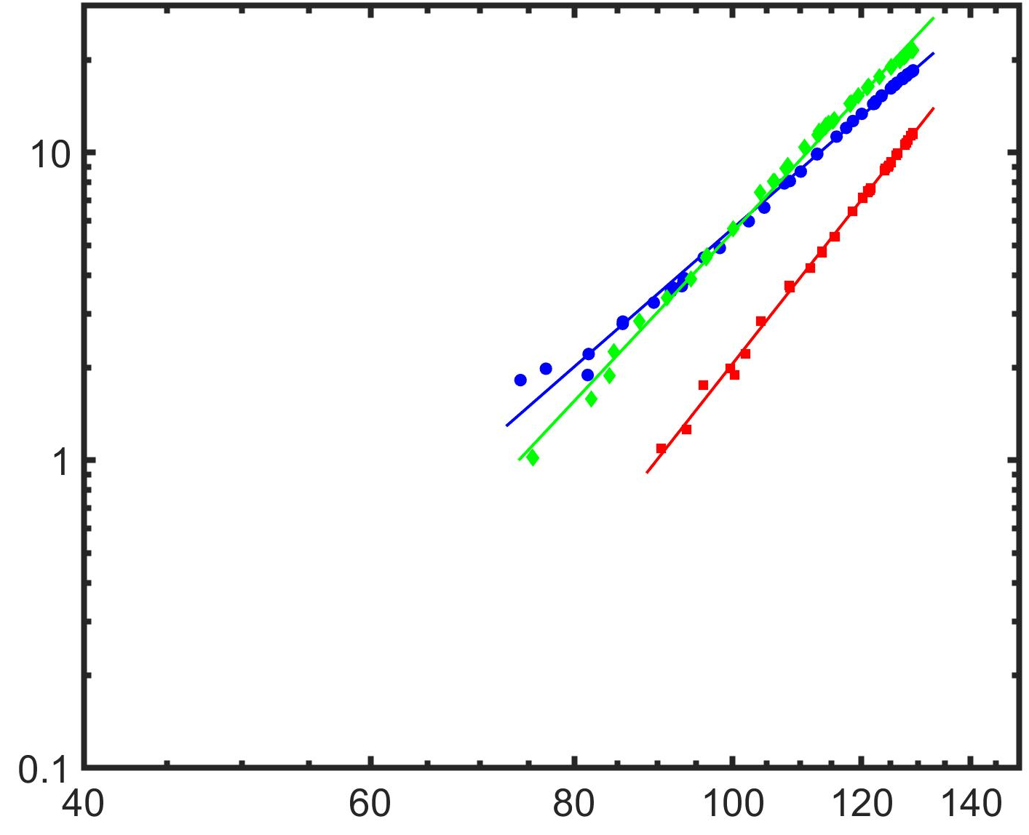
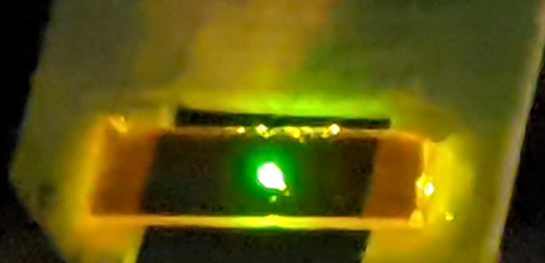


Progress at UCF
Reference
detector
Cr:ZnS laser, 1.2 W, 2.35 µm, 62 fs, 79 MHz
90º off-axis parabolic mirror
Variable neutral density filter
CaF₂ wedge
-z
Chopper
Sample
+z
$${Log−log GaP: E}_{g}/ℏω=5.3$$
Aperture
[111], Slope: 5.6
Spectrum analyzer
Signal
detector
[110], Slope: 4.6
[001], Slope: 6.5
$$\text{−}\text{Δ}\text{T}\text{ (\%)}$$
Open aperture
Zscan
Closed aperture
Zscan
GaP
Transmittance
z
z
Intensity (GW/cm²)

Slide 9
Results and plans

Slide 10
Results 2020-2021
BNL
Deployed and optimized set-up and data analysis procedures.
Measured n₂(air) for a picosecond LWIR pulse.
Measured n₂ of several materials including NaCl, KCl, BaF₂, KBr and ZnS.
Demonstrated bulk-material post-compression at sub-TW level in a combination of KCl and BaF₂.
Studied nonlinear absorption in several materials.
Acquired samples with optimized geometry for continuation of the systematic study.
UCF
Measured nonlinear refractive indices of ZnSe (monocrystals and ceramics), GaP, ZGP, and GaSe crystals at 2.35 μm.
Investigated multiphoton and free-carrier absorption in the same materials using the 2.35 μm pulse with a fixed peak power but varying pulse durations (i.e., 31 fs, 62 fs, and 120 fs).

Slide 11
Plans for 2022
Continued experimental and theoretical study of nonlinear refraction and absorption of MWIR and LWIR materials.
Design and proof-of-principle demonstration of elements of a full-scale post-compressor setup for compressing a multi-terawatt 2-picosecond LWIR laser pulse to sub-picosecond duration.
Study of the dependence of self-focusing and self-phase-modulation effects on the grain structure of polycrystalline materials, such as ZnSe, ZnS, from the viewpoint of the cascaded χ⁽²⁾+χ⁽²⁾→χ⁽³⁾ effect.
[Systematic study of the optical damage mechanisms and damage thresholds for materials generally used to reflect, transmit and manipulate the phase of radiation at LWIR wavelengths]

Slide 12
Products delivered
Journals papers
M. N. Polyanskiy, I. V. Pogorelsky, M. Babzien, R. Kupfer, K. L. Vodopyanov, M. A. Palmer , "Post-compression of long-wave infrared 2 picosecond sub-terawatt pulses in bulk materials", Opt. Express 29, 31714-31725, 2021 (https://doi.org/10.1364/OE.434238)
M. N. Polyanskiy, M. Babzien, I. V. Pogorelsky, R. Kupfer, K. L. Vodopyanov, M. A. Palmer, "Single-shot measurement of the nonlinear refractive index of air at 9.2 µm with a picosecond terawatt CO2 laser", Opt. Lett. 46, 2067, 2021 (https://doi.org/10.1364/OL.423800)
M. N. Polyanskiy, I. V. Pogorelsky, M. Babzien, R. Kupfer, N. Vafaei-Najafabad, M. A. Palmer, "High-peak-power long-wave infrared lasers with CO2 amplifiers", Photonics 8, 101, 2021 (https://doi.org/10.3390/photonics8040101)
Conferences
M. Polyanskiy, I. Pogorelsky, M. Babzien, R. Kupfer, M. Palmer (poster presented by I. Pogorelsky), "Ultrashort-pulse, terawatt, long-wave infrared lasers based on high-pressure CO2 amplifiers", EOS Annual Meeting (EOSAM), Rome (Italy), September 13-17 2021 (https://doi.org/10.1051/epjconf/202125511010)
I. V. Pogorelsky, M. N. Polyanskiy, M. Babzien, M. A. Palmer, "Post-compression of 9.2-μm terawatt laser pulses to femtoseconds", EOS Annual Meeting (EOSAM), Rome (Italy), September 13-17 2021 (https://doi.org/10.1051/epjconf/202125511007)
I. Pogorelsky, M. Polyanskiy, M. Babzien, M. Palmer, “Long-wave IR terawatt laser pulse compression to sub-picoseconds”, 12th International Particle Accelerator Conference, Campinas, SP, Brazil (virtual), 24–28 May 2021 (https://doi.org/10.18429/JACoW-IPAC2021-THPAB062)
T. Kawamori, P. Schunemann, and K. Vodopyanov, “High-order mid-IR multiphoton absorption and nonlinear refraction in GaP, ZnSe, GaSe, and ZGP crystals”. CLEO’21 (virtual), 09–14 May 2021 (https://ieeexplore.ieee.org/document/9572386)
I. Pogorelsky, M. Polyanskiy, M. Babzien, and M. Palmer, “Experiment on long-wave IR terawatt laser pulse compression to sub-picoseconds”. Mid-Infrared Coherent Sources 2020, Washington, DC United States (virtual), 16–20 November 2020 (https://doi.org/10.1364/MICS.2020.MF2C.1)
Other
All-new version of co2amp code “co2amp 2020” with advanced support for nonlinear effects in materials https://github.com/polyanskiy/co2amp

Slide 13
Information for
Program Advisory Committee

Slide 14
Electron Beam Requirements
Parameter | Units | Typical Values | Comments | Requested Values
Beam Energy | MeV | 50-65 | Full range is ~15-75 MeV with highest beam quality at nominal values | -
Bunch Charge | nC | 0.1-2.0 | Bunch length & emittance vary with charge | -
Compression | fs | Down to 100 fs (up to 1 kA peak current) | A magnetic bunch compressor available to compress bunch down to ~100 fs. Beam quality is variable depending on charge and amount of compression required. NOTE: Further compression options are being developed to provide bunch lengths down to the ~10 fs level | -
Transverse size at IP (σ) | μm | 30 – 100 (dependent on IP position) | It is possible to achieve transverse sizes below 10 um with special permanent magnet optics. | -
Normalized Emittance | μm | 1 (at 0.3 nC) | Variable with bunch charge | -
Rep. Rate (Hz) | Hz | 1.5 | 3 Hz also available if needed | -
Trains mode | --- | Single bunch | Multi-bunch mode available. Trains of 24 or 48 ns spaced bunches. | -
Notes:
Basic idea
eV
Van de Graaf
Outlet in the basement
Many millions of volts
--- 5 ---

Slide 15
CO₂ Laser Requirements
Configuration | Parameter | Units | Typical Values | Comments | Requested Values
CO₂ Regenerative Amplifier Beam | Wavelength | μm | 9.2 | Wavelength determined by mixed isotope gain media | -
 | Peak Power | GW | ~3 |  | -
 | Pulse Mode | --- | Single |  | -
 | Pulse Length | ps | 2 |  | -
 | Pulse Energy | mJ | 6 |  | -
 | M² | --- | ~1.5 |  | -
 | Repetition Rate | Hz | 1.5 | 3 Hz also available if needed | -
 | Polarization | --- | Linear | Circular polarization available at slightly reduced power | -
CO₂ CPA Beam | Wavelength | μm | 9.2 | Wavelength determined by mixed isotope gain media | 9.2
Note that delivery of full power pulses to the Experimental Hall is presently limited to Beamline #1 only. | Peak Power | TW | 2 | ~5 TW operation is planned within the next year (requires further in-vacuum transport upgrade). A 3-year development effort to achieve >10 TW and deliver to users is in progress. | 2
 | Pulse Mode | --- | Single |  | Single
 | Pulse Length | ps | 2 |  | 2
 | Pulse Energy | J | ~5 | Maximum pulse energies of >10 J will become available within the next year | 5
 | M² | --- | ~2 |  | 2
 | Repetition Rate | Hz | 0.05 |  | 0.05
 | Polarization |  | Linear | Adjustable linear polarization along with circular polarization can be provided upon request | Linear
Notes:
Limited by voltage
Alternating current
Always see accelerating field
Short but intense bunches
Most modern accelerators
--- 6 ---

Slide 16
Other Experimental Laser Requirements
Ti:Sapphire Laser System | Units | Stage I Values | Stage II Values | Comments | Requested Values
Central Wavelength | nm | 800 | 800 | Stage I parameters are presently available and setup to deliver Stage II parameters should be complete during FY22 | -
FWHM Bandwidth | nm | 20 | 13 |  | -
Compressed FWHM Pulse Width | fs | <50 | <75 | Transport of compressed pulses will initially include a very limited number of experimental interaction points. Please consult with the ATF Team if you need this capability. | -
Chirped FWHM Pulse Width | ps | ≥50 | ≥50 |  | -
Chirped Energy | mJ | 10 | 200 |  | -
Compressed Energy | mJ | 7 | 100 |  | -
Energy to Experiments | mJ | >4.9 | >80 |  | -
Power to Experiments | GW | >98 | >1067 |  | -
Nd:YAG Laser System | Units | Typical Values | Comments | Requested Values
Wavelength | nm | 1064 | Single pulse | -
Energy | mJ | 5 |  | -
Pulse Width | ps | 14 |  | -
Wavelength | nm | 532 | Frequency doubled | -
Energy | mJ | 0.5 |  | -
Pulse Width | ps | 10 |  | -
Notes:
Good but tend to be large
Accelerating structure
2 miles
1000 times smaller
Can afford

Slide 17
Special Equipment Requirements and Hazards
Electron Beam
  -
CO₂ Laser
  Space to arrange 14 meters of open-air beam propagation between laser output and experimental setup (for diffraction-based beam forming)
  Two vacuum chambers for post-compression R&D integrated into CO2-FEL vacuum transport line
Ti:Sapphire and Nd:YAG Lasers
  -
Hazards & Special Installation Requirements
  Large installation (chamber, insertion device, etc.): post-compression (NLPC) chambers
  Cryogens: -
  Introducing new magnetic elements: -
  Introducing new materials into the beam path: -
  Any other foreseeable beam line modifications: -
Notes:
So, what is laser
Specially prepared
Stores some energy
Laser beam
Scientific way
Exhibit interference
Close to parameters
--- 9 ---

Slide 18
Experimental Time Request
CY2022 Time Request
Capability | Setup Hours | Running Hours
Electron Beam Only
Laser* Only (in Laser Areas) | 120 (3 runs: 1 week setup each) | 160 (3 runs: 2+1+1 running weeks)
Laser* + Electron Beam
Remaining Time Estimate Through End of Experiment (including CY2022)
Capability | Setup Hours | Running Hours
Electron Beam Only
Laser* Only (in Laser Areas)
Laser* + Electron Beam
* Laser = Near-IR or LWIR (CO₂) Laser
Notes:
If ps lasted… would last…

