Slide 1
AE101 implications for non-linear pulse compression
Igor Pogorelsky
ATF User Meeting 1/18/2022
The Accelerator Test Facility

Slide 2
Outline
  Motivation for multi-TW sub-ps LWIR
  State of art in picosecond CO₂ laser technology
    Path to femtoseconds via nonlinear post-compression
    Simulations
    Experimental results
    2022 plan

Slide 3
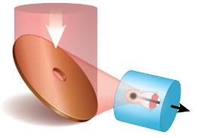
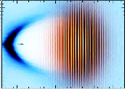
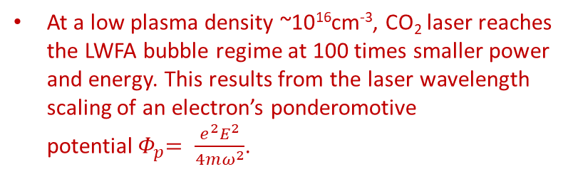
Motivation for multi-TW sub-ps LWIR
Potential applications: LWFA, ion generation, ICS, HHG,…
At a low plasma density ~10¹⁶cm⁻³, CO₂ laser reaches the LWFA bubble regime at 100 times smaller power and energy. This results from the laser wavelength scaling of an electron’s ponderomotive potential${ Φ}_{p}= \frac{e^{2}E^{2}}{4mω^{2}}$.
CO₂
10TW, 0.5 ps
A proposed two-color LWFA with ionization injection opens opportunity for ultra-low beam emittance .
A low plasma density means bigger bubble size
  the ease of phase space control for
    precision electron injection
    reducing energy spread and emittance
    synchronization of acceleration stages
  higher bunch charge
Ti:S
Laser wavelength (μm) | 0.8 | 9.2
Plasma density (×10¹⁶cm⁻³) | 1.1
Plasma wavelength (μm) | 313
Laser pulse duration (fs) | 390
Laser radius (μm) | 200
Accelerating field (GeV/m) | 4.3
Laser peak power (TW) | 3000 | 23
Laser energy per stage (J) | 1200 | 9
Single stage length (m) | 25 | 0.19
plasma
ε_{n}=50 nm
Long-λ laser efficiently produces a big (~300 μm) bubble.
Short-λ laser provides precision ionization injection.
As Φ_{p} for short-λ laser is small, injected electrons are cold and emittance is low.
Existing proposals call for >10 TW, ~0.5 ps CO₂ pulses.

Slide 4
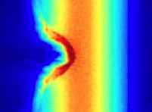

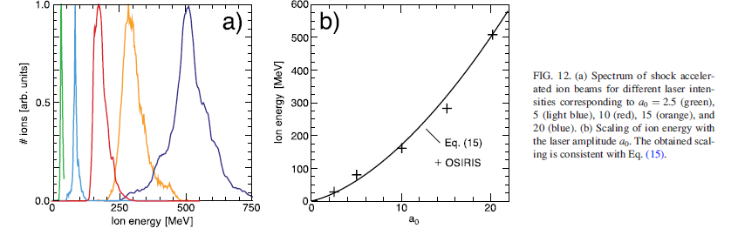
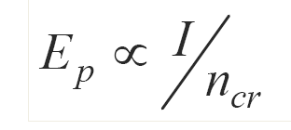
Motivation for multi-TW sub-ps LWIR
Potential applications: LWFA, ion generation, ICS, HHG,…
Collisionless shock wave acceleration
~λ⁻² reduction in critical plasma density allows to generate ions from gas targets where a mechanism of monoenergetic shock wave ion acceleration has been demonstrated.
V
2V
laser
V_{sh}
2V_{sh}
TNSA
+
CSWA
+
+
+
+
Ion energy scaling ~a₀², need a₀~10 for over 100 MeV/nu

Slide 5

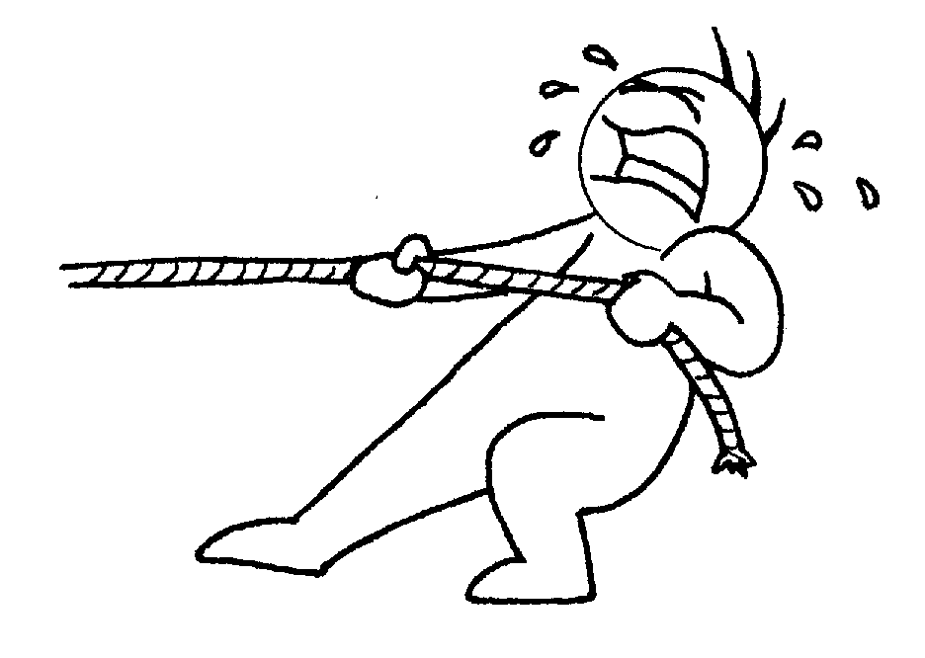
State of art in a short-pulse LWIR laser technology
ATF LWIR Laser System
OPA seed pulse generator
Stretcher
CO₂
CO₂
Compressor
5 TW
2 ps
High-pressure, isotopic
gas amplifiers
Solid-state OPA front end followed by two CO₂ electric discharge amplifiers.
Recently demonstrated upgrade - first CPA CO₂ laser. CPA method allows to reach 5 TW in 2 ps by reducing B-integral<1 on the amplifier’s output window.
Achieving >10TW , <0.5ps regime has been identified as the next major development thrust for ATF

Slide 6
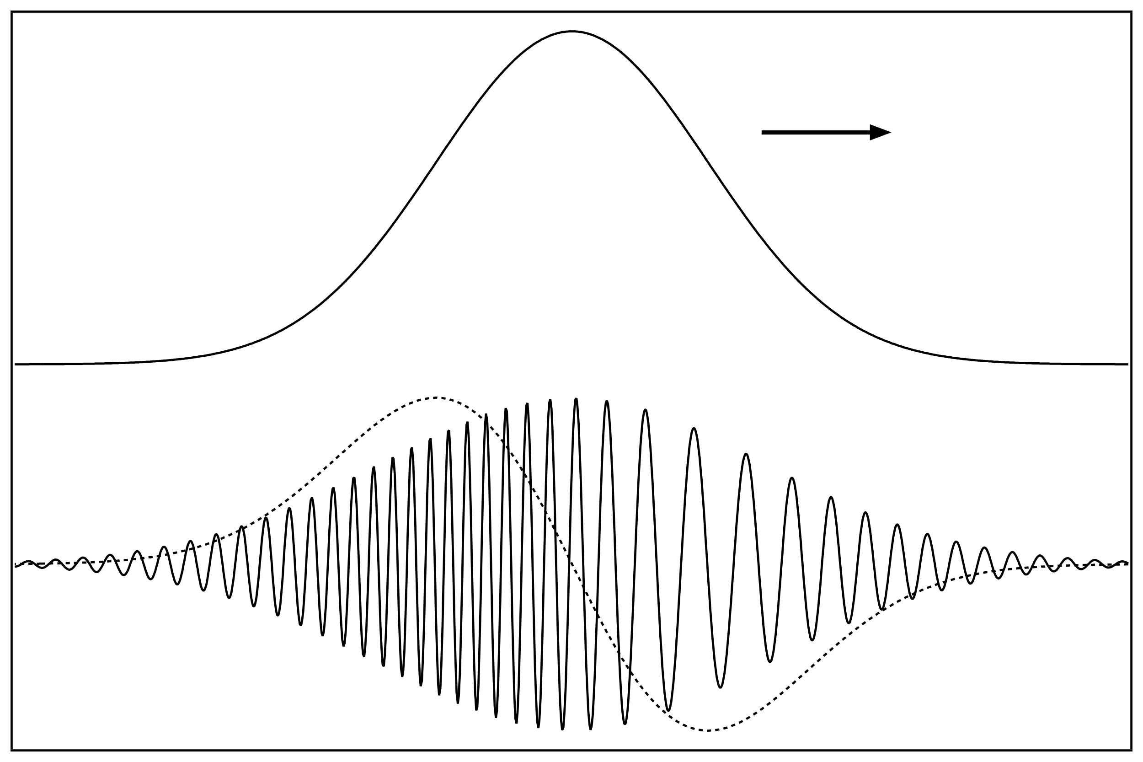
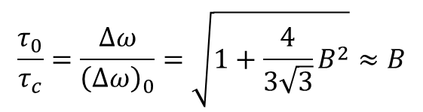

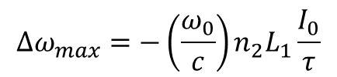


Principles of NonLinear Post-Compression (NLPC)
  Self-phase modulation due to Kerr effect in a nonlinear material results in a quasi-linear frequency chirp.
  A chirped pulse gets compressed in a material with a negative group dispersion.
,
n(t) = n₀ + n₂I(t)
$$τ_{0} =∆ω_{max}(GVD) L_{2}$$
Self-phase
modulation
Dispersive compression
compressible linear chirp ω(t)
$$∆ω_{max}$$
$$∆ω_{max}=−\left(\frac{ω_{0}}{c}\right)n_{2}L_{1}\frac{I_{0}}{τ}$$
= $B$
$$\frac{τ_{0}}{τ_{c}}=\frac{∆ω}{{\left(∆ω\right)}_{0}}=\sqrt{1+\frac{4}{3\sqrt{3}}B^{2}}≈B$$

Slide 7
NLPC R&D Approach
Earlier theoretical studies indicated the opportunity for post-compression of LWIR laser pulses down to 100 fs using self-phase modulation and dispersive compression in bulk materials.
Investigation of scientific opportunities to compress 2-ps, 5-TW pulses delivered by the ATF CO₂ laser system down to sub-picoseconds is supported by the LDRD project launched in 2020 (PI - I. Pogorelsky).
A sub-picosecond compressor demonstrator is the prime deliverable for the LDRD project.
Preliminary survey has revealed significant gaps in our understanding of nonlinear material properties (nonlinear indices, nonlinear absorption) under the high intensity irradiation pertinent to such demonstration.
Our approach is based on leveraging experimental and simulation methods with material studies (Stewardship grant, PI - M. Polyanskiy).
Material studies and NLPC studies are two segments of the AE101 activity

Slide 8
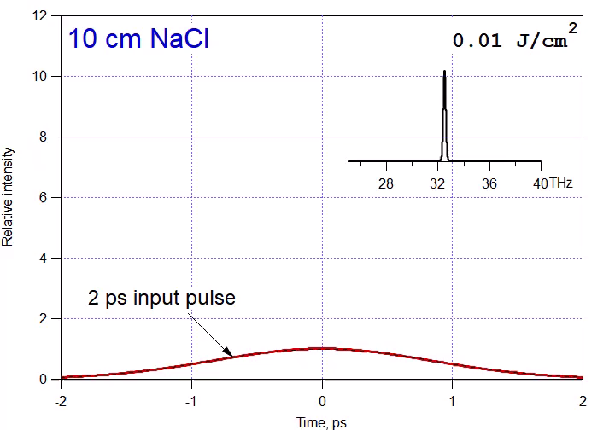
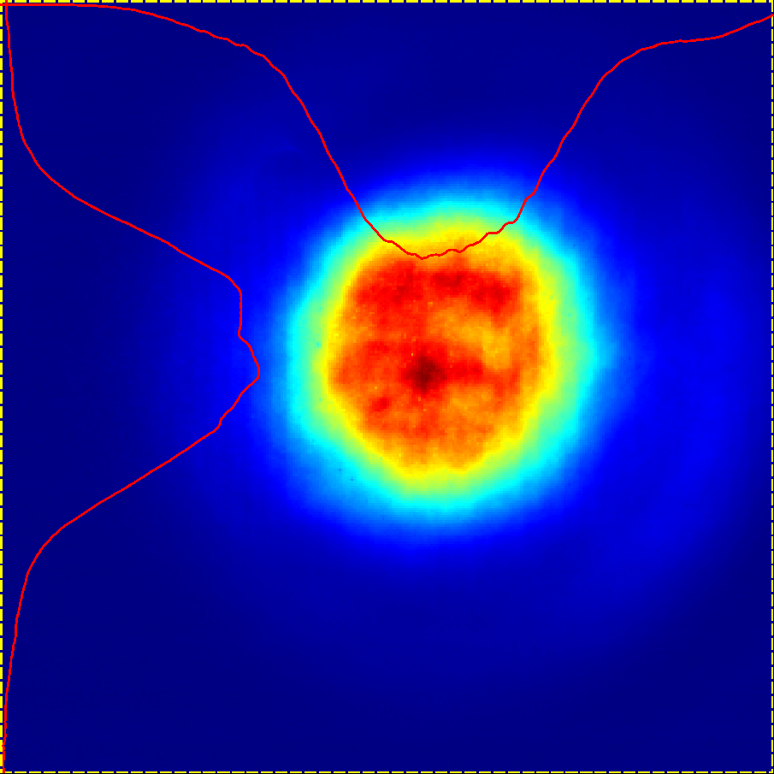

Predictive simulations
for our 1st experiment with a single 10-cm NaCl slab
Transparent to CO₂ laser NaCl material provides $n_{2}$ and GVD.
Our simulations done in approximation of a flat beam profile .
Quasi-gaussian beam from the ATF CO₂ laser system is close to this.

Slide 9
More simulations
over-compression
Compressed pulses and their autocorrelation functions
under-compression
Two observations:
Compression highly critical to laser intensity
best compression
Autocorrelation function considerably enhances the pedestal
Time, ps

Slide 10
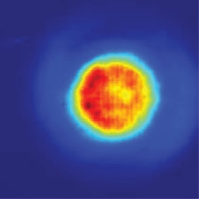
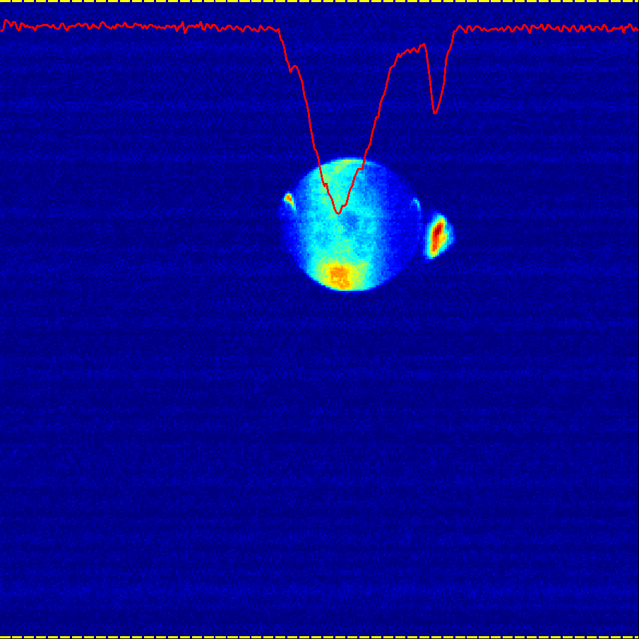
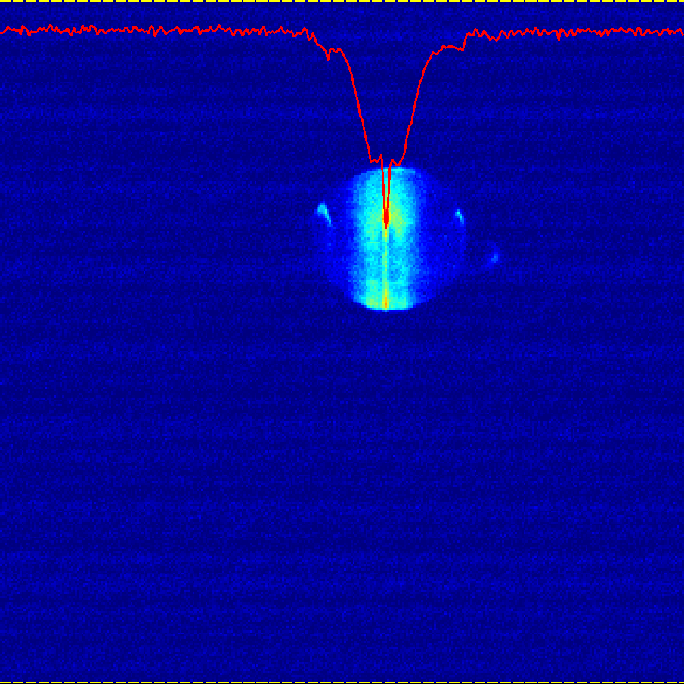
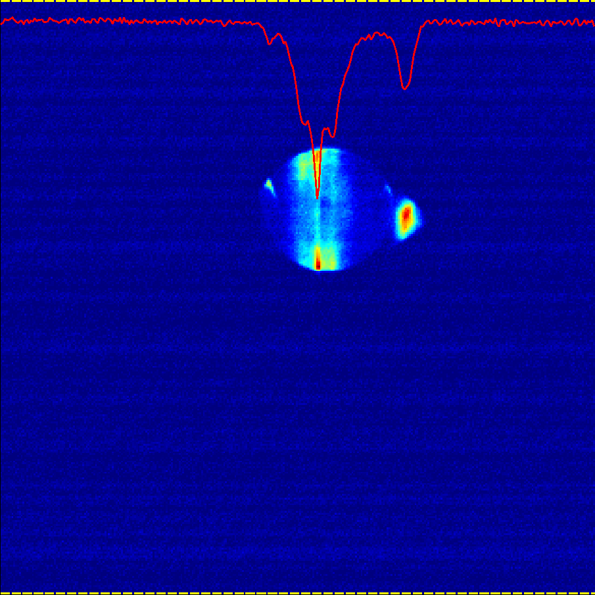
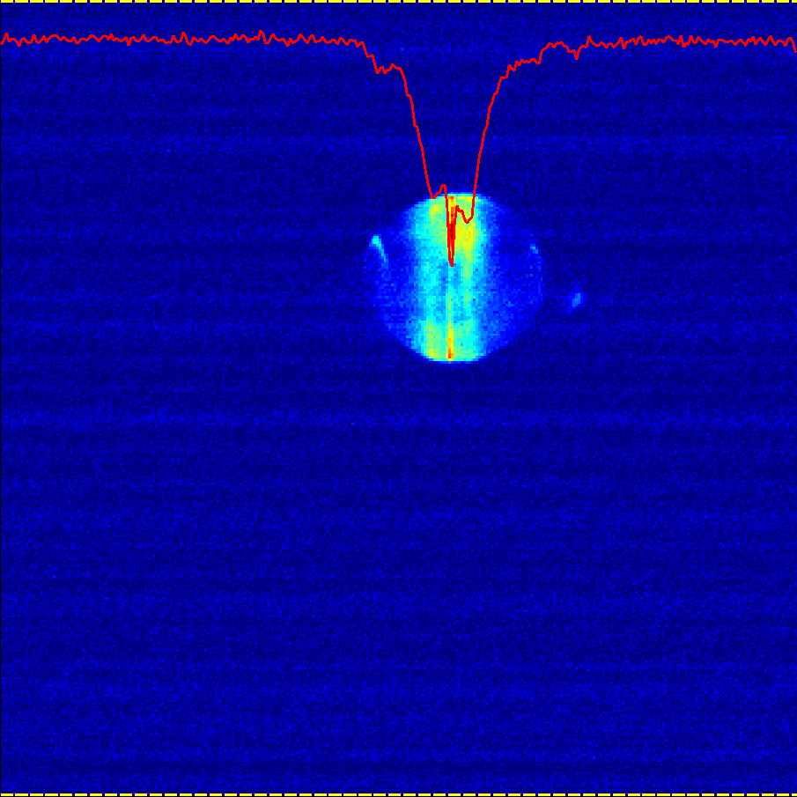
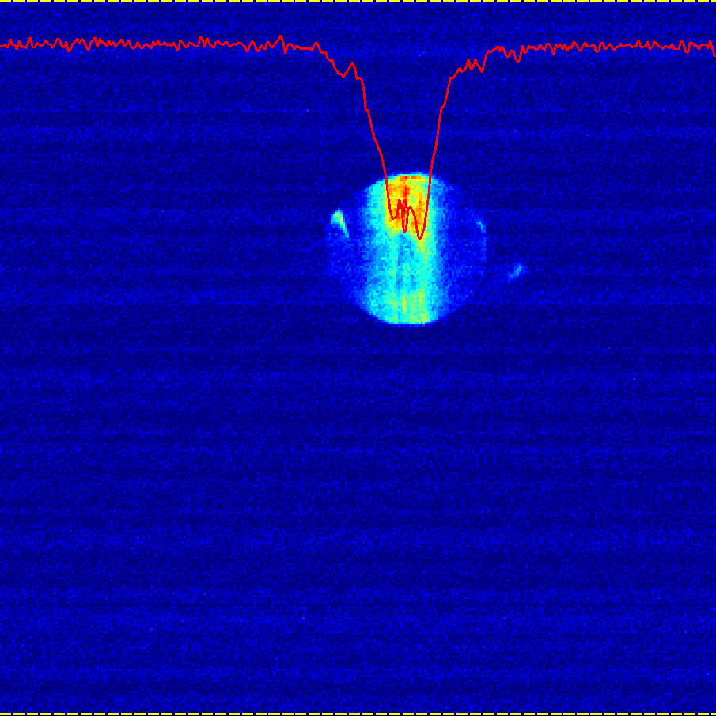
Results from 2020 experiment
<1.5 J or
0.3 J/cm²
~2.5 J or 0.4 J/cm²
>3.5 J or
0.6 J/cm²
Color centers formation at a high intensity above the nonlinear absorption threshold reveals the beam nonuniformity and micro-filamentation
Autocorrelation images versus initial laser energy
Opportunities for improving efficiency of energy conversion to femtoseconds :
  NLPC staging to keep B<3 to avoid micro-filamentation,
  using flat-top beams,
  combination of different NLPC materials.

Slide 11


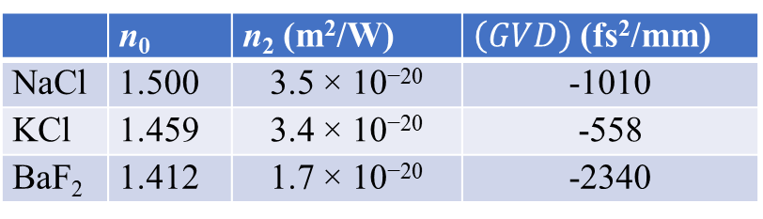
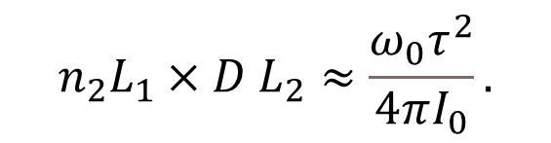
NLPC optimization based on materials study (2021 experiment)
Material properties at 9.2 μm
 | n₀ | n₂ (m²/W) | $\left(GVD\right)$ (fs²/mm)
NaCl | 1.500 | 3.5 × 10⁻²⁰ | -1010
KCl | 1.459 | 3.4 × 10⁻²⁰ | -558
BaF₂ | 1.412 | 1.7 × 10⁻²⁰ | -2340
5cm
5cm
CPA output
at the NLPC
13 mm
5 mm
well-controlled Gaussian beam 14 m after the aperture
compressed from 2 ps to 290 fs
Correlation between the optimum thickness of NLPC components and initial pulse parameters
$$n_{2}L_{1}×D L_{2}≈\frac{ω_{0}τ^{2}}{4πI_{0}}.$$

Slide 12
Pulse compression in KCl + BaF₂
Deconvolution of autocorrelation curves gives us pulse profiles
278 mJ
in 5 mm dia beam
in 13 mm dia beam
Agreement between experimental and simulated autocorrelation curves at different input energy and pulse compression levels
Observations:
Flattop compresses more efficiently than gaussian profile
No compression in KCl
However, notable additional phase modulation in BaF2
12

Slide 13
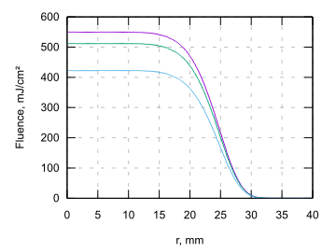
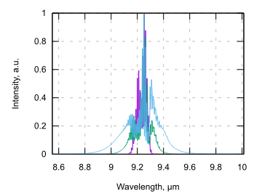
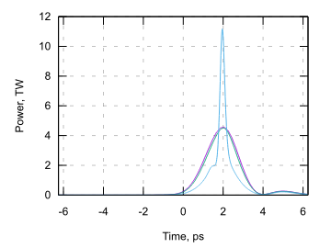
Next goal: Entire 10J beam compression to <500fs, >10TW (simulations)
input beam
after KCl
after BaF2
350 fs
Assumed:
an ideal super-Gaussian (8th order) beam
beam size (1/e^2 radius = 27.5mm)
input energy 10J (~4.5TW)
KCl+BaF2 (50 mm thick each)
B-integrals of both components are ~3
Conclusions:
<500 fs, >10 TW regime can be achieved
Important to create a uniform, flattop beam

Slide 14
2022 Experiment Planning
We will attempt compression of the entire 10 J beam.
Spatial filtering requires putting the experimental setup in vacuum.
Two chambers for inserting NLPC optical elements within LWIR beam transport line in CO2 and FEL rooms.
Both chambers will remain in beamline between and after experiments. They don’t introduce any restriction but rather add flexibility by allowing access to beam transport for beam characterization or extraction, etc.
5 TW
2 ps
10 TW
500 fs
BaF2
lens
KCl
5 cm
BaF2
5 cm
spatial filtering for higher beam profile uniformity

Slide 15
NLPC R&D Plan for 2022
Optimize the NLPC test configuration based on predictive simulations
Install and commission the NLPC vacuum chambers
Conduct in-vacuum NLPC tests at the several terawatt level
Coordinate test results with simulation to confirm models

Slide 16
SUMMARY
AE101 demonstrated post-compression of a sub-Joule portion of the 9.2 µm laser beam at the sub-TW level:
  a flat-top beam compressed from 1.65 ps to 290 fs
  a Gaussian beam compressed from 1.85 ps 480 fs.
The observed effect of pulse compression agrees with simulations.
This builds the foundation for a next step of the full beam compression at the multi-TW level for implementation this year

