Slide 1
Two-Color Ionization-Injection Laser Wakefield Acceleration at BNL-ATF (AE88) Development of Wavelength Conversion Techniques for Generation of Coherent Radiation at the Mid- to Long-wave Infrared (AE108)
R. Kupfer, I. Pogorelsky, M. Polyanskiy, M. Fedurin, K. Kusche, M. Babzien, , M. Palmer, J. Wishart, F. Wang, T. Rao, L. Cultera, I. Petrushina , A. Gaikwa, I. Bromberg, A. Chang, M. Zepeda-Aguilar, V. Litvinenko, R. Samulyak, N. Vafaei-Najafabadi, R. Zgadzaj, G. Tiwari, M. Downer, C. Zhang , Y. Wu, M. Sinclair, A. Farrell, C. Joshi (BNL, SBU, Texas, UCLA)
Funding: LDRD 18-026, LDRD 21-001 (Received)
1/18/22
The Accelerator Test Facility

Slide 2
Outline
Laser wakefield acceleration (LWFA)
Two-color ionization-injection LWFA (TCII-LWFA)
Implementation of TCII-LWFA at the Accelerator Test Facility (ATF)
Preliminary results from first attempt
Ongoing work to improve the long wave infrared (LWIR) performance
Optical pumping of CO₂ – Raman conversion in ionic liquids
Generation of broadband LWIR seed

Slide 3
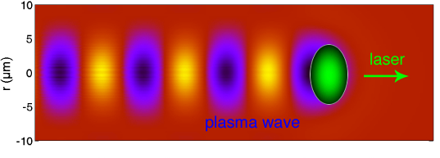
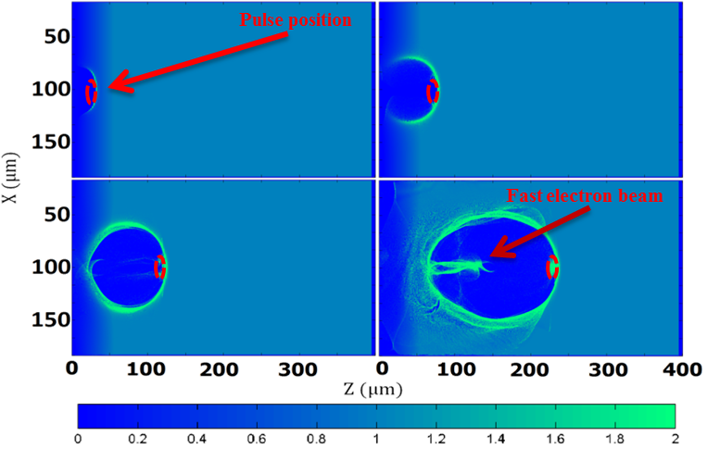
Laser Wakefield Acceleration
The strong electric field of the laser strips electrons from atoms generating plasma
Pondermotive force, $F=−\frac{e^{2}}{4mω_{p}^{2}}∇E^{2},$ pushes electrons away from area of high intensity
Ions are heavier and stay almost stationary on this timescale (fs) - electron waves on a background of stationary ions
In the linear case, collective oscillations at the plasma frequency ($\sim \sqrt{n_{e}}$)
In the nonlinear case, with ‘matching conditions’ for the physical dimensions of the laser pulse - complete blowout of elections to form a ‘bubble’. Nonuniform charge distribution generates strong electric fields – No local charge neutrality
Converts transverse fields to longitudinal (accelerating)
Acceleration gradient ~100GeV/m ($×{10}^{3}$compared to conventional RF accelerators, less stringent vacuum requirements)
In the ‘matching conditions’ LWIR can produce larger bubbles (D~100µm) compared to NIR (D~10µm) at lower plasma densities (~10¹⁷cm⁻³)
“Random” injection results in high emittance (phase space volume) – lower bunch quality compared to conventional accelerators
Limited by diffraction, dephasing and depletion (We are far away from these limits)

Slide 4
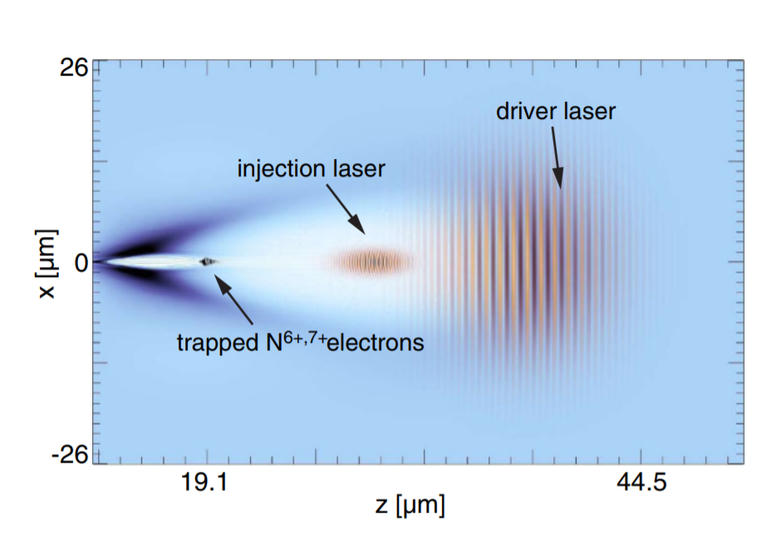
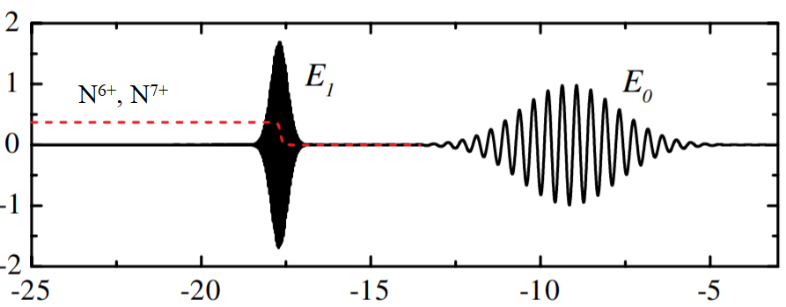
Two-Color Ionization-Injection LWFA
Controlled injection -> better bunch quality
Acceleration efficiency is determined by $a_{0}\sim \sqrt{I×λ^{2}}$
Ionization depends on intensity, $I\left[Wcm^{−2}\right]$
LWIR driver, high a₀, ‘low’ intensity, drive the bubble
NIR injector, low a₀, ‘high’ intensity, inject electrons through additional ionization inside the bubble
Higher charge and lower emittance
Spin polarized injection

Slide 5
Two-Color Ionization-Injection LWFA
A few important details for implementation at ATF (will answer some of the ‘why?’ questions in the implementation):
LWIR
Energy and duration 5J @ ~2ps, 9.2µm CWL
Pulse does not meet the threshold conditions for Blowout regime – appears to be in the self-modulated regime even with f/2 focusing
Energy stability +/- 100%...
Focus position is energy dependent
(un) Availability of high damage threshold dielectric coatings for LWIR
NIR
Limited to ~15mJ, 70fs without vacuum compressor
We need to reach peak intensity higher than LWIR (~3x10¹⁷ Wcm⁻¹) so tight focusing is required
Therefore, we chose to implement transverse injection
Gas target
We chose Krypton because of the many available ionization states accessible with our intensities
Because of the many available ionization states the plasma profile is presumed to be Gaussian vs flattop for Hydrogen (with ~flattop gas density profile from the nozzle)
The problem reduces to intercepting a plasma bubble that is moving at ~speed of light with a tightly focused Ti:Sa pulse.

Slide 6
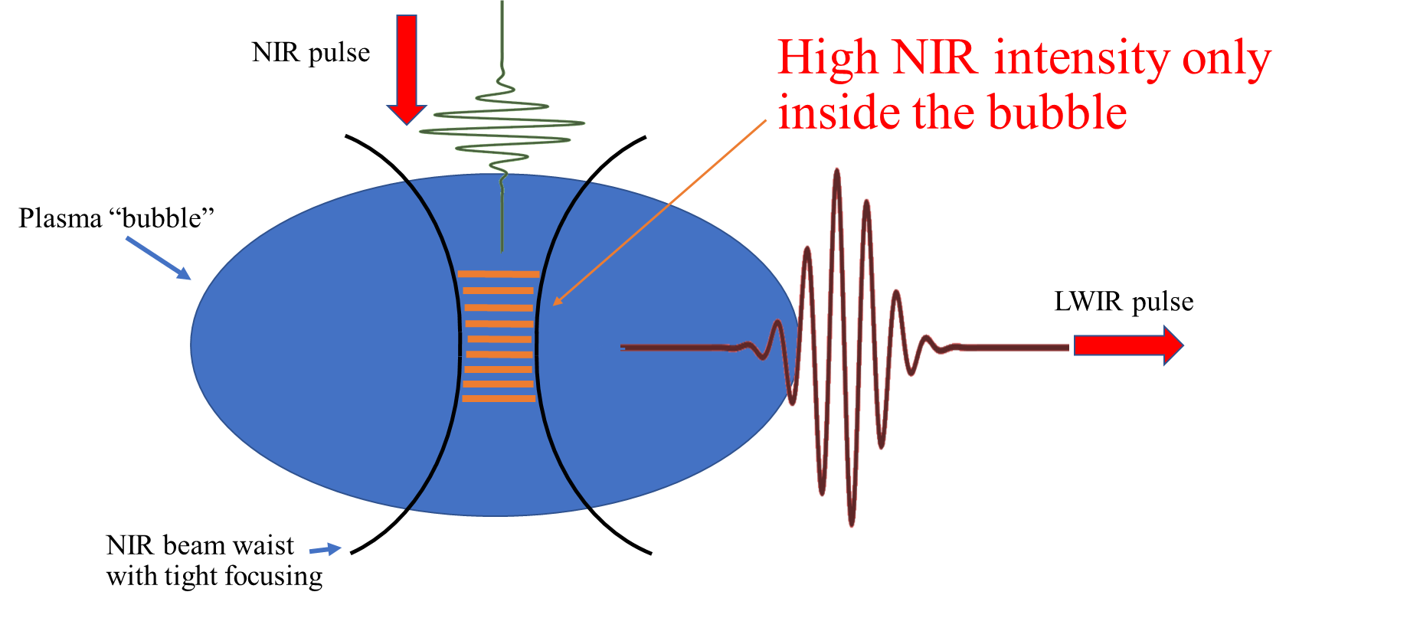
Two-Color Ionization-Injection LWFA

Slide 7
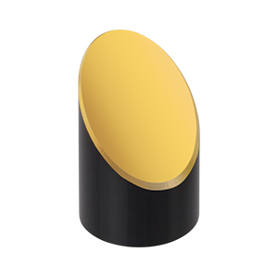
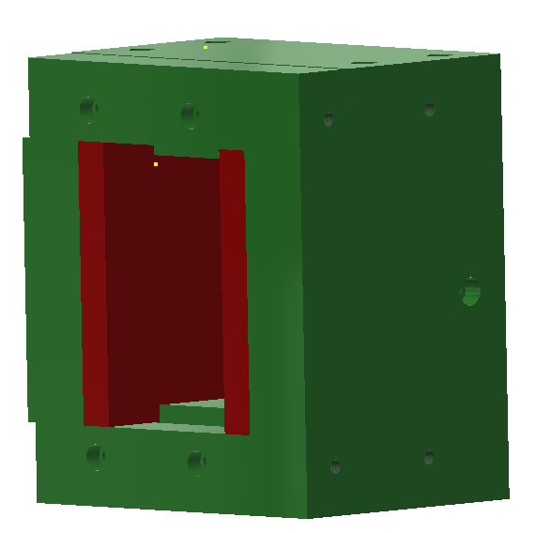
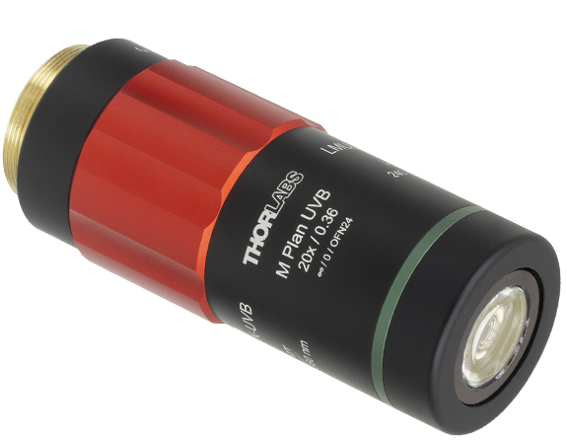
Two-Color Ionization-Injection LWFA
NIR pulse
LWIR pulse
Dipole
magnet
LANEX
Slit
f/#1.5 focusing
Nozzle
LWIR focus diagnostic
NIR focus diagnostic
f/#2 focusing

Slide 8
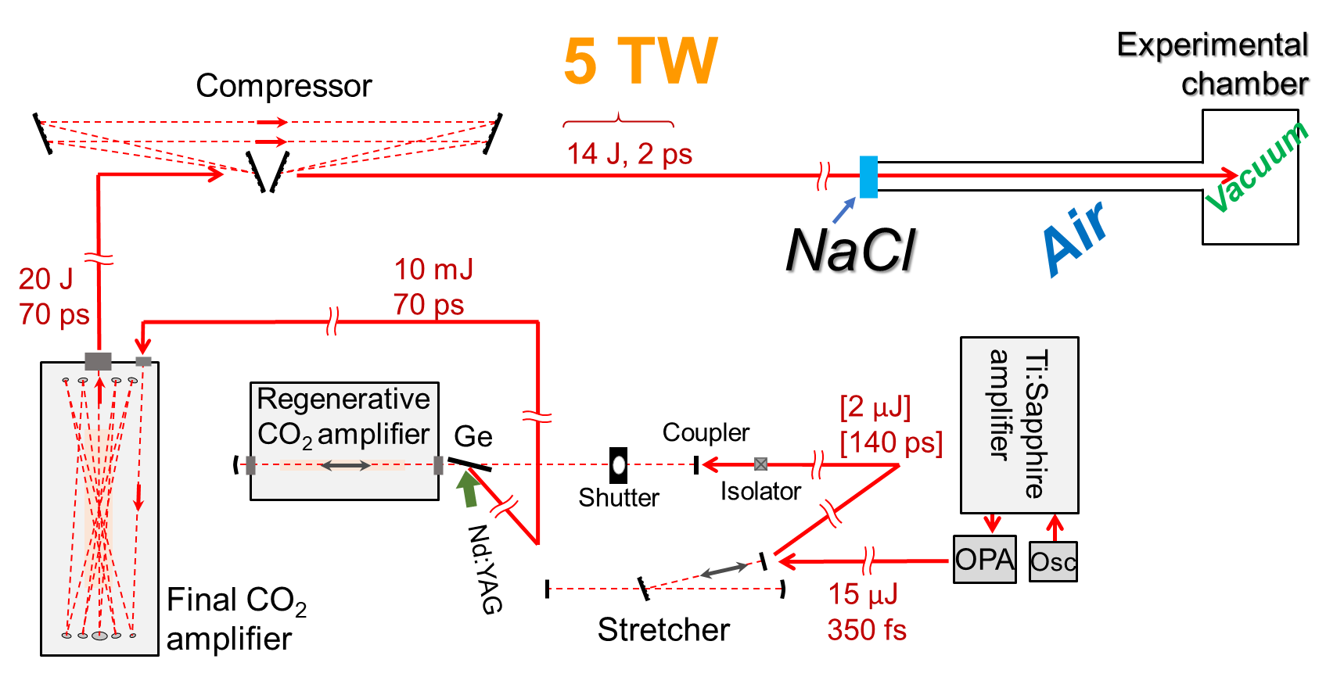
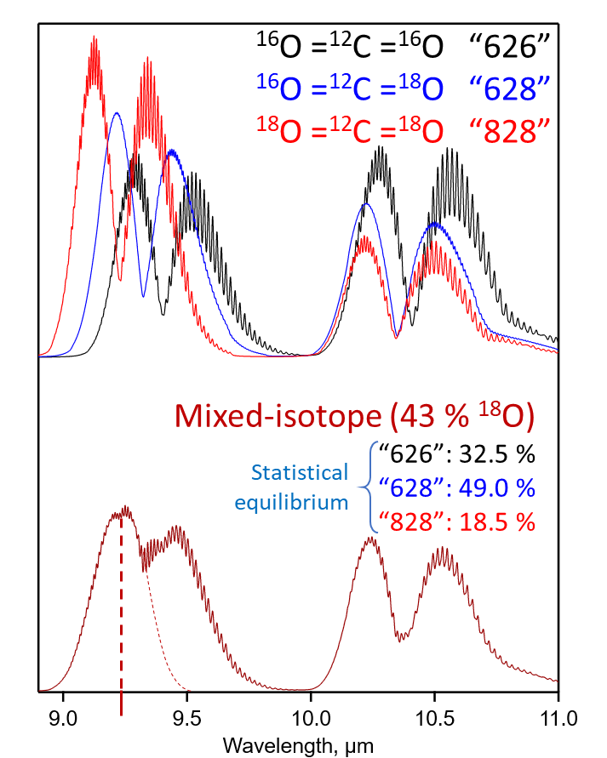
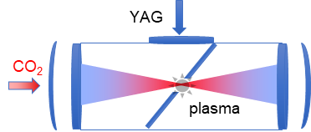
LWIR Drive Laser
LWFA chamber
Compressor
Plasma shutter
Regen
Front-end
9.2µm, ~2ps, 5J, 0.05Hz
Synchronized to master clock
Final amp

Slide 9
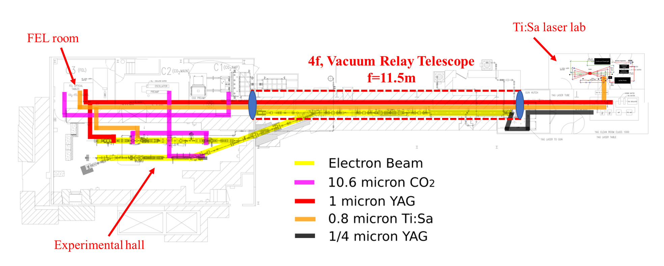
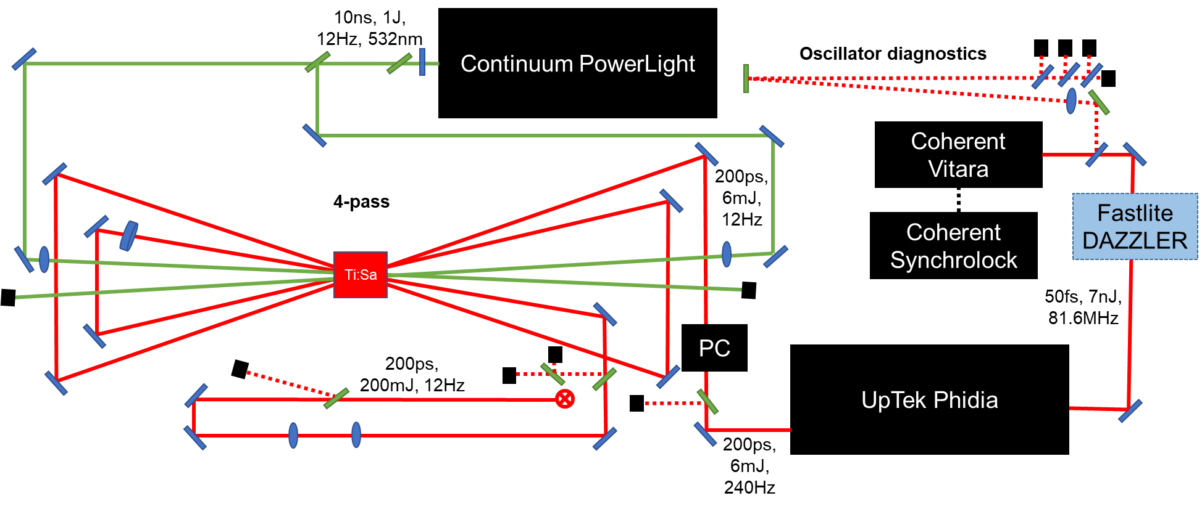
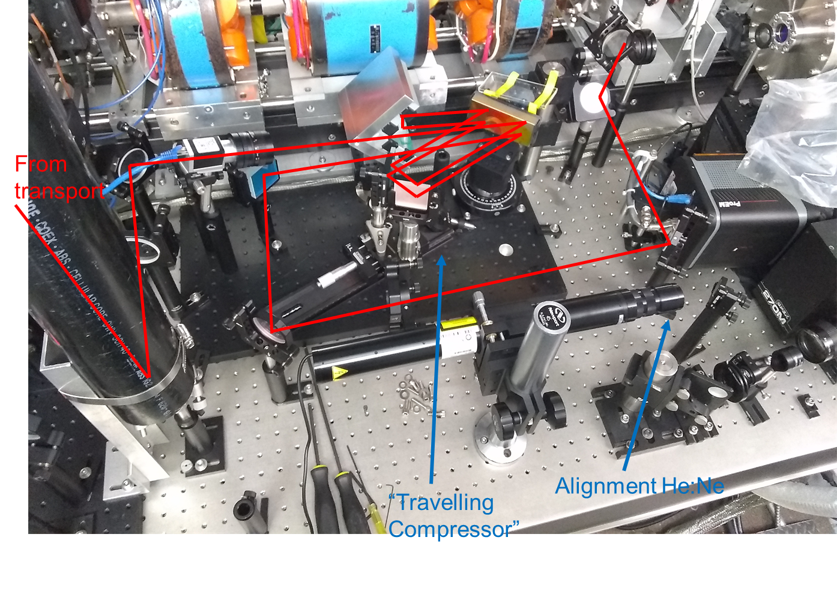
NIR Injector
Master Clock

Slide 10
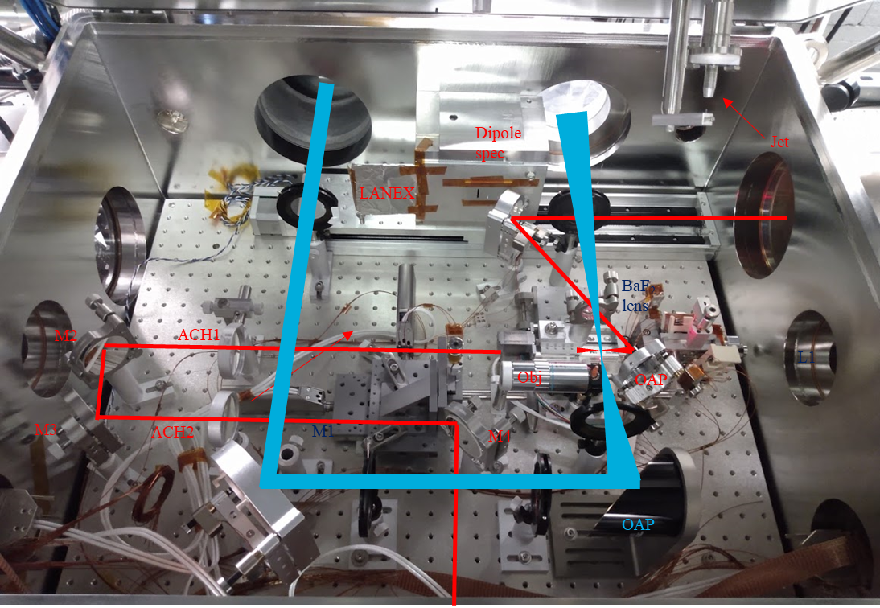
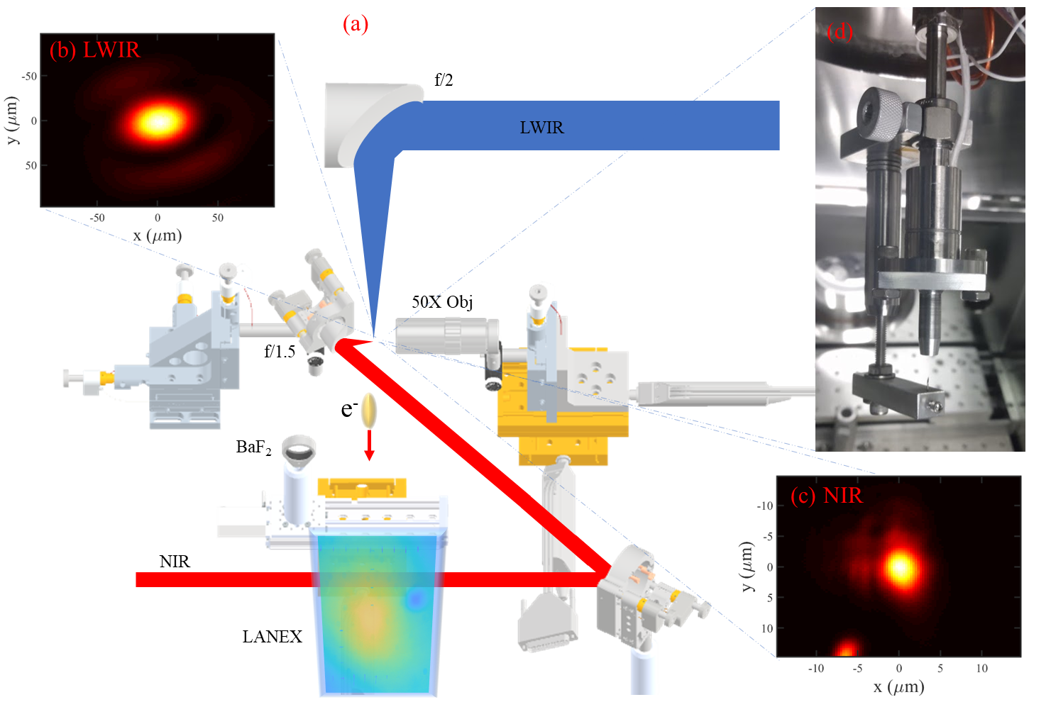
Beam Delivery

Slide 11
Beam Delivery

Slide 12
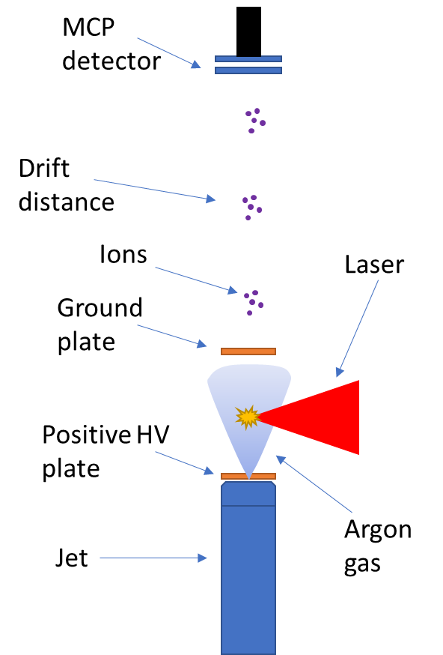
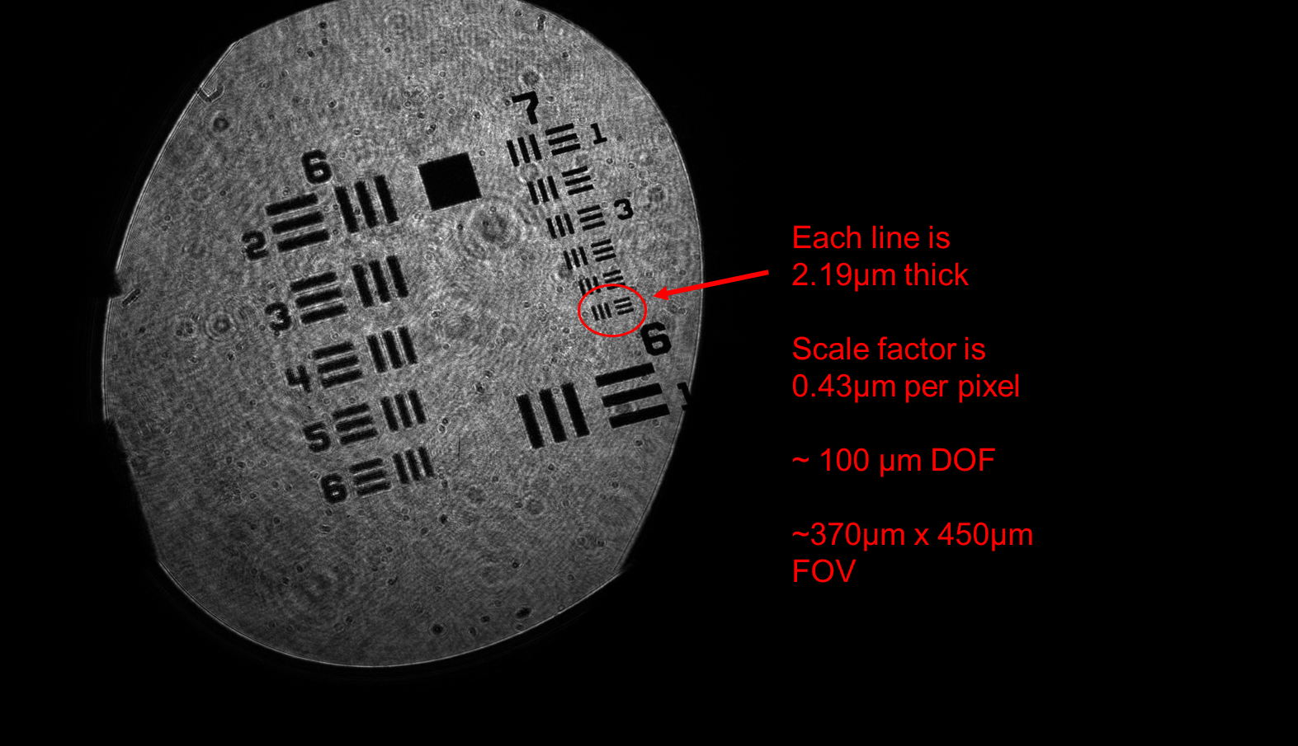
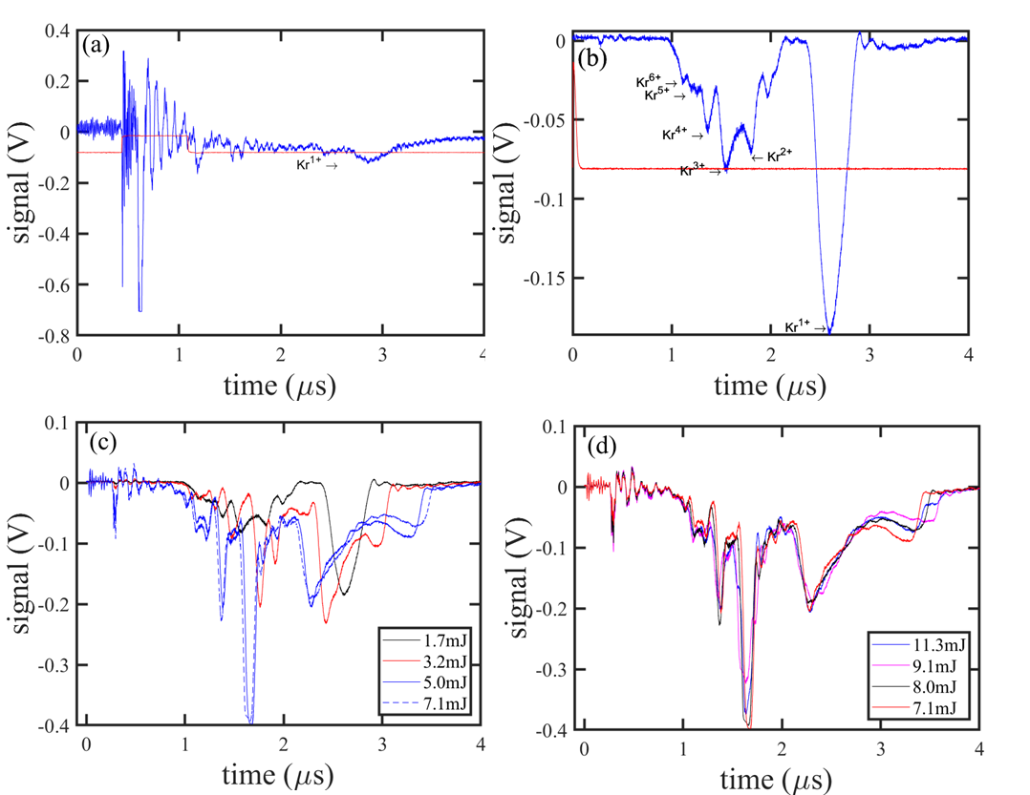
Overlap, Timing and Ionization Measurements
He:Ne backlighter
Ti:Sa
Pin head ~60µm wide

Slide 13
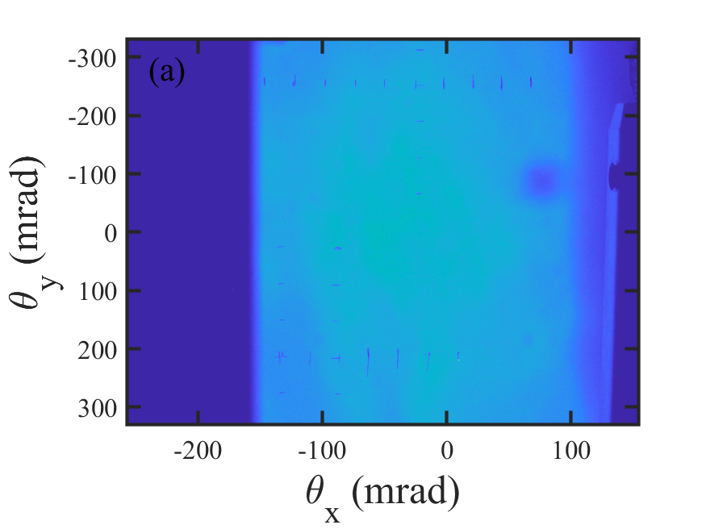
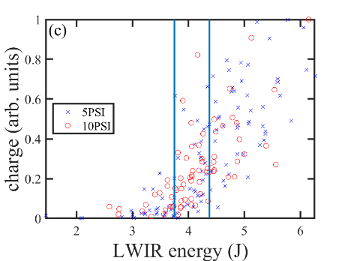
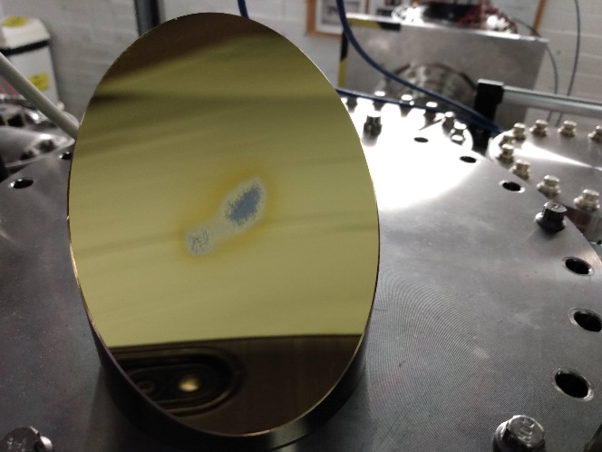
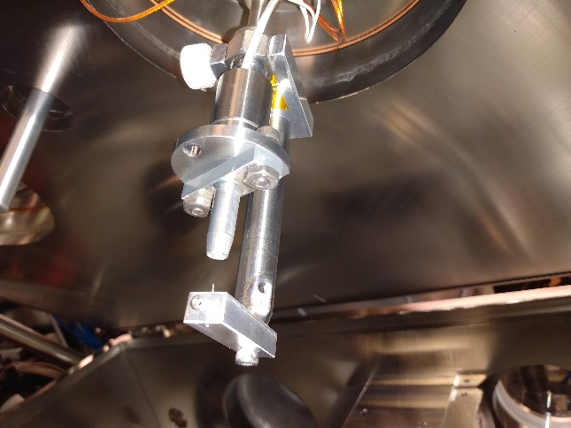
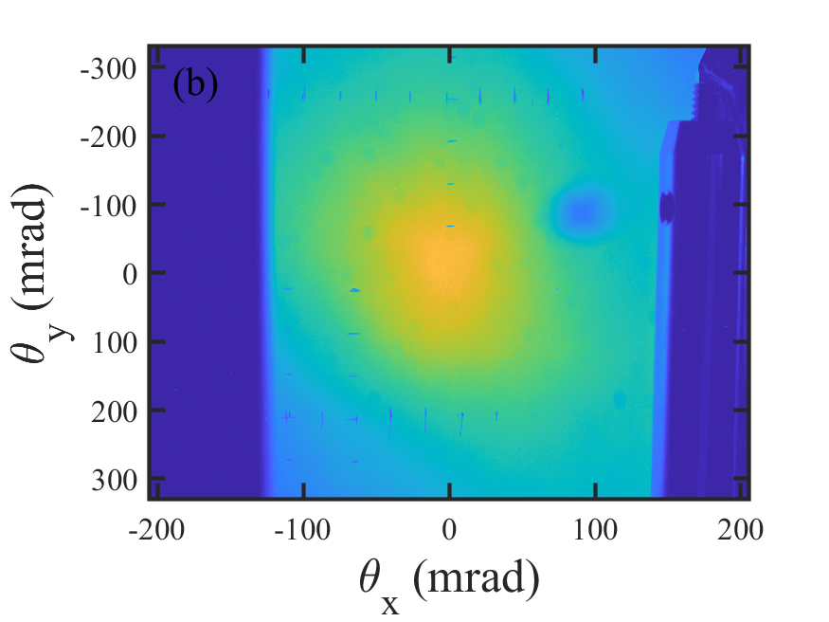
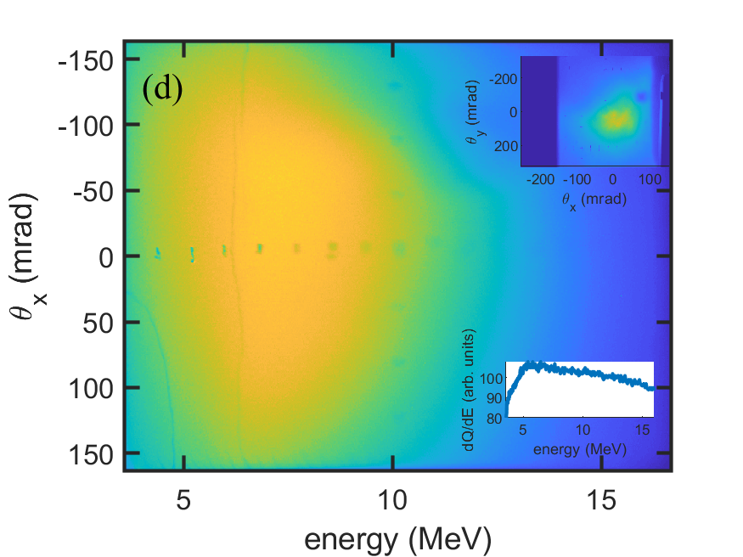
Preliminary Results
*We chose to work slightly above the threshold for self-injection where electron signal is always observed.
P=25PSI
Self injection at E_{LWIR}=5.3J, P=10PSI
Energy spectrum with H target
Completely fried the setup on day 12…

Slide 14
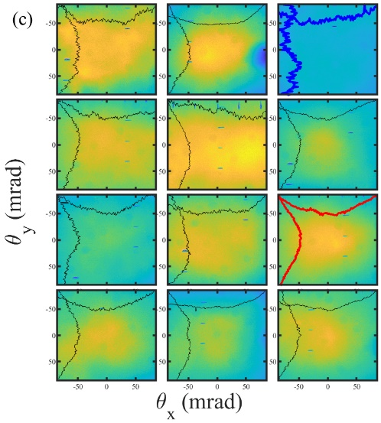
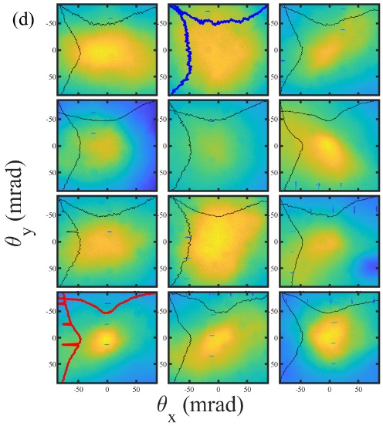
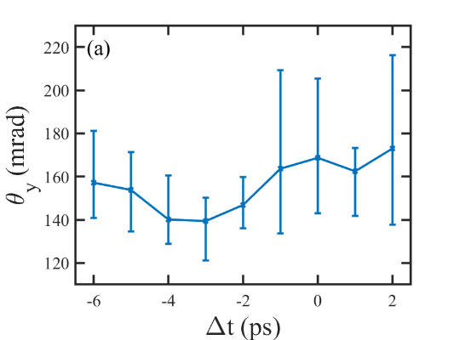
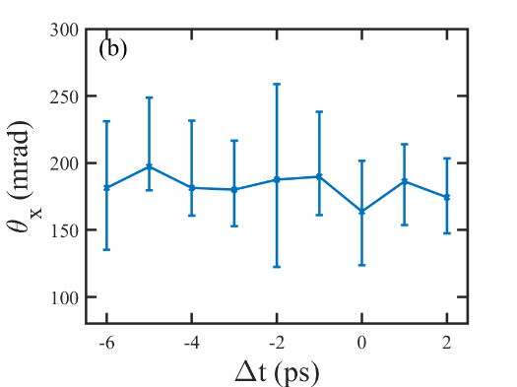
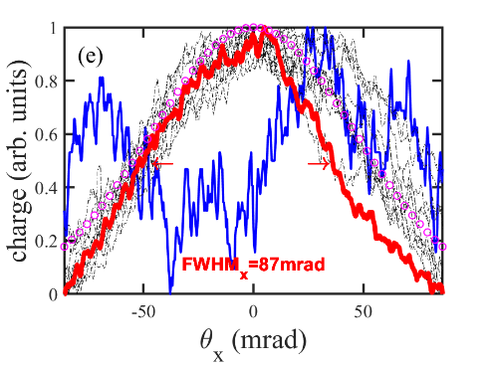
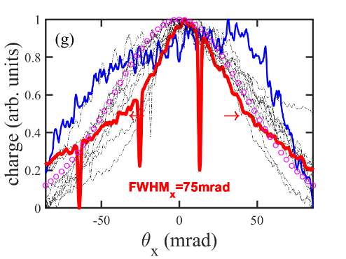
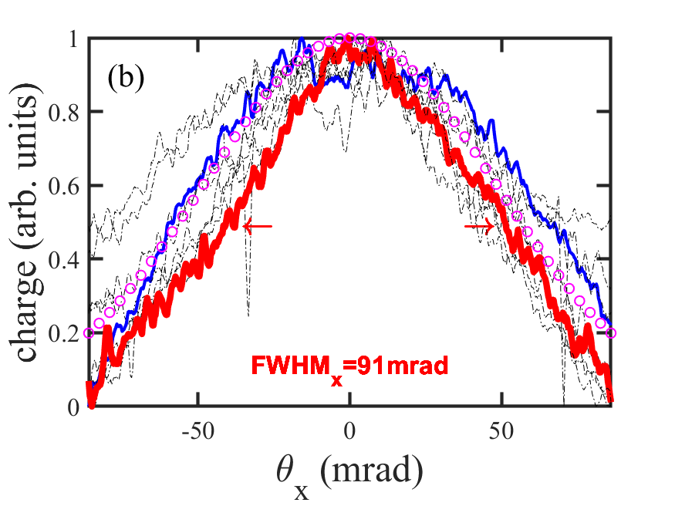
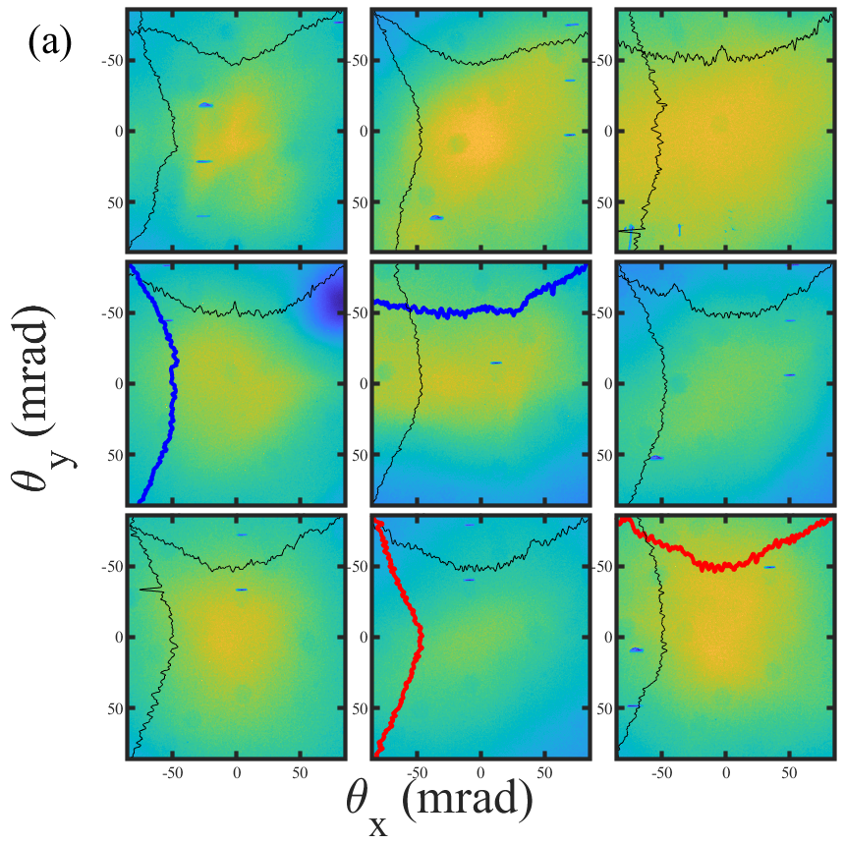
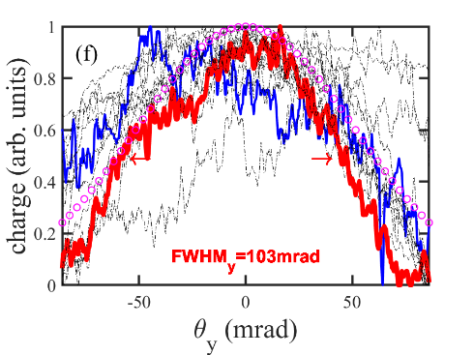
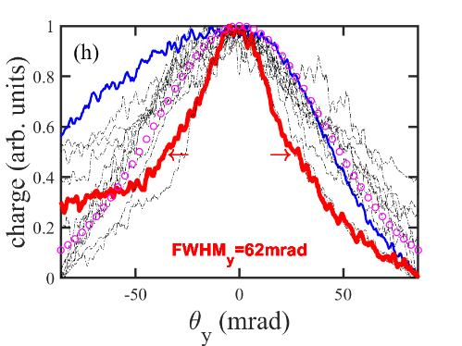
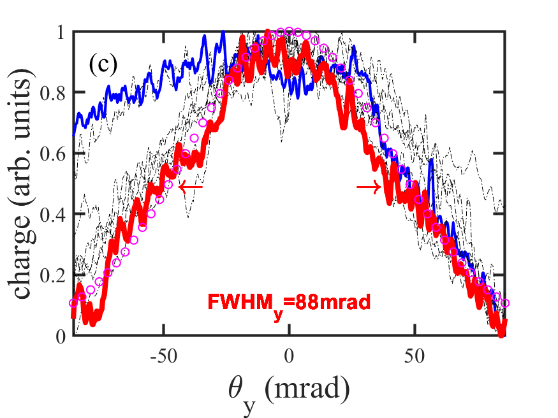
Preliminary Results
Injection OFF*
Injection ON*
Delay scan – effect only on y-divergence
High energy unseeded – self injection with high divergence
* Lowest divergence shots in each. Taken at no particular order

Slide 15
Preliminary Results
Our computational collaborators (Roman Samulyak et. Al.) are working on simulation to answer the following questions:
Why do we see self injection at 3J?
What is the size and shape of the accelerating plasma structures with our parameters? Can we even ‘hit it’?
Is the reduction in divergence really ionization injection? (i.e. a more collimated bunch on top of the self injected bunch)
What are the expected ionization states and plasma density profiles?
What needs to happen for it to work
Injection position on the LWIR z-axis – focus position is energy depended
Improvement of timing stability (?) – oscillators vs paths stabilities
Once the NIR vacuum compressor is implemented collinear injection may become accessible
Reduction of the LWIR duration is needed for blowout regime
Improvement of LWIR energy stability is desirable

Slide 16
Improving the Quality of the LWIR Laser
Pulse duration
High losses in the regenerative amplifier cause significant gain narrowing
Currently the seed is generated with a commercial OPA – low efficiency and many ‘steps’
The regen can be avoided altogether if ~1-10mJ LWIR seed is available
Final amp has enough bandwidth to support ~500fs pulses
Achieving sub-ps, joule level LWIR pulses is important as it will unlock the ‘next regime’ in LWFA
Energy stability
Electric discharge pumping of CO2 becomes harder and less stable at the higher pressures needed for spectrum smoothening
Development of optical pumping scheme using a Fe:ZnSe laser is in progress
An alternative is to find a way to convert ‘cheap’ 1064nm/532nm energy from an Nd:YAG laser to 4.5µm using a two-step process: Raman shift in an ionic liquid followed by difference frequency generation (DFG) in a nonlinear crystal

Slide 17
Raman/DFG Wavelength Conversion
Residual pump ω_{p}
Residual pump ω_{p}
Raman Converter
$$ω_{vibration}=ω_{target}$$
Nonlinear crystal $χ^{(2)}≠0$
$$ω_{p}−\left(ω_{p}−ω_{target}\right)=ω_{target}$$
ω_{target}
‘Cheap’ high energy laser source ω_{p}
Converted pump ω_{p}- ω_{target}
Converted pump ω_{p}- ω_{target}
Nd:YAG and Ti:Sa are already available at ATF as pump sources.

Slide 18
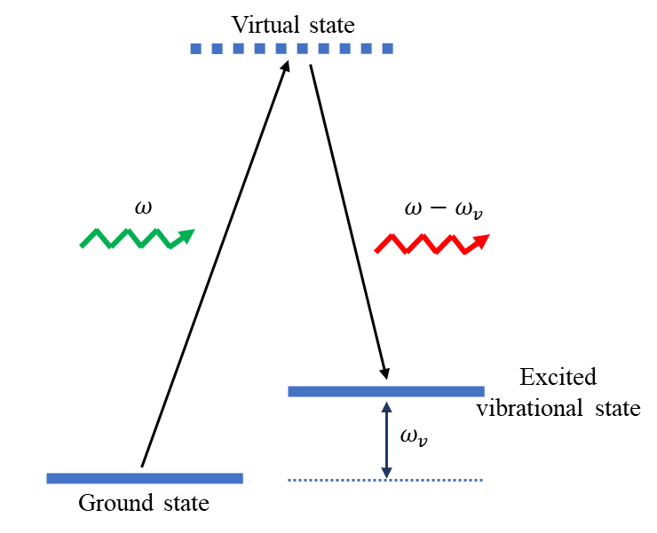
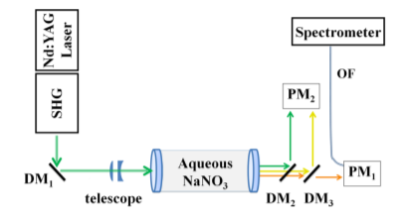
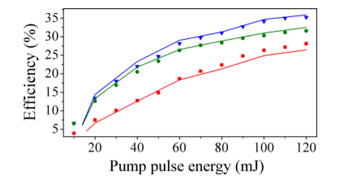
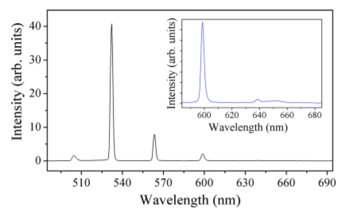
Raman Conversion in Water and Aqueous Solutions
Inelastic scattering from a vibrational degree of freedom (can be used as a stimulated process)

Slide 19
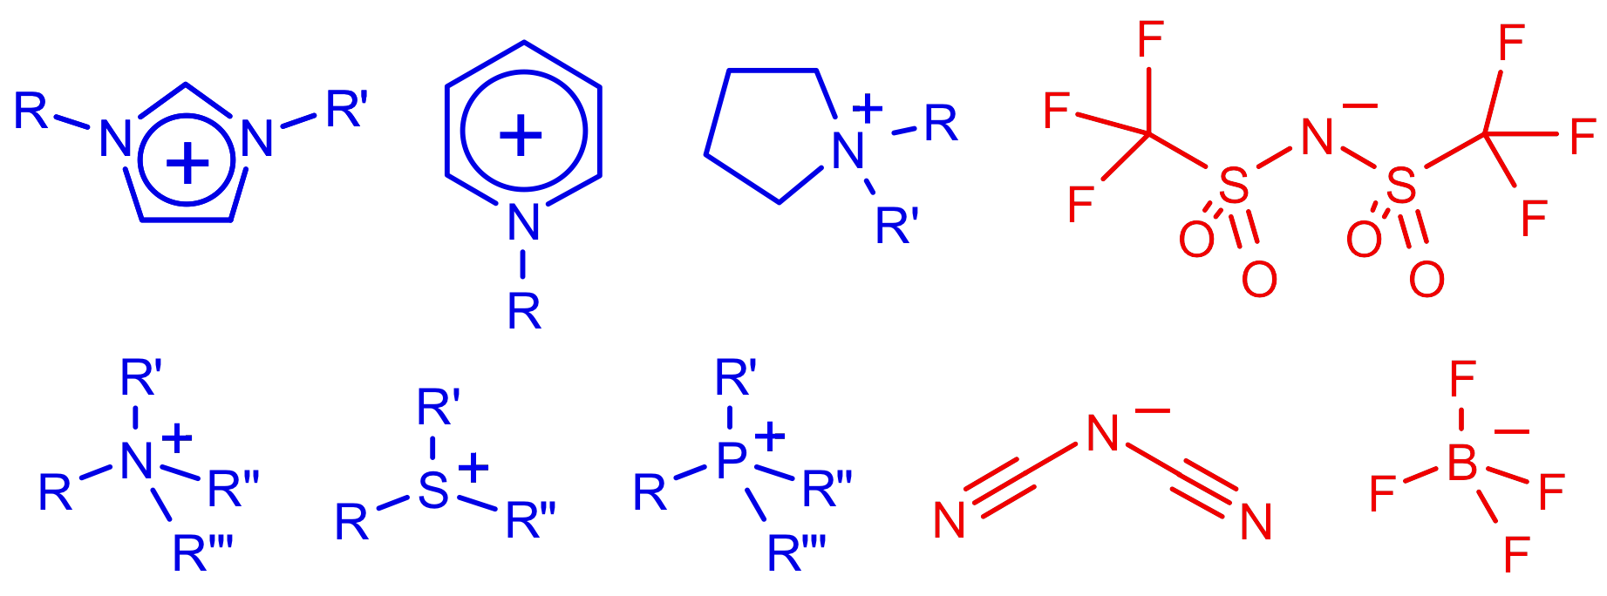
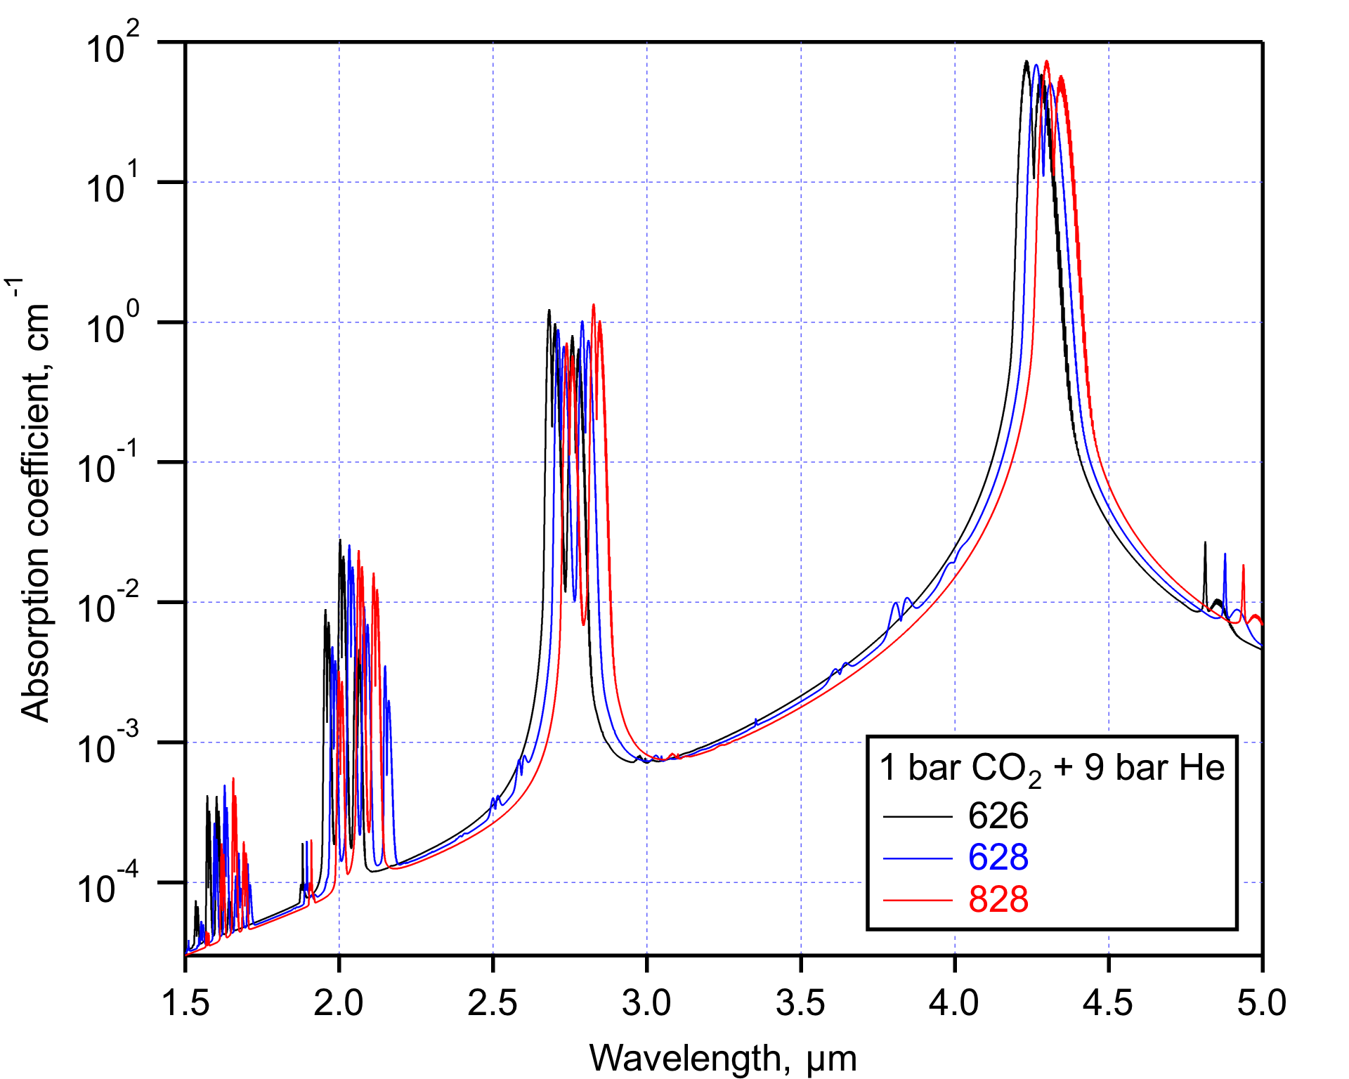
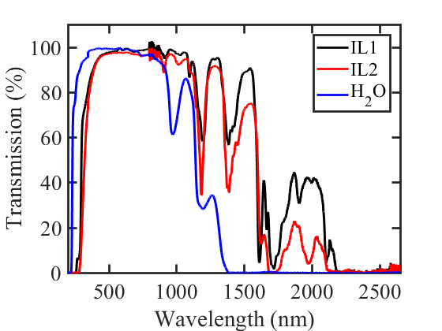
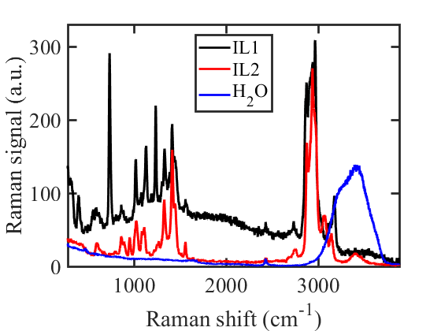
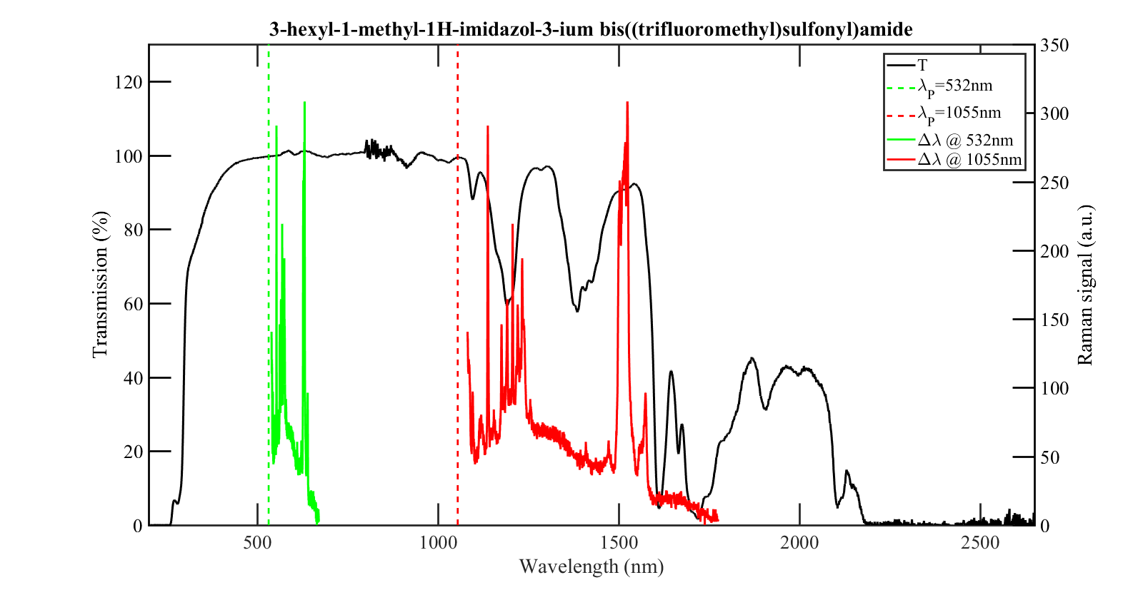
Raman Conversion in Ionic Liquids
If a solution of water and salt is better than water – why can’t we just get rid of the water and use liquid salts?
Ionic liquids are artificial salts that are liquid at room temperature
They can literally be “designed” to have a given set of properties because they can be prepared in an infinite variety of combinations
Because they are liquids the exhibit single molecule vibrational states (vs phonons in solids) and have higher density than gases
Higher IL viscosities reduce Brillouin scattering (scales inversely with viscosity)
Many ILs have wide transmission windows into the IR (may be also useful as coolants)
Selection criteria:
Transparent at the pump and Stokes wavelengths
Peak Raman cross section at the desired shift (or absorption at any serious competitor)
High viscosity (suppress Brillouin scattering)
Good stability
Better transparency at the IR
Higher cross section than water
Transparent at the Raman shifted wavelength
19

Slide 20
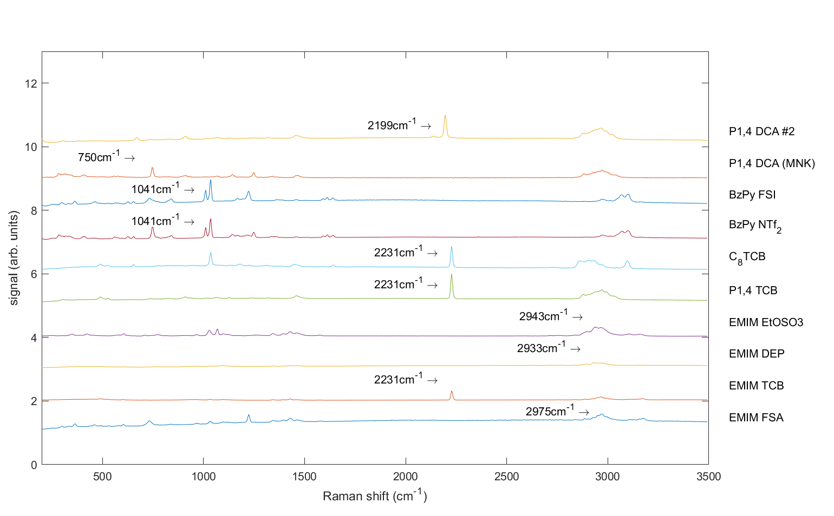
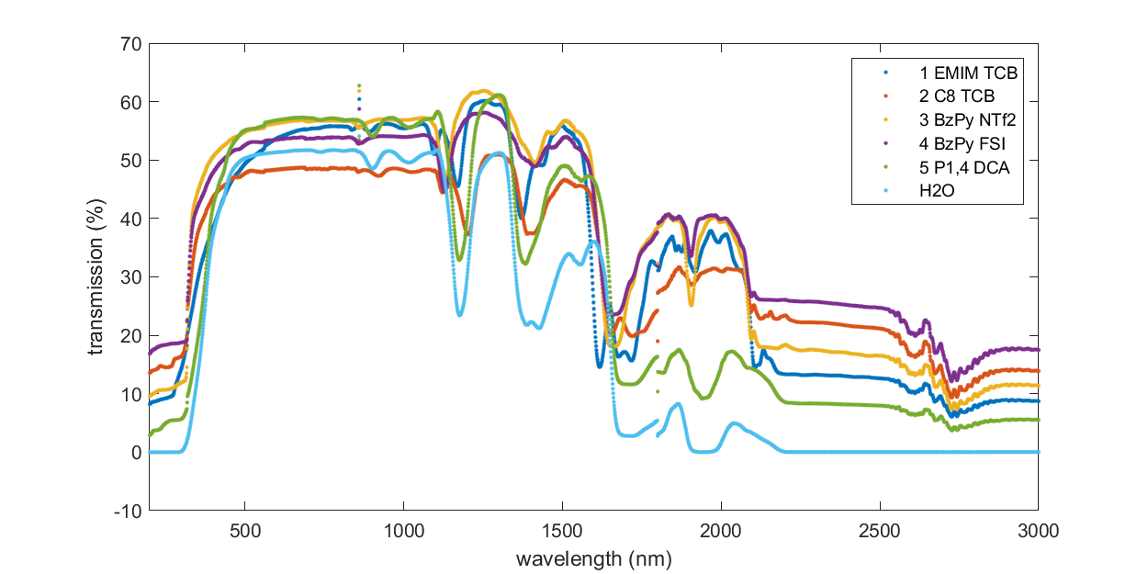
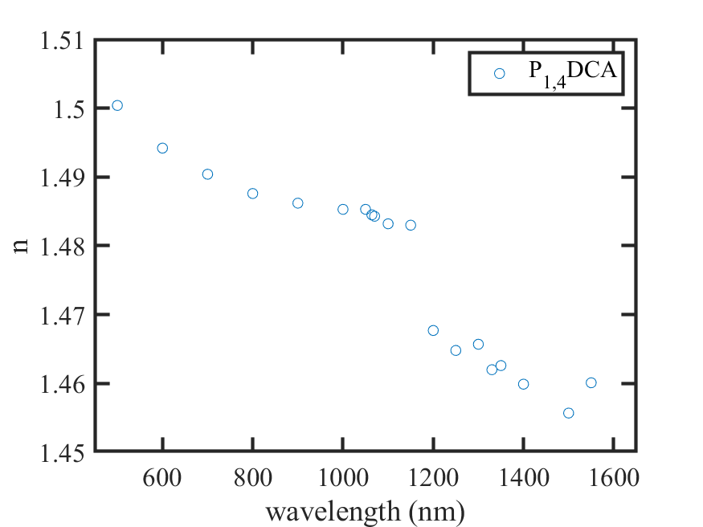
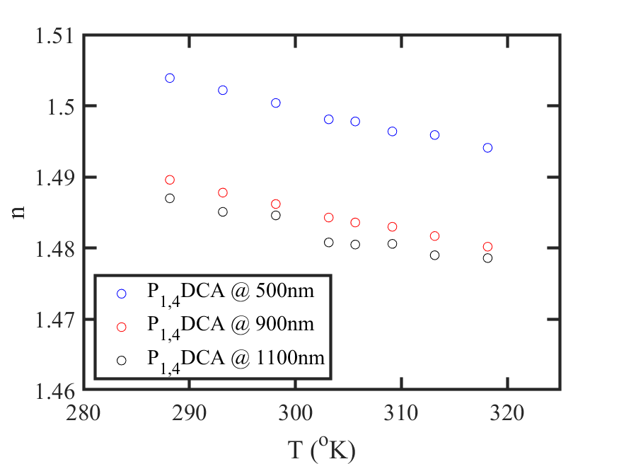
Raman Conversion in Ionic Liquids
Low absorption at the Stokes WL when pumping at 1064nm using cations with the smallest numbers of aliphatic C-H bonds
Negative Thermo-optic coefficient (~-3x10⁻⁴ K⁻¹)
Desired shift (~4300nm for optical pumping of CO₂) using anions containing nitrile groups (C-N triple bonds)
Refractive index variations around absorption peaks (Kramers–Kronig relations) can lead to interesting phase matching conditions.

Slide 21
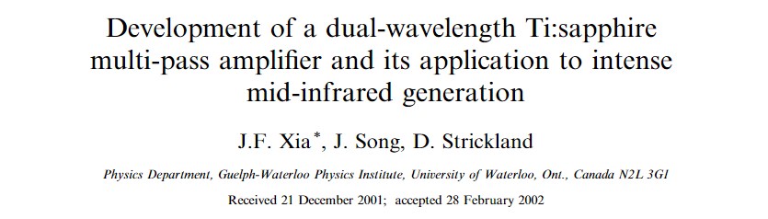
Broadband LWIR Seed Source
We need a nonlinear crystal with no two-photon absorption for 800nm pump (i.e transparent below 400nm)
We need to use chirped pump ($τ≫τ_{R}$)

Slide 22
Broadband LWIR Seed Source
Efficient Raman conversion in solid crystals with chirped pulses (>> dephasing Raman time). Calcite has the right shift @ 1087cm⁻¹
No two-photon absorption in BGS (transparent down to 350nm, bandgap of 3.54eV, d_{eff}~5.1pm/V, phase matchable at 800nm-876nm=9200nm, damage threshold ~3J/cm²)
Maintains the chirp of the pump (i.e. no need for stretching before seeding the final amp)
Two step nonlinear process + reduction of one stretching and one compression stages
Raman efficiency strongly depends on crystal orientation

Slide 23
Next Steps
Continue ionization-injection experiments with improved injection position and laser parameters
Large quantities of ionic liquids obtained. We are ready to begin high energy conversion experiments when lasers are available
Large BGS crystals were fabricated by BAE and are being polished and coated – once they arrive, will be ready to test a prototype
A commercial XUV spectrometer was ordered (1-80nm range), should arrive in ~03/2022. We will need beamtime to commission
Thank You!

Slide 24
Experimental Time Request – AE88
CY2022 Time Request
Capability | Setup Hours | Running Hours
Electron Beam Only
Laser* Only | 2 weeks | 3 weeks
Laser* + Electron Beam
Remaining Time Estimate Through End of Experiment (including CY2022)
Capability | Setup Hours | Running Hours
Electron Beam Only
Laser* Only (in Laser Areas)
Laser* + Electron Beam
* Laser = Near-IR or LWIR (CO₂) Laser
Notes:
If ps lasted… would last…

Slide 25
Experimental Time Request – AE108 (MWIR and LWIR)
CY2022 Time Request
Capability | Setup Hours | Running Hours
Electron Beam Only
Laser* Only (in Laser Areas) |  | 8-12 weeks
Laser* + Electron Beam
Remaining Time Estimate Through End of Experiment (including CY2022)
Capability | Setup Hours | Running Hours
Electron Beam Only
Laser* Only (in Laser Areas)
Laser* + Electron Beam
* Laser = Near-IR or LWIR (CO₂) Laser
Notes:
If ps lasted… would last…

Slide 26
Experimental Time Request – AE108 (XUV)
CY2022 Time Request
Capability | Setup Hours | Running Hours
Electron Beam Only
Laser* Only (in Laser Areas) | 1 week | 1 week
Laser* + Electron Beam
Remaining Time Estimate Through End of Experiment (including CY2022)
Capability | Setup Hours | Running Hours
Electron Beam Only
Laser* Only (in Laser Areas) | 2 weeks | 4 weeks
Laser* + Electron Beam
* Laser = Near-IR or LWIR (CO₂) Laser
Notes:
If ps lasted… would last…

