Slide 1
Progress on AE85
A Multiatmosphere CO₂ Amplifier Optically Pumped by a 4.3 μm Fe:ZnSe Laser
Funded by DOE HEP Accelerator Stewardship Program 2020-2023
SERGEI TOCHITSKY-PI, Dana Tovey, Jeremy Pigeon, Chan Joshi
Department of Electrical Engineering, UCLA
Igor Pogorelsky, Mikhail Polyanskiy
Brookhaven National Laboratory, USA
Sergei Mirov et al
University of Alabama at Birmingham

Slide 2
Motivation
Long-wavelength Infrared range is attractive for particle acceleration and radiation generation. At present we experience a Renaissance of mid-IR ultrafast lasers mainly based on OPA and OPCPA in nonlinear crystals pumped at 1-2 μm.
CO₂ laser is efficient and is able to store a great deal of energy within the active medium. The shortest pulse demonstrated so far is ~2 ps and all high-power picosecond systems operate in a single-shot regime limited by electrical discharge stability in a >10 atm molecular gas.
In AE85 experiment funded by the DoE grant, we study potential of Optically Pumped CO₂ laser technology for production of ≤1 ps pulses at a high-repetition rate. A collaborative effort of UCLA/BNL (gas lasers) built around the state-of the art mid-IR solid-state lasers developed at UAB.
ATF User’s 2021

Slide 3
Optically Pumped CO₂ Laser
CO₂ Molecule
Recipe for success: High-gain CO₂ laser
Population of 001 level Maximized
Population of 100 level Minimized
CO
Gain Spectrum
2
1
0.8
1atm
10atm
20atm
Δν~1.2THz
0.6
Normalized Ampl..
Normalized Gain
0.4
0.2
0
10.4
10.6
10.8
11
10.4
10.6
10.8
11
10.4
10.6
10.8
11
μ
Wavelength (μm)
Wavelength (
m)
ATF User’s 2021

Slide 4
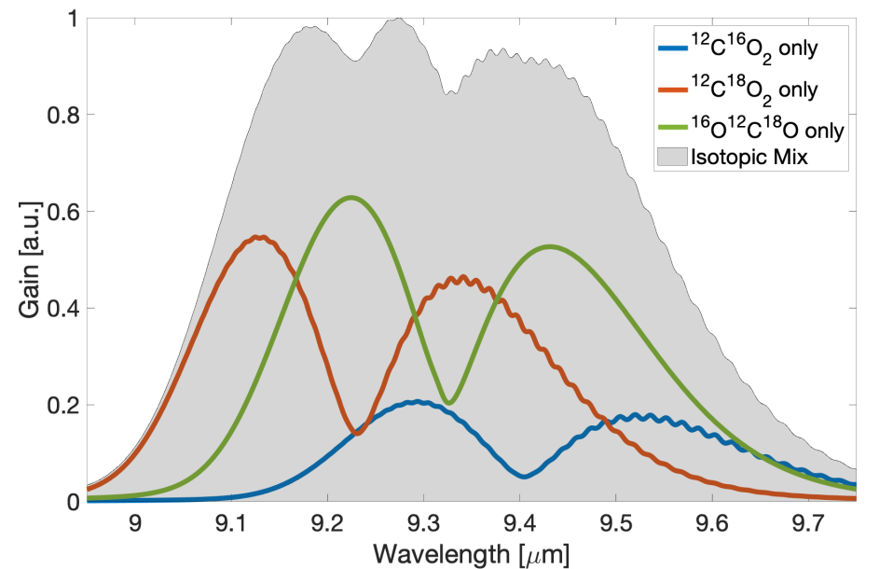
Modeling of Picosecond Pulse Amplification
4.3 μm
Fe:ZnSe
Laser
10 μm pulses
300-500 fs
10 GW
10 μm
300 fs
OPA
Seed
10-15 atm
Isotope CO₂
Amplifier
Feasibility study of a compact GW class CO₂ amplifier and gain dynamics.
D. Tovey et al. Appl. Opt., 58, 5756, 2019, J Appl. Phys. 128, 103103, 2020
ATF User’s 2021

Slide 5
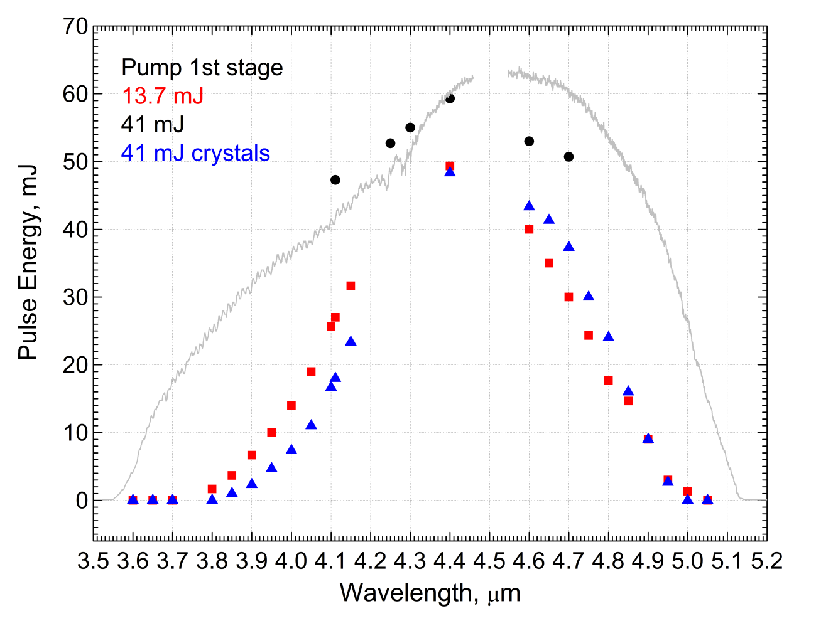
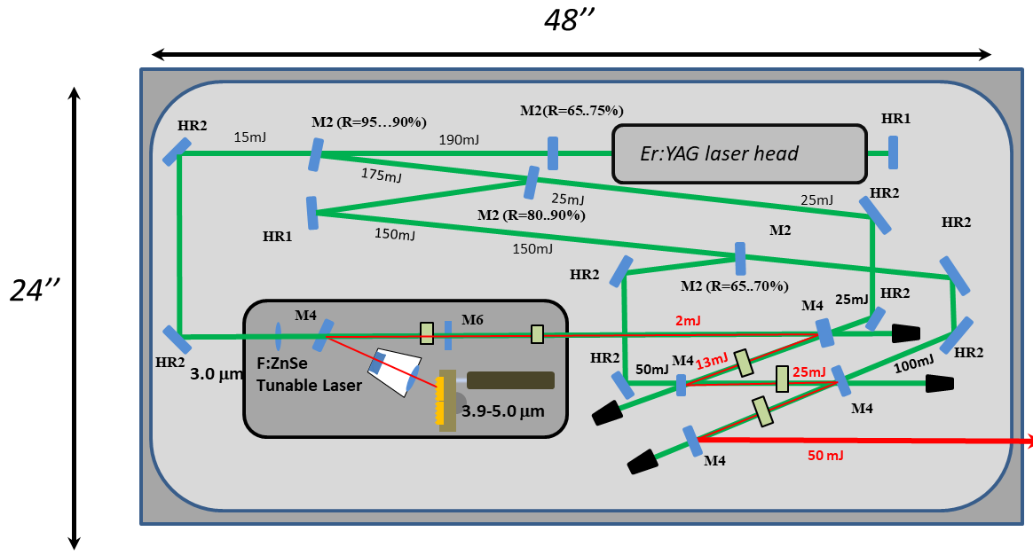
Tunable 3.9-5 μm Fe:ZnSe source for
Optical Pumping of the CO₂ laser at 3 Hz
Group of Prof. S. Mirov
ATF User’s 2021

Slide 6
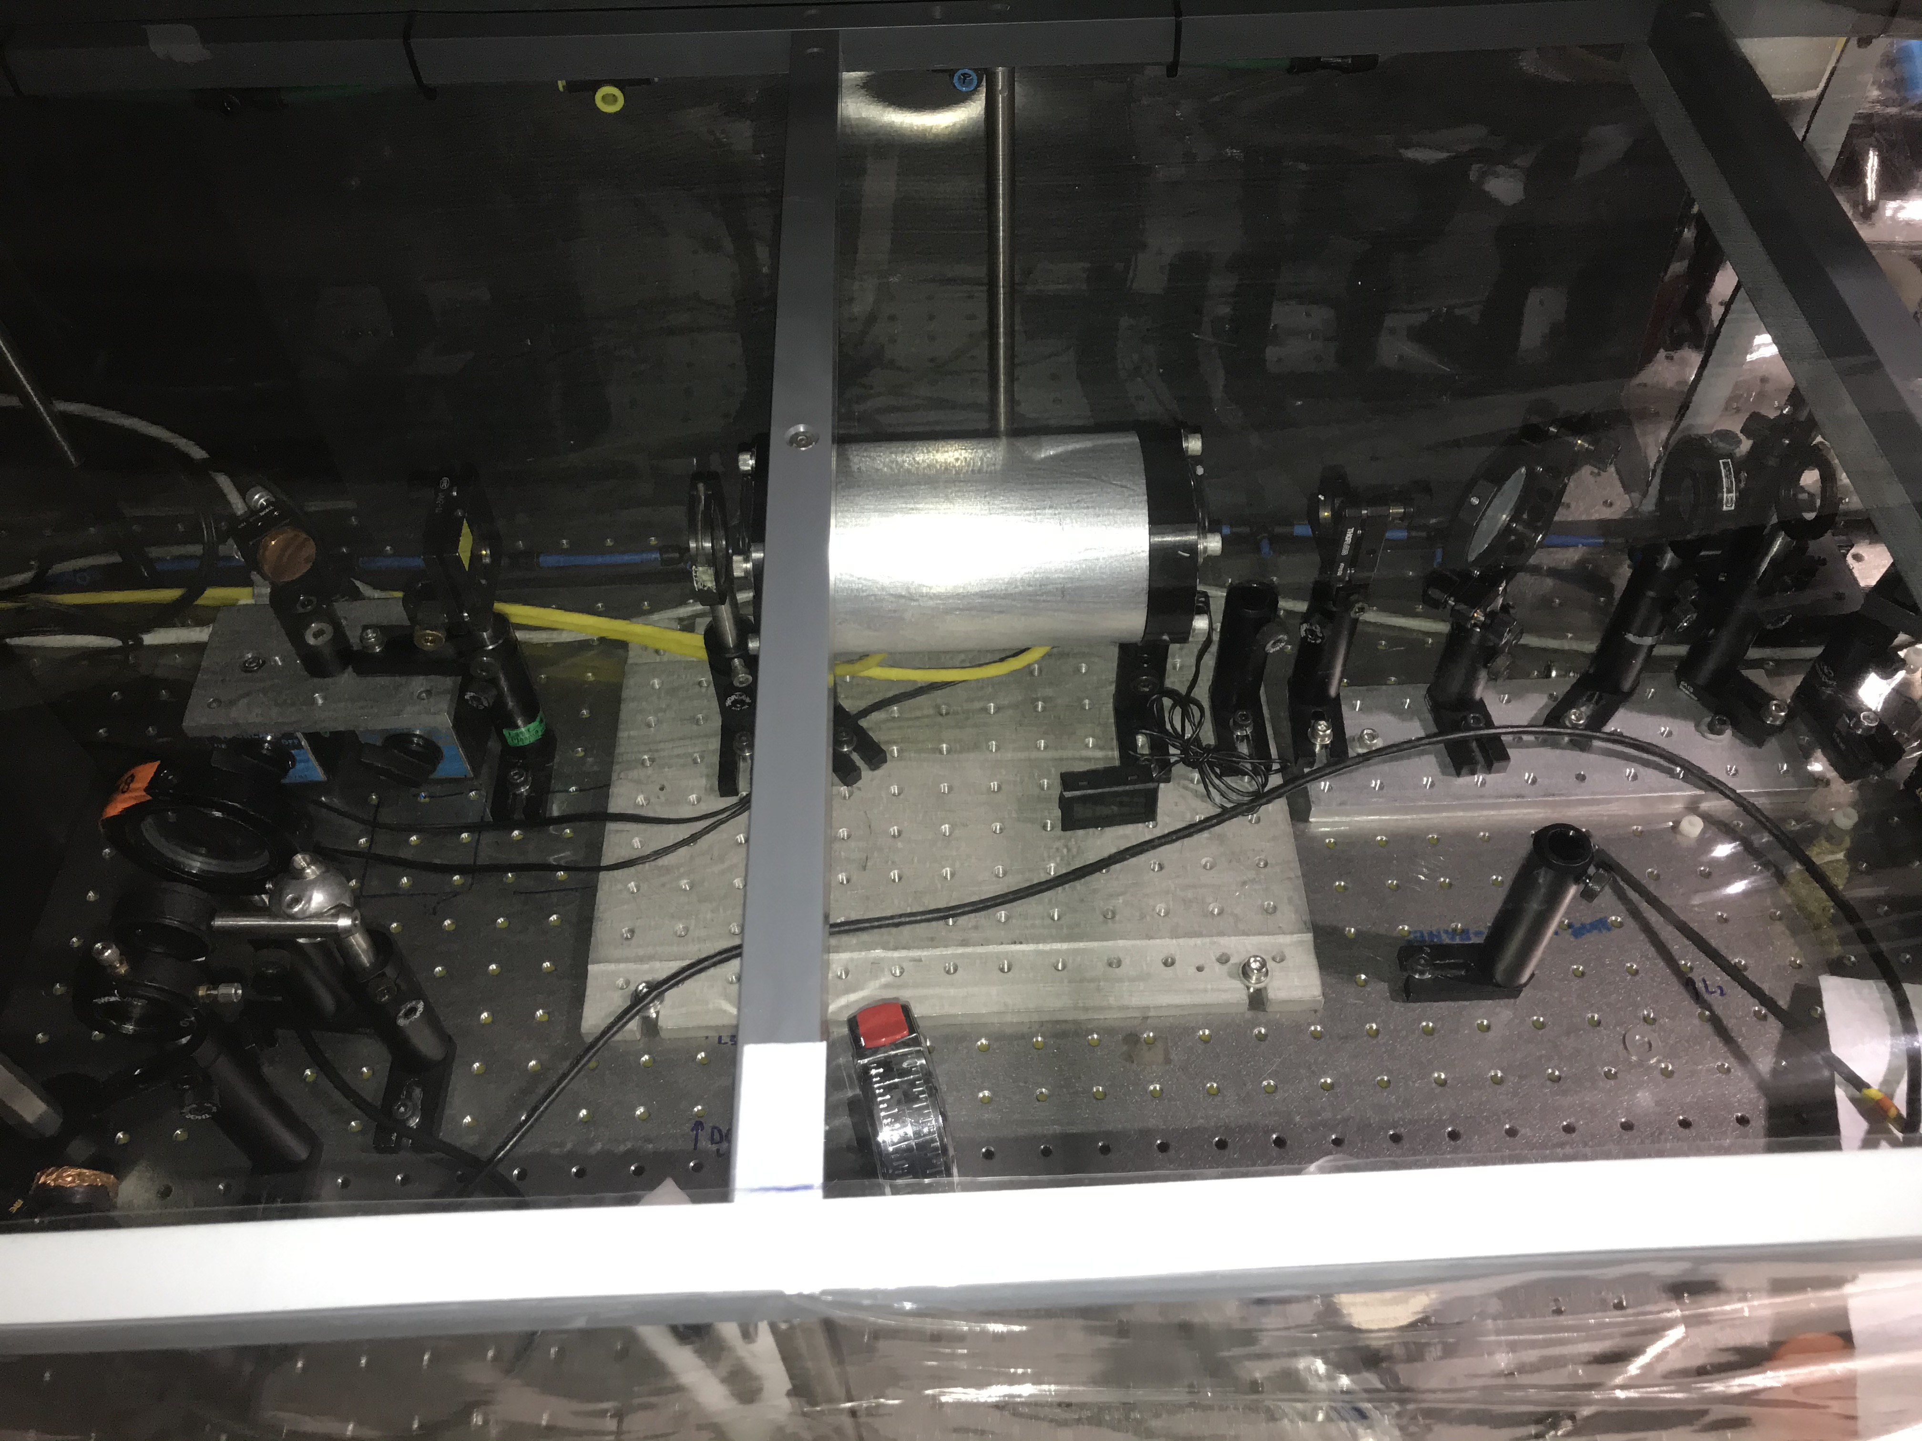
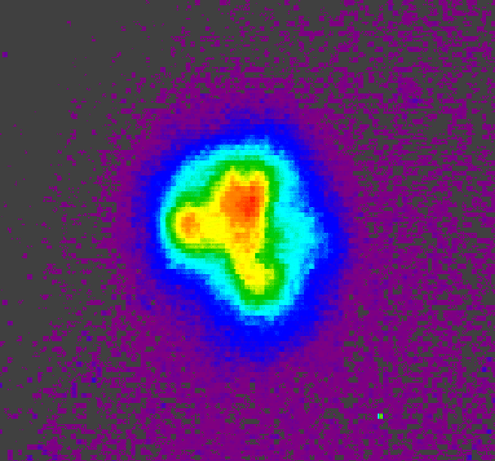
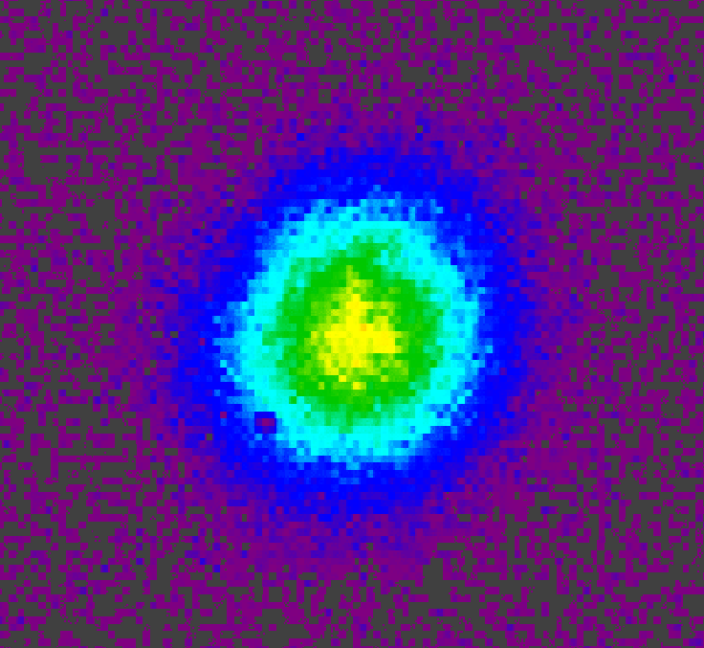
Optically Pumped High-pressure CO₂ Laser
4.3 μm pump pulse
4.3 μm pump
Dichroic mirror
(T = 99% for 4 μm,
R = 99.5% for 10 μm)
High pressure CO₂ cell
Dichroic mirror
Focusing lens
9.3 mm
10 μm cavity
10 μm filter
NaCl window
10 μm lasing
15 atm
Detector
9.3 mm
ATF User’s 2021

Slide 7
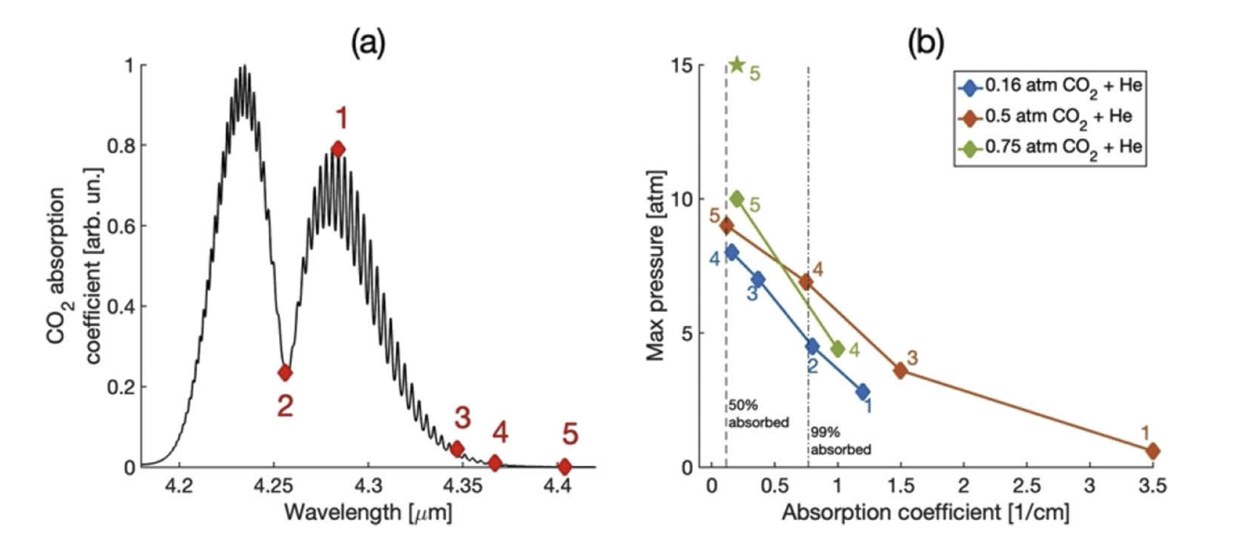
High-pressure optically pumped CO₂:
Lasing up to 15 atm pressure
Measurements of lasing and gain of a high-pressure optically pumped CO₂ laser
>10% efficiency near 10 atm
>10% small signal gain
Can be scaled to 1 KHz – limited by gas dynamics
With >35 mJ absorbed in the multiatmosphere CO₂ cell, >3 mJ in a 10 μm pulse. Dana Tovey et al, Optics Express, 29, 31455 (2021).
Neptune Laboratory
ATF User’s 2021

Slide 8
OPO Source Pumped by Nd:YAG
4 μm pulse:
~50-100 mJ, 10 ns
1064 nm
2128 nm
4.256 μm
Q-switched
Nd:YAG
CO₂ Cell
Amplification
OPO
OPO
1064 nm
1.43 μm signal
Q-switched
Nd:YAG
CO₂ Cell
Amplification
OPO
4.15 μm idler
With >350 mJ, 100 MW/cm² pump, SNLO predicts ~100 mJ, 1.43 μm signal, 30mJ 4.15 μm idler.
ATF User’s 2021

Slide 9
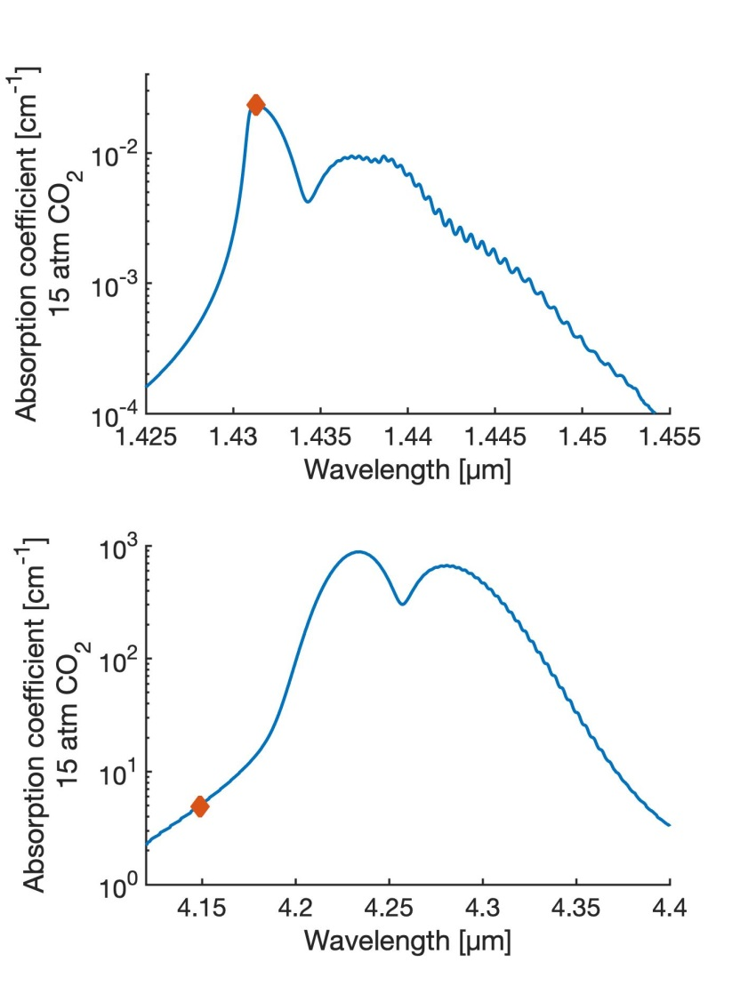
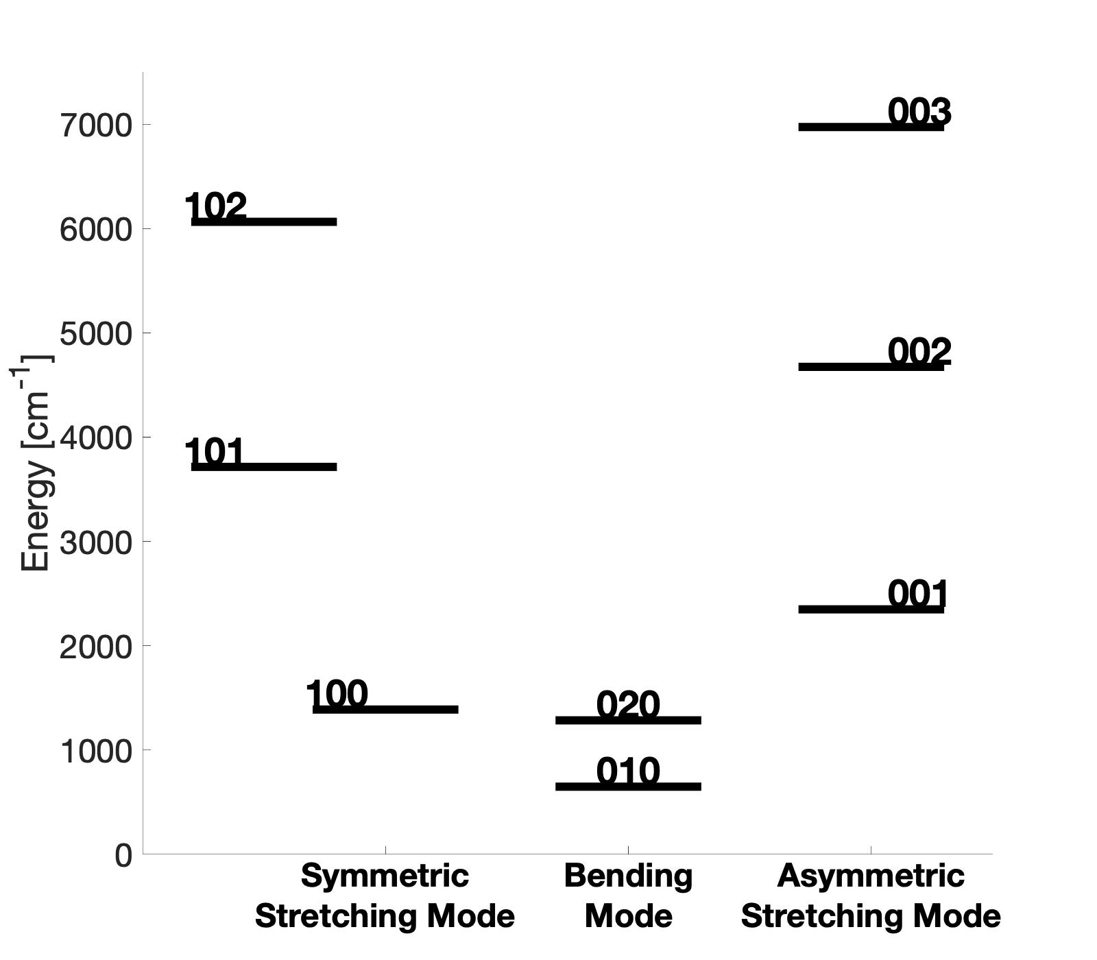
Two-color Pumping Scheme for OP CO₂ Laser
CO₂ Vibrational Energy Levels
1431 nm pumping
10 µm lasing sequence bands
10 µm lasing regular band
4149 nm pumping
Main difficulty: absorption is ~200x stronger at 4149 nm
ATF User’s 2021

Slide 10
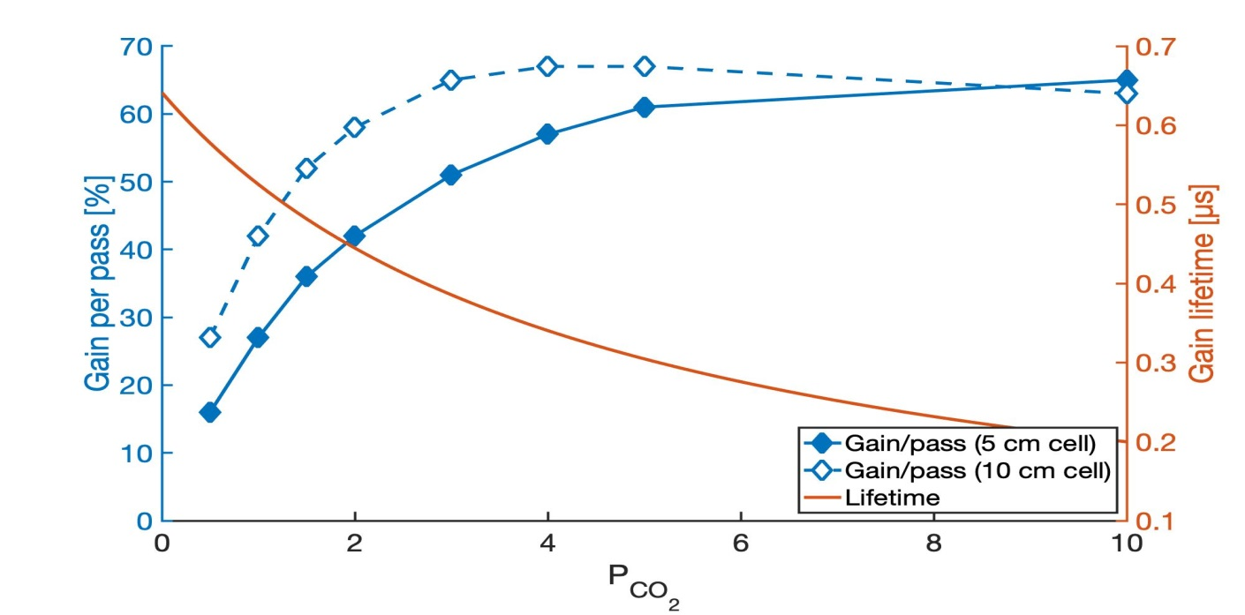
Two-color Pumped OP CO₂ Laser: Modeling
OPCO₂ amplifier:
--1.43 µm pump: 1.5 J/cm² fluence (2 meters)
--4.15 µm pump: 0.45 J/cm² (10 cm)
15 atm total pressure (CO₂+He)
3 atm CO₂+12 atm He 10 cm-long OP cell
4.15 μm Idler
Dielectric mirrors R=99.8% at 1.43 μm
1.43 μm Signal
ATF User’s 2021

Slide 11
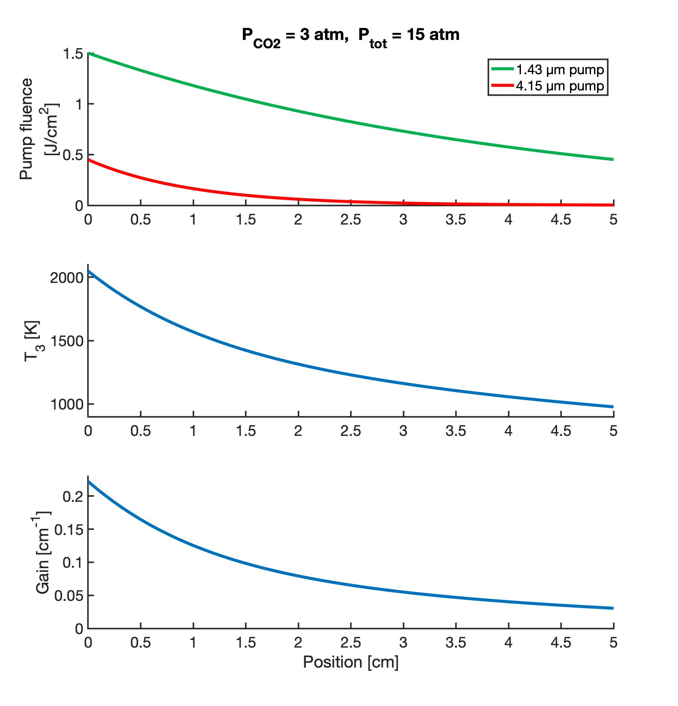
High Gain OP CO₂ Amplifier
ATF User’s 2021

Slide 12
Experimental Time Request
CY2022 Time Request
Capability | Setup Hours | Running Hours
Electron Beam Only
Laser* Only (in Laser Rooms) | 1 week | 1 week
Laser(s)* + Electron Beam
Time Estimate for Remaining Years of Experiment (including CY2022)
Capability | Setup Hours | Running Hours
Electron Beam Only
Laser* Only (in FEL Room) | 2022-2023 5-6 weeks | 4 weeks
Laser(s)* + Electron Beam
* Laser = Near-IR or LWIR (CO₂) Laser

Slide 13
Summary
We have made important and necessary steps in AE85 experiment, a CO₂ Laser only, funded by DOE Accelerator Stewardship Program
Demonstrated efficient 10 μm lasing in a 15 atm CO₂ cell optically by a ~50 mJ Fe:ZnSe laser. The measured gain lifetime ≤1 μs indicates that regenerative amplifier is durable.
Next step in 2022 will be developing at UCLA a 100 mJ, 1.43+4.15 μm laser system based on NdYAG laser pumped single OPO. Design and build a 5-10 cm long cell and experiment at ATF with amplification of ~0.5 ps pulses using the CPA scheme.
We request 2 weeks in 2022 (CO₂ laser only) using front end with the CPA capability and may be the 10 μm CO₂ regen.
ATF User’s 2021

Slide 14
2021 Activities & Impacts Associated with this Experiment (feel free to add pages as necessary)
Invited Talks:
S. Tochitsky et al, “High-pressure CO₂ laser optically pumped at 4.3 μm,” Directed Energy Annual Symposium, Albuquerque, NM, March 2021, paper 21-symp-049.
Manuscripts (books, conference and journal articles, other; please include works submitted by not yet accepted):
Dana Tovey et al, “10 µm lasing in multi-atmosphere CO₂ optically pumped by a tunable 4.3 µm laser”. CLEO 2021, Optical Society of America, STh2L.6.
D. Tovey, J. J. Pigeon, S. Ya. Tochitsky, G. Louwrens, D. Maryshkin, V. Fedorov, K. Karki, S. Mirov, I. Ben-Zvi, and C. Joshi, “Lasing in 15 atm CO₂ cell optically pumped by a Fe:ZnSe laser”Optics Express, 29, 31455-31464 (2021).
J. J. Pigeon, D. Tovey, S. Ya. Tochitsky, G. Louwrens, D. Maryshkin, V. Fedorov, K. Karki, S. Mirov, I. Ben-Zvi, and C. Joshi, “Resonant nonlinear refraction of mid-IR light in CO and CO₂ gas” Phys. Rev. A (2021).
S. Tochitsky and C. Joshi, “Long-Wave Infrared filamentation in air: lasers and high-field phenomena” chapter in Light Filaments: Structures, challenges and applications, ed. J.C. Diels, IET, UK, 2021
Theses awarded
D.T. Tovey “ A compact CO₂ amplifier optically pumped by a tunable 4.3 um Fe:ZnSe laser” M.Sc. 2021

