Slide 1

Radiofrequency emission from 10 μm short pulse laser- ionized air
Proposal#309977
PI: Dr. Jennifer Elle
E. Thornton, O. Sales (AFRL)
Co-PI: Dr. Zachary Quine (ARL)
Funding: ONR (ARL, received)
AFRL Program Funds(received)
Distribution Statement A: Approved for public release; distribution is unlimited.

Slide 2
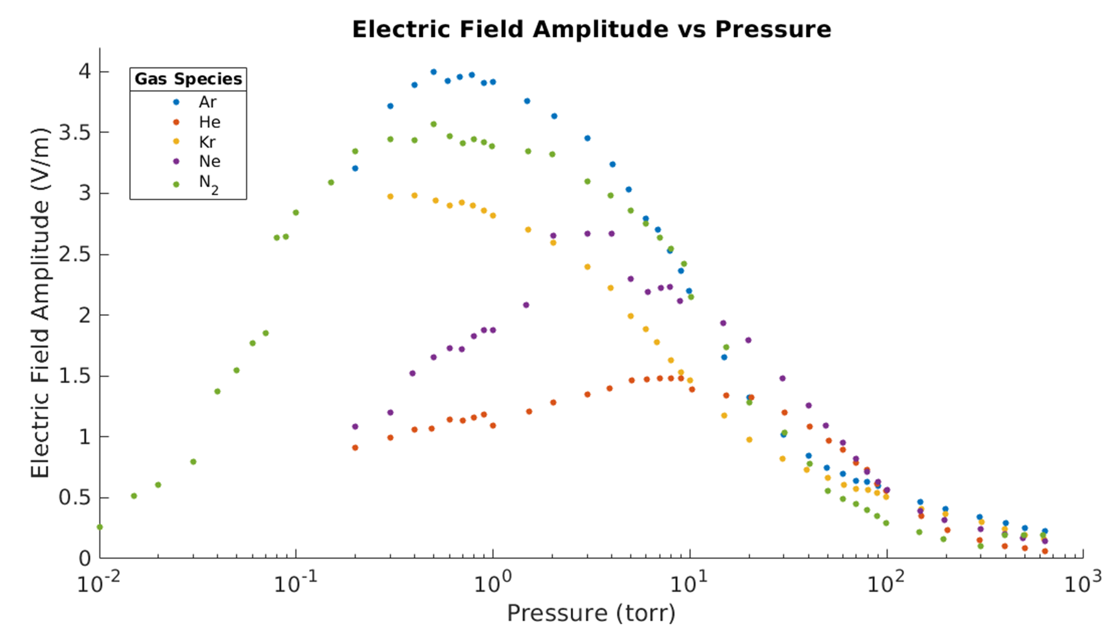
Past Work

Slide 3
Model Illustration

Slide 4
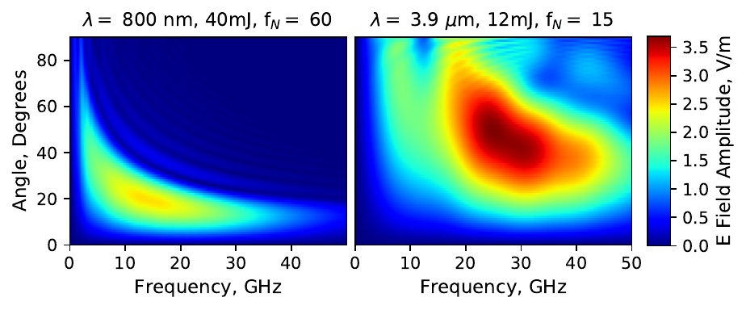
Previous work on wavelength scaling
Plots of simulated electric field strength as a function of frequency and angle for RF pulses from a 40 mJ, focal number f_{N} = 60, 800 nm laser source and a 12 mJ, f_{N} = 15, 3.9 micron source (both run at 10 Torr). The numerical profiles and amplitudes closely match the experimental results.

Slide 5
Research Questions Addressed
What are the dominant ionization processes for high energy long wavelength short pulse ionization, and how does this change with laser energy, gas pressure and focusing geometry?
Does LWIR plasma have higher electron temperatures? High enough to enter a non-collisional regime for RF production?
Does LWIR ionization boost RF production? Using initial plasma conditions from 1. and 2. do experimental measurements match model predictions?
Does LWIR ionization process produce spectral broadened signal at shorter wavelengths as well as RF?

Slide 6
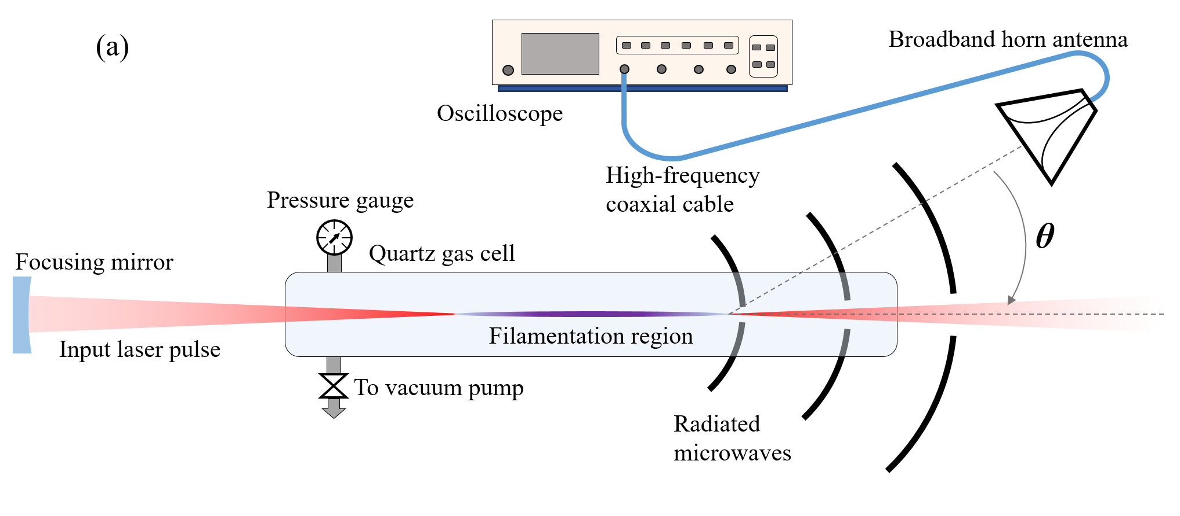
Proposed Experiment
Series of MIR/LWIR spectrometers
Input 10 micron 5 J, ps laser pulse
2 ns gate ICCD

Slide 7
Diagnostics
Nanosecond gated ICCD.
We’ve demonstrated in recent experiments that avalanche and optical ionization are readily distinguishable on a gated ICCD imaging the plasma. The images also allow us to extract plasma column radius and length
RF horns and 70 GHz oscilloscope
The RF signal relies on the ionization front propagating at the speed of light longitudinally on timescales shorter than the electron expansion rate due to coherent addition of radiated RF waves. This is not expected to be true in the case of avalanche ionization, so the RF signal itself may be used to characterize the ionization processes as well as allowing characterization of RF power spectral density
Interferometry
A simple to set up and align interferometer allows us to measure plasma densities above 10¹⁶ electrons/cm², which is within the regime we anticipate achieving for hard focusing conditions
Will require an optically synchronized 800 nm probe beam (low energy)
Conductivity
We have developed a diagnostic to measure longitudinally resolved plasma conductivity on the nanosecond timescale, which combined with electron density and column radius allow extraction of electron temperature.
Spectrometer Suite
LWIR, MWIR and NIR/visible spectrometers allow characterization of shorter wavelength supercontinuum generation due to ionization processes

Slide 8
Timeline
 | Year 1 | Year 2 | Year 3
Characterize ionization vs gas type and pressure | X (E. Thornton Thesis)
Measure RF power spectral density | X (E. Thornton Thesis)
Examine spectral broadening |  | X (ARL funding constraint)
Pulse duration effects on ionization and RF |  |  | ??

Slide 9
References
Englesbe, Alexander, et al. "Gas pressure dependence of microwave pulses generated by laser-produced filament plasmas." Optics letters 43 pp 4953-4956 (2018)
Janicek, A., et al. "Length dependence on broadband microwave emission from laser-generated plasmas." IEEE Transactions on Plasma Science 48 pp 1979-1983 (2020)
Englesbe, Alexander, et al. "Ultrabroadband microwave radiation from near-and mid-infrared laser-produced plasmas in air." Physical Review A 104, 013107 (2021)
Garrett, Travis, et al. "Generation of radio frequency radiation by femtosecond filaments." Physical Review E 104, L063201 (2021)
Mitrofanov, A. V. et al. “Polarizaiton and spatial mode structure of mid-infrared-driven terahertz-to-microwave radiation.” ACS Photonics. 8 pp 1988-1996 (2021)

Slide 10
Electron Beam Requirements: N/A

Slide 11
CO₂ Laser Requirements
Configuration | Parameter | Units | Typical Values | Comments | Requested Values
CO₂ Regenerative Amplifier Beam | Wavelength | μm | 9.2 | Wavelength determined by mixed isotope gain media
 | Peak Power | GW | ~3
 | Pulse Mode | --- | Single
 | Pulse Length | ps | 2
 | Pulse Energy | mJ | 6
 | M² | --- | ~1.5
 | Repetition Rate | Hz | 1.5 | 3 Hz also available if needed
 | Polarization | --- | Linear | Circular polarization available at slightly reduced power
CO₂ CPA Beam | Wavelength | μm | 9.2 | Wavelength determined by mixed isotope gain media | 9.2 microns
Note that delivery of full power pulses to the Experimental Hall is presently limited to Beamline #1 only. | Peak Power | TW | 2 | ~5 TW operation is planned within the next year (requires further in-vacuum transport upgrade). A 3-year development effort to achieve >10 TW and deliver to users is in progress. | 2 TW
 | Pulse Mode | --- | Single |  | Single
 | Pulse Length | ps | 2 |  | 2 ps
 | Pulse Energy | J | ~5 | Maximum pulse energies of >10 J will become available within the next year | 5 J
 | M² | --- | ~2 |  | 2
 | Repetition Rate | Hz | 0.05 |  | 0.05
 | Polarization |  | Linear | Adjustable linear polarization along with circular polarization can be provided upon request | Linear

Slide 12
Other Experimental Laser Requirements
Ti:Sapphire Laser System | Units | Stage I Values | Stage II Values | Comments | Requested Values
Central Wavelength | nm | 800 | 800 | Stage I parameters are presently available and setup to deliver Stage II parameters should be complete during FY22 | 800 nm
FWHM Bandwidth | nm | 20 | 13
Compressed FWHM Pulse Width | fs | <50 | <75 | Transport of compressed pulses will initially include a very limited number of experimental interaction points. Please consult with the ATF Team if you need this capability. | <1 ps
Chirped FWHM Pulse Width | ps | ≥50 | ≥50
Chirped Energy | mJ | 10 | 200
Compressed Energy | mJ | 7 | 100
Energy to Experiments | mJ | >4.9 | >80 |  | <1 mJ
Power to Experiments | GW | >98 | >1067
Nd:YAG Laser System | Units | Typical Values | Comments | Requested Values
Wavelength | nm | 1064 | Single pulse
Energy | mJ | 5
Pulse Width | ps | 14
Wavelength | nm | 532 | Frequency doubled
Energy | mJ | 0.5
Pulse Width | ps | 10

Slide 13
Special Equipment Requirements and Hazards
Electron Beam
  N/A
CO₂ Laser
  Laser focused in air, requires ~ 3-4 m of space
Ti:Sapphire and Nd:YAG Lasers
  Please note any specialty non-CO₂ laser configurations required here:
  Ti:Sapphire probe synchronized with but not co-propagating with CO₂ laser
  Hazards & Special Installation Requirements
  Large installation (chamber, insertion device, etc.): 1 meter gas tube, gas cylinders, and vacuum components
  Cryogens: N/A
  Introducing new magnetic elements: N/A
  Any other foreseeable beam line modifications: Low energy Ti:Sapphire probe beam path routing

Slide 14
Experimental Time Request
CY2022 Time Request
Capability | Setup Hours | Running Hours
Electron Beam Only
Laser* Only (in Laser Areas) | .5 week | 2.5 weeks
Laser* + Electron Beam
Time Estimate for Full 3-year Experiment (including CY2022)
Capability | Setup Hours | Running Hours
Electron Beam Only
Laser* Only (in Laser Areas) | 1 week | 2 weeks
Laser* + Electron Beam
* Laser = Near-IR or LWIR (CO₂) Laser

Slide 15

Questions?
This material is based upon work supported by the Air Force Office of Scientific Research under award numbers FA9550-16RDCOR325, FA9550-19RDCOR023
Distribution Statement A: Approved for public release; distribution is unlimited.

