Slide 1




AE-95 Report: Optical diagnosis of Self-Modulated CO2-laser driven plasma wakes
R. Zgadzaj, James R Welch, M. C. Downer - University of Texas at Austin
M. Babzien, M. Fedurin, P. Kaur, R. Kupfer, K.Kusche, M. Polyanskiy, C. Swinson,
I. Pogorelsky, M. Palmer - Brookhaven National Lab, Accelerator Test Facility
I. Petrushina, L. D. Pinto de Almeida Amorim, M. Flament, P. Iapozzuto, Y. Jing,J. Yan, S. Kongtawong, P. Kumar, R. Samulyak, N. Vafaei-Najafabadi, V. Litvinenko - Stony Brook University
C. Zhang, W.B. Mori, C. Joshi -
University of California Los Angeles
This work is supported by the following grants:
AFOSR-MURI* grant FA9550-16-1-0013 Multi-Institution, UT lead PI - MC Downer
DoE grant DE-SC0011617 PI - MC Downer
DoE grant DE-SC0014043 PI - V. Litvinenko, CoPI – MC Downer
Rafal Zgadzaj ATF Users Meeting 2022 02 21

Slide 2
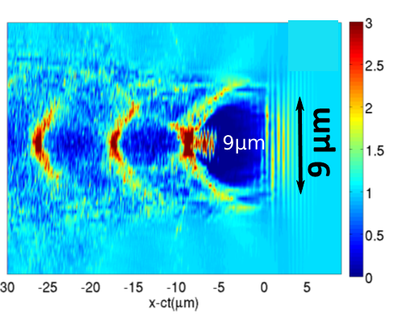
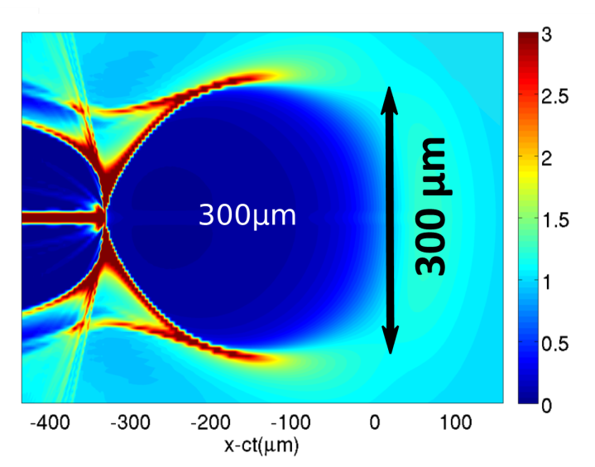

Vision: Quasi-mono-energetic LWFAs based on large, controlled mid-IR laser-driven bubbles
injection with ∆E/E ~ 0.1% from external linac or µm-focused ionizing laser
λ_{drive}= 0.8 µm (UT)
25 TW, 30 fs
λ_{drive}= 10 µm
25 TW, 500fs
n_{e}/n₀
n_{e}/n₀
n_{e} = 2e19cm⁻³
n_{e} = 1 10¹⁶cm⁻³
simulations courtesy G. Shvets
Large blowout region
Precise and controllable injection from ATF Linac (or laser ionization AE88)
Detailed optical visualization of plasma wave structure AE95
Detailed radiographic visualization of plasma wave field AE93
AE-95 ATF Users Meeting 2022 01 18-21

Slide 3
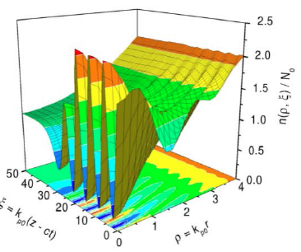
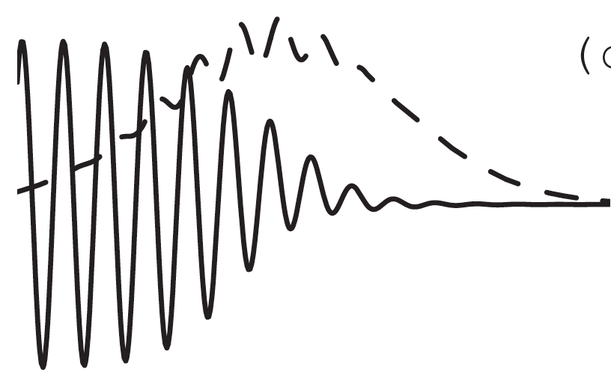
Vision: Quasi-mono-energetic LWFAs based on large, controlled mid-IR laser-driven bubbles
simulations:
N. E. Andreev et al.,
PR-STAB 6, 041301 (2003)
Self-Modulated LWFA
n_{e} (cm⁻³)
τ (ps)
P (TW)
laser
Probe
AE95
ATF CO₂
Laser pulse
~10¹⁸
4
0.5
n_{e}(ρ,ξ)/N₀
<10¹⁸
<2
>2
e⁻
Probe
CO₂ driver
ξ = k_{p}(z – ct)
ρ = k_{p}r
55MeV, <200fs
AE93
Self-injected,
accelerated
Electrons
AE-95 ATF Users Meeting 2022 01 18-21

Slide 4


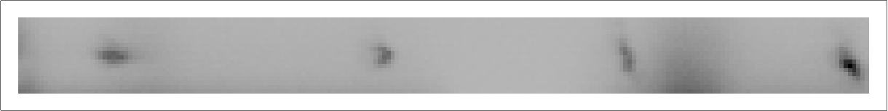
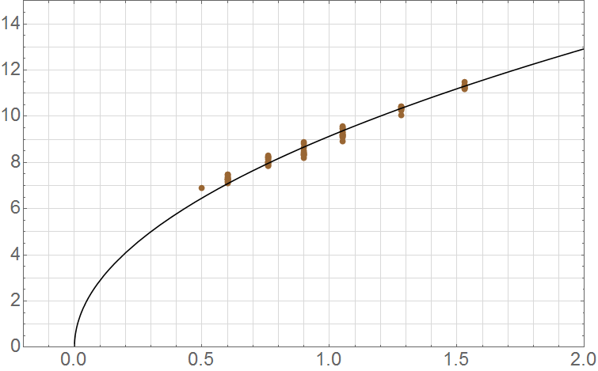

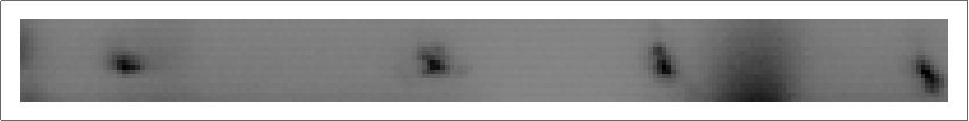

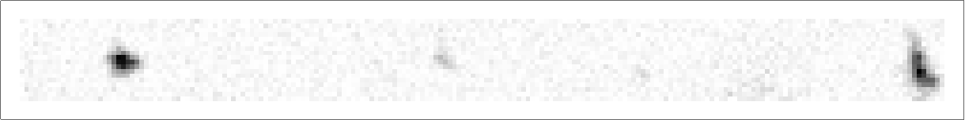
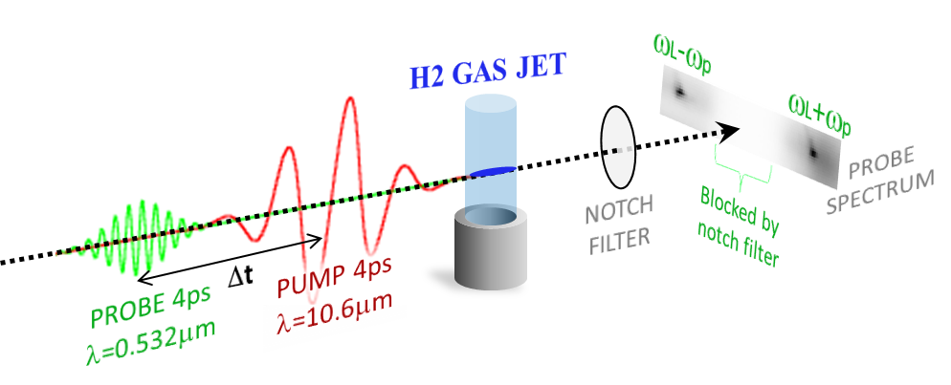
n_{e}-dependent probe spectral shifts 0.5TW, 4ps, λ=10.6µm CO₂ laser pulse drives SM-LWFA
J. Welch, “Self-modulated laser wakefields driven by a CO₂ laser,”
Doctoral Dissertation, UT Austin, August 2019.
n_{e} (10¹⁸ cm⁻³)
“red
zone”
0
0.5
1.0
1.5
2.0
Lower limit:
Notch filter
12
upper n_{e}
limit:
CO₂ laser
reflection
from jet
Notch filter blocking region
8
Mean Thomson shift (nm)
nm
4
n_{e}= 5 10¹⁷ cm⁻³
P_{cr} = 0.4 TW
λ_{p} = 47 µm
n_{e} = 1.8 10¹⁸ cm⁻³
P_{cr} = 0.1 TW
λ_{p} = 25 µm
-30
-20
10
20
30
0
0
1
2
-10
0
collective Thomson shift (nm)
Jet backing pressure (atm)
CO₂ laser pulse
drives SM-LWFA
New narrower notch filter will be used in the future runs to reach lower densities.
ATF solved this problem with the addition of the plasma filter in the FEL room
4 ps, λ = 0.532 µm pulse probes wake via forward collective Thomson scatter as n_{e} , ∆t and P_{CO2} vary.
AE-95 ATF Users Meeting 2022 01 18-21

Slide 5
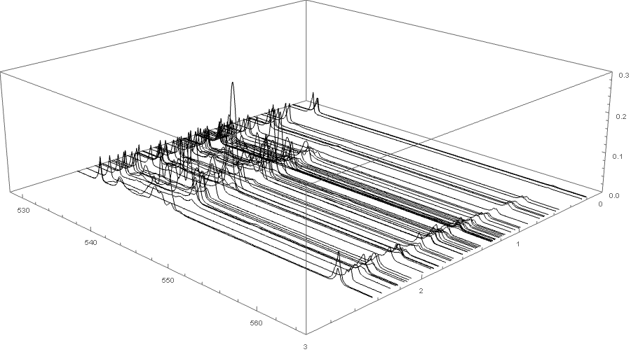
Onset of self modulation is observed near P/Pcrit ~ 1
Leaked Probe spectrum
Stokes side band
Pump and Probe difference frequency
Blocked by interference filter
~1
wavelength[nm]
~P/Pcrit
Edge of notch filter blocking region has been moved closer to the probe wavelength, 532nm, by slight rotation.
n_{e} ~ 1.3 10¹⁸cm⁻³
AE-95 ATF Users Meeting 2022 01 18-21

Slide 6
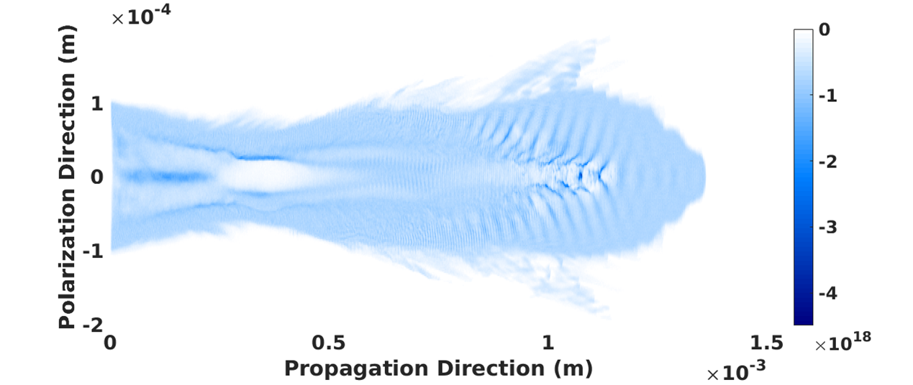
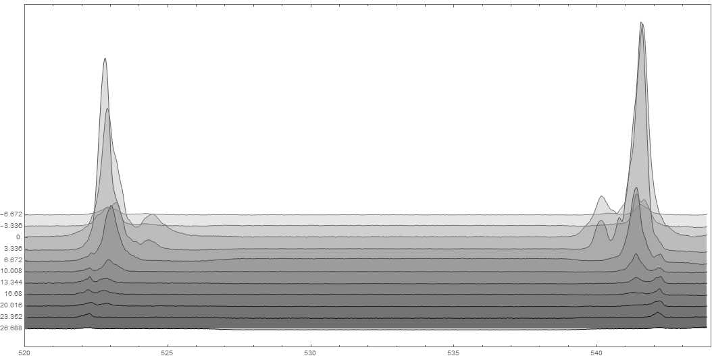
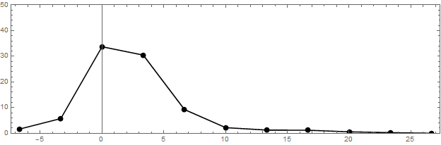
Probe-pump delay (∆t) shows wake decays 90% in ~10 ps, remnants visible at ∆t > 25 ps
K. Yu, R. Samulyak, “SPACE code for beam-plasma interactions,” Proc. IPAC, 728 (2015)
Simulation: Prabhat Kumar SPACE ¹ code
notch filter
anti-Stokes
Stokes
n_{e} = 1.5 × 10¹⁸ cm⁻³
sideband
amplitude
(arb. u.)
Spectral structure
observed around
∆t ≈ 0
average Stokes/
anti-Stokes amplitude
-6.67
0
∆t [ps]
6.67
13.33
20
Probe duration deconvolved
26.67
520
525
530
535
540
544
λ_{probe} [nm]
Cheng, R. Samulyak
SPACE code
J. Welch, “Self-modulated laser wakefields driven by a CO₂ laser,” Doctoral Dissertation, UT Austin, August 2019.
AE-95 ATF Users Meeting 2022 01 18-21

Slide 7
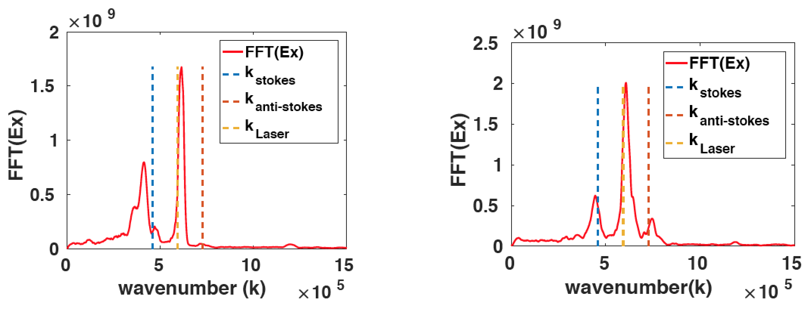
Ionization front seeds the forward Raman instability
Simulations using SPACE¹ code: P. Kumar, R. Samulyak, Stony Brook University
3D parallel, relativistic particle-in-cell code for simulating EM fields, relativistic particles, plasma & atomic processes
K. Yu, R. Samulyak, “SPACE code for beam-plasma interactions,” Proc. IPAC, 728 (2015)
P. Kumar, et al., “Simulation study of CO2 laser-plasma interactions and self-modulated wakefield acceleration”, Phys. Plasmas 26, 083106 (2019);
PRE-IONIZED PLASMA
DYNAMIC IONIZATON
1064nm PROBE SPECTRUM
On-axis Ex
On-axis Ex
0.1
0
0.1
0
Probe spectral side bands have equal amplitudes
0
0
x[mm]
n_{e}[10¹⁷cm⁻³]
x[mm]
n_{e}[10¹⁷cm⁻³]
-14
-12
-0.1
-0.1
0
Z [mm]
1.5
0.2
Z [mm]
1.3
AE-95 ATF Users Meeting 2022 01 18-21

Slide 8
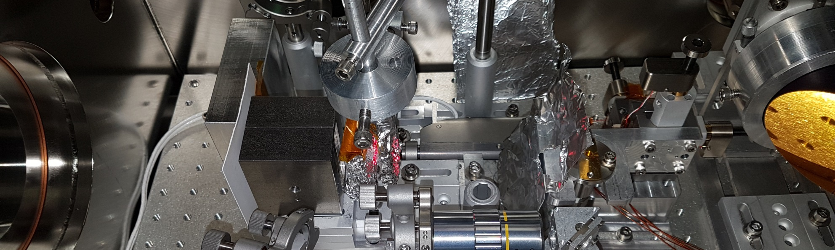
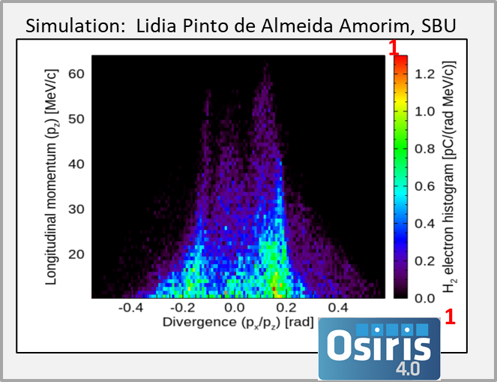
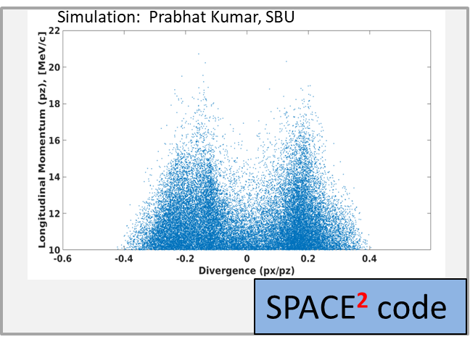
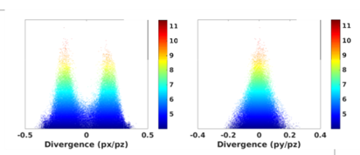
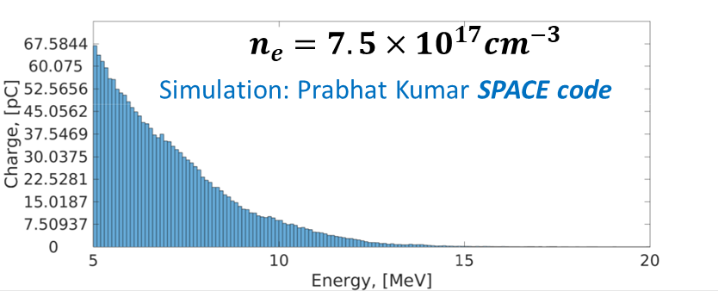
First Demonstration of SM-LWFA in the mid-IR with upgraded CO₂ laser
Pump: w0 =20micron , 2ps, 4J
1.2 mm H₂ jet, ne=7.5 10¹⁷cm⁻³
H2 gas jet 4mm length
n_{e} ~ 5e16 to 5e17/cc
From CTS probe measurement
Magnet
0.25T
Simulation: Prabhat Kumar
SPACE² code
Steel slit
B
slit
Lanex
Ref mask
Al foil
20micron
CO2 laser pulse: ~2ps, 0.5J to 5J
[1] R.A.Fonseca et al., NCS 2331, 343 (2002)
[2] K. Yu, R. Samulyak, “SPACE code for beam-plasma interactions,” Proc. IPAC, 728 (2015)
CCD w/objective
AE-95 ATF Users Meeting 2022 01 18-21

Slide 9
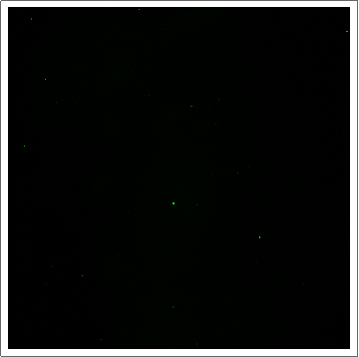
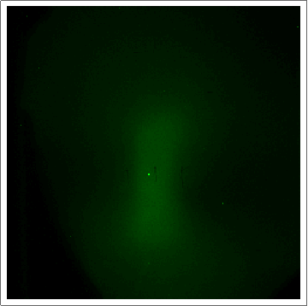
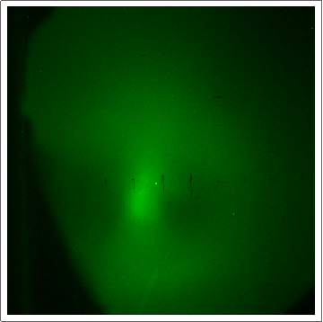
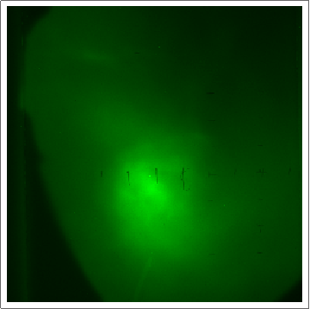
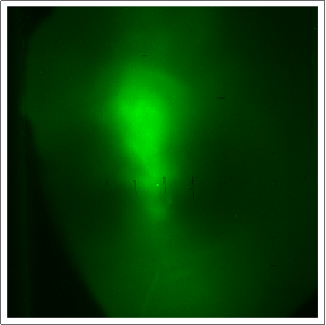
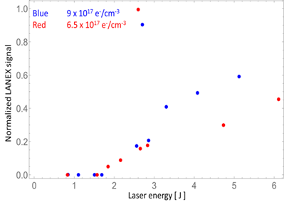
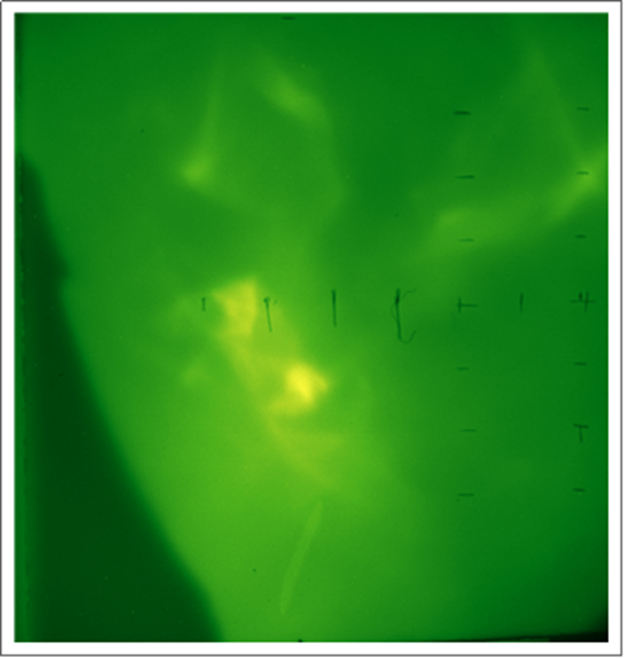
Example measurement of electron spot at increasing laser energy
1.1J 1.4 x 10¹⁷cm⁻³
1.7J 1.4 x 10¹⁷cm⁻³
2.4J 1.4 x 10¹⁷cm⁻³
3.2J 1.4 x 10¹⁷cm⁻³
4.8J 1.4 x 10¹⁷cm⁻³
~4J 0.9 x 10¹⁸cm⁻³
H2 gas jet 4mm length
n_{e} ~ 5e16 to 5e17/cc
From CTS probe measurement
~0.3 rad
Lanex
Al foil
20micron
CO2 laser pulse: ~2ps, 0.5J to 5J
CCD w/objective
AE-95 ATF Users Meeting 2022 01 18-21

Slide 10
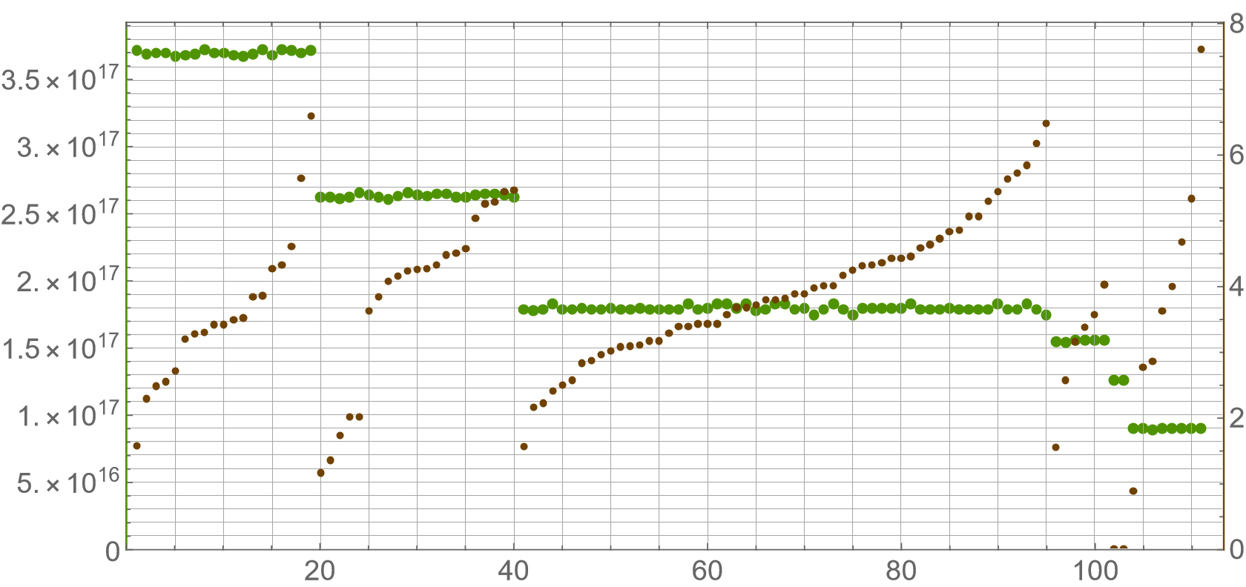
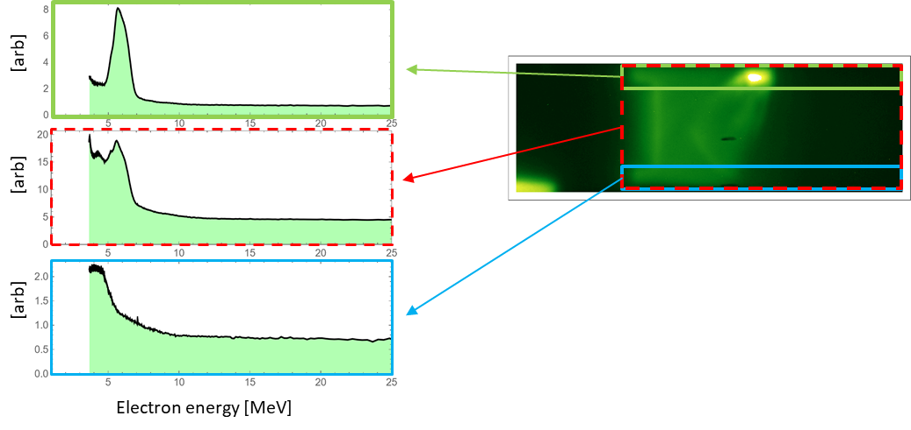
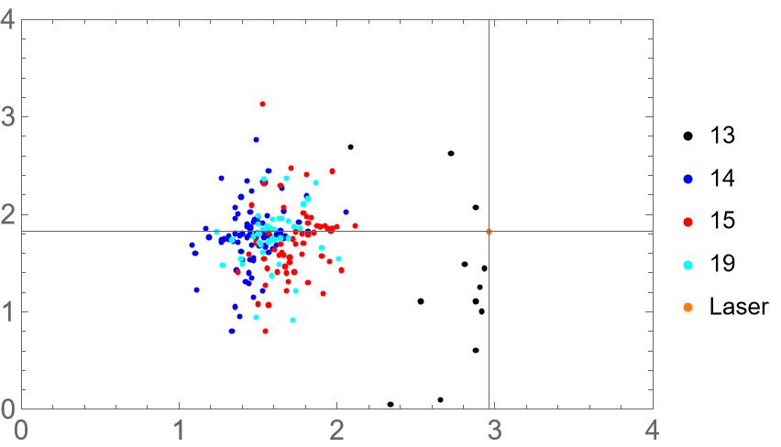
Plasma Density [cm⁻³]
Laser Energy [J]
AE-95 ATF Users Meeting 2022 01 18-21

Slide 11
Future plans
532nm -> 800nm probe
Radiographic
imaging CCD
Extension of CTS probe range with narrower badwidth of Notch filter.
Change of probe wavelength to the Ti:Sapp generated 800nm, and subsequently to larger wavelengths (Thomson scattering, transverse shadowgraphy, frequency domain interferometry). Short pulse 800nm probe will increase temporal resolution. Moving toward longer wavelengths allows stretching optical probing sensitivity toward lower plasma densities.
Continued study of electron spectra, profiles, charge, together with optical plasma probe ( and radiographic field measurement AE93)
Conversion of setup to longitudinal injection scheme when this would become possible
Faraday rotation measurement of magnetic fields associated with SM-LWFA. Additionally, this diagnostic is more sensitive at lower densities than observation of refractive index changes, and is sensitive to presence of injected charge.
Ultimate goal is to transition to blowout regime characterization when the CO2 upgrades allow this.
H2 jet
e- beam
magnet
YAG xtl
Lanex
CCD
CO2 and CTS Spectrum, mode, polarization and wavefront measurement
CO₂ pulse
2TW, 2ps
Thank you!
AE-95 ATF Users Meeting 2022 01 18-21

Slide 12
Products
J. Welch, “Self-modulated laser wakefields driven by a CO₂ laser,”
Doctoral Dissertation, UT Austin, August 2019.
P. Kumar, et al., “Simulation study of CO2 laser-plasma interactions and self-modulated wakefield acceleration”, Phys. Plasmas 26, 083106 (2019)
Kumar, P., et al., “Evolution of the self-injection process in long-wavelength
infrared laser-driven wakefield accelerators,” Phys. Plasmas 28,
013102 (2020).
R.Zgadzaj, et al., “Terawatt CO2-laser-driven plasma acceleration of electrons,” in preparation

Slide 13
Electron Beam Requirements
Parameter | Units | Typical Values | Comments | Requested Values
Beam Energy | MeV | 50-65 | Full range is ~15-75 MeV with highest beam quality at nominal values
Bunch Charge | nC | 0.1-2.0 | Bunch length & emittance vary with charge
Compression | fs | Down to 100 fs (up to 1 kA peak current) | A magnetic bunch compressor available to compress bunch down to ~100 fs. Beam quality is variable depending on charge and amount of compression required. NOTE: Further compression options are being developed to provide bunch lengths down to the ~10 fs level
Transverse size at IP (σ) | μm | 30 – 100 (dependent on IP position) | It is possible to achieve transverse sizes below 10 um with special permanent magnet optics.
Normalized Emittance | μm | 1 (at 0.3 nC) | Variable with bunch charge
Rep. Rate (Hz) | Hz | 1.5 | 3 Hz also available if needed
Trains mode | --- | Single bunch | Multi-bunch mode available. Trains of 24 or 48 ns spaced bunches.

Slide 14
CO₂ Laser Requirements
Configuration | Parameter | Units | Typical Values | Comments | Requested Values
CO₂ CPA Beam | Wavelength | μm | 9.2 | Wavelength determined by mixed isotope gain media | 9.2
Note that delivery of full power pulses to the Experimental Hall is presently limited to Beamline #1 only. | Peak Power | TW | 2 | ~5 TW operation is planned for FY21 (requires further in-vacuum transport upgrade). A 3-year development effort to achieve >10 TW and deliver to users is in progress. | 2
 | Pulse Mode | --- | Single |  | Single
 | Pulse Length | ps | 2 |  | 2
 | Pulse Energy | J | ~5 | Maximum pulse energies of >10 J will become available in FY20 | 5
 | M² | --- | ~2 |  | ~2
 | Repetition Rate | Hz | 0.05 |  | 0.05
 | Polarization |  | Linear | Adjustable linear polarization along with circular polarization will become available in FY20 | Linear and circular

Slide 15
Other Experimental Laser Requirements
Ti:Sapphire Laser System | Units | Stage I Values | Stage II Values | Comments | Requested Values
Central Wavelength | nm | 800 | 800 | Stage I parameters should be achieved by mid-2020, while Stage II parameters are planned for late-2020. | 800nm
FWHM Bandwidth | nm | 20 | 13 |  | 13nm
Compressed FWHM Pulse Width | fs | <50 | <75 | Transport of compressed pulses will initially include a very limited number of experimental interaction points. Please consult with the ATF Team if you need this capability. | 75fs
Chirped FWHM Pulse Width | ps | ≥50 | ≥50 |  | 50ps
Chirped Energy | mJ | 10 | 200 |  | 10mJ
Compressed Energy | mJ | 7 | 100 |  | 5mJ
Energy to Experiments | mJ | >4.9 | >80 |  | 5mJ
Power to Experiments | GW | >98 | >1067
Nd:YAG Laser System | Units | Typical Values | Comments | Requested Values
Wavelength | nm | 1064 | Single pulse
Energy | mJ | 5
Pulse Width | ps | 14
Wavelength | nm | 532 | Frequency doubled | 532nm
Energy | mJ | 0.5 |  | 0.5mJ
Pulse Width | ps | 10 |  | 2-3ps

Slide 16
Special Equipment Requirements and Hazards
Electron Beam
  Please indicate any special equipment that you expect to need, including (but not limited to) the transverse deflecting cavity, shaped bunch using mask technique, plasma capillary discharge system, bolometer/interferometer setup etc.:
CO₂ Laser
  Please note any specialty laser configurations required here: polarization control
Ti:Sapphire and Nd:YAG Lasers
  Please note any specialty non-CO₂ laser configurations required here: Doubled Yag and Ti:Sapphire laser beams at LWFA chamber
Hazards & Special Installation Requirements
  Large installation (chamber, insertion device, etc.):N
  Cryogens:N
  Introducing new magnetic elements: Spectrometer magnet <1T
  Introducing new materials into the beam path: N
  Any other foreseeable beam line modifications: Compressor for electron beam

Slide 17
Experimental Time Request
CY2022 Time Request
Capability | Setup Hours | Running Hours
Electron Beam Only |  | 0
Laser* Only (in FEL Room) |  | 0
Laser* + Electron Beam | 80 | 240
Time Estimate for Remaining Years of Experiment (including CY2022)
Capability | Setup Hours | Running Hours
Electron Beam Only | 0 | 0
Laser* Only (in FEL Room) | 0 | 0
Laser* + Electron Beam | 240 | 720
* Laser = Near-IR or LWIR (CO₂) Laser

